Slide 1
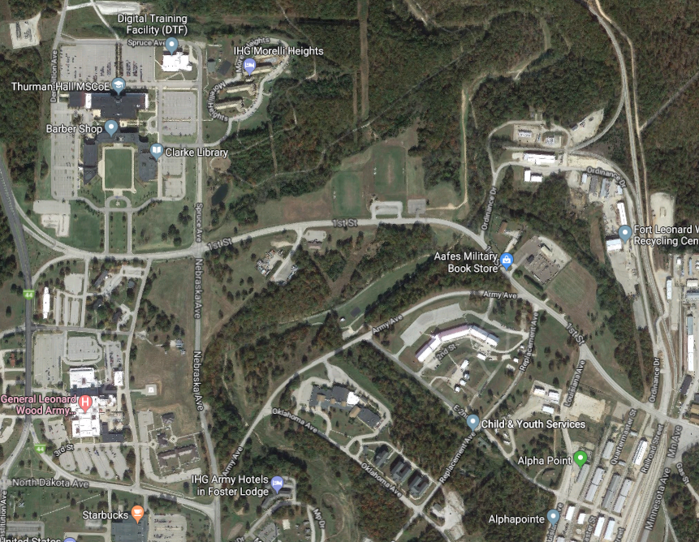
How to get to the APFT location:
From Clarke Library:
- Go South on Spruce Ave
- Turn East on 1st Street
- Follow 1st Street until you get to Quartermaster Street.
- Park and walk up Quartermaster Street.
**If you reach the railroad tracks, you’ve gone one street too far.**

Slide 2
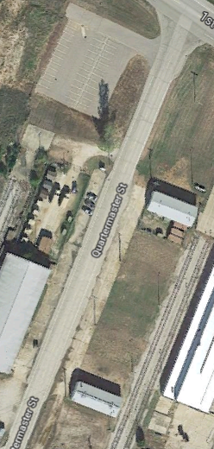
APFT P/U & S/U Location
BOLC Warehouse
APFT will begin at the BOLC Warehouse for push ups and sit ups
Park
Park
P

Slide 3
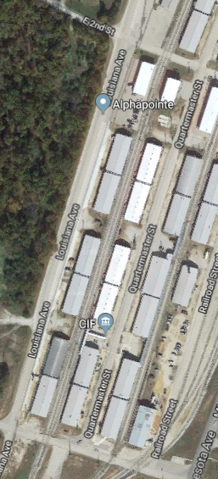
APFT Run Route
Alpha Pointe
You will then move to the vicinity of Alpha Pointe for the run. You will run almost three full laps; start IVO the start point on the map, and finish IVO the finish point. You will see the big clock at the finish point.
Start
Finish

