Slide 1
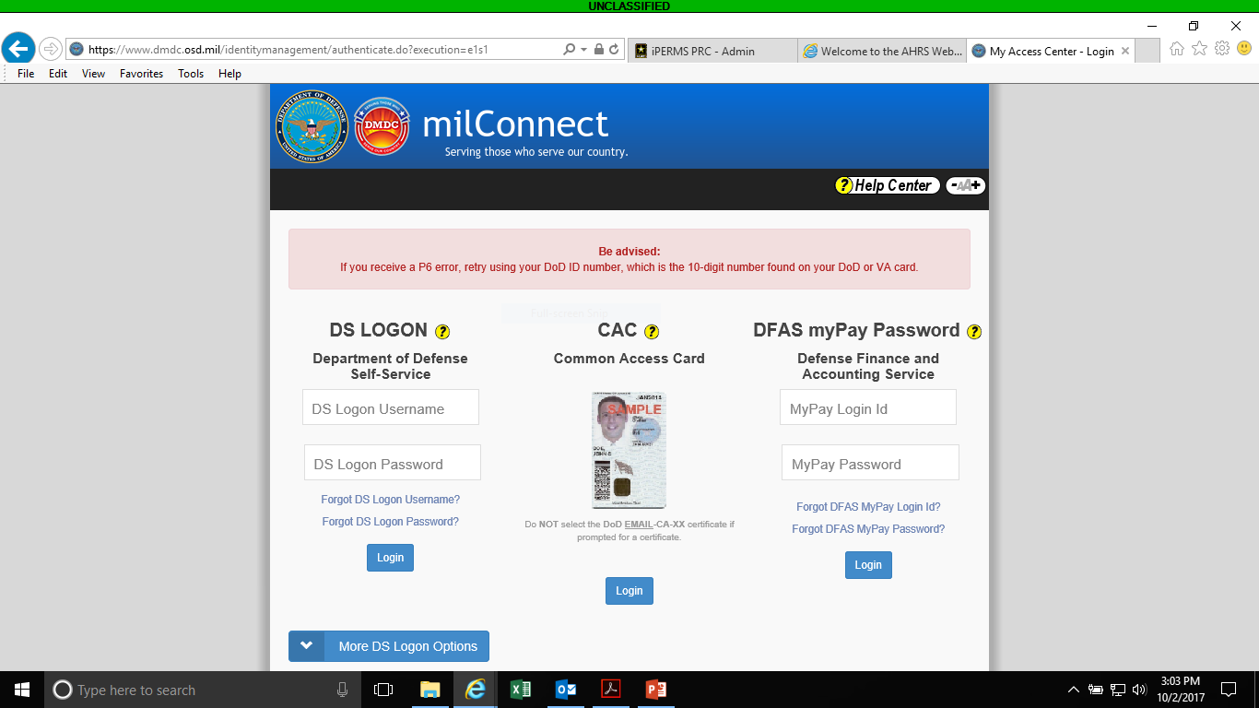
Once opening up website click sign in then you will see this screen
https://www.dmdc.osd.mil/milconnect/

Slide 2
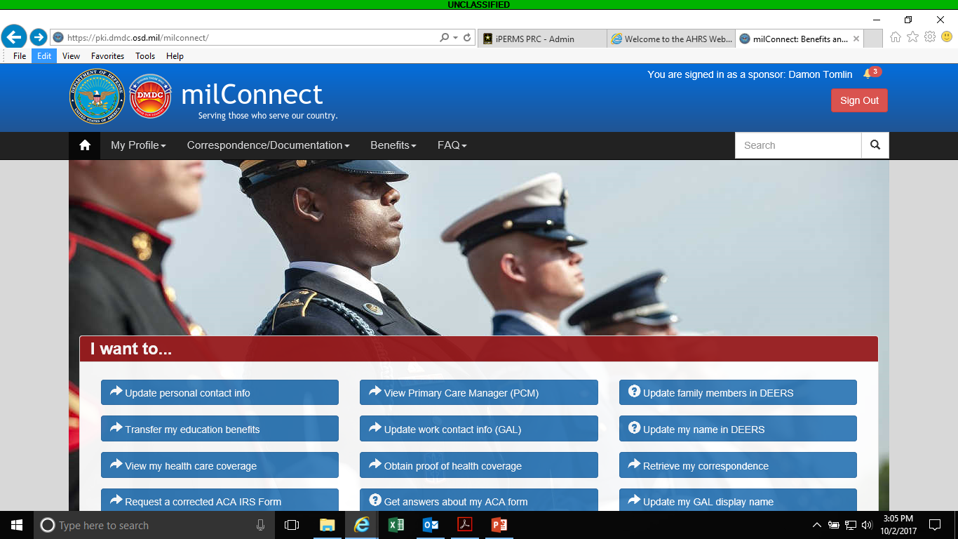
Click on Retrieve my correspondence

Slide 3
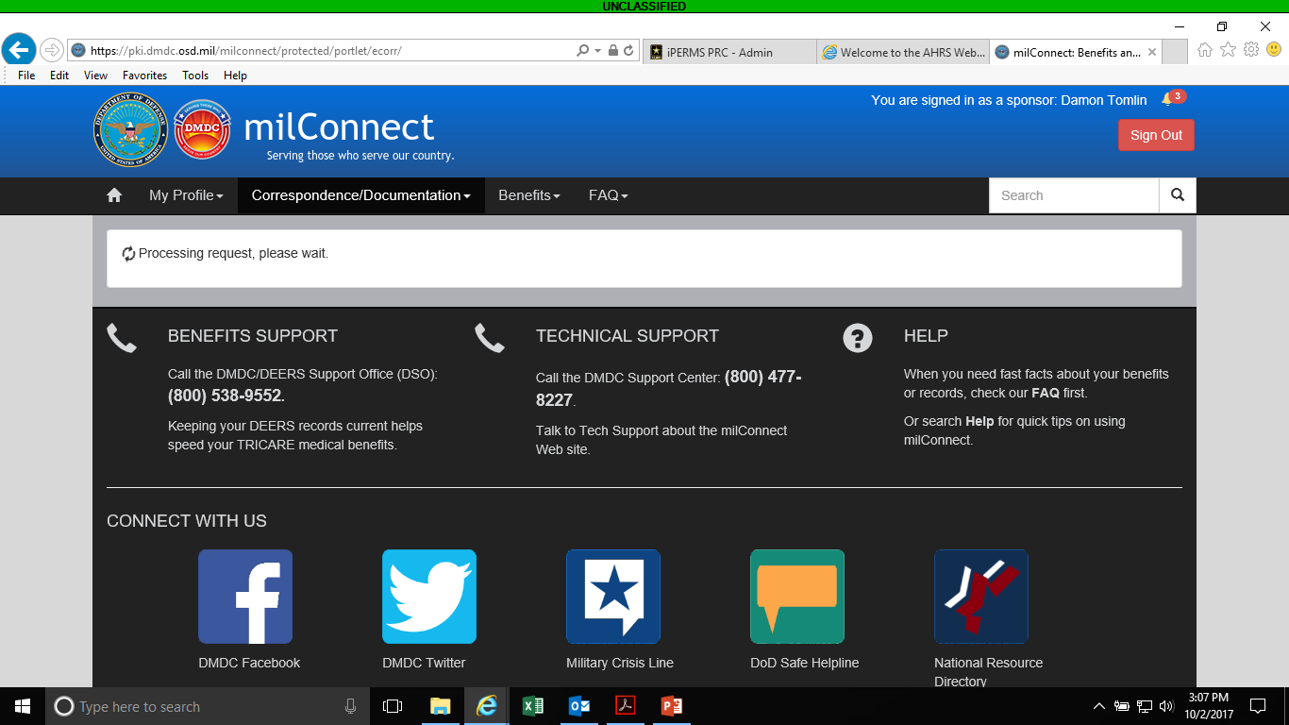

Slide 5
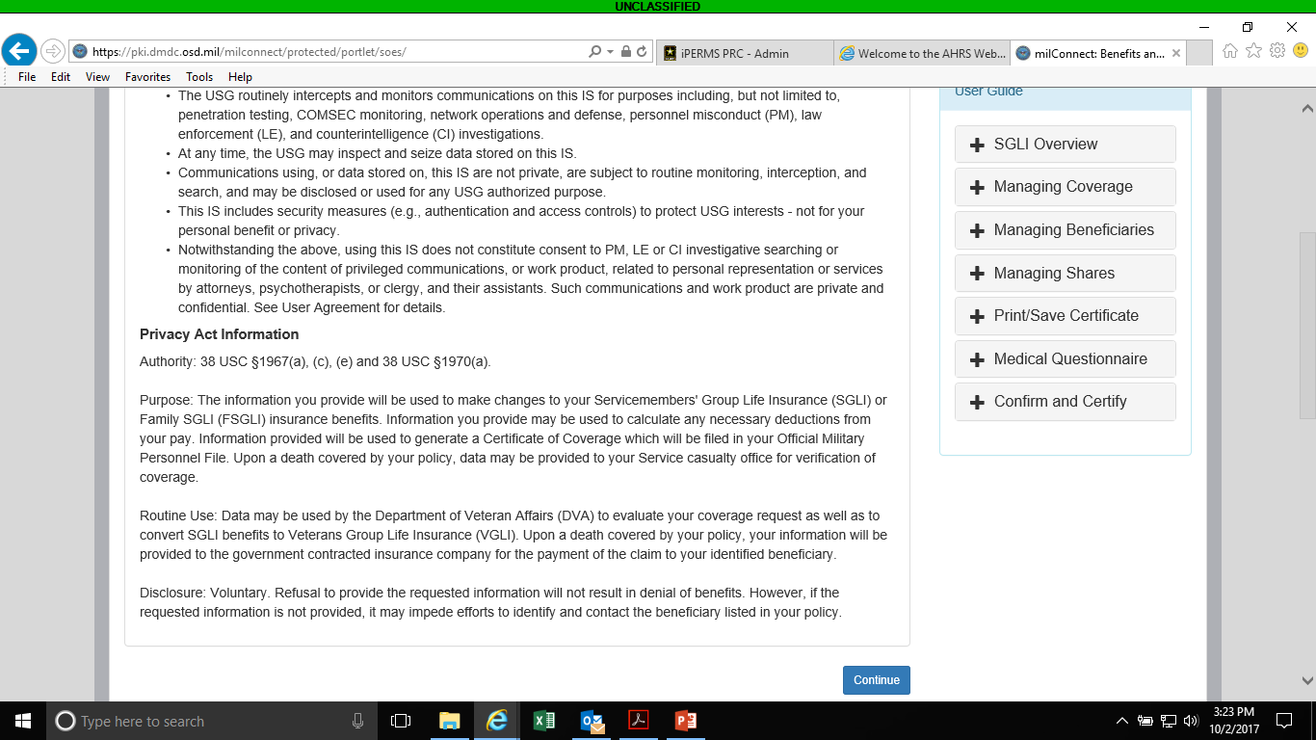

Slide 6
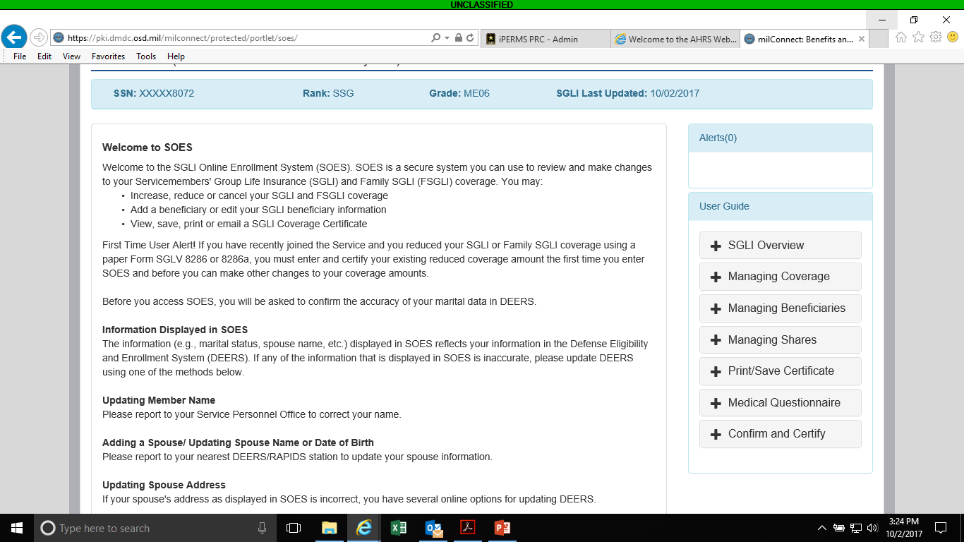

Slide 7
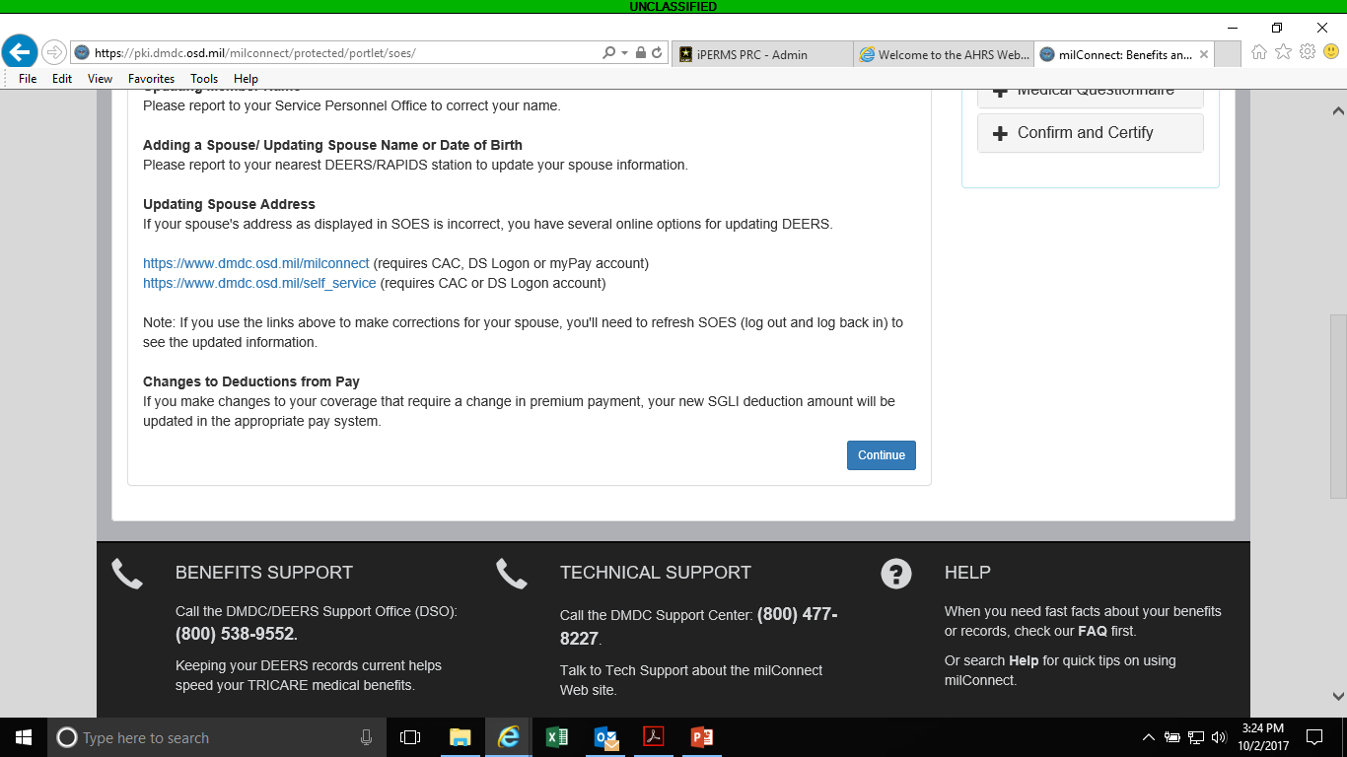

Slide 8
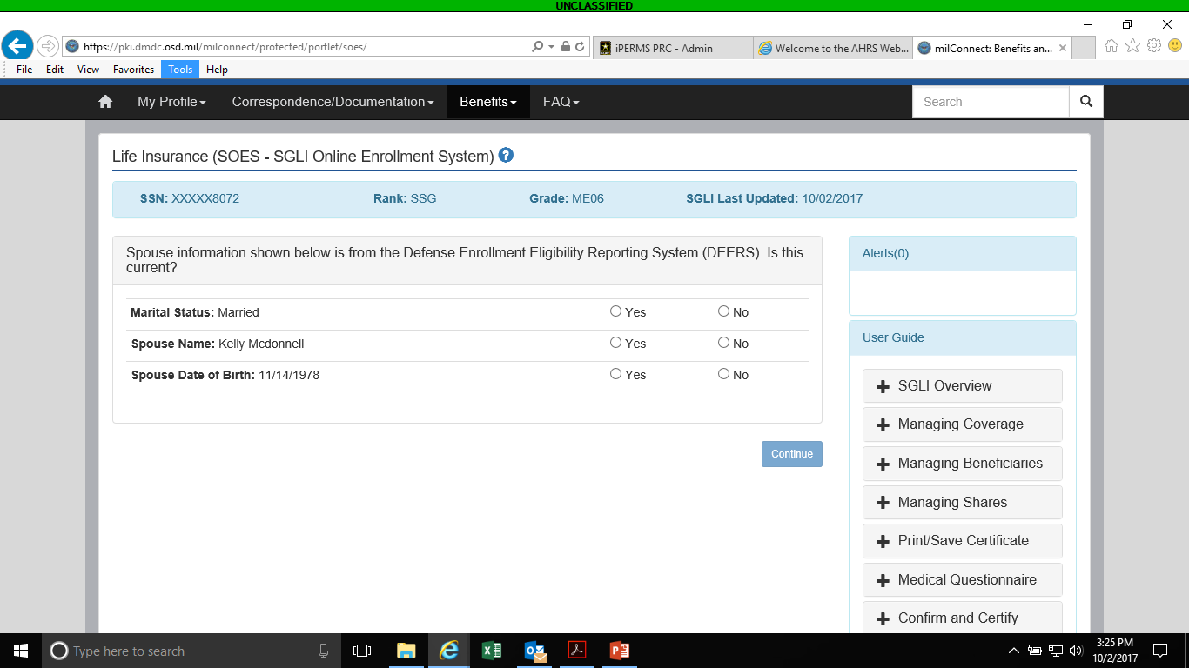
Fill in as appropriate

Slide 9
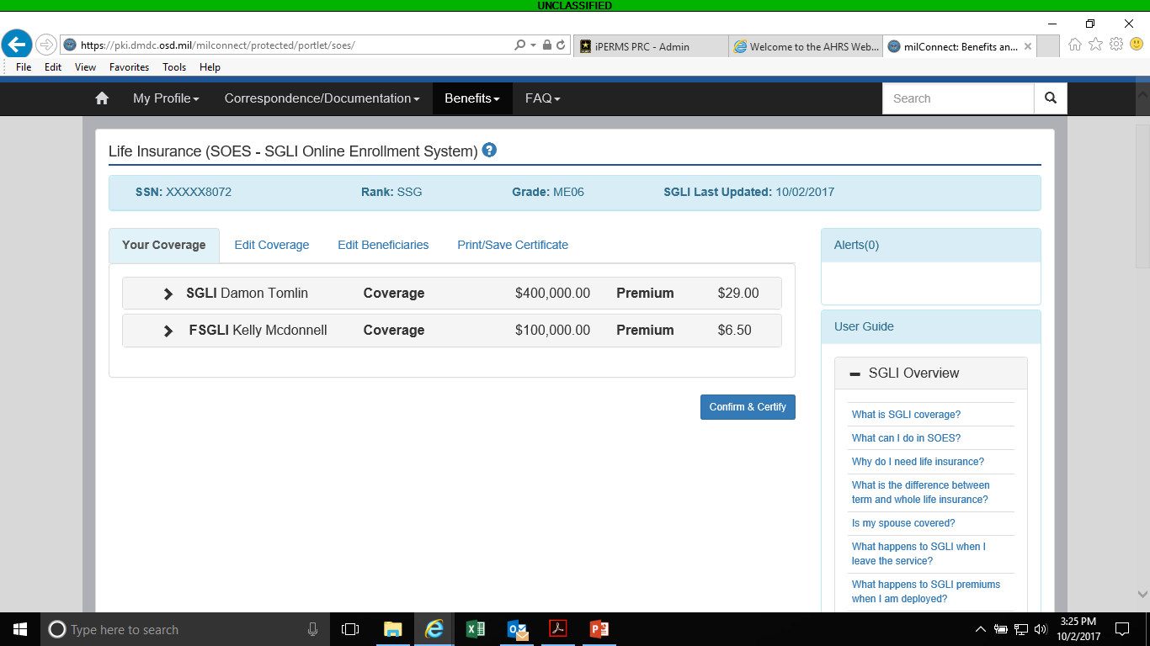
You can change coverage if desired if not click Confrim and Certify

