Slide 1
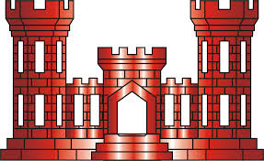
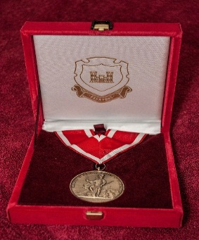
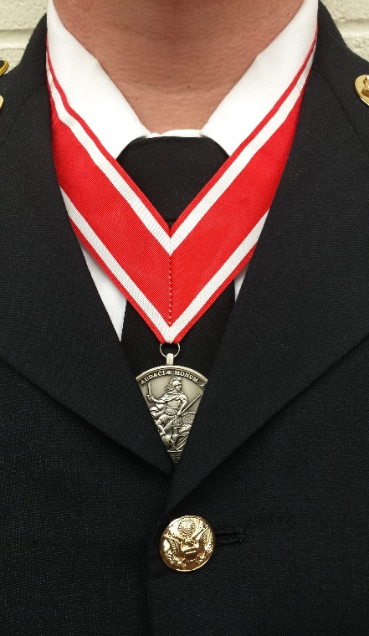
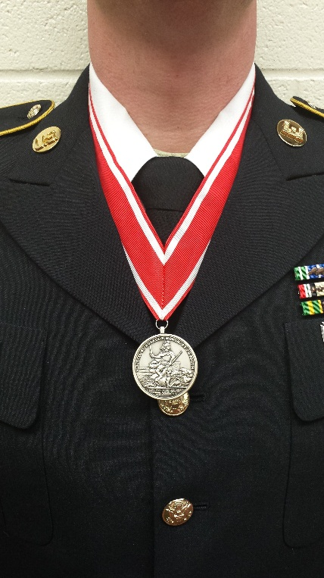
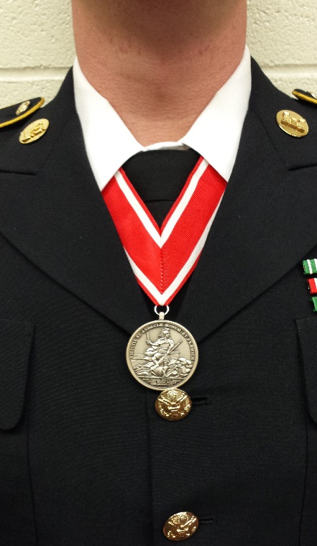
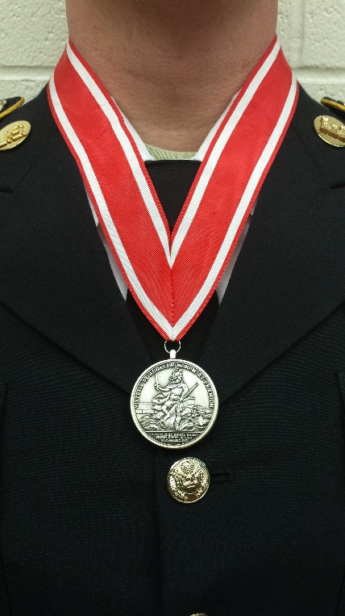
Wear of the de Fleury Medal
Proper Wear
Most Common Mistakes In Wearing The de Fleury Medal
Proper wear of the de Fleury is shown above. The Ribbon is on the outside of the shirt collar, but inside the jacket collar. The medal is on the inside of the jacket, just above the top button with the helmeted soldier facing out in view.
The Medal is not to hang outside the Jacket.
The Ribbon is not to be worn on the inside of the shirt collar.
The Ribbon is not to be worn on the outside of the jacket collar.
Army Service Uniform: and white Mess Uniform: The medal will be worn with the ribbon around the neck, outside the shirt collar and inside the coat collar. The medal will hang over the four-in –hand necktie near the collar and above the top button of the coat or just under the bow tie or neck tab near the collar and above the top button of the coat. Proper positioning may necessitate pinning the ribbon together approximately three inches from the ribbon ends.
General Information: The medal is worn around the neck with the helmeted soldier facing out in view.

