Slide 1
Update JDM on CAC
Step 1: In the web browser type in milconnect rapids- RAPIDS Self Service – DMDC
https://www.dmdc.osd.mil/self_service
Notes:
Step 1: In the web browser type in milconnect rapids- RAPIDS Self Service – DMDC https://www.dmdc.osd.mil/self_service

Slide 2
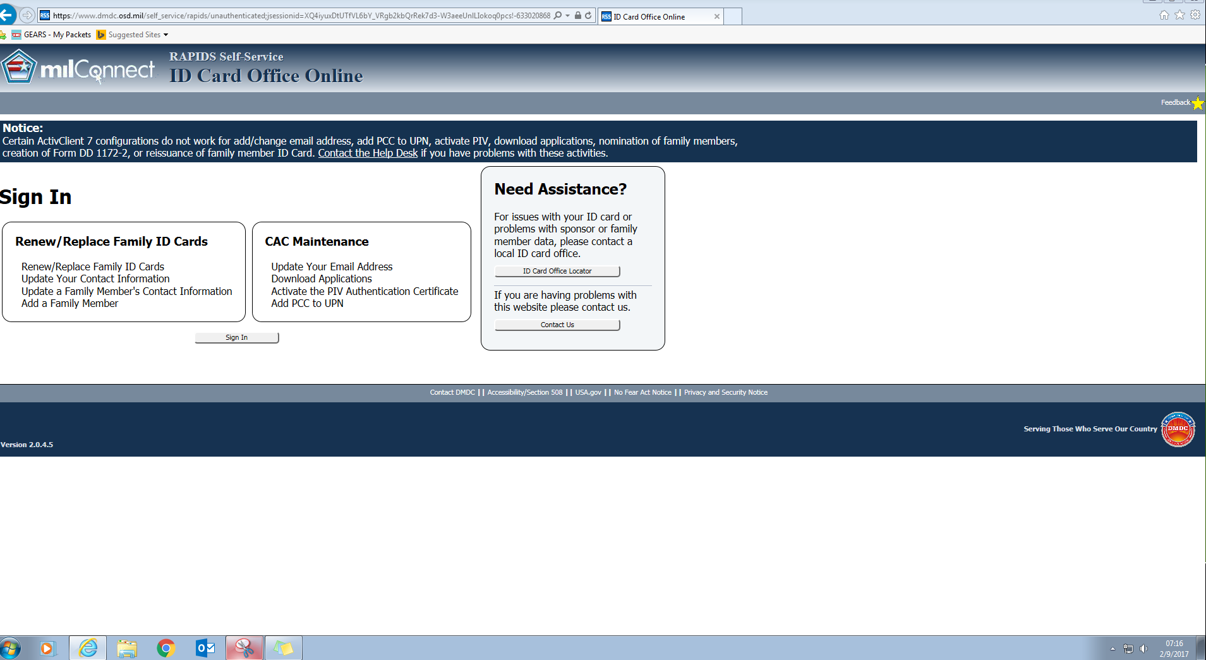
Soldier Member must log into milConnect RAPIDS Self-Service, click the SIGN IN radio button
Notes:
Soldier Member must log into milConnect RAPIDS Self-Service, click the SIGN IN radio button

Slide 3
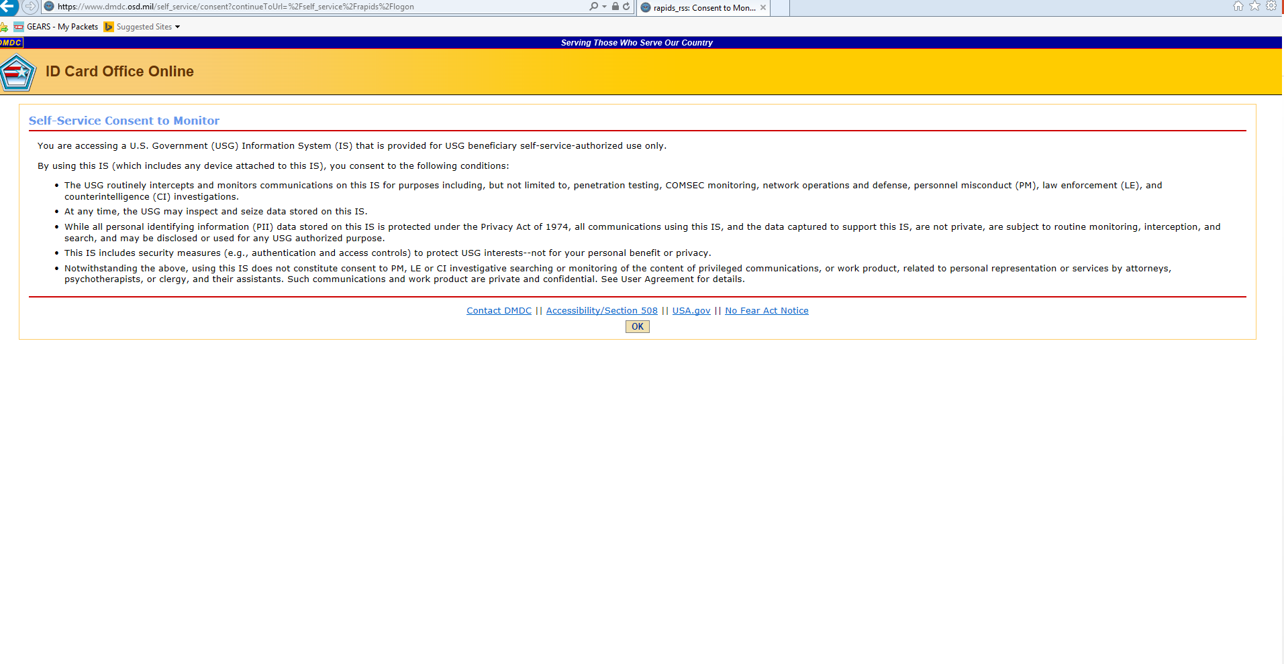
Click on the OK radio button
Notes:
Click on the OK radio button

Slide 4
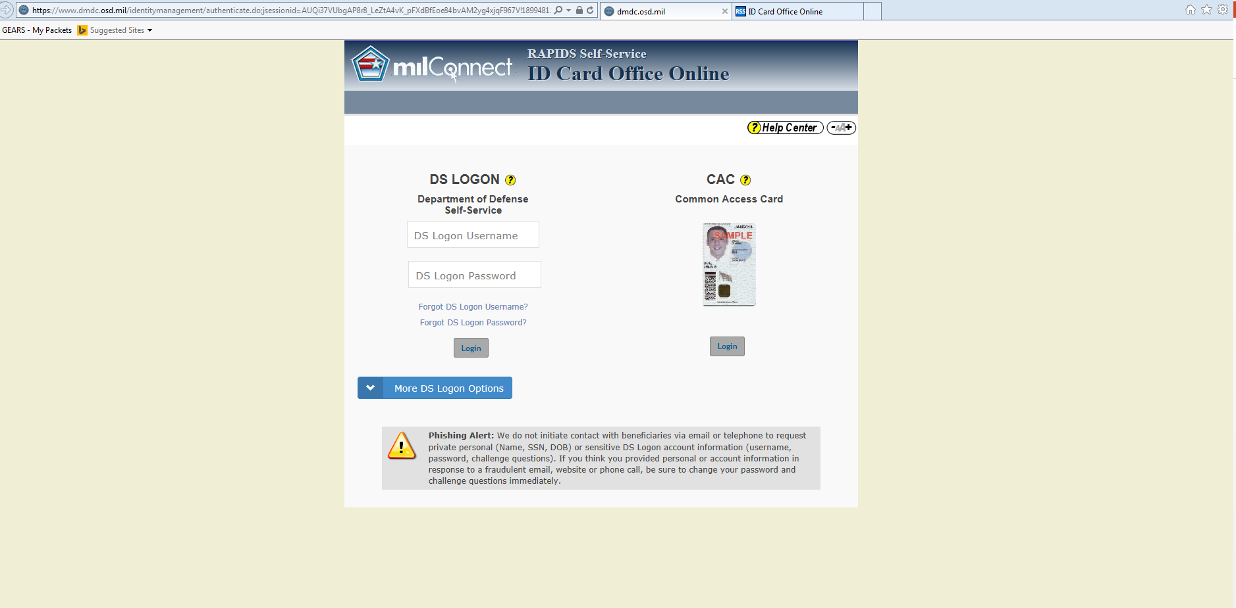
Click on the Login radio button for CAC Common Access Card
Notes:
Click on the Login radio button for CAC Common Access Card

Slide 5
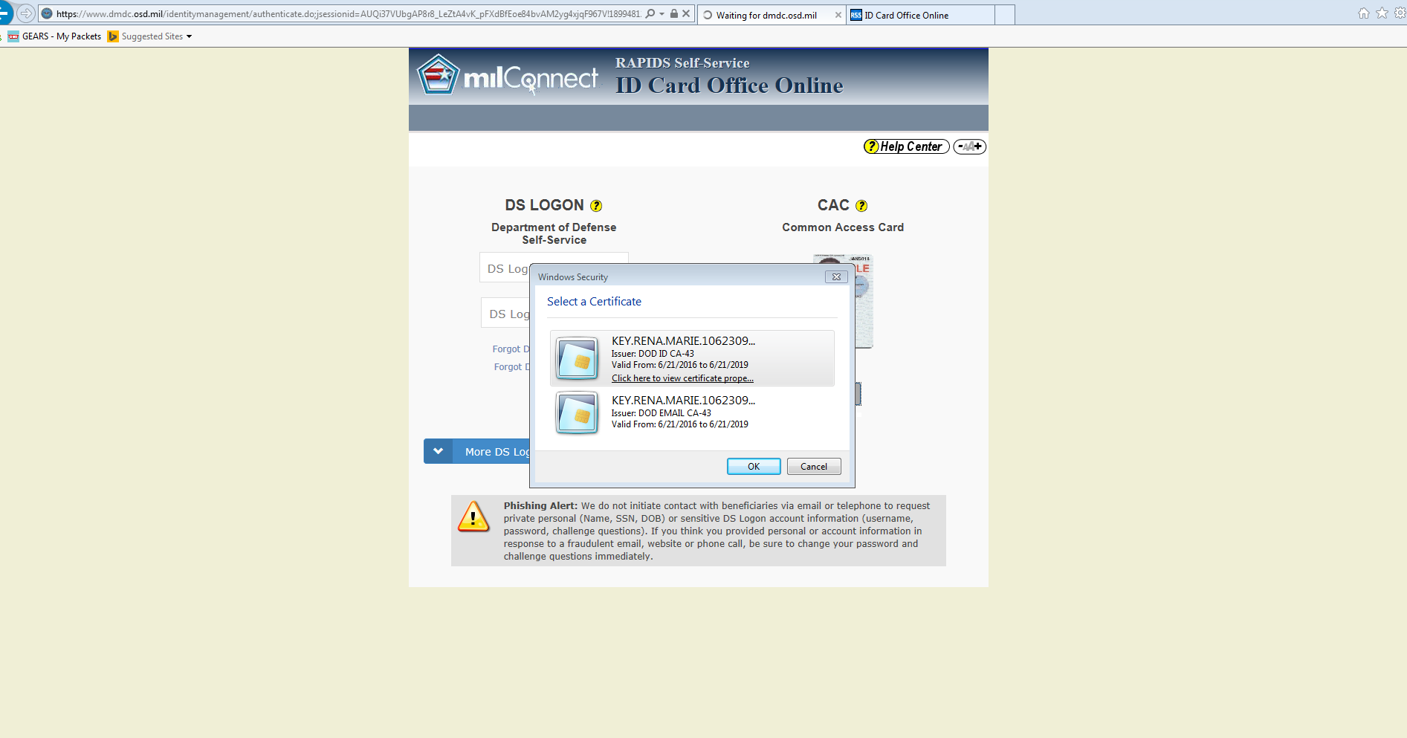
SELECT THE DOD EMAIL CERTIFICATE – (once the email certificate is selected the box will be highlighted in blue)
Click OK radio button
Notes:
SELECT THE DOD EMAIL CERTIFICATE – (once the email certificate is selected the box will be highlighted in blue)
Click OK radio button

Slide 6

Next View : VIEW -the page is in the process of loading
Notes:
Next View : VIEW -the page is in the process of loading

Slide 7
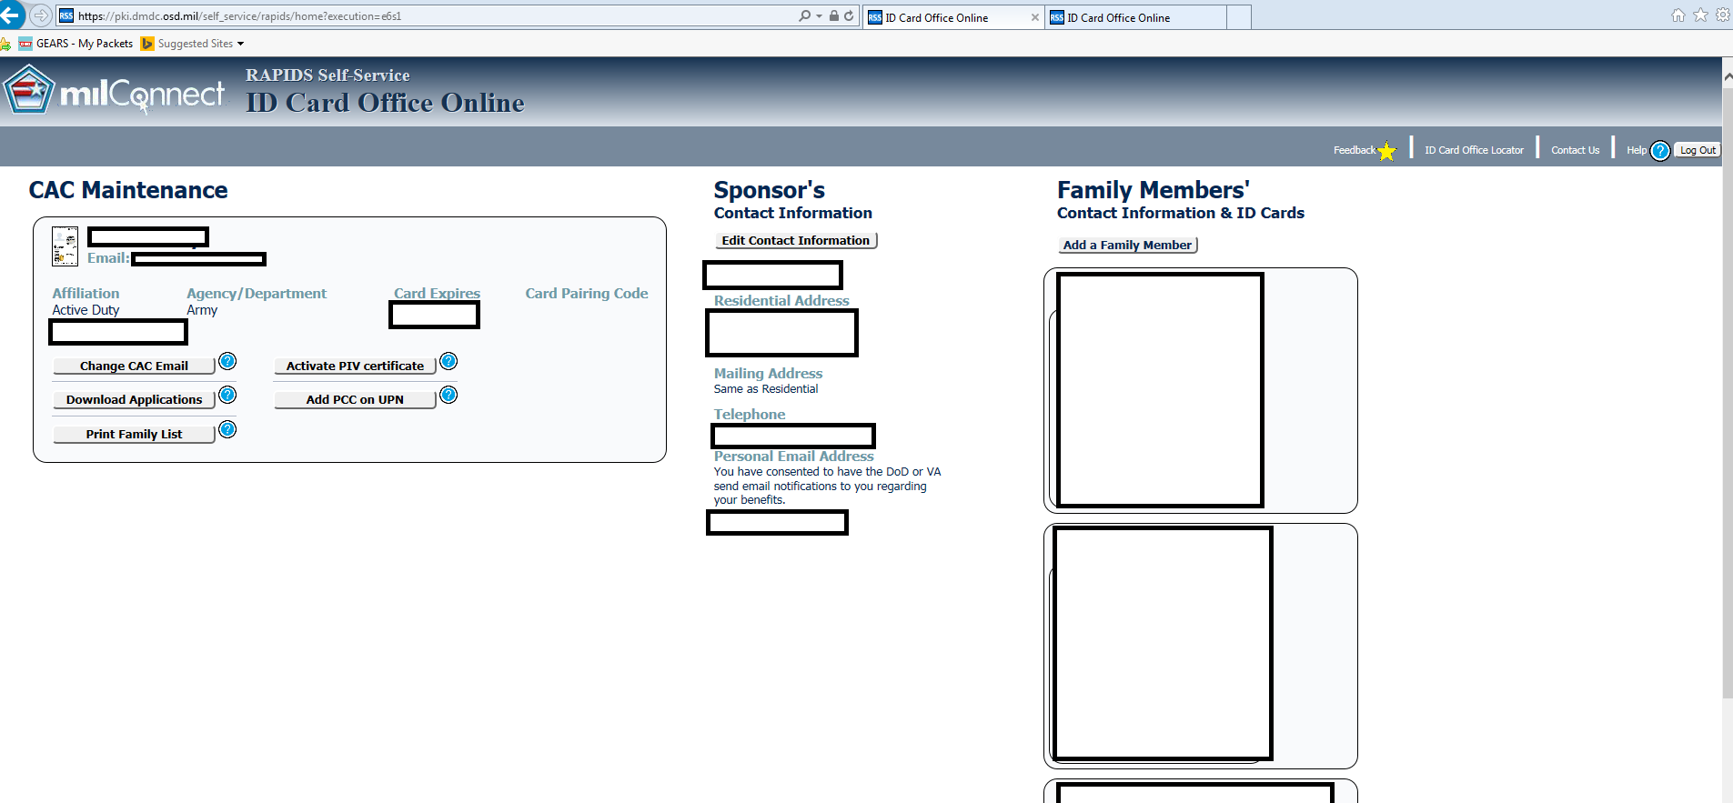
Within the CAC Maintenance Box – CLICK on Download Applications radio button
Notes:
Within the CAC Maintenance Box – CLICK on Download Applications radio button

Slide 8
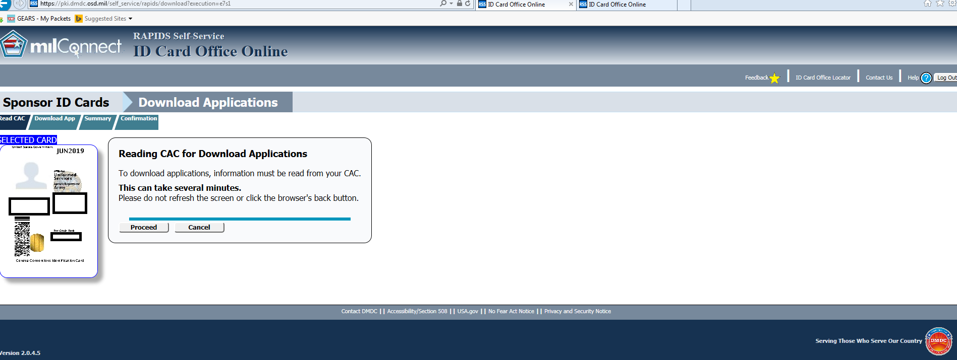
Click the PROCEED radio button
Notes:
Click the PROCEED radio button

Slide 9
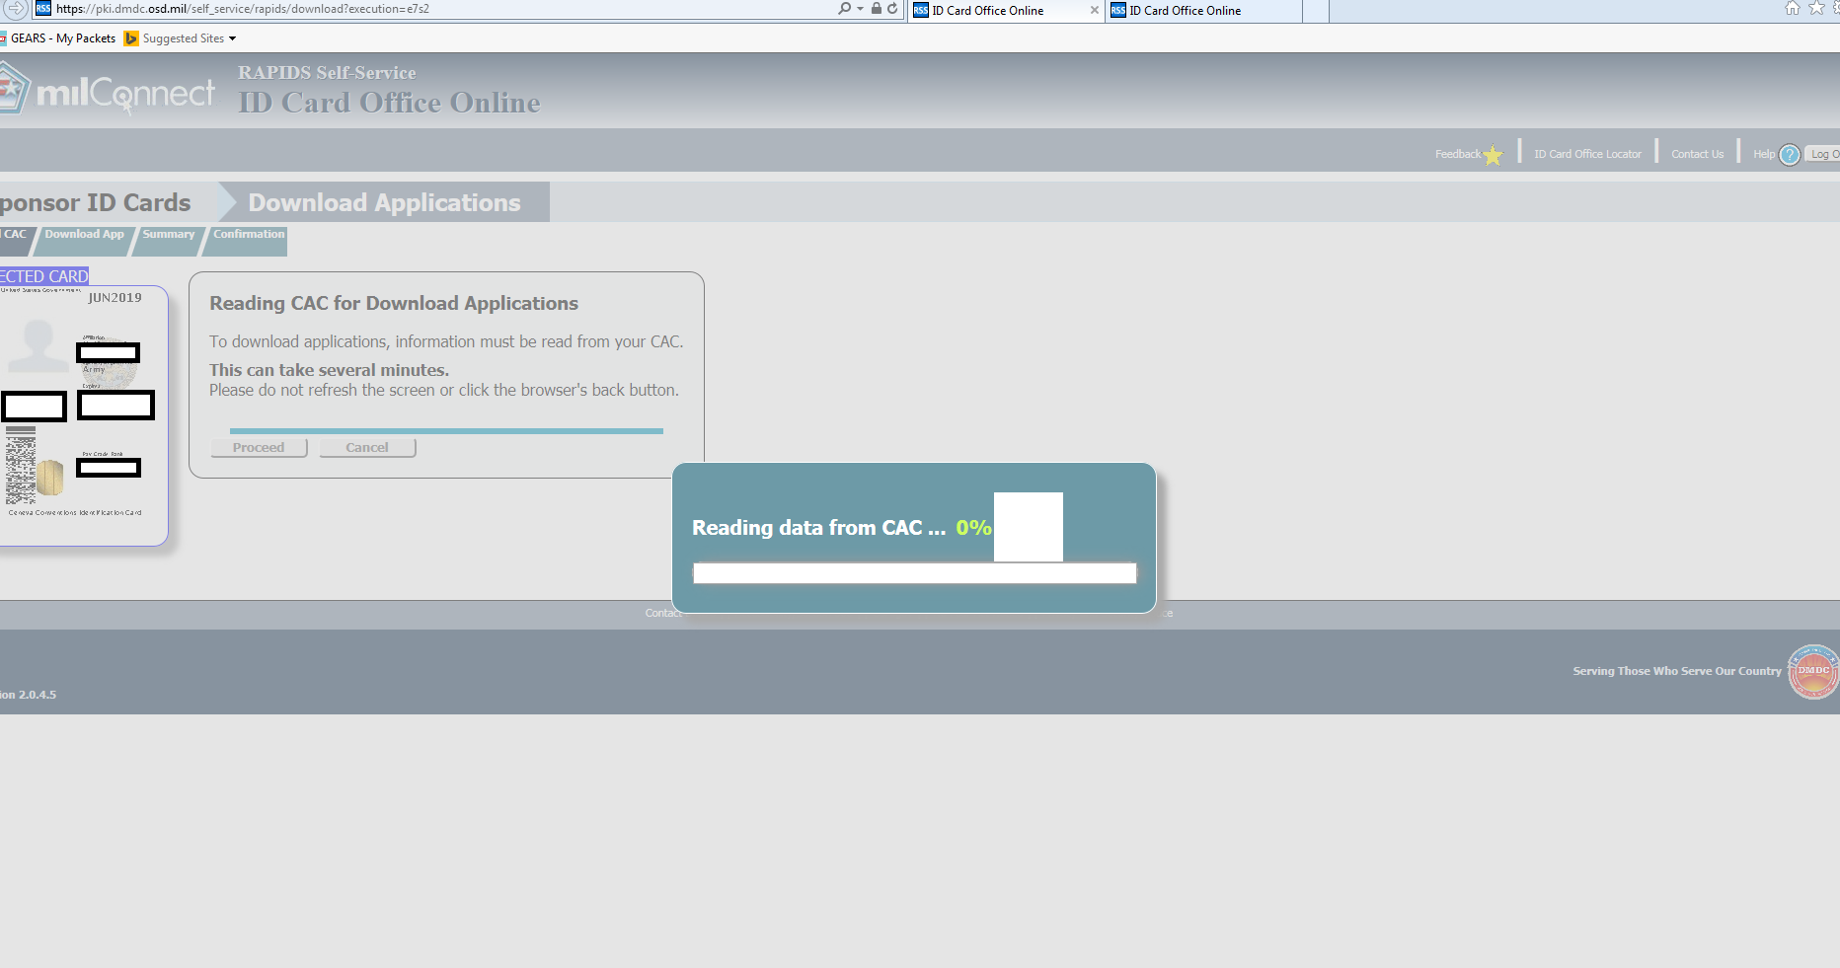
VIEW – System is reading the data (certificates) from the CAC
Notes:
VIEW – System is reading the data (certificates) from the CAC

Slide 10
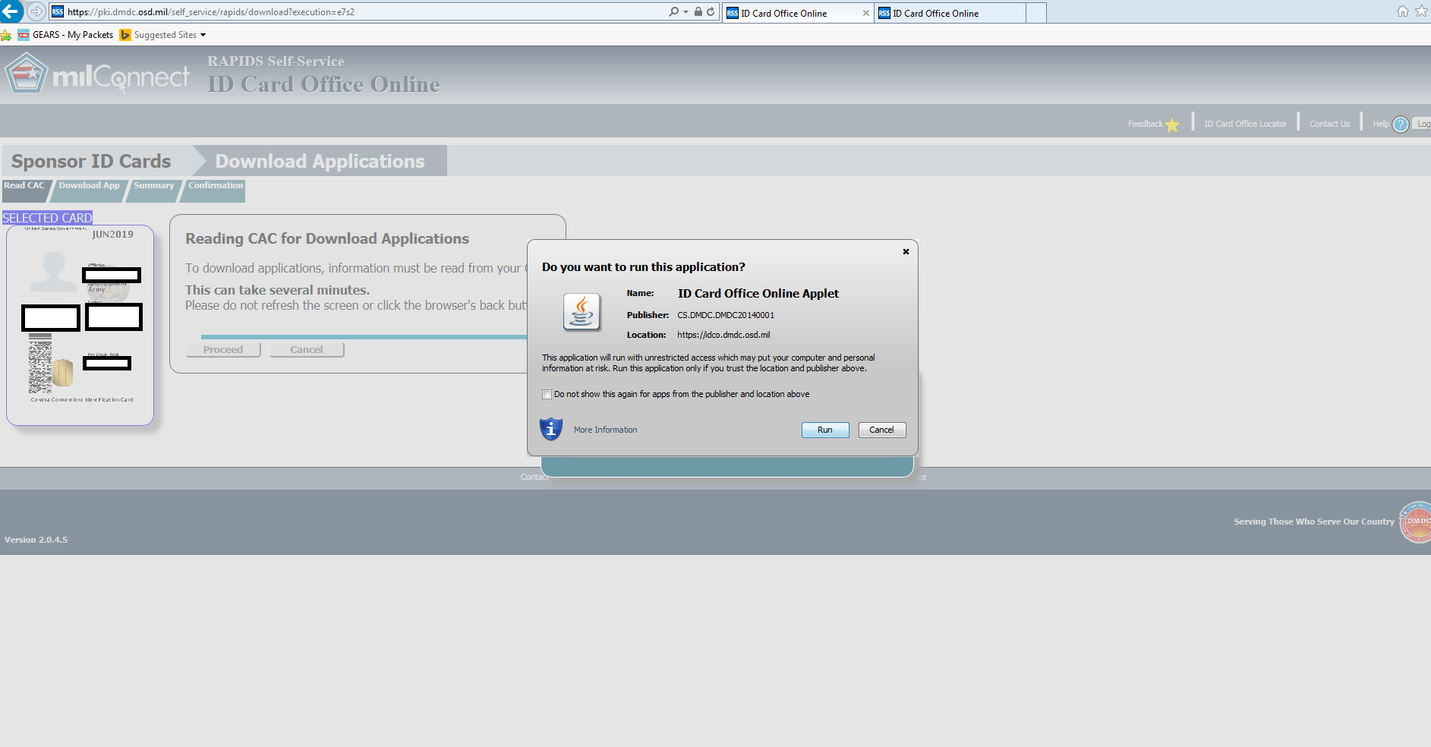
Click in the check box to the left of Do not show again for apps from the publisher and location above
Notes:
Place the mouse over the radio button to the left of Do not show again for apps from the publisher and location above

Slide 11
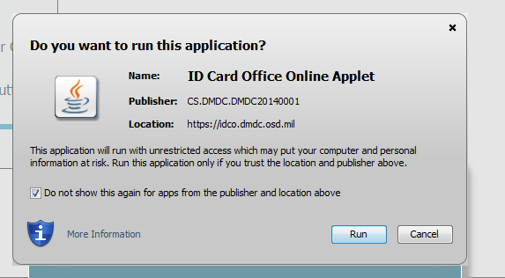
A checkmark will appear in the radio box next to Do not show this again for apps from the publisher and location above
Notes:
A checkmark will appear in the radio box next to Do not show this again for apps from the publisher and location above

Slide 12
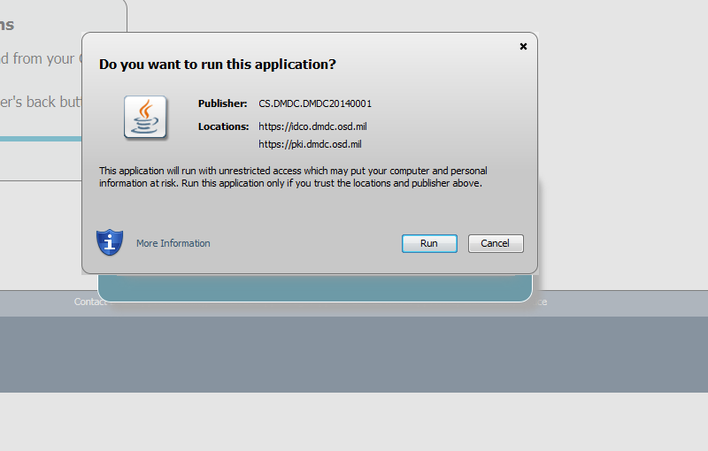
Click on the Run button
Notes:
Click on the Run radio button

Slide 13
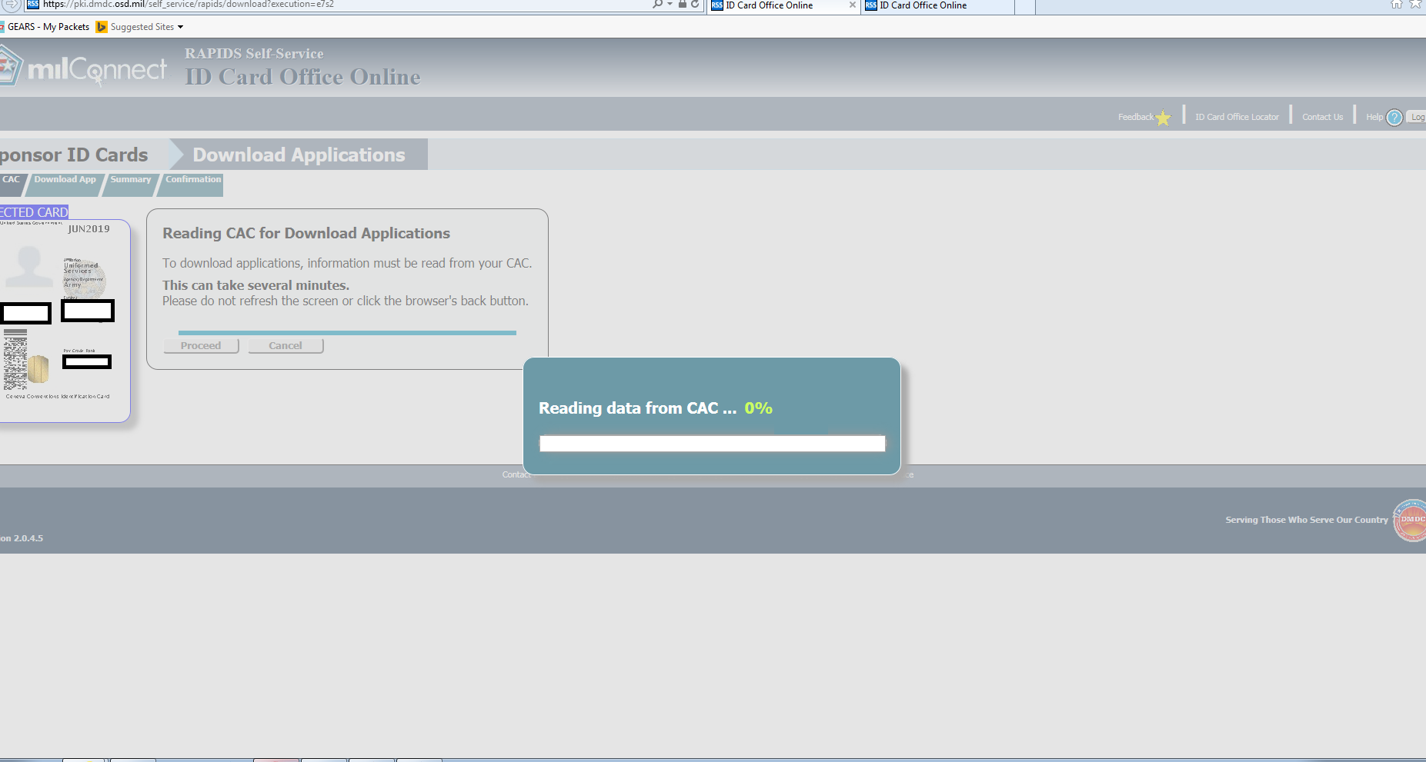
The system is reading data from the CAC
Notes:
The system is reading data from the CAC

Slide 14
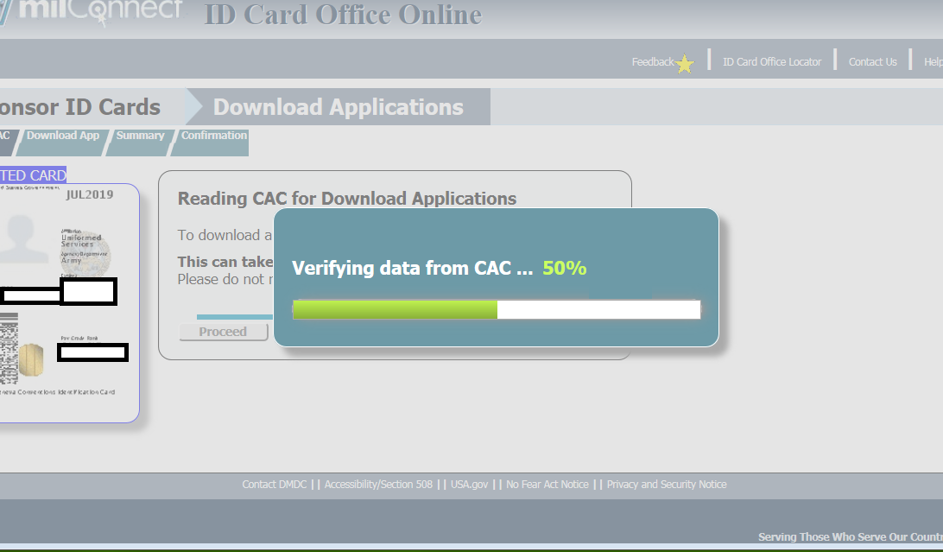
The system is reading data from the CAC

Slide 15
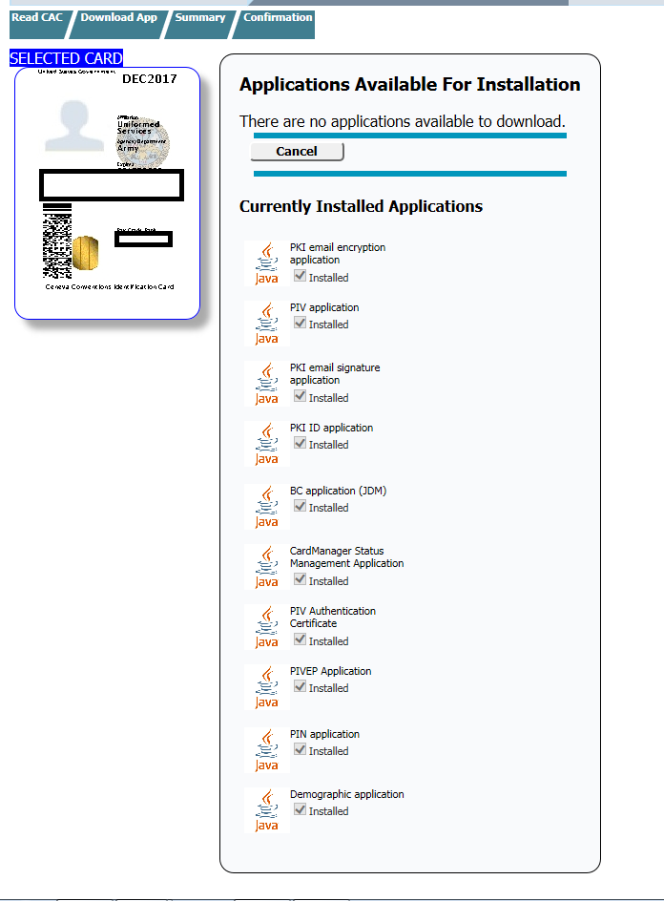
Click on the check box under BC Application (JDM).
Click Update CAC.
Click Yes to confirm that you want to install the selected application(s). The progress of your task is displayed.
Once RSS has completed processing, the screen will notify you of successful completion. Take a Screenshot of this and print.
Notes:
If the message: THERE ARE NO APPLICATIONS AVAILABLE TO DOWNLOAD.
THE JDM APPLICATION HAS BEEN INSTALLED. IF THE SOLDIER MEMBER’S MEALCARD DOES NOT WORK AFTER LOADING OR VERIFYING THE JDM HAS BEEN LOADED CONTACT THE RAPIDS HELP DESK.

