Slide 1
Engineer Regimental Week 2024

Slide 2
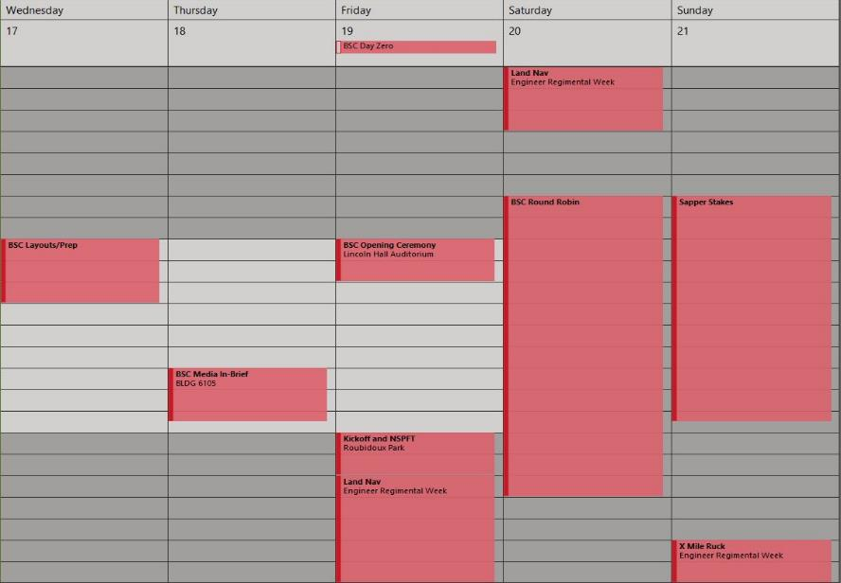

Best Sapper Week
17 – 21 APR

Slide 3
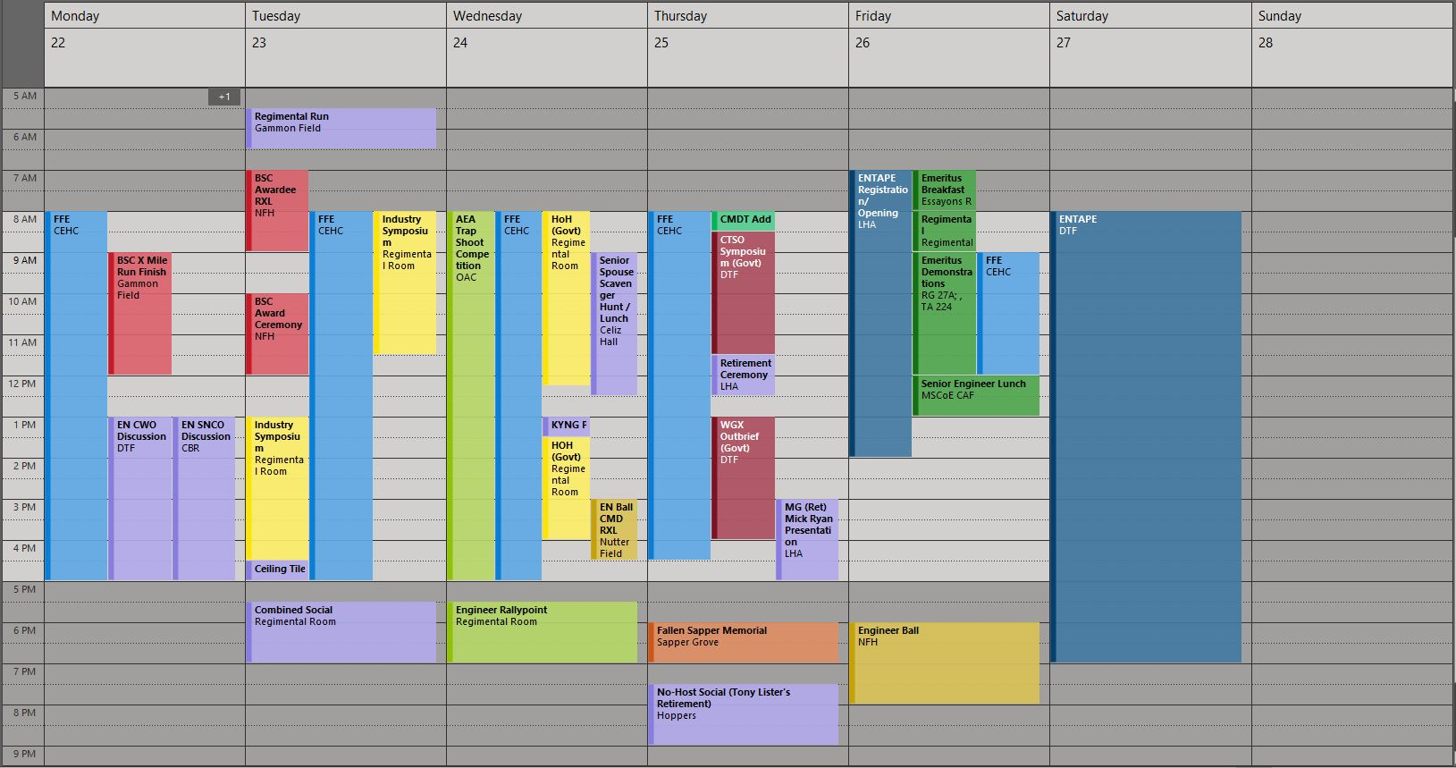
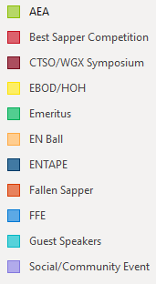
Regimental Week Timeline
22 – 28 APR
By Invite Only
Livestreamed
CoE
CMDT
RCSM
RCWO

Slide 4
Regimental Week Details
MONDAY, 22 APRIL 24
Field Force Engineering (FFE)
Audience – USACE HQ, Military Planners, LNO to CCMDs, ARNG, 412th & 416th TEC
Location – Counter Explosive Hazards Center (CEHC)
Time – 22-26 APR 24
Uniform – Duty (ACU’s , Business Casual)
Engineer Chief Warrant Officer Discussion
Audience – Engineer CWOs
  Hosted by RCWO5 Gadsden
Location – Digital Training Facility (DTF), Room 110
Time – Mon. 22 1300-1600 APR 24
Uniform – Duty (ACU’s , Business Casual)
Best Sapper Competition (BSC) Finish
Audience – Open
Location – Gammon Field
  Spectators will not be able to take vehicles onto routes in the AO (Minnesota Ave, Nebraska Ave, Illinois Ave, etc)
  Plan to park on Iowa Ave running west along Gammon Field
Time – Mon. 22 0900-1100 APR 24
Uniform – Duty (ACU’s , Business Casual)
Engineer Senior NCO Discussion
Audience – Engineer Sergeants Major
  Hosted by RCSM Plummer
Location – MSCoE Briefing Room
  Hoge Hall, 3rd Floor, CG’s Conference Room
Time – Mon. 22 1300-1600 APR 24
Uniform – Duty (ACU’s , Business Casual)

Slide 5
Regimental Week Details
TUESDAY, 23 APRIL 24
Regimental Run
Audience – USACE / CoE, USAES, all FLW EN Units
Location – Gammon Field
Time – Tues. 23 0530-0630 APR 24
  Please plan to be with your group on the field NLT 0500
  Run will start at 0530
Uniform – APFU (no unit shirts or PT belts)
Industry Symposium
Audience – EN BDE/BN CMD Teams, Industry, Labs
Location – Regimental Room (FLW Museum Complex)
Time – Tues. 23 0800-1630 APR 24
Uniform – Duty (ACU’s , Business Casual)
Army Engineer Association Combined Social
Audience – Invitees, HoH Personnel, BN/BDE CMD Teams
Location – Regimental Room
Time – Tues. 23 1700 APR 24
Uniform – Duty (ACU’s, Business Casual)
https://armyengineer.com/regimental-week/
Best Sapper Competition (BSC) Award Ceremony
Audience – Open
Location – Nutter Field House
Time – Tues 23 1000-1200 APR 24
Uniform – Duty (ACU’s , Business Casual)
Textron Ceiling Tile Unveiling
Audience –EN BDE/BN CMD Teams, Industry, Labs, AEA
Location – Regimental Room
Time – Tues. 23 1630-1700 APR 24
Uniform – Duty (ACU’s , Business Casual)

Slide 6

Regimental Week Details
WEDNESDAY, 24 APRIL 24
AEA Shooting Olympics
2nd Annual Trap Shoot Competition
Audience – Open
Location – FLW Outdoor Adventure Center
Time – Wed. 24 1000-1600 APR 24
Uniform – Athletic, Casual
Home on Home
Audience – EN BDE/BN CMD Teams & Senior Leaders
Location – Regimental Room (FLW Museum Complex)
Time – Wed. 24 0800-1630 APR 24
Uniform – Duty (ACUs , Business Casual)
Army Engineer Association
Rally Point
Audience – AEA Members, EN Leaders
Location – Regimental Room
Time – Wed. 24 1730-1900 APR 24
Uniform – Duty (ACUs , Business Casual)
PLEASE CLICK BELOW
FOR THE AEA RALLYPOINT ZOOM LINK
https://us02web.zoom.us/j/88166346448?pwd=SmNXZi9nMy92SzUxNWlRMUZWd3VuQT09
Passcode: 651775
KYNG Plaque Unveiling
Audience – EN BDE/BN CMD Teams & Senior Leaders
Location – Essayons Room (FLW Museum Complex)
Time – Wed. 24 1300-1330 APR 24
Uniform – Duty (ACUs , Business Casual)
Spouse Scavenger Hunt
Audience –Senior Leader Spouses (Invitees)
Location – Varies, ending at Celiz Hall (31/35 DFAC)
Time – Wed. 24 0000-1230 APR 24

Slide 7
Regimental Week Details
THURSDAY, 25 APRIL 24
The 100th Commandant’s Address
Audience – Open
Location – Lincoln Hall Auditorium
Time – Thurs. 25 0800 APR 24
Uniform – Duty (ACUs , Business Casual)
Close Terrain Shaping Obstacle (CTSO)
Symposium
Audience – EN BDE/BN CMD Teams & Senior Leaders
Location – Digital Training Facility (DTF)
  Rooms 104, 107, 110 (conjoined)
Time – Thurs. 25 0830-1130 APR 24
MG (Ret) Mick Ryan Presentation
Hosted by USACE NWD
Audience – Open
Location – Lincoln Hall Auditorium (LHA)
Time – Thurs. 25 1500 APR 24
Retirement Ceremony
Celebrating 1SG (Ret) Tony Lister
Audience – Open
Location – Lincoln Hall Auditorium
Time – Thurs. 25 1130 APR 24
Uniform – Duty (ACUs , Business Casual)
Social to follow at Hopper’s Waynesville from 1930-2100
Wet Gap Crossing (WGX)
Out Brief
Audience – EN BDE/BN CMD Teams & Senior Leaders
Location – Digital Training Facility (DTF)
  Rooms 104, 107, 110 (conjoined)
Time – Thurs. 25 1300-1600 APR 24
Fallen Sapper Memorial
Audience – Open
Location – Sapper Grove
Time – Thurs. 25 1800 APR 24
Uniform (spectators) – Duty (ACUs , Business Casual)
Uniform (participants) – AGSUs

Slide 8
Regimental Week Details
FRIDAY, 26 APRIL 24
Emeritus Breakfast
  Audience – By name invitations have been sent to invited guests. Payments can be made using the following link or by visiting the Protocol Office
  Cost - $15 per person
  https://square.link/u/o20gWJRV
  Location – Regimental Room
  Time – Fri. 26 0700-0800 APR 24
  Uniform – Duty (ACUs , Business Casual)
Regimental Command Council
  Audience – BDE CMD Teams, Invitees
  Location – Regimental Room
  Time – Fri. 26 0800-0900 APR 24
  Uniform – Duty (ACUs , Business Casual)
Senior Engineer Lunch
  Audience – By name invitations have been sent to invited guests. Payments can be made using the following link or by visiting the Protocol Office.
  Cost - $15 per person
  https://square.link/u/1llF6NBW
  Location – MSCoE Cafeteria
  Time – Fri. 26 1200-1300 APR 24
  Uniform – Duty (ACUs , Business Casual)
ENTAPE
Audience – BDE CMD Teams and above, Key Nodes & Directorates
Location – LHA / Digital Training Facility (DTF)
Time – Fri. 26 – Sun. 28 APR 24
Uniform – Duty (ACUs , Business Casual)
Emeritus Demonstrations
  Audience – USAES Leaders Emeritus
  Location – Beginning at Regimental Room
  Time – Fri. 26 0900-1200 APR 24
  Uniform – Duty (ACUs , Business Casual)
Engineer Regimental Ball
Audience – Ticket Holders
Location – Nutter Field House (NFH)
Time – Fri. 26 1800 APR 24

