Slide 1
Titling: Or I how I learned to Stop Worrying and Accept the Process

Slide 2
The Story
SPC Jones and PFC Garcia caught an Uber to a club. After a night of drinking, a Lyft took them to the barracks where they watched Netflix and fell asleep. Jones, however, saw fit to touch the private area of PFC Garcia while she was asleep. Feeling the touching, PFC Garcia woke up and freaked out; she ran to the bathroom in tears. SPC Jones texted her while in the bathroom, saying “you good?” and then he left the room.

Slide 3
The Story Continues
PFC Garcia called the police at 0700, and the MP Desk Sergeant looped in the on-duty CID agent.
The on-duty agent called PFC Garcia to come into the CID office to give a synopsis of the event. She allowed her phone to be photographed before she requested an SVC.

Slide 4
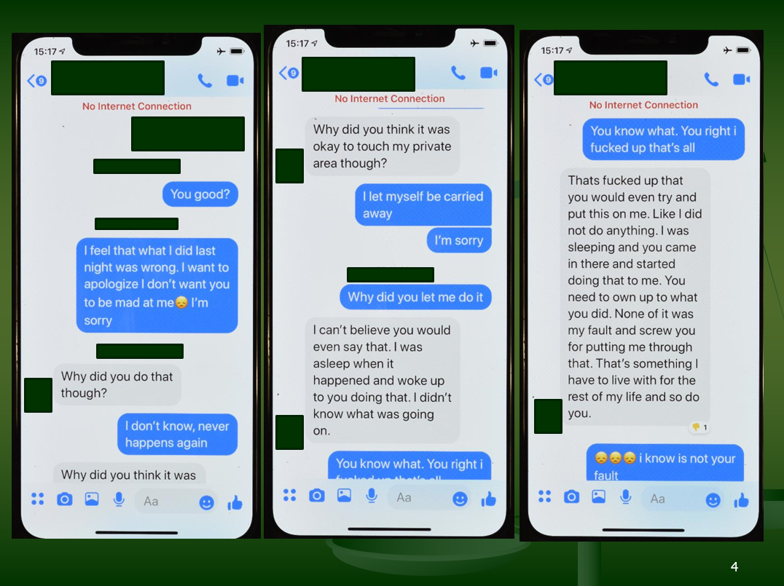

Slide 5
The Agent’s View
The Agent now has three duty days to publish a Report of Investigation (ROI). He is thinking “should I title this guy? Do I have credible information to say he committed sexual assault or abusive sexual contact while this victim was asleep? Do I even have jurisdiction over this offense?”

Slide 6
Jurisdiction
The agent reviews CID-R 195-1 and AR 195-2, and determines he has jurisdiction.
AR 195-2, appendix B, has the jurisdiction breakdown: detailing what is CID and what is MPI purview.

Slide 7
He has jurisdiction, now what?
Without a full victim interview, the agent now has to determine if credible information exists based on the information he has. Does he title sexual assault with penetration however slight? He believes that the touching was without penetration based on the initial statement and text messages. In the end, he published a case number with PFC Garcia as a victim, and an unknown person as a subject; the crime listed is Abusive Sexual Contact.

Slide 8
Titling Decisions
Titling is an operational decision, not a legal or judicial decision.
The agent determines titling (credible information).
The attorney determines the legal decision (probable cause).
The judge/jury determines guilt (beyond a reasonable doubt).

Slide 9
The Standards of Proof
100%
Beyond a Reasonable Doubt (standard for Article 15s or Court Martial)
51%
Preponderance of the Evidence (standard for admin actions, like sep. packets, AR 15-6 investigations, GOMORs, etc.)
Probable Cause (standard for opine; arrest; charging, etc.)
Reasonable Suspicion (standard for a Terry Stop)
Credible Information (CID standard for titling)
0%
No Proof

Slide 10
Credible Information
“Information disclosed or obtained by an investigator which, considering the source and nature of the information, and the totality of the circumstances, is sufficiently believable to indicate criminal activity has occurred and would cause a reasonable investigator under similar circumstances to pursue further the facts of the case to determine whether criminal activity has occurred.”

Slide 11
The Case Continues
Six days after the report, the victim interview occurred. Based on the interview, the subject is clearly SPC Jones. In light of the credible information standard, the agent amends his report to add SPC Jones as the subject in the title block.

Slide 12
An Example of Titling
Let’s say Soldier A has his TV stolen, and he tells CID (this TV is a 4K-curved-75 inch TV costing $5200 dollars)
This was “credible information” that a crime was committed and CID opens an investigation with an unknown subject.
At first, Soldier B is recognized as the subject because he was seen carrying a “huge” TV to his barracks room (across the quad from Soldier A’s room).
At this point, Soldier B is titled as the subject.
After further investigation, Soldier B is able to produce a receipt of purchase saying he bought the TV from the PX.
The offense is “founded” because a TV was, in fact, stolen.
The offense is unsubstantiated as it pertains to Soldier B because there is no PC (he showed the receipt of purchase)
Soldier B, however, is still “titled” with the offense and is listed in the database as a subject --- though it says unfounded after his name, he is still listed.

Slide 13
Back to the Case
The agent has investigated the case, received multiple statements, and is ready for the probable cause opine. He reached out to the Trial Counsel and said he wants an opine. The Trial Counsel asked that the agent make copies of the left side of the file (case activity summary (CAS)) and the right side of the file (the exhibits), along with any notes and CDs. The agent delivered the file as requested, and a paralegal took the file, but required a DA Form 200 be completed annotating the transfer (along with all documents listed)

Slide 14
With the evidence received, what does the TC do next?
“The TC must opine, as to each offense and each alleged offender, whether there is probable cause to believe that the crime occurred and that the alleged offender committed that crime. The TC must also apply the probable cause analysis to each element of each offense presented in the investigation.”
“If there is no probable cause for an offense, the TC must provide a probable cause opine for any potential lesser included or uncharged offenses. Failure to identify a named subject in an investigation does not preclude a probable cause opine that an offense occurred. The TC may opine probable cause exists to believe that an unknown subject committed an offense when the evidence establishes reasonable grounds that an offense was committed, but the investigation has not identified a named subject.”

Slide 15
Decisions, Decisions…
The Special Agent is now asking for 1 of 2 opines from the attorney. The first is a PC opine, and the second is a “final report” opine. The attorney needs to hurry up though, as she only has 14 days to render the first decision.
An MOA was signed by OTJAG and CID in 2018 publishing new rules for how we operate --- to include the 14 day requirement for the opines.
Memorandum of Agreement Between The Office of the Judge Advocate General and the U. S. Army Criminal Investigation Command (CID), Subject: Legal Coordination for CID Law Enforcement Reports, June 5, 2018
Notes:
SUBJECT: Legal Coordination for CID Law Enforcement Reports
References:
DoD Instruction (DoDI) 5505.11 (Fingerprint Card and Final Disposition Report Submission Requirements), 21 July 2014, with change 1, 31 October 2014.
DoDI 5505.14 (Deoxyribonucleic Acid (DNA) Collection Requirements for Criminal Investigations, Law Enforcement, Corrections, and Commanders), 22 December 2015.
DoDI 7730.47 (Defense Incident-Based Reporting System (DIBRS), 23 January 2014.
DoDI 5505.03 (Initiation of Investigations by Defense Criminal Investigative Organizations), 24 March 2011, with change 1, 22 December 2015.
DoDI 4000.19 (Support Agreements) , 25 April 2013.
DoDI 6495.02 (Sexual Assault Prevention and Response (SAPR) Program Procedures), 7 July 2015.
Army Regulation (AR) 27-10 (Military Justice), 11 May 2016.
AR 190-30 (Military Police Investigations), 1 November 2005.
AR 190-45 (Law Enforcement Reporting) , 27 September 2016.
AR 195-2 (Criminal Investigation Activities), 9 June 2014.
This memorandum of agreement (MOA) augments Army policy on the reporting and documenting of legal coordination in law enforcement investigation reports, and supersedes the MOA between the Parties signed 7 March 2016.
Purpose. The investigative and legal processes are inextricably linked. Law Enforcement personnel and Judge Advocates must closely coordinate to ensure investigations are fairly and efficiently processed from the receipt of a criminal allegation to the final disposition of the case. Therefore, supervisors must ensure that Special Agents (SA) and Trial Counsel (TC) coordinate as early as possible in the investigative process, and routinely thereafter. Consistent coordination between the SA and TC will
Printed on (i)Recycled Paper
also help to reduce or preclude subsequent requests for additional investigative activity and will result in more effective prosecutorial and investigative efforts. A complete and thorough investigation provides the commander with the necessary information to determine disposition. Army criminal investigations require legal coordination on two key issues: determining probable cause and deciding when the final report is to be issued. The probable cause opine and final report opine are two separate and distinct opines, discussed below.
The probable cause opine. The probable cause opine can be made at any time during the investigation. The purpose of the probable cause opine is to allow law enforcement personnel to satisfy the requirements for entering data into the Combined Deoxyribonucleic Acid Index System (CODIS, DoDI 5505.14); the Criminal Justice Information Services (CJIS, DoDI 5505.11); and the Defense Incident-Based Reporting System (DIBRS, DoDI 7730.47). A probable cause opine advances the CID investigation. Without a probable cause opine, potential investigative leads resulting from fingerprint and DNA analyses cannot be pursued. A probable cause opine allows for the submission of fingerprints to the National Crime Information Center (NCIC), a critical first step in providing criminal justice information to federal databases and to the SA. However, the probable cause opine is not a sufficient basis, by itself, to produce a final report. The probable cause opinion is separate and distinct from a recommendation for disposition for judicial, non-judicial or administrative actions to be taken by a commander. If additional investigative leads are developed after the final report is dispatched, a supplemental report must be initiated.
Probable Cause. Probable cause exists when there are reasonable grounds to believe an offense was committed and the alleged offender committed it. More than mere suspicion is required; however, the evidentiary threshold for probable cause is lower than a preponderance of the evidence and well below beyond a reasonable doubt. Admissibility of evidence at trial, availability of witnesses, and proving elements beyond a reasonable doubt are not factors to be considered when making probable cause opines. Collateral consequences of a probable cause opine, including background checks, are not part of the legal analysis. However, failure to produce evidence to meet at least one of the elements of an offense can arise either as a result of affirmative evidence negating the element, or there is insufficient evidence to meet the probable cause standard for one of the elements of the offense.
Probable Cause Opine Procedures.
The TC must opine, as to each offense and each alleged offender, whether there is probable cause to believe that the crime occurred and that the alleged offender committed that crime. The TC must also apply the probable cause analysis to each element of each offense presented in the investigation. .
If there is no probable cause for an offense, the TC must provide a probable cause opine for any potential lesser included or uncharged offenses. Failure to identify a named subject in an investigation does not preclude a probable cause opine that an
offense occurred. The TC may opine probable cause exists to believe that an unknown subject committed an offense when the evidence establishes reasonable grounds that an offense was committed, but the investigation has not identified a named subject.
Prior to providing a no probable cause opine, the TC shall coordinate with the Chief of Justice, Senior TC, or Special Victim Prosecutor.
With regard to the probable cause opine, there are only two options: probable cause or no probable cause. The determination of "insufficient evidence" is no longer an acceptable opine.
An opine of no probable cause may be given ONLY in the following cases, No Probable Cause (False) and No Probable Cause (Failure to substantiate all elements of the offense):1
No Probable Cause (False)2: The evidence shows that an offense was not actually committed or attempted by the subject of the investigation. An opinion that an allegation is false is appropriate only in those cases in which the weight of the evidence demonstrates the allegation was falsely made. An example of a false allegation is one in which the subject is proved by the investigation not lo have been present at the location of the alleged offense at the time it was committed. A false allegation can result in a probable cause opinion that the victim or complainant committed a false swearing or made a false official statement. If the subject has been mistakenly identified, the opine could be no probable cause (false) but would not necessarily result in a probable cause opinion that the victim or complainant committed a false swearing or made a false official statement. In these cases, the TC will consider a probable cause opine for an unknown subject.
No Probable Cause (Failure to substantiate all elements of the offense)': The evidence shows that the alleged offense did not meet the probable cause standard for at least one of the elements of an offense, or the subject did not commit or attempt the alleged offense. For example, if the alleged offense is housebreaking, the required elements are: (1) that the accused unlawfully entered a certain building or structure of a certain other person; and (2) that the unlawful entry was made with the intent to commit a criminal offense therein. If the investigation does not produce evidence that the accused did in fact enter the alleged building or structure, then the case fails to substantiate all elements of the offense. An opinion that there is no probable cause due to a failure to substantiate all elements of the offense may be given ONLY after all investigative leads are exhausted. (Note: If the elements of proof for another offense
1 The terms "false" and "baseless" originate from the Uniform Crime Reporting Program at the Federal Bureau of Investigation. A no probable cause opine from a trial counsel will result in a Defense Incident Reporting Database entry of either "false" or "baseless" which is consistent with law enforcement reporting across federal and civilian jurisdictions.
2 A finding of "no-probable cause-false" will result in an ALERTS entry of "false reporting "
3 A finding of "no-probable cause-failure to substantiate all elements of the offense" will result in an ALERTS entry of "baseless."
(e.g., assault instead of abusive sexual contact) are met, then the TC will provide a probable cause opine for that offense)
If evidence developed throughout the investigation alters any previously made probable cause opine, the TC will provide a new probable cause opine based on the totality of the facts.
The final report opine. As discussed, the final report opine is separate from the probable cause opine. The TC must provide a final report opine after facts are developed and investigative leads are substantially completed. The final report opine is normally made when the investigation is concluding, and the following options will serve as the basis for the final report: (1) when all reasonable investigative activity has been completed and all reasonable leads have been exhausted; (2) when there is sufficient admissible evidence available to prosecute; (3) when there is sufficient evidence to find that there is no probable cause a crime was committed; or (4) when the commander indicates intent either to take no action or take action amounting to less than a court proceeding and investigative assistance is no longer required. If the TC believes that investigative leads are not sufficiently pursued to make a case final report opine, then the TC must discuss in detail with the SA what facts remain undeveloped or what leads remain unpursued. A CID investigation is only considered closed after the DA Form 4833 (Commander's Report of Administrative or Disciplinary Action) is received by CID.
Report Summary. The SA and the TC must work together to accurately describe the evidence in the summary of the investigative report. To comply with DoDI 5505.03, the summary and the entire investigative report must be carefully crafted so the report does not reflect investigative conclusions or bias.
When requested by the SA, the TC shall provide a probable cause opine or final report opine within 14 calendar days after the SA has presented the supporting facts to the TC. If a disagreement exists between the SA and TC, then the SA must request a determination be made by the Chief of Military Justice (or the TC's appropriate supervising attorney) in conjunction with the Special Agent in Charge (SAC), who will have 14 additional days to review the case and provide a probable cause or final report opine. If after 14 days the disagreement persists, the SAC will request a review by the TC's Staff Judge Advocate (SJA). The SJA will have 14 additional days to review the case in conjunction with the CID Battalion Commander and render a probable cause or final report opine. If the TC/COJ/SJA believe that investigative leads are not sufficiently pursued to make a probable cause or final report opine, then the TC/COJ/SJA must discuss in detail with the SAJSAC what facts remain undeveloped or what leads remain unpursued. The SAC and SJA are encouraged to meet and resolve the dispute at the lowest level. If the disagreement persists, the dispute will be discussed between the SAC's next higher command authority and the SJA for the next higher General Court­ Martial Convening Authority. The SJA for the next higher General Court-Martial Convening Authority will make the final decision on the opine.
If the TC interviews the victim or potential witnesses prior to adjudication (i.e., Article 15, court-martial, etc.), the TC will consider having the SA available for the documentation of any additional testimonial evidence associated with the investigation.
All personnel within the Judge Advocate General's Corps and Criminal Investigation Command will comply with the provisions of this agreement. The procedures and definitions within this agreement are not limited to any particular class of offenses, but will apply to all offenses.
Modification of MOA. This MOA may only be modified by the written agreement of the Parties, duly signed by their authorized representatives. This MOA will be reviewed annually on or around the anniversary of its effective date, and triennially in its entirely.
Disputes. Any disputes relating to this MOA will, subject to any applicable law, Executive Order, directive, or instruction, be resolved by consultation between the Parties or in accordance with DoDI 4000.1 9.
12 . Termination of Agreement. This MOA may be terminated in writing at will by either party.
Entire Agreement. It is expressly understood and agreed that this MOA embodies the entire understanding between the Parties regarding the MOA's subject matter.
Effective Date. This MOA takes effect beginning on the day after the last Party signs.
Expiration Date. This MOA expires on 1 October 2022.

Slide 16
What if no PC?
“Prior to providing a no probable cause opine, the TC shall coordinate with the Chief of Justice, Senior TC, or Special Victim Prosecutor”
“With regard to the probable cause opine, there are only two options: probable cause or no probable cause”
More specifically, a TC can say “no PC (false)” or “no PC (failure to substantiate the elements)”.
If an attorney says NO PC (Failure to Substantiate the Elements), then the attorney must see if any lessor included offenses are met by the evidence.

Slide 17
NO PC FALSE
If an attorney says NO PC FALSE, then the agent will ask for the attorney to conduct an analysis as to whether the victim that reported the crime lied, and if so, then CID will open a new investigation into a false official statement against the victim
The TC can say no PC False without saying the alleged victim lied(“can”, not “must”)

Slide 18
FYI
If you say no PC false, then the main database records the case “false”.
If you say no PC “failure to substantiate the elements” then the overarching database says “baseless”
There are two big databases. The main DB that indexes cases (DCII), and the CRC that holds the complete investigation that is referenced by the index.
The idea is that if someone hits the DCII, that is only a “go to here” record saying to go to CRC for the full investigative file

Slide 19
Titling Databases
DCII (Defense Central Index of Investigations)*
CRC (Crimes Record Center)
Record | Dks03ksl3
Name | SPC JONES
Offense | Sexual assault
Record | Dks03ksl3
Subject | SPC JONES
Full CID Report | (100s of pages)…
*At least 27 different agencies can do this lookup

Slide 20
Final Report Opine
After the PC opine, a final report opine will be given. The final report is normally made when:
The final opine isn’t based on PC, but on the factors above.
If you don’t feel that “sufficient admissible evidence [is] available to prosecute” then make the agent keep going! The attorney holds the power over both opinions. One is based on PC, the other is based on the factors above (not PC necessarily, but an attorney’s independent decision)

Slide 21
Back to the story: The TC reviewed the case…
The TC said the case was not ready for prosecution, so they asked the agent to interview four more witnesses.
The agent went out and interviewed the witnesses, and after completion of those tasks, the agent was ready to ask for the “final opine” from the TC.
The TC, now satisfied with the investigation, issues the second and “final” opine releasing the completed investigation to the field.
Now completed, the TC prefers charges.

Slide 22
Our case moves on…
An Article 32 hearing was completed saying the accused sexually assaulted the victim without consent.
At trial, the defense presented evidence saying that the victim did consent, or at the very least, the accused had a mistake of fact as to consent. Specifically, she told and texted the accused that her “kink” is being touched while asleep.
The panel found doubt and acquitted.

Slide 23
Now acquitted, SPC Jones wants his name removed from the title block…
-DODI 5505.07:* “Once the subject of a criminal investigation is indexed in the DCII, the information will remain in the DCII, even if the subject is found not guilty of the offense under investigation, unless there is mistaken identity or it is later determined no credible information existed at the time of titling and indexing…”
*https://www.esd.whs.mil/Portals/54/Documents/DD/issuances/dodi/550507p.pdf?ver=2018-02-28-125025-997

Slide 24
SPC Jones prepares his request
After reading AR 195-2 para 4-4, SPC Jones thinks he can get his titling changed because there was not credible information at the start of the investigation.
He prepares his appeal and sends it to Director, U.S. Army Crime Records Center (CICR–FP), 27130 Telegraph Road, Quantico, VA
22134–2253

Slide 25
The Attorney reviews the request…
The commander and attorney for the higher command must asses whether the original “credible information” opinion should be overturned. In the end, the commander upholds the finding. History has shown that the chance of overturning the decision at the CID level is little to none.*
*Requests to amend or unfound offenses in USACIDC LERs will be granted only if the
individual submits new, relevant, and material facts that are determined to warrant revision of the report. The burden of proof to substantiate the request rests with the individual. Requests to delete a person’s name from the subject block will be granted if it is determined that credible information did not exist to believe that the individual committed the offense for which titled as a subject at the time the investigation was initiated, or the wrong person’s name has been entered as a result of mistaken identity. – 195-2, para 4-4 (https://armypubs.army.mil/epubs/DR_pubs/DR_a/ARN30062-AR_195-2-000-WEB-1.pdf)

Slide 26
Request denied, SPC Jones still fights..
Now that CID has denied his claim, SPC Jones’ only chance is the Army Board for Correction of Military Records (ABCMR). He makes his appeal and uploads it to the webapp. (https://arba.army.pentagon.mil/abcmr-app.html)
SPC Jones knows it is a long shot, but this is his last chance.

Slide 27
In the End
SPC Jones fought for a change, but he will be titled for 40 years with abusive sexual contact.
His employers will learn of his titling, along with the “unfounded” finding
Regardless, SPC Jones learns that being titled is bad enough – regardless of the outcome.
He ends up getting a job at Home Depot, and he is thankful.

