Slide 1



Outgoing personnel must complete ALL out-processing steps for both the Defense Travel System DTS and Government Travel Charge Card (GTCC) programs.
It is YOUR responsibility to ensure all steps are completed!

Slide 2
Defense Travel System (DTS)
OUT-PROCESSING
ALL USARAK PERSONNEL
1
Log into the Defense Travel System (DTS): https://dtsproweb.defensetravel.osd.mil/dts-app/pubsite/all/view/
Ensure that you do not have any travel authorizations outstanding (not approved or pending action). Contact your unit Organization Defense Travel Administrator (ODTA) if you need assistance.
Ensure that you do not have any outstanding travel vouchers. Contact your unit Organization Defense Travel Administrator (ODTA) if you need assistance.
2
Out process with your Brigade/Battalion ODTA
You MUST out-process Defense Travel System (DTS) with your UNIT Organizational Defense Travel Administrator (ODTA) before out-processing with GTCC.

Slide 3

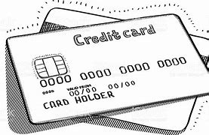
Having a Government Travel Charge Card (GTCC) is MANDATORY for ALL personnel (military or civilian) to pay for ALL official travel costs for TDY and PCS.
DoDI 5154.31-V4, October 16, 2015
PUBLIC LAW 105-264-Oct. 18, 1998: Travel and Transportation Reform Act of 1998
GOVERNMENT TRAVEL CHARGE CARD (GTCC) REGULATIONS, March 2021
If you do not have a GTCC, you will need to apply for a GTCC at least 30 days prior to your PCS. Contact your local unit APC for further instructions.

Slide 4
GTCC
OUT-PROCESSING
If you are departing:
FORT RICHARDSON
All 4/25 IBCT (Abn) will clear GTCC with your BN APC
59th Sig, Meddac, Dentac will clear GTCC with your unit and do not need to clear with G8 TM.
All others will clear GTCC through G8 Travel Management
Bldg. 1, Room 226
Monday – Friday 0900-1130
***Only after clearing BN***
You MUST out-process Defense Travel System (DTS) with your UNIT Organizational Defense Travel Administrator (ODTA) before out-processing with GTCC.

Slide 5
GTCC
OUT-PROCESSING
If you are departing:
FORT WAINWRIGHT
All 1/25 SBCT will clear GTCC with your BN APC
59th Sig, Meddac, Dentac will clear GTCC with your unit and do not need to clear with G8 TM.
All others will clear GTCC through G8 Travel Management
Bldg. 1051, Apt, 14
Tuesday and Thursday 0900-1100
***Only after clearing BN***
You MUST out-process Defense Travel System (DTS) with your UNIT Organizational Defense Travel Administrator (ODTA) before out-processing with GTCC.

Slide 6
GOVERNMENT TRAVEL CHARGE CARD (GTCC) OUT-PROCESSING BRIEF
***Use of the GTCC for official travel is mandatory per the Travel and Transportation Reform Act of 1998, Public Law 105-264 and DoDI5154.31-V4.***
Your GTCC account will be placed in PCS/Mission Critical status for approx. 120 days. This pushes your billing cycle out to allow for voucher processing. This is NOT extra time to file your voucher.
You are required to file your voucher within 5 days of in-processing.
Your credit limit will be temporarily increased to $10k ($15k if traveling via Alaska Marine Hwy System). This is a cushion NOT a target!
You are required to adhere to GTCC regulations and use your GTCC for PCS travel related expenses: food, lodging, and fuel, or ticketed transportation (airline/ferry) and transportation to and from the airport.
No alcohol or tobacco purchases are allowed—only incur expenses that are reimbursable per your official orders.
Know your Citibank GTCC PIN for your card.
Save your receipts! Receipts are required for purchases $75 and above and for all gas and lodging charges. Hold on to your receipts until after your voucher is settled.
Update your profile and change your mailing address with Citibank ASAP to ensure that you get your statements.
In-process with your new APC (GTCC) and ensure your GTCC account is owned by your new unit or you risk having your account closed after 30 days of your report date.
You are responsible for any balance on your GTCC. Make sure to check your GTCC statement even after your voucher has settled.

Slide 7

Many of you may be wondering…Why is out-processing travel so important?

Slide 8


1
Avoid Out-of-Pocket Expenses
PCS travel expenses add up quickly, by ensuring you have a Government Travel Charge Card (GTCC), you avoid out-of-pocket Expenses. Out-processing ensures that you have increased limits to cover expenses.
2
Avoid Past Due Notices & Fees
Out-Processing ensures your GTCC is set up properly, giving you time to travel to your new duty station before payments are due and ensures your DTS travel has been properly settled before you depart.

Slide 9


3
Receive Your Payments Quickly
Proper out-processing helps ensure timely reimbursement payments. Money back into your pocket!
KEY TAKEAWAYS
Outgoing personnel must complete ALL out-processing steps for both the Defense Travel System DTS and Government Travel Charge Card (GTCC)programs.
Proper out-processing benefits you!
It is YOUR responsibility to ensure all steps are completed promptly!

Slide 10
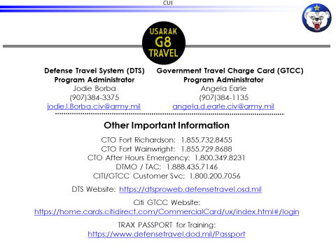
If you have any questions, contact your unit APC and/or OTDA.
Happy & Safe Travels!
The USARAK Travel Management Team

