Slide 1

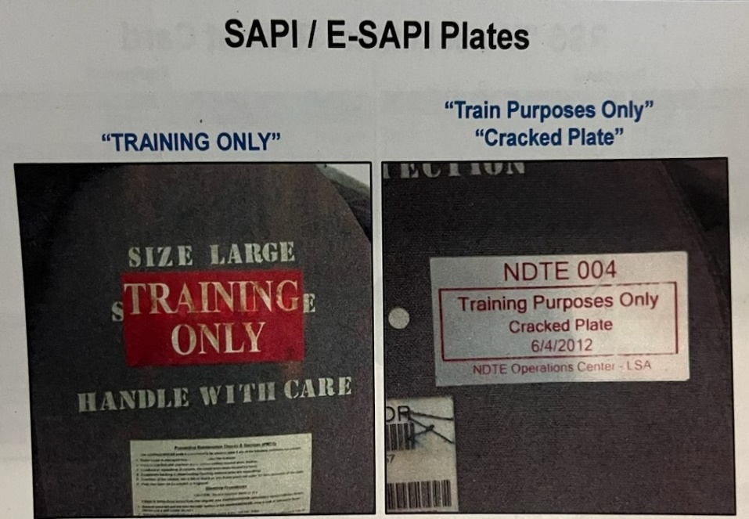
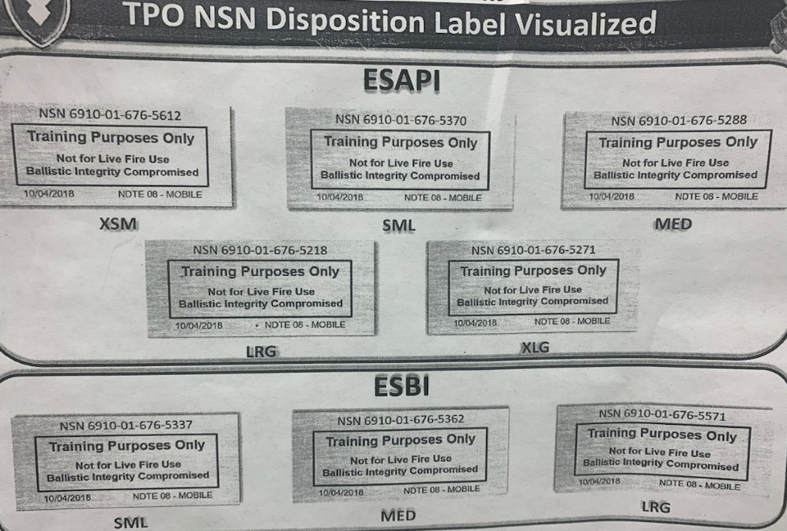
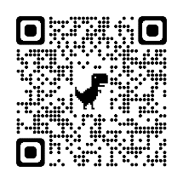
Central Issue Facility (CIF)
Training Purpose Only “TPO” Plates
Training Purpose Only (TPO) Enhanced Small Arms Protective Insert (E-SAPI) and Enhanced Side Ballistic Insert (ESBI) must be turned in and exchanged for a standard passed inspection label (ESAPI/ESBI) plates at CIF. TPO plates are not authorized for Live Fire Use IAW Department of the Army Hard Armor Ballistic Inserts/Plates Inspection Policy. If you have ballistic plates on hand with the specific labels listed above, turn them in and exchange them at your CIF for a set with approved passed inspection label. Also, Soldiers with more than one set of ESAPI/ESBI plates on hand must turn in their excess ballistic plates to CIF.
SOLDIERS – Check your E-SAPI Plates LEADERS- Check your Soldiers

Slide 2
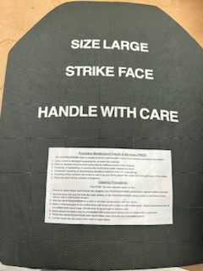
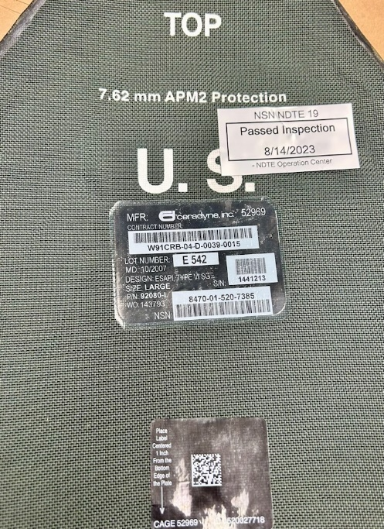
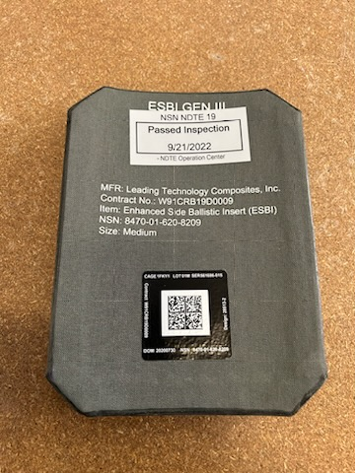
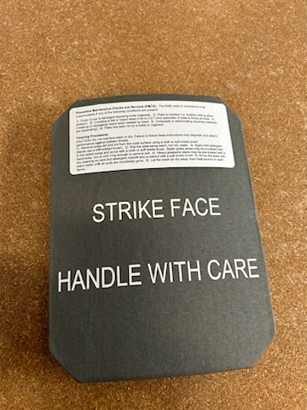


Central Issue Facility (CIF)
Passed Inspection Label ESAPI Plates
ESAPI BACK
ESBI BACK
ESBI FRONT
ESAPI FRONT
Passed Inspection label- Scanned Enhanced Small Arms Protective Insert (E-SAPI) and Enhanced Side Ballistic Insert (ESBI) are authorized for deployments, contingency/rapid deployment missions, and Live Fire Exercise (IAW Department of the Army Hard Armor Ballistic Inserts/Plate Inspection Policy). Per Army policy, Commanders will conduct assessments to determine risk level and mitigation efforts IAW ATP 5-19, DA PAM 385-30 and local range policies. For training purposes, the CIF will issue a set of ESAPI/ESBI plates with a “passed inspection” label that is not identified for deployment purposes . Pictures on the left side, are a set of “passed inspection” label for deployment plates scanned by NDTE Team. Pictures on the right are for a set of ESBI Plates
passed inspection label from Sep 2022 that can be issue for live fire training purposes only,
after user inspection (TM 10-8470-210-10), not deployment.
SOLDIERS – Check your E-SAPI Plates LEADERS- Check your Soldiers

