Slide 1
Benefits Delivery at Discharge Workshop
Germany BDD Intake Site
Landstuhl Regional Medical Center
(LRMC)
Pittsburgh Regional Office (RO)
April 29, 2024

Slide 2
Benefits Delivery at Discharge (BDD)
The BDD program allows Service Members to apply for VA disability compensation benefits between 180 to 90 days prior to separation.
The goal of the program is to deliver a decision within 30 days after separation.

Slide 3
Disability Compensation
What is VA Disability Compensation?
Financial support and/or other benefits, like health care, for an illness or injury that was caused by, or got worse because of, your active military service.
A disability found to be related to service is called a service-connected disability.

Slide 4
Disability Compensation
A disability can be rated as service-connected on a direct basis, if the following are true:
A disability, injury or illness occurred during active-duty service
A currently diagnosed disability exists, and
There is a link (or nexus) between the current diagnosis and the in-service event.
There are other avenues of service connection, but for the purposes of the BDD program, we will focus on direct service connection.

Slide 5
Disability Compensation
Each disability is assigned a percentage depending on the severity of the condition from 0% to 100% and in 10% increments.
The rating assigned is based on the evidence, which includes evidence found in your service medical records and VA examinations.
After all disabilities are assigned a percentage, VA then combines these percentages for an overall disability rating.
Overall disability rating is then translated into a monetary amount using the VA compensation rate tables.
Amount is paid monthly, 1st of the month, in arrears.

Slide 6
BDD Eligibility Requirements
You must have a known separation date.
You must have 90 - 180 days remaining on active-duty date (ETS/Retirement date) at the time you submit your BDD application. This is regardless of when your terminal leave period may begin.
You must be available for 45 days immediately following submission of your BDD claim to attend VA examinations.
You must provide a copy of your service treatment records (STRs) for the current period of service, and if you are claiming behavioral health, dental, or vision records, these records should be submitted, as well.
You must provide a completed Separation Health Assessment - Part A: Self-Assessment
Note: If you do not meet the BDD requirements you can still file your VA claim prior to discharge at VA.gov.

Slide 7
BDD Exclusions
The following issues and conditions are excluded from BDD claims:
Service Members who do not meet the eligibility requirements noted previously
Are seriously ill or injured
Lost a body part
Are terminally ill
Claims for Service Members awaiting discharge while hospitalized in a VA or military treatment facility or
Claims that require a character of discharge determination
Service Members who are excluded from the BDD program can submit a VA claim through the Fully Developed Claim program or the Standard Claim Process.

Slide 8
More than 180 Days remaining
If your release from active-duty date is more than 180 days out, participation in the BDD program will not be permitted.
However, you can take steps to prepare yourself to participate in the program when you do meet the criteria:
Create a VA.gov account
Obtain a complete copy of your service treatment records, to include behavioral health, dental and vision records (if applicable).
Prepare a list of the chronic conditions you will claim

Slide 9
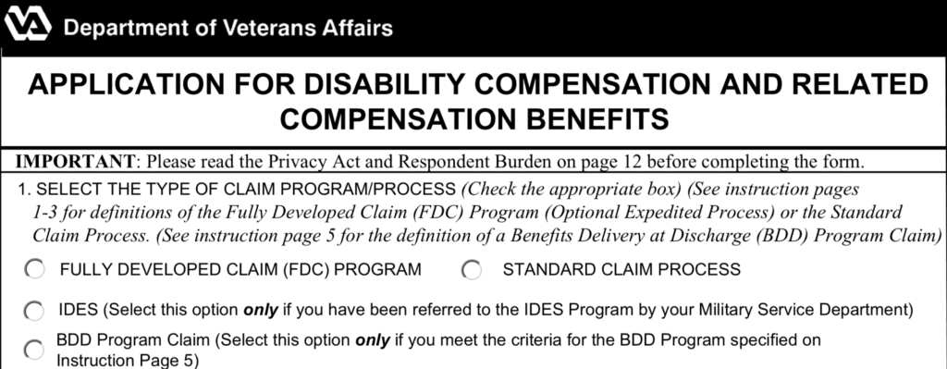
Submitting Claim
Before submitting your BDD claim, please review the BDD Program guide, which can be requested from the Germany BDD Office.
Applications and supporting evidence/records are submitted through https://www.va.gov
After a claim is submitted on VA.gov, Service Members should send an e-mail to GermanyBDD.VBAPIT@va.gov to provide your Va.gov Claim ID number.
A manual/physical application can be submitted to our office via Quick Submit at https://access.va.gov/

Slide 10
Getting Started on VA.gov
When submitting your BDD claim online, you may encounter an error message when starting the application:
"We need more information from you before you can file for disability compensation with VA form 21-526EZ. Please call Veterans Benefits Assistance at 800-827-1000”
With most cases, the BDD office can resolve this matter by updating your VA profile.
If encountering this message, you should e-mail GermanyBDD.VBAPIT@va.gov and provide your 10-digit DoD ID number and full name.
BDD office will update the profile.
If the profile error message is not resolved, a claim can be submitted via Quick Submit. You can e-mail the BDD office to request further instructions.

Slide 11
Starting the Online Application
VA claim routing and examinations are determined based on the mailing address provided on the application.
Please utilize your military (AE) when submitting your BDD application. This will ensure:
Your claim is routed to the correct BDD office
Your exams are scheduled in proximity to your location
For foreign numbers, VA.gov is programmed to phone numbers based on US formatting. You will not be able to enter your foreign number.
Optional: You can also provide your foreign number in the proper format using the free text space provided for your phone number on the Separation Health Assessment – Part A form.

Slide 12
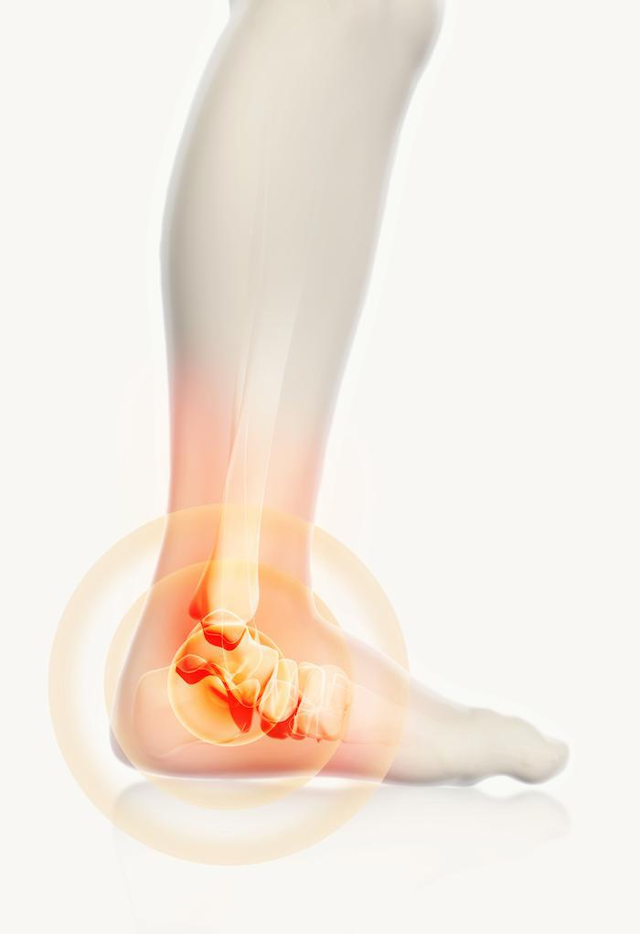
Claimed Conditions
VA.gov will populate a drop-down list with several suggestions.
You are not required to select from the drop-down list and can press the “tab” button or click outside of the box once you are finished typing to proceed to add the disability.
List all chronic conditions regardless of whether you have already been treated for the condition.
Be specific – lay terms are acceptable.. For example, do not claim “joint pain,” instead claim “left ankle condition.”
A great place to start is by mirroring the chronic conditions identified on the Separation Health Assessment, Part A – Self Assessment.

Slide 13
Uploading Evidence
As applicable, copies of Service Treatment Records (STRs) should include:
Military entrance physical
Periodic health assessments
Inpatient and outpatient records
Military and private medical documents
Behavioral health records
Dental and/or Vision records
Tricare online records alone may not be considered a substantially complete copy of service treatment records if they do not contain all the necessary elements noted above.
Separation Health Assessment (SHA) Disability Benefits Questionnaire (DBQ) – Part A, Self-Assessment should be digitally signed and uploaded.
VA Form 21-686c, Application Request to Add and/or Remove Dependents.
This form is required to receive additional disability compensation for your dependent(s), if granted at least 30 percent compensation.
You may complete the form and upload with supporting evidence.

Slide 14
Claim Review
Once a claim is received, a Military Services Coordinator (MSC) at the BDD office will review your claim to ensure:
Service treatment records are present, to include enlistment examination for the current period of service.
Separation Health Assessment – Part A is present.
All claimed conditions are clear and specific
E.g., “Burn Pit” is an exposure and not a disability
Exam requests are system generated based on provider availability in proximity to the Service Member’s location of record. Our vendors will contact you directly to schedule your disability appointments.
We highly encourage you to check your email often throughout the BDD process (to include your junk mail).

Slide 15
VA Examinations
You must be able to attend all scheduled exams (contingent upon exam availability). Overseas examinations are completed by one of two contract exam vendors:
QTC Medical Services or
Veterans Evaluation Services (VES)
Information from VA exams are used to rate claimed disabilities. The rating assigned will be based on the severity of each disability.
You may have several examinations scheduled as part of your BDD claim.
General Medical Examination – Separation Health Assessment
Audio / Hearing
Behavioral Health
Traumatic brain injury (TBI)
Vision, and/or
Dental

Slide 16
VA Examinations (continued)
You do not need to bring anything to your exam, unless specifically requested by the vendor. All records in support of your claim should be submitted directly to the VA, uploaded via VA.gov.
A VA exam is not like a normal medical examination. The provider will not treat for any illness or injury, give referrals to other providers, or prescribe medicine.
The examiners use Disability Benefits Questionnaires (DBQs) to document symptoms and diagnoses related to claimed conditions.
Vendors will:
Perform a basic physical exam.
Schedule other tests—like MRIs, X-rays or blood work, if deemed necessary.
After all exams are completed, to include a vendor quality review process, the reports/results will be forwarded to VA and DoD HAIMS.

Slide 17
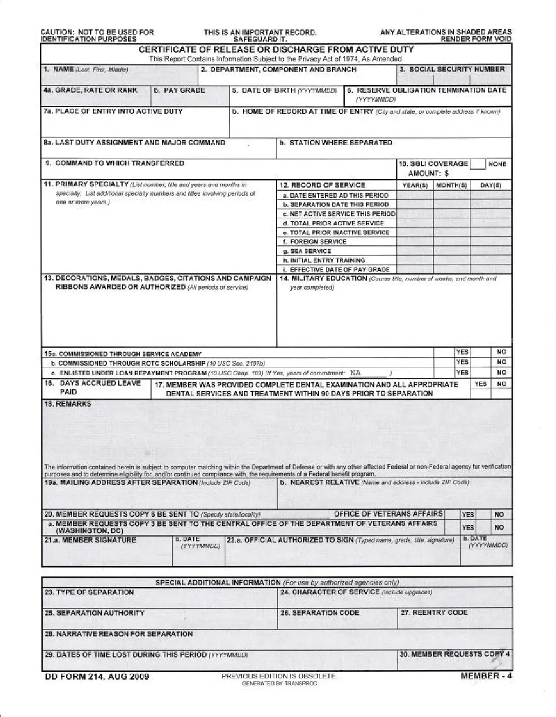
After the Examinations
Please upload a copy of your official DD Form 214 (Member copy 4) using VA.gov.
Once exams are complete and your DD214 is of record, you will be in a waiting pattern until released from active duty. VA typically will not render a decision while you are still on active duty. The goal is to decide your BDD claim within 30 days post separation.

Slide 18
Why BDD?
This program will allow you to apply for VA disability compensation and complete your VA examinations while on active duty.
You will get your VA decision sooner.
Once Service Members are released from active duty, those with BDD claims typically have their claims resolved faster than those filing under the standard VA claim process.
For VA purposes, your exams completed on active duty become in-service evidence, like evidence in your service treatment records.
Even if you have never been treated for a condition, the fact that you have claimed it while on active duty provides evidence of an “in-service complaint” which is the first step to service-connection.
Your VA exams can double as your Separation Health & Physical Examination (SHPE) for the military if completed with sufficient time to provide your reports to your service department.

Slide 19
The PACT Act and Your VA Benefits
The Promise to Address Comprehensive Toxics (PACT) Act is the new law that expands VA health care and benefits for Veterans exposed to burn pits, Agent Orange, and other toxic substances.
The PACT Act adds to the list of health conditions that we assume (or “presume”) are caused by exposure to these substances. This law helps us provide generations of Veterans—and their survivors—with the care and benefits they’ve earned and deserve.
Presumptive conditions: For some conditions, we automatically presume that your service caused your condition. We call these presumptive conditions.
If you have a presumptive condition, you don’t need to prove that your service caused the condition. You only need to meet the service requirements for the presumption.
Gulf War era and post-9/11 Veteran eligibility
Burn Pit and other toxic exposure
Vietnam era Veteran eligibility
Agent Orange
If you should develop any disabilities after service related to toxic exposure, those conditions may be presumptively linked to service.
For more information about the PACT Act, visit https://www.va.gov/pact

Slide 20
Medical Records Request - LRMC
Process / Form
DD Form 2870, Authorization for Release of Medical and/or Dental Information.
Patients should complete blocks 1-13 and include a valid return e-mail address.
Records delivered electronically via DoD Safe
When to Request Your Medical Records?
Approximately 180 days from retirement/separation.
Allows for older records to be located or request MTF to MTF transfers
Request encounters, thereafter
How Can You Help?
Ensure the MTF (or LRMC) has all records, including one’s that are in your personal possession
Ensure LRMC PAD has access to host nation or civilian medical facility encounters
PAD will assist with requesting records when possible.
LRMC / MTFs must have your records for final disposition to the National Personnel Records Center

Slide 21
Medical Records Request - LRMC
Where to Submit the Request…
Scan the signed document and email them, encrypted, if possible, along with a copy of the front and back of the requestor's ID (it cannot be a DOD ID Card) to dha.landstuhl.landstuhl-rmc.mbx.pad-correspondence-request@health.mil
Behavioral health records requests must be submitted on a separate DD 2870.
Please include a legible email address on DD Form 2870. The records will be sent electronically in PDF format with password protection.
A separate email with the password will be sent to you so you may access your records. LRMC Contact Info:
DSN 314-590-5203 or Commercial: 49-6371-9464-5203.

Slide 22
Medical Records Request - Stuttgart
Requesting Information
Patients may request copies of their medical records using form DD Form 2870 (Authorization for Disclosure of Medical or Dental Information) available online at https://www.esd.whs.mil/Portals/54/Documents/DD/forms/dd/dd2870.pdf either by mail or by visiting Patient Administration Department, located on the first floor, building 2300.
Requests for outpatient records, take a minimum of 30 business days to process.
Behavioral Health, Family Advocacy and sensitive records must be reviewed and cleared by a provider before release. Please allow up to 30 business days for processing.
Inpatient records are not available at this location and must be requested directly at the treatment facility where the surgical treatment was completed.
For more information, please visit Stuttgart Patient Administration and Records

Slide 23
File your BDD Claim today!
BDD Claim Window as of today, 29 April 2024:
90-days 07/28/24
180-days 10/26/24
When you submit your claim, e-mail your 9-digit claim ID number to
GermanyBDD.VBAPIT@va.gov
Thank you for your service!

Slide 24
BDD Contact Information
Germany BDD Intake Office handles all BDD claims for Europe, Middle-East, and Africa.
Germany/LRMC BDD Team
Bldg. 3724
Room 110-114
DSN: 314-590-8200
Comm: +49 6371-9464-8200
Email address is: GermanyBDD.vbapit@va.gov
VA Officer in Charge: Phyllis Barnes, Phyllis.Barnes@va.gov

Slide 25
Questions

Slide 26
SURVEY / FEEDBACK!!

