Slide 1

U.S. Department of Veterans Affairs
Veterans Benefits Administration
Pittsburgh Regional Office
USAG Stuttgart Town Hall
April 30, 2024
Notes:
Good Afternoon and welcome to the Pittsburgh VA Regional Office’s inaugural overseas Town Hall Broadcast. My name is Anna McBarron. I am the Foreign Program Manager for the Pittsburgh VA Regional Office, and I will be your moderator for today’s presentation. You will have an opportunity, as time allows, to ask questions following the entire presentation. We will not be stopping in between speakers to take questions, so I ask that you hold all question until the end. So, without further ado, we will get started. I am honored to introduce our first speaker, for some opening remarks – the Director of the Pittsburgh VA Regional Office, Mrs. Jennifer Vandermolen.

Slide 2
Veteran’s Fraud Prevention
Common Scams
Claims Coaches | Impersonating Family Members
Student Loan | Gift Card Scams
Pension Poaching | Robo Calls
Arm yourself with information to protect yourself against Veteran targeted fraud: Protecting Veterans From Fraud | Veterans Affairs (va.gov)
Visit to find an accredited attorney, claims agent, or Veterans Service Organization (VSO) Representative: OGC - Accreditation Search (va.gov)
Notes:
Benefits fraud poses a significant threat to Veterans and their loved ones. Veterans and their families are popular targets for financial fraud. Scammers may try to defraud you through misleading emails, texts, cold calls, or online ads.
You can combat fraud schemes, scams, and other unethical activities by becoming aware of the latest tactics fraudsters are using and the most prevalent types of fraud perpetrated in the Veteran community. Some of the most common scams which seek to gain access to medical and financial benefits Veterans earned through military service include Claims Coaches, Impersonating Family Members, gift card scams, pension poaching, Robo calls, and student loan fraudsters.
Do not provide your personal information to anyone other than a VA-accredited representative.

Slide 3
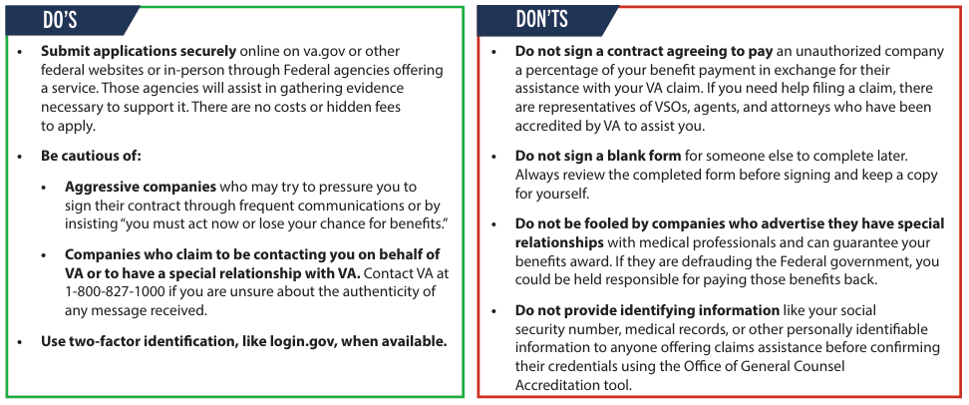
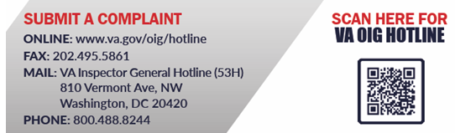
Be Vigilant of Scams
Notes:
Report scams to the VA OIG Hotline.
The OIG hotline receives, screens, and determines the disposition of complaints concerning Veterans or VA that relate to potentially unlawful activity or potential violations of rules or regulations; fraud, waste, and abuse; and gross mismanagement of VA programs and operations. The OIG has transitioned to web forms only for complaints submitted in electronic format; this change means that the OIG no longer accepts free-form email submissions except when OIG hotline staff specifically direct such submissions to ensure the secure transmission of protected information.

Slide 4

VA Benefits & Veterans Abroad
If you are a Veteran who lives overseas, you remain entitled to the benefits and services you earned through your military service. Most VA benefits are payable regardless of your place of residence or nationality.
Notes:
Some challenges exist to Veterans and their VA benefits if they live outside the U.S., specifically some ancillary benefits. Most of those challenges are logistic and are not related to the Veteran’s entitlement. Most VA Benefits are payable regardless of your place of residency.

Slide 5

Federal Benefits Booklet
Updated Federal Benefits Booklet for Veterans, Dependents, Survivors, and Caregivers Now Available
Thorough guide explaining the numerous VA benefits and services available to Veterans, their families, and caregivers
  Includes info on everything from health care and education assistance to housing aid and career development initiatives
  Eligibility requirements, application procedures, and other information to help Veterans make well-informed decisions
Now available in print and online at https://www.va.gov/opa/publications/benefits_book.asp
Notes:
Benefits booklets are available at the claim's clinic/townhall there in Germany. You are also able to access an online version at the link above.

Slide 6

VA Life Insurance
Public Law 116-315 authorized Veterans Affairs Life Insurance (VALife) as Guaranteed Acceptance Whole Life Insurance coverage available to all service-connected Veterans age 80 and under at all disability ratings: 0 to 100%
Veterans who apply for a new disability rating before age 81 and get that rating for a new condition after turning 81, can apply for VALife within two years of rating notification.
Important Things to Know About VALife
Fully automated online application and approval process
No medical underwriting
Death benefit in first 2 years, only pay premiums plus interest
Builds cash value after 2 years
No waiver of premiums
Notes:
VA life insurance with guaranteed acceptance whole life insurance is available to all service-connected Veterans age 80 and under.
Benefits of VA Life include up to $40,000 in coverage payable in $10,000 increments, no medical underwriting, fully automated online enrollment with instant approval, competitive premium rates, and a cash value that builds over the life of the policy.

Slide 7





How can Veterans apply for VALife?
Veterans can apply and manage their VALife policy online.
Online
application
Online instant
decision
Online premium payment option
Online review and management of policy
Electronic filing of
death claim
Veteran’s authorized representative (Guardian, POA, VA Fiduciary) may also apply via DocuSign.
Check eligibility and enroll in VALife at https://insurance.va.gov/VALIFE/
Notes:
You can apply and manage your VALife policy online at the website.

Slide 8
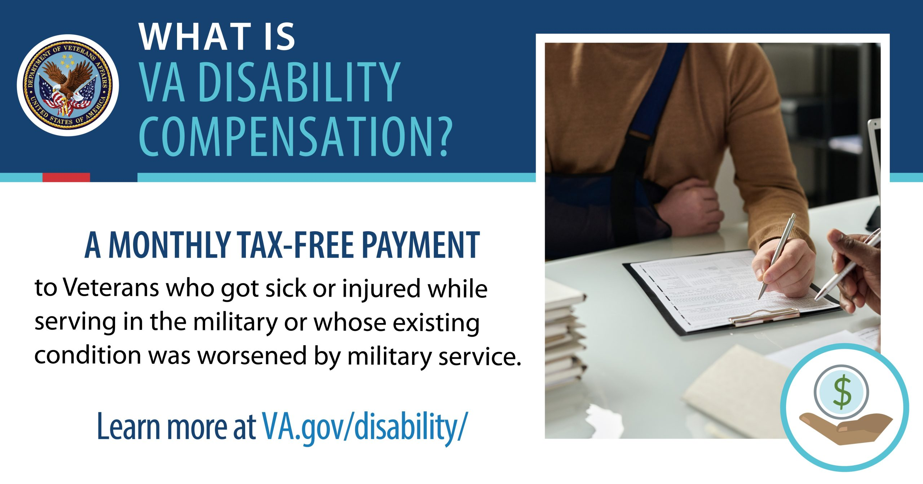
VA Disability Compensation
Notes:
You may qualify for VA disability benefits for physical conditions (like a chronic illness or injury) and mental health conditions (like PTSD) that developed before, during, or after service. If you are already receiving VA Disability Compensation, you may change your rating at any time by submitting new supporting documentation.

Slide 9

PACT Act – Don’t Delay, File Today!
Notes:
The PACT Act expands VA health care and benefits for Veterans exposed to burn pits and other toxic substances. This law helps us provide generations of Veterans – and their survivors- with the care and benefits they’ve earned and deserve.
Pending Claims: If a Veteran’s condition was added to the list of presumptive conditions* after the claim was filed, VA will consider it on a presumptive basis.

Slide 10
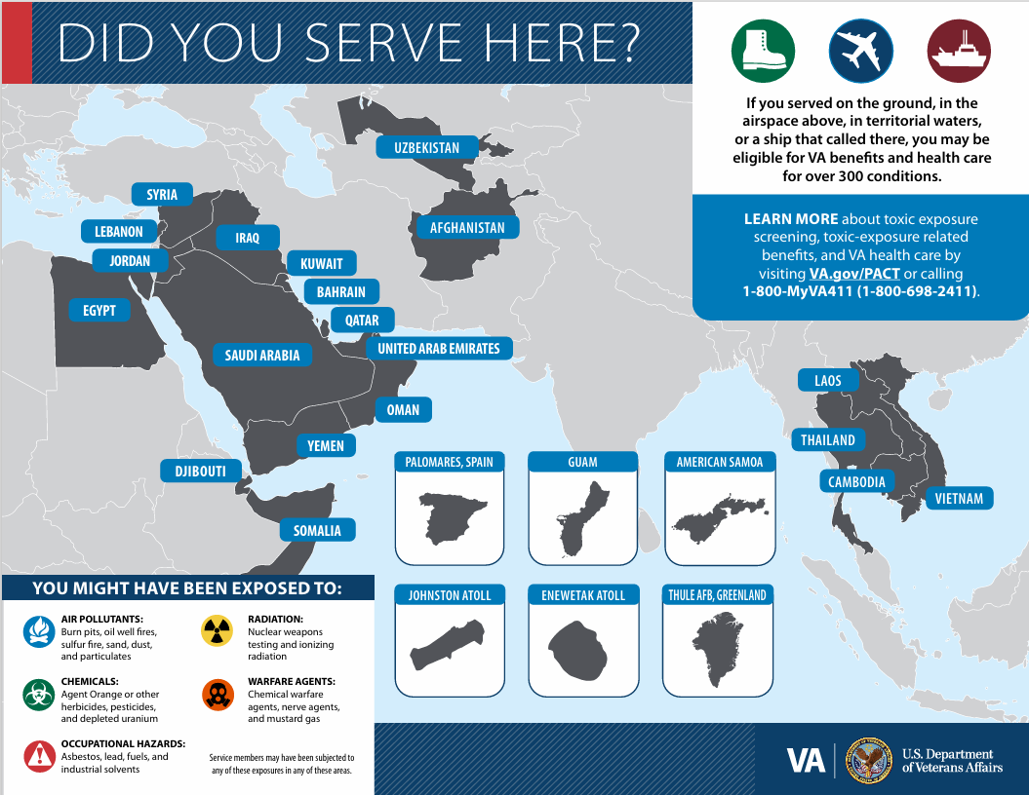
Notes:
If you service on the ground, in the airspace above, in the territorial waters or a ship that called there, you may be eligible for VA benefits and health care for over 300 conditions.

Slide 11
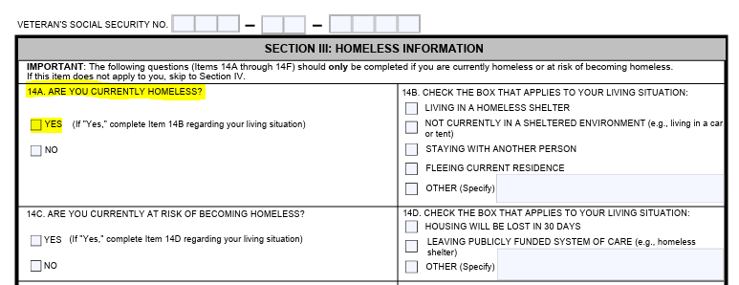
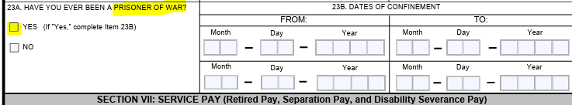
VA Priority Claims
Terminal disease or injury
Amyotrophic Lateral Sclerosis (ALS)
Homeless
Former Prisoner of War
Military Sexual Trauma
Veteran’s age over 85 years old
Extreme Financial Hardship
Medal of Honor recipient
Notes:
If any of these priorities apply to you, you should let us know when you file your claim, or at any time during the claim process. VA can expedite claims if the Veteran or survivor meets certain priority criteria. You should use the VA Form 20-10207, Priority Processing Request when submitting your claim. Please ensure that you are submitting the required documentation, per the form instructions, to support the request.

Slide 12

VA Exam Translations
Disability Benefits Questionnaire (DBQ)
VA Contract Examiners must follow a DBQ when completing VA Examinations
DBQs can be completed by a private medical provider and submitted with a VA claim
Pittsburgh Regional Office has the ability to:
  Have DBQ forms translated from English to another language
  Have the examiner’s report from the DBQ translated into English
Submit requests for DBQ translations to AskVA
Notes:
MDEO will be presenting after us and covering specifics about VA Exams, but we wanted to share that the Pittsburgh RO can help if a Veteran wants to have their exam conducted by their private treatment provider. A DBQ contains all pertinent information that must be included by the examiner for them to properly assess a Veteran’s disability for VA purposes. Private providers have to follow the DBQ in its entirety just like a contracted examiner.
The Pittsburgh RO has the ability to translate evidence submitted in a foreign language, including on a DBQ. If a Veteran would like to have an English DBQ (form) translated into another language so that their private doctor (who may not speak English) can complete it, they should submit their request for a DBQ translation at AskVA by including their identifying information and the language to which they want the documents translated.

Slide 13

Dependents
Eligible for VA disability compensation with a combined disability rating of at least 30%
Veterans outside the U.S. must submit a completed VA Form 21-686c AND evidence of dependency:
Marriage certificate
Divorce Decrees
Birth Certificates
Death Certificates
Notes:
You may receive Dependency Benefits if you have 30 percent or higher overall combined rating evaluation. If you reside overseas: you must submit copies of your dependency documents with your Claim form ( VA Form 21-686C). To add your spouse to your award you will have to provide proof of marriage, If your or your current spouse were previously married, you will have to provide a divorce decree that shows that the prior marriage ended and To add dependent children a proof of birth will be required
If your dependent(s) do not have a U.S. SSN, you can still have them added to your compensation. To do so, you'll need to explain why they don't have a U.S. SSN in the "remarks" section (block 25) of the VA Form 21-686c.

Slide 14
Common Claim Delays
Incomplete Forms
Evidence not identified or submitted
Proof of dependency not submitted
Providing mailing address only
Missed or rescheduled examinations
Missed communication
Notes:
We just wanted to touch on a few common claim delays that may affect timely decisions on your claim.
1. Be sure to be clear about contentions when filing a claim. Is it the right or left knee? If you are claiming that a non-presumptive condition is linked to exposure, tell us about the exposure.
2. You should submit ALL evidence to support your claim, if available, at the time the claim is submitted, to include proof of dependency as discussed on the prior slide (if applicable). If you are unable to obtain the evidence yourself, you must at least identify the evidence for us so that we can request it for you.
3. It is very important that you provide VA with your physical address, even if you utilize a separate mailing address.
If a VA Exam is warranted for your claim, we use your physical address to determine which VA Exam location is closest to you for scheduling purposes.
Providing only your mailing address will cause us to schedule your VA Exam at an inappropriate location, which may result in a denial or delay of your claim.
You can provide your physical address by completing VA Form 21-4138 (Statement in Support of Claim) and including it with your claim. Additionally, you should provide your most current contact information (telephone number and e-mail address) as we will utilize multiple means to notify you of your exam date, time, and location.
4. It is very important that you attend your VA examination. If you need to reschedule your exam, you should notify us as soon as possible. You can submit that request to AskVA.
5. We very frequently communicate with Veterans abroad through e-mail. Please make sure we have your correct e-mail address and that you watch for communication from us.

Slide 15

How To File a Compensation Claim
Online: www.va.gov/disability/file-disability-claim-form-21-526ez/introduction
By mail: Download, print, fill out, and send VA Form 21-526EZ to Department of Veterans Affairs, Claims Intake Center, P.O. Box 4444, Janesville, WI 53547-4444
Get help: Find an accredited representative who can assist you with filing your claim at https://www.va.gov/disability/get-help-filing-claim
Have questions?
1-800-MyVA411 (1-800-698-2411) or AskVA
Choosing VA means getting everything you need in one spot. Learn more about VA disability compensation, eligibility requirements and filing a claim at VA.gov/disability
Notes:
There are many ways to file a claim with VA today including online and by mail. If you need help, you can find an accredited representative who can assit you with filing your claim at the link shown.
If you have any questions you can call 1800-myVA411 or submit an AskVA

Slide 16

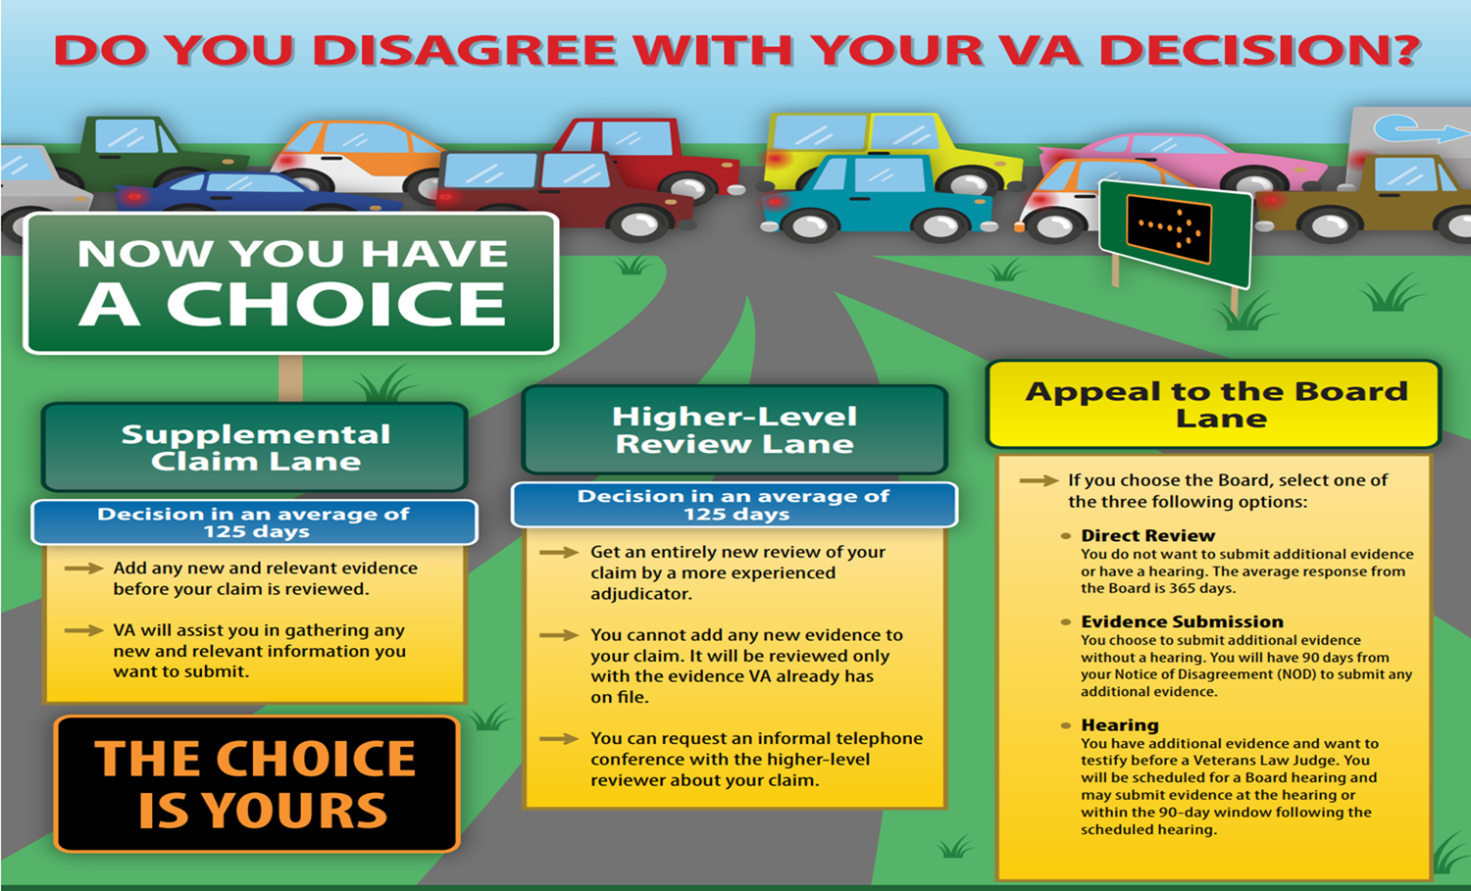
VA APPEALS OPTIONS
Safe Care is our Mission
Notes:
Once we make a decision on your compensation claim, you have the right to appeal that decision if you disagree with it. You have a choice between filing a supplemental claim, requesting a higher-level review, or appealing to the Board of Veterans Appeals.

Slide 17
VA Pension – The Basics
VA Pension is a needs-based benefit paid to those meeting certain criteria:
Service
  Under Other Than Dishonorable conditions.
  Wartime Service
Permanent and Total Disability (Veterans only)
  Rated at 6% or higher for a single disability, or
  Rated at least 70% combined with at least one disability rated at 40%
Income
  All income (including income of dependents) is countable unless specifically excluded by 38 CFR 3.272.
Net Worth
  If calculated NW exceeds the limit, then it is a bar to benefits
Notes:
VA pension is a needs based benefit paid to those meeting certain criteria shown here. Service requirements include a minimum period of Active Duty. Veterans can meet the P&T disability if age 65 or older, in receipt of SS, and in a nursing home. Expenses may be used to reduce countable income. Veterans applying for pension are required to report dependents because their income and net work must be considered when determining benefits.

Slide 18
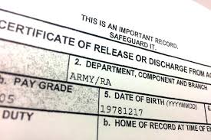
2024 Breaking News
VA’s new regulation expands access to care and benefits for certain former Service Members by:
Eliminating the regulatory bar for “homosexual acts involving aggravating circumstances or other factors affecting the performance of duty” as a bar to benefits.
Creating a “compelling circumstances exception” for certain former service members.
Opening the door for previously denied service members to reapply
VA encourages former Service Members with Other Than Honorable or bad conduct discharges to apply for VA care and benefits
Notes:
VA posted a final rule on April 25th (last week) that amends regulations regarding Character of Discharge Determinations and expands access to care and benefits for some former Service Members who did not receive an Honorable or General Discharge. VA encourages former service members with Other than honorable or bad conduct discharges to apply for VA care and benefits.

Slide 19

BURIAL BENEFITS
Available to U.S. Veterans who did not receive a Dishonorable Discharge:
Gravesite in any VA National Cemetery
Grave Liner (Vault)
Opening and Closing of the Grave
Government Headstone, Marker or Niche Cover
Burial Flag
Presidential Memorial Certificate
Notes:
If you choose to be interred in the U.S., you are eligible for burial benefits through the VA. Your family, or personal representative will be responsible for transportation costs. Eligibility includes a Service Member who died while on Active Duty (may include AD for training and Inactive Duty for training). The cemetery must have available space for casket and cremation burials. Perpetual care of the gravesite is included. Military honors are not included as part of the burial benefit. The family or personal representative will be provided honors contact information.

Slide 20

Burial Pre-Need Eligibility
How It Works
Submit VA Form 40-10007 with proof of military service (if available).
  Mail to:
  NCA Intake Center, P.O. Box 5237
  Janesville, WI., 53547
  Fax to:
  (855) 840-829
Receive written notice of eligibility determination. Keep a copy.
You have the right to file an appeal if the request is denied.
VA will store the information.
At time of need, application will be re-verified.
Notes:
With VA’s new Pre-Need program, you can apply to find out in advance if you can be buried in a VA National Cemetery. It helps eliminate delays and reduce stress for family members at a difficult time.
NOTE: This is only for Veterans to plan their own burial in advance. It is not for after the Veteran is deceased. Eligibility does not enable you to reserve a specific burial space or guarantee a gravesite in a specific VA National Cemetery.

Slide 21

Survivor Benefits
VA Dependency and Indemnity Compensation (DIC)
VA Dependency and Indemnity Compensation is a monthly tax-free benefit provided to an eligible surviving spouse, child, or parent of a Service Member who died in the line of duty, or the survivor of a Veteran who died from a service-related injury or illness.
Applications:
VA Form 21P-634a (Surviving Spouse or Child of Service Member)
VA Form 21P-534EZ (Surviving Spouse or Child of Veteran)
VA Form 21P-535 (Surviving Parent
VA Survivors Pension
A VA Survivors Pension offers monthly payments to qualified surviving spouses and unmarried dependent children of wartime Veterans who meet certain income and net worth limits set by Congress.
Application – VA Form 21P-534EZ
Notes:
DIC benefits are available to surviving spouse, child or parent of service members who died in the line of duty or from a service-related inquiry or illness. DIC benefits paid to surviving spouses and children are not income based. The PACT Act expanded eligibility to DIC. If you are a surviving spouse who was denied DIC previously, you may now be eligible under the PACT Act.
Survivors Pension offers monthly payments to qualified surviving spouses and unmarried dependent children of wartime Veteran’s who meet certain income and net worth limits set by congress.

Slide 22
Veteran Readiness & Employment
VR&E Mission
To help Veterans with service-connected disabilities prepare for, find, and keep suitable jobs.
For Veterans with service-connected disabilities so severe that they cannot immediately consider work, VR&E offers services to improve their ability to live as independently as possible.
Notes:
The Department of Veterans Affairs (VA) provides Veteran Readiness and Employment (VR&E) services outside the United States (U.S.) to ensure that claimants who reside outside the U.S. receive rehabilitation services and other assistance of the same quality as claimants residing in the U.S.
Most aspects of Chapter 31 service delivery for foreign cases, to include processes for providing VR&E services, roles and responsibilities of each stakeholder, documentation requirements, and case management are the same as for non-foreign cases.
However, Independent Living services are not available to Veterans that live abroad.

Slide 23
Eligibility to VR&E Benefits
A case is considered foreign if one of the following two circumstances exists:
The claimant is, or will be, residing abroad and requires an initial evaluation and possible subsequent development of a vocational rehabilitation plan.
The claimant has been pursuing a rehabilitation program in the U.S. and, as part of the rehabilitation plan, needs a period of training outside the U.S. to meet the occupational requirements of the vocational goal.

Slide 24
Eligibility to VR&E Benefits
Acceptable reasons for personal hardship include:
The claimant has accepted employment overseas.
The claimant is married to a foreign national.
The claimant is a spouse of an active duty Service member assigned overseas.
The claimant is accompanying his or her spouse, who is employed overseas.
Notes:
The criteria for pursuing educational and vocational courses outside the U.S. is based on the Veterans counselor’s determination of the best interest of the claimant and the Federal Government.
If the necessary training is available in the U.S., the claimant must demonstrate a personal hardship requires pursuit of training in the requested country.

Slide 25
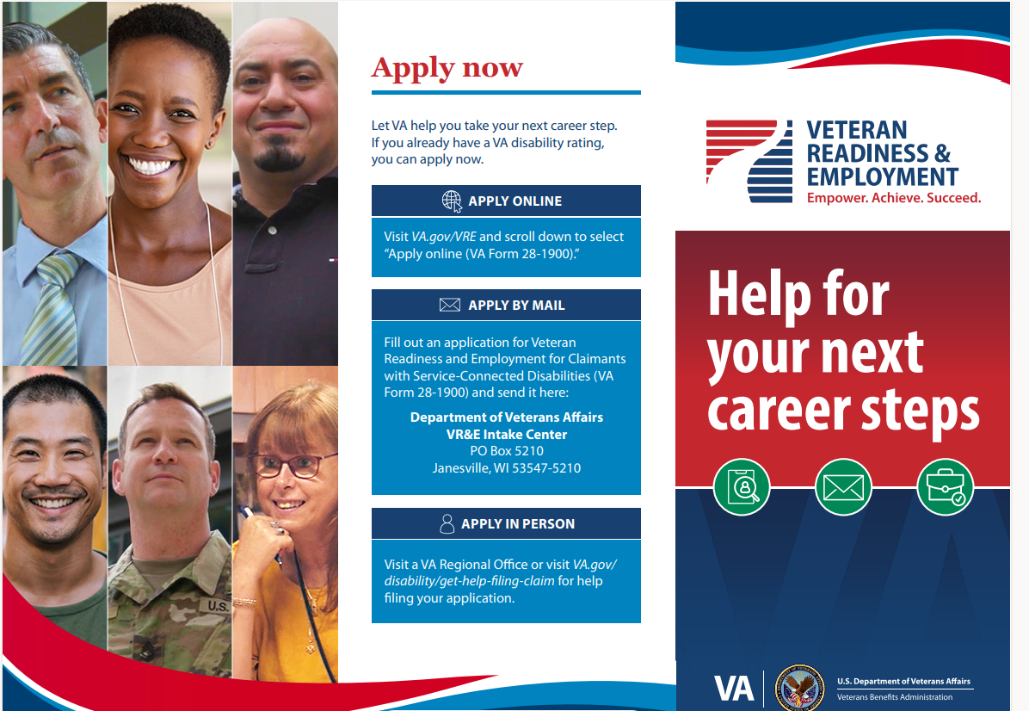

Slide 26
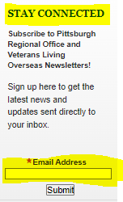
Stay Connected
VA is there for you when and where you need us!
Visit Pittsburgh RO website
Stay Connected by subscribing to the Pittsburgh RO quarterly bulletin, OCONUS Connection which highlights specific information unique to Veterans living abroad, shares outreach initiatives for Veterans abroad, informs of initiatives & policy changes affecting VBA benefit programs, shares VA press releases, & more.
Notes:
See the sign-up sheet to start receiving the OCONUS Connection newsletter at the registration desk or use the QR code provided in the handout packet.

Slide 27
U.S. Department of Veterans Affairs
Veterans Benefits Administration
Medical Disability Examination Office (MDEO)
Germany Town Hall
Date: April 30, 2024
Briefed by: Ivo Kisic and Melanie Kraft

Slide 28
C&P Examination Expectations
A C&P exam is not a normal medical exam
The provider will not treat any illness or injury, give the Veteran referrals to other providers, or prescribe medicine
The purpose of the exam is to gather information that will be used to make a decision for the Veteran or Service members claim

Slide 29
MDE Vendors Internationally
In Germany:
QTC Management (QTC)
  +49 610 23588201 or +49 800 1817435 (Local)
  1-215-942-5506 (OCONUS)
  Examinee Login & Information on Medical Examinations (qtcm.com)
Veterans Evaluation Services (VES)
  1-713-255-5656 (OCONUS)
  Veterans - Veterans Evaluation Services (ves.com)

Slide 30
International Strategies
Continue to recruit new providers
  In Germany
  Work with local area in country networks
Providers travel in to provide coverage as needed
Alternate examination modalities

Slide 31
Alternate Modalities for Examinations
Contract vendors use alternate modalities to decrease travel time such as:
  Acceptable Clinical Evidence (ACE)
  Tele-Health C&P capabilities
These modalities cannot be used for all examination types

Slide 32
govDelivery
govDelivery is a system MDEO uses to proactively contact claimants via e-mail utilizing a “va.gov” account
Emails inform the claimant of upcoming communication from Vendors to schedule C&P examinations
This proactive contact serves as a verification from a VA source that a claimant will be contacted to schedule an appointment with an MDEO designated Vendor
Helps to encourage their willingness to be responsive to notifications/calls and attend their scheduled exams

Slide 33
Exam Scheduling
Written notification of appointments are required ​
  Delivered via FedEx ​with appointment date/time/location
  Provides Examiner information (ex. name, training)​
MDE Vendors attempt to call each examinee​ prior to scheduling
MDE Vendors will attempt to take into consideration​
claimants schedule ​
MDE Vendors will attempt to call, text and email using information provided to the VA ​

Slide 34
Examination Rescheduling
If a claimant needs to reschedule the exam, they should contact their scheduled vendor at least 48 hours prior to the examination
Claimants can only reschedule once per exam for contract examinations
  Rescheduled appointment must be within 5 days of the original appointment
If the claimant is not available during those 5 days, they should tell the vendor and should call VA at 1-800-827-1000 or 412-395-6272

Slide 35
Gender Preference
A claimant can request a male or female provider in these situations:
  If they are having a reproductive health, breast, rectal, or mental health exam, or
  If the claim is related to a mental or physical health condition resulting from military sexual trauma (MST)
The claimant should notify the vendor of their provider preference at the time the appointment is scheduled

Slide 36
Travel/Mileage Requirements for Contract Examinations
Mileage reimbursement is not available outside of the United States and its territories
The contract states the contractor shall schedule examinations no further than 50 miles from the Veterans home for non-specialist examinations and 100 miles for specialist examinations
Authorization may be granted for additional mileage when the Veteran/Service Member expressly indicates willingness to exceed the above limits
The Veteran’s/Service Member’s express consent must be part of the record when the mileage limitations are exceeded

Slide 37
MDEO Inquiry Resolution
MDEO receives inquiries and complaints from a variety of sources, including:
  Office of the Undersecretary for Benefits, White house Hotline, Congressional Offices, Regional and District Offices, Veterans Service Organizations, Veterans Health Administration, office of the Inspector General
Most inquiries and complaints involve:
  Veteran travel issues, appointment scheduling conflicts, examiner complaints, issues claims processors are experiencing with examination requests, Exam Management System inquiries
When an inquiry or complaint is received, MDEO takes the following actions:
  Logs and tracks all inquiries
  Thoroughly reviews the inquiry
  Review VA Systems
  Thoroughly review the Veterans file, and any completed exams, if applicable
  Contact MDE vendors for action
  Contact Veterans for more information or to report resolution
After completion of investigation, a formal response is prepared and provided to the requesting party
MDEO strives to resolve all inquiries and complaints in 10 days or less
  MDEO can pursue additional avenues to address emergent issues in a shorter time period

Slide 38
Additional Examination Resources
How To File A VA Disability Claim | Veterans Affairs
  Information on filing claims and submitting evidence
VA Claim Exam (C &P Exam) | Veterans Affairs
  Answers to commonly asked questions about VA claims exams
VA Claim Exam (C&P Exam) Information and Exam FAQ Links | Veterans Affairs
  Provides information on the examination process and links to additional claims related pages

Slide 39
VA Foreign Medical Program (FMP) – Information Briefing
29 April 2024
Andrew Szymczak
Director

Slide 40
Agenda
FMP Program Overview
Eligibility
Application Process
Claims Process
FMP Payments
Key Points of Consideration / Helpful Tips
Veteran Submitted Questions and Answers
Accessing Ask VA (AVA) for FMP Inquiries
Additional Resources and Further Information

Slide 41
Program Overview
FMP provides reimbursement to Veterans living and travelling abroad for health care services, medications, and durable medical equipment for service-connected conditions and conditions associated with and held to be aggravating a service-connected condition.
VA may authorize foreign medical services for any condition if you are participating in the VA Veterans Readiness and Employment Program (formerly known as the Vocational Rehabilitation Program - Title 38, U.S. Code, Chapter 31).
  Claims associated with this program must have a referral and current treatment plan from a VBA Case Manager.
FMP only covers treatment for service-connected conditions, even for 100% permanent and total service-connected disabled Veterans.

Slide 42
Eligibility
Veterans with service-connected disabilities are not required to be living outside of the United States. Veterans with service-connected disabilities travelling outside of the United States are also eligible.
Veterans with service-connected disabilities, regardless of the percentage of the rating, are eligible to participate in the program.
Veterans in the Chapter 31 VA Veterans Readiness and Employment (VRE) Program can have medical or dental services reimbursed for non-service-connected conditions as long as the case manager deems the treatment is necessary to continue in the program.

Slide 43
Application Process
Veterans must register for the program prior to filing a claim.
Applications can be downloaded from the following website:
https://www.va.gov/vaforms/medical/pdf/vha-10-7959f-1.pdf
FMP applications can be emailed to hac.fmp@va.gov, faxed to 303-331-7803 or mailed to:
  VHA Office of Integrated Veteran Care
  ATTN: FMP
  PO Box 469061
  Denver, CO 80246-9061
Veterans will receive an FMP benefits authorization letter and handbook after the application is processed.

Slide 44
Claims Process
Veterans have two years to submit a claim for payment from the date of service or date of discharge from the hospital.
FMP claims must contain the following information:
  Full Name of the medical provider
  Medical Title
  Office Address
  Office telephone number
  Billing address if different from the office address
  Date of service(s)
  Diagnosis
  Procedure(s) performed
  Date and name of drugs prescribed
  Billed charges
  Proof of payment (only if Veteran is seeking reimbursement)

Slide 45
FMP Payments
All FMP payments are made via paper US Treasury checks. Delivery timeframes vary widely depending on the overseas destination.
US Treasury checks will be sent to the mailing address annotated on the FMP Claim Form when the Veteran has paid for the services out of their own pocket.
Reimbursement requests that go to foreign medical provider addresses must be clearly annotated on the FMP Claim to prevent missent mailings.
Efforts are in place to enable Electronic Fund Transfer (EFT) payments to domestic and foreign bank accounts. Progress updates on this project will be published as milestones are accomplished.

Slide 46
Key Points of Consideration / Helpful Tips
Register for FMP before filing claim. FMP claims may not be processed if a Veteran is not registered in the program.
100% Permanent and Total (P&T) disabled Veterans can only be reimbursed for services directly tied to service-connected disabilities.
FMP cannot authorize reimbursement for medications that are not FDA approved.
Durable Medical Equipment (DME) claims must include a doctor’s prescription with a statement of the medical need and the estimated length of time the equipment will be needed.
Drugs, supplies, treatments, and descriptions of services performed must clearly show a diagnosis that is linked to a service-connected disability.
  Unclear or questionable treatments are reviewed and adjudicated by a clinical nurse.
  Vague descriptions or omitted information on claims may be rejected.

Slide 47
Key Points of Consideration / Helpful Tips (con’t)
FMP cannot pay for any kind of travel costs, including emergency ambulances and travel to Compensation and Pension (C&P) exams.
FMP claims are currently being processed and adjudicated within 120 days of receipt. The delivery timeframe of payments can vary depending on the overseas destination.

Slide 48
Veteran Submitted Questions
Electronic Payments and Improved Claims Processing
Q: Are there any plans to improve the FMP process, like being able to apply and track a claim online? Are there plans to institute electronic payments rather than paper checks?
Q: Veterans are being financially challenged because of the time it takes for an FMP claim to be processed. Local doctors have a lack of faith in receiving payments timely. This prevents Veterans from getting the care they need. Are there initiatives in place to improve the timeliness of FMP claims?
Q: Are there plans in place to improve the Foreign Medical Program and the current processing system by allowing online submission rather than submitting unsecure e-mail attachments? Are there plans to improve the timeliness? Are there plans to have a fully functional online portal to submit claims and receive electronic payments?

Slide 49
Veteran Submitted Questions
Electronic Payments
A: Delivering electronic payments to overseas Veterans is a priority and we are actively working to make that happen. Our first goal is to electronically pay Veterans with domestic bank accounts for their FMP claims by the end of 2024. After we complete this goal, the project will expand to include Veterans with international bank accounts and overseas medical providers to receive electronic payments.
We began work in September 2023, when the Foreign Medical Program received IT development funding to set up capabilities for electronic funds transfer (EFT). The IT development team is looking for ways to modify the FMP claims processing system to enable electronic payments using existing VBA payment information. The team recently found out that there are file parameter constraints that prevent different systems and application programming interfaces from completing EFT payments. Right now, the team is generating workarounds to overcome this challenge.

Slide 50
Veteran Submitted Questions
Improved Claims Processing
A: Improving how we process FMP claims is also a priority. VA is actively working to modernize the FMP registration and claims submission process over the next year. We are making improvements to the software we use to process claims faster. We are also making it possible for Veterans to view in real time where their application is, when the claim is under review and when the claim is approved. The timeline for full delivery remains under development and we will provide updates as they become available.
Veterans can opt to send secure encrypted emails for claim submissions by using personal email server transport layer security (TLS) protocols. Veterans can also send secure communications to Ask VA.

Slide 51
Veteran Submitted Questions
Q: I would like to know more about the Foreign Medical Program.
A: Thank you for your interest. Our presentation today provided an overview of the program, and we will send copies to all attendees. If you have more questions, you can send a message to Ask VA.
Q: Is there a direct contact number for a Veteran to speak with an FMP representative other than the customer service number?
A: There is not a direct contact number for an FMP representative. You can send your questions to Ask VA. You will be connected to an escalation team program analyst who can provide you with more detailed assistance and if necessary, a phone call to address unique or complex program concerns.
Q: Is there medical care for disabled Veterans that live in Japan?
A: There are no VA-sponsored medical facilities in Japan. However, we may cover the cost of your care in Japan to treat conditions related to your VA-rated, service-connected disabilities.

Slide 52
Veteran Submitted Questions
Q: What options are there for Veterans living in western European countries to receive mental health care, specifically for PTSD and TBI, other than private providers, which results in Veterans not receiving the appropriate care because of the stigma regarding U.S. military and PTSD in those countries.
A: Under federal statutes (38 U.S.C. § 1724 and 38 CFR 17.35) and international law, FMP cannot authorize reimbursement for telehealth care provided to overseas Veterans from privately-based mental health providers in the continental United States (CONUS). CONUS-based VA medical providers are also not authorized to provide telehealth services outside the United States, territories and possessions of the United States, the District of Columbia, and the Commonwealth of Puerto Rico because of medical licensing restrictions.
All Veterans are entitled to free mental health support from inTransition. inTransition is a free, confidential program that offers specialized coaching and assistance for active duty servicemembers, National Guard members, reservists, Veterans and retirees who need access to mental health care. inTransition coaches are licensed mental health care providers who understand military culture.

Slide 53
Veteran Submitted Questions
Q: Are there any plans to increase the FMP customer service hours to better accommodate Veterans overseas in different time zones? Are there measures in place to improve wait time when calling the FMP customer service number?
A: The FMP customer service team is experiencing ongoing staff shortages because of budgetary constraints. The best way to make inquiries after hours in CONUS is to email hac.fmp@va.gov or send your questions to Ask VA.
Q: Are claims for hearing aids purchased in Germany reimbursable through FMP or the VA?
A: Yes, if the hearing aids are required for a service-connected disability. If your hearing aids were issued from a CONUS VA facility, replacement hearing aids, batteries, and accessories can be ordered through the Denver Logistics Center. Additional information about the Denver Logistics Center and how to request hearing aid supplies can be found here: Hearing Aid Batteries & Accessories | VA.

Slide 54
Veteran Submitted Questions
Q: Why does a Veteran have to submit decision letters and full medical reports with every FMP claim for treatment reimbursement when the processors are not medically qualified?
A: We may need additional information to answer this question completely. Not all claims are the same and this question appears to address a specific or unique case. Sometimes claims do not have enough information to confirm that the treatment received, or the medication prescribed is connected to service-connected conditions. If the claims examiner cannot clearly determine a connection, they will route the claim to a team of certified nurses for review.
Q: Why is treatment reimbursement through FMP only available for rated service-connected disabilities when many ailments are secondary and get rejected by the VA?
A: The statutory authority that governs FMP only allows reimbursements for services that treat service-connected disabilities. Expanded authorities require new legislation and additional appropriations. Conditions associated with and held to be aggravating a service-connected disability must be evaluated on a case-by-case basis. The best way to make service-connected condition pre-determination inquiries is by submitting a request to Ask VA.

Slide 55
Veteran Submitted Questions
Q: What oversight exists for the FMP to ensure appropriate service to American Veterans?
A: FMP is a claims reimbursement program that allows Veterans to request payment for health care services they receive from any overseas provider they choose to see. There are no networks or internal oversight programs.
Q: What is the staffing of the FMP office in Denver? Are there plans to increase staffing to meet demand?
A: Our FMP staffing authorizations grew from 25 to 38 people in April 2023. Under this new organizational structure, we were authorized to recruit three lead claims examiners and 10 claims examiners. We are waiting for permission to announce our 11 remaining claims examiners because of a temporary VHA hiring pause.

Slide 56
Veteran Submitted Questions
Q: If a Veteran makes a mistake on their cover sheet and the FMP rejects their claim, the Veteran has to resubmit their corrected claim. Why does it start back at the end of the line? Why doesn’t the FMP not offer an expedited service on rejected claims that have already sat waiting for many months?
A: We recently refined how we process claims. Clarifications and requests for information due to minor omissions or mistakes are now sent to the Veteran email address on the FMP claim cover sheet. Manual send-back letters will only be used if a valid email address is not on file or listed on the FMP claim cover sheet. The best way to make inquiries or minor update requests for pending claims is to submit a request to Ask VA.
Q: Why does the average time to process an FMP claim takes seven months?
A: We are experiencing ongoing staff shortages because of budgetary constraints. However, the time it takes to process claims will improve after we are authorized to hire and train the claims examiner positions affected by the temporary VHA hiring pause.

Slide 57
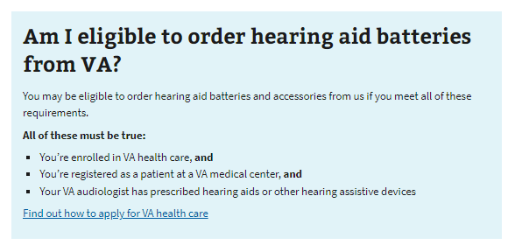
Additional information on VA Hearing Aid Support
https://www.va.gov/health-care/order-hearing-aid-batteries-and-accessories/

Slide 58
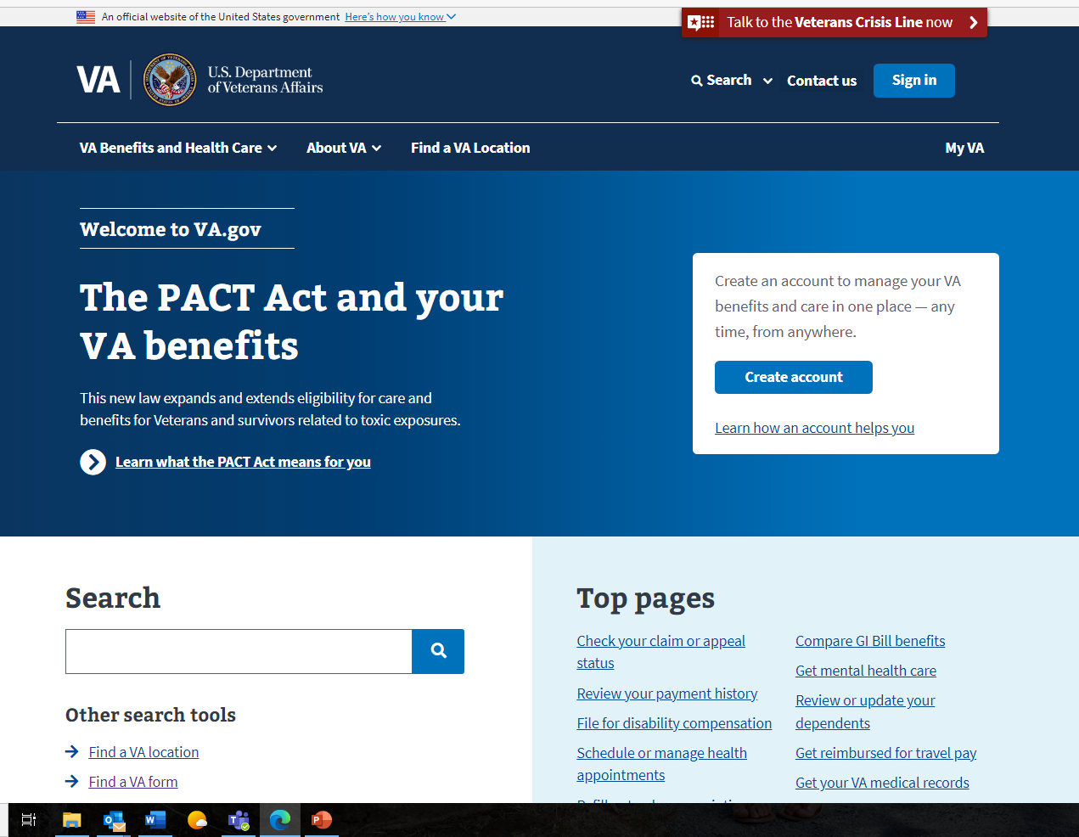
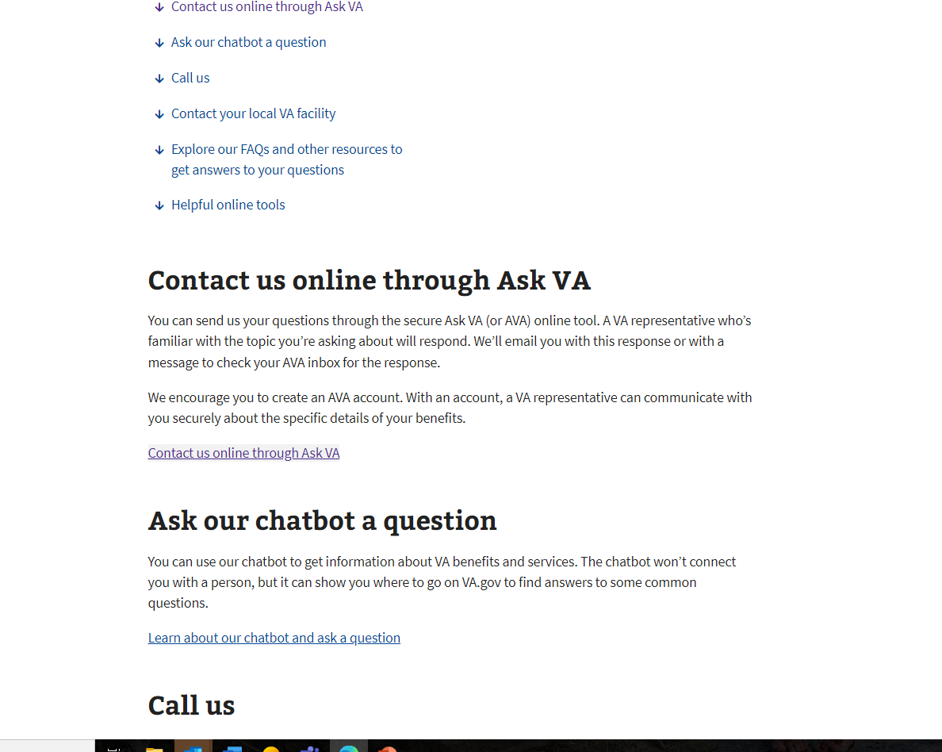
Accessing Ask VA for FMP Inquiries
- Veterans are encouraged to use the Ask VA (AVA) system for all escalated and pre-determination FMP inquiries.
- This system is a much more transparent and easily accessible platform that allows all Veterans to get an individualized inquiry tracking number for future reference.

Slide 59
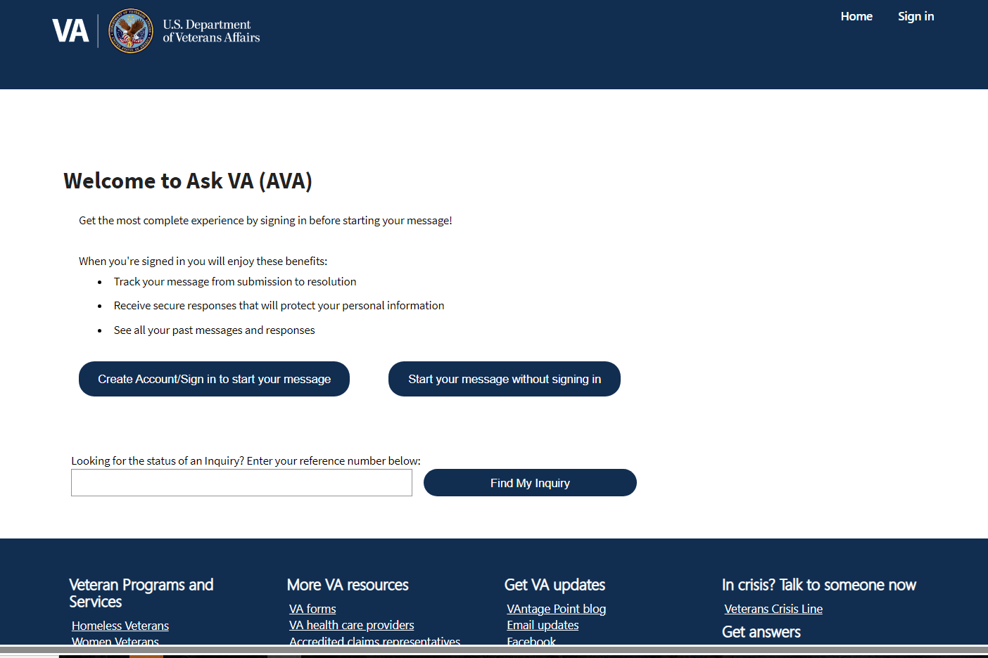
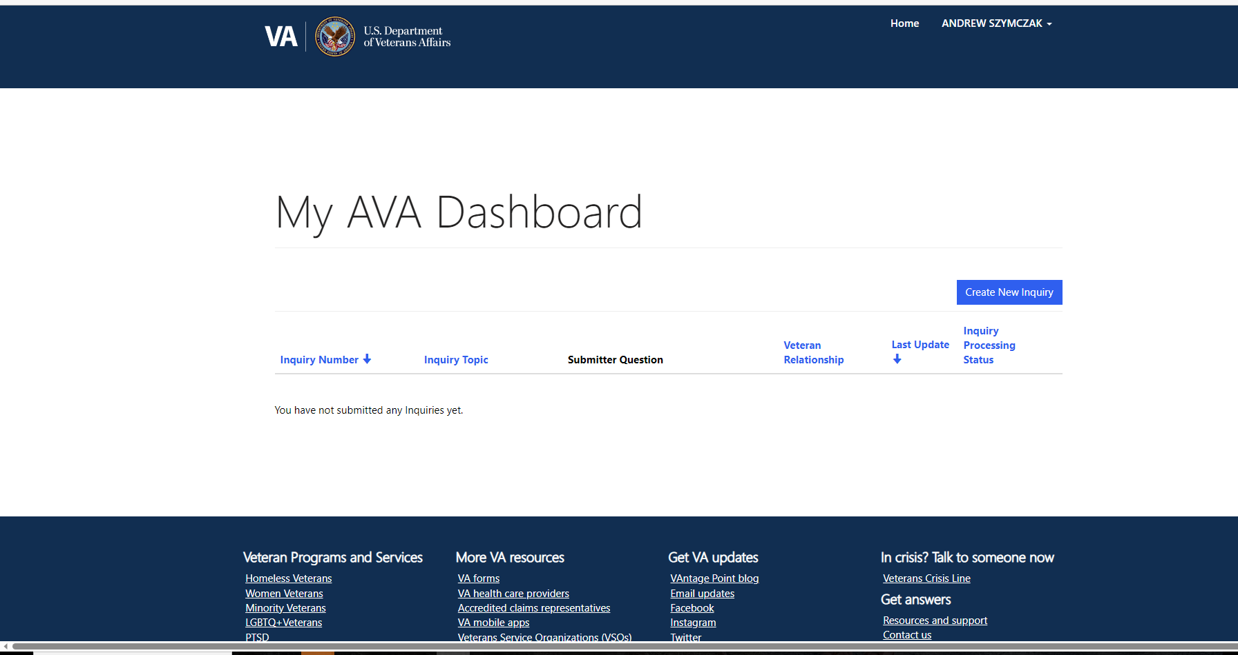
Accessing Ask VA (AVA) for FMP Inquiries - Continued
Either log-in option works, but logging in using your Department of Defense Self Log-in (“DS” Log-in) is more secure and allows us to share Personally Identifiable Information (PII)
This is the AVA Dashboard when you log-in

Slide 60
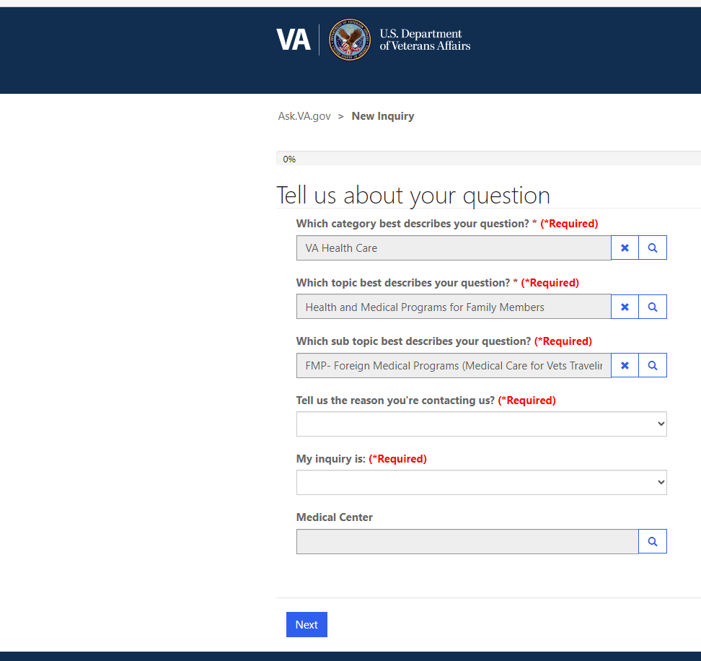
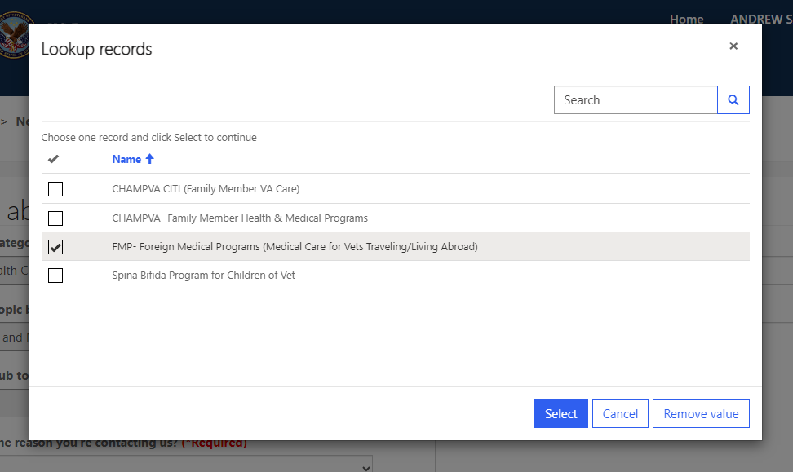
How to Select FMP in Ask VA.gov
Here are the correct drop-down menu selections Veterans should use to get their FMP questions routed appropriately:

Slide 61
FMP Resources and Further Information
Additional information about FMP can be found on the following websites:
General Information:
https://www.va.gov/COMMUNITYCARE/programs/veterans/fmp/index.asp
https://www.youtube.com/watch?v=eY6zyRRhk8E
FMP Claims, Benefits, and Exclusions:
https://www.va.gov/COMMUNITYCARE/programs/veterans/fmp/fmp_benefits_claims.asp
How to file an FMP claim:
https://www.va.gov/COMMUNITYCARE/docs/pubfiles/factsheets/FactSheet_04-02.pdf
FMP Care Benefits Guide:
https://www.va.gov/COMMUNITYCARE/docs/pubfiles/programguides/FMP_Guide.pdf#

Slide 62
Concurrent Receipt of Retired Pay and VA Compensation
Douglas Stenger
Training Specialist
April 30, 2024

Slide 63
VA Disability Compensation and Retired Pay

Slide 64



VA Disability Compensation

Slide 65
VA Disability Compensation
Service Connected
Service Connected
Service Connected
Non-Service Connected

Slide 66

Military Retired Pay

Slide 67
What is this deduction? VA Waiver
VA Waiver
VA Disability Compensation

Slide 68
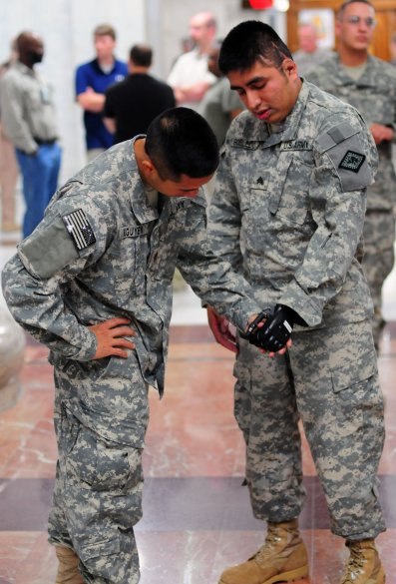

General Waiver Requirement
VA Compensation causes a reduction in retired pay
VA Waiver is a dollar for dollar offset of retired pay
Goodbye!

Slide 69
Concurrent Receipt of Military Retired Pay and VA Disability Compensation

Slide 70
Qualified Retiree
Entitled to Retired Pay
Special Rules for
Chapter 61
Minimum 50% service connected disability rating from VA

Slide 71
Qualified Retiree
Regular retirement
Non-regular retirement and has reached eligible age
Temporary Early Retirement Authorization
Qualified Career Disability Retiree
  Retirement; Laws 1201, 1202, 1204, 1205
  Must have 20 years to qualify
    Qualified for a regular retirement but retired as disability
    Qualified for a non-regular retirement (service and eligible age) but retired as disability

Slide 72
Qualified Retiree for Concurrent Receipt
Exception to the General Waiver Requirement
  Eliminates the VA Waiver
Qualified Career Disability Retirees >20
  Limited exception to the general waiver
  Waive portion of disability pay greater than hypothetical longevity retired pay
Military
Retired
Pay
VA Waiver

Slide 73
Concurrent Receipt

Slide 74
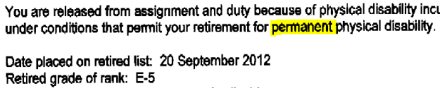
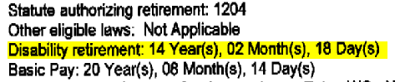
Am I eligible for Concurrent Receipt?
Not eligible

Slide 75
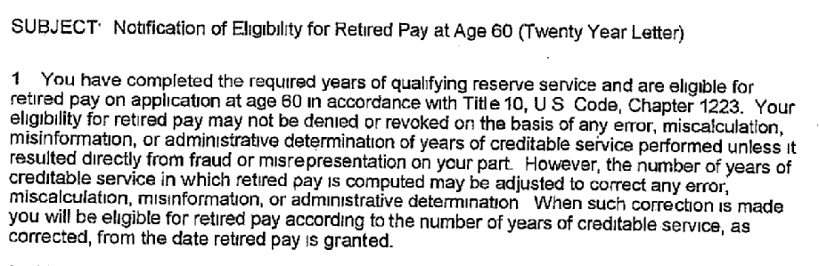
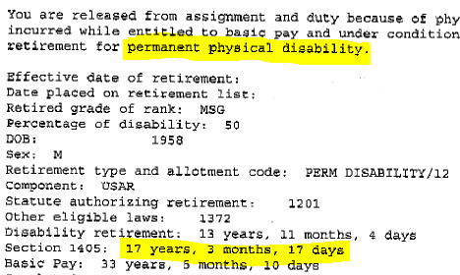
Am I eligible for Concurrent Receipt?
Eligible at 60, or early retirement eligible age

Slide 76
Special Rules for Disability Retirements

Slide 77

Special Rule for Disability Retirements
Less than 20 years
Greater than 20 years
May be required to waive a portion of the Disability Retired Pay
General Waiver Requirement

Slide 78
Special Rule for Disability Retirements
Greater than 20 years
What portion is going to be waived?
Disability Retired Pay
Hypothetical Retired Pay
Waiver Amount

Slide 79
Concurrent Receipt - Special rule for disability retirements
Disability
Regular
VA Waiver
$165.70
$534.30
Without
Concurrent Receipt,
retired pay
would have a
VA Waiver
of
$700.00
$1000.00
x 70.00%
$700.00
$1000.00
x 53.43%
$534.30
Disability – Hypothetical = Waiver

Slide 80
Concurrent Receipt - Special rule for disability retirements
Disability
Regular
VA Waiver
$487.50
Without
Concurrent Receipt,
retired pay
would have a
VA Waiver
of
$2,100.00
$1,612.50
$3,000.00
x 70.00%
$2,100.00
$3,000.00
x 53.75%
$1,612.50
Disability – Hypothetical = Waiver

Slide 81
Concurrent Receipt - Special rule for disability retirements
Disability
Non-regular
(1050 points)
After
age 60,
VA Waiver
$527.00
Before
age 60,
retired pay
had a full
VA Waiver
of
$600.00
$73.00
$1000.00
x 60.00%
$600.00
$1000.00
x 7.30%
$73.00
Disability – Hypothetical = Waiver
Notes:
*Retirement eligible age

Slide 82
Concurrent Receipt - Special rule for disability retirements
Disability
Non-regular
(1050 points)
After
age 60,
VA Waiver
$1,317.50
Before
age 60,
retired pay
had a full
VA Waiver
of
$1,500.00
$182.50
$2,500.00
x 60.00%
$1,500.00
$2,500.00
x 7.30%
$182.50
Disability – Hypothetical = Waiver

Slide 83
www.dfas.mil

Slide 84
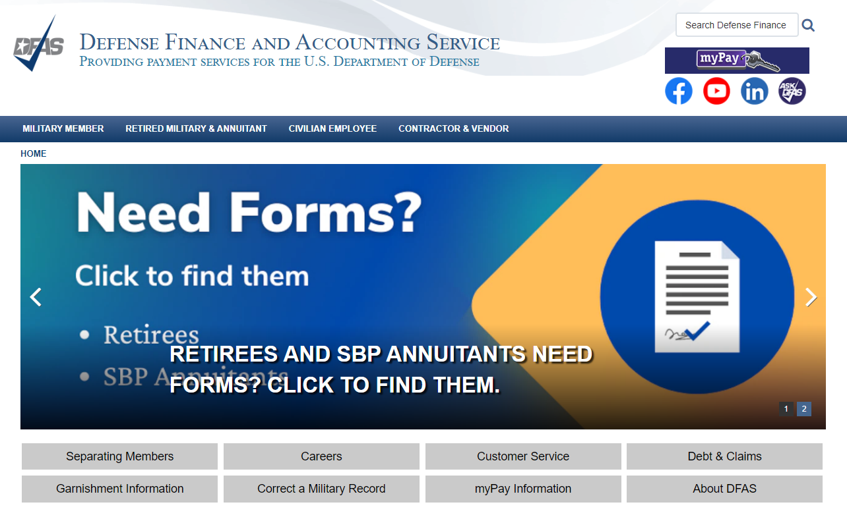
www.dfas.mil

Slide 85
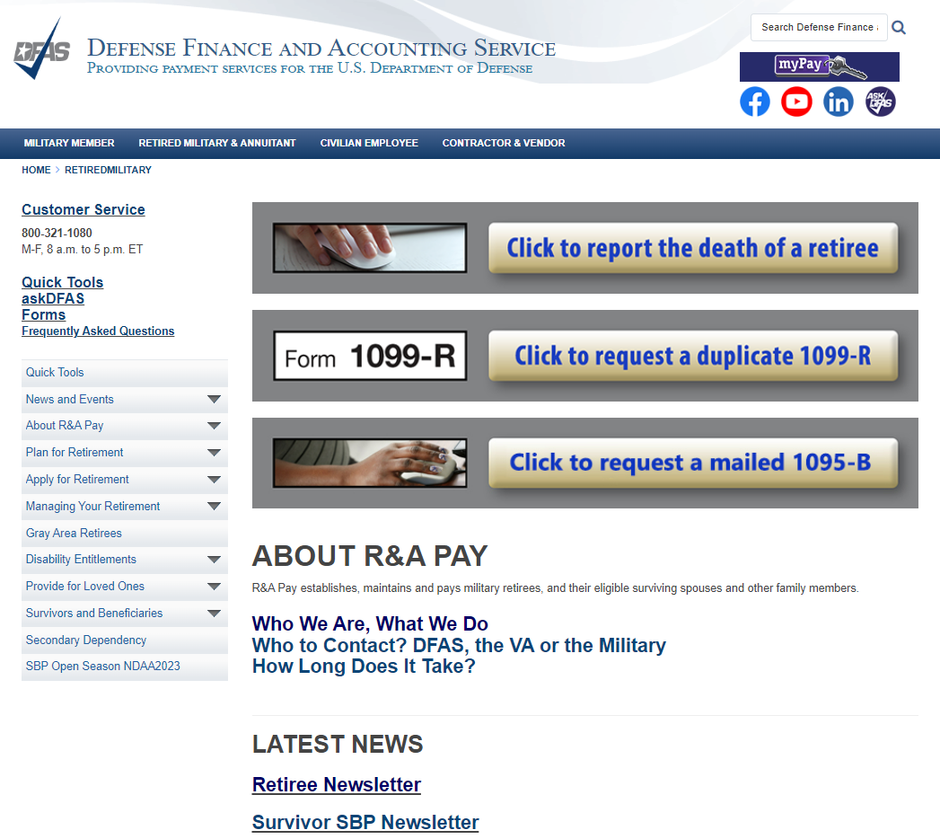
Retired Military & Annuitant – dfas.mil

Slide 86
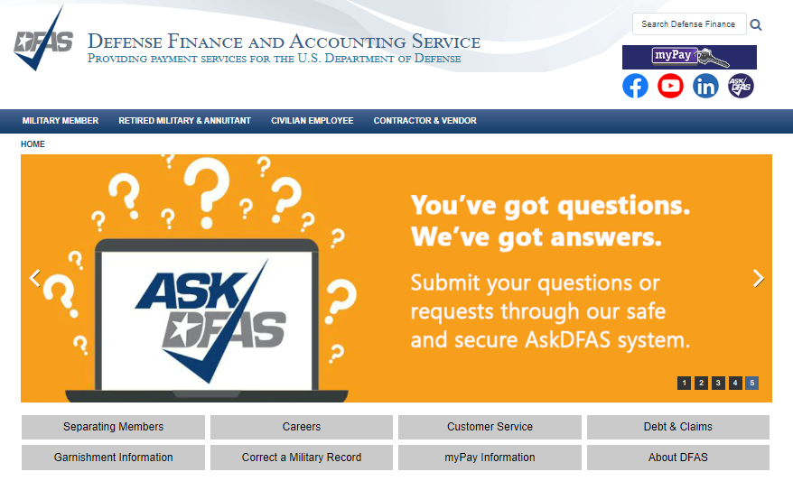
www.dfas.mil

Slide 87

FBU Frankfurt
Frankfurt Region Federal Benefits Officer (RFBO) Marina Ramirez

Slide 88
Role of the Frankfurt fbu
Federal Benefits Units around the world are teams of local employees at U.S. Embassies and Consulates trained to assist with U.S. Federal Benefits
There are 21 FBUs located worldwide as part of 6 regions
Frankfurt FBU along with Paris, Warsaw and Krakow FBUs are part of the Frankfurt region
Social Security Administration (SSA) benefits
Veterans Administration (VA) benefits

Slide 89
Role of Frankfurt fbu
While FBU staff is trained on Social Security work they are not SSA employees
FBU employees can handle intake of applications, communicate with SSA staff in the U.S., and assist with inquiries
FBU employees in Frankfurt are available to the public:
  Via telephone –Tuesdays and Thursdays 9am-12Pm +49-69-7535-4242
  Via email – FBU.Frankfurt@ssa.gov
  Via mail – American Consulate General, Federal Benefits Unit, Giessener Str 30, Frankfurt am Main, 60435
  Via contact form - https://gr.usembassy.gov/u-s-citizen-services/social-security/fbu-inquiry-form

Slide 90
Role of Frankfurt fbu
The primary role of the Frankfurt FBU is to assist with intake of initial claims:
  Retirement
  Disability
  Auxiliary (Spouse/Divorced Spouse/Children)
  Survivor (Widow/er/Children)
  Medicare
For those already receiving benefits:
  Changes of address
  Direct deposit updates
  Work reports
  Death reports
Enumeration actions (Social Security cards):
  1st time applications
  Replacement cards
  Changes – name, gender, etc.

Slide 91
Who is eligible for social security – Retirement/Disability?
Retirement - Workers that have paid into the U.S. Social Security a minimum of 10 years earning 40 quarters (or credits)
  For more information: Prepare for Social Security benefits | SSA
Disability – Must have worked in jobs covered by Social Security and must have a medical condition that meets Social Security’s strict definition of disability
  Must have worked long enough and recent enough to qualify
  For more information: How You Qualify | Disability Benefits | SSA

Slide 92
Who is eligible for social security - Auxiliary?
Spouses of workers are eligible for benefits if at least age 62 and married for at least 1 year
  Benefits are payable even if spouse is not a U.S. citizen nor has a Social Security number
  Spouses can also qualify for Medicare at age 65
Children of workers are eligible for benefits if they are unmarried, under age 18, 18-19 years old and full-time student at or below grade 12 or be 18 or older and disabled from a disability that began before age 22
  Children that are employed are subject to earnings limit
  Parents of children may be eligible for benefits taking care of child until child is age 16
Divorced spouses of workers are eligible for benefits if married at least 10 years, unmarried and at least age 62
  Benefits are payable even if spouse is not a U.S. citizen nor has a Social Security number
  Benefits Planner: Retirement | Benefits For Your Family | SSA

Slide 93
Who is eligible for social security - Survivor?
Widow/er of workers are eligible for benefits if at least age 60 (50 if disabled)
Benefits are payable even if spouse is not a U.S. citizen nor has a Social Security number
  Spouses can also qualify for Medicare at age 65
Children of workers are eligible for benefits if they are unmarried, under age 18, 18-19 years old and full-time student at or below grade 12 or be 18 or older and disabled from a disability that began before age 22
  Children that are employed are subject to earnings limit
  Parents of children may be eligible for benefits taking care of child until child is age 16
Divorced spouses of workers are eligible for benefits if married at least 10 years, unmarried and at least age 60
  Benefits are payable even if spouse is not a U.S. citizen nor has a Social Security number
  Survivors Benefits | SSA

Slide 94
Who is eligible for social security – Lump Sum Death Payment?
To be eligible for this payment ($255), you must be a surviving spouse who was living in the same household with the worker when he or she died. If they were living apart, the surviving spouse can still receive the lump-sum if, during the month the worker died, the spouse met one of the following requirements:
  Was already receiving benefits on the worker's record.
  Became eligible for benefits upon the worker's death.
If there's no eligible surviving spouse, the lump-sum can be paid to the worker's child (or children) if, during the month the worker died, the child met one of the following requirements:
  Was already receiving benefits on the worker's record.
  Became eligible for benefits upon the worker's death.

Slide 95
How to apply for benefits?
Contact the FBU in Frankfurt at the following:
  Via telephone – Tuesdays and Thursdays 9am-12Pm +49-69-7535-4242
  Via email – FBU.Frankfurt@ssa.gov
  Via mail – American Consulate General, Federal Benefits Unit, Giessener Str 30, Frankfurt am Main, 60435
  Via contact form - https://gr.usembassy.gov/u-s-citizen-services/social-security/fbu-inquiry-form
  Current processing time:
  180 days to take application + additional 60 days processing
  Disability applications can take at least 1 year or more

Slide 96
How to apply for benefits?
FBU records your intent to file an application
Schedules an appointment via telephone
Completes your application in SSA’s system and requests relevant documentation
Forwards application to International Benefits Office in Baltimore, MD for final adjudication action

Slide 97
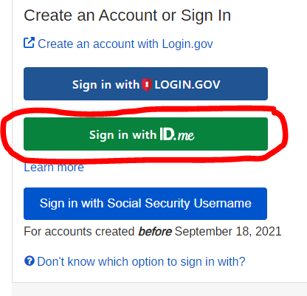
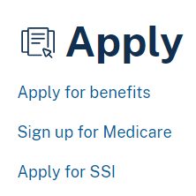
How to apply for benefits?
You can file online if you have an SSN via mySSA account located at www.ssa.gov
Social Security (ssa.gov)

Slide 98
Already receiving benefits?
Things to report to an FBU or SSA:
  Change of address including country of residence
  Starting employment
  Inability to independently manage funds
  Marriage or birth of children
  Death of a beneficiary
  If disabled, improvement in disability

Slide 99
Missing quarters/credits
You qualify for Social Security benefits by earning Social Security credits when you work in a job and pay Social Security taxes.
Credits are based on the amount of earnings. Benefits cannot be paid if you don’t have enough credits.
In 2023 you receive 1 credit for each $1,640 of earnings up to 4 credits per year.
Self-employment has same earnings requirement – net earnings need to be reported to the IRS - Benefits Planner: Retirement | Calculate Your Net Earnings from Self-Employment | SSA
  Additional questions on how far back prior tax returns can be amended should be directed to the IRS – www.irs.gov

Slide 100
Enumeration actions
Social Security card applications:
  1st time over age-12 always need to be done in-person
  1st time under age-12, replacement and changes can be done via mail
  Processing time for complete applications is approximately 60 days
  We can only accept original documents or those certified by the custodian of record

Slide 101
Social Security international (totalization) benefits
Eliminate dual Social Security taxation and help fill gaps in benefit protection for workers who have divided their careers
U.S. and German agreement effective since December 1, 1979
While you work––If your work is covered by both the U.S. and German Social Security systems, you (and your employer, if you are employed) would normally have to pay Social Security taxes to both countries for the same work. The agreement eliminates this double coverage, so that taxes are paid to only one system (see the section on "Coverage and Social Security taxes" section).
When you apply for benefits––You may have some Social Security credits in both the U.S. and Germany but not have enough to be eligible for benefits in one country or the other. The agreement makes it easier to qualify for benefits by letting you add together your Social Security credits in both countries. For more details, see the section on Monthly benefits."

Slide 102
Social Security international (totalization) benefits
If you do not have enough work credits under the U.S. system to qualify for regular benefits, you may be able to qualify for a partial benefit from the United States based on both U.S. and German credits. However, to be eligible to have your German credits counted, you must have earned at least six credits (generally one and one-half years of work) under the U.S. system. Since the U.S. Social Security program did not begin until 1937, any German coverage earned before that year cannot be counted. If you already have enough credits under the U.S. system to qualify for a benefit, the United States cannot count your German credits.
Social Security credits from both countries can also be counted, when necessary, to meet the eligibility requirements for German benefits. To be eligible to have your U.S. and German credits counted, you must have at least 18 months of coverage credited under the German system.
International Programs - Totalization Agreement with Germany (ssa.gov)

Slide 103
Social Security international (totalization) benefits
If we need to request your record from the German system we will do so directly when you apply for benefits.
If German officials need to count your U.S. earnings they will get a copy directly from SSA when you apply for German benefits.
Applying for one benefits does not mean that you apply for the other if you are eligible for both but it may establish a protective filing date if you are eligible for benefits.
  If you wish to apply for Social Security benefits you should contact the FBU to ensure we have recorded your inquiry in our records.
International Programs - Totalization Agreement with Germany (ssa.gov)

Slide 104
Social Security international (totalization) benefits
If you qualify for Social Security benefits from both the United States and Germany and you didn’t need the agreement to qualify for either benefit, the amount of your U.S. benefit may be reduced. This is a result of a provision in U.S. law that can affect the way your benefit is figured if you also receive a pension based on work that was not covered by U.S. Social Security. For more information, get the publication, Windfall Elimination Provision (Publication No. 05-10045).
International Programs - Totalization Agreement with Germany (ssa.gov)

Slide 105
contact
  Via telephone –Tuesdays and Thursdays 9am-12Pm +49-69-7535-4242
  Via email – FBU.Frankfurt@ssa.gov
  Via mail – American Consulate General, Federal Benefits Unit, Giessener Str 30, Frankfurt am Main, 60435
  Via contact form - https://gr.usembassy.gov/u-s-citizen-services/social-security/fbu-inquiry-form or Social Security - U.S. Embassy & Consulates in Germany (usembassy.gov)
  Social Security information available at www.ssa.gov or www.ssa.gov/foreign

Slide 106

Richard Freeman
Director, Project Support Team Office of the COO

Slide 107

The Pittsburgh VA Regional Office thanks all of our partners for joining us this afternoon.
Please proceed to the podium if you have follow-up questions for any of our presenters.
Notes:
We will take questions as time allows.

Slide 108

Notes:
As folks are making their way to the podium to ask questions, I want to inform any recently separated or transitioning Service Members who are with us today, about a virtual event that is coming up next week. Although our Veterans Experience Office is hosting this event for the Northeast part of the U.S., they are opening it up to any recently separated or transitioning Service Members abroad as well.

