Slide 1
DEPARTMENT OF ARMY
WELCOME TO THE ARMY CIVILIAN CORPS

Slide 2
Agenda
Welcome to the Army Civilian Corps
Army Civilians Yesterday and Today
Army Organizational & Leadership Overview
Army Organization & Command Structure
Army Organization Locations
Army Mission and Values
Army Profession – Characteristics, Ethos, Certification
Army Civilian Oath and Creed
Career Programs/Career Management
Army Symbols and Military Information
Military Rank and Insignia
Military ‘Lingo’
Helpful Resources

Slide 3
Welcome to the Army Civilian Corps
We are excited to have you join the Army Civilian Corps!
Since 1775, Army Civilians have been indispensable members of the Army Profession.
Army Civilians:
are committed to the Army mission: to shape, fight, and win our wars.
provide expertise, continuity, stability, and leadership in every major Army organization.
have assumed increased levels of responsibility and greater authority.
During periods of conflict, some Army Civilians volunteer to deploy to war zones, often assuming risks similar to Soldiers in combat sustainment roles.
The Army Civilian Corps comprises approximately 22% of the total Army, or about 290,000 individuals (as of end of FY17*), serving in 500 occupational fields spanning 31 career programs in organizations around the world.
* As of end of fiscal year 2017, Civilian Human Resources Annual Report, https://www.milsuite.mil/book/docs/DOC-468097
Notes:
First 3 bullets pulled from TRADOC Acculturation Handbook
Last bullet on numbers of Civilians pulled from Civilian Human Resources Annual Report, FY17, https://www.milsuite.mil/book/docs/DOC-468097- which is updated annually.

Slide 4
Army Civilians Yesterday
Globally Responsive, Regionally Engaged
1944
16% of the 1.2M civilian employees Were women. 1K served as
Airplane mechanics, served as pilots, Ferrying aircraft and towing targets.
Civilians were hired without necessary skills, and new training was provided.
1990-91
1,600+ Civilian logisticians Deployed to the Persian Gulf Operations Desert Shield/Desert Storm
XXXX
Civilian Expeditionary Workforce created, in response to 9/11/2001
1776
Board of War and Ordnance hired civilian contractors to drive carts and do trade crafts
1917
WWI saw 100K Civilians, most
at Army’s arsenals and depots.
New field of Cryptography emerged.
1969
503K Civilian strength during the Vietnam War.
35K Local National Vietnamese employed.
1980
SA Alexander & CSA Meyer testified to Congress on the critical role of Army Civilians in Army operations in the
first stages of the next war.
Congress raised endstrength to 487,852. Army Civilian Training Education and Development System (ACTEDS) was created.
2001
46 Army Civilians lost their lives and many more injured in the attack
on the Pentagon.
Others displayed true heroism and selfless service.
1865
War Dept. grew to 1M soldiers
& 50K Civilians.
New field of Telegraph Operators. Women
& African Americans hired. Nurses earned
$12/month.
1952
543K Civilian strength during the Korean conflict.
Army G-3/5/7
Notes:
Sourced from Ms. Miller’s AUSA briefing, October 2017

Slide 5
Army Civilians Today*
Army Civilians comprise 22% of the total force. There were more than 293,000 Civilians at the end of FY17.
Some statistics about Army Civilians (in some cases compared to the general civilian workforce—as tracked by the Bureau of Labor Statistics (BLS)):
63% are male, 37% are female
Average age is 48 years; 32% are 55 years old or older; 14% are under 35
50% of Army Civilians are Veterans (compared to 6% BLS)
32% are Minority (compared to 31% BLS)
10% have disabilities (compared to 4% BLS)
*As of end of FY17, according to the Civilian Human Resources Annual Report, FY2017 (AG-1CP), https://www.milsuite.mil/book/docs/DOC-468097
Notes:
Data as of end of FY17, according to the Civilian Human Resources Annual Report, FY2017 (AG-1CP), https://www.milsuite.mil/book/docs/DOC-468097

Slide 6
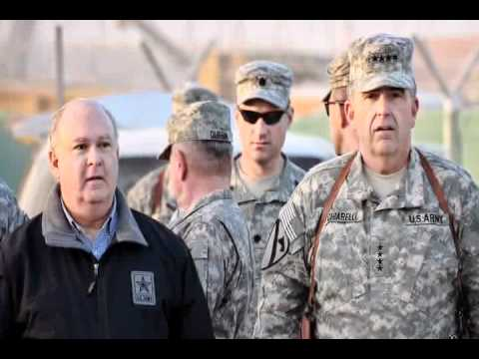
Civilians Work Together with Soldiers
Watch this 3-minute video to see how civilians work with and in support of soldiers.
For additional videos, see the Center for the Army Profession and Ethic (CAPE) website at this link: http://cape.army.mil/civilians.php
Notes:
The web links on this slide are sourced from the CAPE site. There are other videos available there as well…

Slide 7
Army Organization and Leadership
Department of Defense
Army
Active Duty
Reserve Components
Navy
Air Force
Civilians
Office of the Secretary of Defense
Army Senior Leadership:
Secretary of the Army – Dr. Mark T. Esper (Civilian)
Under Secretary of the Army – Ryan D. McCarthy (Civilian)
Chief of Staff of the Army – General Mark A. Milley (Military)
Vice Chief of Staff of the Army – General James C. McConville (Military)
For more information and bios, see https://www.army.mil/info/organization/
Notes:
Speaker Notes:
The Army is one of the three military departments (Army, Navy and Air Force) reporting to the Department of Defense, along with the Office of the Secretary of Defense.
The Army is comprised of three equally important components:
Active component
Reserve component
Civilian component
Army Senior Leadership has 2 Civilian leaders – the Secretary of the Army and the Under Secretary, and 2 Military leaders – the Chief of Staff and the Vice Chief of Staff. Their names are linked to their bios on army.mil if interested
Source: https://www.army.mil/leaders/

Slide 8
Army Organizational Overview
Army
Civilians
Active Duty
US Army Reserve
Reserve Components
Army National Guard
The Active and Reserve components conduct operational and institutional missions
The Operating Force
The operational Army consists of numbered armies, corps, divisions, brigades, and battalions that conduct full spectrum operations around the world.
The Secretary of Defense assigns these units to the various combatant commanders.
Civilians are part of the Generating Force
The Generating Force
The institutional Army, or Generating Force, supports the operational Army by providing the infrastructure necessary to raise, train, equip, deploy, and ensure the readiness of all Army forces.
Army Commands, Service Component Commands, Direct Reporting Units, and installations provide the power-projection platforms required to deploy land forces promptly to support combatant commanders.
Once operational forces are deployed, the institutional Army provides the logistics needed to support them.
Without the Generating Force, the Operating Force cannot function.
Without the Operating Force, the Generating Force has no purpose.
Notes:
Speaker Notes:
The Active and Reserve components conduct both operational and institutional missions; the Civilian component is part of the institutional Army, or Generating Force - supporting the Operational Army.

Slide 9
Army Organization & Command Structure
AFC
You can find this chart along with descriptions of the organizations here
Notes:
Speaker Notes:
Mention that these Commands, ASCCs, and DRUs are spread out all over the world (reference slide 6)…
Point out where these new employees fit in the overall organization, and briefly explain how they support the mission and interact with other organizations.
Org chart found here: https://www.army.mil/info/organization

Slide 10
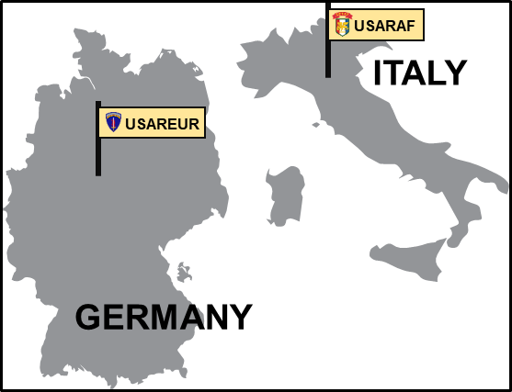
Army Organization Locations
USAASC
INSCOM
USARCYBER
USMA
Arlington
National Cemetery
MDW
USACE
US Army War College
SDDC
ATEC
USACIDC
HRC
US Army
Accessions Support Brigade
TRADOC
FORSCOM
USASOC
USARPAC
USASMDC
IMCOM
AMC
USARCENT
HAWAII
MEDCOM
USARSO
USARNORTH
ARMY COMMANDS
FUTURES
COMMAND
ARMY SERVICE COMPONENT COMMANDS
DIRECT REPORTING UNITS

Slide 11
Army Civilian Oath and Creed
Army Civilians take a similar Oath of Office as Army Officers and members of Congress, solemnly pledging to support and defend the Constitution of the United States. Army Civilians are expected to perform their duties to the same standard of ethical conduct as Soldiers - embodied in the Army Civilian Creed, Army Values, and the Code of Ethics for Government Service. Regardless of your position, it is a privilege to be an Army Civilian, providing honorable service to the Nation.
THE ARMY CIVILIAN CORPS CREED
I am an Army Civilian – a member of the Army Team
I am dedicated to our Army, our Soldiers and Civilians
I will always support the mission
I provide stability and continuity during war and peace
I support and defend the Constitution of the United States and consider it an honor to serve our Nation and our Army
I live the Army values of Loyalty, Duty, Respect, Selfless Service, Honor, Integrity, and Personal Courage
I am an Army Civilian

Slide 12
Army Mission and Values
Army Mission
The U.S. Army’s mission is to fight and win our Nation’s wars by providing prompt, sustained land dominance across the full range of military operations and spectrum of conflict in support of combatant commanders.
Army Values
Loyalty Duty Respect Selfless Service | Honor Integrity Personal Courage

Slide 13
Army Professional Ethos
The Army Profession is a unique vocation of experts certified in the ethical design, generation, support, and application of landpower, serving under civilian authority and entrusted to defend the Constitution and the rights and interests of the American people
An Army professional is a Soldier or Army Civilian who meets the Army Profession’s certification criteria in character, competence, and commitment
Character: an Army professional’s dedication and adherence to Army Values and the Profession’s Ethic as consistently and faithfully demonstrated in decisions and actions
Competence: an Army professional’s demonstrated ability to successfully perform his/her duties and to accomplish the mission with discipline and to standard
Commitment: the resolve of an Army professional to contribute honorable service to the nation, to perform his/her duties with discipline and to standards, and to strive to successfully and ethically accomplish the mission despite adversity, obstacles, and challenges
The Army Ethic is the evolving set of laws, values, and beliefs, embedded within the Army culture of trust that motivates and guides the conduct of Army professionals bound together in common moral purpose
Notes:
Sourced from ADRP1, page 1-2: http://data.cape.army.mil/web/repository/doctrine/adrp1.pdf

Slide 14
Becoming an Army Professional
Upon taking your initial oath, you voluntarily joined the Army Profession as an aspiring Army professional. Upon completion of the following requirements, you will achieve initial certification:
Successful accomplishment of performance standards identified in your performance plan, objectives, and standards
Development of an Individual Development Plan (IDP) with the assistance of your supervisor
Completion of Civilian Education System (CES) requirements (e.g. Foundation Course)
Completion of Supervisor Development Course (SDC), if required
Completion of Career Program specific training and education requirements, if applicable
Completion of all Army required training
Successful completion of the experiential onboarding and acculturation process and all requirements set forth by your supervisor
Progressive certification will be dictated by your career program and other training and development requirements.
Certification demonstrates to the American people that the Army is qualified to perform its expert work effectively and ethically – thereby reinforcing trust with the Nation.
Notes:
Sourced from TRADOC Handbook
ADRP1 includes a graphic (Figure 5-3) on page 5-4 that makes reference to initial certification, and states in paragraph 5-17. “Upon taking our initial oath, we voluntarily join the Army Profession as aspiring Army professionals. Upon completion of the appropriate requirements, we receive our initial certification (see figure 5-3)." The O&A program clarifies the "appropriate requirements" for initial certification.

Slide 15
Career Programs/Career Management
Career Program Management
Recognizing the importance of civilian contributions to accomplishing the mission, in 2011 the Army adopted a Civilian Career Program Management approach to ensure that Army Civilians are effectively trained and developed to fulfill their important responsibilities. The civilian workforce was aligned under 31 career programs, each headed by a functional chief and functional chief representative. Career programs are, in functions and responsibilities, roughly equivalent to the Army’s officer branches. Army career program management supports the systematic occupational and individual growth of Army Civilians in their designated career programs through a series of training, education, and professional development programs and assignments.
Core Career Program Management Structure
Functional Chief (FC): The Senior Career Program Official (General Officer or SES) has enterprise-level responsibility for ensuring the readiness of employees in occupational series and Career Programs in support of Army missions. Functional Chief Representative (FCR): An Army Senior Civilian, designated by the FC, to serve as the principle advisor on Career Program Management issues Career Program Managers (CPMs): Personnel that support the FC and FCR in the execution of Career Program management responsibilities. Career Program Managers are employed at various organizational levels: Career Program Proponency Offices; Army Commands (Command Career Program Managers – (CCPM)); and Activities (Activity Career Program Managers – (ACPM))
For more information, see http://www.asamra.army.mil/cwt/career.html
Notes:
Speaker Notes:
As you introduce the concept of Career Programs, ask if the participants know which CP they are in, if they know who their FCR/CPM are? Let them know whom they can contact if they haven’t heard from their CP.
Source: http://www.asamra.army.mil/cwt/career.html

Slide 16
Army Career Programs
The 31 Army Career Programs
CP-10: Civilian Human Resources (CHR) Management | CP-29: Installation Management
CP-11: Comptroller | CP-31: Education Services
CP-12: Safety and Occupational Health | CP-32: Training, Capabilities, and Doctrine Warfighting Developers
CP-13: Supply Management | CP-33: Ammunition Management
CP-14: Contracting and Acquisition | CP-34: Information Technology Management
CP-15: Quality and Reliability Awareness | CP-35: Intelligence (General)
CP-16: Engineers and Scientists (Non-Construction) | CP-36: Analysis, Modeling, and Simulation (M&S)
CP-17: Material Maintenance Management | CP-50: Military Personnel Management
CP-18: Engineers and Scientists (Resources and Construction) | CP-51: General Administration and Support
CP-19: Physical Security and Law Enforcement | CP-53: Medical
CP-20: Quality Assurance Specialist (Ammunition Surveillance) | CP-55: Inspector General
CP-22: Public Affairs and Communication Media | CP-56: Legal
CP-24: Transportation and Distribution Management | CP-60: Strategic Planning and Foreign Affairs
CP-26: Manpower and Force Management | CP-61: Historian/Museum Curator
CP-27: Housing Management | CP-64: Aviation
CP-28: Equal Employment Opportunity
See https://actnow.army.mil for a Community Page for each Career Program
Notes:
Source: http://www.asamra.army.mil/cwt/career.html
Army Regulation 690–950

Slide 17
Army Emblem
The sword, esponton (a type of half-pike formerly used by subordinate officers), musket, bayonet, cannon, cannon balls, mortar, and mortar bombs are representative of Army implements.
The drum and drumsticks are symbols of public notification of the Army's purpose and intent to serve the nation and its people.
The Phrygian cap (often called the Cap of Liberty) supported on the point of an unsheathed sword and the motto, "This We'll Defend," on a scroll held by the rattlesnake is a symbol depicted on some American colonial flags and signifies the Army's constant readiness to defend and preserve the United States.
The colors of the design elements are those traditionally associated with the ideals of the United States and of the Army.
The flags are in proper colors.
Blue is symbolic of loyalty, vigilance, perseverance and truth.
Red denotes courage, zeal and fortitude. White alludes to deeds worth of remembrance.
Black is indicative of determination and constancy.
Gold represents achievement, dignity and honor.
Notes:
Sourced from the original TRADOC Acculturation Handbook

Slide 18
Army Flag
The Army’s history is reflected in the battle and campaign streamers that adorn the Army flag.
The Army flag honors all who served and are serving
It reminds each American that our place today as the world’s preeminent landpower was not achieved quickly or easily but built on the sacrifices from the Revolution through today.
Notes:
Sourced from the original TRADOC Acculturation Handbook

Slide 19
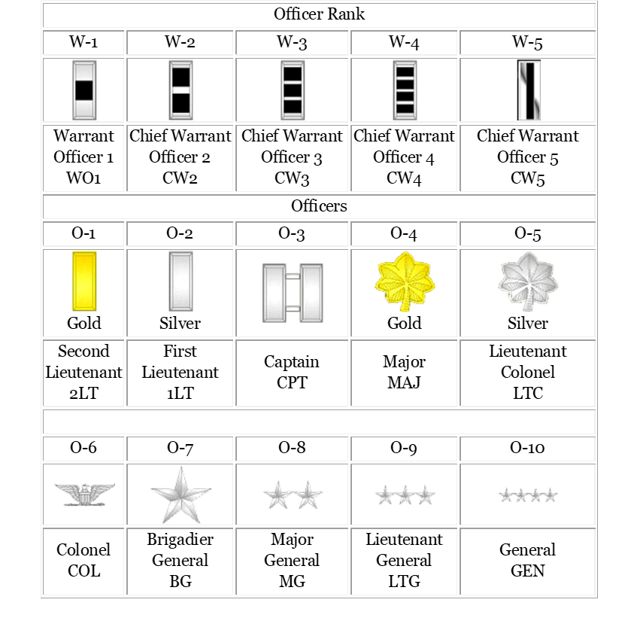
Military Rank and Insignia
Notes:
Sourced from the original TRADOC Acculturation Handbook

Slide 20
Military Lingo
MILITARY TIME
The military operates off a 24-hour clock, beginning at midnight (which is 0000 hours).
1:00 a.m. is 0100 hours, 2:00 a.m. is 0200 hours, and so-on up until 11:00 p.m. which is 2300 hours.
MILITARY PHONETIC ALPHABET
Spoken words from this approved list are substituted for letters to prevent confusion between similar sounding letters, such as “m” or “n.”
A | B | C | D | E | F | G | H | I
Alpha | Bravo | Charlie | Delta | Echo | Foxtrot | Golf | Hotel | India
J | K | L | M | N | O | P | Q | R
Juliet | Kilo | Lima | Mike | November | Oscar | Papa | Quebec | Romeo
S | T | U | V | W | X | Y | Z
Sierra | Tango | Uniform | Victor | Whiskey | X-Ray | Yankee | Zulu
Notes:
Sourced from the original TRADOC Acculturation Handbook

Slide 21
Helpful Resources
Army Career Tracker: https://actnow.army.mil/
O&A materials
IDPs
Career Program Communities
MilSuite: https://www.milsuite.mil/
There are many helpful pages on Milsuite
Must register for milbook account once you receive your CAC

Slide 22
OPTIONAL –
Continue with Command Brief

Slide 23
DEPARTMENT OF ARMY
WELCOME TO [Command Name]

Slide 24
Agenda
Welcome and Introductions
Overview of the Organization
Organizational Mission, Vision and Values
Command Organizational Chart
Leadership and Bios
Key Policies
Security Information and ID Badges
Maps
Information for Transportation on Base
Important POCs and Contact Information
Collective Bargaining
Helpful Web Links

Slide 25
Welcome and Introductions
Seek participation from leadership team to do a 5-minute welcome speech.
If numbers allow, ask participants to introduce themselves
Name
Division
Position
Ice-Breaker Question: for example – What do you enjoy doing when you are not working? What are the values that drive you?

Slide 26
Overview of the Organization
History of the Command, when it was established
Command responsibilities
How this Command fits into the rest of the Army
Interactions with other Commands
Consider organizing briefings by each of the Departments within the Command, to provide an overview of the mission, roles, and responsibilities of each. This overview should ideally make clear the interrelationships and interdependencies among the Departments, in order to give new employees a good overview of the overall command organization.

Slide 27
Organizational Mission, Vision and Values
The mission of [our org] is:
XXX
The vision of [our org] is:
XXX
The values of [our org] are:
XXX
If the Command has a video, consider showing it to highlight the Command mission and its impact on the larger Army mission.

Slide 28
Command Organizational Chart
Include an org chart(s) for the organization, showing the various divisions, etc.

Slide 29
Leadership and Bios
Include names, and bios if possible, for the Command/organization leadership
Include both Civilian and Military leadership, as applicable, and explain their roles within the organization

Slide 30
Key Policies
Include information about any organization-specific policies:
Time and attendance
Dress code
Work hours
Health and wellness
Smoking
Severe weather and emergency operations

Slide 31
Security Information and ID Badges
Emergency numbers and contact information
Evacuation and assembly areas
CAC

Slide 32
Maps
Include maps of the base/installation, building, local area…

Slide 33
Information for Transportation on Base
If applicable, include information about on-base transportation like bus routes/schedules, etc.
Transportation Subsidy Program, if applicable

Slide 34
Important POCs and Contact Information
For example:
Security & Safety -
IT Help Desk & Phone Issues –
Pay Issues –
Training Coordinator –
In/Out Processing –
Building Badge/CAC –
Building Facility Manager -
GOV Travel Card -

Slide 35
Collective Bargaining
If applicable, invite Union Representatives to speak about membership

Slide 36
Helpful Web Links
List any websites that new employees may find useful, particularly Command-specific sites (social media, etc.)
Include resources for communication and collaboration (e.g., milsuite, google groups, listservs, etc.)

