Slide 1


BLC (Distance learning) information sheet
Soldiers will receive an email with instructions on how to self-enroll into blackboard. More information can be found at following webpages:
Fort Stewart webpage: https://home.army.mil/stewart/index.php/units/tenant-units/NCO-Academy
Fort Stewart NCOA Facebook page: https://www.facebook.com/thefortstewartncoa
To access our ACT Community page go to https://actnow.army.mil and follow these steps:
1. Click on Communities located on the left hand side
2. Click on the drop down Communities located on the left hand side
3. Click the drop down labeled "Select a Category" located on the top of the page and select "Other Communities"
4. Select NCO Academies
5. Scroll down until you see Fort Stewart NCO Academy and select it. (Self-enrollment is found here)
6. Select Follow this community in the upper left hand corner of page.
Soldiers are to self-enroll into blackboard starting 7 – 13 April 2020
Create initial “introduction” post NLT 1200 hours on 13 April 2020
That is day zero “roll call.” If a Soldier reserved for BLC 06-20 fails to self-enroll and create introduction post, they will be marked as a “NO-SHOW” in ATRRS
Monday-Saturday, students are required to create daily discussions on various lessons. Accountability will be tracked daily. If a student fails to post for two days, SGLs will make contact with student’s chain of command.
Battalion leadership will need to provide a valid reason to Fort Stewart NCO Academy Commandant for student missing days. If no response or valid excuse, student can be dismissed from BLC.
Soldiers need to be proactive. They should not wait until 13 April to realize they do not have the required recourses to graduate BLC (for example, computer, internet access, and a CAC reader).

Slide 2
BLC (Distance learning) information sheet
Learner Daily Battle Rhythm
MON-FRI
FRI: 1500-1700 SGL/STU 1 on 1 feedback/counseling
SAT: 0900-1000 Instructor led Q&A with Learners
Sundays: Off/Self study
0000
0830
0900
1500
2359
Class / Resources Available
Daily Announcement
Identify Tech Issues with Instructor
SGL Feedback on main discussion posts (0900-1000)
Next Day Class / Resources Available
Daily Announcement
Discussion question for next day opens. Initial Post and Responses due NLT 0830 next morning.
Discussion Initial Post and Responses Due 0830
Facilitation of Classroom Distance Learning w/ SGL Interaction
Peer to Peer discussion and interaction within Classroom Group Discussion Board
Student Check-in
Learner/peer/ self research
Learner/peer/ self research

Slide 3
0830-0900
BLC (Distance learning) information sheet
LEARNER
LOG IN/REPORT
Log into Blackboard NLT 0830 and prepare for that days lesson
Open and prep all references and slides
Report in the Platoon/Classroom Group Discussion Board under the daily reporting Forum
NOTE- Failure to report after two occasions may result in disenrollment
Report issues:
Notify SGL of any issues prior to 0900. (Email, Phone, BB posts)
If you have been experiencing ongoing Technical Issues post into the Platoon General Forum during this timeframe to get feedback
Note – notifying your Instructor of issues you are having does not relieve the Learner of responsibilities (discussions/tasks/assignments due, etc.) unless cleared through BLC Chief
Your place of duty is participating in class. Personal or Unit issues are not excusable unless cleared by the BLC Chief and Commandant. This includes appointments.

Slide 4
0900-1500
BLC (Distance learning) information sheet
LEARNER
Discussion and Facilitation:
Instructors will open class discussing your posts and individual research the night prior.
They will then facilitate further discussion posts on the days topic to improve your knowledge. This may entail discussions, group activities or research, websites, videos, etc.
This is a student led curriculum. You will be engaged with other students. The instructor facilitates the learning environment.
All posts are professional and are generally grammatically correct, with good sentence structure.
Be respectful and open minded even during disagreements

Slide 5
1500-0830
BLC (Distance learning) information sheet
LEARNER
Resources for the next day become available.
Be on lookout for Daily Announcements
This is the time for Self and Peer research and collaboration
Visit Platoons Group Discussion Board:
A forum will be posted for the next days topic
Answers are due NLT 0830 the next morning, and must be your own. (Plagiarism)
Answers to each question should be at least five to seven sentences, and grammatically correct using good sentence structure. Each student will create a Thread in the Forum. Label the Thread with student number and title of post. (STU7_Title). Students will read and respond to one post from another student. Responses will be three to five sentences and labeled with your student number (STU7_RE:Title). *Answers are submitted in your Platoon Main Discussion Board, under the forum labeled with the same lesson number and name.
Failure to complete work can result in dismissal. Notify instructors immediately of any issues.
Note – notifying your Instructor of issues you are having does not relieve the Learner of responsibilities (discussions/tasks/assignments due, etc.) unless cleared through BLC Chief

Slide 6
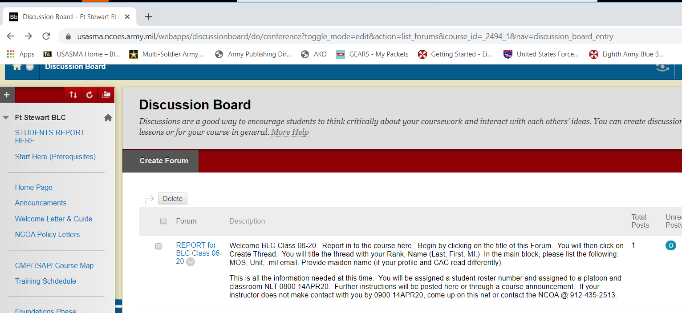
BLC (Distance learning) information sheet
Student Reporting Instructions
1
2
3
Log in to Blackboard [usasma.ncoes.army.mil] click on My Courses [682_600-C44_2020_005_00_N: Ft Stewart BLC ]
On Home Page, Click on “Students Report Here”. It will take you to the academy discussion board.
Click on “Report for BLC Class 06-20” after reading the instructions.

Slide 7
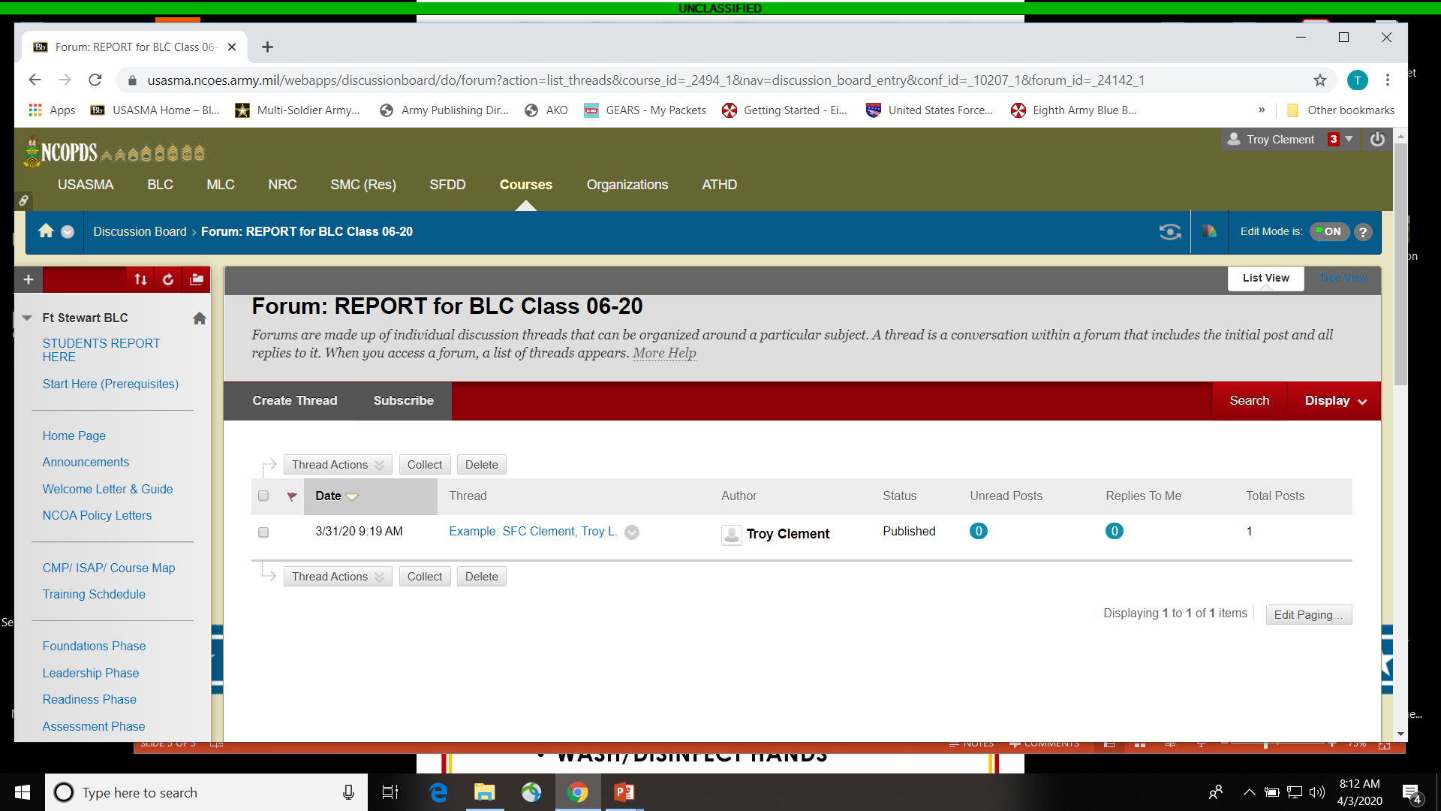
BLC (Distance learning) information sheet
Student Reporting Instructions
4
5
Click on “Create Thread”. Follow the instructions and provide information asked. Click “Submit” when done.
An example has been provided that you may view.

Slide 8
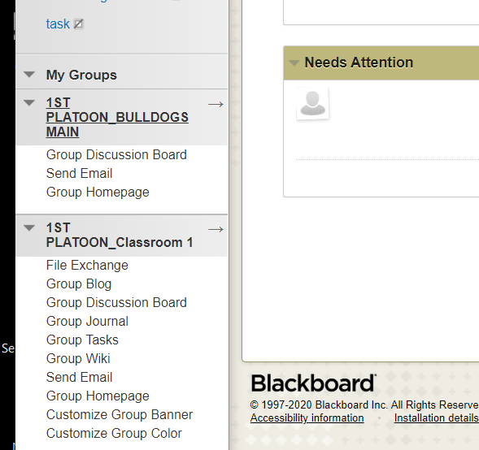
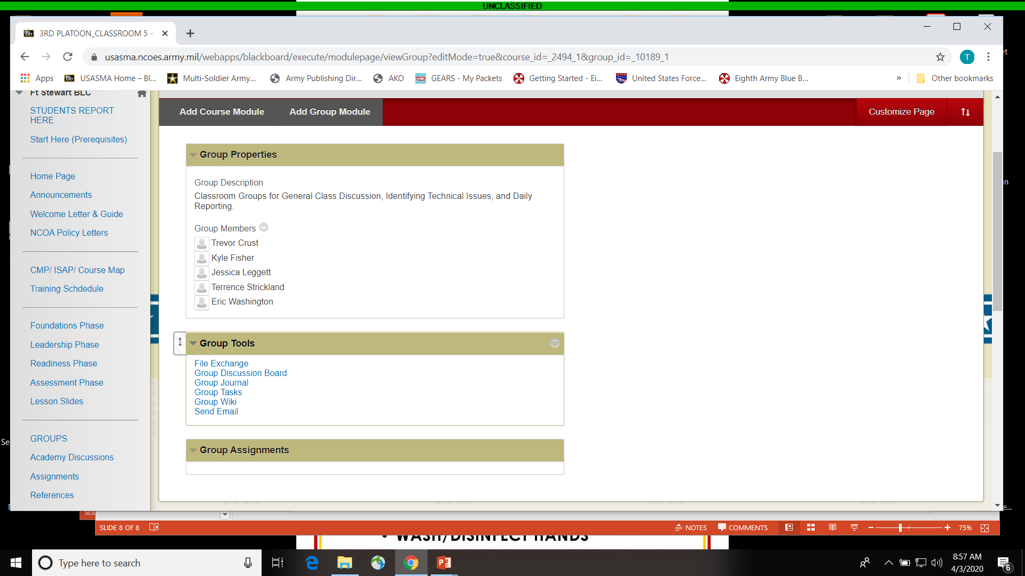
BLC (Distance learning) information sheet
Platoon Groups and Classrooms
1
2
- NLT 1700 13APR20 you will be assigned to a platoon, and then assigned a Student Roster Number.
- You will be pulled into that platoon’s blackboard GROUP.
- Each GROUP has their own Group Discussion Board.
- You will have to Report daily in the Report Forum for that group.
Your assigned groups can be found on the left side of screen.
The Group Discussion Board and other Tools can be found here, or on the Group’s Homepage.

Slide 9
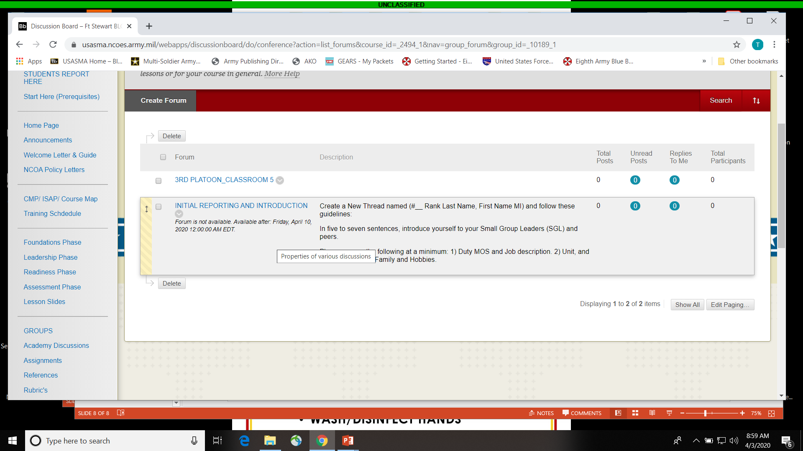
BLC (Distance learning) information sheet
Daily Reporting and Discussions
You will have to Report daily in the Report Forum for that group.
This is also where you will participate in the classroom facilitation and learning, as well as answering the daily discussion assignments.

Slide 10
BLC (Distance learning)
Contact information
BLC Chief (1SG Cortes): Miguel.a.cortes.mil@mail.mil
Administrator: 912-435-2513
Senior Small Group leaders and Small group leaders contact information will be provided on Blackboard

