Slide 1
Installation Housing Office
Plain Language Briefing
Annex F to OPORD 20-xxx – Plain Language Brief
USAG Fort Polk
As of 13 July 2020

Slide 2
Welcome to the Garrison Housing Office
The USAG Fort Polk Housing staff are employed by the Army to assist Service Members and their Families with housing matters and advocate on their behalf with community partners/agencies both on and off the installation
The Housing Service Office (HSO) provides referral services and tenant/landlord dispute services
The Installation Housing Office provides oversight of the privatized company managing on post housing and provides tenant/landlord dispute services
The Garrison Housing Manager manages the Installation Housing Office and reports directly to the Director, Public Works and garrison leadership
Garrison Leadership
Garrison Commander: COL Ryan K. Roseberry, 337-531-1606
Garrison Command Sergeant Major: CSM Christopher M. Ausbun, 337-531-1606
Garrison Deputy to the Garrison Commander/Manager: Mr. Johnny D. Bevers, 337-531-1606
Garrison Housing Manager: Ms. Betty M. Beinkemper, 337-531-6000 or 337-208-3229

Slide 3
Privatized Housing Contacts
Corvias Military Living, sometimes referred to as the Residential Communities Initiative (RCI) Company, is the privatized company that owns and manages the family housing on this installation
Corvias is the private partner and managing member of Fort Polk
Corvias is the property management company that manages the day to day operations of the privatized housing to include ensuring prompt and professional maintenance and repair, property concerns, and rent/billing issues. This is your landlord privatized housing
Contacts:
Operations Director: Mr. Wil Motta, 337-537-5036
Facilities Director: Mr. Danny Bartlett, 337-537-5014
Maintenance Supervisors: Mr. Dwight Gonzalez, 337-537-5837
Mr. Mike Josey, 337-537-5856

Slide 4
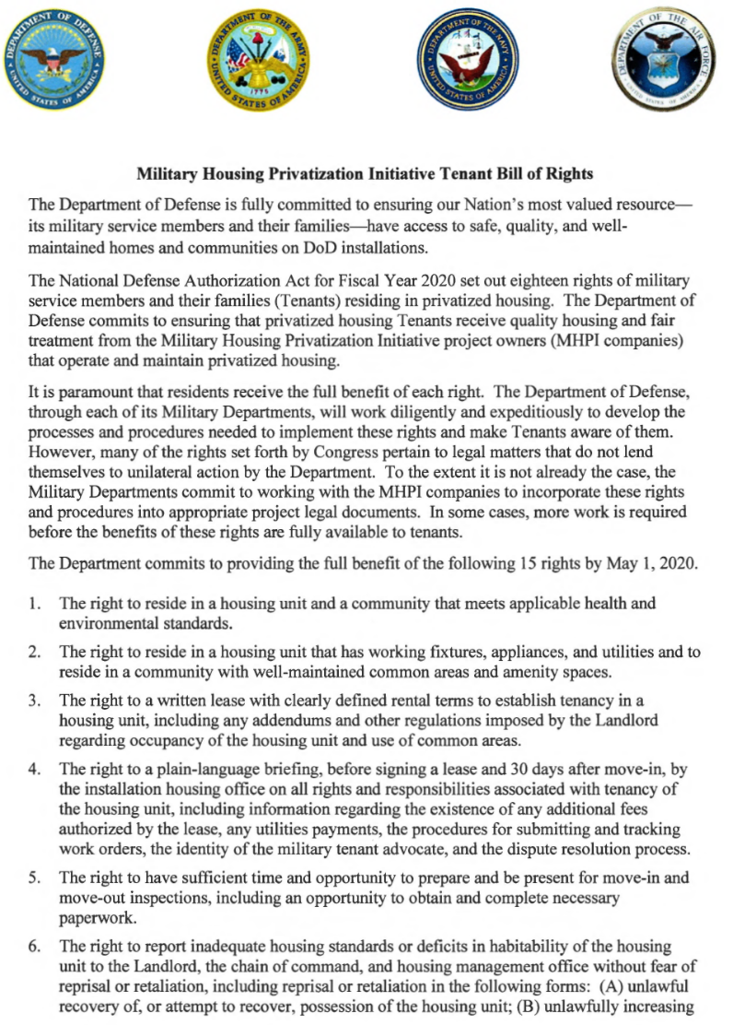
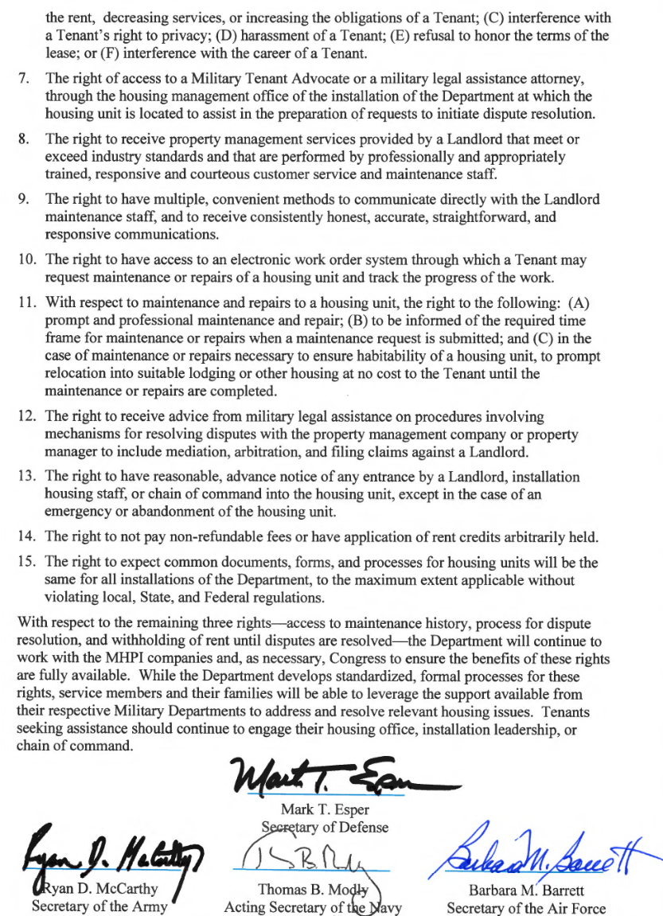
Privatized Housing - Tenant Bill of Rights
* Copy is available upon request

Slide 5
Privatized Housing - Tenant Bill of Rights
The Military Housing Privatization Initiative Tenant Bill of Rights requires the Garrison Housing Office provide a plain language brief to all residents of privatized housing prior to lease signing and again 30 days after move-in on all rights and responsibilities associated with tenancy of the housing unit
  You have the right to reside in a housing unit and a community that meets applicable health and environmental standards. (Right 1)
  You have the right to reside in a housing unit that has working fixtures, appliances, and utilities and to reside in a community with well-maintained common areas and amenity space. (Right 2)
  You have the right to a written lease with clearly defined rental terms to establish tenancy in a housing unit, including any addendums and other regulations imposed by the Landlord regarding occupancy of the housing unit and use of common areas. (Right 3)
  The right to a plain-language briefing, before signing a lease and 30 days after move-in, by the installation housing office on all rights and responsibilities associated with tenancy of the housing unit (Right 4)
  You have the right to have sufficient time and opportunity to prepare and be present for move-in and move-out inspections, including an opportunity to obtain and complete necessary paperwork. (Right 5)

Slide 6
Privatized Housing - Tenant Bill of Rights
You have the right to report inadequate housing standards or deficits in habitability of the housing unit to the Landlord, the chain of command, and Installation housing office without fear of reprisal or realization, including (A) unlawful recovery of, or attempt to recover, possession of the housing unit; (B) unlawfully increasing the rent, decreasing services, or increasing the obligations of a tenant; (C) interference with a tenant’s right to privacy; (D) harassment of a tenant; (E) refusal to honor the terms of the lease; (F) interference with the career of the tenant (Right 6)
You have the right to access to a Military Tenant Advocate or a military legal assistance attorney, through the Installation housing office to assist in the preparation of requests to initiate dispute resolution (Right 7)
The right to receive property management services provided by the Landlord that meet or exceed industry standards and that are performed by professionally and appropriately trained responsive and courteous customer service and maintenance staff. (Right 8)
    The Fort Polk Housing Assistance Office serves as your Military Tenant Advocate.
    Housing Chief Ms. Betty M. Beinkemper, 337-531-6000 or 337-208-3229

Slide 7
Privatized Housing - Tenant Bill of Rights
You have the right to receive advice from military legal assistance on procedures involving mechanisms for resolving disputes with the property management company or property manager in include mediation, arbitration, and filing claims against the Landlord. (Right 12)
  JRTC & Fort Polk Legal Assistance: 337-531-2580
You have the right to have multiple, convenient methods to communicate directly with the privatized Landlord maintenance staff, and to receive consistent, honest, accurate, straightforward and responsive communications. (Right 9)
You have the right to have access to an electronic work order system through which a tenant may request maintenance or repairs of a housing unit and track the progress of the work. (Right 10)
  Corvias Property Management
Maintenance Work Order Hotline: 866-436-2047
Maintenance Shop Location: 7059 Magnolia Drive
Maintenance Website: www.FortPolkCorvias.residentportal.com
Maintenance Application: www.FortPolkCorvias.residentportal.com

Slide 8
Privatized Housing - Tenant Bill of Rights
You have the right to the following: (A) prompt and professional maintenance and repair; (B) to be informed of the required time frame for maintenance and repairs when a maintenance request is submitted; and (C) in the case of maintenance or repairs necessary to ensure habitability of a housing unit, to prompt relocation into suitable lodging or other housing at no cost to the tenant until the maintenance or repairs are completed. (Right 11)
Displaced Resident Policies
  ASAIE&E Memorandum, SAIE, Feb 14, 2020, Army Residential Communities Initiative Company Minimum Standard Resident Displacement Guidelines
  ASAIE&E Memorandum, SAIE, Jan 23, 2020, Subject: Procedures for Approving Privatized Housing Habitability after Remediation, Mitigation, Stabilization and abatement
  IMCOM Memorandum, Headquarters Installation Management Command, IMPW-H, JAN 31 2020, subject: Procedures for Certifying Housing Habitability for Army Family Housing, Leased Housing, Unaccompanied Housing and Privatized Homes
  IMCOM Memorandum, Headquarters Installation Management Command, IMPW-H, MAR 11 2020, subject: Command Guidance Army Residential Communities Initiative (RCI) Company Minimum Standard Resident Displacement Guidelines
  ASA IE&E Memorandum, “Housing Maintenance Quality Assurance and Environmental Hazard Oversight Program” provides clear standards and details of required oversight of Army housing maintenance
* Copy of Tenant Bill of Rights is available upon request

Slide 9
Privatized Housing - Tenant Bill of Rights
Resident agrees to notify the property management team when maintenance is required. Maintenance work orders may be placed via telephone call, email, fax, in person, or through the resident work order portal. Residents can track the progress of their work order through the resident portal at : www.FortPolkCorvias.residentportal.com or by contacting the Maintenance Work Order Hotline at:1-866-436-2047. Routine work orders are generally completed within 10 working days.
    Emergency Work Orders – immediate threat of life, security or property and responded to quickly to resolve the emergency. Emergencies include but not limited to electrical shorts or sparking, inoperable stove or oven, hot water outage and frozen pipes.
      Life / Health / Safety Work Orders – issues pertaining to life, health and safety and responded to as an Emergency. Includes environmental concerns, HVAC issues during extreme conditions and water infiltration.
    Routine Work Orders – requests serving to maintain the home in good working order. Routine maintenance includes repairs on slow drains, light bulb replacements and air filter replacements.
Work order or maintenance ticket to be closed only once the tenant and Installation Housing Office signs off.

Slide 10
Privatized Housing - Tenant Bill of Rights
The right to have reasonable advance notice of any entrance by the Landlord, Installation housing staff, or chain of command into the housing unit, except in the case of an emergency or abandonment of the housing unit. (Right 13)
A Resident will be deemed to have provided permission to enter the home to Owner, Community Manager, their employees, agents and/or contractors when the Resident requests repairs or maintenance within the Home and agrees upon a time/date for routine service to occur or when Owner requests to conduct an annual maintenance inspection for which the Resident agrees upon a time with 24-hour advance notice for such service to occur.
When such permission is granted, anticipated repair completion will be provided to Resident to provide predictability on technician response. Permission to enter will be used in case of an emergency; to include completion of Emergency, Urgent and Life/Heath/Safety work order requests.
The Home is located within exclusive federal jurisdiction of the United States and therefore under military control, which includes the Installation Commander's inherent authority and obligation to ensure good order and discipline. As such, the Installation Commander has the right and power to inspect, search and/or order the inspection or search of military persons and property within the family housing areas of the Installation.

Slide 11
Privatized Housing - Tenant Bill of Rights
The right to not pay non-refundable fees or have application of rent credits arbitrarily withheld. (Right 14)
  Fort Polk Corvias Residents are not required to pay any pet deposits. Corvias residents are only required to register their pets with both VETCOM and Corvias upon arrival to the installation, or at the time a pet is added to the family composition. There is no charge to register the pet, but VETCOM should be notified to confirm what days and times are best to ensure a quick and seamless visit .
The right to expect common documents, forms, and processes for housing units will be the same for all Army Installations, to the maximum extent applicable without violating local, state, or federal regulations. (Right 15)

Slide 12
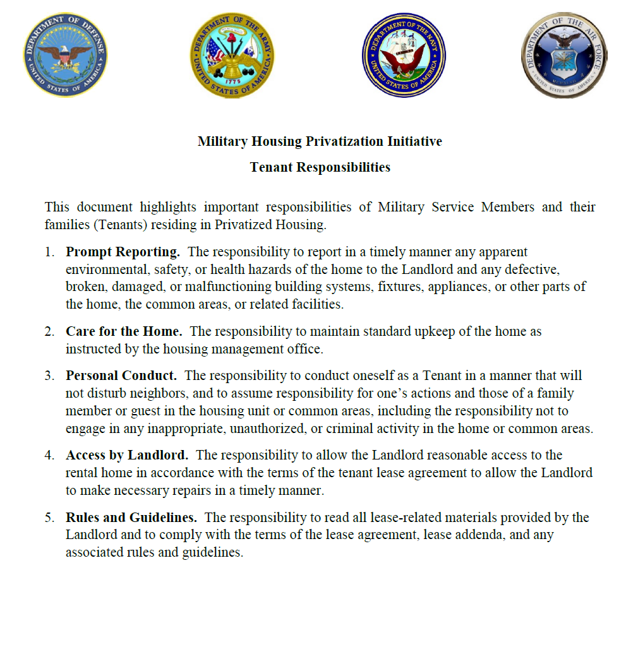
Privatized Housing – Tenant Responsibilities
* Copy is available upon request

Slide 13
Privatized Housing – Tenant Responsibilities
The Military Housing Privatization Initiative Tenant Bill of Rights highlights 5 important responsibilities for Service Members and their Families while they reside in privatized family housing.
  The responsibility to report in a timely manner any apparent environmental, safety, or health hazards of the home to the Landlord and any defective, broken, damaged, or malfunctioning building systems, fixtures, appliances, or other parts of the home, the common areas, or related facilities.
  The responsibility to maintain standard upkeep of the home as instructed by the housing management office.
Residents should practice good housekeeping throughout their residency on post, in an effort to decrease safety hazards such as fire. Any leaks, or non-working fixtures or appliances should be reported to maintenance for repair at time the resident becomes aware to ensure timely repair or replacement, and provide the best possible experience for the resident while living in a Corvias home.
Fort Polk On-Post Housing does not provide curbside recycling services, however Residents are encouraged to utilize the JRTC and Fort Polk Recycling Center for all their recyclables and hazardous waste items. Residents can dispose of bulk trash at the Corvias Warehouse during working hours or put on curb the day of your trash pick-up.
Regular pickup schedules will be weekly and vary by community. Residents can obtain a schedule of pick up days from the Community Office, or by visiting the Corvias at Fort Polk website at: www.polk.corviasmilitaryliving.com

Slide 14
Privatized Housing – Tenant Responsibilities
  The responsibility to conduct oneself as a Tenant In a manner that will not disturb neighbors, and to assume responsibility for one’s actions and those of a family member or guest in the housing unit or common areas, including the responsibility not to engage in any inappropriate, unauthorized, or criminal activity in the home or common areas.
    Residents and other authorized occupants and guest may not disturb the peaceful enjoyment of the Community. (Fort Polk) Directorate of Emergency Services has policing authority of (Fort Polk) housing areas. Community quiet hours are: from 2200 to 0500 Sunday evening – Friday morning and 2400 to 0600 Friday evening - Sunday morning and should be observed by all residents and their guests that reside or visit homes at Fort Polk. Residents are required to control their pets to avoid disturbance during the quiet hours as defined above as well as from becoming a nuisance due to prolonged or frequent barking.
    Please refer to the Resident Responsibility Guide on the Corvias website at www.polk.corviasmilitaryliving.com for more information.
  The responsibility to allow the Landlord reasonable access to the rental home in accordance with the terms of the tenant lease agreement to all the Landlord to make necessary repairs in a timely manner.
  The responsibility to read all lease-related materials provided by the Landlord and to comply with the terms of the lease agreement, lease addenda, and any associated rules and guidelines.

Slide 15

Garrison Housing Services Office (HSO)
The goal of the HSO is to implement and maintain a high quality worldwide resource for relocation services that is innovative, comprehensive, and the first choice of information and support when Soldiers and families relocate.
  Non-discriminatory listings of adequate and affordable rental and for-sale housing
  Counseling/referral on eligible installation services (i.e. legal, education, Exceptional Family Member Program)
  Preliminary inquiries to validate housing discrimination complaints
  Liaison with community and government officials / organizations (on and off post)
  Housing data exchange with other DoD housing offices
  Liaisons with Army Community Services in support of the Housing Relocation Assistance Program
  Housing market area data for use in developing market analyses Rental negotiations and lease review

Slide 16
Garrison Housing Services Office (HSO)
One-Stop, Full Service from Arrival to Departure for the Following:
  Home buying counseling
  Landlord-tenant dispute resolution
  Basic Allowance for Housing (BAH) data submission
  Property inspections
    NEW---Per FY20 NDAA: If tenant is not available for pre-assignment walkthrough inspection, Housing Office must attend on tenant's behalf
    NEW---Per FY20 NDAA: The Housing Manager shall initiate contact with resident 15 day and 60 days after move in regarding the satisfaction of the resident.
  Administrative assistance with utility company fees/deposits, connections, and billings
  Informational briefings (in- and out-processing, entitlements),community outreach

Slide 17
Furniture Safety & Additional Information
Tenants are permitted to anchor any furniture, television, or large appliance to the wall of the unit for purposes of preventing such item from tipping over without incurring a penalty or obligation to repair the wall upon vacating the unit if the Landlord does not anchor the furniture for the tenant.
Corvias will mark wall studs for occupants to place anchors.

Slide 18
End of Brief

