Slide 1
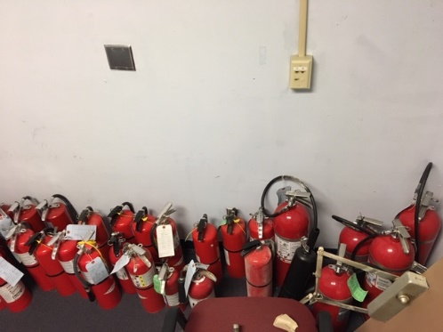
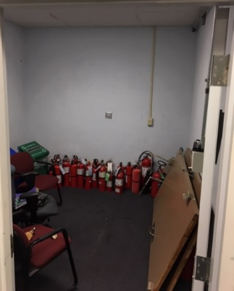
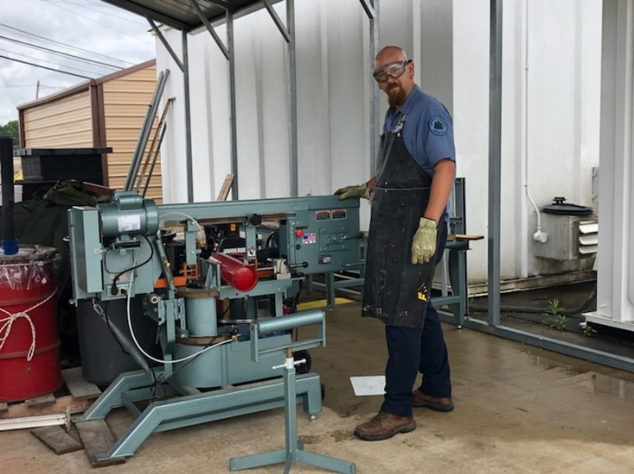
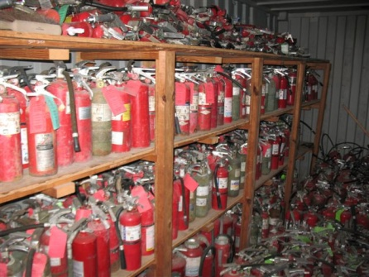
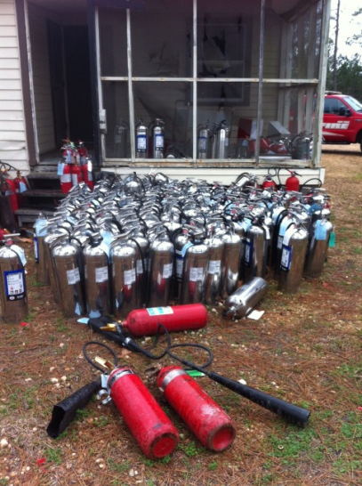
JRTC & Fort Polk, Facility - Fire Extinguisher Disposal and Recycling by DPW-ENRMD-CMB
MISSION: To dispose of, deactivate and scrap expired or unserviceable fire extinguishers assigned to installation facilities
WHO: DPW-ENRMD-CMB (Compliance Management Branch), Hazardous Waste (HW), Qualified Recycling Program (QRP), and Logistics Readiness Center (LRC)
WHAT: Scrap fire extinguishers and sell the metal
WHEN: Continuous support
WHERE: JRTC & Fort Polk - HW BLDG 4369 and QRP BLDG 3622
WHY: To minimize disposal cost and generate QRP funds for the installation
EXECUTIVE SUMMARY:
DPW-ENRMD-CMB-HW implemented facility fire extinguisher disposal procedures in 2017 for expired or unserviceable facility fire extinguishers. All facility fire extinguishers can be turned in at the HW Office, located at Building 4369. Customers are required to provide name, unit/organization and building/facility number. Exchanges or refills are not provided. DPW-ENRMD-CMB-HW neutralize the old fire extinguishers, deform them with a band saw, and place them in a roll-off-hopper for pick up and recycling by the QRP. All vehicle fire extinguishers can be turned in at the LRC Fire Extinguisher Shop, building 7386. Customers submit a service request to the LRC during turn-in of vehicle fire extinguishers. The LRC Fire Extinguisher Shop neutralize the old vehicle fire extinguishers, deform them, and place them in a roll off hopper for pick up and recycling by the QRP.

