Slide 1
Camp Kosciuszko Full Guide to Medical Care

Slide 2
Contents
QR Code for Camp K MED and Emergency on Signal​
Camp K Emergency Flowchart​
Urgent Care, Sick Call, and Appointments​
Camp K Aid Station (CKAS) Map​
Host Nation Referrals​
Tricare Reimbursement Instructions​
Medications​
Dental​
Periodic Health Assessments (PHA)​
Hearing​
Vision​
Labs​
Immunizations​
Physicals​
Behavioral Health and Other Info

Slide 3
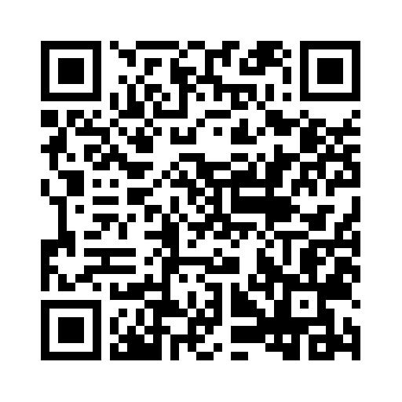
Camp K MED and Emergency Signal QR Code Join now!!!
The Camp K MED and Emergency Signal chat is to be used in the event of an emergency by following the flowchart on the next slide and posted in most buildings on Camp K.​
​
The Camp K Aid Station (CKAS) also uses it to put out information such as when we adjust our normal operating hours such as on DONSAs.

Slide 4
Are you at the scene of a medical emergency?
Post in Camp K MED the number of people who need help, if they are ill or injured, and what caused the illness or injury if known.
Y
Is there an emergency alert on Camp K MED chat?
Y
Ask them to call 112.
Y
Are you with a person who speaks Polish?
N
Call 112 and say English.
Tell the operator that there is an emergency at Marcelinska 15, the number of ill or injured, and what caused the illness or injury if known.
Did you confirm that help is on the way?
Y
Post “EMS in route.” Cease calling and move to location to provide assistance if needed.

Slide 5
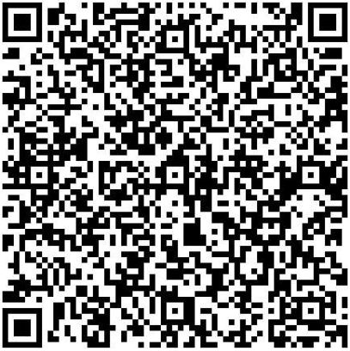
Urgent Care, Sick Call, Appointments
Not an emergency but can’t wait until sick-call: Call the on-call medic at +49 152 346 32277 or on Signal at Camp K On-call Medic.​
Sick-call is M-F 0800-1000 except on DONSAs and holidays.​
Use the CKAS MED Request QR code below to request an appointment, medication refill, schedule a PHA, or to follow-up after receiving host nation medical care.

Slide 6
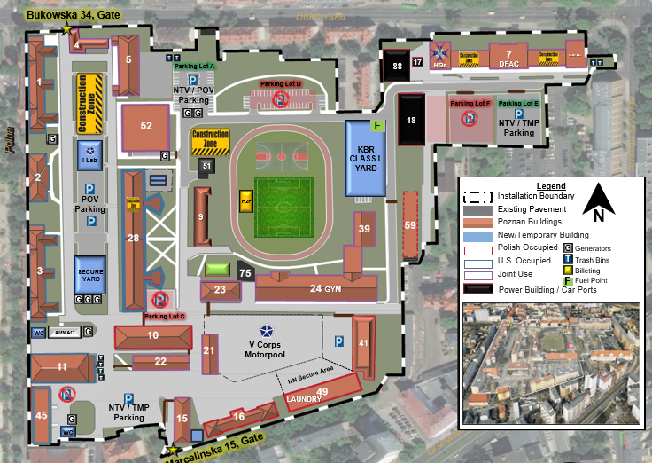
Camp Kosciuszko Building 1

Slide 7
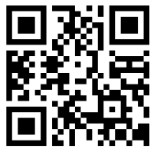
Host Nation Referrals
Since there are currently no U.S. military medical facilities in Poland, we receive certain services from host nation medical facilities.​
Referrals for host nation medical care are processed by International SOS (ISOS), the Tricare administrator for remote medical care.​
Downlaod the MyCare Overseas app using the QR code below to receive authorization notifications and appointment letters, contact Tricare and ISOS, get records translated to English, and call a translator during appointments.

Slide 8
Host Nation Referrals
Most host nation care is cashless, claimless. Nothing is required on your part other than to go to your appointment.​
Some "out-of-netowork" services that require out-of-pocket payment that is reimbursable.​
The following page contains instructions on how to file a claim for reimbursement.

Slide 9
Tricare Reimbursement Instructions
When submitting your DD 2642 Claim Form you need to include an itemized bill or invoice, diagnosis describing why the medical care was needed, and an explanation of benefits from your other health insurance (if applicable). For additional information regarding proof of payment please visit the below website.
https://tricare.mil/FormsClaims/Claims/MedicalClaims/FilingOverseas/ProofofPayment Please indicate on the DD 2642 Claim Form; "Patient paid in full and payment needs to be reimbursed to patient directly" You can submit your DD 2642 Claim Form using any of the following three methods: A.) Web based Secure Message Transmission You will need to register online via a secure login option at the TRICARE Overseas website for this option: https://www.tricare-overseas.com/beneficiaries/claims/claims-portal-register Once registered you can submit your DD 2642 Claim Form with the bill/invoice and proof of payment to your claims account: by following the below steps. 1. Go to the Link "Contact Customer Service" and then "Secured Message" where you can either create a "New message" or select "Other" and then type in "claim submission". 2. Upload claim form, invoice and proof of payment. B.) Post (Conventional mail carrier) Active Duty Service Members (ADSMs) TRICARE Overseas Program PO Box 7968 Madison, Wisconsin 53707-7968 USA All Other Beneficiaries (Eurasia-Africa) TRICARE Overseas Program PO Box 8976 Madison, Wisconsin 53708-8976 USA C.) Fax Fax submission: +1 608 301 2251 Once your claim has been submitted you can follow up on progress by contacting +44 208 762 8384, Option 2. You can also find toll free customer numbers for your region by following the below link. https://www.tricare-overseas.com/contact-us

Slide 10
Medication
A large supply of medications are available at the CKAS for new prescriptions or while awaiting refills from Express Scripts.​
​
Regularly scheduled medications that are taken long-term can be delivered by mail through Express Scripts. You must have an APO address at the Camp Kosciuszko Post Office to receive medication by mail.​
You may be sent to a local pharmacy for certain prescriptions not available at the CKAS.​
Certain prescriptions not available through other means may be obtained at Grafenwoehr or other MTFs in Europe.​
Refills of previously prescribed medications can be obtained using the CKAS MED Request form.

Slide 11
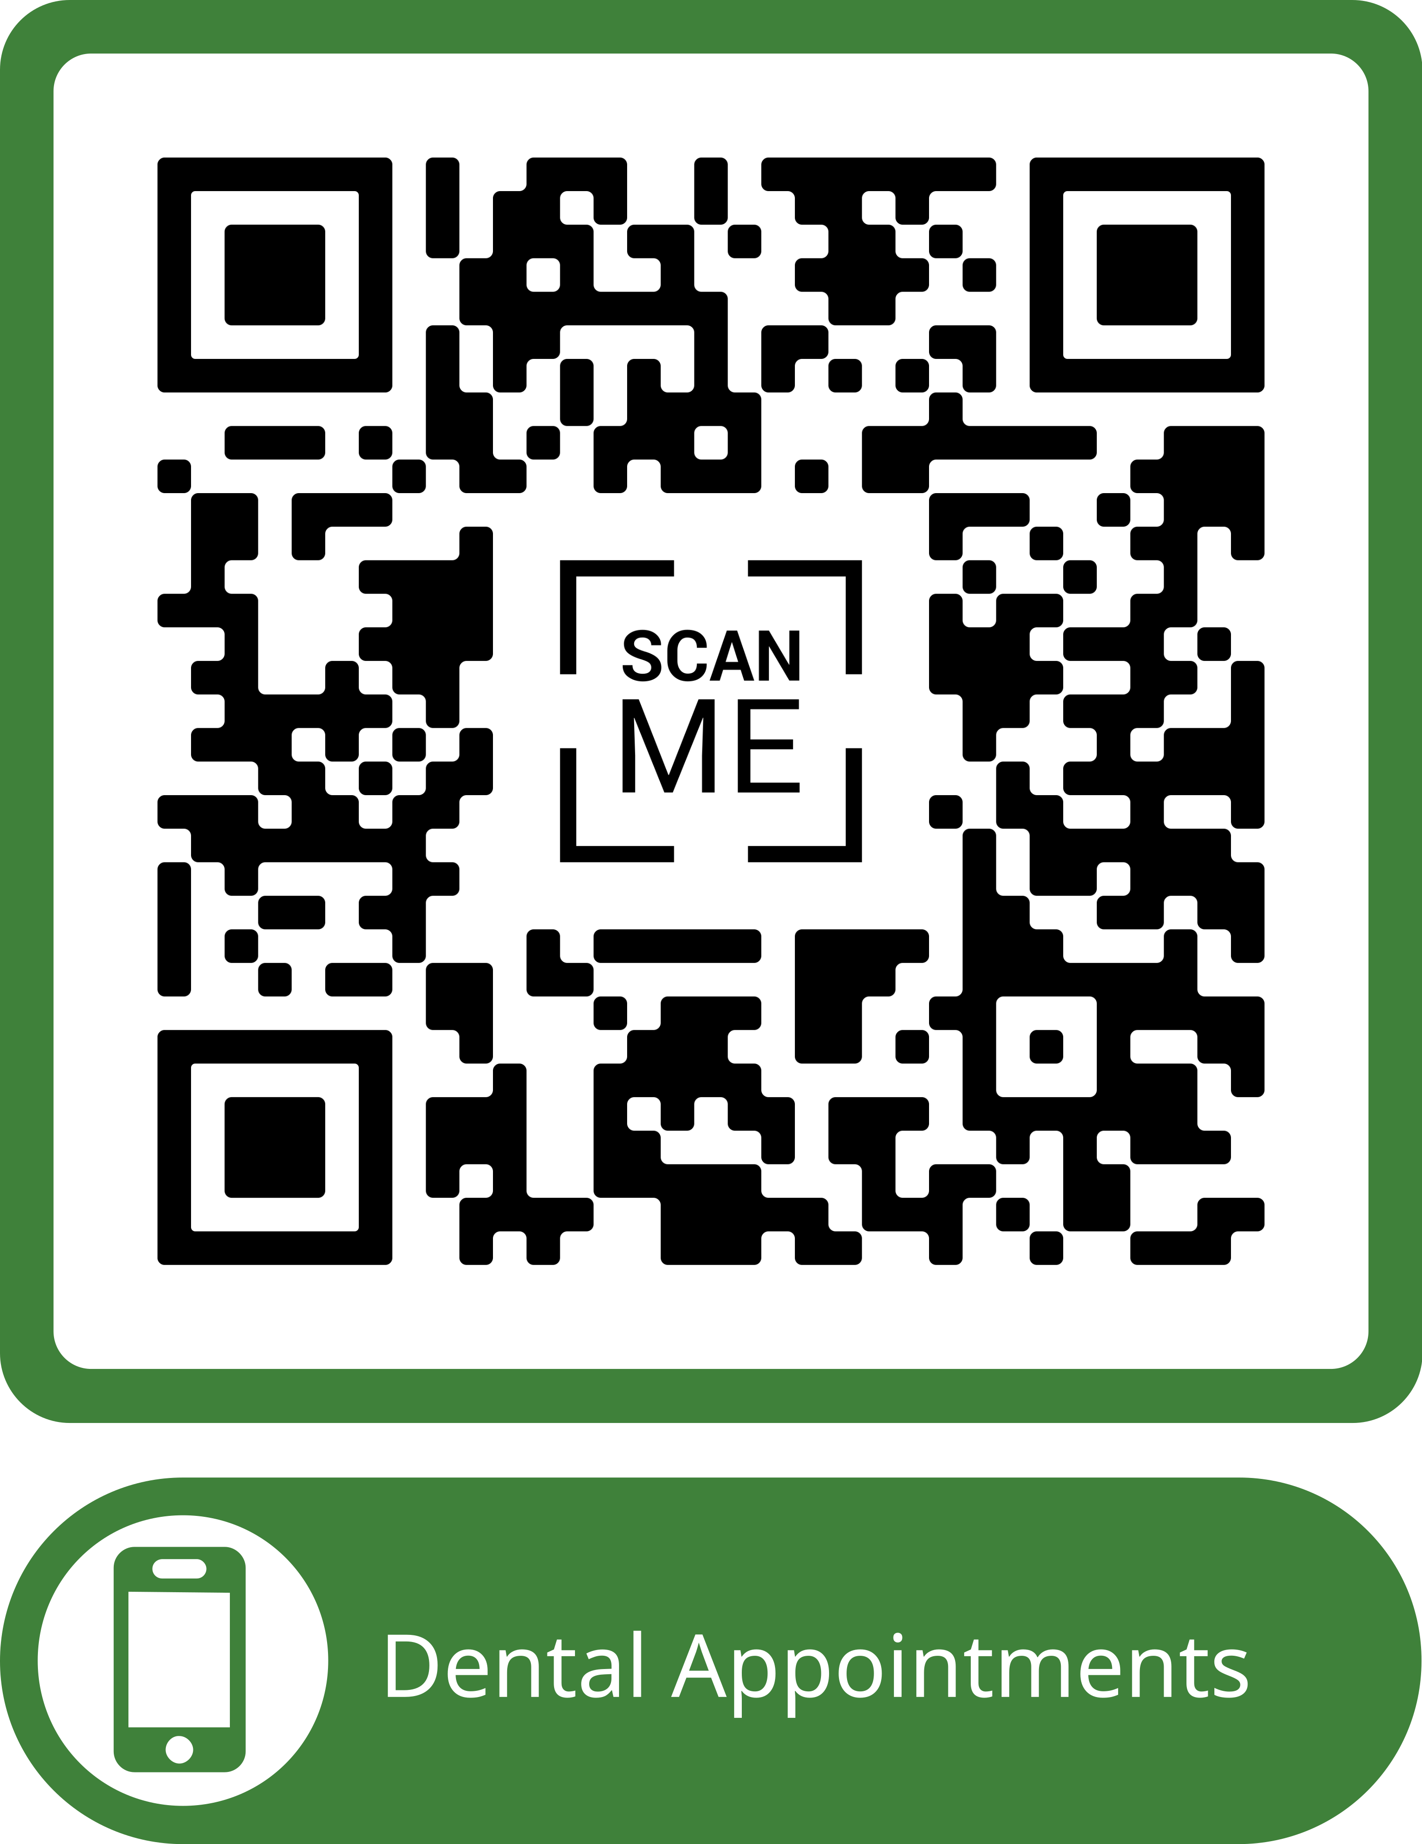
Dental
See the Host Nation Dental Care presentation to learn how to schedule dental care, including routine exams, at a host nation dental facility. For routine exams, have the dentist complete form DD 2813, scan it, and then send it to usarmy.jbsa.medcom.mbx.cda@health.mil. ​
Some dental services, including routine exams but not cleanings, are available at Powidz. Use the QR code below but note that access is sometimes blocked by Polish networks depending on location, cell service, and phone type.

Slide 12
Periodic Health Assessments (PHA)
Complete part 1 online by going to https://rc.mods.mil/MHA.​
Request an appointment to complete part 2 with a CKAS provider.​
Part 1 must be completed before scheduling an appointment.

Slide 13
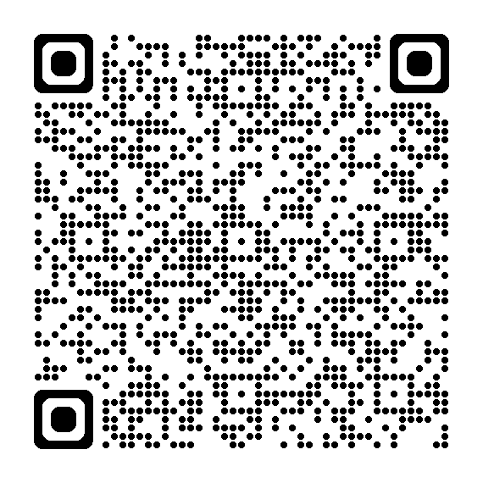
Hearing
Routine audiology (hearing) is available at Powidz and can be scheduled using the link below.
If you have any hearing related issues for which you would like a medical evaluation, send a request using the QR code in the appointments slide.
For significant hearing changes such as sudden loss of hearing in one or both ears, go to sick-call or to a local Emergency Room for evaluation.

Slide 14
Vision
For anything affecting your vision or causing severe eye pain, follow the procedures for emergency medical care.​
​
Routine vision screening at the Camp Kosciuszko Aid Station can be completed during regular business hours.​
Host nation ophthalmology services are available for eye exams, vision changes, or other eye problems that cannot be addressed in the Aid Station.​
There is a resource for obtaining prescription eyewear by mail, but you must have a previous prescription in your medical or personal records to use this resource.

Slide 15
Labs
Routine HIV screening for MEDPROS must be done through a U.S. military treatment facility (MTF) such as Grafenwoehr.​
Most other labs can be completed at a host nation facility.

Slide 16
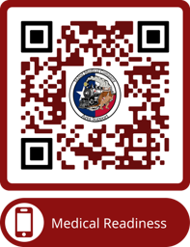
Immunizations
Flu, tetanus, and typhoid are the only immunizations available at the Camp Kosciuszko Aid Station.​
​
For those going TDY or on vacation to places in the southern half of the V Corps AO, such as Romania, Typhoid is a required immunization.​
Other immunizations are normally available at Powidz by using the QR code below to request.

Slide 17
Physicals
Physicals are only available to service members here for at least 6 months
They may require TDY travel to Germany.
Send a request to the CKAS using the QR code on the appointments slide to discuss the requirements of the physical you need. Please include what type of physical you are requesting.

Slide 18
Behavioral Health and Other Information
Behavioral Health is currently available virtually through LRMC in Germany. You can self-refer by calling International SOS at +44 20 8762 8384.
To access virtual BH, you must have a computer with a good internet connection and a camera. Stop by the aid station if you would like to use our computer for a virtual BH appointment.
The Military and Family Life Counselor (MFLC) can be reached at +1 202-913-3124 (signal).
Don’t drink the water on Camp Kosciuszko. May use to shower. Consider bottled water when brushing teeth.
Don’t touch any pets or wildlife on or off post.
Don’t use local vape products.

