Slide 1
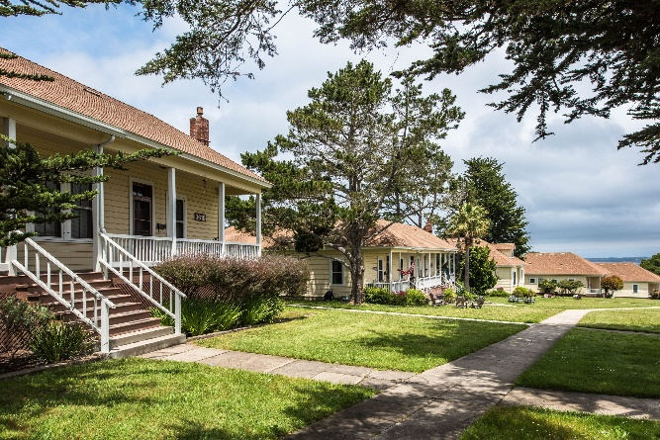
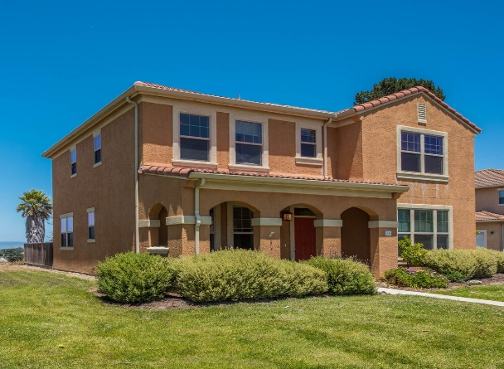
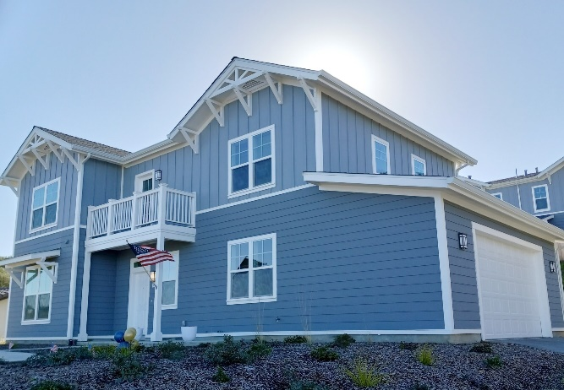
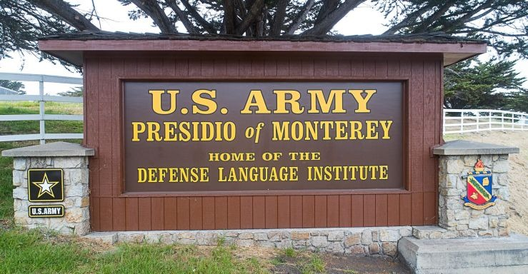
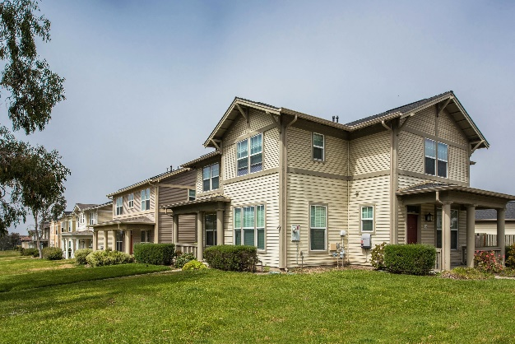
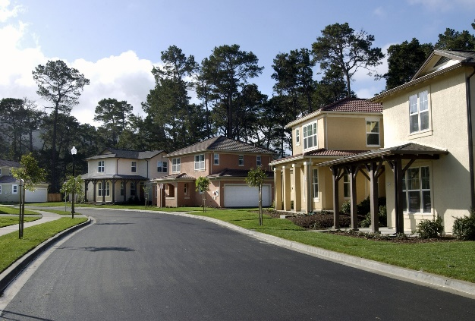
Plain Language Brief
As of: 10OCT24
Presidio of Monterey
U.S. Army Installation Management Command
Plain Language Brief_ Version 2

Slide 2
Plain Language Brief Explained
The Military Housing Privatization Initiative Tenant Bill of Rights requires the garrison AHO to provide a plain language brief presenting the facts on tenants’ rights and responsibilities associated with tenancy of the housing unit to all residents of privatized housing prior to lease signing and again 30 days after move-in on all rights and responsibilities.
“The Department of Defense is fully committed to ensuring that associated with tenancy of the housing unit, including Military Housing Privatization Initiative (MHPI) housing projects provide our Nation’s most valued resource—its military members and their families—safe, quality, and well-maintained housing where our members and their families want and choose to live.
“The Department of Defense has issued all policy guidance necessary to implement prospectively all rights for military members and their families residing in privatized family and unaccompanied housing (Tenants) at all MHPI housing projects. However, as Congress recognized, retroactive application of the requirements at existing projects requires voluntary agreement by the respective MHPI company; the Department cannot unilaterally change the terms of the complex, public-private partnerships that established the MHPI housing projects. The Department of Defense has been seeking to secure voluntary agreements, and nearly all of the MHPI companies have agreed to implement all 18 Tenant rights at their existing projects. The Department will continue to pursue agreements not yet reached. Tenants should contact their installation housing office to confirm the rights fully available to them.”

Slide 3
Garrison Points of Contact
The Presidio of Monterey Army Housing Office (AHO) staff are employed by the Army to assist Service Members and their Families with housing matters and advocate on their behalf with community partners/agencies both on and off the installation.
The Army Housing Officer reports directly to the Director, Public Works and garrison leadership.
The AHO provides oversight of the privatized project to privatized housing company managing on post housing and provides tenant/landlord dispute services.
The garrison Army Housing Office (AHO) provides referral services to Service Members and Families that reside or are seeking to reside off the installation.
Garrison Leadership:
Garrison Commander: COL Daniel Artino
Garrison Command Sergeants Major: CSM Adam Bossart
Garrison Deputy Garrison Commander / Manager: Mr. Stephen Bickel
Garrison Army Housing Officer (AHO): Ms. Teresa Watkins

Slide 4
PHP Company Contacts
Monterey Bay Military Housing (MBMH), sometimes referred to as the Privatized Housing Project (PHP) Company, is the privatized company that owns and manages the Family housing on this installation.
The Michaels Organization (TMO) is the private partner and managing member of MBMH.
The Michaels Organization is the property management company that manages the day to day operations of the privatized housing to include ensuring prompt and professional maintenance and repair, property concerns, and rent/billing issues. This is your landlord for privatized housing.
The Parks at Monterey Bay (TPMB) Contacts:
Civilian Leasing Office: (831) 661-6221
Military Leasing Office: (831) 661-6262
Maintenance Department: (831) 661-6187

Slide 5
Tenant Bill of Rights
RIGHT 1: You have the right to reside in a housing unit and a community that meets applicable health and environmental standards.
RIGHT 2: You have the right to reside in a housing unit that has working fixtures, appliances, and utilities and to reside in a community with well-maintained common areas and amenity spaces.
RIGHT 3: The right to be provided with a previous seven-year maintenance history of the prospective housing unit within two business days after making request before signing a lease. A current Tenant who did not receive maintenance information before signing a lease has the right to receive such information within five business days after making the request.
RIGHT 4: You have the right to a written lease with clearly defined rental terms to establish tenancy in a housing unit including any addendums and other regulations imposed by the Landlord regarding occupancy of the housing unit and use of common areas.
RIGHT 5: The right to a plain language briefing, before signing a lease and 30 days after move-in, by the AHO on all rights and responsibilities associated with tenancy of the housing unit, including information regarding the existence of any additional fees authorized by the lease, any utilities payments, the procedures for submitting and tracking work orders, the identity of the Military Tenant Advocate, and the dispute resolution process.
RIGHT 6: You have the right to have sufficient time and opportunity to prepare and be present for move-in and move-out inspections, including an opportunity to obtain and complete necessary paperwork.

Slide 6
Tenant Bill of Rights
RIGHT 7: You have the right to report inadequate housing standards or deficits in habitability of the housing unit to the Landlord, the chain of command, and Installation housing office without fear of reprisal or retaliation.
RIGHT 8: You have the right to access a military tenant advocate or a military legal assistance attorney, through the AHO to assist in the preparation of requests to initiate a dispute resolution. This includes the ability to submit a request to withhold payments during the formal dispute resolution process.
o Tenants are required to attempt to resolve disputes informally either through an informal dispute resolution process or as identified in the tenant lease. If the dispute cannot be resolved informally a tenant may then file a request for formal dispute resolution.
RIGHT 9: The right to receive property management services provided by the Landlord that meet or exceed industry standards and that are performed by professionally and appropriately trained responsive and courteous customer service and maintenance staff.
RIGHT 10: You have the right to have multiple, convenient methods to communicate directly with the Landlord maintenance staff, and to receive consistent, honest, accurate, straightforward and responsive communications.

Slide 7
Tenant Bill of Rights
RIGHT 11: You have the right to have access to an electronic work order system through which a tenant may request maintenance or repairs of a housing unit and track the progress of the work.
The Parks at Monterey Bay
Maintenance Shop Contact Number: (831) 661-6187
Maintenance Shop Location: 1301 Leahy Road, Monterey, CA 93940
OMC Maintenance Shop Location: 4518 Joe Lloyd Way, Seaside, CA 93955
Maintenance Website: https://montereycrc.activebuilding.com/login
Maintenance Application: Active Building
RIGHT 12: You have the right to prompt and professional maintenance and repair, to be informed of the required time frame for maintenance and repairs when a maintenance request is submitted and when maintenance or repairs are necessary to ensure habitability of a housing unit, to prompt relocation into suitable lodging or other housing at no cost to the tenant until the maintenance or repairs are completed.
RIGHT 13: You have the right to receive advice from military legal assistance on procedures involving mechanisms for resolving disputes with the property management company or property manager to include mediation, arbitration, and filing claims against the Landlord.
Installation legal office : Kristeen Thomas, (831) 242-5084

Slide 8
Tenant Bill of Rights
RIGHT 14: The right to enter into a dispute resolution process should all other methods be exhausted and, in which case, a decision in favor of the tenant may include a reduction in rent or an amount to be reimbursed or credited to the tenant.
RIGHT 15: The right to have your basic allowance housing payments segregated and held in escrow, with approval of a designated commander, and not used by the property owner, property manager, or landlord pending completion of the dispute resolution process.
RIGHT 16: The right to have reasonable advance notice of any entrance by the Landlord, Installation housing staff, or chain of command into the housing unit of no less than 24 hours, except in the case of an emergency or abandonment of the housing unit.
RIGHT 17: The right to not pay non-refundable fees or have application of rent credits arbitrarily withheld.
RIGHT 18: The right to expect common documents, forms, and processes for housing units will be the same for all Army Installations, to the maximum extent applicable without violating local, state, or federal regulations.
Note: Tenants seeking assistance with housing issues should continue to engage their garrison Army Housing office, installation leadership, and/or chain of command.

Slide 9
Community Specific Addendum
Liability (Section 10.B):
Owner requires all Tenants to maintain a policy of liability insurance issued by an authorized insurance company that provides limits of liability in an amount of at least $100,000 liability and $10,000 personal property per occurrence (the “Minimum Required Insurance”). Monterey Bay Military Housing LLC must be listed as additional insured. Tenant must furnish proof of insurance to Owner on or before the Lease Commencement Date and, Tenant must continue to provide evidence of coverage throughout the term hereof.
(b) Paragraph 10.B.1 - Owner will not be liable for any damage or injury to Tenant or others, or to any property, occurring on the Premises, except as otherwise provided by law. Owner and Owner’s Related Parties do not insure your personal property.
Early Termination Fee (Paragraph 10.G.4):
Tenant is expected to remain in possession of the Premises for the entire term specified in the Lease. If Tenant fails to do so, Tenant will be responsible to Owner for all damages provided by law, including (but not limited to) rent due through the end of the Lease term, minus rents paid by a replacement tenant (if any). This amount will vary depending upon how long it takes the Owner to find a replacement tenant.

Slide 10
Community Specific Addendum
Rent
The monthly rental rate for Military Members for the premises shall be equal to either the military resident’s Basic Allowance for Housing with dependents (BAH/WD) or in the case of military without dependents the Basic Allowance for Housing without dependents. The military resident shall notify The Parks at Monterey Bay within fourteen (14) days of any changes in his/her family status, military status, or pay grade.
In the instance of a married military couple living together, the monthly rent will be equal to the BAH/WD of the senior ranking active-duty individual.
Payment will be made through an allotment from residents’ pay accounts as provided in the Tenant Lease Agreement. The allotment will be increased/decreased when increases/decreases occur to a resident’s BAH rate (i.e. promotion, demotion, etc.). The military resident shall notify The Parks at Monterey Bay within fourteen (14) days of any changes in his/her family status, military status, or pay grade.
Occupants who are not eligible for an allotment payment such as unaccompanied geographic bachelors, foreign students, etc. will be afforded the opportunity to pay rent with a certified check, cashier’s check, money order, or debit/credit card at the beginning of every month.

Slide 11
Tenant Responsibility
The Military Housing Privatization Initiative Tenant Bill of Rights highlights five important responsibilities for Service Members and their Families while they reside in privatized family housing.
RESPONSIBILITY 1: The responsibility to report in a timely manner any apparent environmental, safety, or health hazards of the home and any defective, broken, damaged, or malfunctioning building systems, fixtures, appliances, or other parts of the home, common areas, or related facilities to the landlord.
RESPONSIBILITY 2: The responsibility to maintain standard upkeep of the home as instructed by the property management company.
RESPONSIBILITY 3: The responsibility to conduct oneself as a tenant in a manner that will not disturb neighbors, and to assume responsibility for one’s actions and those of a family member or guest in the housing unit or common areas, including the responsibility not to engage in any inappropriate, unauthorized, or unlawful activity in the home or common areas.
o The Property Management Resident Handbook provides specific information. The Resident Community Guidelines handbook can be found online at www.parksatmonterey.com/mi/residents.
RESPONSIBILTY 4: The responsibility to allow the landlord reasonable access to the rental home in accordance with the terms of the tenant lease agreement to make necessary repairs in a timely manner.
RESPONSIBILITY 5: The responsibility to read all lease-related materials provided by the landlord and to comply with the terms of the lease agreement, lease addenda, and any associated rules and guidelines.

Slide 12
Work Order Process
The Parks at Monterey Bay Work Order Process
To alert the Landlord (The Parks at Monterey Bay) of maintenance issues:
Emergency or Urgent work orders – Call in immediately to: (831) 661-6187
Routine work orders – enter online through the Resident Portal
The Resident Portal is available online at:
https://www.parksatmonterey.com/mi/maintenance or download the ActiveBuilding App in the Apple Store or on Google Play.
https://montereycrc.activebuilding.com
Track progress of work orders by viewing information in the ActiveBuilding App.
Work order or maintenance ticket will be closed once tenant and Garrison Housing Office signs off stating that the work was completed.
Important to contact The Parks at Monterey Bay to report maintenance issues right away.
Contact The Parks at Monterey Bay to report emergency, urgent, routine work orders, trouble calls, safety concerns, or resident compliance issues.
§
In person at the management offices
Residents may review or track work orders in the Resident Portal/Mobile App.
Work orders are classified as follows:
Emergency: situations which threaten life, health, or safety such as fire, electrical hazards, gas leaks, carbon monoxide alarms, sewage backup, flooding/water leaking through the walls/ceiling, mold, significant property damage, etc.

Slide 13
Types of Service Calls
Types of Service Calls | Examples | Response Time
Emergency Critical safety, life threatening issues Resident with a medical requirement for stable temp levels | Gas leaks, fire, power outage, sewage back-up, flood, only toilet inoperable | 01 hour response Available 24/7/365
Urgent Habitability Issue | Broken window, garage door inoperable, kitchen sink back-up, light-fixtures not working, Refrigerator inoperable | 04 hours initial response
Routine Convenience Unit care issues | Single burner inoperable, repair screens, light bulb replacement | 72 hours initial response
*Depending on parts

Slide 14
Informal Dispute Resolution
The informal dispute resolution process is a measured approach intended to resolve disputes at the garrison level that may be used to resolve disputes pertaining to the lease as well as issues that fall outside the specific parameters of the lease document, such as personal property claims.
The tenant may submit a completed informal dispute resolution request form with any documents that support the dispute to the AHO.
An informal dispute resolution form is available at the AHO and on-line at https://home.army.mil/monterey/about/garrison-directorates/public-works/housing-services-office
Tenants may also visit the garrison Installation legal office to seek assistance in completing the informal dispute resolution form.
The Garrison Commander will serve as the mediator between the property owner and tenant in an effort to resolve the dispute at the local level, normally within 10 business days.

Slide 15
Formal Dispute Resolution
The formal dispute resolution process allows eligible tenants to obtain prompt and fair resolution of housing disputes concerning rights and responsibilities set forth in the lease that could not be resolved through the informal dispute process.
A formal dispute resolution form is available at the AHO and on-line at https://home.army.mil/monterey/about/garrison-directorates/public-works/housing-services-office . The tenant may submit a completed formal dispute resolution request form with any documents that support the dispute to the AHO. Tenants may also visit the Installation legal office to seek assistance in completing the formal dispute resolution form.
The formal dispute resolution may include a home inspection. If the tenant fails to grant access to the premises for inspection the formal dispute resolution process shall terminate and no decision will be rendered.
The HQ IMCOM Commanding General is the Deciding Authority and will generally render a decision within 30 days, but not later than 60 days.
Tenants may request “rent segregation” for up to 60 days while the dispute is being reviewed.
The formal dispute resolution eligibility is limited to military members, their spouse or other eligible individual who qualifies as a “tenant” as defined in 10 USC Section 2871.
Tenants may seek legal advice or dispute resolution through any remedy available by law, except that Tenant and Owner shall not pursue such remedy available in law while a formal dispute resolution under this process is pending.

Slide 16
Additional Information
Tenants are permitted to anchor any furniture, television, or large appliance to the wall of the unit for purposes of preventing such item from tipping over without incurring a penalty or obligation to repair the wall upon vacating the unit if the Landlord does not anchor the furniture for the tenant.
Please refer to the next slide for locations of the Presidio of Monterey Privatized Family Housing (The Parks at Monterey Bay) Leasing Center and the Army Housing Office.

Slide 17
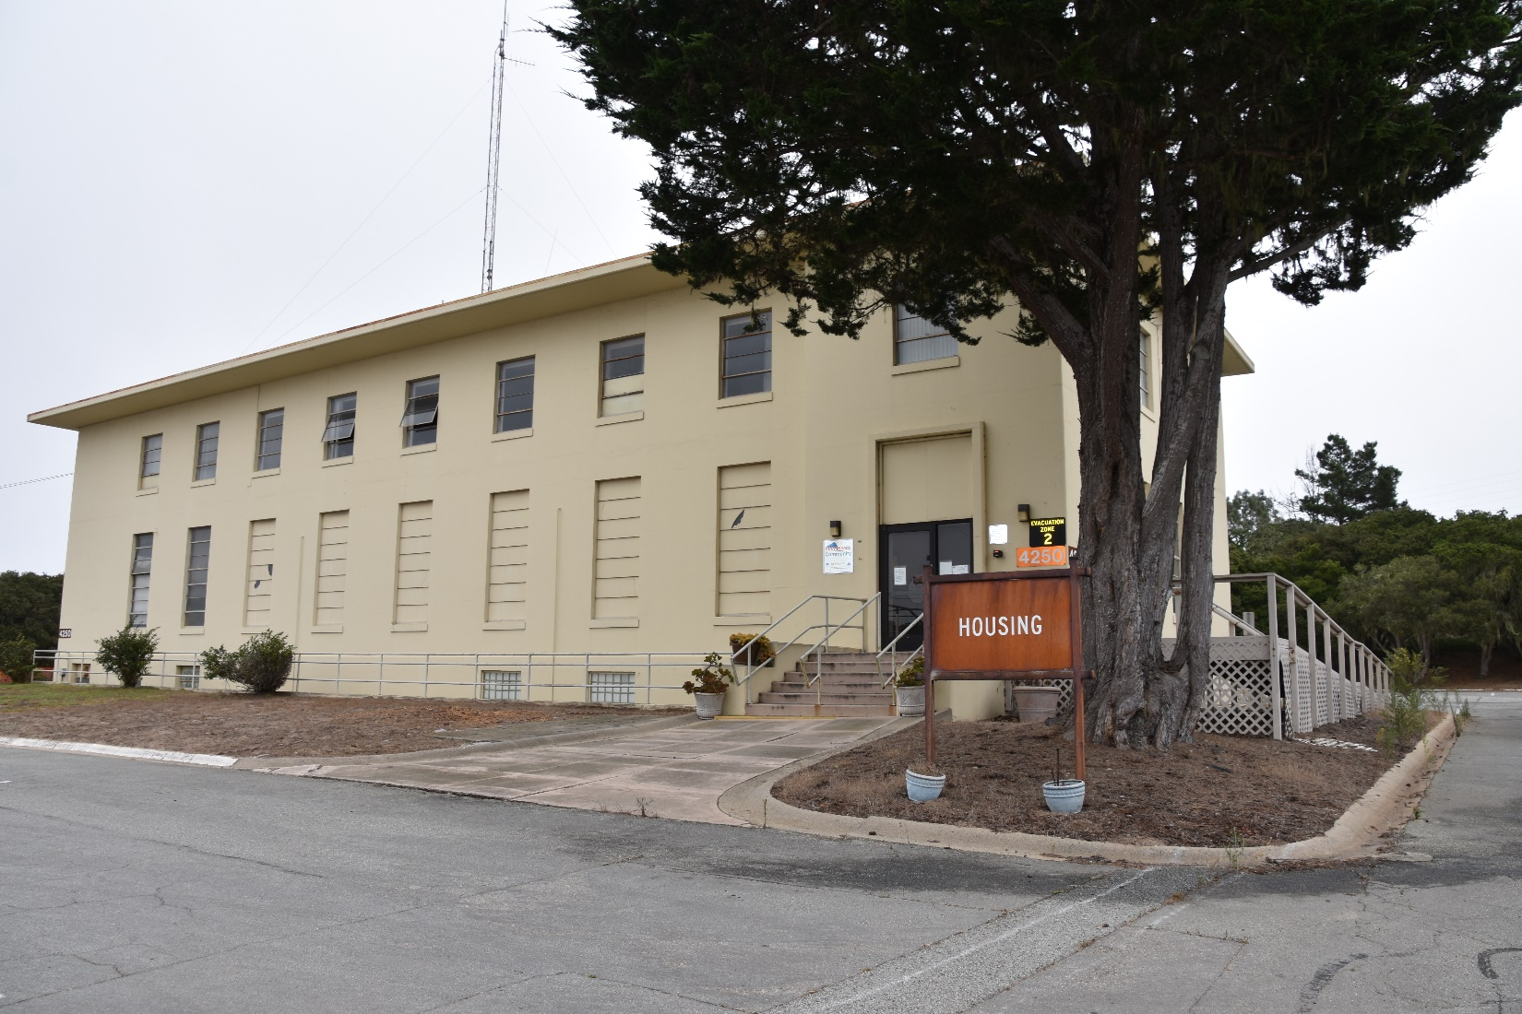
Army Housing Office
4250 Gen. Jim Moore Blvd, Seaside CA 93955 (831) 242-7979

Slide 18
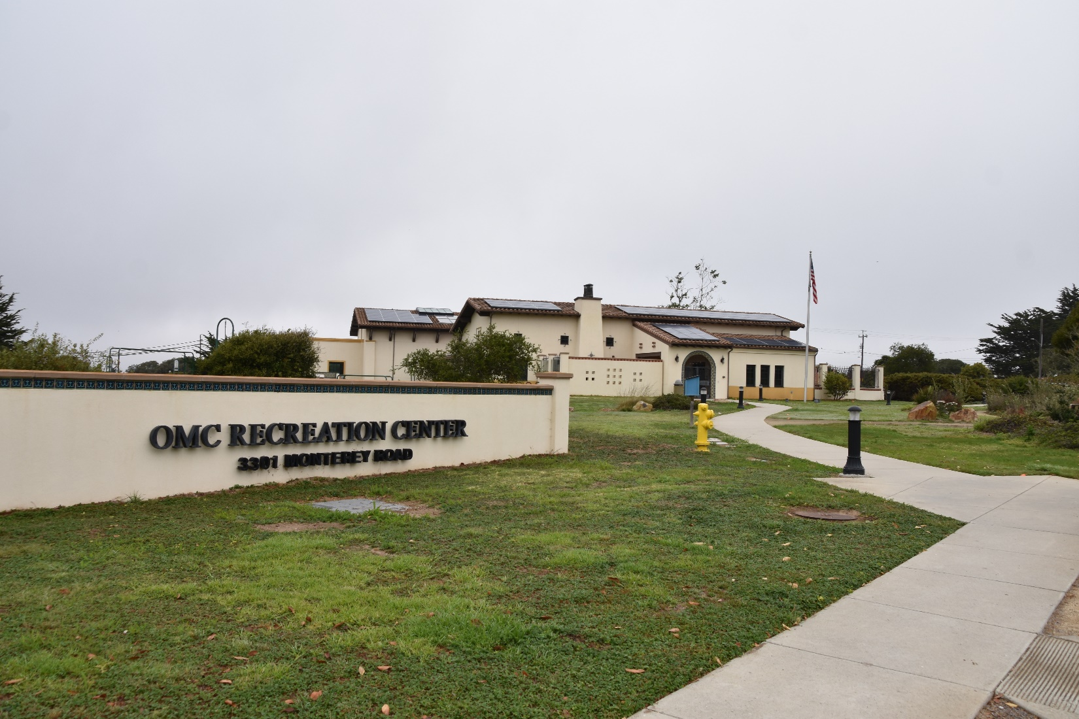
TPMB Military Leasing Office
3301 Monterey Rd, Seaside CA 93955 (831) 661-6262

Slide 19
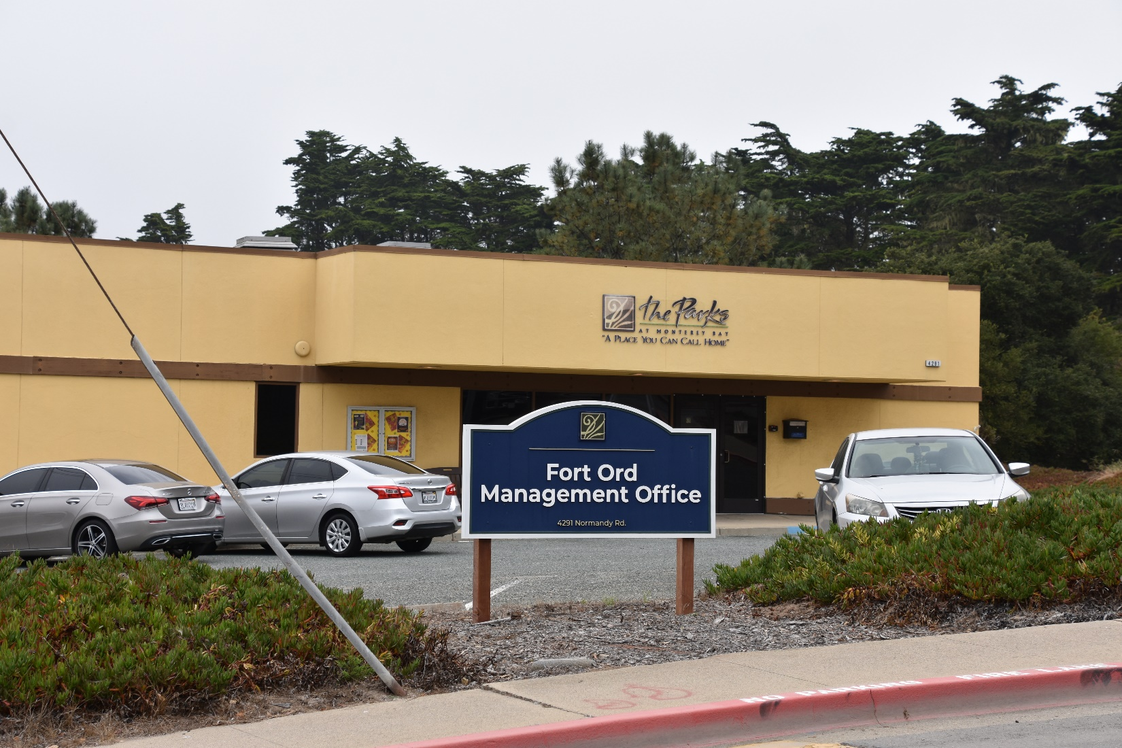
TPMB Civilian / DOD / Veterans Leasing Office
4291 Normandy Rd, Seaside CA 93955 (831) 661-6221

Slide 20
DOD Housing Feedback System
Section 3016(b) of the Fiscal Year (FY) 2020 National Defense Authorization Act (Public Law 116-92) added a new section 2894a to title 10 United States Code (10 U.S.C.) that requires the Department of Defense (DoD) establish a publicly available database that permits privatized housing tenants to file a complaint regarding their housing unit.
To satisfy this requirement, the Department developed the DoD Housing Feedback System (DHFS) to enable Military Housing Privatization Initiative (MHPI) tenants to submit complaints, compliments and/or “feedback.”
Publicly accessible information in the DHFS regarding tenant feedback includes the name of the installation where the housing unit is located, the name of the privatized housing landlord responsible for the unit, and a description of the feedback nature.
The DHFS can be accessed at https://www.dhfs.mil

