Slide 1
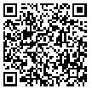
LRC POM - Belas Dining Facility
USE A QR CODE READER ON YOUR SMART PHONE
for instant access to ICE service providers

Slide 2
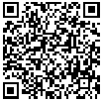
LRC POM - Chay Dining Facility
USE A QR CODE READER ON YOUR SMART PHONE
for instant access to ICE service providers

Slide 3
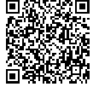
LRC POM - On Post Shuttle Bus Service
USE A QR CODE READER ON YOUR SMART PHONE
for instant access to ICE service providers

