Slide 1
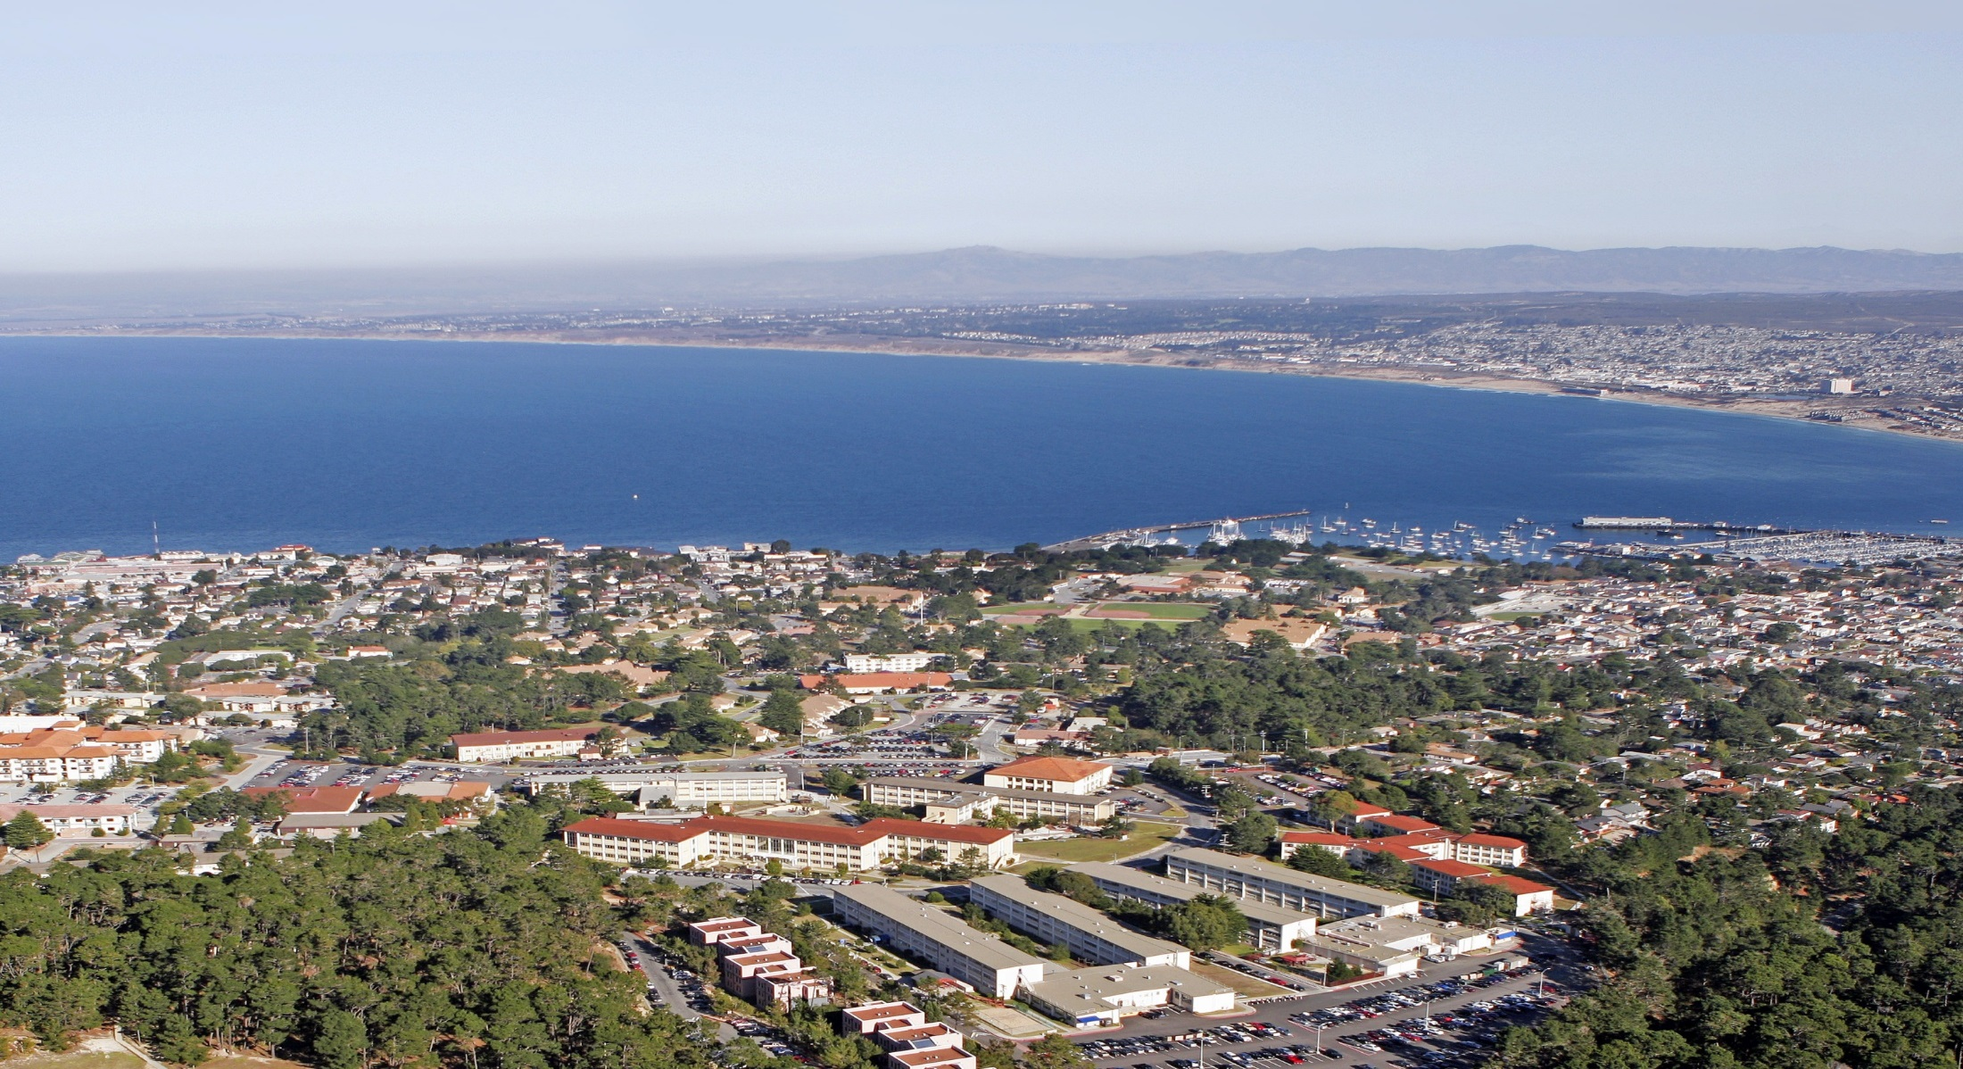
Welcome To The Presidio Of Monterey (POM)
Joint Services In-Processing Briefing (JSIB)

Slide 2


BARRACKS (Local Addresses)
ARMY
431 Rifle Range Rd,
Monterey, CA 93944
Duty phone (831)242-5224 / 5456
AIR FORCE
443 Chaplain Magsig Ave,
Monterey, CA 93944
Duty Phone (831) 242-5115
MARINES
431 Rifle Range Rd,
Monterey, CA 93944
Duty Phone (831)242-6855
NAVY
485 Caffrey Ct,
Monterey, CA 93944
Duty Phone (831)242-5142/(831)-760-0336

Slide 3


Instructions for all
Regardless of vaccination status all personnel are mandated to wear a mask when indoors
Please complete and fill out forms provided inside the folder. (Army Personnel) complete info sheet & provide copy of orders
Silence/turn off cell phones
Emergency Procedures
Restrooms/water fountains (back of the building, left side)

Slide 4

U.S. ARMY GARRISON, PRESIDIO OF MONTEREY
TIME | MINUTES | DIRECTORATE / ORGANIZATION | POC
 |  | JSIB MORNING AGENDA
0630 | 0:30 | All Branches Sign-In Introduction | Mr. Johnson x7211
0700 | 0:15 | Medical/TRICARE | Ms. Drakeford x6734
0715 | 0:15 | Dental | SPC Martinez x5612
0730 | 0:20 | Army Community Service (ACS) Exceptional Family Member Program (EFMP) | Mr. Lyons x6890/7196
0750 | 0:05 | Army Substance Abuse Program (ASAP) | Ms. Levy x6960
0755 | 0:05 | R2 Performance Center | Mr. Phillips x2321
0800 | 0:15 | SHARP | SFC Bosold x3446
0815 | 0:15 | Legal Assistance | Mr. Strickland x5084
0830 | 0:05 | Public Affairs (Digital Garrison) | Mr. Rappahahn x5555
0835 | 0:15 | Housing Service Office | Ms. West/Ms. Sutton x7979/x5702
0850 | 0:10 | BREAK
0900 | 0:15 | Inspector General (IG) | LTC Lemieux/Mr. Johnson x5205/x6510
0915 | 0:15 | School Liaison/Family Morale, Welfare & Recreation (FMWR) | Ms. Vrolyks/Mr. Tena x6904/x0895
0930 | 0:15 | Chaplain | SGT Gallegos x5281/7004
0945 | 0:10 | OPSEC | Mr. Tarver x7119/5114
0955 | 0:15 | POM Police Department/POM Security | POM Police x7851
1010 | 0:10 | Equal Opportunity | SFC Almeida X 4431
1020 | 0:10 | Medical Wellness | Mr. Larson x3538
1030 | 0:15 | Safety | Mr. Hilton x6353
~1045 |  | END OF BRIEFING
POC IS THE DIRECTORATE OF HUMAN RESOURCES (DHR) – 242-4074 |  |  | As Of 28 October 2021

Slide 5
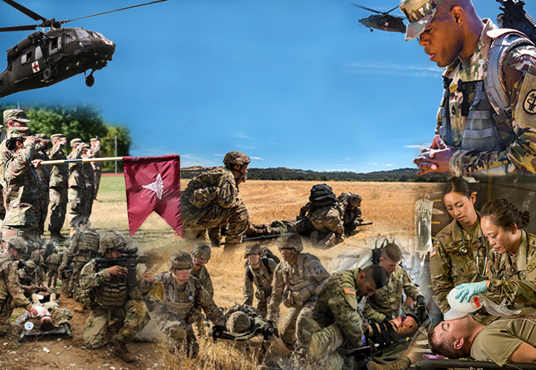
California Medical Detachment (CAL MED)
Presidio of Monterey Army Health Clinic (POM AHC)
MG William H. Gourley VA-DoD Health Clinic
Lexus N. Drakeford
Chief, Managed Care
Lexus.N.Drakeford.civ@mail.mil

Slide 6
Access to Care Easy As 1, 2, 3
Access to Care
1. UPDATE: DEERS
https://www.tricare.mil/deers
2. ENROLL: TRICARE West 1-844-866-9378
https://www.tricare-west.com or
https://milconnect.dmdc.osd.mil/milconnect
3. ACCESS: MHS GENESIS Patient Portal
https://patientportal.mhsgenesis.health.mil
1-866-957-2256

Slide 7
Clinic Locations
Active Duty Service Members
Presidio of Monterey U.S. Army Health Clinic
473 Cabrillo Street, Bldg. 422
Monterey, CA 93944
https://calmed.tricare.mil
1-866-957-2256
0700-1600 Primary Care and Behavioral Health
0700-0730 Sick Call
Family and Pediatrics
MG William H. Gourley VA-DoD Health Clinic
201 9th St
Marina, CA 93933
https://calmed.tricare.mil
1-866-957-2256
0730-1630

Slide 8
Access to Care After Hours
Access to Care After Hours
Nurse Advice Line (800)TRI-CARE (800-874-2273)
TRICARE benefits, enrollment, referrals, covered services, FAQs www.tricare-west.com
1-844-866-9378

Slide 9
PHAs
Part I: Complete online with respective service
Part II: Virtually Integrated Patient Readiness & Remote (VIPRR) Care Clinic
1-844-VMEDCEN
1-844-863-3236
*Make sure UIC is updated in DEERS to utilize VIPRR*

Slide 10
DENTAL CLINIC
LOCATION AND HOURS
Location: Bldg. 423 Corporal Evans Rd. (831) 242-5612/5613
Hours of Operation: 0700-1600 Mon-Fri (open most training holidays)
Sick Call hours: 0700-0830 Mon-Fri
After hours: Dental emergencies call Staff Duty at (831) 242-6912
For Dependents: Visit United Concordia at www.uccitdp.com to find a dentist
******You must check in at the dental clinic following this brief to verify Dental Readiness Classification and make necessary appointments ******

Slide 11
ARMY COMMUNITY SERVICE
FRONT DESK / INFORMATION AND REFERRAL
831 - 242 - 7660
2218 GIGLING RD, BLDG 4260
SEASIDE CA 93955
Military Family Life Counselors (MFLC):
415 - 889 - 0397 or 831 - 236 - 8958
Personal Financial Counselor: 831 - 887 - 8299
Directory Information / Base Operator: 831 - 242 - 5000

Slide 12

ARMY COMMUNITY SERVICE
“Real-Life Solutions for Successful Army Living”
Family Advocacy
Strengthening Families to Prevent Abuse
Victim Advocacy
Parenting and Relationship Classes
Army Emergency Relief
Interest-free loans
Grants
Dependent Children Scholarships
Spouse Education Assistance
www.armyemergencyrelief.org
Financial Readiness Classes
Money Management
Debt Management
Planning & Budgeting
Using Credit Wisely
Saving and Investing
Thrift Savings Plan (TSP)
Consumer Scams
ACS EFMP
Community Support and Advocacy
Housing , Schools Advocacy
Mandatory Enrolments Mandatory Medical Screenings & Disenrollment
3 Year Enrollment
Survivor Outreach Services
Access to Federal & State Benefits and Entitlements
Grief & Bereavement Counseling
Latest Congressional Updates
Local/National Nonprofit Support
Army Volunteer Program
Spouse Employment Referrals
Spouse Resume Writing
Employment Navigation Assistance
Relocation Readiness
JSIB Orientation
Out-Processing Plan My Move
Lending Closet
Sponsorship Program
Information & Referral
Military and Civilian Community Resources
Referrals: Soldiers, Civilians & Family Members
Welcome Packets
www.militaryonesource.mil
New Parent Support
Education and Support
Home Visits
Child Friendly Events
Resources and Consults for Parenting Assistance

Slide 13
ARMY COMMUNITY SERVICE
FRONT DESK / INFORMATION AND REFERRAL
831 - 242 - 7660
2218 GIGLING RD, BLDG 4260
SEASIDE CA 93955
Military Family Life Counselors (MFLC):
415 - 889 - 0397 or 831 - 236 - 8958
Personal Financial Counselor: 831 - 887 - 8299
Directory Information / Base Operator: 831 - 242 - 5000

Slide 14
R2 Performance center
DLIFLC support team
Monterey, CA
shane phillips - on-site performance expert – Dliflc
Sophia White – On-site Performance expert - DLIFLC
Aaron davis - site manager – R2 Performance Center - camp parks
SFC Alyssa Klozer – R2 program manager – camp parks

Slide 15
R2 Mission
BLUF: There is no cost for Ready and Resilient (R2) support. Resilience and enhanced mental performance skills when taught, applied and practiced can positively impact soldier and family readiness.
R2 Mission: The Army provides R2 capabilities to commanders, leaders, soldiers and families to enable them to achieve and sustain personal readiness and optimize human performance when in environments circumstances where there is uncertainty, stress and or persistent danger.

Slide 16

R2 Performance Center – WAYS to engage
Defense Language Institute

Slide 17
R2 Performance center
DLIFLC - Monterey team
Mr. Shane Phillips
E-mail: phillipss@magellanfederal.com
Miss. Sophia White
E-mail: whites@magellanfederal.com

Slide 18
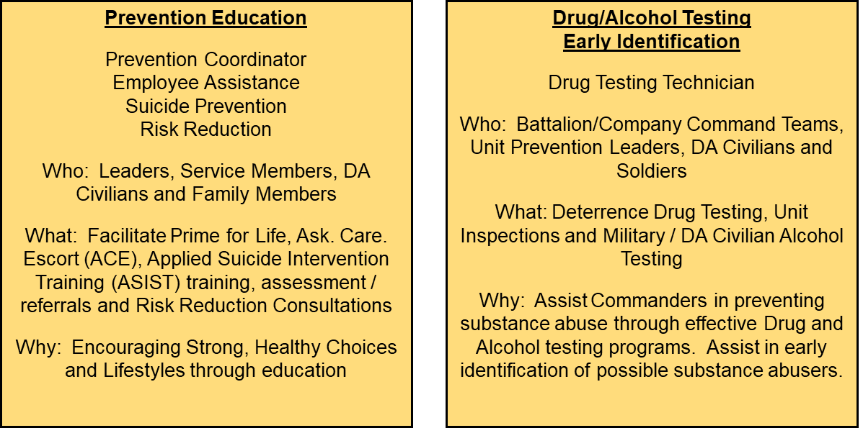
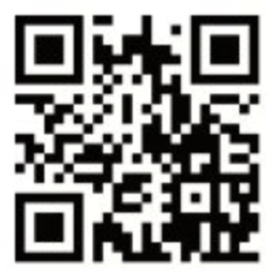

Army Substance Abuse Program
Army Substance Abuse Program Manager
Mrs. Kyrashia “Kai” Levy
(831) 242-6960
(831) 887-8925
Email: kyrashia.l.levy.civ.mil@mail.mil
Pillars of Service
Prevention Education
ASAP Specialist (PC/EAP)
Mr. Thomas Russell
(831) 242-6810
Email: thomas.l.russell.civ@mail.mil
ASAP Specialist (SPPM/RRC)
Mr. Josémanuel “José” Bernal
(831) 242-6805
Email: josemanuel.m.bernal.civ@mail.mil
Deterrence
Drug Testing Technician
Mr. Francis “Toni” Cortez
(831) 242-6588
Email: francis.a.cortez.civ@mail.mil
For Additional Information and Resources Scan QR Code or download the Digital Garrison application available on iTunes or Google Play
Notes:
Digital Garrison: Explore all the benefits the Presidio of Monterey has to offer; such as restaurants, events, shops, clinics, activity centers, and directorates. Navigate to on-post facilities, stay updated on local weather, and be informed about gate closures or other important installation information in real time, all from the palm of your hand.

Slide 19
Army Substance Abuse Program
Army Substance Abuse Program Manager
Mrs. Kyrashia “Kai” Levy
(831) 242-6960
Email: kyrashia.l.levy.civ.mil@mail.mil
Pillars of Service
Prevention Education
ASAP Specialist (PC/EAP)
Vacant
(831) 242-6810
ASAP Specialist (SPPM/RRC)
Vacant
(831) 242-6805
HBA Employee Assistance Program
1-800-937-7770
Deterrence
Drug Testing Technician
Mr. Francis “Toni” Cortez
(831) 242-6588
Email: francis.a.cortez.civ@mail.mil
For Additional Information and Resources Scan QR Code or download the Digital Garrison application available on iTunes or Google Play
Notes:
Digital Garrison: Explore all the benefits the Presidio of Monterey has to offer; such as restaurants, events, shops, clinics, activity centers, and directorates. Navigate to on-post facilities, stay updated on local weather, and be informed about gate closures or other important installation information in real time, all from the palm of your hand.

Slide 20

SHARP/SAPR
Army: SFC Bosold (Installation Lead SARC, 831-242-3446/831-392-5728) & Ms. Bassanello (Installation Victim Advocate, 831-242-5819/831-620-9542)
Air Force: Ms. Stone (Victim Advocate, 831-242-6623/831-277-0153)
Navy: Ms. Schoen (SARC, 831-656-3175)
Marine Corps: SSgt Smart (Victim Advocate, 831-242-5873)
Sexual Harassment complaints: Anonymous, Informal, & Formal
For Soldiers, make complaints through SFC Bosold. For other Services, make complaints through your EO channels.
Sexual Assault reports: Restricted & Unrestricted
The mention of a sexual assault to a noncommissioned officer, petty officer, warrant officer or commissioned officer can limit the option of a restricted report. All NCOs, Petty Officers, and Officers must immediately report any mention of a sexual assault to command.
24/7 hotlines:
Army & Marine Corps: (831) 915-2351
Air Force: (831) 261-2895
Navy: (831) 760-0020
DOD Safe Helpline: (877) 995-5247

Slide 21

Office of the Staff Judge Advocate
Legal Assistance Division
Hours of operation: 0730-1630 M-F
Location: BLDG 358, Facebook, and POM website
Phone for appointment: (831) 242-5084
Services are free to all active duty, family members, and retirees
Services Available: Family Law: separation agreements, divorce, child support, and paternity cases; Estate Planning: wills, testamentary trusts, and Advance Medical Directives; Real & Personal Property: mortgages, security agreements, warranties, cancellations, and consumer affairs; Landlord Disputes: tenant and property contracts; Financial/Economic: debtor agreements/disputes, bankruptcy, garnishment, allotment, debt, credit card, insurance, non-governmental claims; Civilian Administrative: notarizations, immigration, naturalization, and identity theft; Personal Injury/Torts: counseling on prosecution or defense of civil lawsuits; Taxes: filing of federal and state income taxes; Civilian Criminal Matters: general advice; Military Matters: SCRA and security clearance issues; Trial Defense Services: will connect you with attorneys who will assist and defend you against military charges.
What we cannot do: IAW AR 27-3: We cannot provide services or consultation regarding private business ventures; No in court representation; No consultation regarding the Uniform Code of Military Justice.

Slide 22
Digital Garrison App
U.S. ARMY GARRISON, PRESIDIO OF MONTEREY
Public Affairs Office

Slide 23





The Presidio of Monterey Military Housing Office
Ord Military Community BLDG 4250 General Jim Moore Blvd.
usarmy.pom.106-sig-bde.mbx.pres-dpw-housing@mail.mil
Housing Services Office (HSO) (831) 242-7979
Residential Communities Initiative (RCI) (831) 242-7984
Unaccompanied Personnel Housing (UPH) (831) 242-7973
The Parks at Monterey (831) 644-0400

Slide 24
BREAK
U.S. ARMY GARRISON, PRESIDIO OF MONTEREY
10 MINUTES

Slide 25


Inspector General (IG)
Defense Language Institute
Foreign Language Center
& Presidio of Monterey, California

Slide 26

Directorate of Family and Morale, Welfare & Recreation
  Business & Recreation
  Price Fitness Center Intramural Sports
  Hobson Recreation Center BOSS
  Outdoor Recreation Java Cafes
  Stilwell Ballroom Navy Ticketing Office
  POC Hugo Tena 831 242-0895 hugo.ambriztena.naf@army.mil
  Child & Youth Services
  Monterey Road Child Dev Center School Age Services
  Middle School & Teen Program Youth Sports
  School Liaison Office Parent Central Services 831 242-7765
  Family Child Care Militarychildcare.com
  POC Elaine Vrolyks 831 242-6904 elaine.l.vrolyks.naf@army.mil
  https://presidio.armymwr.com/

Slide 27


ARMY
Army Chaplain
229th Military Intelligence Battalion
(Alpha, Bravo, Golf, HHC Company)
Phone: 831-293-4955
(Charlie, Delta, Echo, Foxtrot, HHC Company)
Phone : 831-238-5840
NAVY/MARINES
Navy and Marine Chaplain
IWTC/MCD
Phone : 831-293-4735
AIR FORCE
Air Force Chaplain:
517th Training Group’s 311th and 314th Training Squadrons
Phone : 831-747-5875
Emergency Chaplain Hotline 831-887-8551
Installation Services
Muslim Prayer Service Church of Jesus Christ Latter Day Saints
1200 Friday @ BLDG 324 Chapel Annex 0830 Sunday @ BLDG 324 Chapel Annex
Protestant Service Catholic Service
0945 Sunday @ BLD 326 POM Chapel 1130 Sunday @ BLDG 326 Chapel
Heart Chan Meditation 1000 Saturday @ BLDG 324 Chapel Annex

Slide 28

OPSEC

Slide 29
How we give it away!
5 Step OPSEC Process. - Identify Critical Information - Analyze Threats - Analyze Vulnerabilities – Asses Risks – Apply Countermeasures
PII loss. PII is often found in the trash/recycle bin, on social media sites. Where do you have your DOB posted? Your mother’s maiden name? (password reset answers). When emailing, use encryption. Family Information
Computer Use. Using personal Emails/Web Links, or personal mobile devices for Official Business, particularly when it comes to CIL or FOUO/CUI.
Badges/CACs in public. Badges can be cloned. Hide or remove them when you leave the secure area. The parking lot is not a secure area.
Trash INT. Take a look in the trash cans and recycle bins in your areas. Many FOUO, PII, and CIL information can be found there. Adversaries know this.
Military information. Deployment dates- Special Missions - Unit Readiness - TTP’s – Vulnerabilities
Unauthorized cell phones in Secret briefings/VTCs.
Social Media. Web Postings are subject to surveillance and personnel can be held to administrative action for their unauthorized postings.
Threats. Insiders – Foreign Governments – Terrorists – Criminals
UNCLASSIFIED

Slide 30




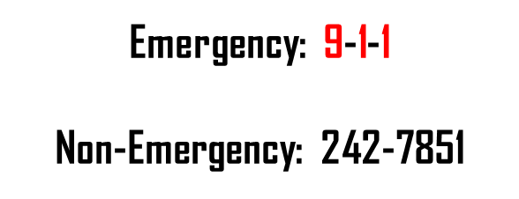
PRESIDIO OF MONTEREY POLICE DEPARTMENT
Force Protection & Security
License & Registration Requirements
Crosswalks / Buses / Cellphones
Motor Vehicle Accident Reporting
Traffic Enforcement
Alcohol Related Offenses
Crime Prevention
Firearms

Slide 31
ALCOHOL-RELATED OFFENSES
Drunk in Public
  CPC 647(f): Public Intoxication; Being under the influence of alcohol or a controlled substance in a public place and, (1) are unable to exercise care for your own safety or the safety of others, or (2) interfere with, obstruct, or prevent others from using streets, sidewalks, or other “public ways”.
  Penalty: Misdemeanor; Up to 6 months in jail and/or a fine of up to $1000.
Drunk on Duty
Article 112, UCMJ: (1) That the service member was on a certain duty; and (2) That the service member was found drunk while on this duty, including duties of an anticipatory nature (i.e., standby, on-call)
Penalty: As a court-martial may direct.

Slide 32
ALCOHOL-RELATED OFFENSES
Underage Drinking & Driving
CVC 23136*: Under the age of 21 driving with a B.A.C. of 0.01% or greater
Penalty: Infraction; One (1) year suspension of your driver’s license
* - California Zero Tolerance Law
CVC 23140: Under the age of 21 driving with a B.A.C. of 0.05% or greater
Penalty: Infraction; One (1) year suspension of your driver’s license; $100 fine; Mandatory Alcohol Education Program.
CVC 23224: Possession of alcohol in a vehicle by persons under 21
Penalty: Misdemeanor; One (1) year suspension of your driver’s license; $1000 fine; Up to 6 months in jail; Vehicle impoundment for up to 30 days.

Slide 33
FIREARMS
All service members living on the Presidio of Monterey, OMC, and La Mesa Village MUST register their firearms with the Presidio of Monterey Police Department within 14-days of arrival.
POM Form 4-562-1 (Request for Firearms Registration) can be found at the POM Police Department or online.
    One (1) weapon per form - Completed in “triplicate”
DO NOT bring your weapons inside the police station prior to getting your Unit Commander’s verification and signature.
Firearms registration does not give the service member the right to carry a concealed weapon, or act as a hunting permit.
For federal firearms statutes and CA firearms laws, go to: http://ag.ca.gov/firearms/

Slide 34
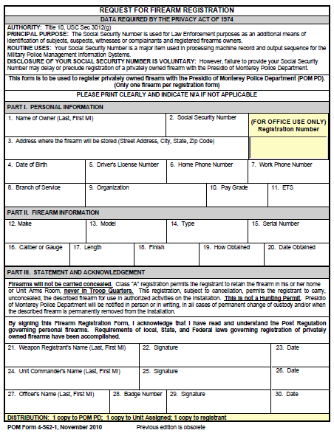
FIREARMS
Firearms Registration Process:
Receive POM Form 4-562-1 from the
Police Station or online at –
www.monterey.army.mil
Complete the form and have your Unit
Commander verify and sign the form.
  Verifying Make, Model, Caliber & Serial
  Verifying where the weapon(s) will be stored
  (i.e., 275 Okinawa Road, Seaside - OMC)
Bring your legal weapon(s) to the Police
Station on OMC with the completed form(s).
Upon clearing your weapon(s) through NCIC, police will sign the form and give you a copy for your records.

Slide 35
PRESIDIO OF MONTEREY POLICE DEPARTMENT
Force Protection & Security
License & Registration Requirements
Crosswalks / Buses / Cellphones
Motor Vehicle Accident Reporting
Traffic Enforcement
Alcohol Related Offenses
Crime Prevention
Firearms

Slide 36


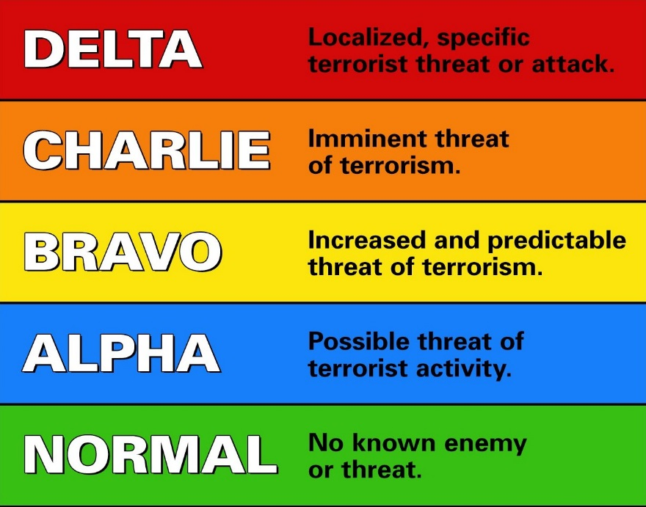
Presidio of Monterey Security
Access Gates
  Bolio - 24/7
  Taylor – Monday to Friday 0600 - 1300 / 1600 to 1800 outbound only
  Franklin – Monday to Friday 0600 - 1300 / 1600 to 1800 outbound only
  Highstreet – Closed
Access Procedures
  Service Members – CAC
  Family Members – Dependent ID Card
  Visitors (family/friend) – Pass (complete a Form POM-7)
Bolio Visitor’s Control Center
  Visitor’s Passes / General Information
  Hours: Mon – Fri, 0400 to 2000
Turnstiles
  24/7 Access
  Franklin, Taylor, and Highstreet Gates
  CAC or Dependent ID
Force Protection Condition
(FPCON-B)

Slide 37
EQUAL OPPORTUNITY BRIEF
EO POLICY
COMPLAINT PROCESSING SYSTEM
INFORMAL AND FORMAL COMPLAINT
ALTERNATE AGENCIES
EOA CONTACT INFO
Installation Equal Opportunity Advisor
SFC Marlo Almeida
COMM: 831-242-4431
Email: marlo.s.almeida.mil@mail.mil/marlo.almeida@dliflc.edu
Defense Language Institute Foreign Language Center Bldg 634 Rm 8

Slide 38
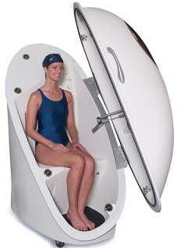

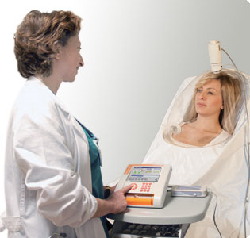
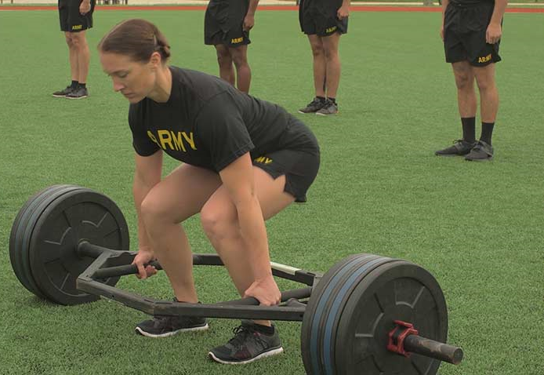
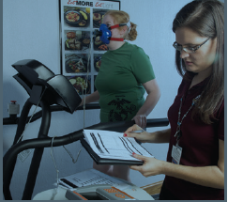
Improve Your Quality of Life
HEALTH
READINESS
RESILIENCE
Testing
Body Composition Testing (Bod Pod)
Metabolic Testing
Fitness Testing (Sub Max Vo2)
Exercise RX
Classes/Instruction
Performance
ACFT Movements
Healthy Sleep Habits
Energy, Metabolism and Weight Loss
Building 267
831-242-3538
usarmy.pom.medcom-pomahc.mbx.wellness@mail.mil

Slide 39

SAFETY
DLIFLC Safety Office
    Jerome H Hilton, Safety Director 242-6353
    jerome.h.hilton.civ@mail.mil
    jerome.hilton@dliflc.edu
Garrison Safety Office
    Joseph Alfonso, SOH Manager 242-6332
joseph.alfonso.civ@mail.mil
    Gregory J. Sanches, SOH Specialist 242-6507
gregory.j.sanches.civ@mail.mil
    Ramon Velasquez, SOH Specialist 242-5884
    ramon.l.velasquez.civ@mail.mil
  PMSA
  Bldg Maintenance Service Request Desk 242-5526

Slide 40
End of Briefing
Thank you for Attending the JSIB
Best of Luck to All of You!
U.S. ARMY GARRISON, PRESIDIO OF MONTEREY

Slide 41
AFTERNOON SESSION
U.S. ARMY GARRISON, PRESIDIO OF MONTEREY

Slide 42
Welcome To The Presidio Of Monterey (POM)
Joint Services In-Processing Briefing (JSIB)

Slide 43
BARRACKS (Local Addresses)
ARMY
431 Rifle Range Rd,
Monterey, CA 93944
Duty phone (831)242-5224 / 5456
AIR FORCE
443 Chaplain Magsig Ave,
Monterey, CA 93944
Duty Phone (831) 242-5115
MARINES
431 Rifle Range Rd,
Monterey, CA 93944
Duty Phone (831)242-6855
NAVY
485 Caffrey Ct,
Monterey, CA 93944
Duty Phone (831)242-5142/(831)-760-0336

Slide 44
Instructions for all
Regardless of vaccination status all personnel are mandated to wear a mask when indoors
Please complete and fill out forms provided inside the folder. (Army Personnel) complete info sheet & provide copy of orders
Silence/turn off cell phones
Emergency Procedures
Restrooms/water fountains (back of the building, left side)

Slide 45
AGENDA
U.S. ARMY GARRISON, PRESIDIO OF MONTEREY
TIME | MINUTES | DIRECTORATE / ORGANIZATION | POC
 |  | JSIB AFTERNOON AGENDA
1200 | 0:30 | All Branches Sign-In Introduction | Mr. Johnson x7211
1230 | 0:15 | SHARP | SFC Bosold x3446
1245 | 0:15 | Medical/TRICARE | Ms. Drakeford x6734
1300 | 0:05 | Public Affairs (Digital Garrison) | Mr. Rappahahn x5555
1305 | 0:10 | Dental | SPC Martinez x5612
1315 | 0:20 | Army Community Service (ACS) Exceptional Family Member Program (EFMP) | Mr. Lyons x6890/x7196
1335 | 0:05 | R2 Performance Center | Mr. Phillips x2321
1340 | 0:05 | Army Substance Abuse Program (ASAP) | Ms. Levy x6960
1345 | 0:15 | POM Police Department/POM Security | POM Police x7851
1400 | 0:10 | BREAK
1410 | 0:15 | Legal Assistance | Mr. Strickland x5084
1425 | 0:15 | Inspector General (IG) | LTC Lemieux/Mr. Johnson x5205/x6510
1440 | 0:15 | School Liaison/Family, Morale, Welfare & Recreation (FMWR) | Ms. Vrolyks/Mr. Tena x6904/x0895
1455 | 0:15 | Chaplain | SGT Gallegos x5281/7004
1510 | 0:10 | Equal Opportunity | SFC Almeida X 4431
1520 | 0:10 | Medical Wellness | Mr. Larson x3538
1530 | 0:10 | OPSEC | Mr. Tarver x7119/5114
1540 | 0:15 | Housing Service Office | Ms. West/Ms. Sutton x7979/x5702
1555 | 0:15 | Safety | Mr. Hilton x6353
~1610 |  | END OF BRIEFING
POC IS THE DIRECTORATE OF HUMAN RESOURCES (DHR) – 242-4074 |  |  | As Of 28 OCTOBER 2021

Slide 46
SHARP/SAPR
Army: SFC Bosold (Installation Lead SARC, 831-242-3446/831-392-5728) & Ms. Bassanello (Installation Victim Advocate, 831-242-5819/831-620-9542)
Air Force: Ms. Stone (Victim Advocate, 831-242-6623/831-277-0153)
Navy: Ms. Schoen (SARC, 831-656-3175)
Marine Corps: SSgt Smart (Victim Advocate, 831-242-5873)
Sexual Harassment complaints: Anonymous, Informal, & Formal
For Soldiers, make complaints through SFC Bosold. For other Services, make complaints through your EO channels.
Sexual Assault reports: Restricted & Unrestricted
The mention of a sexual assault to a noncommissioned officer, petty officer, warrant officer or commissioned officer can limit the option of a restricted report. All NCOs, Petty Officers, and Officers must immediately report any mention of a sexual assault to command.
24/7 hotlines:
Army & Marine Corps: (831) 915-2351
Air Force: (831) 261-2895
Navy: (831) 760-0020
DOD Safe Helpline: (877) 995-5247

Slide 47
California Medical Detachment (CAL MED)
Presidio of Monterey Army Health Clinic (POM AHC)
MG William H. Gourley VA-DoD Health Clinic
Lexus N. Drakeford
Chief, Managed Care
Lexus.N.Drakeford.civ@mail.mil

Slide 48
Access to Care Easy As 1, 2, 3
Access to Care
1. UPDATE: DEERS
https://www.tricare.mil/deers
2. ENROLL: TRICARE West 1-844-866-9378
https://www.tricare-west.com or
https://milconnect.dmdc.osd.mil/milconnect
3. ACCESS: MHS GENESIS Patient Portal
https://patientportal.mhsgenesis.health.mil
1-866-957-2256

Slide 49
Clinic Locations
Active Duty Service Members
Presidio of Monterey U.S. Army Health Clinic
473 Cabrillo Street, Bldg. 422
Monterey, CA 93944
https://calmed.tricare.mil
1-866-957-2256
0700-1600 Primary Care and Behavioral Health
0700-0730 Sick Call
Family and Pediatrics
MG William H. Gourley VA-DoD Health Clinic
201 9th St
Marina, CA 93933
https://calmed.tricare.mil
1-866-957-2256
0730-1630

Slide 50
Access to Care After Hours
Access to Care After Hours
Nurse Advice Line (800)TRI-CARE (800-874-2273)
TRICARE benefits, enrollment, referrals, covered services, FAQs www.tricare-west.com
1-844-866-9378

Slide 51
PHAs
Part I: Complete online with respective service
Part II: Virtually Integrated Patient Readiness & Remote (VIPRR) Care Clinic
1-844-VMEDCEN
1-844-863-3236
*Make sure UIC is updated in DEERS to utilize VIPRR*

Slide 52
Digital Garrison App
U.S. ARMY GARRISON, PRESIDIO OF MONTEREY
Public Affairs Office

Slide 53
DENTAL CLINIC
LOCATION AND HOURS
Location: Bldg. 423 Corporal Evans Rd. (831) 242-5612/5613
Hours of Operation: 0700-1600 Mon-Fri (open most training holidays)
Sick Call hours: 0700-0830 Mon-Fri
After hours: Dental emergencies call Staff Duty at (831) 242-6912
For Dependents: Visit United Concordia at www.uccitdp.com to find a dentist
******You must check in at the dental clinic following this brief to verify Dental Readiness Classification and make necessary appointments ******

Slide 54
ARMY COMMUNITY SERVICE
FRONT DESK / INFORMATION AND REFERRAL
831 - 242 - 7660
2218 GIGLING RD, BLDG 4260
SEASIDE CA 93955
Military Family Life Counselors (MFLC):
415 - 889 - 0397 or 831 - 236 - 8958
Personal Financial Counselor: 831 - 887 - 8299
Directory Information / Base Operator: 831 - 242 - 5000

Slide 55
ARMY COMMUNITY SERVICE
“Real-Life Solutions for Successful Army Living”
Family Advocacy
Strengthening Families to Prevent Abuse
Victim Advocacy
Parenting and Relationship Classes
Army Emergency Relief
Interest-free loans
Grants
Dependent Children Scholarships
Spouse Education Assistance
www.armyemergencyrelief.org
Financial Readiness Classes
Money Management
Debt Management
Planning & Budgeting
Using Credit Wisely
Saving and Investing
Thrift Savings Plan (TSP)
Consumer Scams
ACS EFMP
Community Support and Advocacy
Housing , Schools Advocacy
Mandatory Enrolments Mandatory Medical Screenings & Disenrollment
3 Year Enrollment
Survivor Outreach Services
Access to Federal & State Benefits and Entitlements
Grief & Bereavement Counseling
Latest Congressional Updates
Local/National Nonprofit Support
Army Volunteer Program
Spouse Employment Referrals
Spouse Resume Writing
Employment Navigation Assistance
Relocation Readiness
JSIB Orientation
Out-Processing Plan My Move
Lending Closet
Sponsorship Program
Information & Referral
Military and Civilian Community Resources
Referrals: Soldiers, Civilians & Family Members
Welcome Packets
www.militaryonesource.mil
New Parent Support
Education and Support
Home Visits
Child Friendly Events
Resources and Consults for Parenting Assistance

Slide 56
ARMY COMMUNITY SERVICE
FRONT DESK / INFORMATION AND REFERRAL
831 - 242 - 7660
2218 GIGLING RD, BLDG 4260
SEASIDE CA 93955
Military Family Life Counselors (MFLC):
415 - 889 - 0397 or 831 - 236 - 8958
Personal Financial Counselor: 831 - 887 - 8299
Directory Information / Base Operator: 831 - 242 - 5000

Slide 57
R2 Performance center
DLIFLC support team
Monterey, CA
shane phillips - on-site performance expert – Dliflc
Sophia White – On-site Performance expert - DLIFLC
Aaron davis - site manager – R2 Performance Center - camp parks
SFC Alyssa Klozer – R2 program manager – camp parks

Slide 58
R2 Mission
BLUF: There is no cost for Ready and Resilient (R2) support. Resilience and enhanced mental performance skills when taught, applied and practiced can positively impact soldier and family readiness.
R2 Mission: The Army provides R2 capabilities to commanders, leaders, soldiers and families to enable them to achieve and sustain personal readiness and optimize human performance when in environments circumstances where there is uncertainty, stress and or persistent danger.

Slide 59
R2 Performance Center – WAYS to engage
Defense Language Institute

Slide 60
R2 Performance center
DLIFLC - Monterey team
Mr. Shane Phillips
E-mail: phillipss@magellanfederal.com
Miss. Sophia White
E-mail: whites@magellanfederal.com

Slide 61
Army Substance Abuse Program
Army Substance Abuse Program Manager
Mrs. Kyrashia “Kai” Levy
(831) 242-6960
(831) 887-8925
Email: kyrashia.l.levy.civ.mil@mail.mil
Pillars of Service
Prevention Education
ASAP Specialist (PC/EAP)
Mr. Thomas Russell
(831) 242-6810
Email: thomas.l.russell.civ@mail.mil
ASAP Specialist (SPPM/RRC)
Mr. Josémanuel “José” Bernal
(831) 242-6805
Email: josemanuel.m.bernal.civ@mail.mil
Deterrence
Drug Testing Technician
Mr. Francis “Toni” Cortez
(831) 242-6588
Email: francis.a.cortez.civ@mail.mil
For Additional Information and Resources Scan QR Code or download the Digital Garrison application available on iTunes or Google Play
Notes:
Digital Garrison: Explore all the benefits the Presidio of Monterey has to offer; such as restaurants, events, shops, clinics, activity centers, and directorates. Navigate to on-post facilities, stay updated on local weather, and be informed about gate closures or other important installation information in real time, all from the palm of your hand.

Slide 62
PRESIDIO OF MONTEREY POLICE DEPARTMENT
Force Protection & Security
License & Registration Requirements
Crosswalks / Buses / Cellphones
Motor Vehicle Accident Reporting
Traffic Enforcement
Alcohol Related Offenses
Crime Prevention
Firearms

Slide 63
ALCOHOL-RELATED OFFENSES
Drunk in Public
  CPC 647(f): Public Intoxication; Being under the influence of alcohol or a controlled substance in a public place and, (1) are unable to exercise care for your own safety or the safety of others, or (2) interfere with, obstruct, or prevent others from using streets, sidewalks, or other “public ways”.
  Penalty: Misdemeanor; Up to 6 months in jail and/or a fine of up to $1000.
Drunk on Duty
Article 112, UCMJ: (1) That the service member was on a certain duty; and (2) That the service member was found drunk while on this duty, including duties of an anticipatory nature (i.e., standby, on-call)
Penalty: As a court-martial may direct.

Slide 64
ALCOHOL-RELATED OFFENSES
Underage Drinking & Driving
CVC 23136*: Under the age of 21 driving with a B.A.C. of 0.01% or greater
Penalty: Infraction; One (1) year suspension of your driver’s license
* - California Zero Tolerance Law
CVC 23140: Under the age of 21 driving with a B.A.C. of 0.05% or greater
Penalty: Infraction; One (1) year suspension of your driver’s license; $100 fine; Mandatory Alcohol Education Program.
CVC 23224: Possession of alcohol in a vehicle by persons under 21
Penalty: Misdemeanor; One (1) year suspension of your driver’s license; $1000 fine; Up to 6 months in jail; Vehicle impoundment for up to 30 days.

Slide 65
FIREARMS
All service members living on the Presidio of Monterey, OMC, and La Mesa Village MUST register their firearms with the Presidio of Monterey Police Department within 14-days of arrival.
POM Form 4-562-1 (Request for Firearms Registration) can be found at the POM Police Department or online.
    One (1) weapon per form - Completed in “triplicate”
DO NOT bring your weapons inside the police station prior to getting your Unit Commander’s verification and signature.
Firearms registration does not give the service member the right to carry a concealed weapon, or act as a hunting permit.
For federal firearms statutes and CA firearms laws, go to: http://ag.ca.gov/firearms/

Slide 66
FIREARMS
Firearms Registration Process:
Receive POM Form 4-562-1 from the
Police Station or online at –
www.monterey.army.mil
Complete the form and have your Unit
Commander verify and sign the form.
  Verifying Make, Model, Caliber & Serial
  Verifying where the weapon(s) will be stored
  (i.e., 275 Okinawa Road, Seaside - OMC)
Bring your legal weapon(s) to the Police
Station on OMC with the completed form(s).
Upon clearing your weapon(s) through NCIC, police will sign the form and give you a copy for your records.

Slide 67
Presidio of Monterey Security
Access Gates
  Bolio - 24/7
  Taylor – Monday to Friday 0600 - 1300 / 1600 to 1800 outbound only
  Franklin – Monday to Friday 0600 - 1300 / 1600 to 1800 outbound only
  Highstreet – Closed
Access Procedures
  Service Members – CAC
  Family Members – Dependent ID Card
  Visitors (family/friend) – Pass (complete a Form POM-7)
Bolio Visitor’s Control Center
  Visitor’s Passes / General Information
  Hours: Mon – Fri, 0400 to 2000
Turnstiles
  24/7 Access
  Franklin, Taylor, and Highstreet Gates
  CAC or Dependent ID
Force Protection Condition
(FPCON-B)

Slide 68
BREAK
U.S. ARMY GARRISON, PRESIDIO OF MONTEREY
10 MINUTES

Slide 69
Office of the Staff Judge Advocate
Legal Assistance Division
Hours of operation: 0730-1630 M-F
Location: BLDG 358, Facebook, and POM website
Phone for appointment: (831) 242-5084
Services are free to all active duty, family members, and retirees
Services Available: Family Law: separation agreements, divorce, child support, and paternity cases; Estate Planning: wills, testamentary trusts, and Advance Medical Directives; Real & Personal Property: mortgages, security agreements, warranties, cancellations, and consumer affairs; Landlord Disputes: tenant and property contracts; Financial/Economic: debtor agreements/disputes, bankruptcy, garnishment, allotment, debt, credit card, insurance, non-governmental claims; Civilian Administrative: notarizations, immigration, naturalization, and identity theft; Personal Injury/Torts: counseling on prosecution or defense of civil lawsuits; Taxes: filing of federal and state income taxes; Civilian Criminal Matters: general advice; Military Matters: SCRA and security clearance issues; Trial Defense Services: will connect you with attorneys who will assist and defend you against military charges.
What we cannot do: IAW AR 27-3: We cannot provide services or consultation regarding private business ventures; No in court representation; No consultation regarding the Uniform Code of Military Justice.

Slide 70
Inspector General (IG)
Defense Language Institute
Foreign Language Center
& Presidio of Monterey, California

Slide 71
Directorate of Family and Morale, Welfare & Recreation
  Business & Recreation
  Price Fitness Center Intramural Sports
  Hobson Recreation Center BOSS
  Outdoor Recreation Java Cafes
  Stilwell Ballroom Navy Ticketing Office
  POC Hugo Tena 831 242-0895 hugo.ambriztena.naf@mail.mil
  Child & Youth Services
  Monterey Road Child Dev Center School Age Services
  Middle School & Teen Program Youth Sports
  School Liaison Office Parent Central Services 831 242-7765
  Family Child Care Militarychildcare.com
  POC Elaine Vrolyks 831 242-6904 elaine.l.vrolyks.naf@mail.mil
  https://presidio.armymwr.com/

Slide 72
ARMY
Army Chaplain
229th Military Intelligence Battalion
(Alpha, Bravo, Golf, HHC Company)
Phone: 831-293-4955
(Charlie, Delta, Echo, Foxtrot, HHC Company)
Phone : 831-238-5840
NAVY/MARINES
Navy and Marine Chaplain
IWTC/MCD
Phone : 831-293-4735
AIR FORCE
Air Force Chaplain:
517th Training Group’s 311th and 314th Training Squadrons
Phone : 831-747-5875
Emergency Chaplain Hotline 831-887-8551
Installation Services
Muslim Prayer Service Church of Jesus Christ Latter Day Saints
1200 Friday @ BLDG 324 Chapel Annex 0830 Sunday @ BLDG 324 Chapel Annex
Protestant Service Catholic Service
0945 Sunday @ BLD 326 POM Chapel 1130 Sunday @ BLDG 326 Chapel
Heart Chan Meditation 1000 Saturday @ BLDG 324 Chapel Annex

Slide 73
EQUAL OPPORTUNITY BRIEF
EO POLICY
COMPLAINT PROCESSING SYSTEM
INFORMAL AND FORMAL COMPLAINT
ALTERNATE AGENCIES
EOA CONTACT INFO
Installation Equal Opportunity Advisor
SFC Marlo Almeida
COMM: 831-242-4431
Email: marlo.s.almeida.mil@mail.mil/marlo.almeida@dliflc.edu
Defense Language Institute Foreign Language Center Bldg 634 Rm 8

Slide 74
Improve Your Quality of Life
HEALTH
READINESS
RESILIENCE
Testing
Body Composition Testing (Bod Pod)
Metabolic Testing
Fitness Testing (Sub Max Vo2)
Exercise RX
Classes/Instruction
Performance
ACFT Movements
Healthy Sleep Habits
Energy, Metabolism and Weight Loss
Building 267
831-242-3538
usarmy.pom.medcom-pomahc.mbx.wellness@mail.mil

Slide 75
OPSEC

Slide 76
How we give it away!
5 Step OPSEC Process. - Identify Critical Information - Analyze Threats - Analyze Vulnerabilities – Asses Risks – Apply Countermeasures
PII loss. PII is often found in the trash/recycle bin, on social media sites. Where do you have your DOB posted? Your mother’s maiden name? (password reset answers). When emailing, use encryption. Family Information
Computer Use. Using personal Emails/Web Links, or personal mobile devices for Official Business, particularly when it comes to CIL or FOUO/CUI.
Badges/CACs in public. Badges can be cloned. Hide or remove them when you leave the secure area. The parking lot is not a secure area.
Trash INT. Take a look in the trash cans and recycle bins in your areas. Many FOUO, PII, and CIL information can be found there. Adversaries know this.
Military information. Deployment dates- Special Missions - Unit Readiness - TTP’s – Vulnerabilities
Unauthorized cell phones in Secret briefings/VTCs.
Social Media. Web Postings are subject to surveillance and personnel can be held to administrative action for their unauthorized postings.
Threats. Insiders – Foreign Governments – Terrorists – Criminals
UNCLASSIFIED

Slide 77
The Presidio of Monterey Military Housing Office
Ord Military Community BLDG 4250 General Jim Moore Blvd.
usarmy.pom.106-sig-bde.mbx.pres-dpw-housing@mail.mil
Housing Services Office (HSO) (831) 242-7979
Residential Communities Initiative (RCI) (831) 242-7984
Unaccompanied Personnel Housing (UPH) (831) 242-7973
The Parks at Monterey (831) 644-0400

Slide 78
SAFETY
DLIFLC Safety Office
    Jerome H Hilton, Safety Director 242-6353
    jerome.h.hilton.civ@mail.mil
    jerome.hilton@dliflc.edu
Garrison Safety Office
    Joseph Alfonso, SOH Manager 242-6332
joseph.alfonso.civ@mail.mil
    Gregory J. Sanches, SOH Specialist 242-6507
gregory.j.sanches.civ@mail.mil
    Ramon Velasquez, SOH Specialist 242-5884
    ramon.l.velasquez.civ@mail.mil
  PMSA
  Bldg Maintenance Service Request Desk 242-5526

Slide 79
End of Briefing
Thank you for Attending the JSIB
Best of Luck to All of You!
U.S. ARMY GARRISON, PRESIDIO OF MONTEREY

