Slide 1
Installation Housing Office
Plain Language Briefing
Annex F to OPORD 20-048 – Plain Language Brief
USAG POM
As of 2 September 2021 / 1322

Slide 2
Welcome to the Garrison Housing Office
The Presidio of Monterey, AHO staff are employed by the Army to assist Service Members and their Families with housing matters and advocate on their behalf with community partners/agencies both on and off the installation
The Housing Service Office (HSO) provides referral services and tenant/landlord dispute services
The AHO provides oversight of the privatized company managing on post housing and provides tenant/landlord dispute services
The Army Housing Officer manages the AHO and reports directly to the Director, Public Works and garrison leadership
Garrison Leadership
Garrison Commander: COL Varman Chhoeung
Garrison Command Sergeants Major: CSM Robert N. Londers
Garrison Deputy Garrison Commander/Manager: Mr. Stephen Bickel
Garrison Housing Manager: Mr. Oscar M. Ordonez

Slide 3
Privatized Housing Contacts
Monterey Bay Military Housing (MBMH), sometimes referred to as the Residential Communities Initiative (RCI) Company, is the privatized company that owns and manages the Family housing on this installation
The Michaels Organization is the private partner and managing member of MBMH
The Michaels Organization (TMO) is the property management company that manages the day to day operations of the privatized housing to include ensuring prompt and professional maintenance and repair, property concerns, and rent/billing issues. This is your landlord for privatized housing
TMO Contacts:
Community Director: (831) 644-0400, ext. 350
Facilities Director: (831) 644-0400, ext. 101
La Mesa Community Manager: (831) 644-0400, ext. 341
La Mesa Maintenance Supervisor: (831) 644-0400 ext. 401
OMC Community Manager: (831) 644-0400, ext. 507
OMC Maintenance Supervisor: (831) 644-0400 ext. 103

Slide 4
Privatized Housing - Tenant Bill of Rights
* Copy is available upon request

Slide 5
Privatized Housing - Tenant Bill of Rights
The Army Housing Privatization Initiative Tenant Bill of Rights requires the AHO to provide a plain language brief to all Residents of privatized housing prior to lease signing and again 30 days after move-in on all rights and responsibilities associated with tenancy of the housing unit
  You have the right to reside in a housing unit and a community that meets applicable health and environmental standards. (Right 1)
  You have the right to reside in a housing unit that has working fixtures, appliances, and utilities and to reside in a community with well-maintained common areas and amenity space. (Right 2)
  The right to be provided with a maintenance history of the prospective housing unit before signing a lease, as provided in section 2892a of this title. (Right 3)
  You have the right to a written lease with clearly defined rental terms to establish tenancy in a housing unit, including any addendums and other regulations imposed by the Landlord regarding occupancy of the housing unit and use of common areas. (Right 4)
  The right to a plain-language briefing, before signing a lease and 30 days after move-in, by the installation housing office on all rights and responsibilities associated with tenancy of the housing unit (Right 5)
  You have the right to have sufficient time and opportunity to prepare and be present for move-in and move-out inspections, including an opportunity to obtain and complete necessary paperwork. (Right 6)

Slide 6
Privatized Housing - Tenant Bill of Rights
You have the right to report inadequate housing standards or deficits in habitability of the housing unit to the Landlord, the chain of command, and Installation housing office without fear of reprisal or realization, including (A) unlawful recovery of, or attempt to recover, possession of the housing unit; (B) unlawfully increasing the rent, decreasing services, or increasing the obligations of a tenant; (C) interference with a tenant’s right to privacy; (D) harassment of a tenant; (E) refusal to honor the terms of the lease; (F) interference with the career of the tenant (Right 7)
You have the right to access to a military tenant advocate or a military legal assistance attorney, through the Installation housing office to assist in the preparation of requests to initiate dispute resolution, including the ability to submit a request to withhold payments during the resolution process. (Right 8)
    Tenants are required to attempt to resolve disputes informally either through an informal dispute resolution process or as identified in the tenant lease. If the dispute cannot be resolved informally a tenant may then file a request for formal dispute resolution
    The Presidio of Monterey procedures for requesting informal and formal dispute resolution processes can be found at usarmy.pom.106-sig-bde.mbx.pres-dpw-housing@army.mil

Slide 7
Privatized Housing - Tenant Bill of Rights
The AHO staff are able to provide the dispute resolution process instructions and forms and can assist tenants in completing the request and explain the procedures.
Additional details are available later in this briefing
The right to receive property management services provided by the Landlord that meet or exceed industry standards and that are performed by professionally and appropriately trained responsive and courteous customer service and maintenance staff. (Right 9)
  The Presidio of Monterey Installation Housing Office serves as your Military Tenant Advocate.
  Ms. Zina Bennett, RCI Project Manager (831) 242-7984
You have the right to have multiple, convenient methods to communicate directly with the privatized Landlord maintenance staff, and to receive consistent, honest, accurate, straightforward and responsive communications. (Right 10)

Slide 8
Privatized Housing - Tenant Bill of Rights
You have the right to have access to an electronic work order system through which a tenant may request maintenance or repairs of a housing unit and track the progress of the work. (Right 11)
  The Parks at Monterey Bay
Maintenance Shop Contact Number: 831-644-0400, Option 1
La Mesa Maintenance Shop Location: 1301 Leahy Road, Monterey, CA 93940
Fort Ord Maintenance Shop Location: 4518 Joe Lloyd Way, Seaside, CA 93955
Maintenance Website: https://montereycrc.activebuilding.com/login
Maintenance Application: Active Building
You have the right to the following: (A) prompt and professional maintenance and repair; (B) to be informed of the required time frame for maintenance and repairs when a maintenance request is submitted; and (C) in the case of maintenance or repairs necessary to ensure habitability of a housing unit, to prompt relocation into suitable lodging or other housing at no cost to the tenant until the maintenance or repairs are completed. (Right 12)

Slide 9
Privatized Housing - Tenant Bill of Rights
Displaced Resident Policies
  ASAIE&E Memorandum, SAIE, Feb 14, 2020, Army Residential Communities Initiative Company Minimum Standard Resident Displacement Guidelines
  ASAIE&E Memorandum, SAIE, Jan 23, 2020, Subject: Procedures for Approving Privatized Housing Habitability after Remediation, Mitigation, Stabilization and abatement
  IMCOM Memorandum, Headquarters Installation Management Command, IMPW-H, JAN 31 2020, subject: Procedures for Certifying Housing Habitability for Army Family Housing, Leased Housing, Unaccompanied Housing and Privatized Homes
  IMCOM Memorandum, Headquarters Installation Management Command, IMPW-H, MAR 11 2020, subject: Command Guidance Army Residential Communities Initiative (RCI) Company Minimum Standard Resident Displacement Guidelines
  ASA IE&E Memorandum, Dated 16 Dec 2013
    “Housing Maintenance Quality Assurance and Environmental Hazard Oversight Program” provides clear standards and details of required oversight of Army housing maintenance
  You have the right to receive advice from military legal assistance on procedures involving mechanisms for resolving disputes with the property management company or property manager in include mediation, arbitration, and filing claims against the Landlord. (Right 13)
  SJA Office POC: Kristeen Thomas, (831) 242-5084
* Copy is available upon request

Slide 10
Privatized Housing - Tenant Bill of Rights
There are multiple ways to submit a work order:
  Primary Method – 24-hour Maintenance Call Center (831) 644-0400, option 1
  Alternate Methods
    Online via Resident Portal (https://montereycrc.activebuilding.com)
    Online via email (parksatmontereybay@tmo.com)
    Mobile App via Active Building
    In person at the management offices
Residents may review or track work orders in the Resident Portal/Mobile App.
Work orders are classified as follows:
  Emergency: situations which threaten life, health, or safety such as fire, electrical hazards, gas leaks, carbon monoxide alarms, sewage back-up, flooding/water leaking through the walls/ceiling, mold, significant property damage, etc.
  Urgent: Definition: circumstances that would soon inconvenience and/or affect the health or well-being of residents, such as inoperable refrigerators, ranges,
  and water heaters, clogged drains, inoperable toilet, broken window, minor water leaks, etc.
  Routine: services that do not qualify as urgent or emergency.

Slide 11
Privatized Housing - Tenant Bill of Rights
Work order or maintenance ticket to be closed only once the tenant and Installation Housing Office signs off
The right to enter into a dispute resolution process, as provided in section 2894 of this title, should all other methods be exhausted and, in which case, a decision in favor of the tenant may include a reduction in rent or an amount to be reimbursed or credited to the tenant. (Right 14)
The right to have the tenant’s basic allowance housing payments segregated and held in escrow, with approval of a designated commander, and not used by the property owner, property manager, or landlord pending completion of the dispute resolution process. (Right 15)
The right to have reasonable advance notice of any entrance by the Landlord, Installation housing staff, or chain of command into the housing unit, expect in the case of an emergency or abandonment of the housing unit. (Right 16)
  Unless permission to enter has been granted, residents will receive written notice at least 24 hours prior to entry.

Slide 12
Privatized Housing - Tenant Bill of Rights
The right to not pay non-refundable fees or have application of rent credits arbitrarily withheld. (Right 17)
The right to expect common documents, forms, and processes for housing units will be the same for all Army Installations, to the maximum extent applicable without violating local, state, or federal regulations. (Right 18)

Slide 13
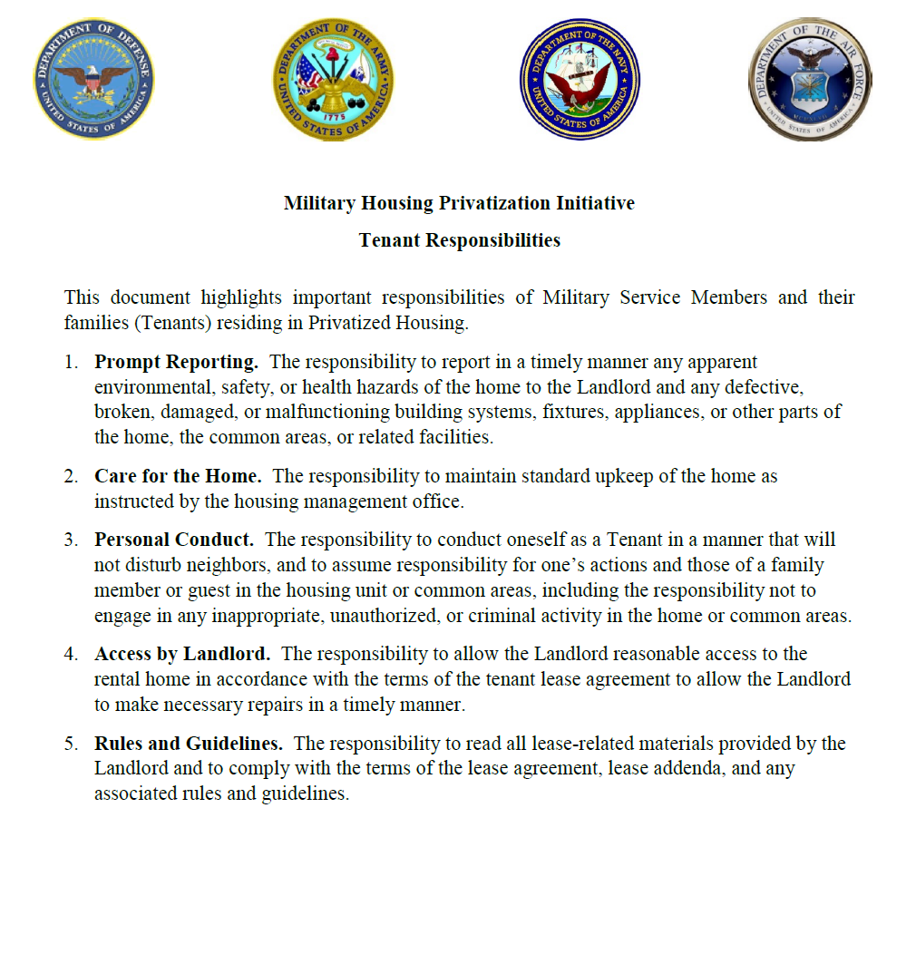
Privatized Housing – Tenant Responsibilities
* Copy is available upon request

Slide 14
Privatized Housing – Tenant Responsibilities
The Army Housing Privatization Initiative Tenant Bill of Rights highlights 5 important responsibilities for Service Members and their Families while they reside in privatized family housing.
  The responsibility to report in a timely manner any apparent environmental, safety, or health hazards of the home to the Landlord and any defective, broken, damaged, or malfunctioning building systems, fixtures, appliances, or other parts of the home, the common areas, or related facilities.
  The responsibility to maintain standard upkeep of the home as instructed by the housing management office.
  Each household is provided trash and recycle receptacles. In order to ensure pick-up, residents are responsible for sorting waste correctly, closing containers fully, and placing receptacles in the designated pick-up area and placing them back at the home after pick up.
  Hazardous waste is not permitted.
  Large item pick ups can be arranged by the management office; a fee from the waste management company will be billed to the resident for this service. Call the management office for any fees associated with pick up.
  Trash service depends on the location of your community. Please see the welcome booklet for detailed service days for your area.
  It is resident responsibility to maintain an uncluttered and clean residence. Fire pits are prohibited on the property. Car washing, vehicle maintenance, and parking cars on the grass or yard is prohibited.
  Recreational and Utility vehicles are only allowed on property for 24 hours.
  Dogs must be leashed when walking in the community.

Slide 15
Privatized Housing – Tenant Responsibilities
  The responsibility to conduct oneself as a Tenant In a manner that will not disturb neighbors, and to assume responsibility for one’s actions and those of a family member or guest in the housing unit or common areas, including the responsibility not to engage in any inappropriate, unauthorized, or criminal activity in the home or common areas.
    Unless otherwise specified in the lease, if a resident violates community polices, the following process will occur:
    A violation notice will be delivered to the Resident in the mailbox via USPS or posted on Resident’s door in a sealed envelope, and a copy will be kept in the residence file. Resident has 72 hours to correct the violation.
    A warning letter will be issued if the violation has not been corrected after the first notice is delivered. Resident will have 72 hours to correct the violation.
    A final three day notice to comply or vacate will be issued. Failure to adhere to this final notice could result in legal action.
  4. The responsibility to allow the Landlord reasonable access to the rental home in accordance with the terms of the tenant lease agreement to all the Landlord to make necessary repairs in a timely manner.
  5. The responsibility to read all lease-related materials provided by the Landlord and to comply with the terms of the lease agreement, lease addenda, and any associated rules and guidelines.

Slide 16
Privatized Housing – Tenant Responsibilities
  Recognizing that landlord/tenant issues can be overwhelming for Soldiers, it is important to know where you can go for help. The Legal Assistance Office can assist clients by explaining terms and negotiating disputes. Understand that California Landlord Tenant laws will apply with your lease agreement.
  The two most important things a Tenant can do is look at the home they are going to rent and make sure they understand the lease before signing. Tenants should not sign a lease until they have seen the exact home they will be renting. Previewing the home gives the Tenant the chance to see if repairs are needed before committing to the lease. Additionally, Tenants should understand the lease BEFORE they sign. The lease is a legally binding contract between the Tenant and the Landlord. It explains each party’s rights and responsibilities. Tenants should assume that they are responsible for all of the terms in the lease, unless otherwise agreed to in writing. Be aware that verbal agreements do not change the lease.
  Before you sign the lease you should read it carefully. The lease is a legally binding contract between you and the owner/property manager. The lease explains your rights and responsibilities. It is important that you understand what you agreed to.
  Document any issues with the property so when it comes time to move out, you are not responsible for those issues. It is difficult to determine when damage to the property occurred unless you have documentation to prove that the damage was present before you moved in.
  If you have military orders including PCS or ETS orders you can terminate your lease early under the SCRA. You must give landlord a written notice of your intent to end the lease early and a copy of your orders or a memo from your Command. Legal Assistance can help you write the letter.
  If you are considering breaking your lease, meet with an attorney at the Legal Assistance Office. There are very limited circumstance in which you may be able to break your lease. The consequences can be severe if you wrongly break your lease. You should talk to an attorney first.

Slide 17
Privatized Housing – Tenant Responsibilities
The informal dispute resolution is a measured approach intended to resolve disputes at the garrison level that may be used to resolve disputes pertaining to the lease as well as issues that fall outside the specific parameters of the lease document, such as personal property claims
Tenants shall attempt to resolve disputes by bringing the dispute or concern to the owner. If the tenant and owner are unable to resolve the issue satisfactorily, then the tenant shall attempt to resolve the disputer through the informal dispute resolution process.
The tenant may submit an informal dispute resolution request by submitting to the AHO a completed request form with any documents that support the dispute and a description of the dispute.
An informal dispute resolution form is available at the AHO, who is available to assist residents in completing the form. Tenants may also visit the garrison Staff Judge Advocate’s office to seek their assistance in completing the informal dispute resolution form.
    The informal dispute resolution form is also available on-line at: usarmy.pom.106-sig-bde.mbx.pres-dpw-housing@army.mil.
The garrison commander will review the request and will serve as the mediator between the property owner and tenant in an effort to resolve the dispute at the local level, normally within 10 business days.

Slide 18
Privatized Housing – Tenant Responsibilities
The formal dispute resolution process allows eligible tenants to obtain prompt and fair resolution of housing disputes concerning rights and responsibilities set forth in the lease, including maintenance, repairs, rental payments, displacement rights, lease termination, inspections, or fees and charges.
The tenant may submit a formal dispute resolution request by submitting to the AHO a completed request form with any documents that support the dispute and a description of the dispute.
The formal dispute resolution may include a home inspection. If the tenant fails to grant access to the premises for inspection the formal dispute resolution process shall terminate and no decision will be rendered
Tenants may request “rent segregation” for up to 60 days while the dispute is being reviewed.
The HQ IMCOM Commanding General is the Deciding Authority and will generally render a decision within 30 days but not later than 60 days.
A formal dispute resolution form are available at the AHO, who is available to assist residents in completing the form. Tenants may also visit the garrison Staff Judge Advocate’s office to seek their assistance in completing the formal dispute resolution form.
    The formal dispute resolution form is also available on-line at: usarmy.pom.106-sig-bde.mbx.pres-dpw-housing@army.mil.
The formal dispute resolution eligibility is limited to military members, their spouse or other eligible individual who qualifies as a “tenant” as defined in 10 USC Section 2871
Tenants may seek legal advice or dispute resolution through any remedy available by law, except that tenant and owner shall not pursue such remedy available in law while a formal dispute resolution under this process is pending.

Slide 19

Garrison Housing Services Office (HSO)
The goal of the HSO is to implement and maintain a high quality worldwide resource for relocation services that is innovative, comprehensive, and the first choice of information and support when Soldiers and families relocate.
  Non-discriminatory listings of adequate and affordable rental and for-sale housing
  Counseling/referral on eligible installation services (i.e. legal, education, Exceptional Family Member Program)
  Preliminary inquiries to validate housing discrimination complaints
  Liaison with community and government officials / organizations (on and off post)
  Housing data exchange with other DoD housing offices
  Liaisons with Army Community Services in support of the Housing Relocation Assistance Program
  Housing market area data for use in developing market analyses Rental negotiations and lease review

Slide 20
Garrison Housing Services Office (HSO)
One-Stop, Full Service from Arrival to Departure for the Following:
  Home buying counseling
  Landlord-tenant dispute resolution
  Basic Allowance for Housing (BAH) data submission
  Property inspections
    NEW---Per FY20 NDAA: If tenant is not available for pre-assignment walkthrough inspection, Housing Office must attend on tenant's behalf
    NEW---Per FY20 NDAA: The Housing Manager shall initiate contact with resident 15 day and 60 days after move in regarding the satisfaction of the resident.
  Administrative assistance with utility company fees/deposits, connections, and billings
  Informational briefings (in- and out-processing, entitlements),community outreach

Slide 21
Furniture Safety & Additional Information
Fort Ord Village - parks/tot-lots, tennis court, basketball courts, dog parks, soccer fields, picnic area with grills, gym, pool, kiddie pool, super park, business center
La Mesa Village - parks/tot-lots, volleyball court, dog parks, basketball court, soccer fields, tennis courts, baseball field, backyard annex, birthday room, billiards room, ballroom, meeting room, activity center, gym, pool, business center

Slide 22
End of Brief

