Slide 1
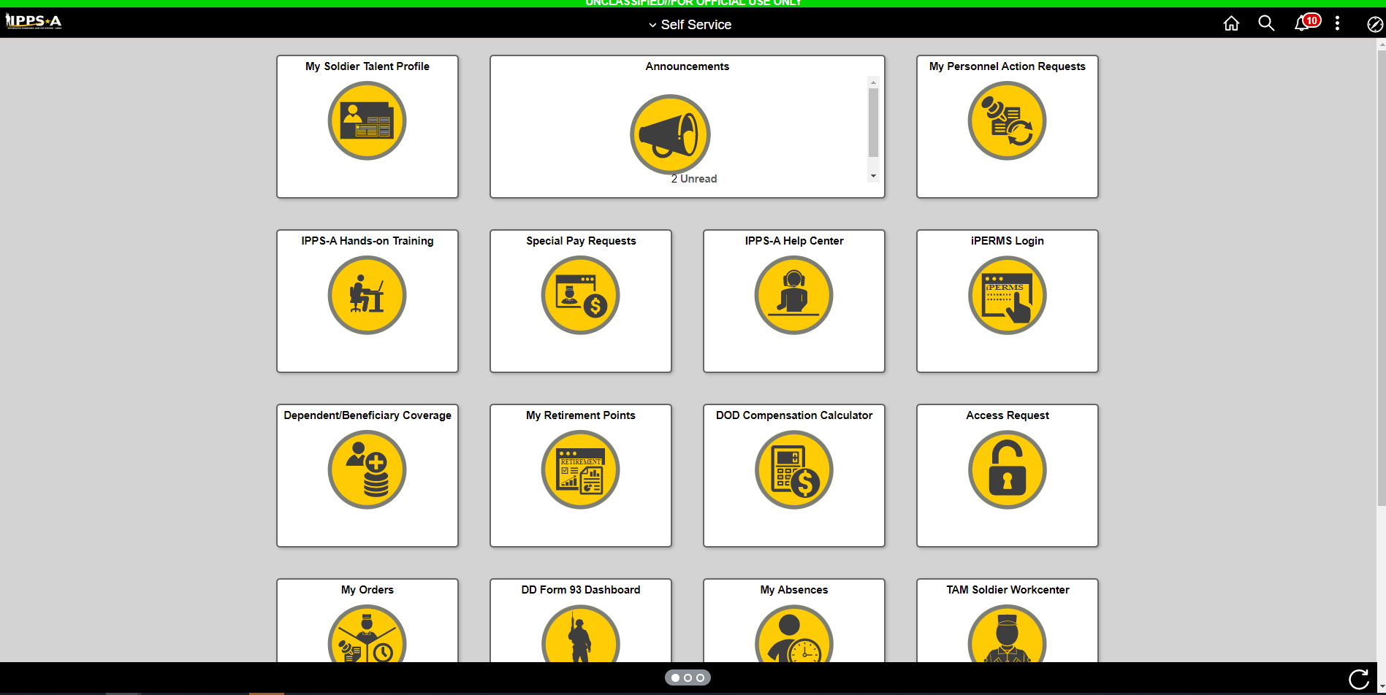
Click Here

Slide 2
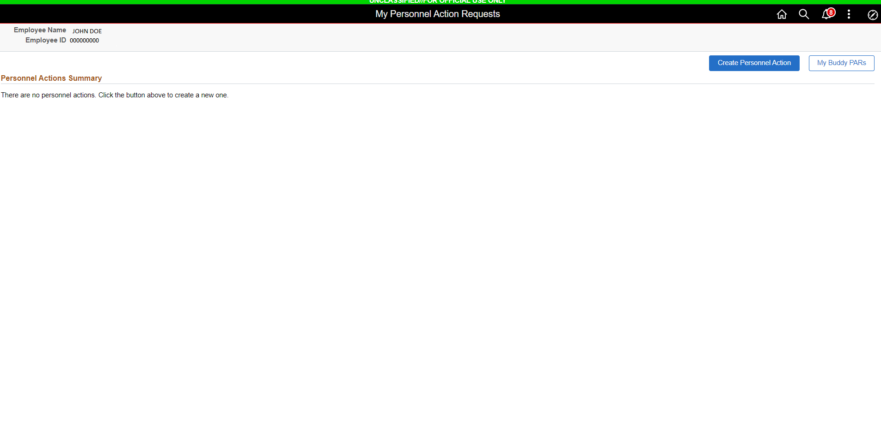
Click Here

Slide 3
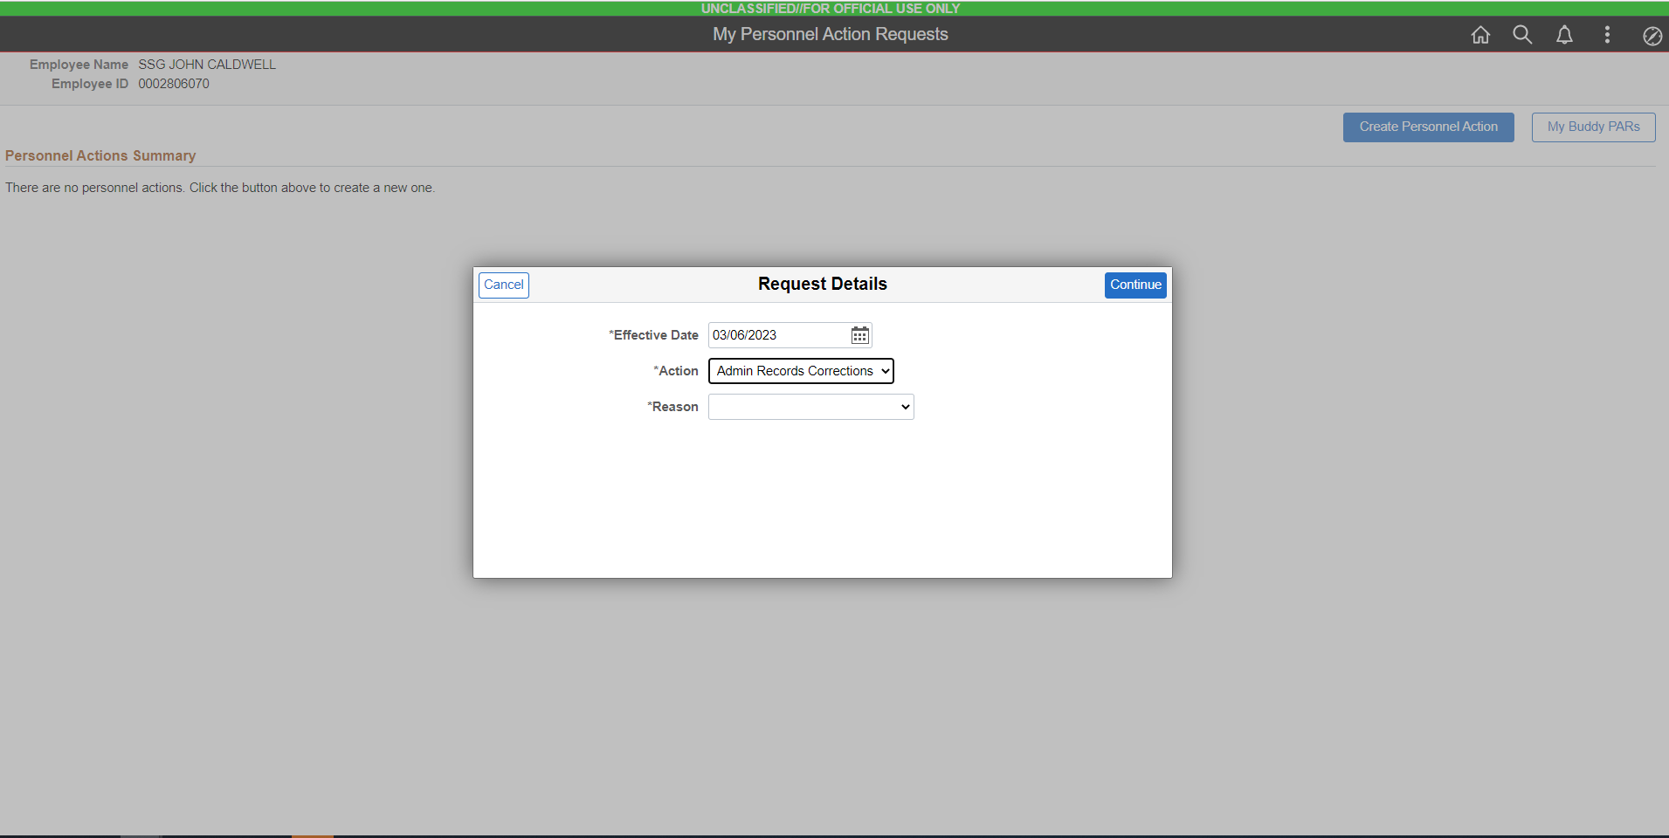
Select This

Slide 4
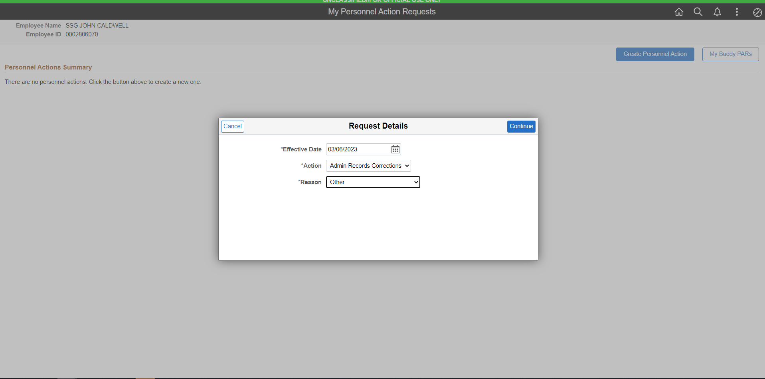
Select This

Slide 5
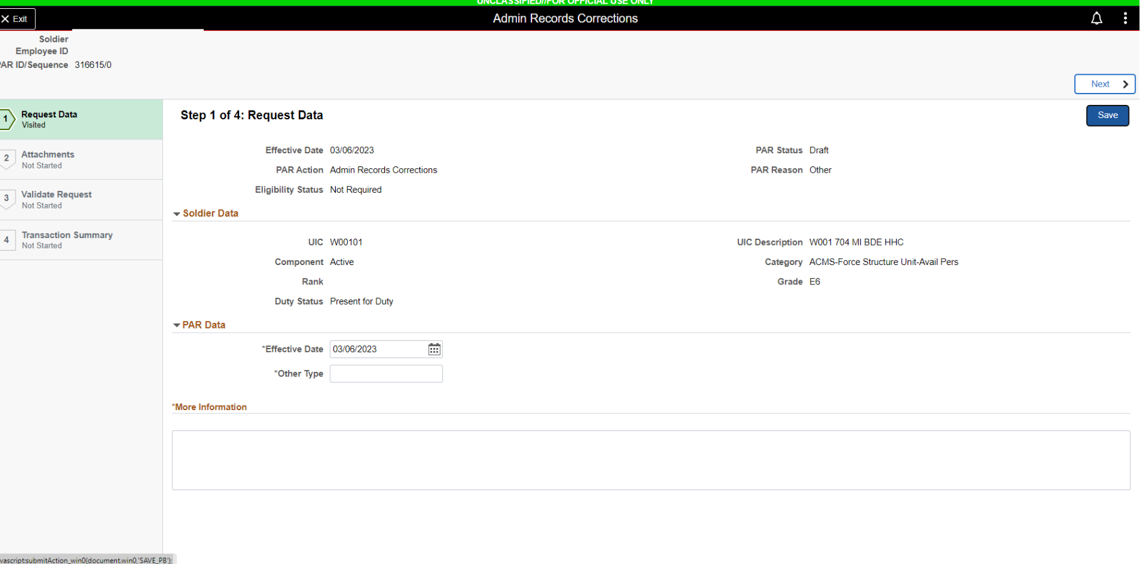
RFO CONUS
TYPE RFO CONUS/OCONUS
RPT DT: 04/01/23
TYPE RPT DT

Slide 6
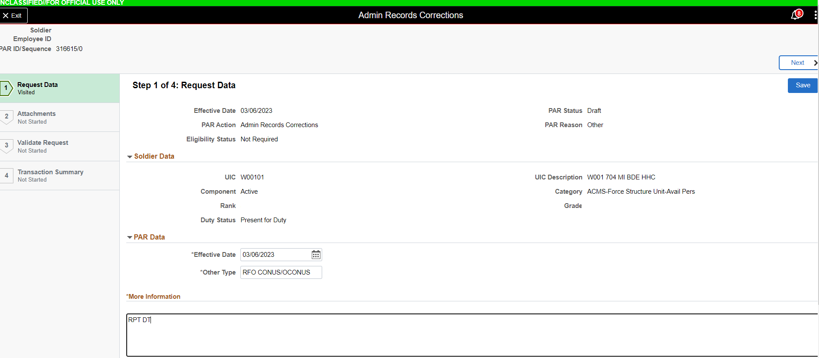
HIT SAVE

Slide 7
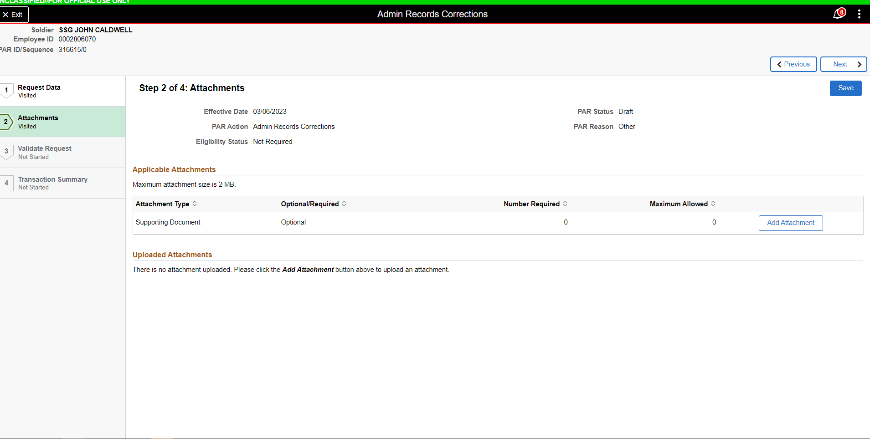
ADD CONUS DOC: DA 5118 (Enlisted) - Reassignment Status & Election Statement
o **DA 5434 – Sponsorship Request Form
o RFO (Officers) - Request for Orders (NO LONGER NEEDED)
o WOCS/Recruiting/Airborne/Drill-please provide 1059 or your completion certificate to receive orders after school completion.
o TDY Opt Form for SMs who have TDY before next
o DA FORM 7415 (IF SM HAS FAMILY)

Slide 8
ADD OCONUS DOC: o DA 5118 (Enlisted) – Reassignment Status & Election Statement
o RFO (Officers) – Request for Orders (NO LONGER NEEDED)
o **DA 5434 – Sponsorship Request Form
o DA 4036 – Medical & Dental Preparation for Overseas Movement
o DA 4787 – Reassignment Processing
o DA 5121 – Oversea Tour Election Statement o UA Tour SOU (if going Unaccompanied) o If Dependents are residing on Ft Meade while on a UA Tour, an ETP from Housing is required.
o *****MUST DO****** ALL SM BRINGING FAMILY MEMBERS MUST LOG IN TO EEFMP, COMPLETE AND SUBMIT 5888

Slide 9
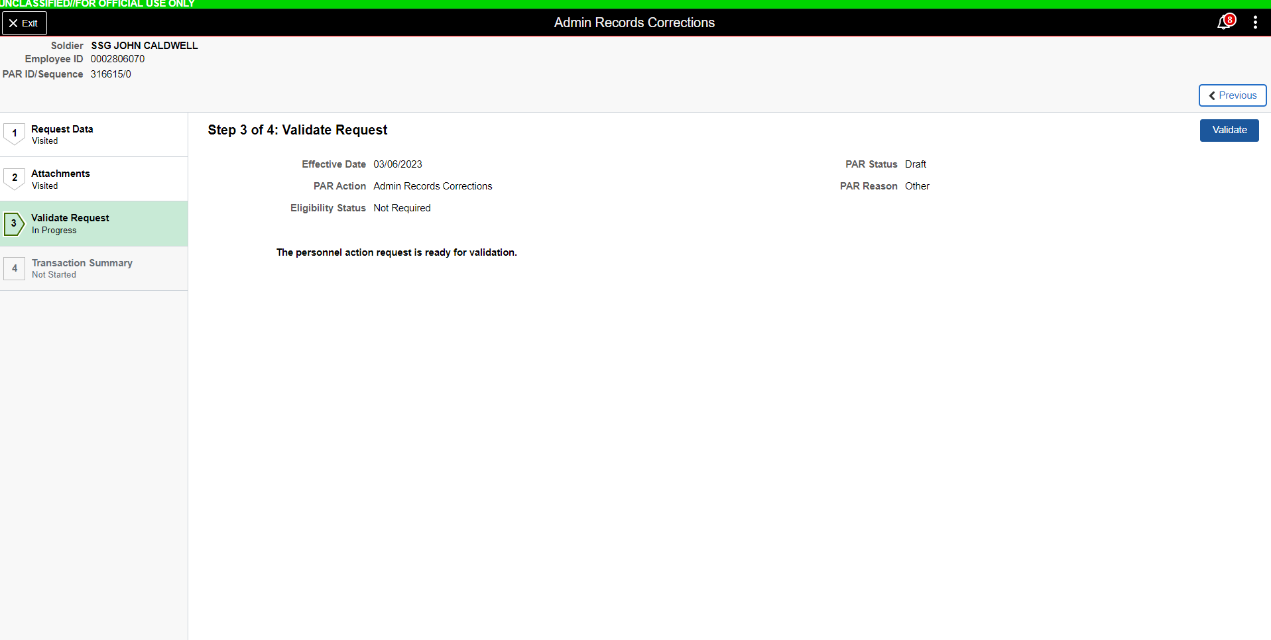
CLICK HERE

Slide 10
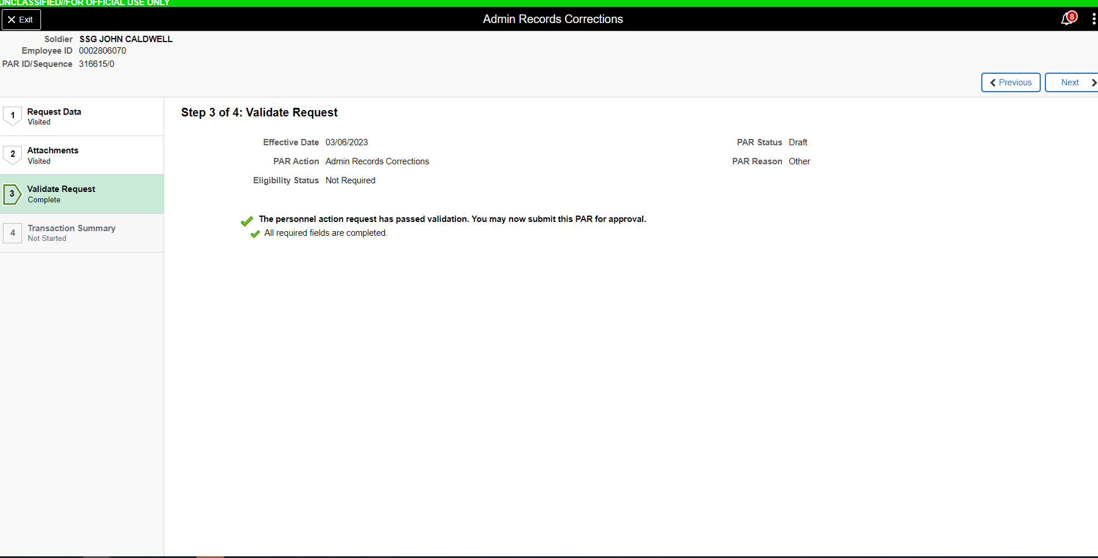
CLICK NEXT

Slide 11
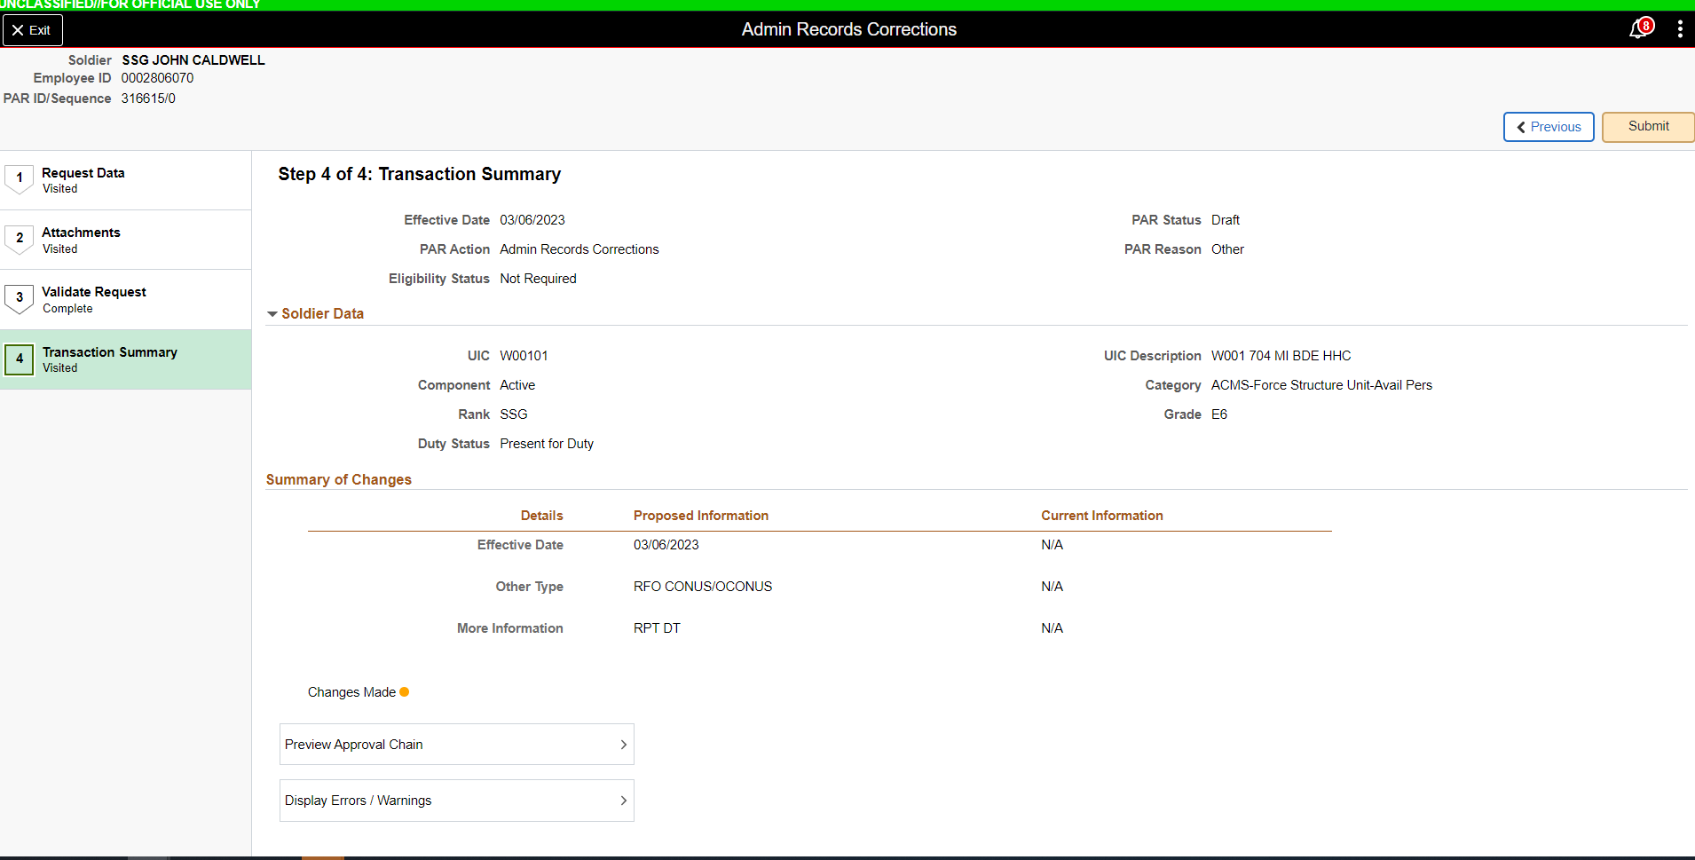
CLICK SUBMIT

