Slide 1
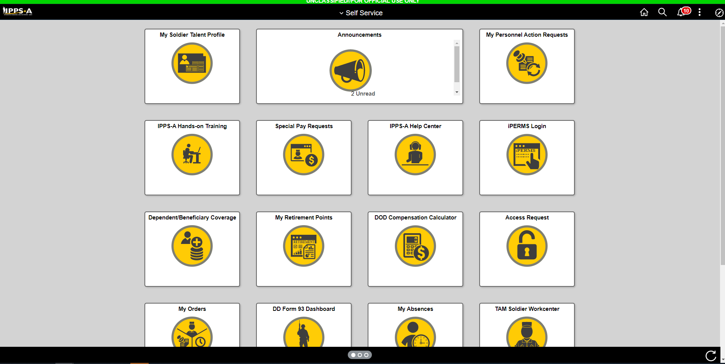
Click Here

Slide 2
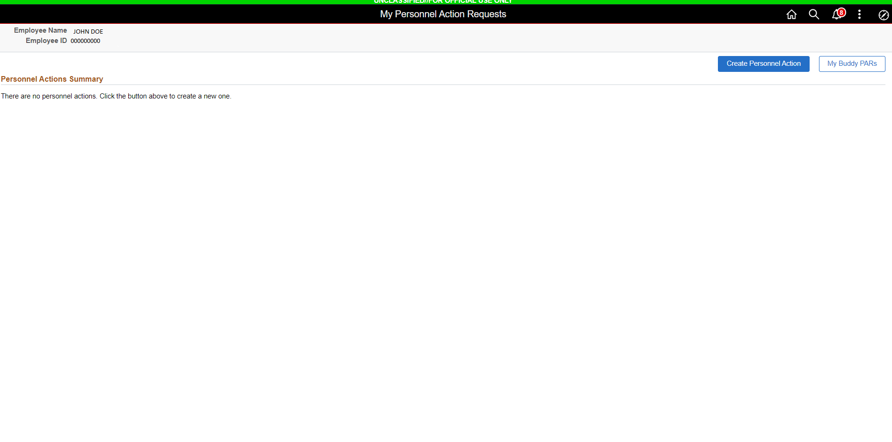
Click Here

Slide 3
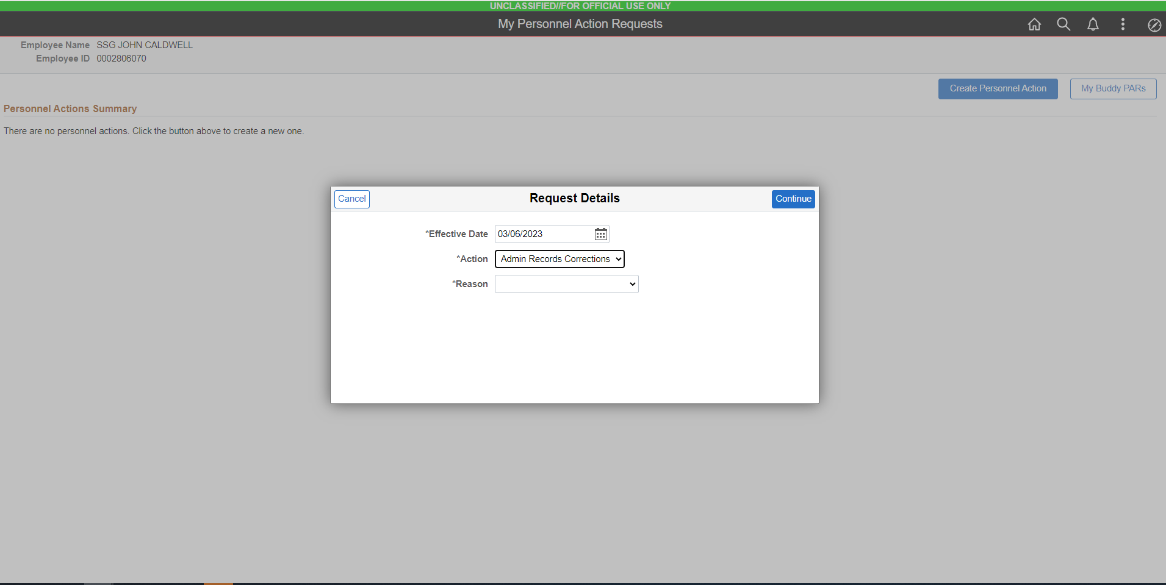
Select This

Slide 4
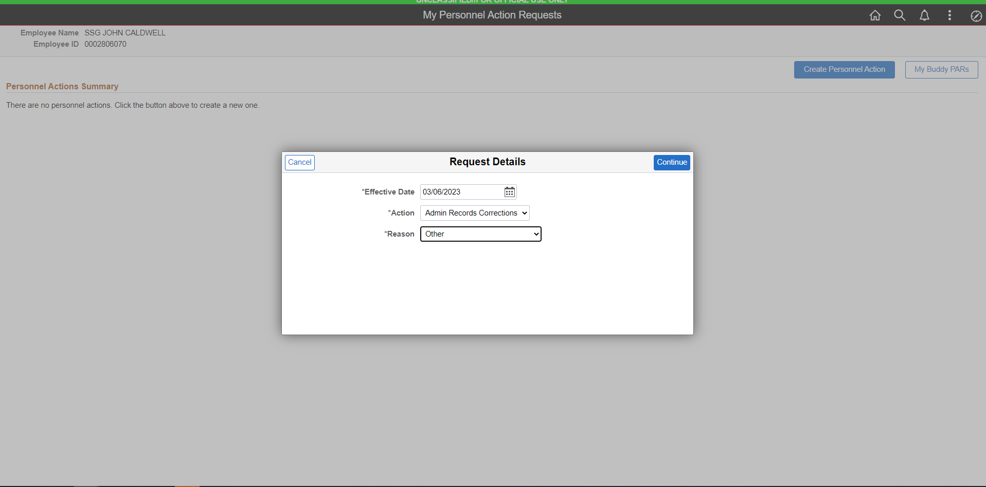
Select This

Slide 5
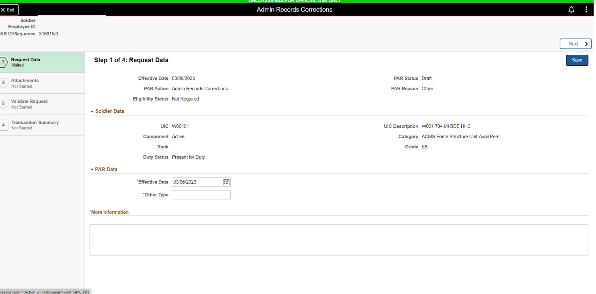
HIT SAVE
NCM
NCM REQUEST
RPT DT: 04/01/23
RPT DT

Slide 6
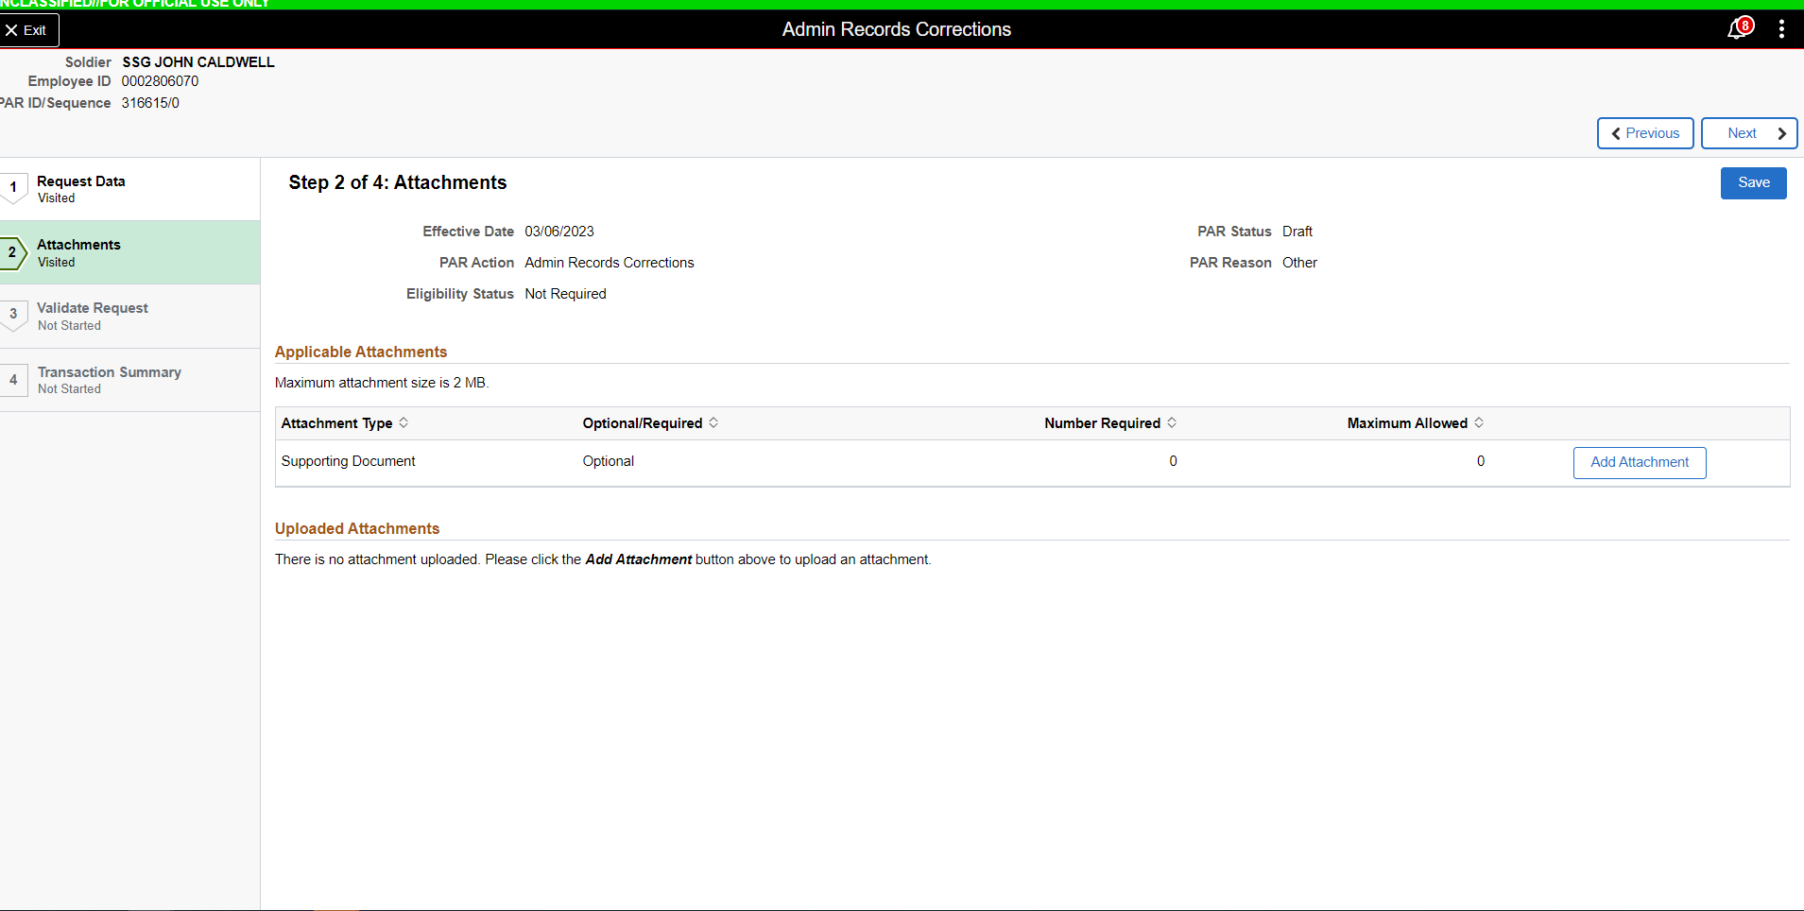
NCM REQUEST DOCUMENTS:
SUPPORTING DOCS (ANY SPECIAL PROGRAM)
SCHOOL DOCS (IF APPLICABLE)
UNIT TRANSFER DOCS (IF APPLICABLE)

Slide 7
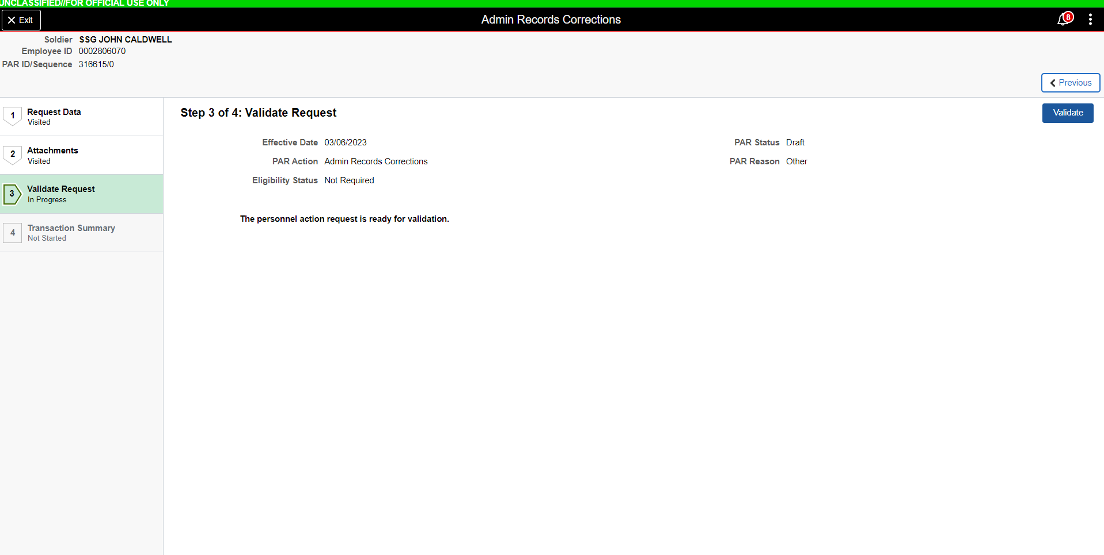
CLICK HERE

Slide 8
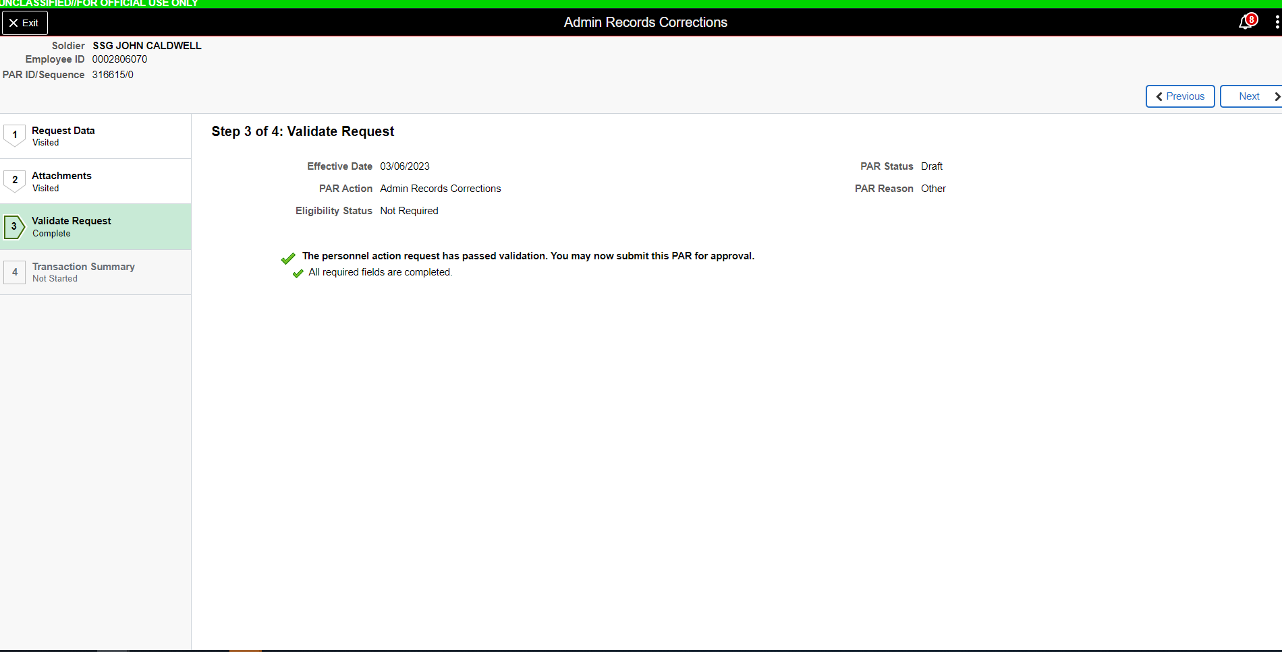
CLICK NEXT

Slide 9
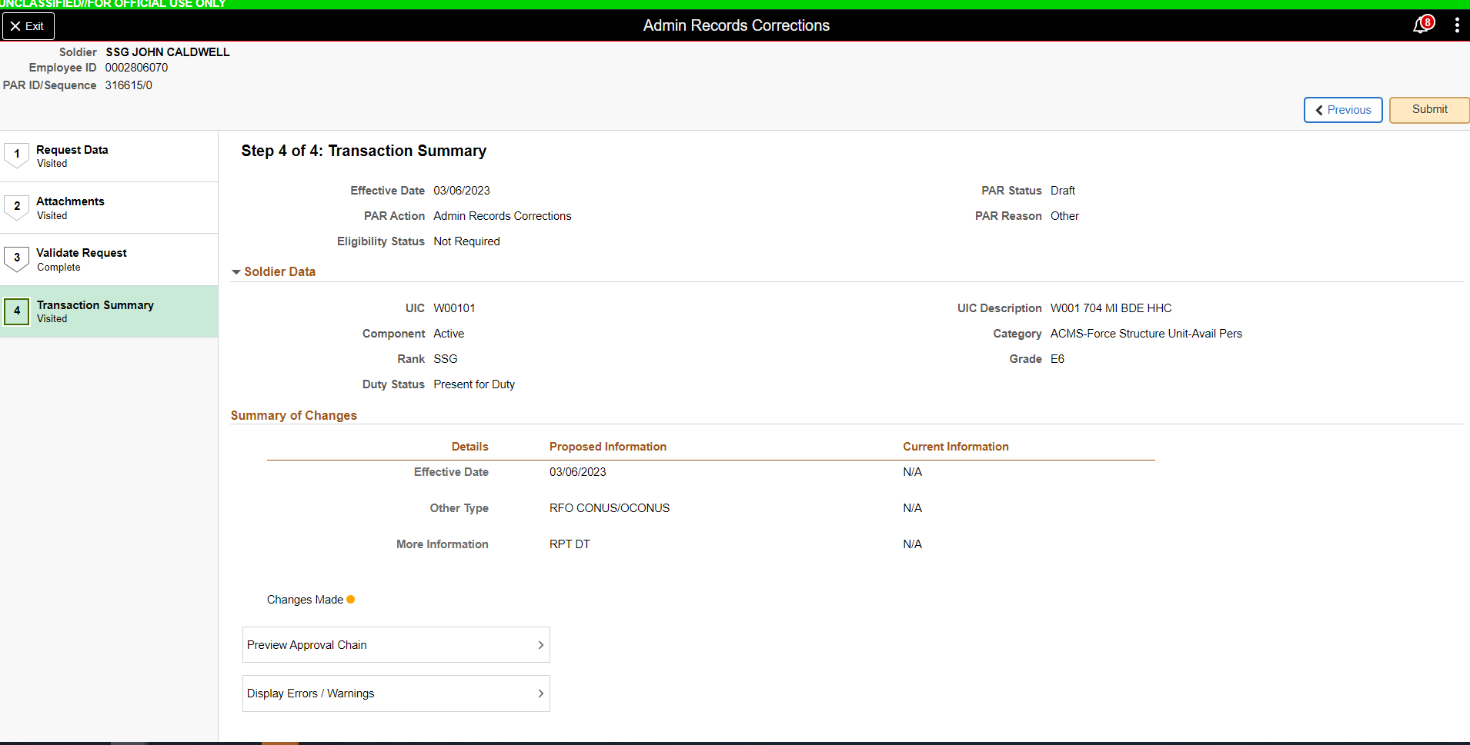
CLICK SUBMIT
NCM REQUEST

