Slide 1
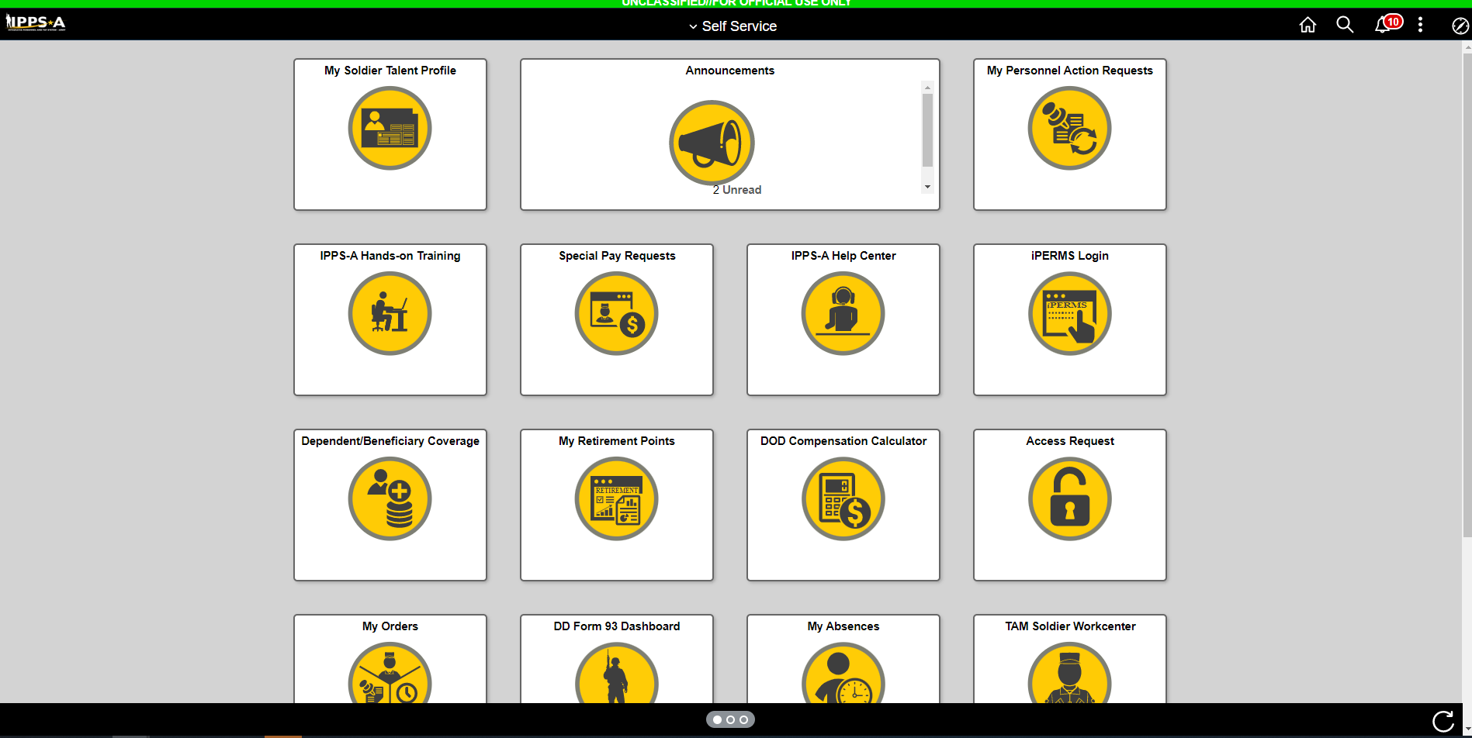
Click Here

Slide 2
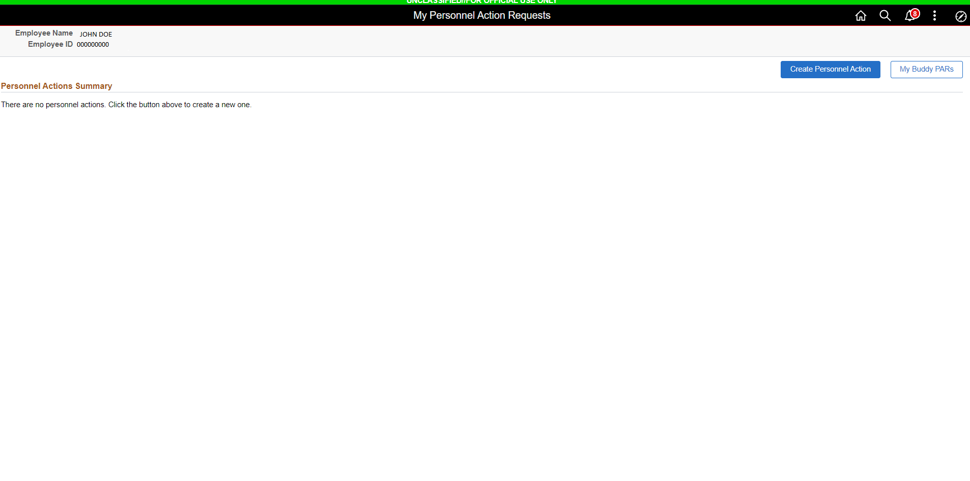
Click Here

Slide 3
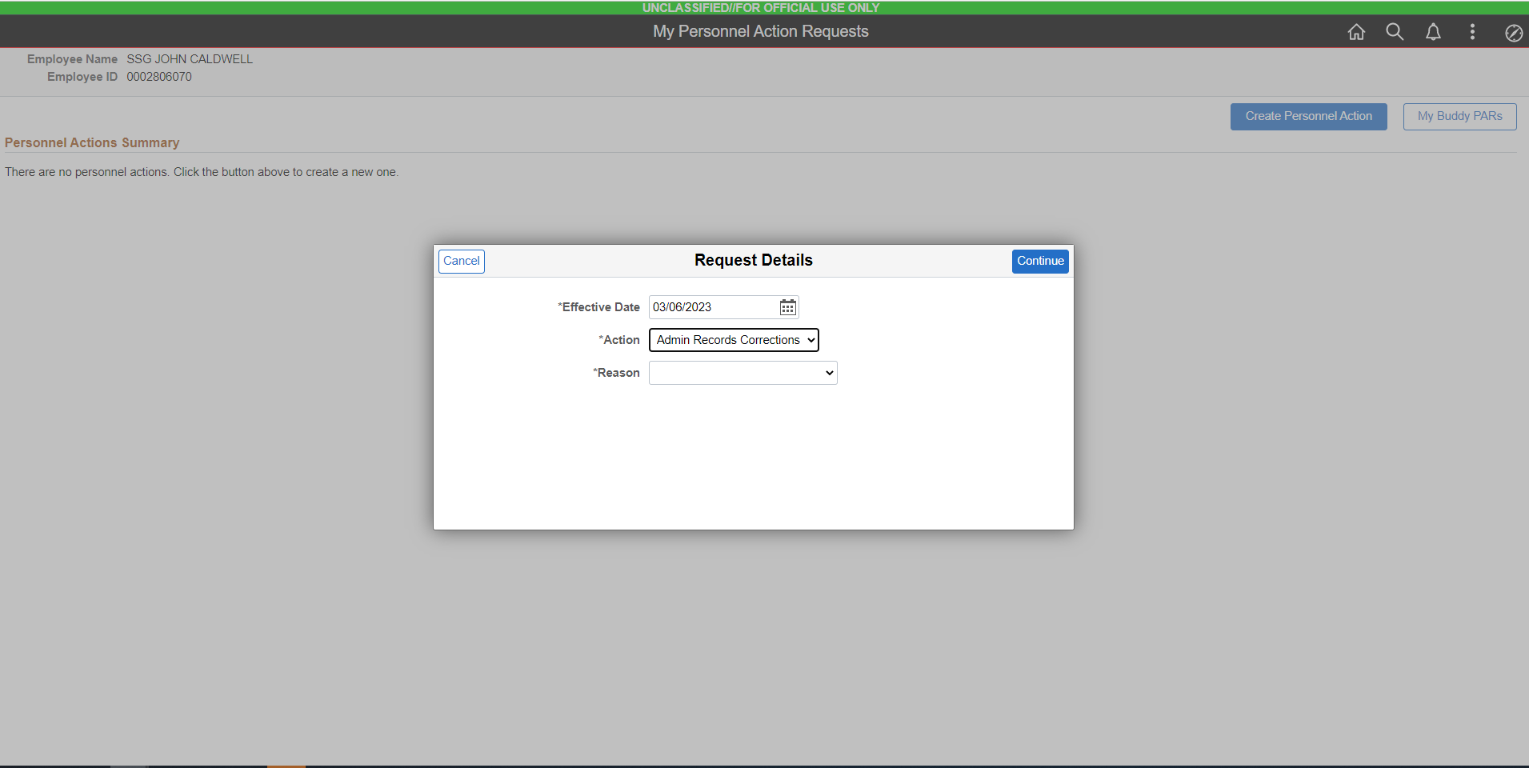
Select This

Slide 4
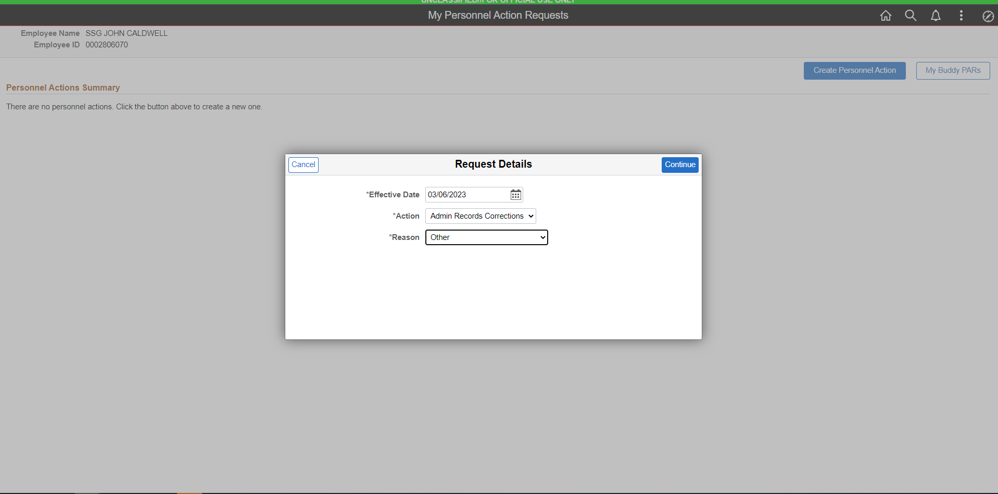
Select This

Slide 5
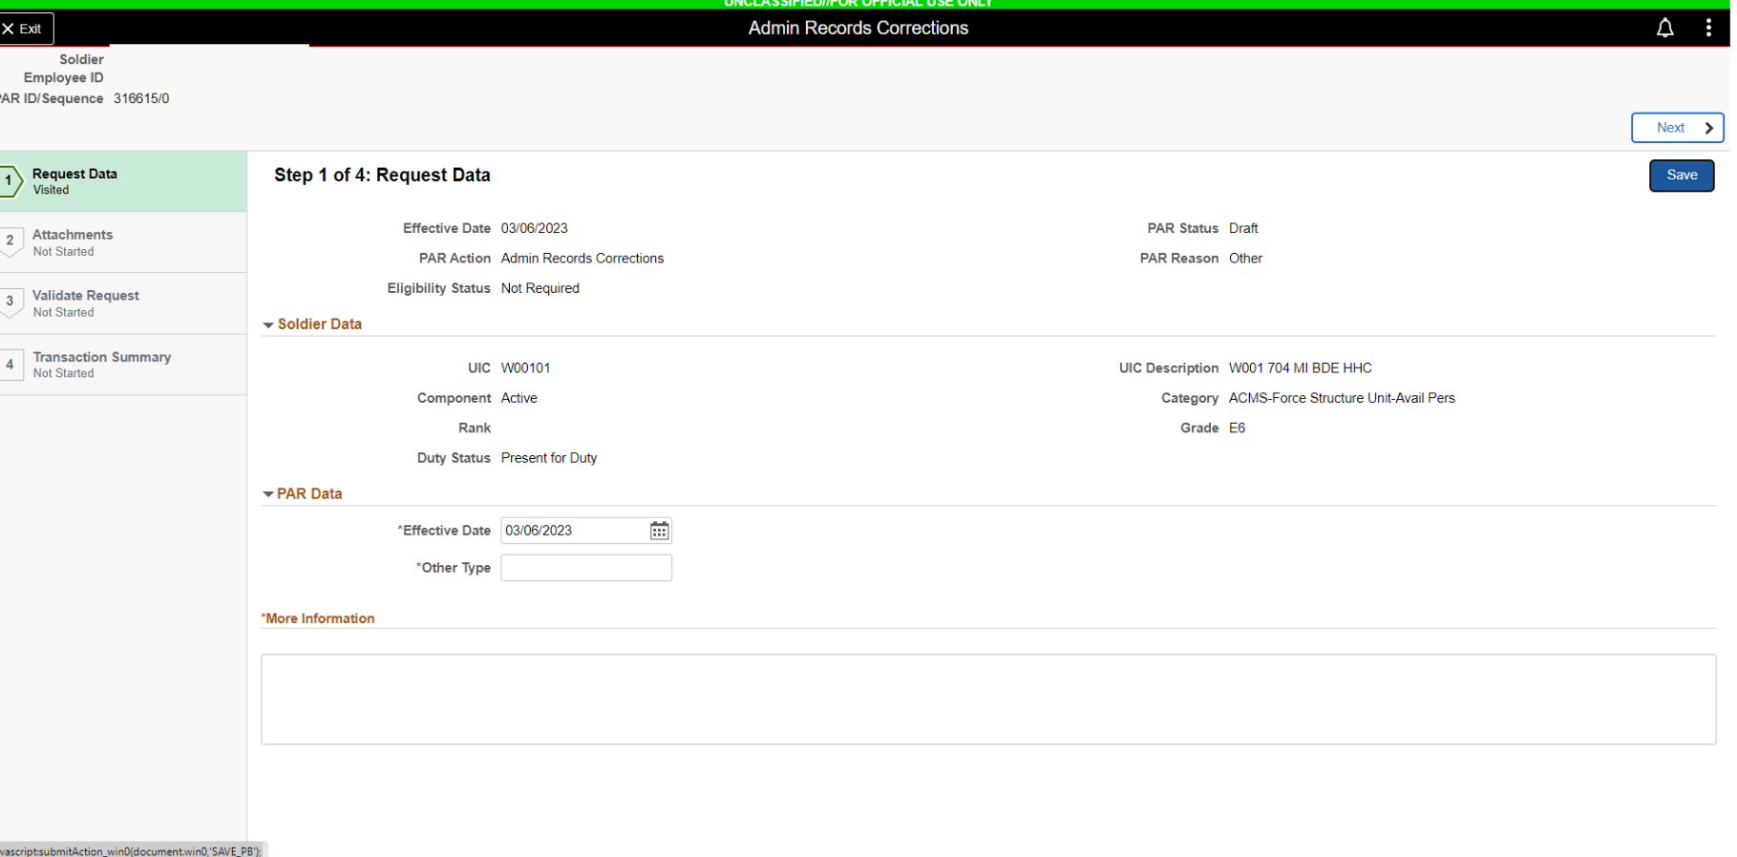
HIT SAVE
FINAL OUT
LV ST DT: 04/01/23

Slide 6
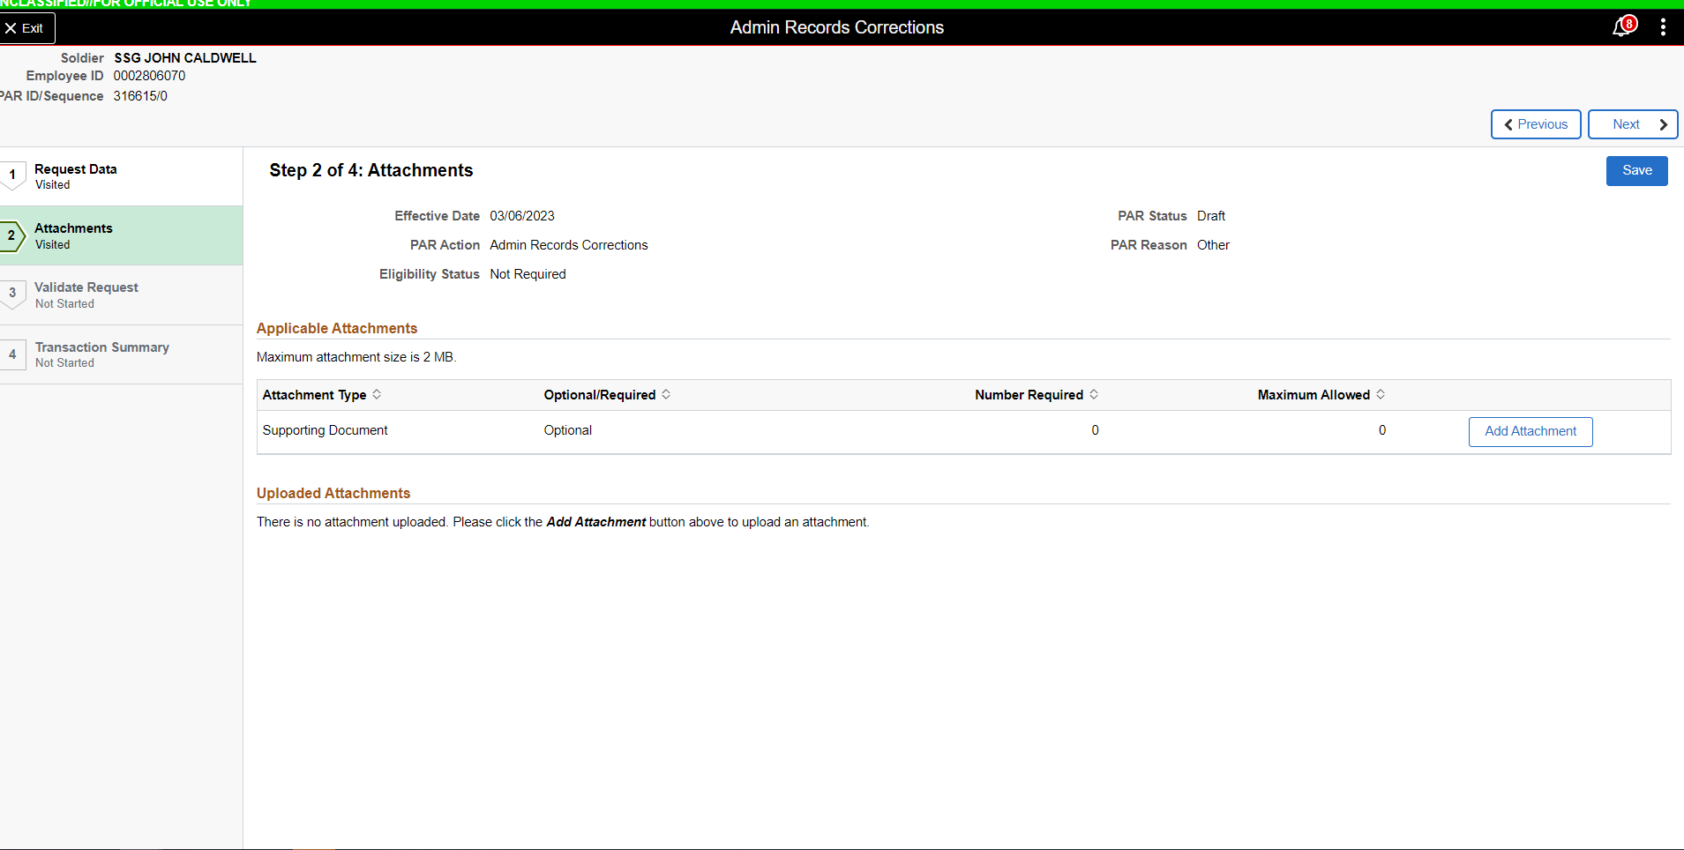
FINAL OUT DOC: 137-1 UNIT CLEARING PAPERS AND 137-2 INSTALLATION CLEARING PAPERS

Slide 7
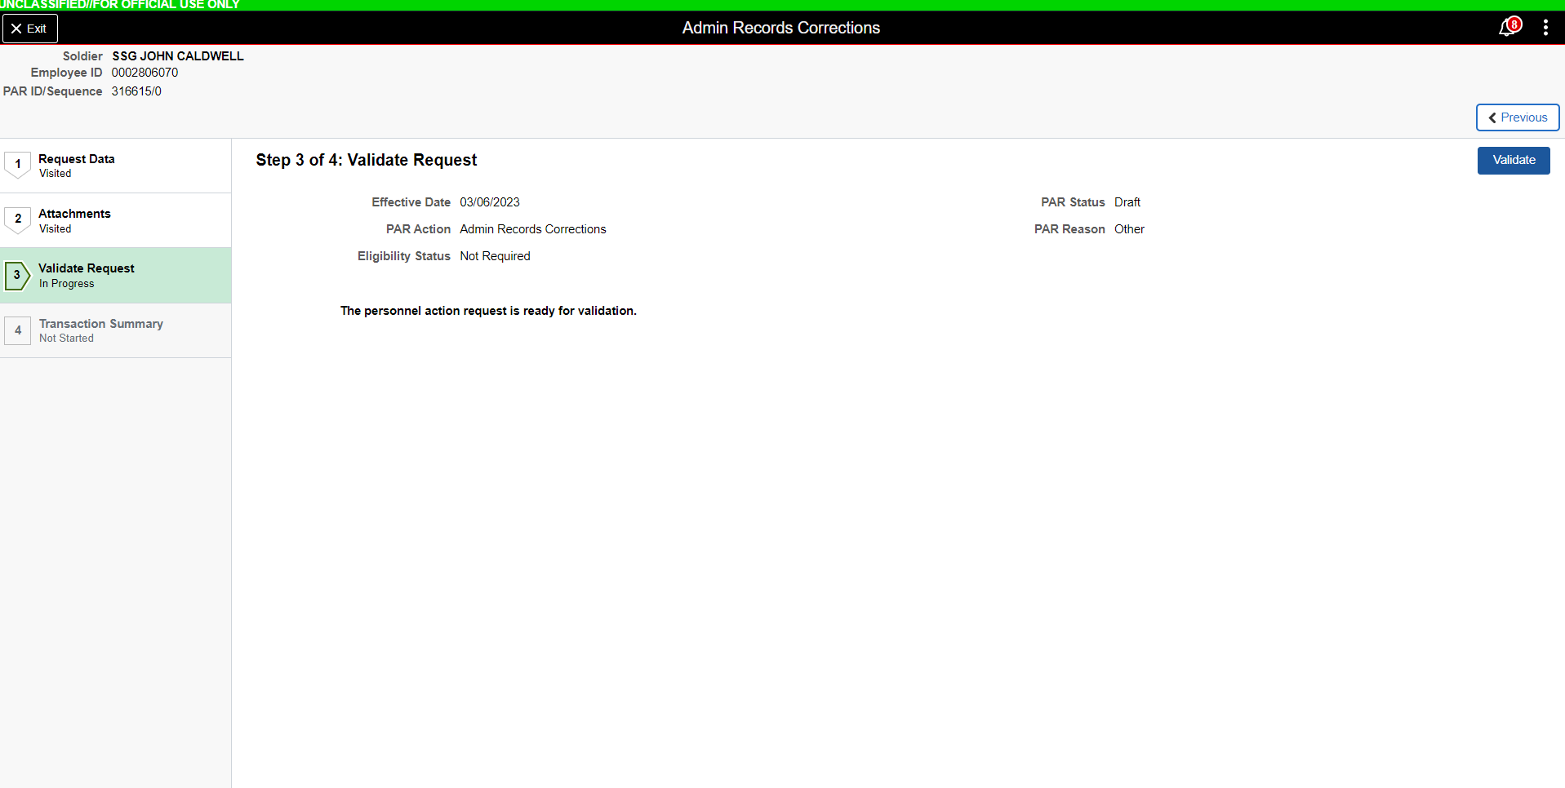
CLICK HERE

Slide 8
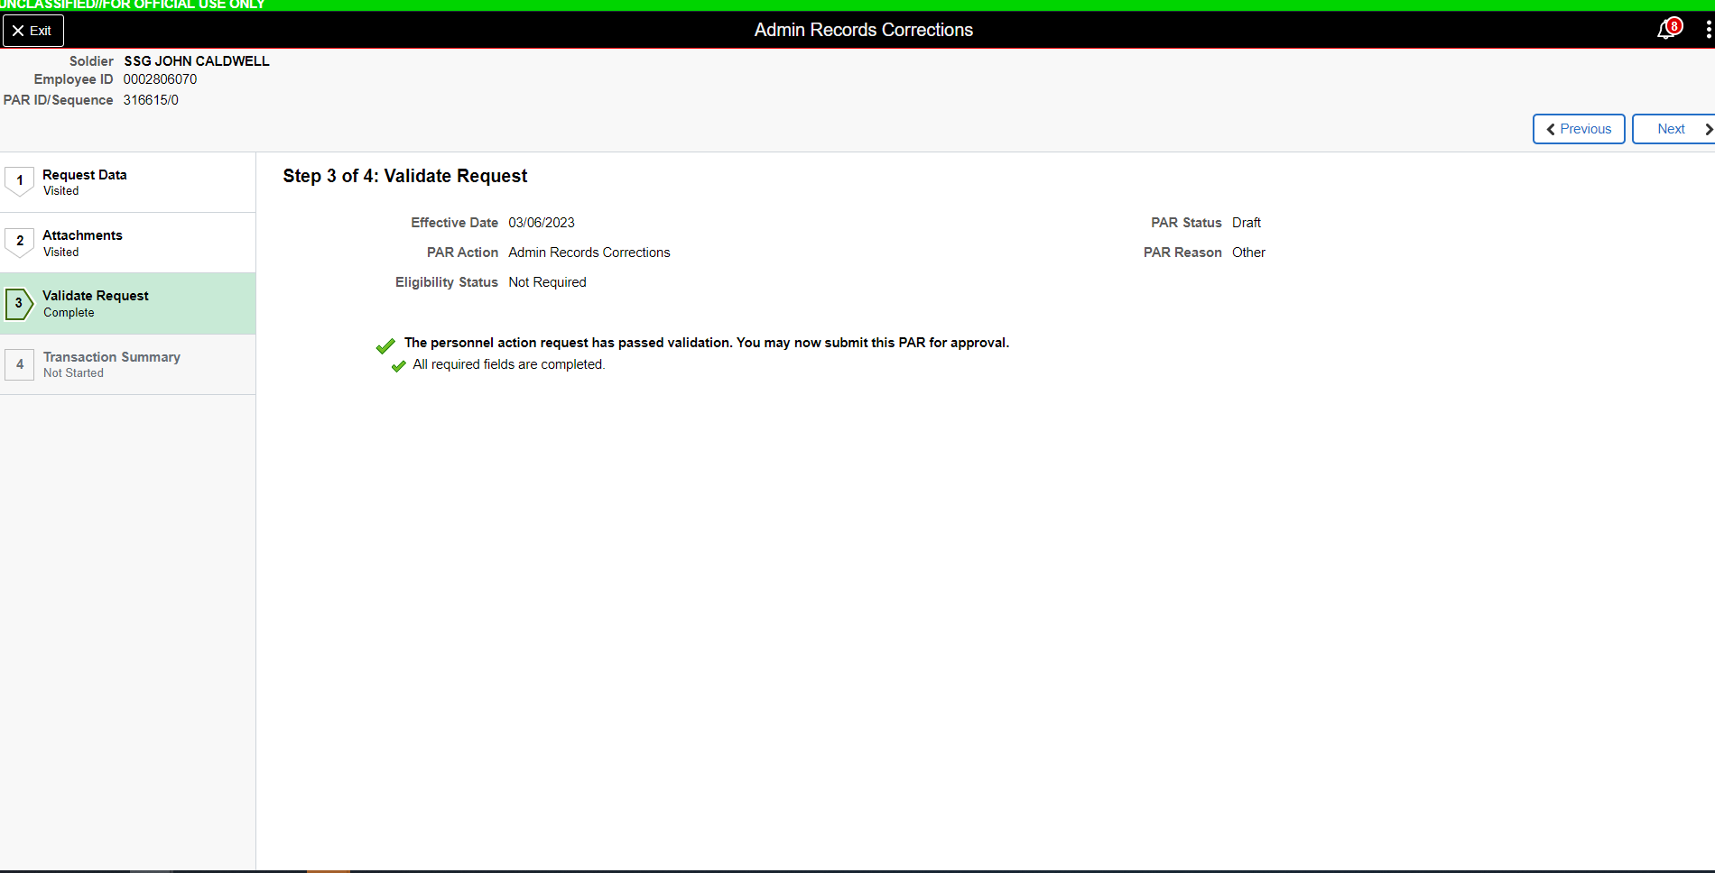
CLICK NEXT

Slide 9
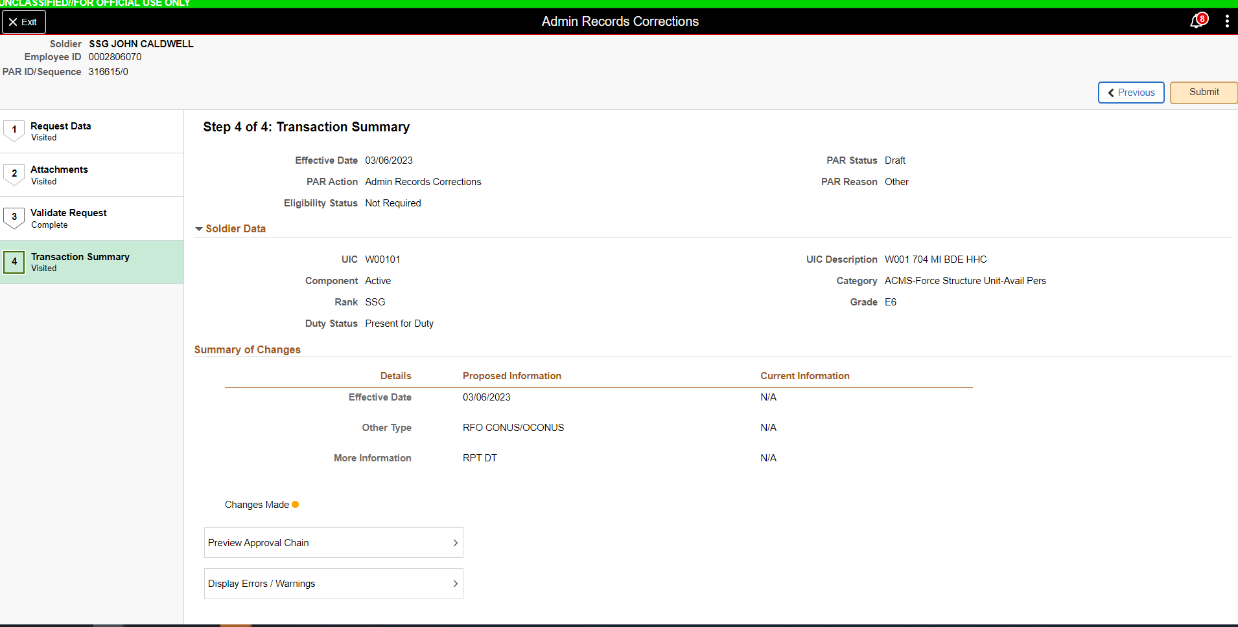
CLICK SUBMIT

