Slide 1
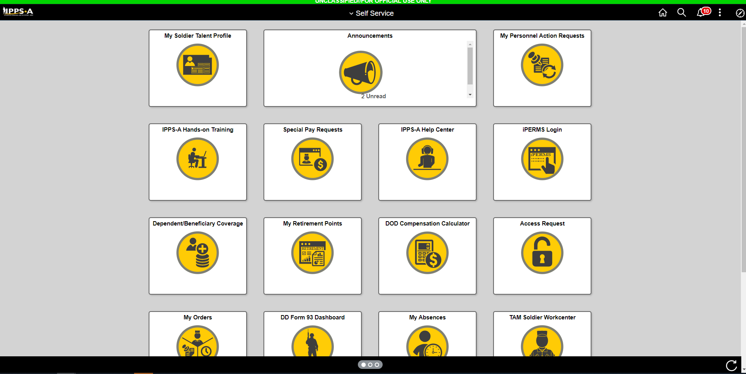
Click Here

Slide 2
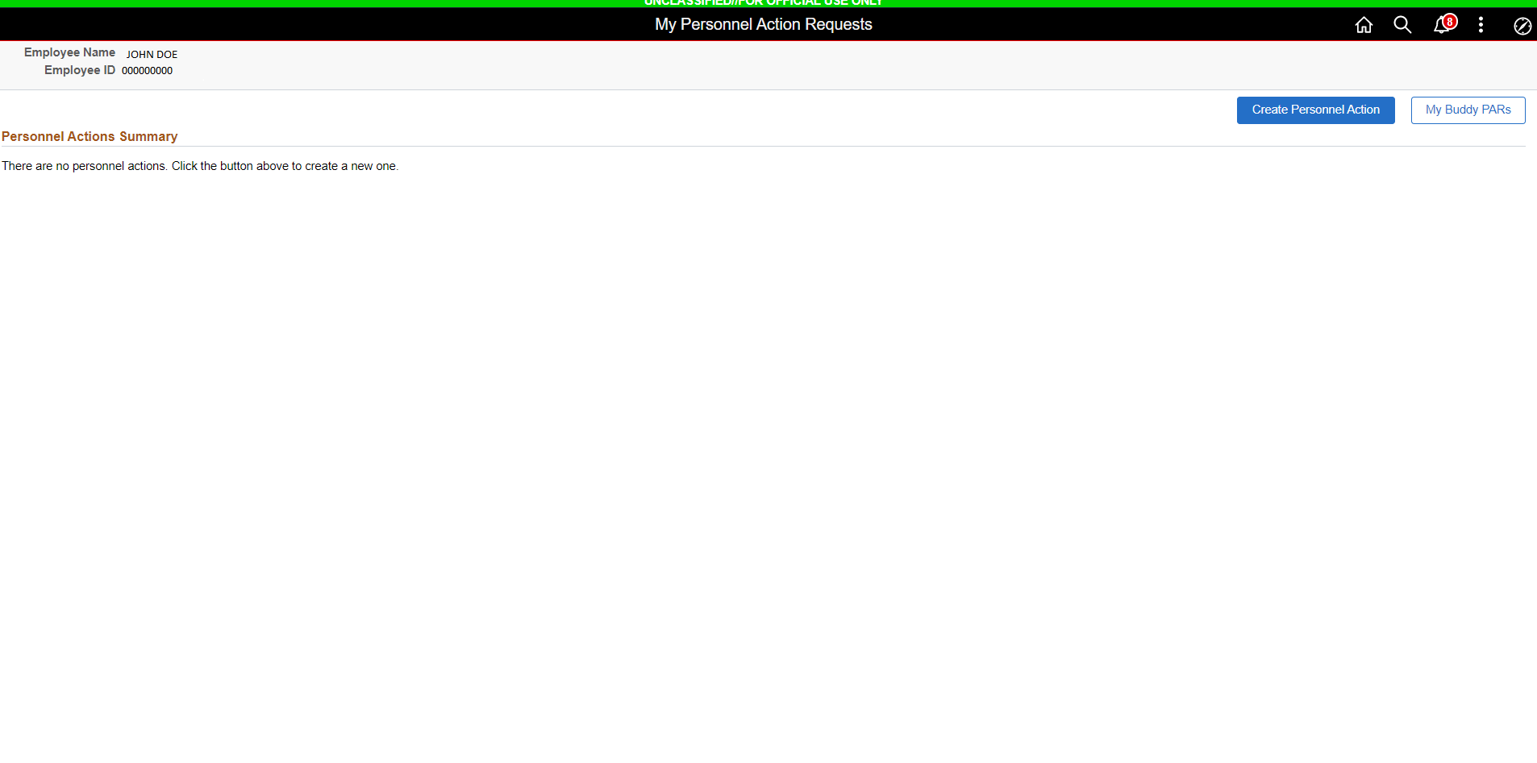
Click Here

Slide 3
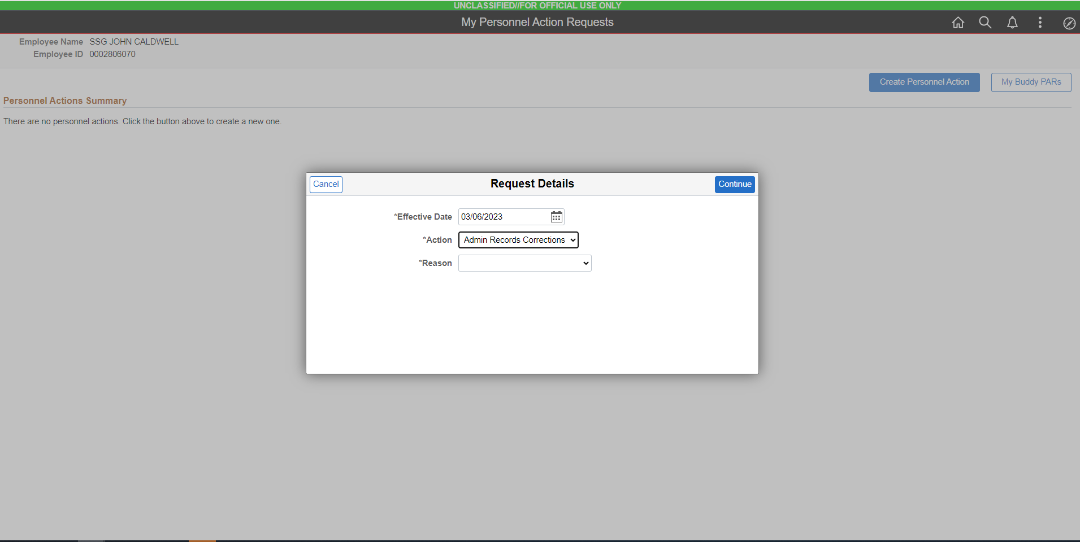
Select This

Slide 4
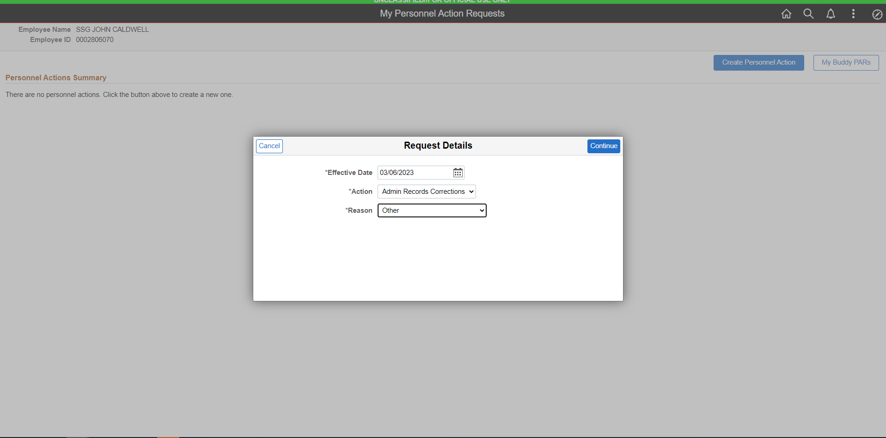
Select This

Slide 5
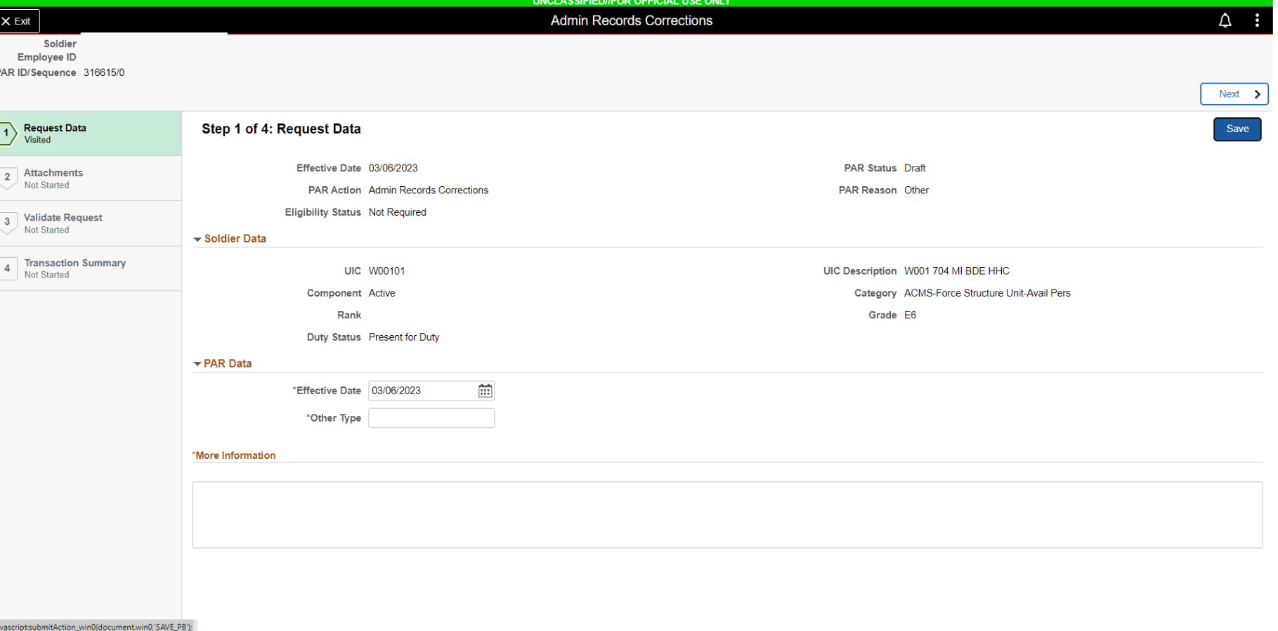
HIT SAVE
ICP REQUEST
ICP REQUEST
ABSENCE REQUEST ST DT: 04/01/23
ABSENCE RQ ST DT

Slide 6
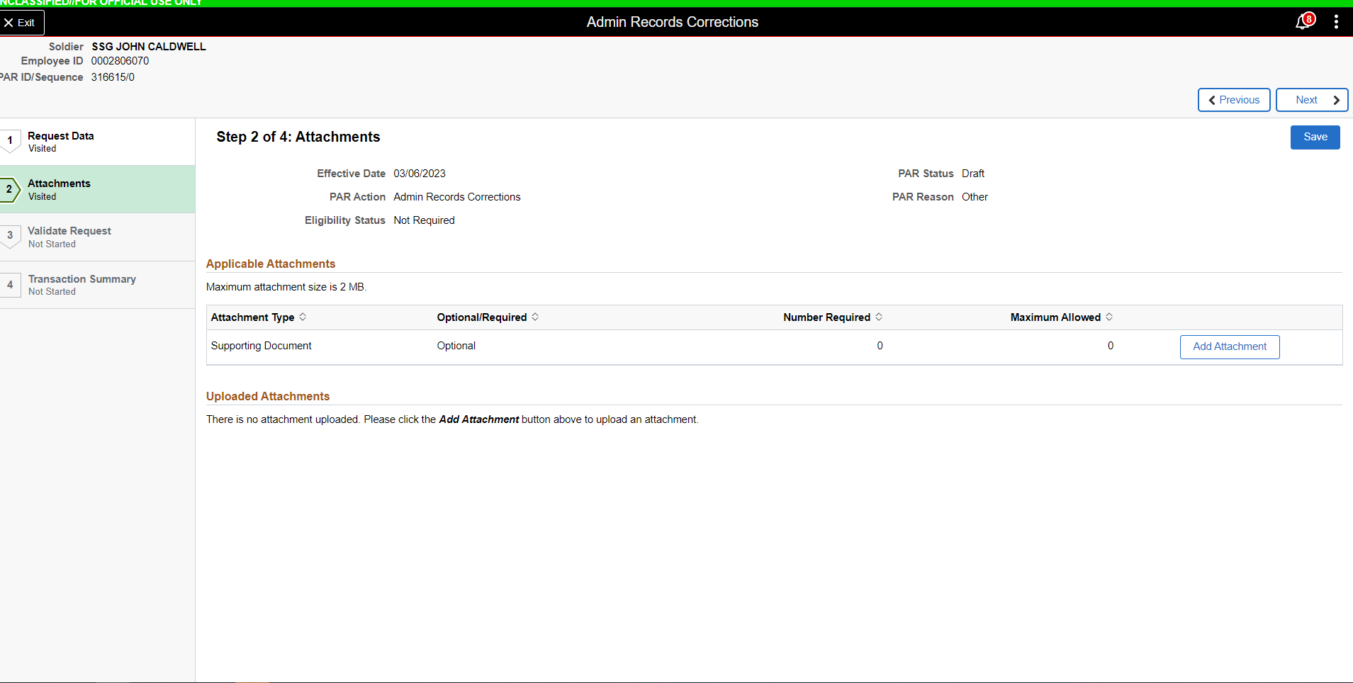
ICP REQUEST DOCUMENTS:
ABSENCE REQUEST
5434 (IF APPLICABLE)
ORDER

Slide 7
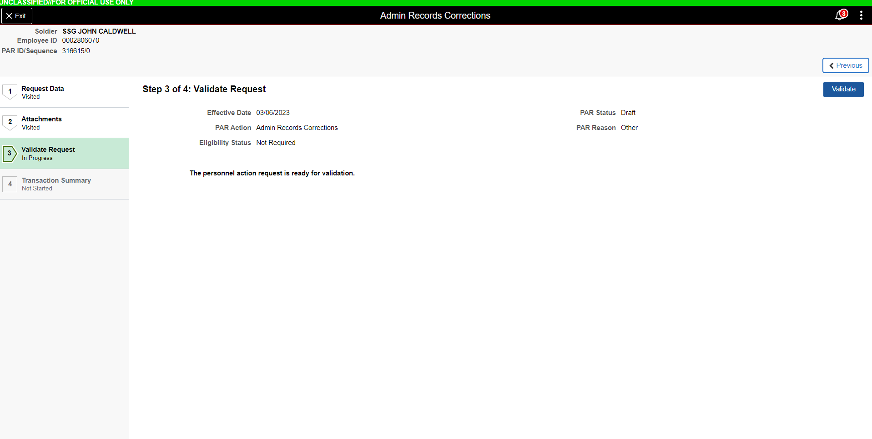
CLICK HERE

Slide 8
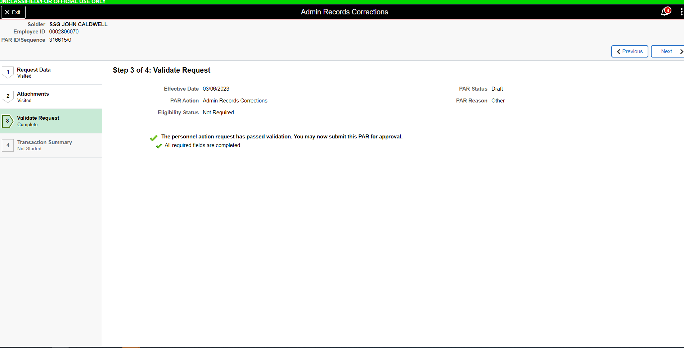
CLICK NEXT

Slide 9
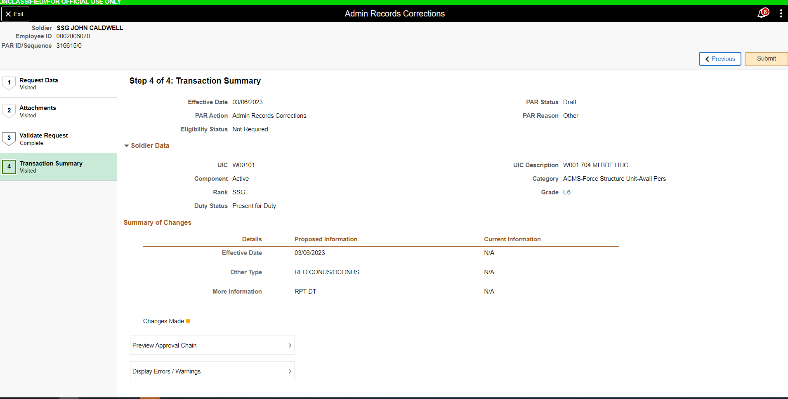
CLICK SUBMIT
ICP REQUEST

