Slide 1
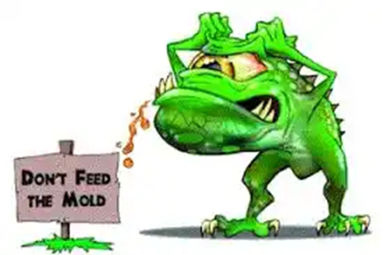
COUNTER MOLD 101
Counter Mold Communication Resource Guide
Scott Malcom
Director, Public Affairs
U.S. Army Installation Management Command
Controlled by: HQ IMCOM Controlled by: AMIM-PA
Maria.e.gallegos6.civ@army.mil 210.466.0122
As of: 051723

Slide 2
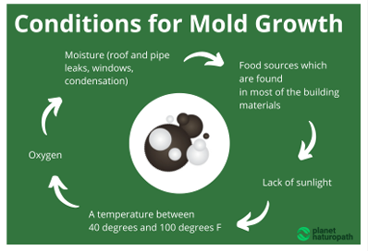
Counter Mold 101
Table of Contents
Inform and Educate
Forward | 3
Definitions | 4
Top Line Messaging | 5
Media Engagement | 6
Mold Checklist | 7
Questions & Answers | 8-10
Digital Garrison App Reporting | 11
Army Maintenance Reporting | 12
Counter Mold Flyers for Use | 13-15
Remediation Guidance | 16-17
Counter Mold Videos | 18
IMCOM HQ SharePoint Links | 19
The purpose of this Counter Mold Communications Resource Guide is to provide guidance and resources for IMCOM professionals to effectively communicate key messages that are consistent throughout the command to improve and maintain Quality of Life for our Soldiers, Families, and Civilians who work and live in Army-maintained barracks, housing, and other facilities.
Operations Order (OPORD) 23-007
  IMCOM executes offensive counter mold operations within Army-maintained barracks, housing, and facilities to improve the Quality of Life (QoL) for Army Soldiers, Families, and Civilians, and inform resource decisions made by Army Senior Leaders (ASL).
2

Slide 3
Counter Mold 101
Forward
Thank you for utilizing this Counter Mold Resource Guide, compiled by the U.S. Army Installation Management Command Headquarters Public Affairs team. This guide provides IMCOM professionals with tools and ideas for developing content to effectively communicate with our Soldiers, Families, and Civilians about operation counter mold.
The purpose of this operation is to proactively eliminate threats to life, health, and safety from mold and improve the quality of life for people in Army facilities.
As IMCOM professionals, our main objective is taking care of our people. We all know mold exists; let’s collectively do what we can to ensure all facilities are free of hazardous mold by enforcing our standards, informing and educating residents and leaders, developing and sharing command-wide prevention tactics, techniques and procedures, and constructively reframing how we all think about mold.
To that end, this resource guide encompasses the “best practices” from various garrisons' public affairs offices. We hope these examples will inspire and enable you to develop new materials relevant to your location.
We encourage you to use this resource guide to synchronize communication with your teammates, leaders, residents, and community partners.
U.S. Army Installation Management Command Headquarters Public Affairs Team
WE ARE THE ARMY’S HOME
3
CUI

Slide 4
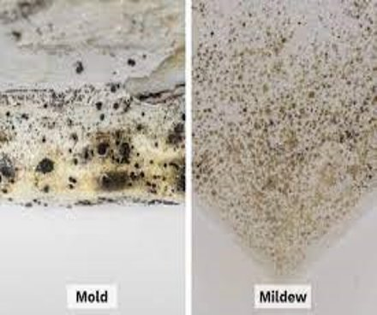
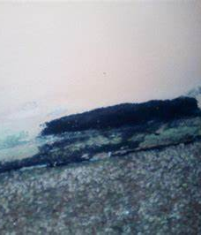
Counter Mold 101
Definitions
Mold - A naturally occurring microscopic fungi that can grow on indoor and outdoor surfaces. Mold can live in all environments, climates, and seasons but requires oxygen, moisture, and a nutrient source to grow. The types of molds and their abundance in an area depend on the availability of nutrients like dirt, water, and temperature. Molds grow well on cardboard, ceiling tiles, paper, and wood products.
Mildew - A general term used to refer to certain kinds of mold or fungus that typically grow in a flat growth pattern and found on shower walls, windowsills, and other places with high moisture levels.
Black/Toxic Mold - A generic term used to refer to toxigenic molds, or molds that produce mycotoxins. This term typically refers to the species stachybotrys chartarum, which can be identified in water damaged buildings.
4
Notes:
Need TP for FIP

Slide 5
Counter Mold 101
Top line messaging
The Army is committed to providing safe quality housing, barracks, and other facilities for our Soldiers, Families, and civilians. A critical aspect of this commitment is ensuring all facilities are free of hazardous mold.
As the Army Materiel Command (AMC) major subordinate command responsible for managing the Regular Army’s infrastructure and for overseeing the Army’s privatized housing projects, Installation Management Command (IMCOM) has undertaken a holistic, global effort to reduce the risk of hazardous mold in Army facilities and housing.
This effort has been informed by the Army’s public health experts and is grounded in the Army Public Health Center’s (APHC) Technical Guides 277 titled “Army Mold Remediation Guidance,” and 278 titled “Mold Assessment Guide”. IMCOM applies these publication’s definition of hazardous mold and mitigation/remediation standards across the command.
IMCOM Garrison Commanders are training and certifying all mold inspectors and government remediation teams to the APHC standard and placing these individuals on appointment orders.
IMCOM will ensure all work orders for mold in Army facilities are responded to by a certified inspector within 24 hours. The command is also ensuring the privatized housing companies similarly respond to mold work orders.
If the certified inspector identifies a hazardous condition based on the APHC standard, the area is appropriately contained and isolated while a certified mitigation and remediation team (government or contracted) eliminates the hazardous condition. The privatized housing companies are following a similar approach and safely displacing families while remediation occurs.
A certified government inspector will validate that no hazardous conditions exist before allowing the facility to fully reopen. Certified government inspectors will also validate that no hazardous conditions exist in privatized housing during the quality assurance process.
5

Slide 6
Counter Mold 101
Media Engagement
Leader Quotes: “In our Army, it’s about People First and the care and quality of life for our Soldiers and their families is always forefront in our minds. We’re investing in our barracks and housing to give our Soldiers and families the quality of life that’s equal to the quality of their service.” --- General James C. McConville, Chief of Staff of the U.S. Army.
“Our purpose is to proactively eliminate threats to life, health, and safety from mold and improve the quality of life for people in Army facilities. This will allow IMCOM, Army Materiel Command (AMC), and the Army to reinforce the Army’s commitment to quality facilities and investment in our Army Soldiers, Families, and Civilians.” ---
Lt. Gen. Omar Jones IV, Commanding General, U.S. Army Installation Management Command.
Public Statement: The Army’s Installation Management Command (IMCOM) is implementing a comprehensive and enduring plan to inform and educate Soldiers, Families, and Civilians about how they can help counter the presence of mold in all Army facilities before the summer, when mold presents the highest risk to our people, and facilities.
6
Notes:
Need TP for FIP

Slide 7
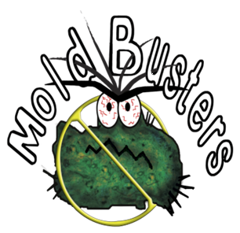
Counter Mold 101
Mold Identification, Remediation, and Prevention Checklist
LIVING ROOM
Walls and Ceilings
If mold is greater than 10 sq. ft. submit Demand Maintenance Order (DMO)
Clean all excess dust, dirt, and grime (routine housekeeping)
Furniture
Make sure furniture is not blocking HVAC air flow
Clean all dirt, dust, and grime (routine housekeeping)
Windows
Check for cracks or chips in the glass or surrounding frame (submit DMO)
Make sure blinds are open (sunlight inhibits mold growth)
Check for any water intrusion or condensation on sill or surrounding area (submit DMO)
Clean all dirt, dust, and grime (routine housekeeping)
Any outside air intrusion (submit DMO)
Thermostat and Heating, Ventilation,
and Air Conditioning (HVAC) System
A/C should be set per Army requirements.
HVAC – should remain on at all times
Clean all vents of excess dirt, dust, and grime (routine housekeeping)
KITCHEN
Refrigerator
Inspect for mold (routine housekeeping)
Check for excessive condensation or water leaks (repair or replace seals, contact Facility Manager to have unit replaced)
Clean excess dirt, dust, and grime (routine housekeeping)
Sink and Cabinets
Inspect sink and plumbing for leaks (submit DMO)
If mold is greater than 10 sq. ft. (submit (DMO)
Front Door and Entrance Way
Malfunctions: auto-closer that do not work or lock properly (submit DMO)
Check for large gaps or weather-stripping damage (submit DMO)
If mold is greater than 10 sq. ft. (submit DMO)
Common area
Clean floors, furniture, kitchen cabinetry, and appliances (routine housekeeping)
Dispose of trash and food (routine housekeeping)
BATHROOM
Walls and Ceiling
If mold is greater than 10 sq. ft. (submit DMO)
If visible moisture appears in bathroom. Make sure exhaust vent is working properly, if it is not working (submit DMO)
If mold is in tub caulking (submit a DMO to replace caulking)
Sink
Inspect sink and plumbing for leaks (submit DMO)
If mold is greater than 10 sq. ft. (submit DMO)
ACTIONS TAKEN/REQUIRED
Barracks Facilities
Mold Growth
Less than 10 sq. ft. Sign out a “Mold Buster Kit” from Self-Help Bldg. 4541 or Environmental Bldg. 2522; Kit includes all cleaning agents, personal protective equipment, and instructions for cleaning
If mold is greater than 10 sq. ft. (submit DMO)
7

Slide 8
Counter Mold 101
Questions & Answers
Q1. How does the Army define mold?
A1. Mold is a naturally occurring microscopic fungi that can grow on indoor and outdoor surfaces. Mold can live in all environments, climates, and seasons but requires oxygen, moisture, and a nutrient source to grow. The types of molds and their abundance depend on the availability of nutrients like dirt, water, and temperature. Molds grow well on cardboard, ceiling tiles, paper, and wood products.
Q2: Why the big effort to counter mold now?
A2: Last fall, Army senior leaders directed IMCOM and installation leaders to inspect Army facilities with an emphasis on life, health, and safety with a focus on mold. More importantly, one of IMCOM’s core competencies is to manage the regular Army’s infrastructure. We recognize Soldiers, Families and Civilians are concerned with mold, but may lack sufficient knowledge on how to properly identify it, report it and, when appropriate, mitigate it. As part of this operation, IMCOM professionals will inform and educate members of the Army community of roles they can play to help increase our collective understanding of how to think about and deal with mold on our installations. IMCOM professionals are also training and certifying inspectors to meet the standards established for this operation.
Q3: To date, what has been done to remediate these mold issues?
A3: Between November 2022 and January 2023, leaders inspected active Army barracks, childcare facilities, and Army-owned family housing (67,859 facilities). 97% of facilities were mold free, the mold that was found was immediately remediated to standard.
IMCOM held a Counter Mold Workshop Jan.10-12, 2023, with healthcare professionals, industry experts, DoD partners, and garrison leadership to find ways to raise awareness and prevent and mitigate mold. This effort was informed by the Army’s public health experts and grounded in the Army Public Health Center’s (APHC) Technical Guides 277 titled “Army Mold Remediation Guidance,” and 278 titled “Mold Assessment Guide”. IMCOM applies the definition of hazardous mold and mitigation/ remediation standards across the command from these publications.
8
Notes:
Need TP for FIP

Slide 9
Counter Mold 101
Questions & Answers
Q4: What does mold treatment entail?
A4: Remediation plans will vary depending on the extent of damage. Smaller, isolated areas of less than 10 square feet of visible mold can generally be remediated by either housing staﬀ or tenants. Larger areas of visible mold may require experienced professional mold remediation teams. During treatment the area will be contained to prevent the mold from spreading to other areas. All surfaces will be cleaned.
Q5: How will the Army enable its personnel to protect against and prevent mold in the future?
A5: Identified Soldiers will attend a Mold Assessment and Remediation in Buildings training course. The course teaches industry-standard mold remediation practices these Soldiers can bring back to their units and apply at their installation. Following a 100-question exam at the end of the course, participants are awarded a Mold Inspector/Remediator certification. As part of the training, participants are taught how mold forms and receive hands-on training with specialized tools and equipment that they will use to inspect, identify, and treat mold. The emphasis is on prevention as the best way to manage mold.
Q6: Is the Army treating all mold as if it were hazardous or toxic?
A6: APHC treatment guidelines are based on the size of an affected area to make it easier for exterminators to select the appropriate treatment. When in doubt, caution is advised.
9
Notes:
Need TP for FIP

Slide 10
Counter Mold 101
Questions & Answers
Q7: If Soldiers reside in a barracks that is known to have mold, are they entitled to any additional health claims or considerations? Is there a registry anywhere?
A7: U.S. Army Medical Command (MEDCOM) established a Housing Environmental Health Response Registry to address Army family concerns about Army family housing and related health issues.
Q8: How Do I get rid of Mold?
A8: It is impossible to get rid of all mold and mold spores indoors; some mold spores will be found floating through the air and in house dust. The mold spores will not grow if moisture is not present. Indoor mold growth can and should be prevented or controlled by controlling moisture indoors. Where there is mold/mildew growth, it must be cleaned up the water leak repaired. Simply cleaning up without fixing the water problem will not prevent the mold from coming back.
Q9: Who should do the cleanup?
A9: Clean up is the individual responsibility of every Soldier, Civilian professional, or Family member living or working in Army-maintained barracks, housing, or other facility in the prevention phase. Accomplish this through daily cleaning, using shower fans and ensuring they work, drying surface areas and fixing water or moisture leaks as soon as they are identified.
Who should do the cleanup also depends on several factors. Smaller, isolated areas of less than 10 square feet of visible mold can generally be remediated by either housing staﬀ or tenants. If it larger that 10 square feet but less than about 25 square feet, the tenant should put in a work order. Contact DPW via 24/7 hotline through ArMA, the Army’s on-line work order submission and tracking system at ArmyMaintenance.com (ArMA).
10
Notes:
Need TP for FIP

Slide 11

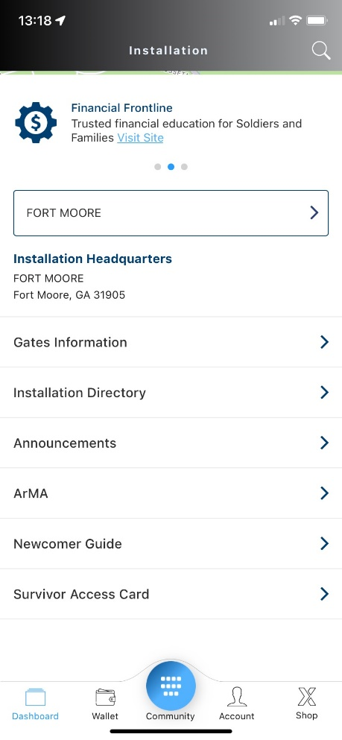
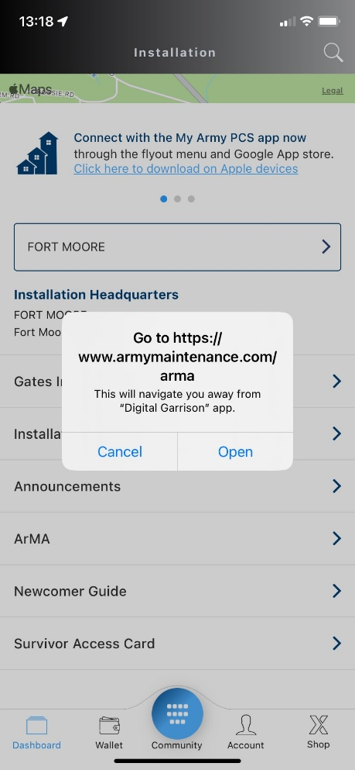
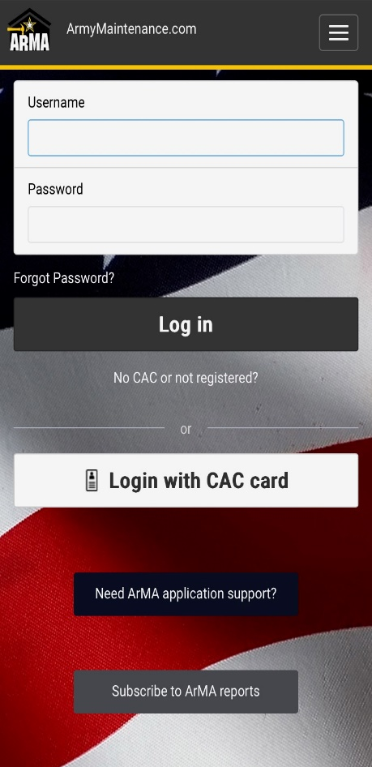
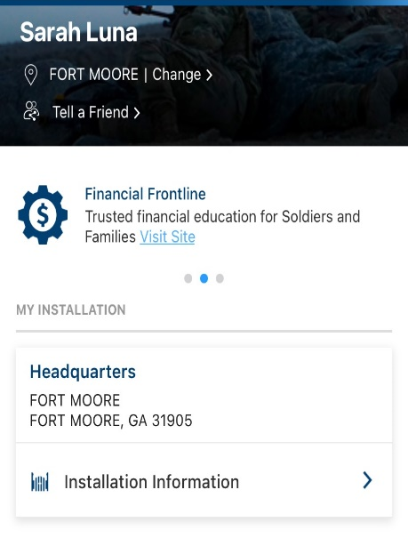
Counter Mold 101
ArMA Access through Digital Garrison
1. Download or open Digital Garrison
2. Tap Installation Information
3. Tap ArMA
4. Tap Open
5. Log into ArMA
11
Notes:
Need TP for FIP

Slide 12
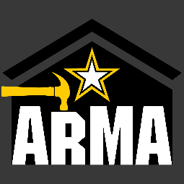
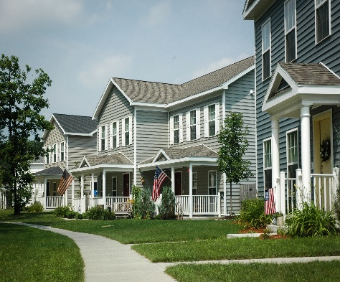
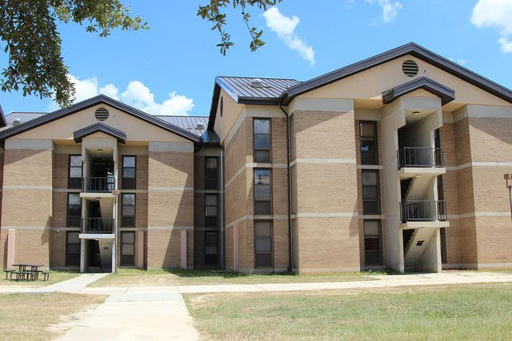
Counter Mold 101
Army Maintenance Reporting
Family housing residents who suspect mold should submit a service order to the 24/7 Maintenance Request Line at xxx-xxx-xxxx. Soldiers with mold concerns in barracks should submit a work order by visiting www.armymaintenance.com/arma, or call the Directorate of Public Works work order request line at xxx-xxx-xxxx.
Housing residents may also contact the (Garrison) Housing Office hotline at xxx xxx-xxxx.
All work orders for mold in Army facilities are responded to by a certified inspector within 24 hours or the next business day.
12
Notes:
Need TP for FIP

Slide 13
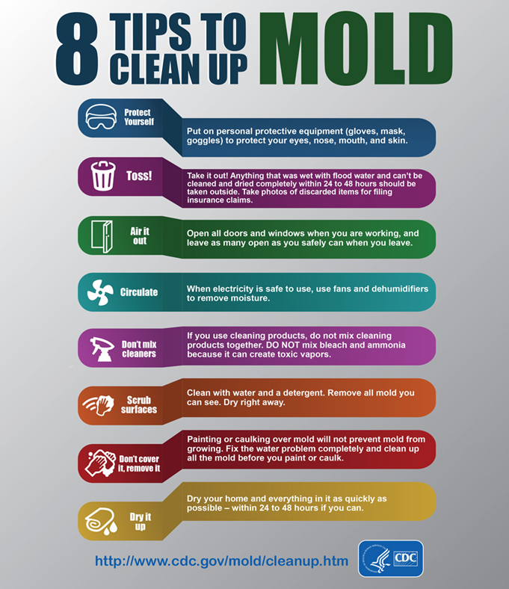
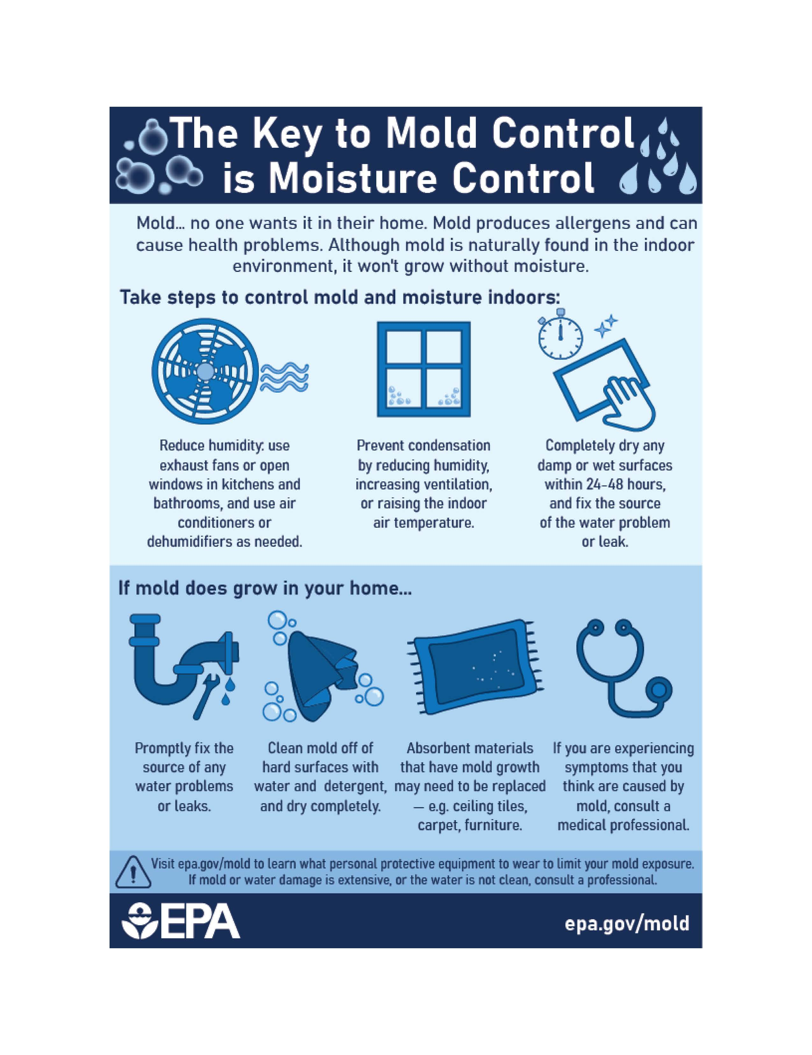
Counter Mold 101
Flyers for Use
13

Slide 14
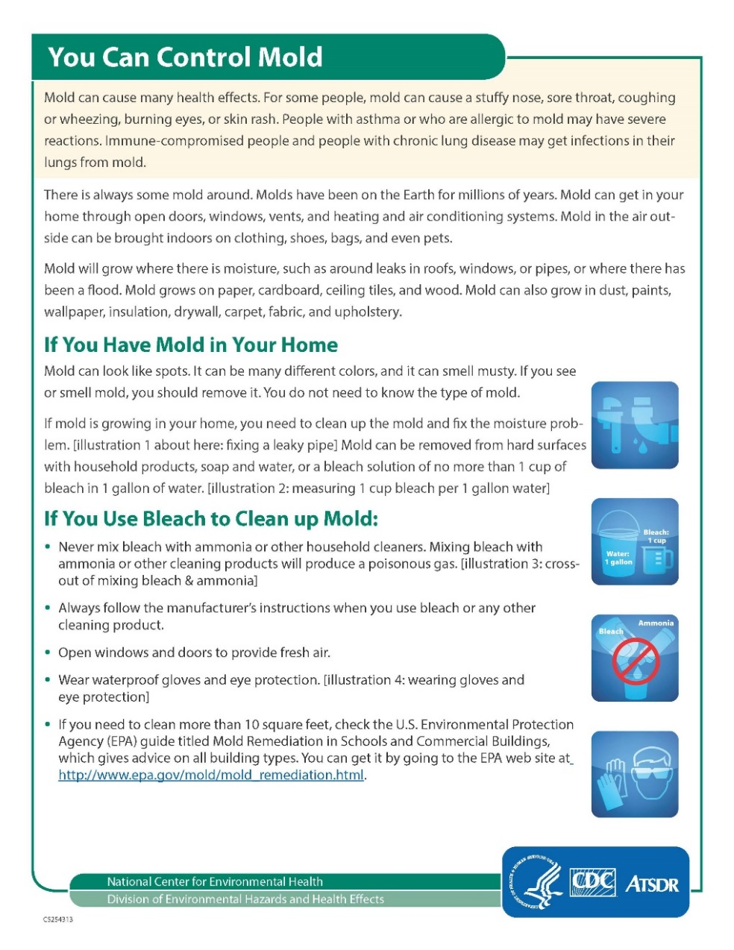
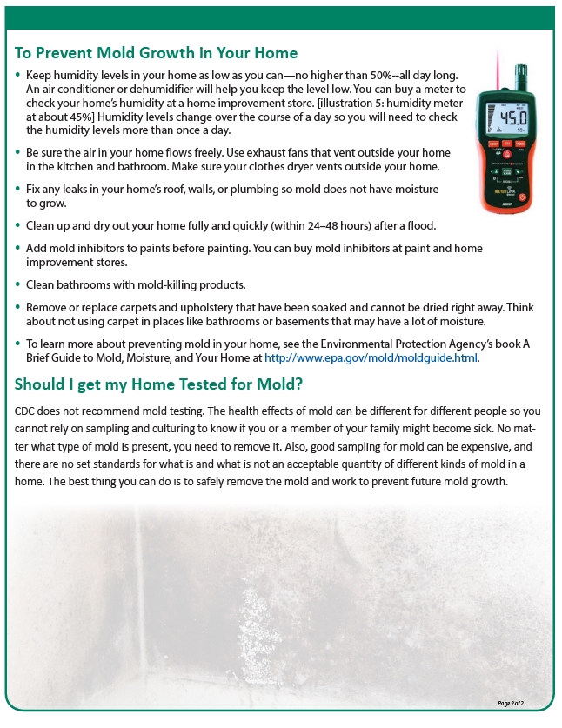
Counter Mold 101
Flyers for Use
14

Slide 15
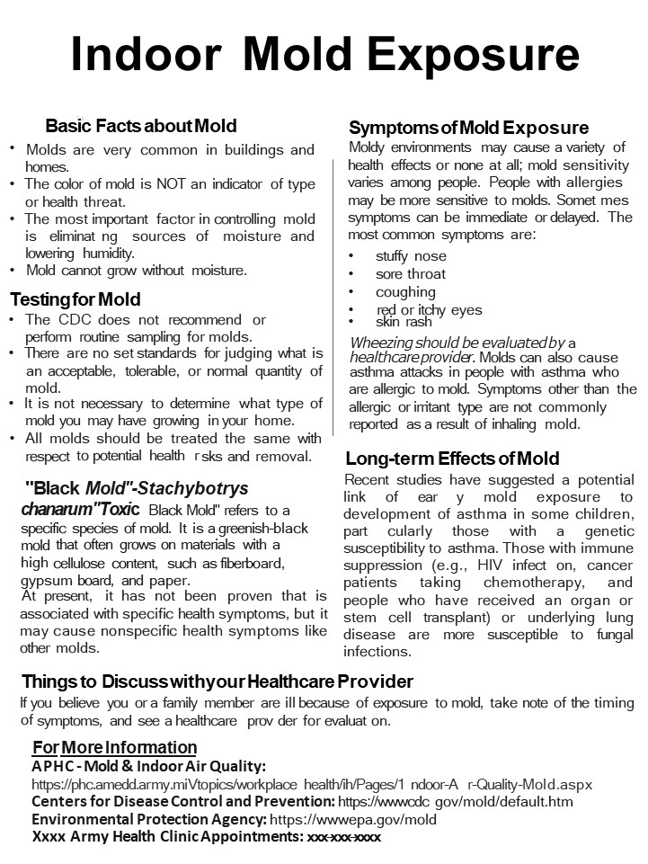
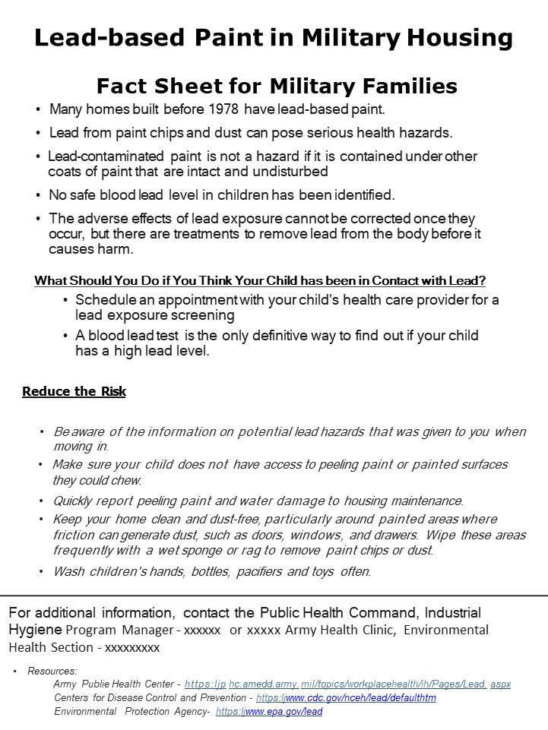
Counter Mold 101
Flyers for Use
15

Slide 16
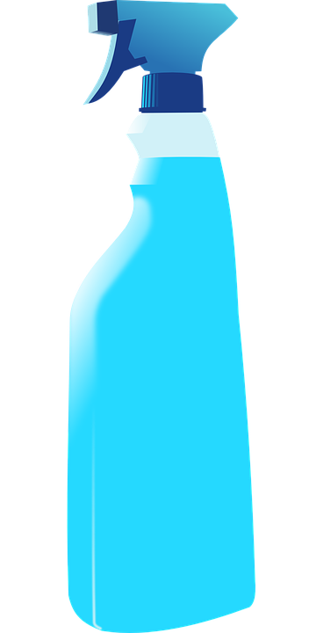

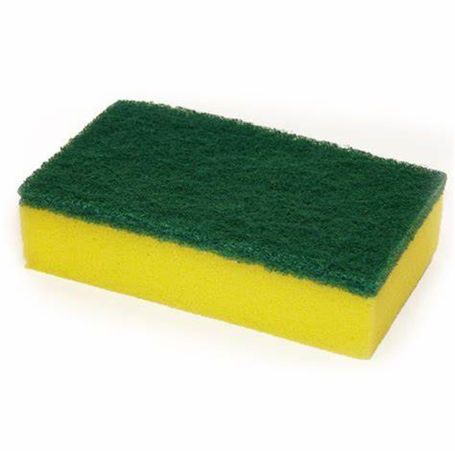
Counter Mold 101
Remediation Guidance
Do not use bleach to clean mold
It is not effective at “killing” mold nor does it
remove it from the surface. A simple soap
solution or disinfecting cleaner should be used.
Dampen areas prior to cleaning
Surface dusting should include the use of
cleaners to avoid sweeping mold and allergens
into the air.
Wash clothing
Items used during remediation should be
washed as soon as possible after mold clean-up
is complete.
General Purpose Cleaning Solution
Light cleaning and surface mold: pour general purpose cleaner into gallon container and dilute to one gallon with water.
If one gallon container is not available: pour about 1/4 of the bottle into a spray bottle contained in the Mold Buster Kit and dilute with water.
Heavy mold growth or dirt: use in concentrated form directly from the bottle.
Re-Growth
If mold growth is present on a porous material surface cleaning may not remove all mold growth.
Surface cleaning and sanitizing will not penetrate deep enough to kill all the hidden "root-like" parts of the mold colony, particularly if materials can not be adequately dried.
Mold contamination below the surface may indicate additional concerns and should be assessed by DPW personnel.
16

Slide 17
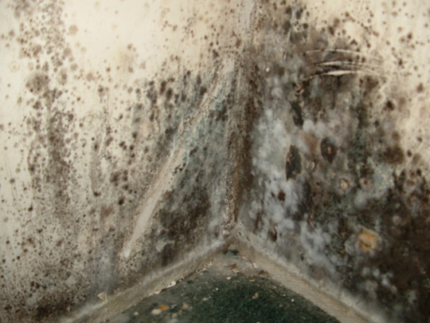
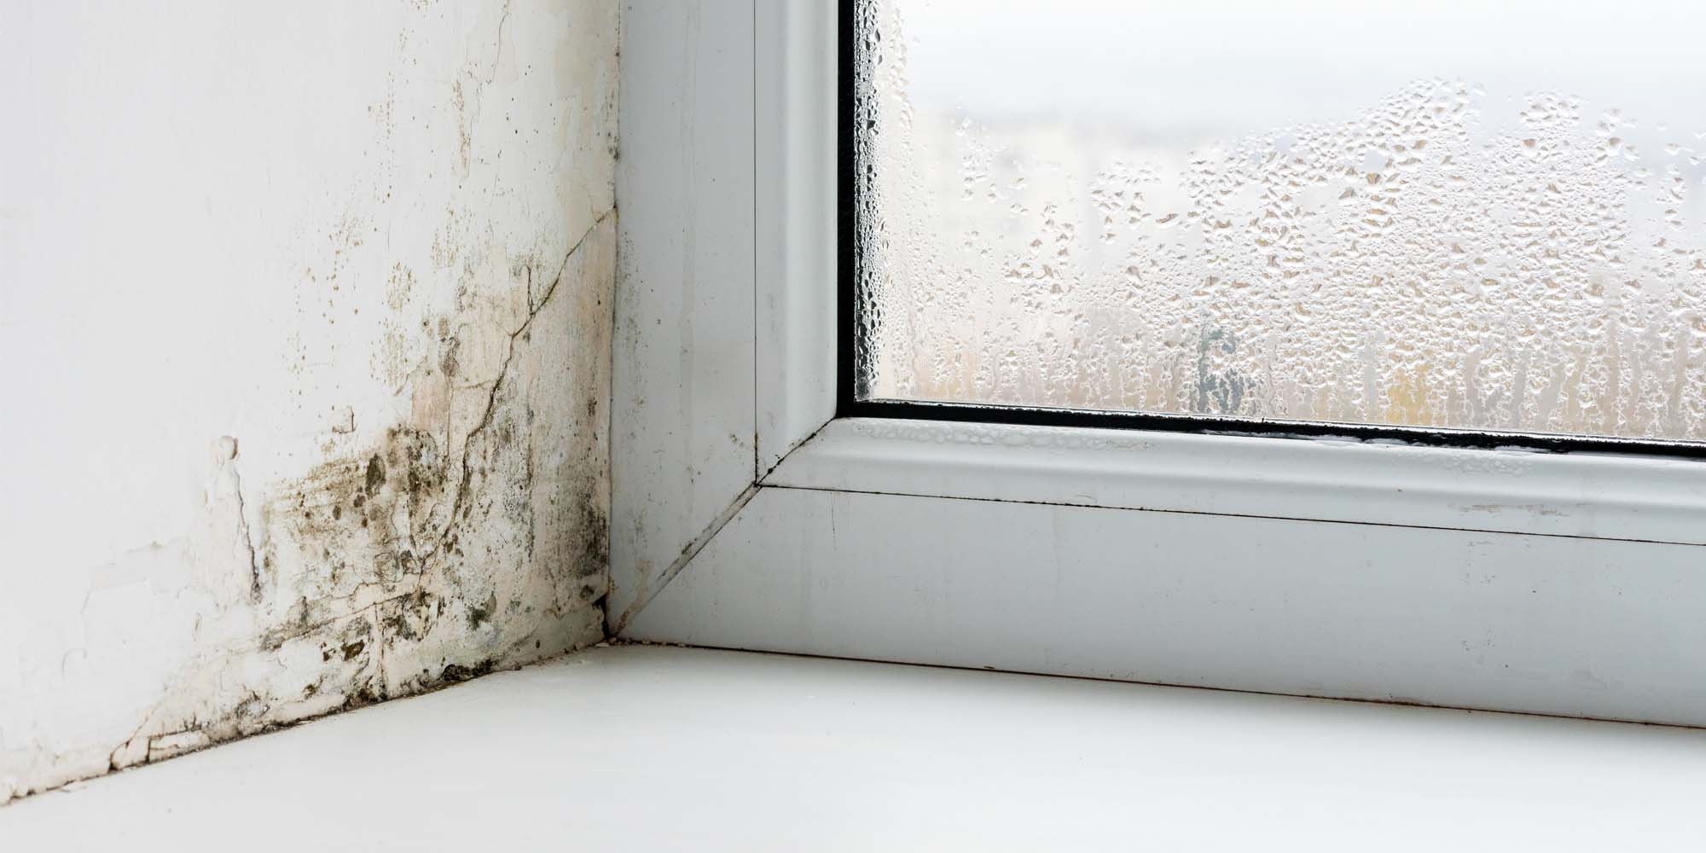
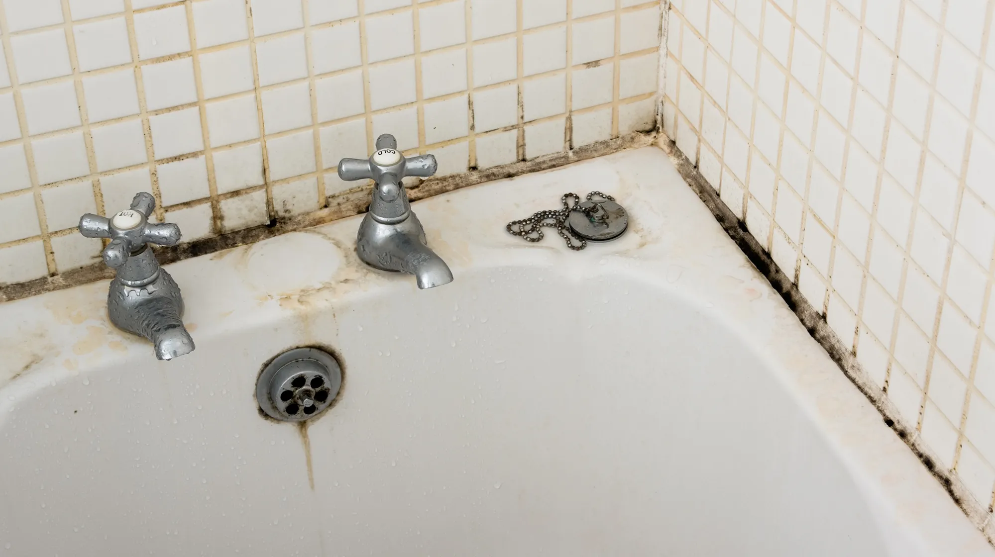
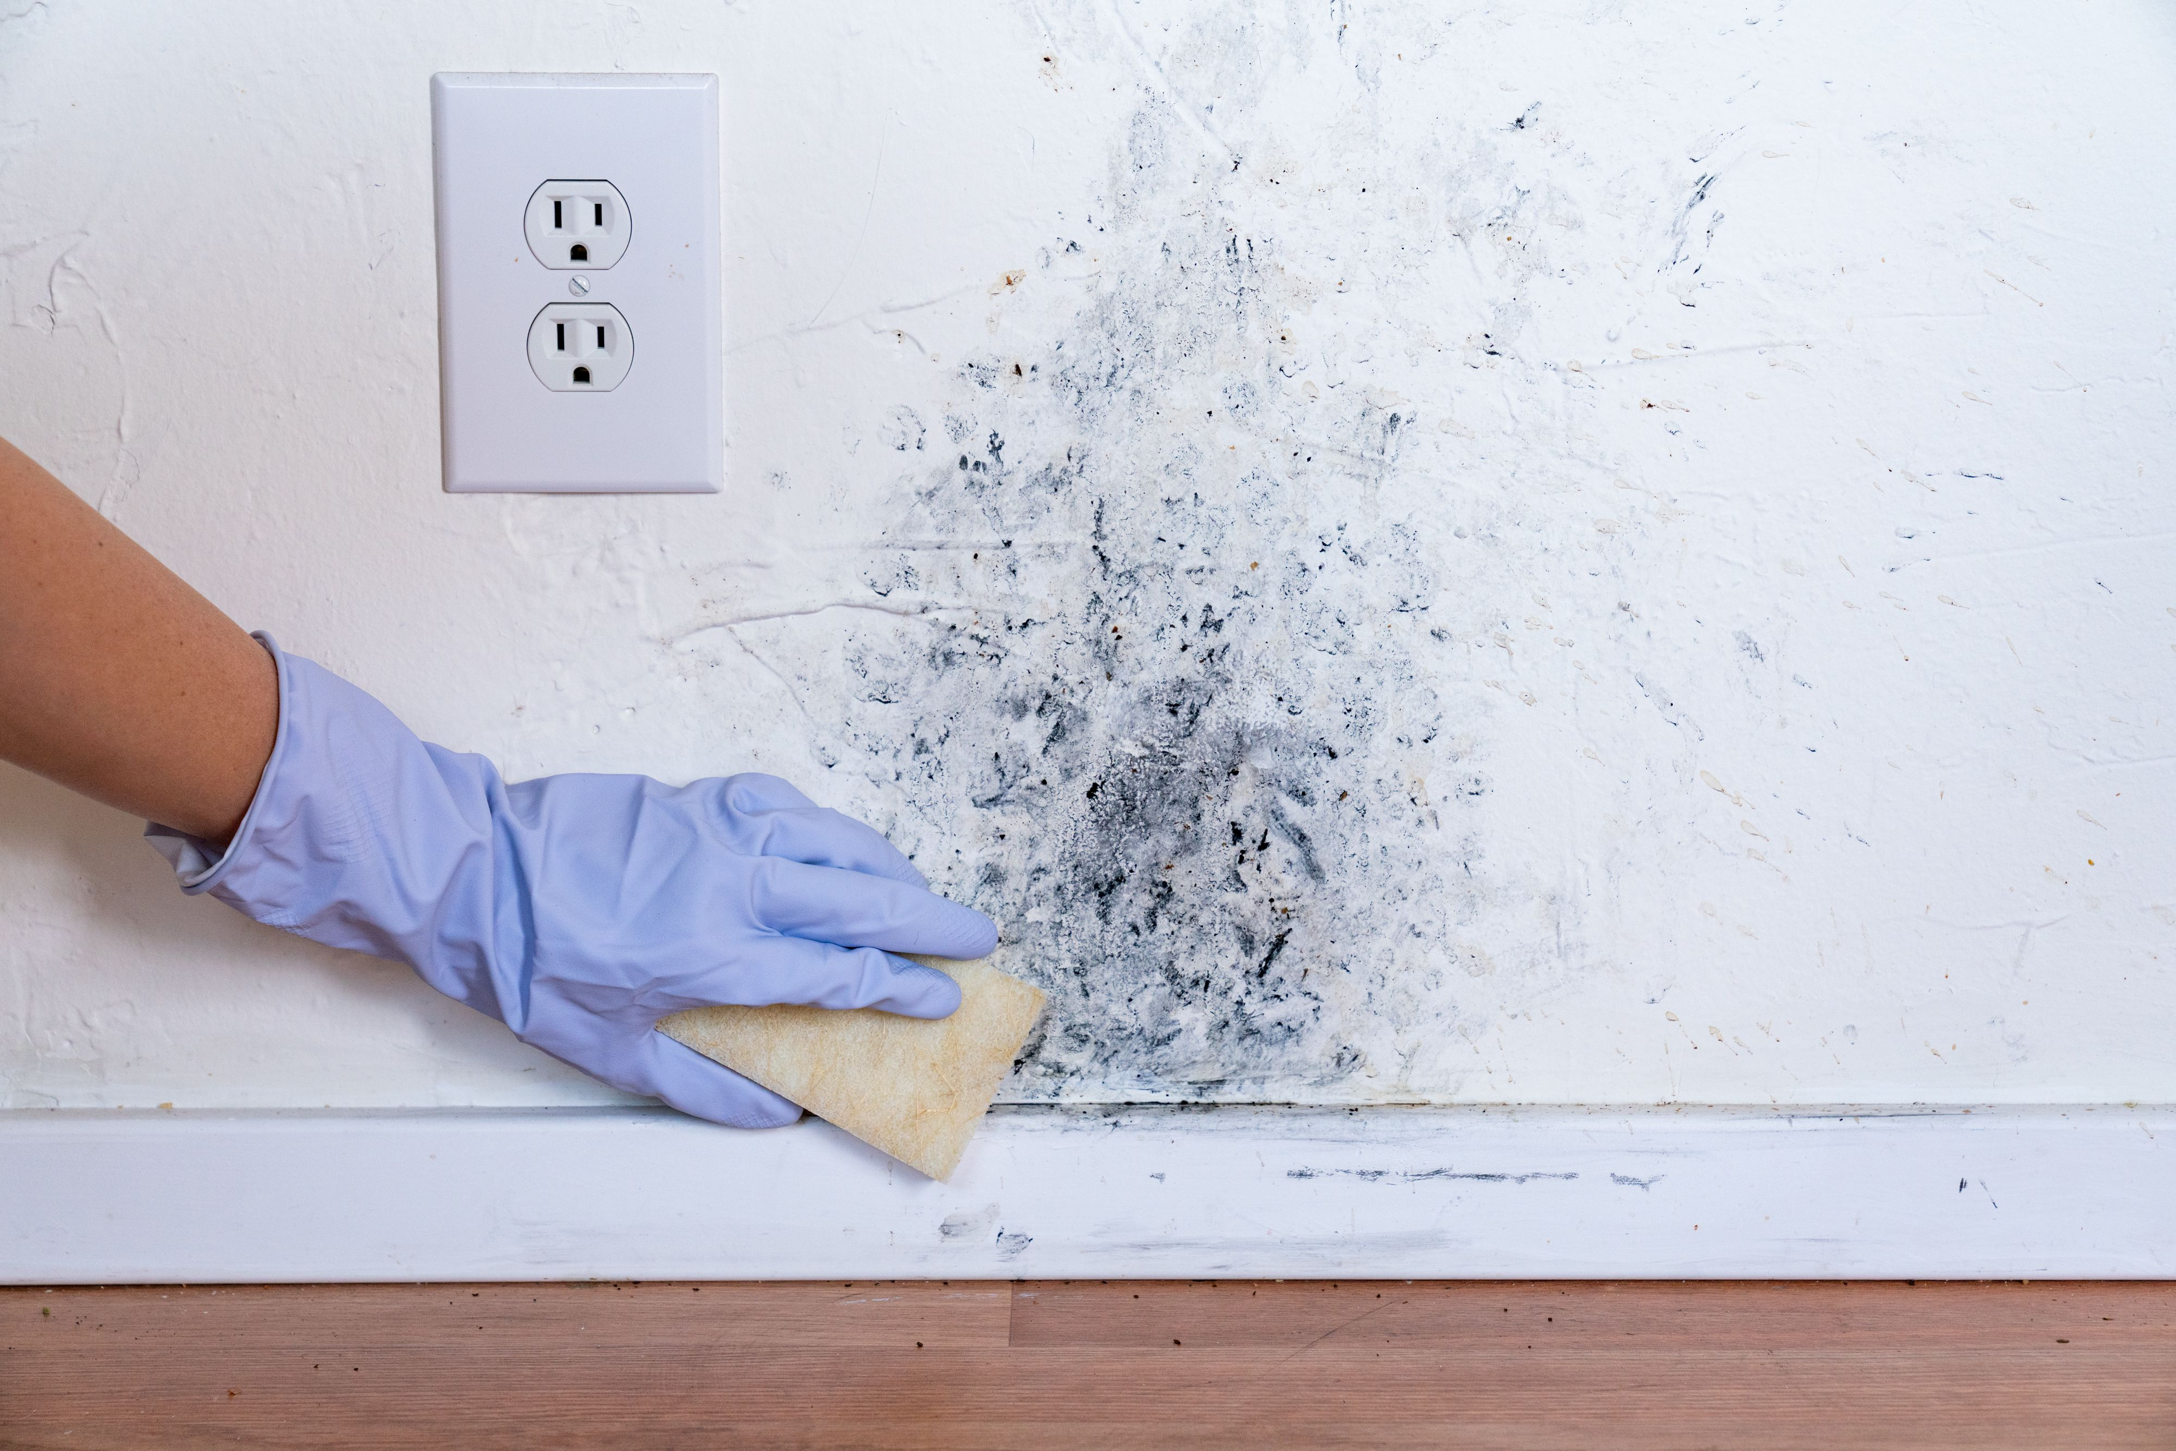
Counter Mold 101
Remediation Guidance
Occupant Facility Maintenance
Air Conditioning/Heating System must remain on at all times.
Utilize the exhaust fan when taking a shower.
Dry moisture on surfaces daily, if present.
Call in a DMO to repair plumbing leaks and other water problems as soon as possible.
Open blinds before leaving room.
Remove dust, dirt, and grime weekly through routine housekeeping.
Clean mold growth with general purpose cleaner, when it first appears. Do not use bleach to clean mold.
Mold removal process - moisten, wipe, rinse and dry.
Do not use blankets or covers to darken the room.
Keep windows and doors closed at all times.
Government Property
Care should be utilized when cleaning or sanitizing to avoid damage to government property.
Disposal of government property contaminated with mold growth, should only be undertaken with the permission of the property book holder and your chain of command.
Removing Mildew
Soap and water mix in a spray mix in a spray bottle is the preferred solution for mildew removal. Use PPE when cleaning.
Ensure to dry the surface after cleaning.
17

Slide 18
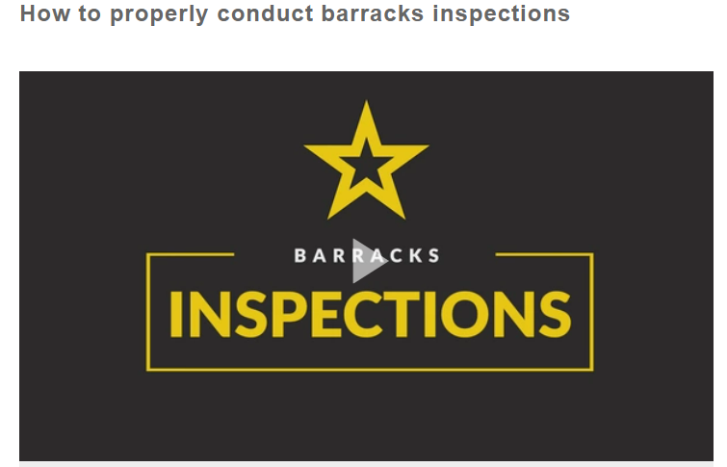
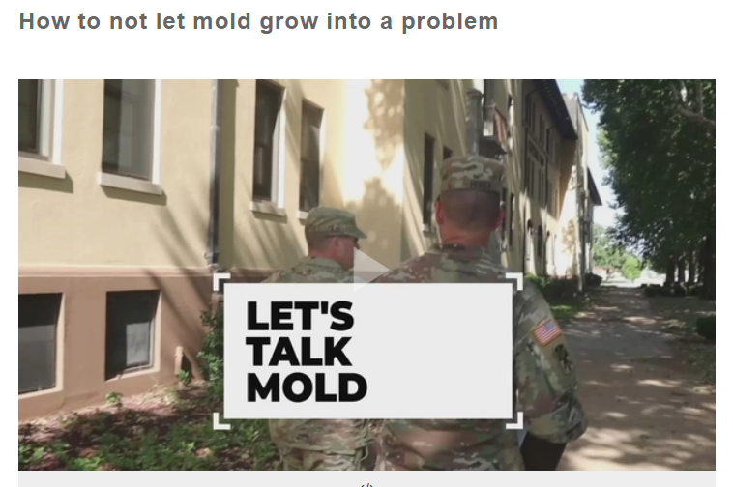
Counter Mold 101
Counter Mold Videos
CTRL + Click to follow links to the videos
18

Slide 19
Counter Mold 101
Additional Resources
IMCOM HQ Counter Mold SharePoint
IMCOM Public Affairs:
https://armyeitaas.sharepoint-mil.us/sites/IMCOM-HQ-PAO/SitePages/Counter-Mold.aspx
IMCOM G4:
https://armyeitaas.sharepoint-mil.us/sites/IMCOM-HQ-G4/SitePages/Counter-Mold-Home.aspx
Defense Centers for Public Health:
https://phc.amedd.army.mil/search/Pages/results.aspx?k=mold
19

