Slide 1
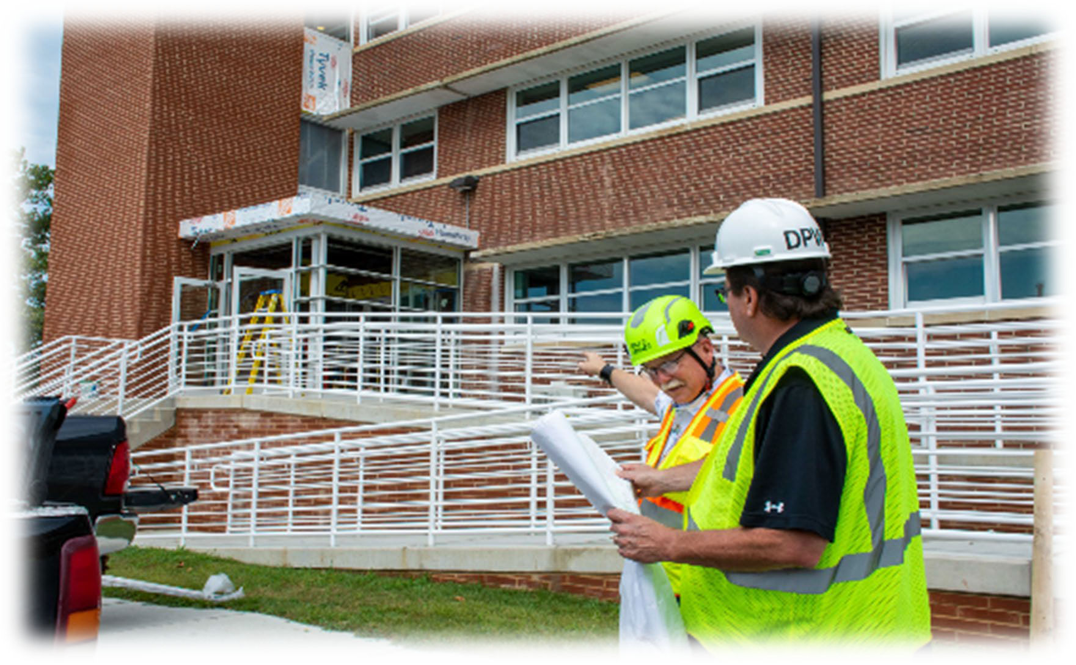
Army Housing Office Plain Language Brief (PLB)
WE ARE THE ARMY’S HOME
Installation Fort George G. Meade
U.S. Army Installation Management Command
Controlled by: HQ IMCOM Controlled by: AMIM-G3 Category: OPSEC
Limited Dissemination Control: DL ONLY POC: Name/e-mail/Phone Number
As of: AUG 2024
Plain Language Brief_ Version I

Slide 2
Plain Language Brief Explained
The Military Housing Privatization Initiative (MHPI) Tenant Bill of Rights requires the garrison AHO to provide a plain language brief presenting the facts on tenants’ rights and responsibilities associated with tenancy of the housing unit to all residents of privatized housing prior to lease signing and again 30 days after move-in on all rights and responsibilities.
“The Department of Defense is fully committed to ensuring that associated with tenancy of the housing unit, including MHPI housing projects provide our Nation’s most valued resource—its military members and their families—safe, quality, and well-maintained housing where our members and their families want and choose to live.
“The Department of Defense has issued all policy guidance necessary to implement prospectively all rights for military members and their families residing in privatized family and unaccompanied
housing (Tenants) at all MHPI housing projects. However, as Congress recognized, retroactive
application of the requirements at existing projects requires voluntary agreement by the respective
MHPI company; the Department cannot unilaterally change the terms of the complex, public-private
partnerships that established the MHPI housing projects. The Department of Defense has been
seeking to secure voluntary agreements, and nearly all of the MHPI companies have agreed to
implement all 18 Tenant rights at their existing projects. The Department will continue to pursue
agreements not yet reached. Tenants should contact their installation housing office to confirm the
rights fully available to them.”
WE ARE THE ARMY’S HOME

Slide 3
Garrison Points of Contact
The Fort George G. Meade Army Housing Office (AHO) staff are employed by the Army to assist Service Members and their families with housing matters and advocate on their behalf with community partners/agencies both on and off the installation
The Army Housing Chief reports directly to the Director, Public Works and garrison leadership
The AHO provides oversight of the privatized on post housing project managed by the privatized housing company and provides tenant/landlord dispute services
The AHO provides referral services to Service Members and families that reside or are seeking to reside off the installation
Garrison Leadership
- Garrison Commander: COL Yolanda Gore
- Garrison Command Sergeant Major: CSM Richard Moore
Deputy Garrison Commander/Manager: Brian Foley
Garrison Housing Chief: Aimee Stafford
Army Housing Office
3081 Ernie Pyle St
Fort Meade, MD 20755
301-677-7748
WE ARE THE ARMY’S HOME

Slide 4
Project Company Contacts
Corvias Property Management is the privatized company that owns and manages the Family or Privatized Unaccompanied housing on this installation
Corvias Property Management is the private partner and managing member of Meade Communities and your landlord.
Corvias Property Management is the property management company that manages the day to day operations of the privatized housing to include ensuring prompt and professional maintenance and repair, addressing of property concerns, and rent/billing issues.
Corvias Property Management Contacts and contact numbers:
Operations Director: Brittney Dabney - Program Office 410-672-4570
Assistant Operations Director: Christie Taylor - Program Office 410-672-4570
Community Manager: Ryan Marsh – 410-672-4059
Facilities Director: David Brooks - Program Office 410-672-4570
WE ARE THE ARMY’S HOME

Slide 5
Tenant Bill of Rights
In 2020, laws were passed to assure military tenants basic rights to:
Reside in a housing unit and a community that meets applicable health and environmental standards.
Reside in a housing unit that has working fixtures, appliances, and utilities and to reside in a community with well-maintained common areas and amenity spaces.
A previous seven-year maintenance history of the prospective housing unit within two business days after making request before signing a lease. A current tenant who did not receive maintenance information before signing a lease has the right to receive such information within five business days after making the request.
A written lease with clearly defined rental terms to establish tenancy in a housing unit including any addendums and other regulations imposed by the Landlord regarding occupancy of the housing unit and use of common areas.
A plain-language briefing, before signing a lease and 30 days after move-in, by the AHO on all rights and responsibilities associated with tenancy of the housing unit, including information regarding the existence of any additional fees authorized by the lease, any utilities payments, the procedures for submitting and tracking work orders, the identity of the Military Tenant Advocate, and the dispute resolution process.
Given sufficient time and opportunity to prepare and be present for move-in and move-out inspections, including an opportunity to obtain and complete necessary paperwork.
Report inadequate housing standards or deficits (deficiencies) in habitability of the housing unit to the Landlord, the chain of command, and Installation housing office without fear of reprisal or retaliation.
WE ARE THE ARMY’S HOME
Notes:
Follow Verbiage from Federal Regulation/ Federal Law

Slide 6
Tenant Bill of Rights
Access a military tenant advocate or a military legal assistance attorney, through the AHO to assist in the preparation of requests to initiate a dispute resolution. This includes the ability to submit a request to withhold payments during the formal dispute resolution process.
Receive property management services provided by the Landlord that meet or exceed industry standards and that are performed by professionally and appropriately trained responsive and courteous customer service and maintenance staff.
Have multiple, convenient methods to communicate directly with the Landlord maintenance staff, and to receive consistent, honest, accurate, straightforward and responsive communications.
Have access to an electronic work order system through which a tenant may request maintenance or repairs of a housing unit and track the progress of the work.
Corvias Property Management Maintenance Contacts:
Maintenance Shop Contact Number: 1-844-346-1490
Maintenance Shop Location: 1001 21st St, Fort Meade
Maintenance Website: https://meade.corviaspm.com
Maintenance Application: https://fortmeade.residentportal.com
Prompt and professional maintenance and repair, to be informed of the required time frame for maintenance and repairs when a maintenance request is submitted and when maintenance or repairs are necessary to ensure habitability of a housing unit, to prompt relocation into suitable lodging or other housing at no cost to the tenant until the maintenance or repairs are completed.
WE ARE THE ARMY’S HOME

Slide 7
Tenant Bill of Rights
Receive advice from military legal assistance on procedures involving mechanisms for resolving disputes with the property management company or property manager to include mediation, arbitration, and filing claims against the Landlord.
Installation Legal Office : Legal Assistance Office – 301-677-9504 or 9536
Enter into a dispute resolution process should all other methods be exhausted and, in which case, a decision in favor of the tenant may include a reduction in rent or an amount to be reimbursed or credited to the tenant.
Have your basic allowance housing payments segregated and held in escrow, with approval of a designated commander, and not used by the property owner, property manager, or landlord pending completion of the dispute resolution process.
Have reasonable advance notice of any entrance by the Landlord, Installation housing staff, or chain of command into the housing unit of no less than 24 hours, except in the case of an emergency or abandonment of the housing unit.
Not pay non-refundable fees or have application of rent credits arbitrarily withheld.
Corvias Property Management charges non-refundable pet fees
Expect common documents, forms, and processes for housing units will be the same for all Army Installations, to the maximum extent applicable without violating local, state, or federal regulations.
Note: Tenants seeking assistance with housing issues should continue to engage their garrison AHO, installation leadership, and/or chain of command.
WE ARE THE ARMY’S HOME

Slide 8
Tenant Responsibility
Per your lease, it is your responsibility to:
Report in a timely manner any apparent environmental, safety, or health hazards of the home and any defective, broken, damaged, or malfunctioning building systems, fixtures, appliances, or other parts of the home, common areas, or related facilities to the landlord.
Maintain standard upkeep of the home as instructed by the property management company.
Conduct oneself as a tenant in a manner that will not disturb neighbors, and to assume responsibility for one’s actions and those of a family member or guest in the housing unit or common areas, including the responsibility not to engage in any inappropriate, unauthorized, or unlawful activity in the home or common areas.
The Property Management Resident Handbook provides specific information. Located at https://meade.corviaspm.com under residents.
Allow the landlord reasonable access to the rental home in accordance with the terms of the tenant lease agreement to make necessary repairs in a timely manner.
Read all lease-related materials provided by the landlord and to comply with the terms of the lease agreement, lease addenda, and any associated rules and guidelines.
WE ARE THE ARMY’S HOME

Slide 9
Work Order Process
Corvias Property Management
To alert the Landlord (Corvias Property Management) of maintenance issues:
Emergency or Urgent work orders – Call in immediately to: 1-844-346-1490
Routine work orders – enter online through the Resident Portal
The Resident Portal is available online https://fortmeade.residentportal.com
or download the Resident Portal Mobile in the App Store or on Google Play
Track progress of work orders by viewing information in the Resident Portal Mobile App
Work order or maintenance ticket will be closed once tenant and Garrison Housing Office signs off stating that the work was completed
Important to contact Corvias Property Management to report maintenance issues right away
Contact Corvias Property Management to report emergency, urgent, routine work orders, trouble calls, safety concerns, or resident compliance issues
WE ARE THE ARMY’S HOME

Slide 10
Types of Service Calls
Types of Service Calls | Examples | Response Time
Emergency Critical safety, life threatening issues Resident with a medical requirement for stable temp levels | Gas leaks, fire, power outage, sewage back-up, flood, only toilet inoperable | Emergency 1-1 hour Emergency 2-4 hours Emergency 3-8 hours
Urgent Habitability Issue | Broken window, garage door inoperable, kitchen sink back-up, light-fixtures not working, Refrigerator inoperable | 2 working days
Routine Convenience Unit care issues | Single burner inoperable, repair screens, light bulb replacement | 3 working days to respond
*Depending on parts
WE ARE THE ARMY’S HOME

Slide 11
Informal Dispute Resolution
The informal dispute resolution process is a measured approach intended to resolve disputes at the garrison level that may be used to resolve disputes pertaining to the lease as well as issues that fall outside the specific parameters of the lease document, such as personal property claims.
The tenant may submit a completed informal dispute resolution request form with any documents that support the dispute to the AHO.
An informal dispute resolution form is available at the AHO
Tenants may also visit the garrison Installation legal office to seek assistance in completing the informal dispute resolution form.
The Garrison Commander will serve as the mediator between the property owner and tenant in an effort to resolve the dispute at the local level, normally within 10 business days.
WE ARE THE ARMY’S HOME

Slide 12
Formal Dispute Resolution
The formal dispute resolution process allows eligible tenants to obtain prompt and fair resolution of housing disputes concerning rights and responsibilities set forth in the lease that could not be resolved through the informal dispute process.
A formal dispute resolution form is available at the AHO
The tenant may submit a completed formal dispute resolution request form with any documents that support the dispute to the AHO. Tenants may also visit the Installation legal office to seek assistance in completing the formal dispute resolution form.
The formal dispute resolution may include a home inspection. If the tenant fails to grant access to the premises for inspection the formal dispute resolution process shall terminate, and no decision will be rendered.
The Commanding General, HQ IMCOM, is the Deciding Authority and will generally render a decision within 30 days, but not later than 60 days.
Tenants may request “rent segregation” for up to 60 days while the dispute is being reviewed.
The formal dispute resolution eligibility is limited to military members, their spouse or other eligible individual who qualifies as a “tenant” as defined in 10 USC Section 2871.
Tenants may seek legal advice or dispute resolution through any remedy available by law, except that Tenant and Owner shall not pursue such remedy available in law while a formal dispute resolution under this process is pending.
WE ARE THE ARMY’S HOME

Slide 13
Additional Information
Tenants are permitted to anchor any furniture, television, or large appliance to the wall of the unit for purposes of preventing such item from tipping over without incurring a penalty or obligation to repair the wall upon vacating the unit if the Landlord does not anchor the furniture for the tenant.
Please refer to the next slide for locations of Corvias Leasing Center and the Army Housing Office
WE ARE THE ARMY’S HOME

Slide 14
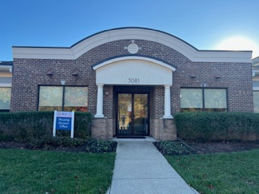
Army Housing Office
Located at 3081 Ernie Pyle St, Fort Meade, MD
WE ARE THE ARMY’S HOME

Slide 15
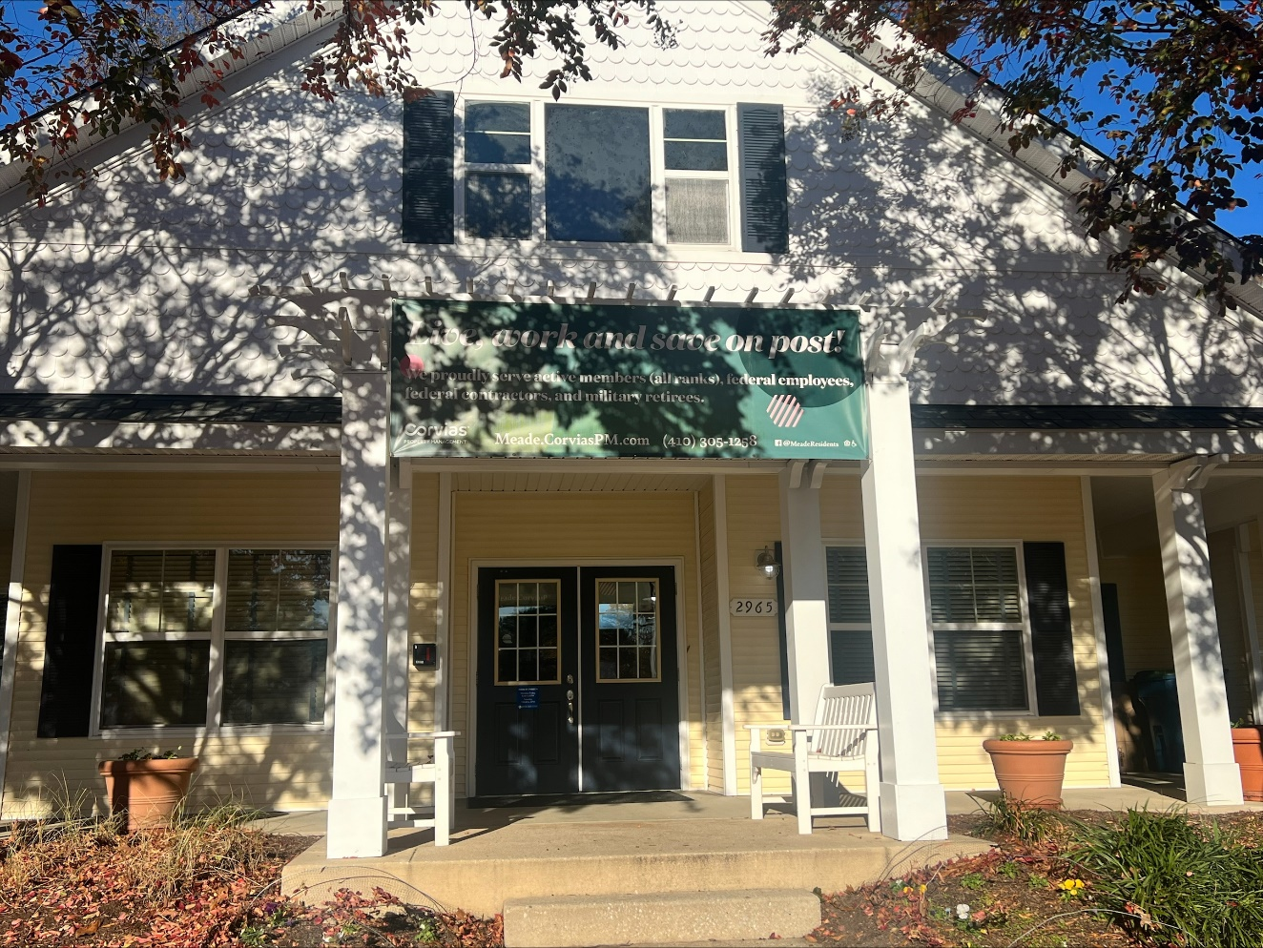
Corvias Leasing Center
Located at 2965 2nd Army Dr, Fort Meade, MD
WE ARE THE ARMY’S HOME

Slide 16
DOD Housing Feedback System
Section 3016(b) of the Fiscal Year (FY) 2020 National Defense Authorization Act (Public Law 116-92) added a new section 2894a to title 10 United States Code (10 U.S.C.) that requires the Department of Defense (DoD) establish a publicly available database that permits privatized housing tenants to file a complaint regarding their housing unit.
To satisfy this requirement, the Department developed the DoD Housing Feedback System (DHFS) to enable Military Housing Privatization Initiative (MHPI) tenants to submit complaints, compliments and/or “feedback.”
Publicly accessible information in the DHFS regarding tenant feedback includes the name of the installation where the housing unit is located, the name of the privatized housing landlord responsible for the unit, and a description of the feedback nature.
The DHFS can be accessed at https://www.dhfs.mil.
WE ARE THE ARMY’S HOME

