Slide 2
Due Outs
The major discussion concerned the Garrison Commander’s desire to change some of the output being pushed out at Community Council. He proposed engaging council participants in developing a comprehensive “Community Events” calendar which would:
Include information on the major events within the community that are available for community members to attend and/or support,
Have visibility on the Fort Meade website and on the Fort Meade App, and
Establish “permanent” points of contact for the organizations that have events listed on the events calendar.
The July 25 Community Council meeting will have a portion dedicated to informing participants about expectations for their input into the Community Events calendar during the September (Sept. 26) meeting session.
The reason for the road closure of 6th Armored Cavalry Road between Mapes and Simonds St. remained open.

Slide 3
Directorate of Plans, Training Mobilization and Security
Installation Key Events
JULY
25 – Soldier for Life – Transition Assistance Program (SFL-TAP) Hiring Event
25 – Community Council
26 - Murder Mystery Dinner Theater
AUGUST
AT Awareness Month
01 – Prayer Breakfast
22 – Women’s Equality Day Observance
23 – Bowie Baysox Military Appreciation Day
24 – The US Army Field Band Summer Concert
30 - Maddie & Tae Concert

Slide 4
Directorate of Plans, Training Mobilization and Security
SEPTEMBER
National Recovery Month
Suicide Prevention Month
Emergency Preparedness Month
Hispanic Heritage Month
05 - Prayer Breakfast
11 – Installation 9/11 Remembrance Run
18 - Community Job Fair
24 – Housing Town Hall
25 – Hispanic Heritage Observance
26 – Community Council
OCTOBER
Cyber Awareness Month
Disability Awareness Month
Domestic Violence Awareness Month
Energy Action Month
03 - Prayer Breakfast
06 – Army Ten Miler
26 - Run Series: Ghosts, Ghouls, & Goblins 5K
31- Hallelujah Fest / Halloween
Flu Shot Campaign Dates/TBD

Slide 5
Directorate of Plans, Training Mobilization and Security
NOVEMBER
Native American Heritage
Military Family Appreciation Month
Warrior Care Month
07 - Prayer Breakfast
07 – FGGM Veteran’s Day Observance
13 - Community & Veteran's Job Fair
20 – Native American Observance
21 – Community Council
23 - Run Series: Turkey Trot 5K
DECEMBER
05 – Prayer Breakfast
05- Holiday Tree Lighting
07 - Run Series: Reindeer Run
31 – New Years at the Lanes

Slide 6
Deputy Garrison Commander - Transformation
Access Control Points:
Mapes / 175
Estimated Completion Date- Sept 2019 (USACE)
SHA- Gate install (Dec 2019)
Reece
Bids came in over cost
USACE is negotiating
18 months for construction
Rockenbach
SHA project run by Eastern Federal Lands
Re-Start Date was April 2019
Estimated Completion date- March 2021
MD 175
Disney to Reece
Estimated completion date- December 2019
87% complete. On schedule
Reece to Mapes
Estimated completion date- April 2020
82% complete.
New Crofton Connector
504 Ending August 2019
Being replaced by AA County Crofton Connector
Schedule TBP

Slide 7
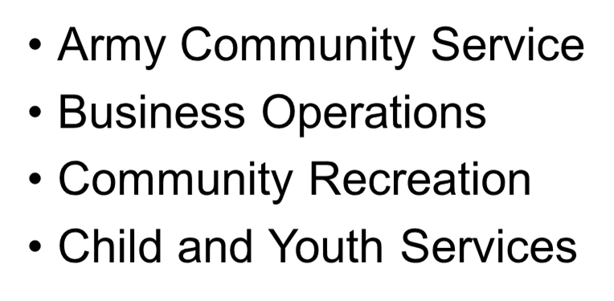
Directorate of Family and Morale, Welfare and Recreation

Slide 8
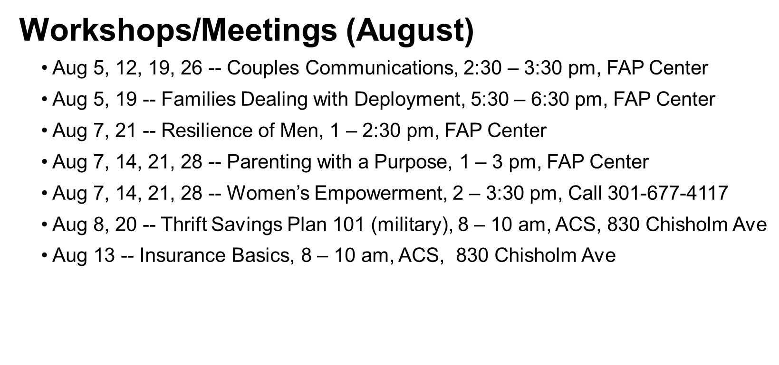
Directorate of Family and Morale, Welfare and Recreation
Army Community Services Division

Slide 9
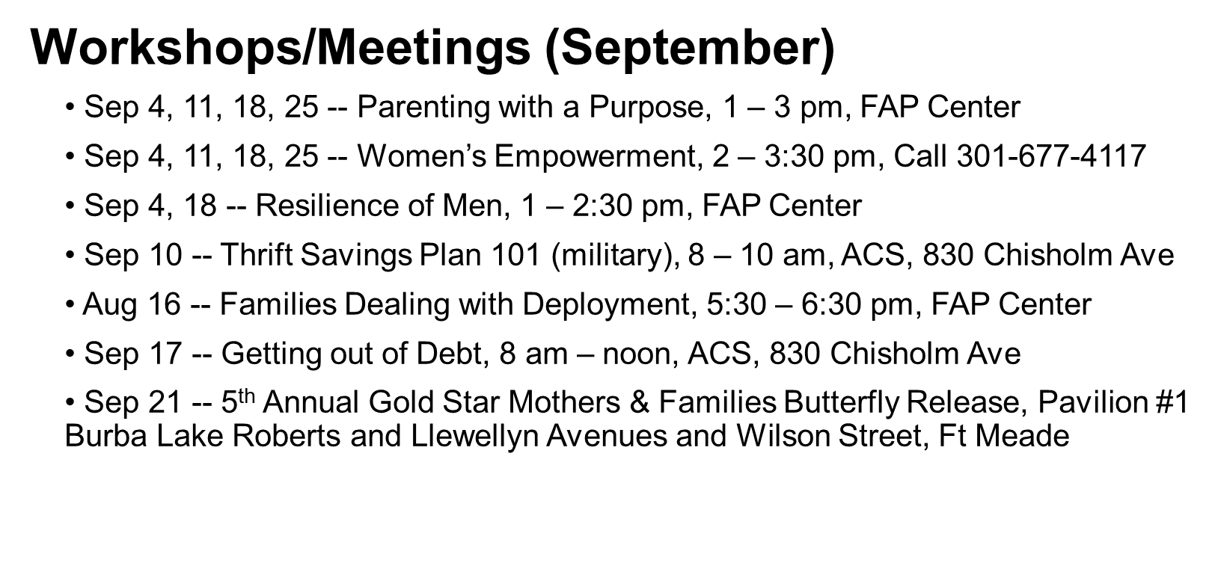
Directorate of Family and Morale, Welfare and Recreation
Army Community Services Division

Slide 10
DFMWR
Business Operations Division
Fort Meade, Woman Rock the Forts Concert, Army Entertainment:
Location McGill Training Center
August 30
7 pm
Tickets = $25 in advance / $35 at the door
Featuring Maddie & Tae
- Platinum Single – Girl in a Country Song / Gold Single - Fly
- Toured with Dierks Bentley, Lee Brie, Brad Paisley
- Featured as CMT’s 2017 Next woman of Country
- Forbes 30 under 30 Musicians List
Special Guest
Ruthie Collins & Natale Stovall
Lakin
----------------------------------------------------------------===========
TICKETS ARE LIMITED & ON SALE NOW
Call Club Meade @ 301-677-3831 for more information.

Slide 11
DFMWR
Community Recreation Division
Around the Fort Sprint Triathlon
September 14, Gaffney Fitness Center
500 meter swim, 12.8 bike, 5k Run
Must be 18 years or older to participate
Worried about doing the swim, or bike, or run? Put a
three person team together!!!
Register online at www.meade.army.mwr.com
Event starts at 8 am
First time Triathletes Welcome!!!
Pricing (good through August 2, then rates increase)
Active Duty Individual: $55
Non-Active Duty Individual: $65
Teams: $85
For more information, call: 301-677-5822

Slide 12
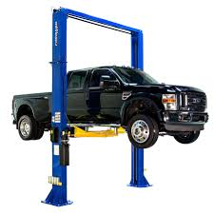
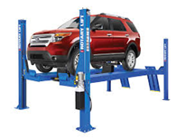
Automotive Skills Center 6530A Taylor Avenue, Fort Meade, MD 301-677-5542
23 bays - 15 with hydraulic lifts, 8 flat bays, and a motorcycle lift
State-of-the-art tools and equipment for use on all domestic and
foreign privately owned vehicles
Safe, clean and earth-friendly environment
Qualified staff and volunteers to guide customers through repairs
Hours of Operation: THU & FRI, 1200 – 2000; SAT, 0900 – 1700; SUN, 1000 – 1500
New equipment includes a John Bean tire changer and a Branick Nitrogen Inflation System
New front end alignment, call for prices, worked performed while you wait
DFMWR
Community Recreation Division
23 bays - 15 with hydraulic lifts, 8 flat bays, and a motorcycle lift
State-of-the-art tools and equipment for use on all domestic and
foreign privately owned vehicles
Safe, clean and earth-friendly environment
Qualified staff and volunteers to guide customers through repairs
Hours of Operation: Thu & Fri, noon – 8 pm; Sat, 9 am – 5 pm; Sun, 10 am – 3 pm
New equipment includes a John Bean tire changer and a Branick Nitrogen Inflation System
New front end alignment, call for prices, worked performed while you wait
Convert all four tires to nitrogen
with our new Nitrogen Inflation System
Passenger cars: $20
SUVs: $25
Refills: $2 per tire
No appointment necessary

Slide 13
DFMWR
Child and Youth Services
Career Opportunities
Seeking individuals to fill entry level Child and Youth Program Assistant positions with flexible hours starting at $14.03 per hour
Family members who are interested in working with children and youth ages 6 weeks to 18 years old are encouraged to apply. Requirements: 18+ years, H.S. diploma, lift 40 lbs
Job announcement is open on a continuous basis at www.usajobs.gov or call (301) 677-6660 (NAF Human Resources Office) for more information on how to apply

Slide 14
DFMWR Child and Youth Services
CYS Fall Sports Program
Did you play sports in high school or college? Do you have a desire to encourage children to explore the world of sports, learn the fundamentals of good sportsmanship, and have fun at the same time?
Volunteers are a very important resource for Child and Youth Services (CYS). Even if you have never played or coached a sport before, you can still become a certified volunteer coach!
Head coaches and assistant coaches can receive discounts. Parent Central Services will calculate discounts offered to each coach.
Call the CYS Sports Department at 301-677-1177 to register.
Coaching Requirements:
Required CPR / First Aid and instructional training is provided by CYS prior to the beginning of the season.
Background checks must be cleared on all coaches prior to team assignment.
Coaches must be certified through the National Alliance for Youth Sports (NAYS).

Slide 15
Life Skills Education
Stress Management
Aug 8, 9-11 am
Sep 12, 9-11 am
Anger Management
Aug 8, 1-3 pm
Sep 12, 1-3 pm
Time Management
Aug 22, 9-11 am
Effective Communication
Sep 26, 9-11 am
Transition, Goals, Plans, Success
• Retiree Brief, 8-11:30 am
Aug 5
Sep 16
• Accessing Higher Education
Aug 28-29, 8 am-4 pm
Transition, Goals, Plans, Success (Cont’d)
• Career Exploration and Planning Track
Sep 4-5, 8 am-4 pm
Financial Classes
• Car Buying 8-10 am
Aug 7
Sep 11
• Developing a Spending Plan
8 am-10 am
Aug 21
Sep 25
• Maryland 529 12:30-2 pm
Sep 12
• Family Financial Planning Workshop
Sep 13, 9-11 am

Slide 16
RECENT SERVICE RELOCATIONS
Allergy & Immunizations – 1st floor,1M08
Behavioral Health/SUDCC/FAP – 3rd floor, 3C01
Force Health Protection – Bldg. T-2746
*** MEDDAC Organizational Day***
KACC and PX Pharmacy Closed
Friday, August 9 at Noon

Slide 17
*** MEDDAC Training Day***
KACC and PX Pharmacy Closed
AUG 27, 7 am – 1 pm
Food Handlers’ Course- Next course: August 6 at Bldg. 4550 Pershing Conference Room, 1-3:30 pm
Upcoming course dates: SEP 3, OCT 1, NOV 5, DEC 3
**NEW** Kimbrough Newcomers Orientation
Wednesday, August 21, 10 am & 2 pm

Slide 18
Housing Update
Reece Crossings Pool Party
Complete sets of new fitness equipment installed at Midway & Heritage Community Centers
Popsicles Every Friday at Meuse and
Potomac Community Center’s
Check out our Newsletter for updates

Slide 19
Fort Meade Exchange
The Exchange celebrates 124th Anniversary on TODAY, July 25th
Cake cutting at 1130 am
Product Demos, Tastings, and Giveaways.
Vendor specials and drawings throughout the mall.
August 1–31, 2019 – Awake Chocolate Company and the Exchange will offer Exchange customers worldwide the opportunity to enter the AWAKE CHOCOLATE SWEEPSTAKES for a chance to win a ONE of 10, $500 Exchange Gift Cards. Customers will need to enter online at ShopMyExchange.com/sweepstakes.
August 3–29, 2019 – Unilever and the Exchange will offer Exchange customers worldwide the opportunity to enter the UNILEVER AXE BACK TO SCHOOL SWEEPSTAKES for a chance to win ONE of 25, $500 Exchange Gift Cards. Customers will need to enter online at ShopMyExchange.com/sweepstakes.
August 17, 2019 – Back-To-School In Store Beauty Event. This event has 2 coupon money saving offers; $5 off $30 purchase and $15 off $60 purchase with MILITARY STAR® card.

Slide 20
Fort Meade Commissary
July 2019
- DAX/IM Deployment August 18th - 24th, 2019
301.677.4316
www.commissaries.com
- EMERALD POS 8TH – 14TH September 2019
- Back to School Sidewalk Sale 26th - 28th September 2019
- Military STAR Card is Accepted at Your Commissary

Slide 21
Fort Meade Commissary
301.677.4316
www.commissaries.com

Slide 22
Religious Support Office
CH (MAJ) Dwayne W. Hughes, Acting, Senior Garrison Chaplain
SFC Tysean Chapman 301 766-5823
Weekly Services:
Roman Catholic Service – Sun, 9 am (AHCC), Tues – noon (MPC)
Jewish – Mon–Fri, 6:20 am (AHCC), Luncheon Wednesday noon (AHCC)
Protestant – Sun, 10:30 am Traditional (MPC), 10:30 am Chapel Next, (CAV), 11 am Gospel, (AHCC)
Latter Day Saints (LDS) – 9 am (CAV)
Garrison Bible Study – Wed, 11:45 am (MPC) – Discussion Group/Study Book of Job
Protestant Women of the Chapel – Wed, 9:30-11:30 am (AHCC)
Catholic Women of the Chapel - Tues 9-11 am (MPC)
Catholic Mass – Tues – Noon (MPC) (Tuesdays Only)
**Historic Main Post Chapel (MPC); Argonne Hills Chapel Center (AHCC); Cavalry Chapel (CAV)
Upcoming Events:
Prayer Breakfast – Aug 1, 7 am, Club Meade
Strong Bonds (Single Parent Enrichment) – Sep 6-8 – Tentative (Details TBD)
Kings Kids (Resumes) – Sep 13, 10:30 am (MPC) (3-5th Grade) During Protestant Worship
PWOC Weekly Evening Bible Study (NEW) – Sep 17 – 6:45 pm (CAV)
Annual Hallelujah Festival (Alternative to Halloween) – Oct 1, 7 pm – Fort Meade Pavilion

Slide 23
Directorate of Human Resources
Army Community Service Division
Goal:
500 Participants
Also, can access thru Fort Meade website and FGGM App

Slide 24
use the Meade App

Slide 25
Next MDW CG Town Hall, Sept. 24, at 6 p.m., at the Post Theater
Next Fort Meade GC Facebook Town Hall will be August 27, at 5 p.m.
New Fort Meade website continues to evolve to meet information needs of the community and the general public – newly hired New Media Manager on board – Joe Nieves

Slide 26
Next Meeting:
September 26, 2019

