Slide 1
LRC MEADE Transportation PPPO Briefing

Slide 2
PPPO Briefing
DPS Registration
Register for your DPS username and password immediately.
Go to www.militaryonesource.mil. Click on Menu and select Moving and Housing.
Click Log in to DPS.
DPS HELP DESK: 1-800-462-2176
In the event you need to file a claim for damaged and/or lost items, you will need access to the DPS system.

Slide 3
PPPO Briefing
NOTE!!
If you have previously used DPS you will see your old shipments in the system.
DO NOT create a shipment using the old order information.
Click Start a new move: proceed with entering your new order information.
If the system ask you to select a GBLOC for Origin Address: Select BGAC

Slide 4
PPPO Briefing
OCONUS PCS
Authorized 3 Shipments:
Unaccompanied baggage (UB) Transit time: 30-45 days
Household Goods (HHG) Transit time: 45-60 days
Non-Temporary Storage (NTS) Transit time: tour duration
CONUS PCS
Authorized 2 Shipments:
Household Goods (HHG)
Personally Procured Move (PPM)

Slide 5
PPPO Briefing
RETIREMENT
On retirement orders you have one year from the effective
date of retirement to make any final move to home of selection.
HHG must be turned over for transportation within 1 year following your effective retirement date. Time limit extensions may be authorized or approved only for the specific period of time the Service member anticipates is needed to complete the move.
Extension may be requested; however, there is no guarantee that it will be approved.
Requests should be submitted to the Transportation Office in writing via email, fax, or walk-in at least 60-90 days prior to your entitlement expiring. Request must be submitted in one year increments- up to five years.
All retirees are authorized to move to your home of selection within the continental US (including Hawaii, and Alaska).

Slide 6
PPPO Briefing
RETIREMENT continued
Once shipment reaches its destination you will be authorized
90 days of storage and a local delivery out.
-OR-
You may choose to leave shipment in Non-Temporary Storage for up to one year from retirement date at origin until a home of selection is determined. You must request release of household goods in writing to our office and have an address at the time of request. Understand once the shipment is released and reaches its destination storage is not authorized.
If you have not requested delivery prior to your NTS expiration, the storage costs will be converted to a commercial account in your name. In order to have the property shipped at government expense, you will need to request a shipping and travel entitlement extension prior to the storage expiration date. An extension approval ONLY covers shipment of the property, not storage beyond the initial one year.

Slide 7
PPPO Briefing
Separation / ets
On separation orders you have 180 days from effective date of separation to ship household goods to Home of Record or Place Of Entry.
If shipping HHGs to anywhere other than HOR or PLEAD you will pay the excess cost if any is associated with the move. Once shipment reaches destination you are authorized 90 days of storage and a local delivery out.
-OR-
You may choose to leave HHG in Non-Temporary Storage at origin for 180 days. You must request release of household goods in writing to our office and have an address at the time of request. Understand once shipment is released and reaches destination storage is not authorized.
Time Limit: Travel must begin before the 181st day following separation from the service or relief from active duty. When travel before the 181st day would impose a hardship on the member, a time extension may be approved/disapproved for a specific additional period of time through the Secretarial Process.

Slide 8
PPPO Briefing
Local moves
On a Retirement or a Separation Order you are authorized to do a local move which will be considered as your final move on your separation or retirement order.
-OR-
If you live in government quarters/housing and directed/required by appropriate authority to vacate, you would then be authorized a Courtesy Move to the local economy at government expense and the move will not be counted as your final move. In this situation the Housing Office will provide the documentation to authorize this move.
Before our office will schedule your local move you must have keys in hand because storage is not authorized on local move.

Slide 9
PPPO Briefing
releasing property stored in nts
First submit your request in the DPS system as a HHG shipment please make sure your request is complete with; delivery address, current phone number, and any authorized receiving agents over the age of 18 as well as their phone numbers. Please sign and date your DD1299& DD1797, provide us with the signed copies and orders to our email address so that we may process your request.
Once request is received, depending on time of year & delivery location, it could take 4-6 weeks to receive property when going CONUS; allow more transit time if going OCONUS.
Remember: NO storage is authorized at destination.
DO NOT create a NTSR shipment in the DPS website. The shipment should be created as a HHG shipment.

Slide 10
PPPO Briefing
Personally procured move (PPM)
PPMs for Separations and Retirements will not be processed by DFAS until after your effective date of separation or retirement.

Slide 11
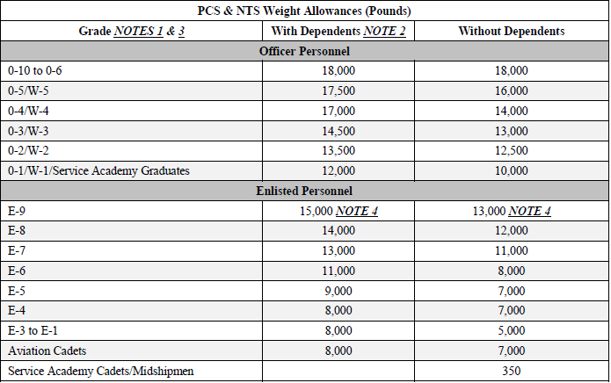
PPPO Briefing

Slide 12
PPPO Briefing
Excess COSTS
Transportation to areas other than your authorized locations
If you have more than one lot shipping from origin to destination conducted under the same order
Overweight (all moves count toward weight allowance)
Transportation of unauthorized items
Any additional service requested by member (i.e. crates)
Attempted Pick-up/Delivery
Excess costs will be handled by DFAS; could take anywhere from 6 months to 2 years to settle.

Slide 13
PPPO Briefing
Pick Up Date and Changes
NO WEEKENDS OR FEDERAL HOLIDAYS
1,000 lbs per fully furnished room
1 - 4,999 lbs = 1 day
5,000 – 11,999 = 3 days
Over 12,000 lbs = 4 days
Date changes must be submitted in writing to Transportation office and negotiated with the Transportation Service Provider (TSP).
24 hours notice for change is required.
Dates are not 100% until TSP has accepted the shipment. If you have turned in your documents to the transportation office and have NOT been contacted by the TSP after 10 business days, contact transportation office.

Slide 14
PPPO Briefing
Peak season
The demand for transportation movement of HHGs during the summer months or Peak Season exceeds the capabilities of Transportation Service Providers (TSPs) servicing our area.
Which can make our shipping dates for Household goods pickup sometimes 4-6 weeks out.
It is unrealistic to believe TSPs can significantly “ramp up” their operations, both from a financial standpoint and availability of skilled personnel in the transportation network for four months in the summer.
When a TSP cannot satisfy the timeframe, we suggest conducting a PPM, arranging for a releasing agent, or contracting with a TSP not within the network that has availability. We provide a cost estimate for reimbursement for a PPM to ensure the service member does not exceed the projected rate from the government.

Slide 15
PPPO Retirement / Separation Briefing
PREPARATION
1) You or your releasing agent must be at pick up address between 8:00 am and 5:00 pm.
2) Disassemble outdoor equipment (i.e. playhouses, swing sets, or trampolines).
3) Disconnect all electronics and appliances. Empty, defrost, and clean freezers and refrigerators.
4) Store everything that YOU are moving (i.e. PPM items or luggage you plan to take on the plane) into an area that the movers won’t be in, so it is not packed by mistake.
5) Secure all valuables and paperwork that you do not want packed. If property is inadvertently packed the TSP will charge a retrieval fee.
6) If you have the original boxes for your electronics, place them with the equipment for the movers to use.

Slide 16
PPPO Briefing
PREPARATION
7) You can’t ship unauthorized items such as: combustible liquids, corrosive liquids, explosives, flammables, compressed gases, aerosol cans, perishable foods, cleaning supplies, perfume, and plants. If you are unsure if an item can be shipped, please ask.
8) Ensure your home is clean and orderly. Any untidiness that hinders the performance of the packers could result in your move being stopped.
9) If you have more than one shipment (i.e. HHG & NTS), separate your items. Do not schedule multiple shipments for the same days.
10) Remove property from an attic or crawl space. Packers are not required to go into areas with unfinished floors or inadequate lighting.
11) Ensure property is free of infestation.
12) Small pictures can remain on walls but mounted TVs do need to be taken down.
13) Before the packers leave do a final walk-thru to ensure that everything has been
packed and loaded onto the moving truck.
14) If you have any concerns during your move, please call the transportation office

Slide 17
PPPO Retirement / Separation Briefing
SPECIAL ITEMS
Motorcycles - drain fuel, keep oil at a low level, disconnect the battery, and tape the terminals.
Boats/Trailers over 14ft - could result in excess cost due to mode of shipment (OTO).
Firearms - Must be able to provide make, model, manufacturer, serial number, and caliber.
NOTE: Ammunition cannot be shipped

Slide 18
PPPO Briefing
Pets
If you have pets, they must be put away when the packers come to pack and load. If a pet is packed by mistake and boxes have to be searched, the cost will be at member’s expense.

Slide 19
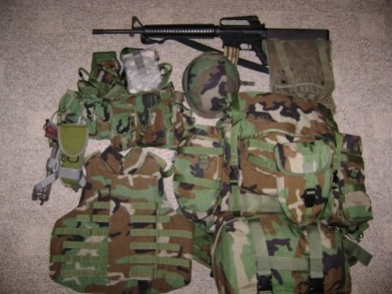
PPPO Briefing
Pro-Gear / PBP&E
What is considered pro-gear or MILITARY UNIFORMS, PROFESSIONAL BOOKS, PAPERS, AND EQUIPMENT (PBP&E)?
Professional:
Military Uniforms, Reference material (books), papers, associated w/current MOS but not to exceed a 2000 pounds max weight.
Exclusions:
1. Commercial products for sale/resale used in conducting business
2. Sports equipment
3. Office furniture
4. Household furniture
5. Shop fixtures
6. Furniture of any kind
7. Plaques, awards, and memorabilia
8. Personal computer equipment and peripheral devices
9. Table servicing (flatware, dishes, and glassware)
“M-PRO” MUST be on inventory to annotate PRO/PBP&E
EFFECTIVE 01 APRIL ALL SPOUSE PRO-GEAR MUST BE ANNOTATED ON A SPOUSE PRO-GEAR WORKSHEET AND APPROVED BY OUR GOVERNMENT OFFICALS PRIOR TO SHIPMENT OF HOUSEHOLD GOODS. THIS FORM IS PROVIDED BY OUR OFFICE. THIS ONLY APPLIES TO ALL ARMY, NAVY, MARINE, AND COAST GUARD MEMBERS.

Slide 20
PPPO Briefing
Inventory
Ensure your inventory is accurate. If you disagree with an item, make sure you annotate the inventory before signing.
High value inventory should include make, model, and serial numbers for electronics.
Pro-gear must be annotated on inventory.
Keep a copy of your inventory.

Slide 21
PPPO Briefing
At destination
90 days of Temporary Storage authorized, unless the property has released from NTS there is no additional storage.
Additional 90 days can be requested at destination transportation office.
If storage is converted to owner’s expense, full replacement value no longer applies. Local delivery is still authorized.
Additional delivery is authorized within 50 miles of primary delivery address.

Slide 22
PPPO Briefing
REMINDERS
Before you submit any paperwork to PPPO:
Make sure you have listed required information if shipping/storing motorcycle and/or firearms.
If you have an extra-pick address at a storage facility, don’t forget to give the complete street address, storage facility name, and unit number.
If you think you may not be available during the entire pack/load days, please list a releasing agent; we need their name & phone number.
Review all documents before submitting to ensure correct address, phone numbers, email address, etc. have been updated.
For all service members doing a partial PPM, you may return all your paperwork back to our office via email or fax for processing.

Slide 23
PPPO Briefing
Contact Information
Front Desk Number: 301-677-9639
Email address: usarmy.meade.406-afsb-lrc.mbx.personal-property-group-box@army.mil
JPPSOMA- Fort Belvoir: 1-800-521-9959

Slide 24
PPPO Briefing
ARE THERE ANY QUESTIONS?
Reminder: You MUST submit below documents to the transportation office. You can email or bring the documents into the office.
Orders/Amendments
Signed DD1299
Signed DD1799

