Slide 1
Installation Housing Office
USAG Fort Meade
As of 14 December 2021

Slide 2
Welcome to the Garrison Housing Office
The Fort Meade Garrison Housing staff provides assistance to Service Members and their Families with housing matters and advocates on their behalf with community partners/agencies both on and off the installation
The Housing Service Office (HSO) provides referral services and tenant/landlord dispute services
The Installation Housing Office provides oversight of the privatized company managing on post housing and provides tenant/landlord dispute services
The garrison Housing Manager manages the Installation Housing Office and reports directly to the Director, Public Works and garrison leadership
Garrison Leadership
Garrison Commander: COL Christopher Nyland
Garrison Command Sergeant Major: CSM Michael Behnkendorf
Garrison Deputy Garrison Commander-Transformation & Housing: LTC Stephen Ward
Garrison Housing Manager: Aimee Stafford

Slide 3
Privatized Housing Contacts
Corvias Military Living, sometimes referred to as the Residential Communities Initiative (RCI) Company, is the privatized company that owns and manages the family housing on this installation
Corvias is the private partner and managing member.
Corvias is also the property management company that manages the day to day operations of the privatized housing to include ensuring prompt and professional maintenance and repair, addresses property concerns, and rent/billing issues. This is your landlord for privatized housing
Corvias Contacts:
Operations Director: Heather Fuller (Acting)
Assistant Operations Director: Brittany Dabney
Resident Manager: Christie Taylor and Abraham Santiago
Facilities Director: Dresin Paris

Slide 4
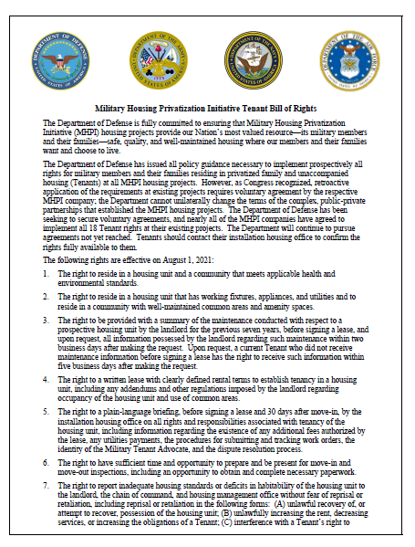
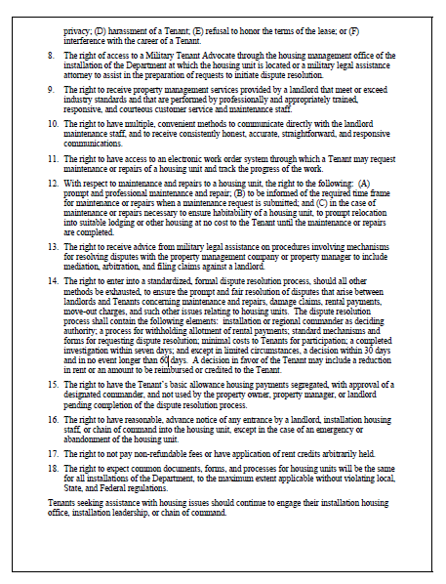
Privatized Housing - Tenant Bill of Rights
* Copy is available upon request

Slide 5
Privatized Housing - Tenant Bill of Rights
The following rights are effective on August 1, 2021:
1. The right to reside in a housing unit and a community that meets applicable health and
environmental standards.
2. The right to reside in a housing unit that has working fixtures, appliances, and utilities and to
reside in a community with well-maintained common areas and amenity spaces.
3. The right to be provided with a summary of the maintenance conducted with respect to a
prospective housing unit by the landlord for the previous seven years, before signing a lease, and
upon request, all information possessed by the landlord regarding such maintenance within two
business days after making the request. Upon request, a current Tenant who did not receive
maintenance information before signing a lease has the right to receive such information within
five business days after making the request.
4. The right to a written lease with clearly defined rental terms to establish tenancy in a housing
unit, including any addendums and other regulations imposed by the landlord regarding
occupancy of the housing unit and use of common areas.

Slide 6
Privatized Housing - Tenant Bill of Rights
5. The right to a plain-language briefing, before signing a lease and 30 days after move-in, by the installation housing office on all rights and responsibilities associated with tenancy of the housing unit, including information regarding the existence of any additional fees authorized by the lease, any utilities payments, the procedures for submitting and tracking work orders, the identity of the Military Tenant Advocate, and the dispute resolution process.
6. The right to have sufficient time and opportunity to prepare and be present for move-in and move-out inspections, including an opportunity to obtain and complete necessary paperwork.
7. The right to report inadequate housing standards or deficits in habitability of the housing unit to the landlord, the chain of command, and housing management office without fear of reprisal or retaliation, including reprisal or retaliation in the following forms: (A) unlawful recovery of, or attempt to recover, possession of the housing unit; (B) unlawfully increasing the rent, decreasing services, or increasing the obligations of a Tenant; (C) interference with a Tenant’s right to privacy; (D) harassment of a Tenant; (E) refusal to honor the terms of the lease; or (F) interference with the career of a Tenant.

Slide 7
Privatized Housing - Tenant Bill of Rights
8. The right of access to a Military Tenant Advocate through the housing management office of the installation of the Department at which the housing unit is located or a military legal assistance attorney to assist in the preparation of requests to initiate dispute resolution.
The Fort Meade Installation Housing Office serves as your Military Tenant Advocate.
The Fort Meade Installation Housing Office is located at 3081 Ernie Pyle Street, contact number 301-677-7748.
9. The right to receive property management services provided by a landlord that meet or exceed industry standards and that are performed by professionally and appropriately trained, responsive, and courteous customer service and maintenance staff.
10. The right to have multiple, convenient methods to communicate directly with the landlord maintenance staff, and to receive consistently honest, accurate, straightforward, and responsive communications.
11. The right to have access to an electronic work order system through which a Tenant may request maintenance or repairs of a housing unit and track the progress of the work.

Slide 8
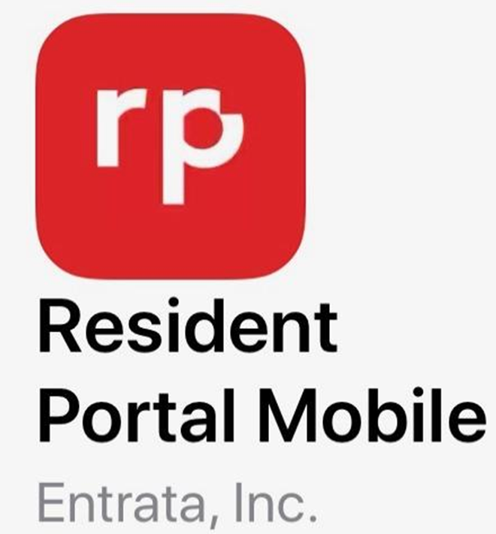
Privatized Housing - Tenant Bill of Rights
12. With respect to maintenance and repairs to a housing unit, the right to the following: (A) prompt and professional maintenance and repair; (B) to be informed of the required time frame for maintenance or repairs when a maintenance request is submitted; and (C) in the case of maintenance or repairs necessary to ensure habitability of a housing unit, to prompt relocation into suitable lodging or other housing at no cost to the Tenant until the maintenance or repairs are completed.
Corvias
Maintenance Shop Contact Number: 1-844-346-1490
Maintenance Shop Location: 3000 Ernie Pyle St. Fort Meade
Maintenance Website: https://fortmeadecorvias.residentportal.com
Maintenance Application:
13. The right to receive advice from military legal assistance on procedures involving mechanisms for resolving disputes with the property management company or property manager to include mediation, arbitration, and filing claims against a landlord
SJA Office POC: Legal Assistance Office- (301) 677-9504 or 9536
You have the right to have multiple, convenient methods to communicate directly with the privatized Landlord maintenance staff, and to receive consistent, honest, accurate, straightforward and responsive communications. (Right 9)

Slide 9
Privatized Housing - Tenant Bill of Rights
14. The right to enter into a standardized, formal dispute resolution process, should all other methods be exhausted, to ensure the prompt and fair resolution of disputes that arise between landlords and Tenants concerning maintenance and repairs, damage claims, rental payments, move-out charges, and such other issues relating to housing units. The dispute resolution process shall contain the following elements: installation or regional commander as deciding authority; a process for withholding allotment of rental payments; standard mechanisms and forms for requesting dispute resolution; minimal costs to Tenants for participation; a completed investigation within seven days; and except in limited circumstances, a decision within 30 days and in no event longer than 60 days. A decision in favor of the Tenant may include a reduction in rent or an amount to be reimbursed or credited to the Tenant.
Displaced Resident Policies
ASAIE&E Memorandum, SAIE, Feb 14, 2020, Army Residential Communities Initiative Company Minimum Standard Resident Displacement Guidelines
ASAIE&E Memorandum, SAIE, Jan 23, 2020, Subject: Procedures for Approving Privatized Housing Habitability after Remediation, Mitigation, Stabilization and abatement
IMCOM Memorandum, Headquarters Installation Management Command, IMPW-H, JAN 31 2020, subject: Procedures for Certifying Housing Habitability for Army Family Housing, Leased Housing, Unaccompanied Housing and Privatized Homes
IMCOM Memorandum, Headquarters Installation Management Command, IMPW-H, MAR 11 2020, subject: Command Guidance Army Residential Communities Initiative (RCI) Company Minimum Standard Resident Displacement Guidelines
ASA IE&E Memorandum,
“Housing Maintenance Quality Assurance and Environmental Hazard Oversight Program” provid clear standards and details of required oversight of Army housing maintenance

Slide 10
Privatized Housing - Tenant Bill of Rights
15. The right to have the Tenant’s basic allowance housing payments segregated, with approval of a designated commander, and not used by the property owner, property manager, or landlord pending completion of the dispute resolution process.
16. The right to have reasonable, advance notice of any entrance by a landlord, installation housing staff, or chain of command into the housing unit, except in the case of an emergency or abandonment of the housing unit.
Neighborhood Offices will retain keys to each home in their neighborhoods, which will be kept under secure control of Property Manager’s staff members at all times. These keys are used to provide access for routine and emergency maintenance service to the homes and to assist the resident in the event of an accidental lockout. In order to protect our residents’ rights to privacy and freedom of contentment, every effort will be made to keep disruptions to a minimum. Property Manager’s staff generally requires permission from a resident to enter a home for routine and preventative maintenance services and will provide the request for permission to the resident with at least 24 hours advance notice. Homes are located within exclusive federal jurisdiction of the US and therefore under military control, which includes the Installation Commander’s inherent authority and obligation to ensure good order and discipline. As such, the Installation Commander has the right and power to inspect, search and/or order the inspection or search of military persons and property within the family housing areas.
17. The right to not pay non-refundable fees or have application of rent credits arbitrarily held.
18. The right to expect common documents, forms, and processes for housing units will be the same for all installations of the Department, to the maximum extent applicable without violating local, State, and Federal regulations.
Tenants seeking assistance with housing issues should continue to engage
their installation housing office, installation leadership, or chain of command.

Slide 11
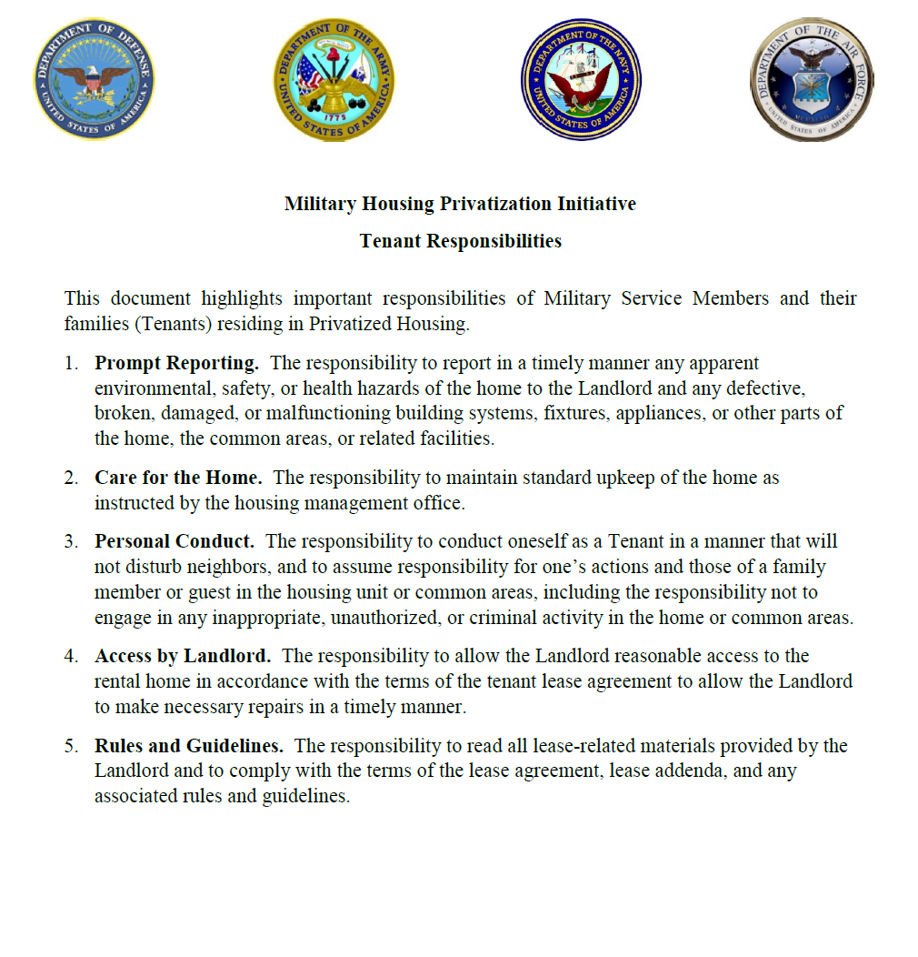
Privatized Housing – Tenant Responsibilities
* Copy is available upon request

Slide 12
Privatized Housing – Tenant Responsibilities
The Military Housing Privatization Initiative Tenant Bill of Rights highlights 5 important responsibilities for Service Members and their Families while they reside in privatized family housing.
The responsibility to report in a timely manner any apparent environmental, safety, or health hazards of the home to the Landlord and any defective, broken, damaged, or malfunctioning building systems, fixtures, appliances, or other parts of the home, the common areas, or related facilities.
The responsibility to maintain standard upkeep of the home as instructed by the housing management office.
Trash containers should be placed out on the curb after 6:00 PM on the evening before the regularly scheduled pick up day. On the pickup day, containers must be cleared from the curb area no later than 6:00pm. Trash container must be emptied and stored in the designated location, rear yard or garage.

Slide 13
Privatized Housing – Tenant Responsibilities
The responsibility to conduct oneself as a Tenant In a manner that will not disturb neighbors, and to assume responsibility for one’s actions and those of a family member or guest in the housing unit or common areas, including the responsibility not to engage in any inappropriate, unauthorized, or criminal activity in the home or common areas.
The Resident and other authorized occupants may not disturb the peaceful enjoyment of the neighborhood. The Resident shall keep the volume of any radio, stereo, TV, musical instrument or electronic device in their home or vehicle sufficiently reduced at all times so as not to disturb other residents. Please use extra discretion during the hours of 10:00 p.m. and 8:00 a.m. Fort Meade’s Directorate of Emergency Services (“DES) has policing authority over all Meade Communities housing areas. The Installation Commander and DES have ultimate authority in determining enforceable quiet hours.
https://meade.corviasmilitaryliving.com/residents/resident-responsibilities
The responsibility to allow the Landlord reasonable access to the rental home in accordance with the terms of the tenant lease agreement to all the Landlord to make necessary repairs in a timely manner.
The responsibility to read all lease-related materials provided by the Landlord and to comply with the terms of the lease agreement, lease addenda, and any associated rules and guidelines.

Slide 14
Garrison Housing Services Office (HSO)
The goal of the HSO is to implement and maintain a high quality worldwide resource for relocation services that is innovative, comprehensive, and the first choice of information and support when Soldiers and families relocate.
Non-discriminatory listings of adequate and affordable rental and for-sale housing
Counseling/referral on eligible installation services (i.e. legal, education, Exceptional Family Member Program)
Preliminary inquiries to validate housing discrimination complaints
Liaison with community and government officials / organizations (on and off post)
Housing data exchange with other DoD housing offices
Liaisons with Army Community Services in support of the Housing Relocation Assistance Program
Housing market area data for use in developing market analyses, rental negotiations and lease review

Slide 15
Garrison Housing Services Office (HSO)
One-Stop, Full Service from Arrival to Departure for the Following:
Home buying counseling
Landlord-tenant dispute resolution
Basic Allowance for Housing (BAH) data submission
Property inspections
NEW---Per FY20 NDAA: If tenant is not available for pre-assignment walkthrough inspection, Housing Office must attend on tenant's behalf
NEW---Per FY20 NDAA: The Housing Manager shall initiate contact with resident 15 days and 60 days after move-in regarding the satisfaction of the resident.
Administrative assistance with utility company fees/deposits, connections, and billings
Informational briefings (in- and out-processing, entitlements), community outreach

Slide 16
Furniture Safety & Additional Information
Tenants are permitted to anchor any furniture, television, or large appliance to the wall of the unit for purposes of preventing such item from tipping over without incurring a penalty or obligation to repair the wall upon vacating the unit if the Landlord does not anchor the furniture for the tenant.
Fort Meade features playgrounds, picnic areas, outdoor basketball courts and other outdoor activities to include 5 swimming pools for the enjoyment of our residents.

Slide 17
End of Brief

