Slide 1
Registration Instructions
for
Fort George G Meade

Slide 2
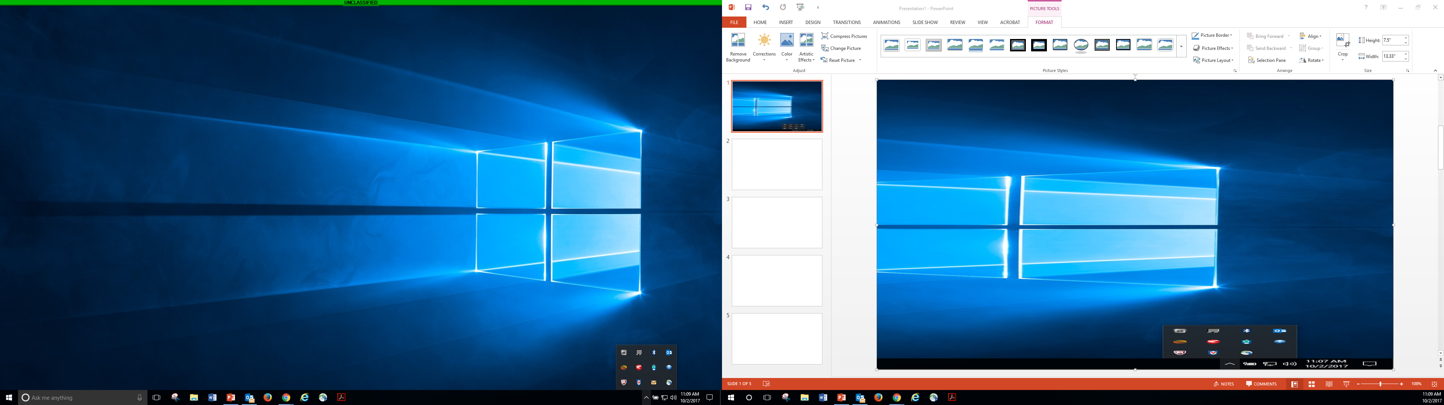
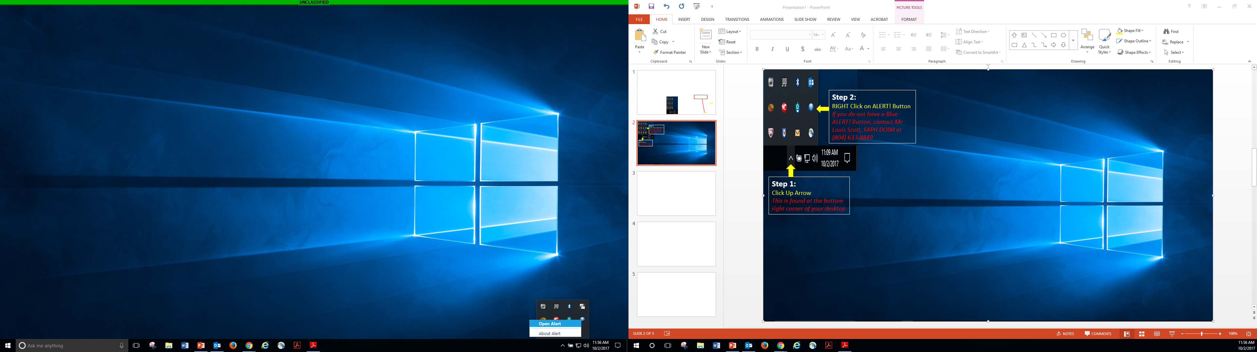
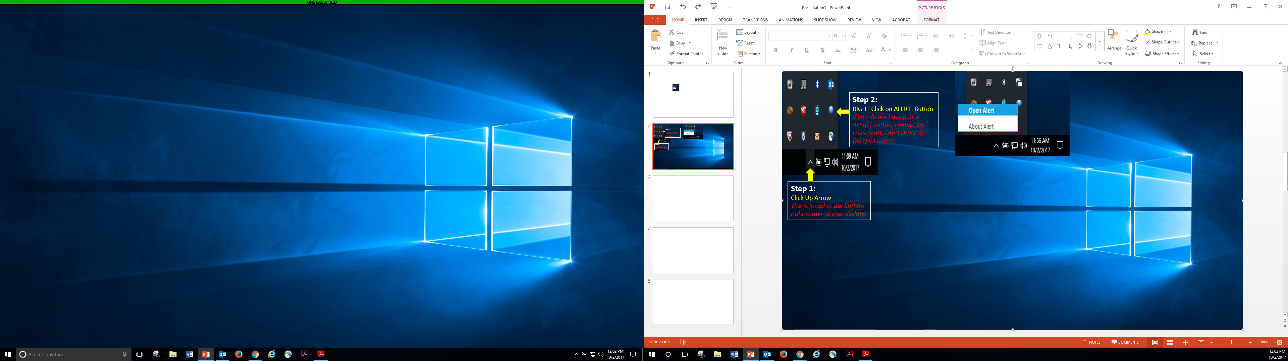
Step 1
Click Up Arrow
This is found on the TASK BAR
Step 2
RIGHT Click on ALERT! Button
If you do not have a Blue ALERT Button, contact Mr. Bernardo Perdomo, FGGM, NEC at (301) 677-1611
Step 3
Click OPEN ALERT

Slide 3
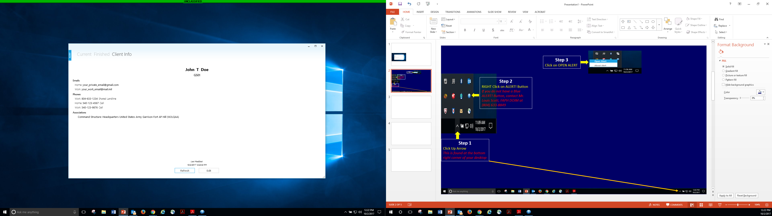
Step 4
Click CLIENT INFO
Step 5
Click EDIT

Slide 4
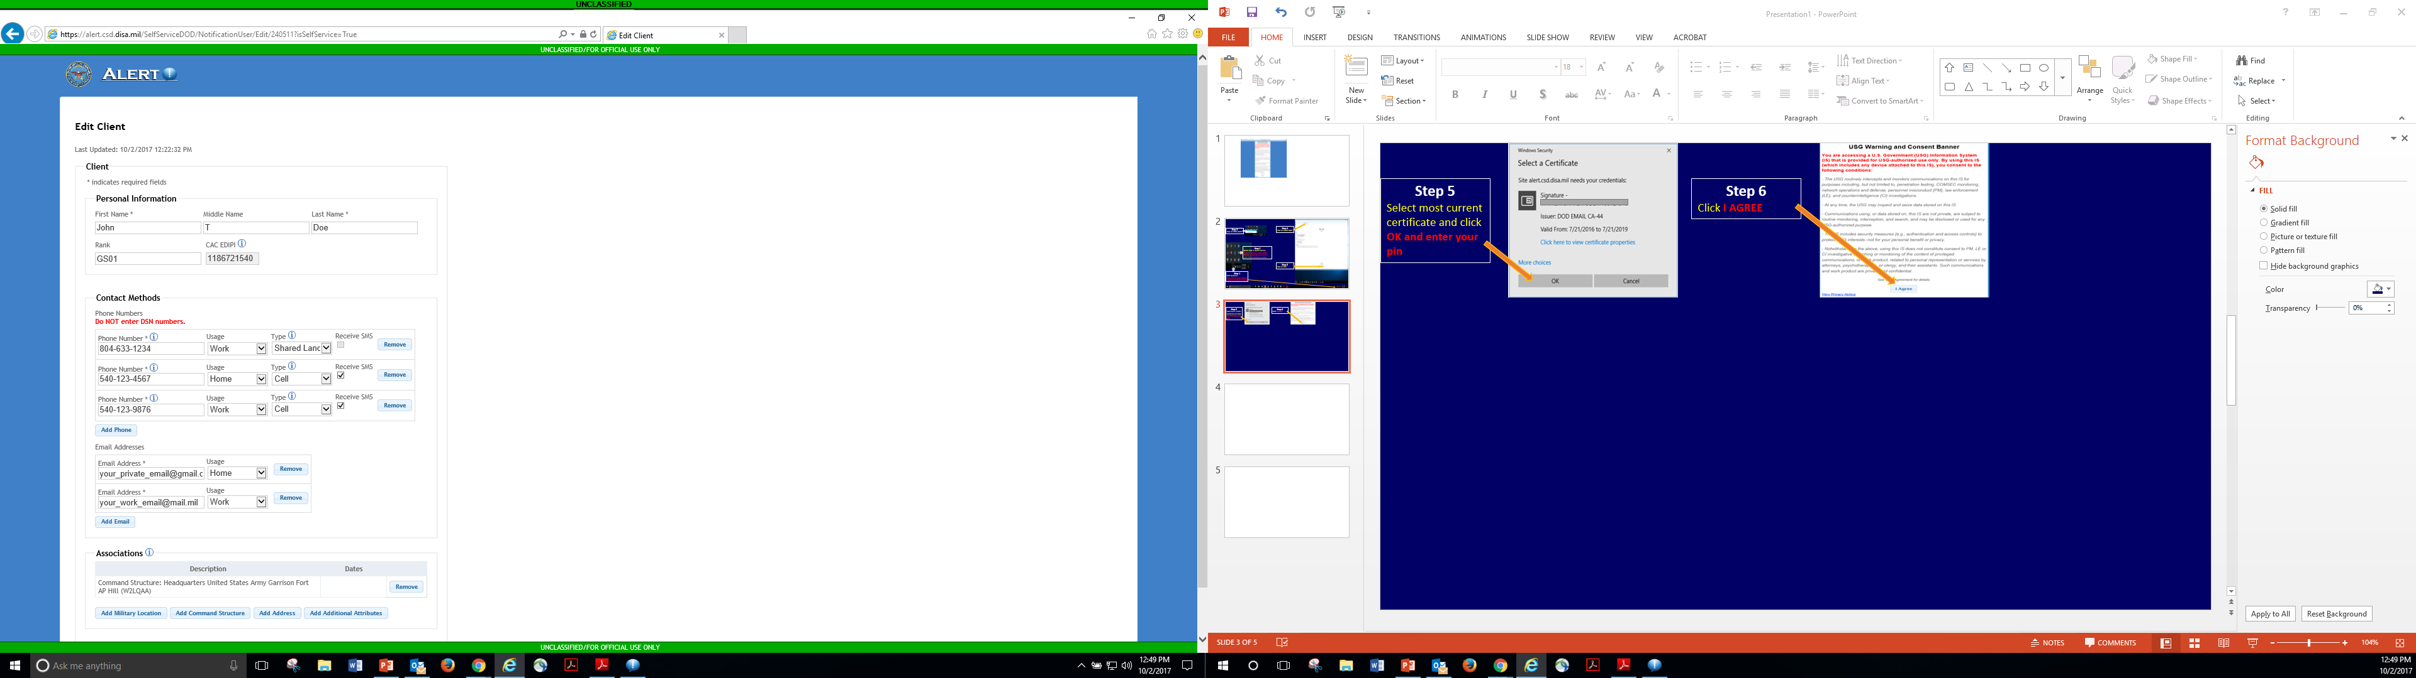
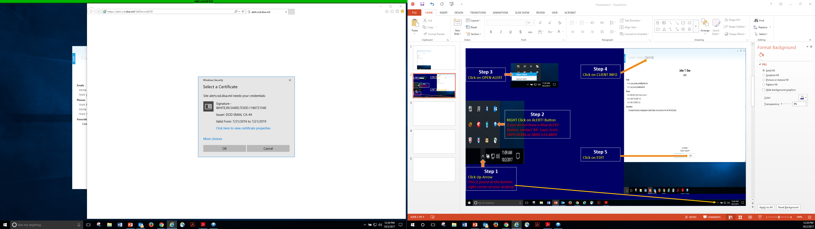
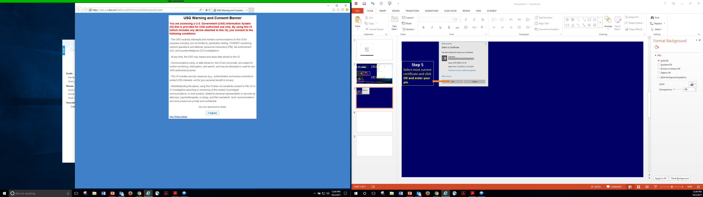
Step 6
Select most current certificate and click OK and enter your pin
Step 8
Personal Information:
Enter First Name and Last Name (required); Middle Name (Optional);
Rank
Civilians – Enter Grade (GSXX, WGXX)
Military – Enter Rank (SPC/CPT/LTC)
CAC EDIPI auto-fills from the inserted CAC
Step 7
Click I AGREE

Slide 5
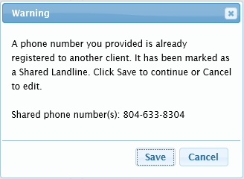
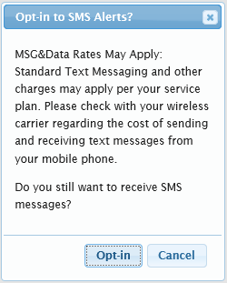
Step 9
Contact Methods:
Phone Numbers
-- In textbox, enter 10-digit phone number (e.g., xxx-xxx-xxxx).
-- From Usage drop-down, select Work or Home.
-- From Type drop-down, select Cell, Landline, Shared Landline, or Text-only.
-- Cell: A phone that uses mobile/cellular technology; selection of cell phone has the additional option to receive SMS.
-- Landline: A standard phone, i.e., a desk phone or hard-wired phone.
-- Shared Landline: A phone that is shared among two or more individuals or the number is on 2 or more phones.
-- Text-only: A device or phone that can only receive text messages (SMS).
Shared Landline - When a phone number is entered that is registered as a Shared Landline, the below Warning dialog displays appears when you save your data; click Save again. cancel to edit and provide another contact number from
your desktop phone if you have more than 1 number on your office phone.
Add additional Phone Numbers, Click here:
Enter email in Email Address textbox and
from Usage drop-down, select Work or Home :
If you Check “Receive SMS”,
the below message displays

Slide 6
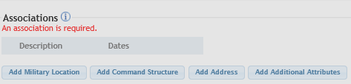
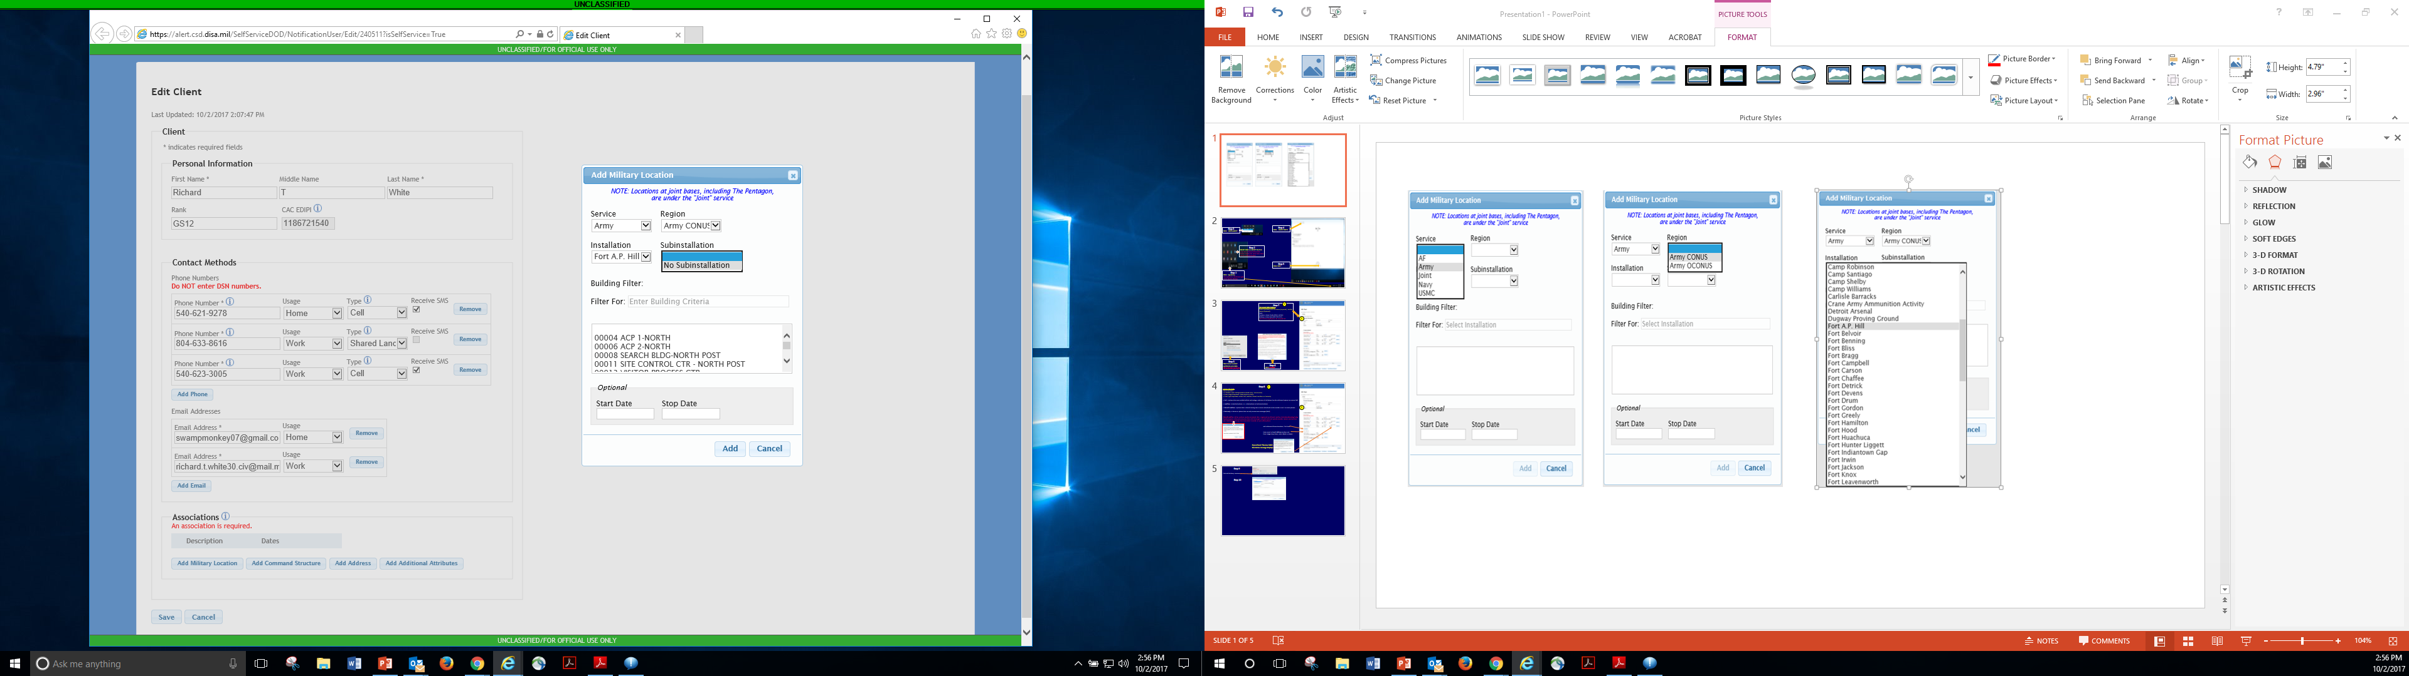
Step 11
Click: ARMY
Click: ARMY CONUS
Click: Fort A.P. Hill
Click: No Subinstallation
Step 10
Click Add Military Location
Type in your Building Number
Select your Building Number, then click ADD at the bottom
Only complete this section if you know your departure date from Fort A.P. Hill and no longer want to be notified.
Lastly Click: ADD

Slide 7
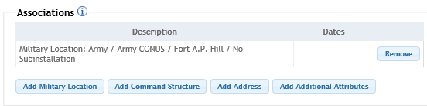
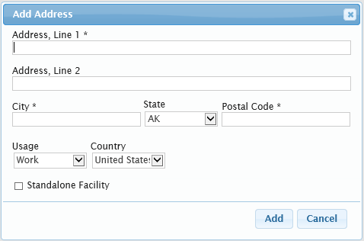
Step 13
Complete your work address information
(textboxes with asterisks (*) are mandatory).
THIS IS ONLY FOR RECRUITING STATIONS,
DO NOT CHECK THIS BOX
Step 12
Click Add Address button
Lastly Click: ADD

Slide 8
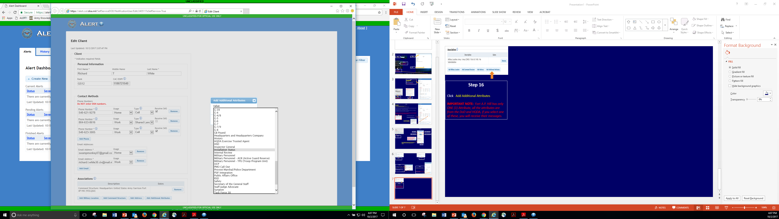
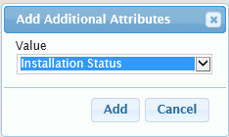
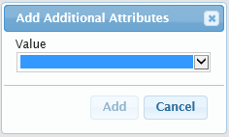
Step 16
Scroll Down until you find:
INSTALLATION STATUS
Installation Status Attribute will ONLY be used for those who want to Base Status (opening, closures, Delays) and Destructive Weather ALERTS.
IMPORTANT NOTE: Fort A.P. Hill has only ONE (1) Attribute, all the attributes are from the DoD and HQDA, if you select one of these, you will receive their messages and Alerts.
ONLY SELECT: INSTALLATION STATUS
Step 14
Click Add Additional Attributes
Step 15
Click DOWN ARROW
Step 17
Click Add

Slide 9
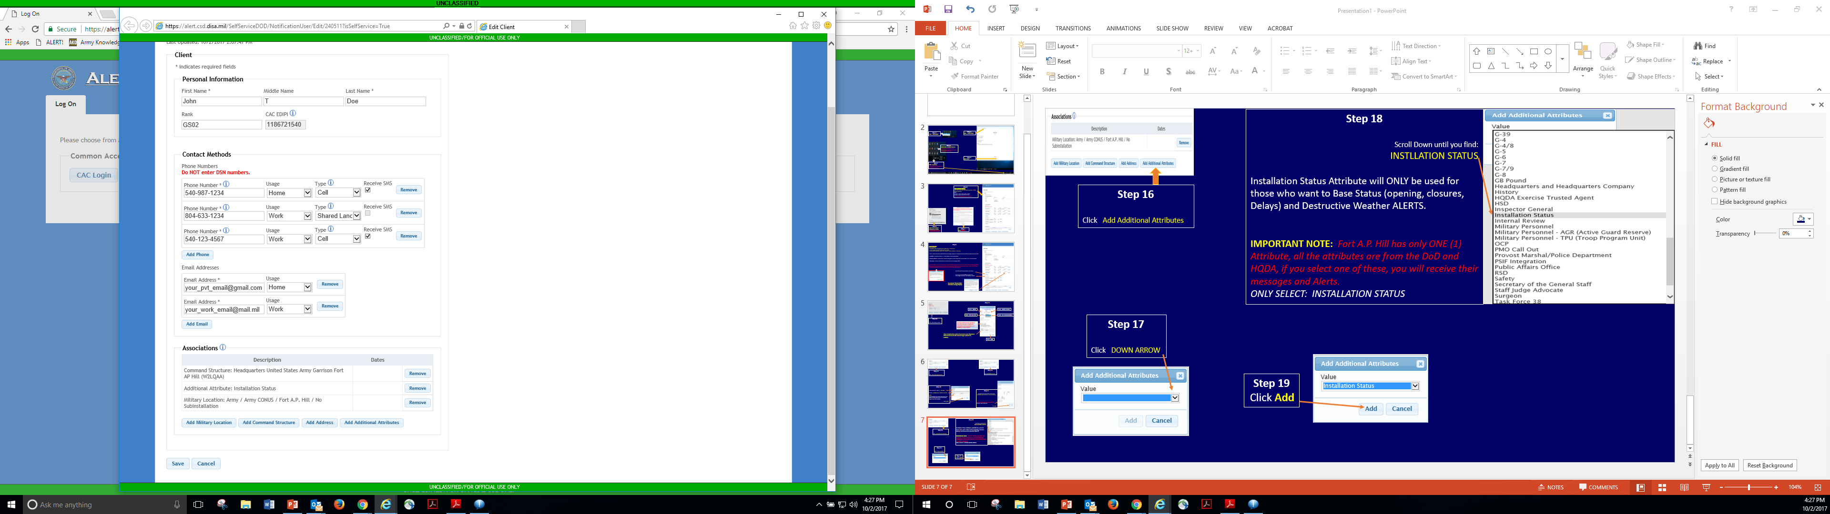
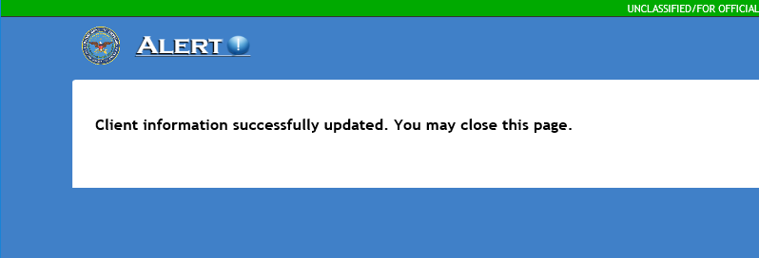
Step 19
You have successfully updated your ALERT! information.
Step 18
Click SAVE

