Slide 1
Self Registration Instructions
for
Fort George G. Meade Alert!

Slide 2
ALERT! HOME PAGE
The Alert! home page URL (link) below is the access point where personnel who do not have the Alert! Icon in their task bar on their desktop/workstation (See Figure 1, STEP 2 ) can self-register on the Fort George G Meade Alert! Notification System.
STEP 1: Cut and paste the Fort George G Meade Alert! home page URL to your browser-- https://alert.csd.disa.mil

Slide 3
STEP 2: USG Warning and Consent Banner displays (Figure 1), click I Agree; Alert! home page will then display
Figure 1 USG Warning and Consent Banner

Slide 4
Step 3: From Alert! home page (Figure 2 below), click on DoD Seal
Figure 2 Alert! Home Page

Slide 5
Step 4: Windows Security appears (Figure 3), Select your Certificate and Click OK.
Figure 3 Select Certificate, Click OK

Slide 6
STEP 5: Alert! Log On page displays (Figure 4), Click CAC Login and enter your pin#
Figure 4 Alert! Log On Page
NOTE
If you receive error message (403 Forbidden), close and restart browser to clear.
If problem persist, contact your system administrator.

Slide 7
STEP 6: Clients page displays (Figure 5), See Step 7 for details
Figure 5 Create Client Page

Slide 8
STEP 7: Complete the following steps to create a client.
STEP 7A. Personal Information:
MUST Enter First Name and Last Name (required)
Optional to enter: Middle Name, Rank and CAC EDIPI.

Slide 9
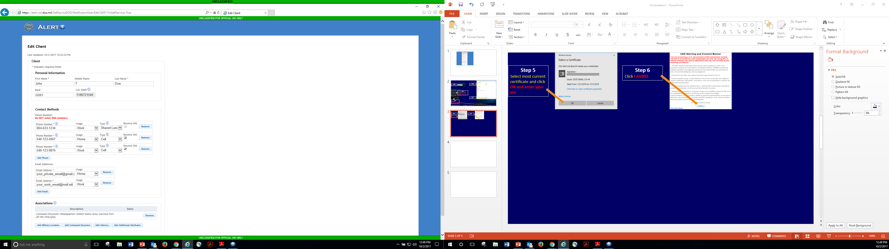
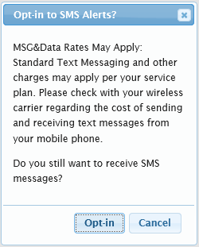
STEP 8: Contact Methods:
Phone Numbers:
8B1: In textbox(s), enter 10-digit phone number. (example: 123-45-6789)
(DO NOT ENTER DSN NUMBERS)
8B2: From Usage drop-down, select Work or Home.
8B3: From Type drop-down, select Cell, Landline, or Text-only.
Disregard Shared Landline
8B4: Receive SMS is selectable when Cell is selected. If you Check “Receive SMS”, the below message displays, Click Opt-in to receive Text Messages
You Can add up to 10 Phone Numbers

Slide 10
STEP 9:
Email Addresses:
Enter email in Email Address textbox and from Usage drop-down,
select Work or Home.
DO NOT USE SIPR ADDRESSES
YOU CAN ADD UP TO 10 EMAIL ADDRESSES

Slide 11
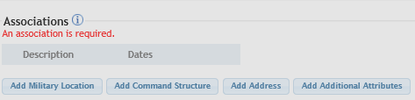
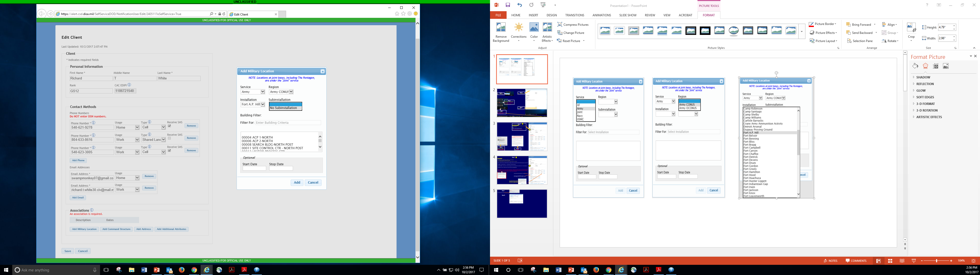
Step 11
Click: ARMY
Click: ARMY CONUS
Click: Fort George G Meade
Click: No Subinstallation
Step 10
Click Add Military Location
Type in your Building Number
Select your Building Number, then click ADD at the bottom
Only complete this section if you know your departure date from Fort A.P. Hill and no longer want to be notified.
Lastly Click: ADD

Slide 12
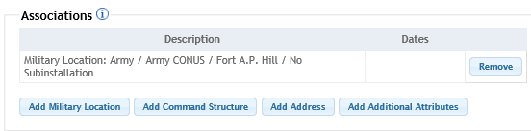
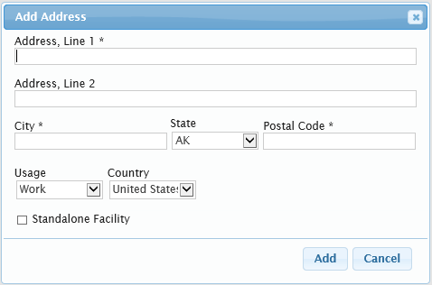
Step 13
Complete your work address information
(textboxes with asterisks (*) are mandatory).
THIS IS ONLY FOR RECRUITING STATIONS,
DO NOT CHECK THIS BOX
Step 12
Click Add Address button
Lastly Click: ADD

Slide 13
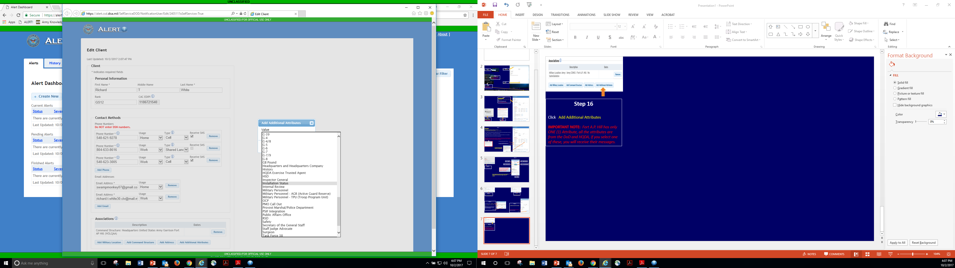
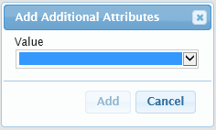
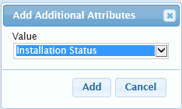
Step 16
Scroll Down until you find:
INSTALLATION STATUS
Installation Status Attribute will ONLY be used for those who want to Base Status (opening, closures, Delays) and Destructive Weather ALERTS.
IMPORTANT NOTE: Fort George G Meade has only ONE (1) Attribute, all the attributes are from the DoD and HQDA, if you select one of these, you will receive their messages and Alerts.
ONLY SELECT: INSTALLATION STATUS
Step 14
Click Add Additional Attributes
Step 15
Click DOWN ARROW
Step 17
Click Add

Slide 14
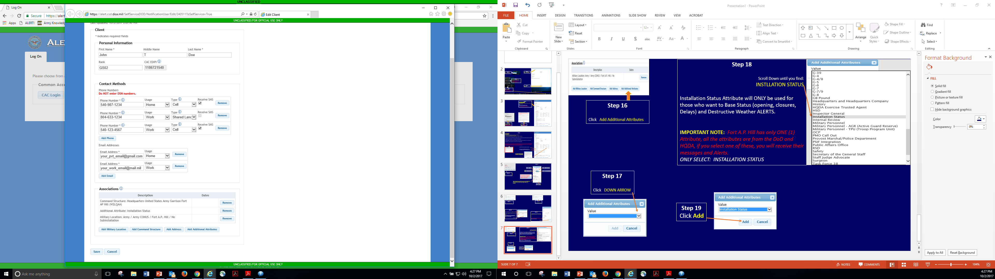
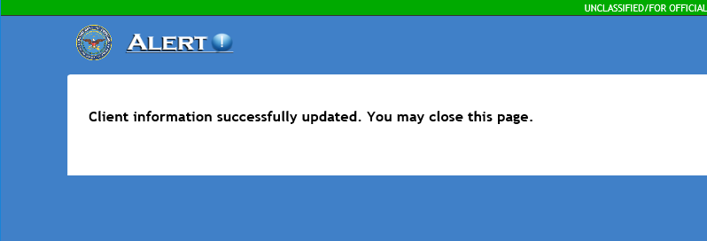
Step 19
You have successfully created/updated your ALERT! information.
Step 18
Click SAVE

