Slide 1
Notes:
Objective:
Students will be able to prepare their vehicle for winter operation and identify what is a winter storm and the terms associated with one (freezing rain, sleet, blizzards, heavy snow, squalls, etc.). Students will be able to make a plan for themselves and what they should do during a winter storm.
Lesson Activities:
1. Begin by asking the students to brainstorm different types of problems they may have had in the past winter months.
2.The instructor should have the students explore various classroom station, each looking at a type of winter weather,.) 3.lists emergency type items, not just extra things
Accommodations:
This lesson requires the students to work together in a groups. The students will also be provided with many hands-on activities during this lesson so that learning will take place by not just listening and reading, but through exploration.
Teaching Information:
The term winter storm covers a broad range of weather conditions (ex: blizzard, heavy snow, snow squalls, snow showers, snow flurries, freezing rain, and sleet). A blizzard is snow and blowing snow with winds at least 35 miles per hour and stronger gusts creating snow drifts. Heavy snow is at least four inches - six inches of snow need to fall within a 12 hour period. Snow Squalls are a sudden snow burst, like a mini blizzard happening in a small area, not affecting a whole region. Snow Showers are similar to that of a rain shower, but instead of rain it is snow. Snow Flurries are a light shower of short duration spreading a dusting of snow over the area. Freezing Rain is when the ground temperature is cold than that of the atmosphere and what starts as rain, freezes as it falls to the ground -- one of the most dangerous of the winter storms events for driving and walking. Sleet is balls of ice that form when raindrops fall from the warm air of the atmosphere and go through a cold layer near the Earth's surface, thus covering the ground with ice balls.

Slide 2
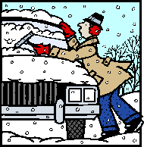
RISK MANAGEMENT DRIVING DECISIONS
CAN I DO THIS LATER?
AM I PREPARED FOR EMERGENCIES?

Slide 3
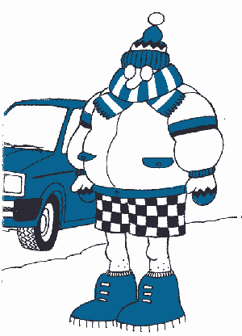
Prepare the driver
Wear warm clothes that do not restrict movement.
In bad weather, let someone
know your route and intended
arrival time, so you can be
searched for, if you don't turn
up after a reasonable delay.

Slide 4
Dress Properly
Wear several layers of thick loose-fitting clothing.
Wear a hat, scarf and turtleneck sweater.
The head and neck lose heat faster than any other part of the body.
Dress for the cold.
Don’t forget a hat and gloves.

Slide 5
Risk Management Reminders
Prepare the driver
If you must drive in bad weather, plan ahead and make sure you have enough fuel.
See and be seen; clear all snow from the hood, roof, windows and lights.
Clear all windows of fog.
If visibility becomes poor, find a place to safely pull off the road as soon as possible.

Slide 6
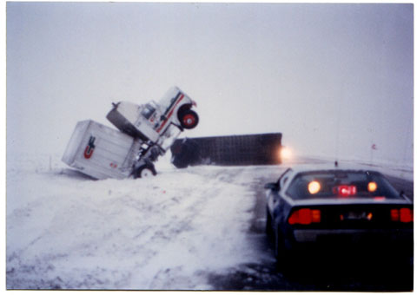
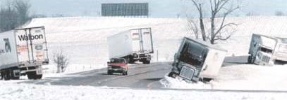
You must Understand how cold weather's effect’s your vehicle before, during and after operation.

Slide 7
Routine precautions help you avoid starting problems:
Get an engine tune-up in the fall.
Be sure all lights are in good working order.
Have the brakes adjusted.
Remember to switch to winter-weight oil if you aren't already (using all-season oil).
Battery and voltage regulator should be checked.
Notes:
PREPARE YOUR CAR Before you depart on a winter trip, make sure your car is in good mechanical condition. Ask your repair shop to inspect the hoses and belts as well as the electrical, exhaust and coolant systems. Test your headlights, turn signals and flashers. Make sure the seat belts and wiper blades operate properly. Change the oil and oil filter every 3,000 miles and rotate the tires on schedule. Check the inflation on your spare tire and keep your container of windshield washer fluid full.

Slide 8
Make sure battery connections are good.
If the battery terminal posts seem to be building up a layer of corrosion, clean them with a paste of baking soda and water. Let it foam, and then rinse with water. Apply a thin film of petroleum jelly to the terminal posts to prevent corrosion, and reconnect.
Be sure all fluids are at proper levels.
Notes:
CHECK YOUR BATTERY Pay particular attention to your car battery because it is a common cause of on-the-road problems. Today's batteries don't require water, but make sure that the terminals ends are clean and free of corrosion and that the cable connections are secure. Carefully monitor the condition of any battery more than two years old. Replace any battery more than four year old.

Slide 9
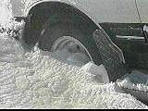
Antifreeze should not only be strong enough to prevent freezing, but fresh enough to prevent rust.
Make sure wiper blades are cleaning properly. Consider changing to winter wiper blades, which are made for driving in snow. They are covered with a rubber boot to keep moisture away from working parts of the blade.

Slide 10
The exhaust system: Have the exhaust system fully checked for leaks that could send carbon monoxide into your vehicle.
Heating and cooling system: Check your radiator and hoses for cracks and leaks. Make sure the radiator cap, water pump and thermostat work properly. Test the strength of the anti-freeze, and test the functioning of the heater and defroster.

Slide 11
Windshield: Make sure wipers are in good condition and fill up on winter washer fluid. Ensure your windshield can give you clear vision of the road and traffic around you.
One way to find a good repair facility to tune-up your vehicle is to look for an ASI Approved Auto Repair Services sign at garages or ask a friend.

Slide 12
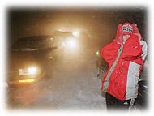
Stay in your car until help arrives
HOT HOT HOT -- DON’T FORGET TO FILL UP WITH FUEL
Don’t forget the gloves. Your fingers will stick to the cold metal

Slide 13
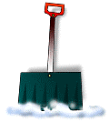
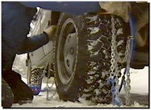
Here's what you'll want to have on hand, especially in an emergency:
Snow shovel.
Scraper with a brush on one end.
Tow chain or strap.
Warning device (flares or reflective triangles).
Notes:
basic supply kit--flashlight, jumper cables, flares or reflective triangles, hand tools, and gloves--is absolutely essential. But it is not enough protection if your car is disabled in winter weather.

Slide 14
Here's what you'll want to have on hand, especially in an emergency (Con’t):
Flashlight (with extra batteries)
Abrasive material (cat litter, sand, salt, or traction mats).
Compass, Warning light or road flares, Booster cables
First Aid Kit

Slide 15
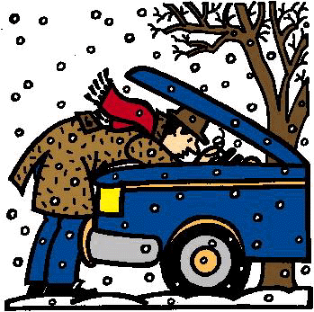
Notes:
Students will be able to prepare their vehicle for winter operation and identify what is a winter storm and the terms associated with one (freezing rain, sleet, blizzards, heavy snow, squalls, etc.). Students will be able to make a plan for themselves and what they should do during a winter storm.
INSTRUCTOR WILL CONTINUE DISCUSSION FROM PREVIOUS SLIDE.
INSTRUCTOR WILL INTERJECT PERSONAL EXPERIENCES WHILE DISCUSSING DRIVING IN EXTREME WEATHER CONDITIONS.

Slide 16
Winter Deaths
Everyone is potentially at risk during winter storms. The actual threat to you depends on your specific situation. Recent observations indicate the following:
Related to ice and snow:
About 70% occur in automobiles.
About 25% are people caught out in the storm.
Majority are males over 40 years old.

Slide 17
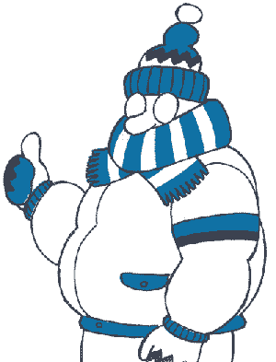
FLURRIES - Light snow falling for short durations. No accumulation or light dusting is all that is expected.
SHOWERS - Snow falling at varying intensities
for brief periods of time. Some
accumulation is possible.
SQUALLS - Brief, intense snow showers accompanied by strong, gusty winds. Accumulation may be significant. Snow squalls are best known in the Great Lakes region

Slide 18
BLOWING SNOW - Wind-driven snow that reduces visibility and causes significant drifting. Blowing snow may be snow that is falling and/or loose snow on the ground picked up by the wind.
Heavy snow - Ten centimeters or more
in 12 hours, or 15 cm or more in 24
hours, and snow falling reduces visibility
up to a quarter of a mile or less.

Slide 19
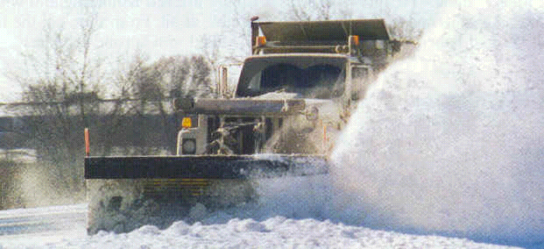
Snow is frozen precipitation in the form of six-side crystals. Snow is produced when water vapor is deposited directly into o airborne particles as ice crystals, which remain frozen as they fall. When temperatures remain below freezing from the cloud to the ground, snow results.

Slide 20
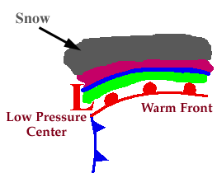
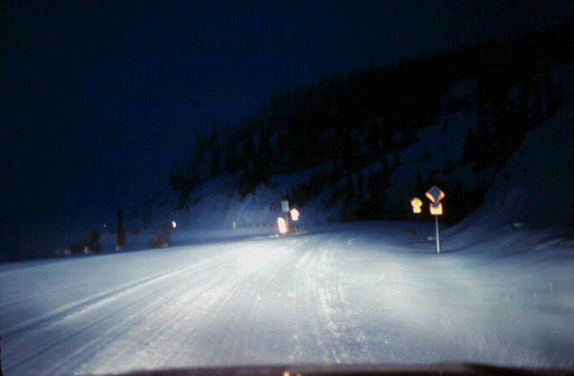
Progressing even further away from the warm front, surface temperatures continue to decrease and the sleet changes over to snow.

Slide 21
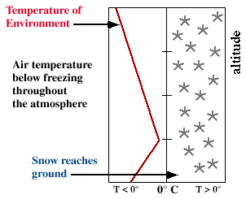
Snowflakes are simply aggregates of ice crystals that collect to each other as they fall toward the surface.
Notes:
The diagram shows a typical temperature profile for snow with the red line indicating the atmosphere's temperature at any given altitude. The vertical line in the center of the diagram is the freezing line. Temperatures to the left of this line are below freezing, while temperatures to the right are above freezing
Since the snowflakes do not pass through a layer of air warm enough to cause them to melt, they remain in tact and reach the ground as snow.

Slide 22
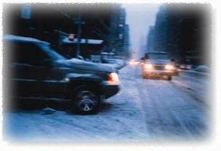
BLIZZARD - The most perilous of winter storms combining falling, blowing, drifting snow, winds of 40 km/hour or more, visibility less than 1 km, temperatures less than -10_C; duration: six hours or more.
Cold Wave - A rapid fall in temperature in a short period, requiring greater than normal protective measures.
Winds The cause of blizzard conditions, drifting, reduced visibility and wind-chill effects.

Slide 23
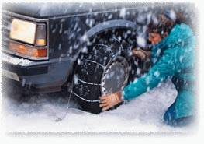
Sleet falls to earth as ice pellets. These ice pellets are formed as snowflakes melt into raindrops as they pass through a thin layer of above-freezing air. The rain drops than refreeze into particles of ice as they pass through a sub-freezing layer of air near the ground.

Slide 24
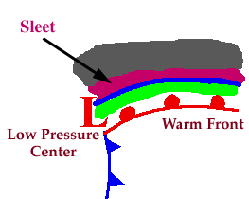
Sleet
Progressing further ahead of the warm front, surface temperatures continue to decrease and the freezing rain eventually changes over to sleet. Areas of sleet are located on the colder side (typically north) of the freezing rain band.

Slide 25
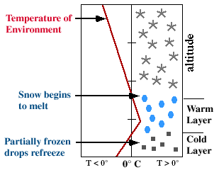
Sleet is less prevalent than freezing rain and is defined as frozen raindrops that bounce on impact with the ground or other objects.
Notes:
The diagram shows a typical temperature profile for sleet with the red line indicating the atmosphere's temperature at any given altitude. The vertical line in the center of the diagram is the freezing line. Temperatures to the left of this line are below freezing, while temperatures to the right are above freezing.

Slide 26
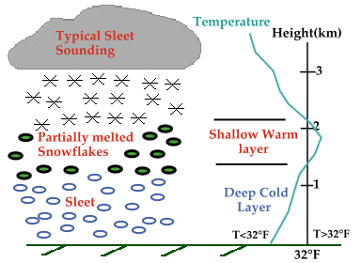
Sleet is more difficult to forecast than freezing rain because it develops under more specialized atmospheric conditions. It is very similar to freezing rain in that it causes surfaces to become
very slick, but is
different because its
easily
visible.

Slide 27
Freezing Rain
Freezing rain is caused by rain droplets that freeze on contact with the ground or objects near the ground, leaving a frozen glaze. The temperature of the ground must be below freezing, and the rain droplets must exist in a liquid state at temperatures below freezing for freezing rain to occur.
Freezing rain can glaze roadways with ice causing extremely hazardous driving conditions.

Slide 28
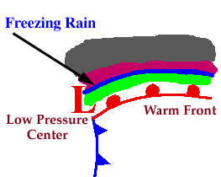
Ice storms can be the most devastating of winter weather phenomena and are often the cause of automobile accidents, power outages and personal injury. Ice storms result from the accumulation of freezing rain, which is rain that becomes super cooled and freezes upon impact with cold surfaces. Freezing rain is most commonly found in a narrow band on the cold side of a warm gront,
where surface temperatures are
at or just below freezing.
Notes:
Freezing rain develops as falling snow encounters a layer of warm air deep enough for the snow to completely melt and become rain. As the rain continues to fall, it passes through a thin layer of cold air just above the surface and cools to a temperature below freezing. However, the drops themselves do not freeze, a phenomena called supercooling (or forming "supercooled drops"). When the supercooled drops strike the frozen ground (power lines, or tree branches), they instantly freeze, forming a thin film of ice, hence freezing rain.

Slide 29
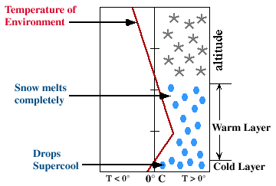
The diagram below shows a typical temperature profile for freezing rain with the red line indicating the atmosphere's temperature at any given altitude. The vertical line in the center of the diagram is the freezing line. Temperatures to the left of this line are
below freezing, while
temperatures to the
right are above freezing.

Slide 30
ICE
Expect icy conditions any time the outside air temperature reaches 40 degrees F or lower. Although water freezes at 32 degrees F, road surface can freeze when the air temperature drops to 40 degrees or less.
An important place to watch for this condition is on bridges. Bridge surfaces are exposed to the wind and cool off faster than the rest of the road.
You should also prepare for icy conditions on roads through shaded areas where a cold wind can freeze a wet road surface.

Slide 31
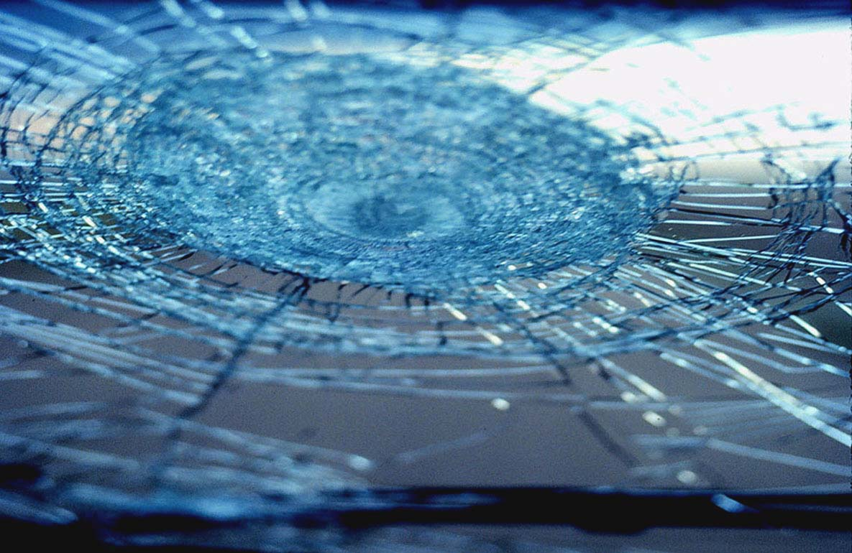
Visualize a baseball dropped from a 747 flying at 30,000 feet; it's speed reaches 120 MPH, visualize you going 70 MPH under this big ugly cloud......bam!
Notes:
A picture of Hail that hit a wind shield

Slide 32
Snow that has been compacted during the day and has slightly melted will freeze at night. Usually this white ice can be seen on the road. When traveling on white ice, drive very slowly. If you cannot find a place to park until conditions improve, install tire chains for better traction.
Slick trick -- Watch for slippery spots called glare ice. These may appear on an otherwise clear road in shaded areas. If you see a patch of ice ahead, brake before reaching it and try not to brake while actually on the ice
WHITE ICE

Slide 33
Black Ice
Black ice fools drivers. Its shine tricks them into thinking it's water on the road. What they may not realize is that condensation, such as dew, freezes when temperatures reach 32 degrees or below. This forms an extra-thin layer of ice on the road.
This shiny ice surface is one of the most slippery road conditions. Black ice is likely to form first under bridges and overpasses, in shady spots and at intersections.

Slide 34
FOLLOW THE TEN-POINT PLAN FOR SAFER WINTER DRIVING
Hand in hand with winter comes heavy rain, fog, ice and snow. Bad weather affects visibility and stopping distances. Follow this ten-point plan and be a safer winter driver.
1. Allow extra time for your journey and reduce your speed.
2. Increase the distance between you and the vehicle in front and be certain you can stop within the distance you can see to be clear.

Slide 35
3. If visibility is seriously reduced by fog, use dipped headlights and rear fog lights. Switch on your wipers to keep your windscreen clear.
4. Remember to turn fog lights off when they are no longer needed as they can be a distraction to other drivers.
5. Remember the obvious - you can see snow, but you can't always see ice.
6. Avoid sudden braking, accelerating too quickly and harsh steering in slippery conditions

Slide 36
7. Keep your windscreen clear of snow and check from time to time that there is not a build up of snow on your lights.
8. Carry a shovel, extra warm clothing, a blanket, a snack and a drink - especially if you are traveling through isolated areas.
9. If you are going on a long journey, advise someone of your destination and what time you expect to arrive.
10. If you feel uncomfortable driving in bad weather, consider whether your journey is really necessary or whether you can go by an alternative to the car.

Slide 37
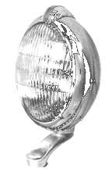
When do I use Fog Lights?
Fog lights are designed to be used during fog or foul weather, in conjunction with your low beams to focus as much light as possible on the ground directly in front of you. Providing increased light on the ground helps you to follow the road and helps reduce the reflection on the fog from your headlights.
Notes:
Question: Why are fog lights yellow? Does it help that they are? Does it matter if you are driving in city or countryside? jessica v. Answer: My understanding is that it is important for fog lights to be one color (rather than white, which is all colors) because the different wavelengths(colors) of visible light scatter off the fog droplets differently. This phenomenon is known as "dispersion," because the different colors of light in an image will separate from each other, causing the image to "disperse." If you illuminate the road with only one wavelength (color) of light, the images of the objects you see will still become somewhat blurry because of the scattering of light by the fog, but at least you won't have extra problems from dispersion. So, if we want to use just one wavelength of light, which wavelength should we use? It turns out that light with short wavelengths scatters more than light with long wavelengths (short to long: violet, indigo, blue, green, yellow, orange, red). So, a long wavelength light will be best. There's another thing to consider, too: our eyes are not equally sensitive to all colors. It turns out that we are most sensitive to yellow and green light. So, our best compromise between sensitivity for our eyes and a long wavelength for least scattering is yellow light. Now, I don't know what kind of light bulbs are used in fog lights, but another consideration used in street lighting is cost and efficiency. You may have seen some yellow street lighting in some places; this is "low-pressure sodium vapor" lighting. The special thing about this light is that it is almost entirely one (actually two very close together) wavelength of yellow light, and that it gives the most illumination for the amount of electricity. A big problem with this light, though, is that it throws off color perception. Under sodium vapor light, something blue looks gray. This makes it hard to, say, recognize your car in a parking lot. Richard Barrans Jr., Ph.D. ========================================================= There is no good reason why fog lights are yellow. Here is an excellent explanation provided by Professor Craig Bohren of Penn State University: "First I'll give you the wrong explanation, which you can find here and there. It goes something like this. As everyone knows, scattering (by anything!) is always greater at the shortwavelength end of the visible spectrum than at the longwavelength end. Lord Rayleigh showed this, didn't he? Thus to obtain the greatest penentration of light through fog, you should use the longest wavelength possible. Red is obviously unsuitable because it is used for stop lights. So you compromise and use yellow instead. This explanation is flawed for more than one reason. Fog droplets are, on average, smaller than cloud droplets, but they still are huge compared with the wavelengths of visible light. Thus scattering of such light by fog is essentially wavelength independent. Unfortunately, many people learn (without caveats) Rayleigh's scattering law and then assume that it applies to everything. They did not learn that this law is limited to scatterers small compared with the wavelength and at wavelengths far from strong absorption. The second flaw is that in order to get yellow light in the first place you need a filter. Note that yellow fog lights were in use when the only available headlights were incandescent lamps. If you place a filter over a white headlight, you get less transmitted light, and there goes your increased penetration down the drain. There are two possible explanations for yellow fog lights. One is that the first designers of such lights were mislead because they did not understand the limitations of Rayleigh's scattering law and did not know the size distribution of fog droplets. The other explanation is that someone deemed it desirable to make fog lights yellow as a way of signalling to other drivers that visibility is poor and thus caution is in order. Designers of headlights have known for a long time that there is no magic color that gives great penetration. I have an article from the Journal of Scientific Instruments published in October 1938 (Vol. XV, pp. 317-322). The article is by J. H. Nelson and is entitled "Optics of headlights". The penultimate section in this paper is on "fog lamps". Nelson notes that "there is almost complete agreement among designers of fog lamps, and this agreement is in most cases extended to the colour of the light to be used. Although there are still many lamps on the road using yellow light, it seems to be becoming recognized that there is no filter, which, when placed in front of a lamp, will improve the penetration power of that lamp."

Slide 38
Fog Safety Tips:
Drive with lights on low beam
Reduce speed
Avoid crossing traffic unless absolutely necessary
Listen for traffic you cannot see
Notes:
Fog lights are yellow and driving lights are white ... WRONG. There's more to it than that.
When someone is thinking about installing fog lights, I start with questions: First of all, do you know what fog lights are? Secondly, what do you drive, where do you drive, what kinds of roads do you drive on? What kind of weather do you drive in? What do you want the fog lights for -- do you live in a real foggy area? Are they for pea soup fog or light fog, for snow, rain? Or just to look cool when you're cruising?
Fog lights aren't necessarily amber lights, nor are amber lights always fog lights. There are amber driving lights, amber spotlights, and, in France, there are amber headlights. What makes a fog light is the light pattern, regardless of the type of lamp or color of the light. A real fog light -- one that will do you good when you're trying to see in the fog -- has a wide beam pattern (70 degrees to 120 degrees) with a sharp, flat cutoff on top.
So beyond that, not all "fog lights" are created equal. There are lots of lights being marketed as fog lamps -- some very low priced, some hundreds of dollars a pair -- that, if I were driving in extreme weather, I would not turn on. They would make it harder to see.
Fog lights, of course, are just one kind of auxiliary light. There are also driving lights, midbeams (passing lights) and spotlights for other purposes. And fog lights have many other functions besides fog, such as other types of bad weather and increasing side light for cornering. While fog lights are beneficial in fog or any other glare-producing conditions, they can also help you see better when you drive on a clear night. Mainly when you think of fog lights, you think of fog.
Seeing through the fog? You can't see "through" fog. You see in foggy weather by lighting up the road under the fog, illuminating as little of the fog as possible to avoid producing glare.
Fog is defined as a thick cloud of water droplets, 0.00039 to 0.00156 inches in diameter, suspended in the atmosphere at or near the earth's surface and reducing visibility to below half a mile.
Your high beam headlights produce a wall of glare -- a whiteout -- from the light bouncing off these droplets of water. You're being blinded by the glare of your own lights reflected off the water vapor in front of you. Similar experiences occur in rain, snow, dust, etc.
One solution would be to buy heated blowers like giant hair driers to dry the air in front of your car -- works great, costs a lot and uses a ton of energy. We may never deliver any of these, but you can start sending deposits in now (big ones).
The amount of glare from the airborne moisture is affected by the relationship of angles between your line of sight and the angle of your car's lights. That's why you want a wide, flat beam from your fog lights. What you want your fog lamp to do is light up the road in front of you without lighting up the fog that's higher up, right in front of your eyes.
Lenses and reflectors It helps to know something about the construction of the light -- specifically its lens and its reflector. The cuts in the lens, called fluting, shape the pattern by how they deflect the light. Ever knocked the lens out of your fog light? And noticed how it turned into a spot light? That's what it would be if it had a totally clear lens, with no fluting.
Since the light passes through the lens, obviously the material of the lens would have an effect on how much light passes through. Lead crystal, being the clearest, allows the most light to pass through. Both ordinary glass and hardened glass are full of dirt and impurities that affect the passage of light. Plastic lenses block even more of the light.
Most of the better lights are made with lead crystal lenses. Hardened glass doesn't break as easily, but is still as impure as ordinary glass. Plastic is basically useless for lenses because of impurities and because it gets scratched up.
Breakage is, of course, an occasion for replacing lenses. And if fog lights are mounted in an air dam and you drive across the desert a lot, they get essentially sand blasted and all the little pits affect the flow of light and the light pattern. Even if you don't drive across the desert, your lenses will still be scuffed up by grit and you likely will want to replace them sooner or later, especially if you're using good quality lights.
You also will care about the quality of the reflector, the shiny part that gathers the light from the bulb and reflects it out at precise angles through the lens. Good reflectors aren't chrome -- chrome appears to be shiny and reflective to the eye, but for reflecting light, it's not efficient!
Some reflectors are silver plated. This is from the olden days. Prior to the invention of sealed beam headlights, American cars had separate bulbs, reflectors and lenses, and the reflectors were silver. Silver is not optimally reflective even when first applied. And through tarnishing, it loses 40 - 50% of its reflectivity after about 48 hours. These reflectors were supposed to be polished monthly.
The preferred and most reflective material is an aluminized vapor coating. This is the neat stuff they use in microscopes and in mirrors for aiming lasers. Most of the higher quality lamps use this.
Some lights also use a bulb shield, like a cup in front of the bulb. It blocks direct light from the bulb to the lens so that only light from the designed shape of the reflector passes through the lens. This reduces stray light above the cut-off.
A word about bulbs Halogen bulbs have been around for about 30 years now. Most of the replaceable bulb type lamps utilize a halogen bulb. Some use a tungsten bulb -- this does not produce as much light per watt.
Three common types of single-filament halogen type bulbs are H1, H2 and H3. The H1 puts out 29 lumens per watt (lm/w), the H2 is 33 lm/w and the H3 is 26 lm/w -- versus the 13 lm/w of a tungsten bulb. Any of these three could be found in a fog light. The bulbs don't interchange -- a lamp is built to take a certain bulb.
The most common bulb wattage is 55 watts. A brighter option is a 100w bulb, which produces nearly twice as much light at the bulb filament, which wouild be a benefit in a larger lamp. In many of the smaller lamps, the reflector area is too small to efficiently gather the light and very little increase in light output occurs.
Of course, the question of yellow, or amber, versus white needs to be addressed. I prefer white. Regardless of the fog lights' various types of construction, generally speaking amber or yellow fog lights become amber or yellow from coloring the lens or the reflector. This may reduce the light 15% to, in extreme cases, 50%.
I once equipped a car with amber headlights, driving lights, spot lights and fog lights. I could light up reflective signs two miles away. But from not having the full spectrum of light, a lot of darker objects simply were not as visible.
So I use white lights for their benefits the majority of the time. Some people prefer amber lights for more severe weather, and, obviously, for much less glare off of snow. But to me the disadvantages outweigh that benefits.
Bigger lights are, all other things being equal, better. More reflector area reflects more light. Bigger, better lights do, however, cost more.
Round lights are better than square ones with an equal area because the corners in a square lamp are sacrificing area. It isn't for the aerodynamics that rally cars have rows of big round lights across the front.
There are various designs ranging from sealed beams (of which there are still some on the market) to the projector lights. Projector lights have the bulb sitting way in the back with an ellipsoid reflector behind it. A shield is used to perform the cutoff. The convex lens projects the light -- hence the term projector -- like a slide projector light. It's a sophisticated design whose advantages are that you can get the same amount of light with half the size of lamp, the beam is very wide and even, and the stray light above the cutoff is practically nil.
The oldest and still most common types of separate bulb lamps use parabolic reflectors, which are something like a cross between a bowl and a funnel in shape.
Another kind of lamp is called bi-focus or free-form. Instead of a parabolic reflector, it has a multi-planed reflector. This means the reflector itself has many different planes which focus the light before it hits the fluting in the lens, sort of "pre-aiming" the light from the bulb.
Obviously, this begins to get fairly complex and much is done by the lighting manufacturers to research and develop materials and construction to make a light do what it's supposed to do.
Mounting After you have the right kind of fog light with the right pattern, next is how to mount it to get maximum benefit and this depends on what your goals are for your fog lights. For really severe weather, mounting the lights lower is better.
But the lower the lights are mounted, the more vulnerable they are to impacts from stones and other various objects. The lower mountings also decrease how far forward the light will go (thanks to hills and the like). And the lower they're mounted, the more the shadowy effect from from rises and depressions in the road increases, which I find irritating.
Mounting the lights low on the vehicle is useful only for pea-soup fog, snow squalls, etc. -- 20 mph driving conditions -- which I encounter very infrequently. So for the majority of the time, I feel I am better off with fog lights mounted on top of the bumper -- for greater distance and more visibility overall in less severe conditions. I'm still retaining the option of aiming them lower for extreme conditions (I can get out a wrench and point them at the ground 10 feet in front of the bumper when the weather is really bad).
I also drive with my fog lights on in clear weather as cornering lights and for seeing animals and other things off on the side of the road waiting to attack my vehicle.
Another important consideration when mounting fog lights is that they be mounted rigidly, so the beam stays pointed the way it's aimed, as opposed to dancing over tar strips on the road and the like. Dancing light beams will prove to be very irritating and, if they're dancing up and hitting those droplets of water, you're still going to have glare.
Aiming Fog lights should be aimed straight ahead and level, or down a few degrees. For really severe weather, aim them down lower and give up the longer distance. In that situation, you don't need them to go 600 feet down the road, since you can only see 60 feet.
A wide pattern with the light aimed straight ahead will give you some light off to the sides for cornering. So some people, whose prime concern is cornering light, will aim their fog lights so they spread apart off to the sides, pointed away from each other, to increase the off-the-road light. This will increase the amount of side light from the outside part of each light. But it will decrease the light in front of the car, and thus the distance they go straight down the road in front of you.
Here's a better idea. On some of the rally cars I've prepared, we aimed the fog lights so the light patterns would cross each other (the left light would light up the right side, and the right light, the left side). This gives the same amount of light off to each side, but in front of the vehicle, it's brighter where the beams overlap.
Keep 'em clean No matter what the color or pattern of your fog lights, keep them clean. Just a few days' worth of road dirt can cut the light be up to 50%. In winter, mud and snow can reduce light up to 90%!
But now you know the basics -- what fog is, the types of fog lamps available, how to mount and aim fog lights for your intended purpose.
So, how do you chose a fog light? Buy them all and compare them, or consult an expert. You could read everything there is about a light, but that won't tell you everything. For example, you can't compare reflective ranges from different manufacturers, because they may not all use the same reflector.
Ultimately, you can't know how a light works until you put it in a vehicle and drive down the road with it -- or talk to someone who has.

Slide 39
Fog Safety Tips (Con’t):
Use wipers and defroster as necessary for maximum vision
Be patient! Don’t pass lines of traffic
Unless absolutely necessary, don’t stop on any freeway or other heavily traveled road
Consider postponing your trip until the fog clears

Slide 40
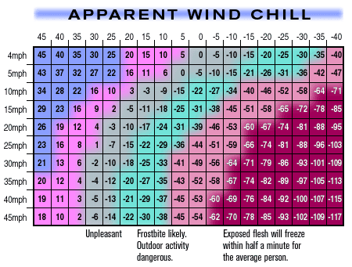
Examples of wind chill:
Read right and down from the calm-air line. For example, a temperature of 0ºF combined with a 20 mph wind, has an equivalent cooling effect of -39ºF.
with a temperature of -15°F and winds blowing at 35 mph, the wind chill index would be -74°F and would cause exposed skin to freeze in 30 seconds
with the temperature of 15°F and winds blowing at 35 mph, the wind chill index would be -27°F, which would likely cause frostbite and make outdoor activities dangerous
Notes:
Wind Chill Equivalent Index The Wind Chill Equivalent Index is an air temperature index that measures the heat loss from exposed human skin surfaces. Heat loss is caused by a potentially lethal combination of wind and low air temperature. The actual air temperature is not as low as the Wind Chill Equivalent Index. Wind removes heat from the body in addition to the low temperature. Risk of frostbite from low wind chill indices makes the wind chill a winter weather hazard

Slide 41
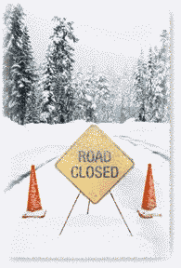
Remember!
The speed you travel in adverse weather, has a negative correlation to stopping distance and maneuver space.

