Slide 1
Search “EIN”
Notes:
Record your own notes here:

Slide 2
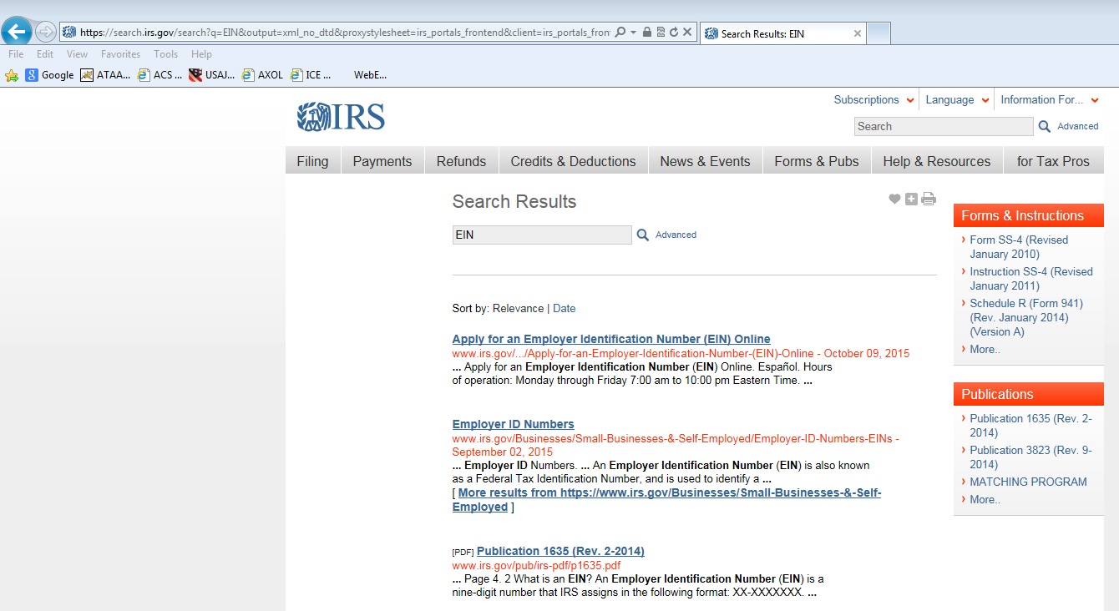
Select “Employer ID Numbers”
Notes:
Record your own notes here:

Slide 3
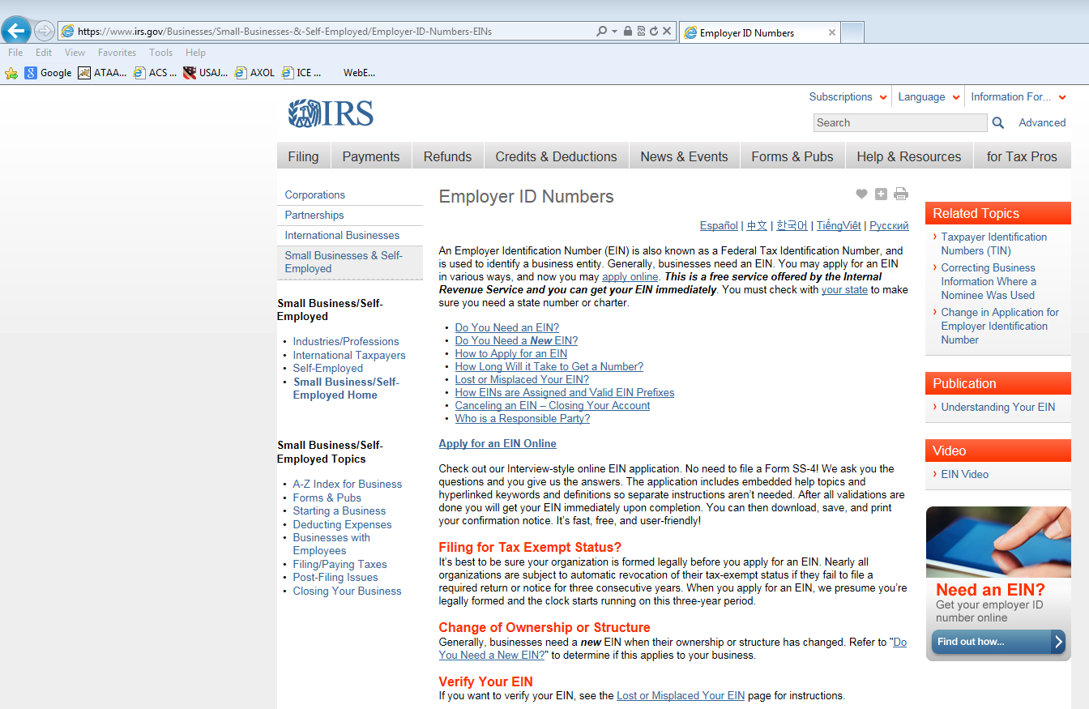
Select “Apply for EIN Online”
Notes:
Record your own notes here:

Slide 4
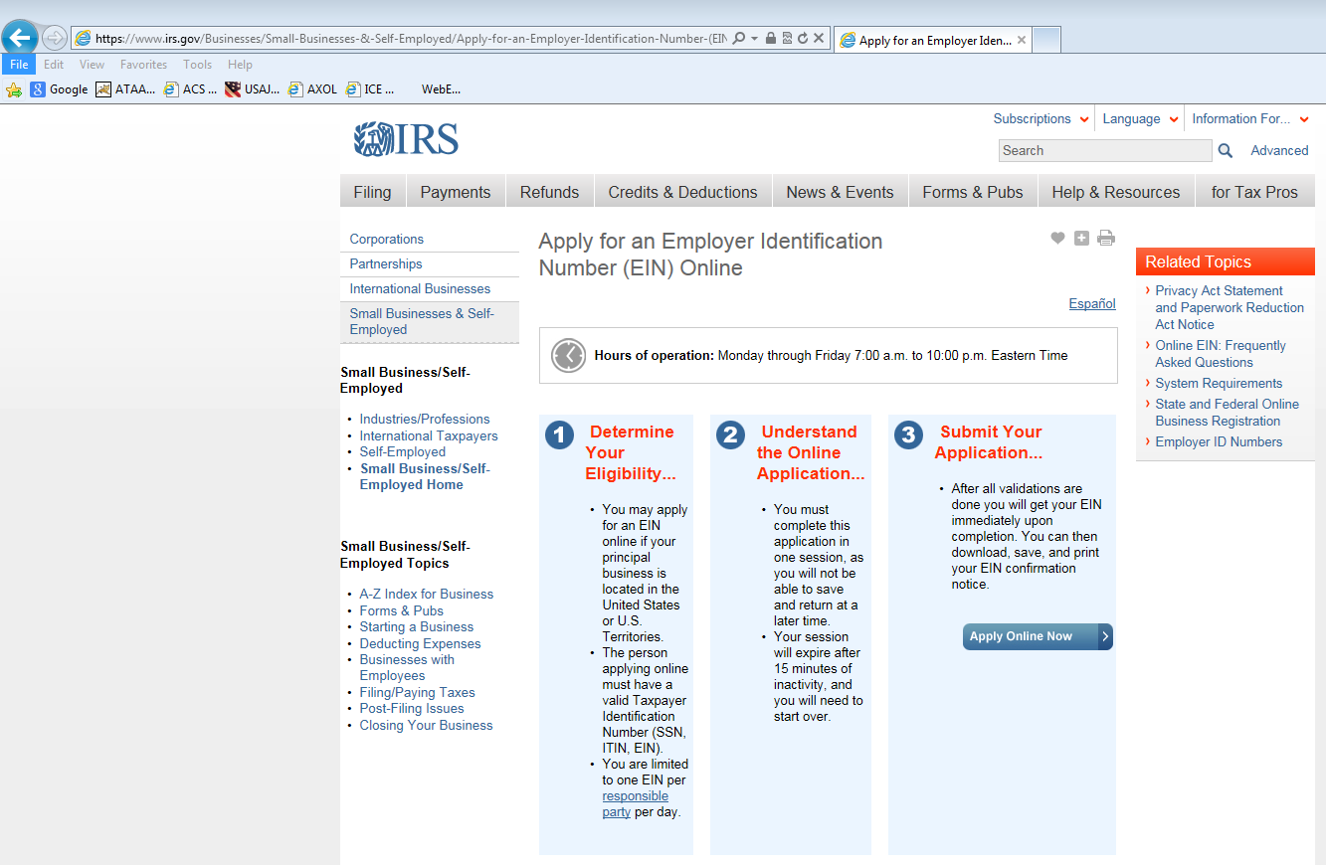
Select
“Apply Online Now”
Notes:
Record your own notes here:

Slide 5
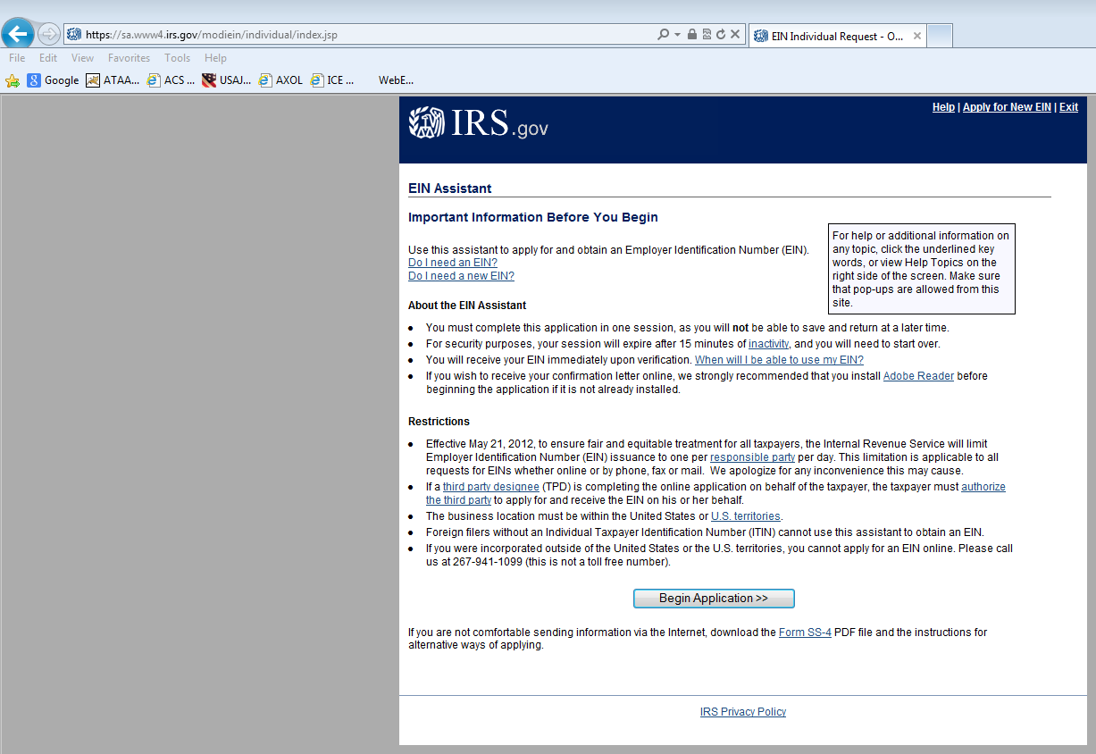
Select “Begin Application
Notes:
Record your own notes here:

Slide 6
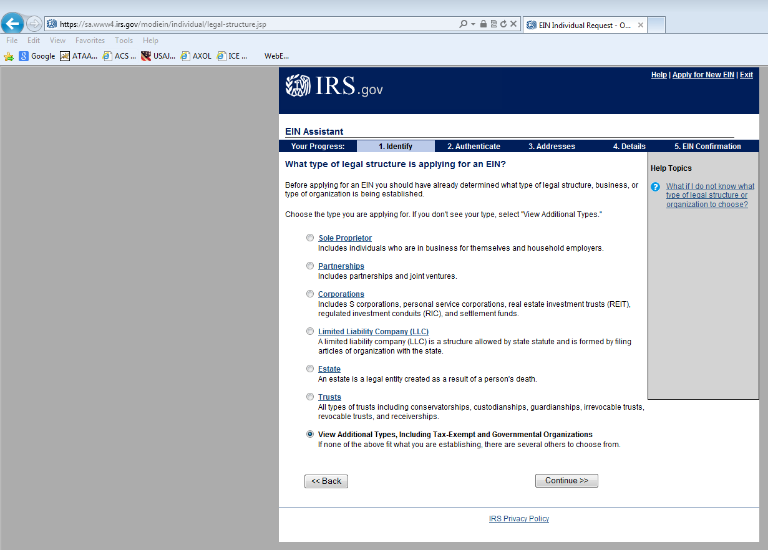
1. Select “View Additional…”
2. Select “Continue>>”
Notes:
Record your own notes here:

Slide 7
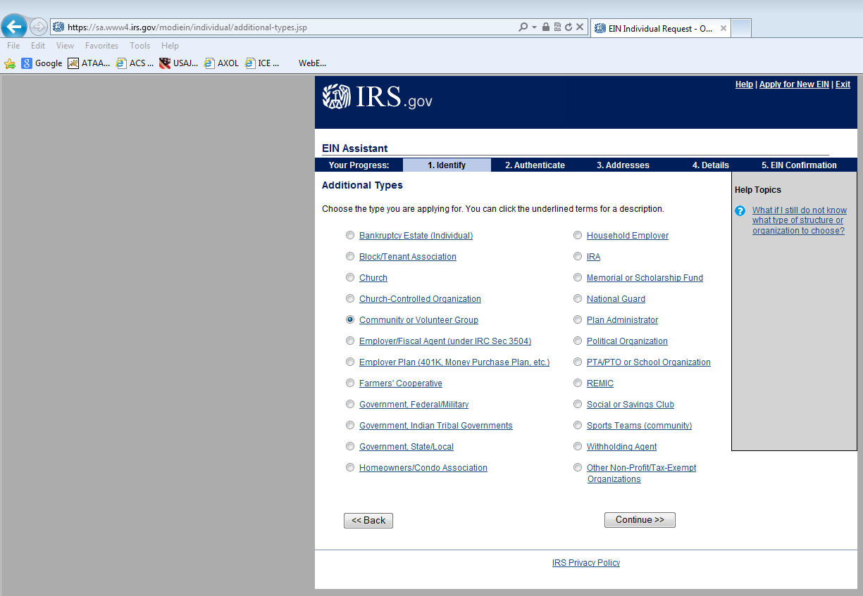
1. Select “Community”
2. Select “Continue>>”
Notes:
Record your own notes here:

Slide 8
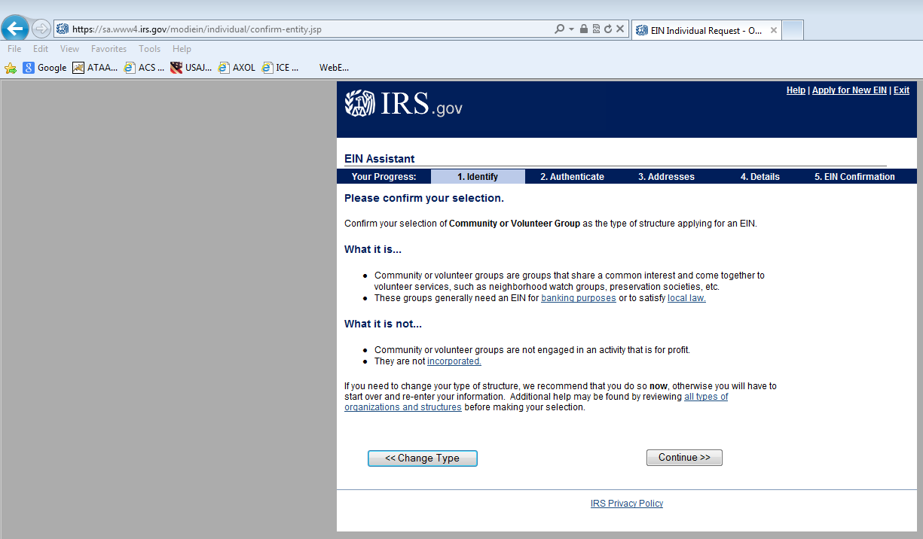
Select “Continue>>”
Notes:
Record your own notes here:

Slide 9
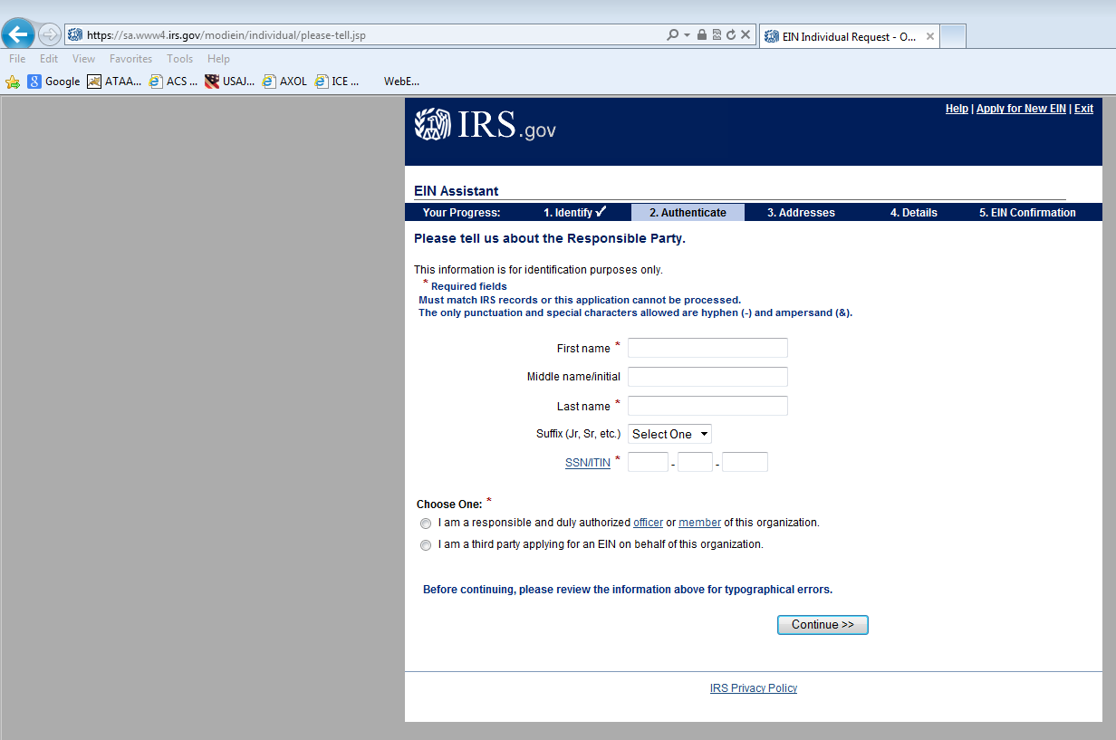
1. Follow the instructions from
this point forward.
You will finish all mailing and address information; add additional details; and confirm Employer Identification Number.
If you encounter a problem or question, contact the
Commercial Concerns Coordinator
for further assistance.
2. Select “Continue>>”
Notes:
Record your own notes here:

