Slide 1
DA FORM 7708
Personnel Reliability Program
Determining reliability. The following positions or duties in Army physical policies require a determination of reliability—
(1) Unaccompanied access to arms, ammunition, and explosives per AR 190-11.
(2) Unaccompanied access to controlled medical substances per AR 190-51.
(3) Employment and retention as a DA police officer or DA security guard, per AR 190-56.
The DA Form 7708 (Personnel Reliability Screening and Evaluation Form), with instructions on use in appendix E, is used to document the reliability determination process.
For personnel with a Current DA Fm 7281, that document is valid until it expires. Between 12 DEC 19 and 3 FEB 20 either form can be used. After 3 FEB 20 the DA 7281 will no longer be valid/accepted.

Slide 2
DA FORM 7708
Personnel Reliability Program, 7708
a. Part I, IMMEDIATE SUPERVISOR/COMMANDER INTERVIEW.
Instructions on following slide
Notes:
AR 190-13, Appendix D
a. Part I: Immediate supervisor, commander, or director interview.
(1) Block 1. Enter the name of the interviewed individual.
(2) Block 2. Enter the organization.
(3) Block 3. Enter position title.
(4) Block 4. Enter the person’s Social Security number.
(5) Block 5. The person will check one of the two blocks. The interview process will be terminated if the person indicates objection to the screening requirements. The certifying official will record the objection in blocks 49 and 50.
(6) Block 6. Check the applicable block for the pending duty. If the duty is not listed, use the “other” block and specify the duty.
(7) Block 7. The person will electronically sign the form in this block.
(8) Block 8. The date is automatically applied when Block 7 is signed.
(9) Block 9. Enter the name of the interviewer.
(10) Block 10. The interviewer will electronically sign the form in this block.
(11) Block 11. The date is automatically applied when Block 10 is signed.

Slide 3
DA FORM 7708
AR 190-13, Appendix D
a. Part I: Immediate supervisor, commander, or director interview.
(1) Block 1. Enter the name of the interviewed individual.
(2) Block 2. Enter the organization.
(3) Block 3. Enter position title.
(4) Block 4. Enter the person’s Social Security number.
(5) Block 5. The person will check one of the two blocks. The interview process will be terminated if the person indicates objection to the screening requirements. The certifying official will record the objection in blocks 49 and 50.
(6) Block 6. Check the applicable block for the pending duty. If the duty is not listed, use the “other” block and specify the duty.
(7) Block 7. The person will electronically sign the form in this block.
(8) Block 8. The date is automatically applied when Block 7 is signed.
(9) Block 9. Enter the name of the interviewer.
(10) Block 10. The interviewer will electronically sign the form in this block.
(11) Block 11. The date is automatically applied when Block 10 is signed.

Slide 4
DA FORM 7708
Personnel Reliability Program, 7708
a. Part II, CHECK OF PERSONNEL RECORDS
Instructions on following slide
Notes:
AR 190-13, Appendix D
(1) Block 12. The reviewing personnel official will check one of the two blocks, indicating whether potentially disqualifying information was or was not found.
(2) Block 13. The reviewing personnel official will enter their name.
(3) Block 14. The reviewing personnel official will electronically sign the form in this block.
(4) Block 15. The date is automatically applied when Block 14 is signed.

Slide 5
DA FORM 7708
AR 190-13, Appendix D
(1) Block 12. The reviewing personnel official will check one of the two blocks, indicating whether potentially disqualifying information was or was not found.
(2) Block 13. The reviewing personnel official will enter their name.
(3) Block 14. The reviewing personnel official will electronically sign the form in this block.
(4) Block 15. The date is automatically applied when Block 14 is signed.

Slide 6
DA FORM 7708
Personnel Reliability Program, 7708
a. Part III, CHECK OF SECURITY RECORDS
Instructions on following slide
Notes:
AR 190-13, Appendix D
(1) Block 16. The reviewing security official will check one of the two blocks, indicating whether potentially disqualifying information was or was not found.
(2) Block 17. The reviewing security official will enter the date of the personnel security adjudication, the type of investigation, if the adjudication was favorable, or if the dossier requires a review.
(3) Block 18. The reviewing security official will enter the date and type of investigation, if a personnel security investigation or reinvestigation was requested.
(4) Block 19. The reviewing security official will indicate the level of security clearance.
(5) Block 20. The reviewing security official will enter their name in this block.
(6) Block 21. The reviewing security official will electronically sign the form in this block.
(7) Block 22. The date is automatically applied when Block 21 is signed.

Slide 7
DA FORM 7708
AR 190-13, Appendix D
(1) Block 16. The reviewing security official will check one of the two blocks, indicating whether potentially disqualifying information was or was not found.
(2) Block 17. The reviewing security official will enter the date of the personnel security adjudication, the type of investigation, if the adjudication was favorable, or if the dossier requires a review.
(3) Block 18. The reviewing security official will enter the date and type of investigation, if a personnel security investigation or reinvestigation was requested.
(4) Block 19. The reviewing security official will indicate the level of security clearance.
(5) Block 20. The reviewing security official will enter their name in this block.
(6) Block 21. The reviewing security official will electronically sign the form in this block.
(7) Block 22. The date is automatically applied when Block 21 is signed.

Slide 8
DA FORM 7708
Personnel Reliability Program, 7708
a. Part IV, CHECK OF MEDICAL RECORDS
Instructions on following slide
Notes:
AR 190-13, Appendix D
(1) Block 23. The reviewing medical official will check one of the two blocks, indicating whether potentially disqualifying information was or was not found.
(2) Block 24. The reviewing medical official will enter their name.
(3) Block 25. The reviewing medical official will electronically sign the form in this block.
(4) Block 26. The date is automatically applied when Block 25 is signed.

Slide 9
DA FORM 7708
AR 190-13, Appendix D
(1) Block 23. The reviewing medical official will check one of the two blocks, indicating whether potentially disqualifying information was or was not found.
(2) Block 24. The reviewing medical official will enter their name.
(3) Block 25. The reviewing medical official will electronically sign the form in this block.
(4) Block 26. The date is automatically applied when Block 25 is signed.

Slide 10
DA FORM 7708
Personnel Reliability Program, 7708
a. Part V, CHECK OF LAW ENFORCEMENT RECORDS
Instructions on following slide
Notes:
AR 190-13, Appendix D
(1) Block 27. The reviewing law enforcement official will check one of the two blocks, indicating whether potentially disqualifying information was or was not found.
(2) Block 28. The reviewing law enforcement official will enter their name.
(3) Block 29. The reviewing law enforcement official will electronically sign the form in this block.
(4) Block 30. The date is automatically applied when Block 29 is signed.

Slide 11
DA FORM 7708
AR 190-13, Appendix D
(1) Block 27. The reviewing law enforcement official will check one of the two blocks, indicating whether potentially disqualifying information was or was not found.
(2) Block 28. The reviewing law enforcement official will enter their name.
(3) Block 29. The reviewing law enforcement official will electronically sign the form in this block.
(4) Block 30. The date is automatically applied when Block 29 is signed.

Slide 12
DA FORM 7708
Personnel Reliability Program, 7708
a. Part VI, RESULTS OF RANDOM/DIRECTED DRUG TESTING
Instructions on following slide
Notes:
AR 190-13, Appendix D
(1) Block 31. The reviewing drug-testing official will check one of the two blocks, indicating whether potentially disqualifying information was or was not found.
(2) Block 32. The reviewing drug-testing official will enter their name.
(3) Block 33. The reviewing drug-testing official will electronically sign the form in this block.
(4) Block 34. The date is automatically applied when Block 33 is signed.

Slide 13
DD FORM 7708
AR 190-13, Appendix D
(1) Block 31. The reviewing drug-testing official will check one of the two blocks, indicating whether potentially disqualifying information was or was not found.
(2) Block 32. The reviewing drug-testing official will enter their name.
(3) Block 33. The reviewing drug-testing official will electronically sign the form in this block.
(4) Block 34. The date is automatically applied when Block 33 is signed.

Slide 14
DA FORM 7708
Personnel Reliability Program, 7708
a. Part VII, IMMEDIATE SUPERVISOR/COMMANDER EVALUATION/ BRIEFING
Instructions on following slide
Notes:
AR 190-13, Appendix D
(1) Block 35. After reviewing all provided records, the certifying official making the informed decision that the individual is suitable for the duty will check one of the two blocks. The certifying official will brief the individual on the duties and standards.
(2) Block 36. The person will read this statement.
(3) Block 37. The person will affirm an understanding of the duties and standards by electronically signing the form in this block.
(4) Block 38. The date is automatically applied when Block 37 is signed.
(5) Block 39. Enter the name of the certifying official (interviewer).
(6) Block 40. The certifying officer will electronically sign in this block.
(7) Block 41. The date is automatically applied when Block 40 is signed.

Slide 15
DA FORM 7708
AR 190-13, Appendix D
(1) Block 35. After reviewing all provided records, the certifying official making the informed decision that the individual is suitable for the duty will check one of the two blocks. The certifying official will brief the individual on the duties and standards.
(2) Block 36. The person will read this statement.
(3) Block 37. The person will affirm an understanding of the duties and standards by electronically signing the form in this block.
(4) Block 38. The date is automatically applied when Block 37 is signed.
(5) Block 39. Enter the name of the certifying official (interviewer).
(6) Block 40. The certifying officer will electronically sign in this block.
(7) Block 41. The date is automatically applied when Block 40 is signed.

Slide 16
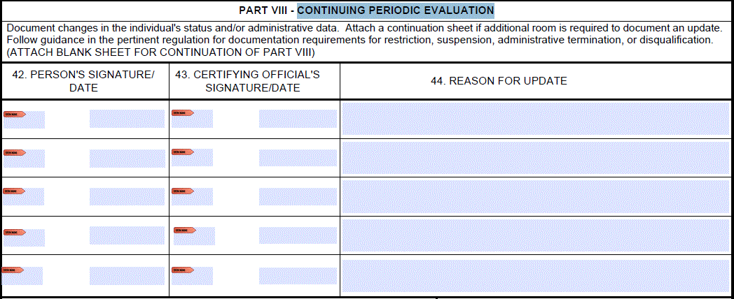
DA FORM 7708
Personnel Reliability Program, 7708
a. Part VIII, CONTINUING PERIODIC EVALUATION
Instructions on following slide
Notes:
AR 190-13, Appendix D
(1) Block 42. The person will electronically sign the form in this block.
(2) Block 43. The certifying official will electronically sign the form in this block.
(3) Block 44. The certifying official will enter relevant comments in this block.

Slide 17
DA FORM 7708
AR 190-13, Appendix D
(1) Block 42. The person will electronically sign the form in this block.
(2) Block 43. The certifying official will electronically sign the form in this block.
(3) Block 44. The certifying official will enter relevant comments in this block.

Slide 18
DA FORM 7708
Personnel Reliability Program, 7708
a. Part IX & X, SUSPENSION OR TEMPORARY DISQUALIFICATION / ADMINISTRATIVE TERMINATION
Instructions on following slide
Notes:
AR 190-13, Appendix D
Block 45. The certifying official will enter the date in this block. The certifying official will annotate information about the suspension or disqualification in Part VIII.
Block 46. The certifying official will enter the date in this block. The certifying official will annotate information about the administrative termination in Part VIII.

Slide 19
DA FORM 7708
AR 190-13, Appendix D
Block 45. The certifying official will enter the date in this block. The certifying official will annotate information about the suspension or disqualification in Part VIII.
Block 46. The certifying official will enter the date in this block. The certifying official will annotate information about the administrative termination in Part VIII.

Slide 20
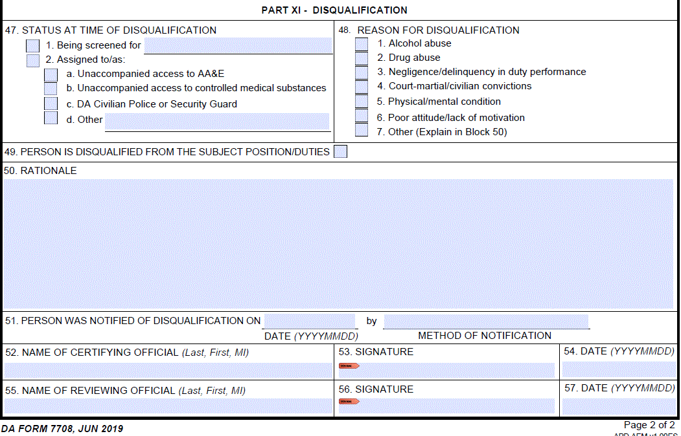
DA FORM 7708
Personnel Reliability Program, 7708
a. Part XI, DISQUALIFICATION
Instructions on following slide
Notes:
AR 190-13, Appendix D
(1) Block 47. The certifying official will annotate the status of the individual at the time of the disqualification in this block.
(2) Block 48. The certifying official will annotate the reason for the disqualification in this block, and use Block 50 as the reason, if other than the listed reasons.
(3) Block 49. The certifying official will check this block to indicate the individual is disqualified.
(4) Block 50. The certifying official will annotate the rationale for disqualifying the individual in this block.
(5) Block 51. The certifying official will annotate the date the person was notified of the disqualification and the means of notification in this block.
(6) Block 52. Enter the name of the certifying official.
(7) Block 53. The certifying official will electronically sign the form in this block.
(8) Block 54. The date is automatically applied when Block 53 is signed.
(9) Block 55. Enter the name of the reviewing official.
(10) Block 56. The reviewing official electronically signs the form in this block.
(11) Block 57. The date is automatically applied when Block 56 is signed.

Slide 21
DA FORM 7708
AR 190-13, Appendix D
(1) Block 47. The certifying official will annotate the status of the individual at the time of the disqualification in this block.
(2) Block 48. The certifying official will annotate the reason for the disqualification in this block, and use Block 50 as the reason, if other than the listed reasons.
(3) Block 49. The certifying official will check this block to indicate the individual is disqualified.
(4) Block 50. The certifying official will annotate the rationale for disqualifying the individual in this block.
(5) Block 51. The certifying official will annotate the date the person was notified of the disqualification and the means of notification in this block.
(6) Block 52. Enter the name of the certifying official.
(7) Block 53. The certifying official will electronically sign the form in this block.
(8) Block 54. The date is automatically applied when Block 53 is signed.
(9) Block 55. Enter the name of the reviewing official.
(10) Block 56. The reviewing official electronically signs the form in this block.
(11) Block 57. The date is automatically applied when Block 56 is signed.

