Slide 1
Updated 3-6-23 Getting the Passport Started
All documents including final orders are required at your appointment or it may be rescheduled.
Failure to come prepared to the appointment MAY result in your appointment being rescheduled
DOCUMENTS MUST BE PRINTED ONE-SIDED
Call/email the Passport Office for an appointment.
913-684-4078 Niranh Ounkham
usarmy.leavenworth.407-afsb-lrc.mbx.passports@army.mil
Appointments are scheduled during these times.
Mon, Tues & Thur, Fri – 0830-1130 and 12:45-1415
Wed 12:45-14:15
Expedites are not accepted for dependent passport processing.

Slide 2
Children and Passports
BOTH PARENTS for Children under 16 MUST BE PRESENT at the appointment, otherwise a DS-3053 will need to be filled out by the ABSENT PARENT for EACH child and signed IN FRONT of a NOTARY PUBLIC.
(one original form per child no faxes, or scanned copies are accepted)
ABSENT PARENT MUST BE TDY OR DEPLOYED (conflicting schedule is NOT a reason)…OR
Absent parent is the biological parent to the child of the sponsor.
A copy FRONT and BACK of the absent parent’s ID
(CAC ID-if absent parent is military and out of country)
We will do pictures here in the office. Please don’t wear any white or light color clothing.
ALL applicants must be present for the appointment.

Slide 3
Go to https://travel.state.gov/content/travel.html
Click US Passports

Slide 4
We will do pictures at the appointment.
DO NOT Deviate from instructions – RESIST the urge

Slide 5
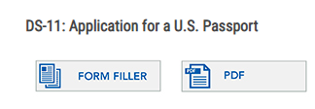
Instructions cont…
Scroll down and click on the “+”
You will use the FORM FILLER only

Slide 6
Instructions cont…
Check the disclaimer box and hit SUBMIT

Slide 7
Instructions cont…

Slide 8
Fill out contact information – Passport will always be sent to the Passport Office Put in this address in below and check Permanent Address

Slide 9
Fill out all areas – Email can be personal or government

Slide 10
Instructions cont…
Be sure to enter your dates (Estimate if needed) Be sure to list the country

Slide 11
Fill out as requested

Slide 12
DO NOT enter any tourist passport information here
Click “NONE if you have NEVER had an Official (Maroon) or Dependent No-Fee Passport.
If you HAVE been issued an Official (Maroon) or Dependent No-Fee then, select Passport Book and enter the information

Slide 13
Everything MUST be filled out

Slide 14
Fill out if applicable

Slide 15
Review all the information and make changes if needed

Slide 16
Make sure your pages has these selections and click “next”
It will not prompt for payment

Slide 17
Next steps – scroll to number 3
Click the disclaimer box
Only print pages 5 and 6. Must be
one-sided pages

Slide 18
Required documents for NEW passports (1 for each person)
ALL documents (including orders) must be one-sided w/o staples
DS-11 pages 5-6 unsigned
Copy front/back of Sponsor’s CAC ID (1 for each person)
Copy front/back of dependent ID of spouse (1 for each person)
Copy front/back dependent ID for ALL children over 16 y/o
COLOR photocopy of signed tourist passport data page.
With a copy of birth certificate for each child
OR
Original birth certificate PLUS a copy of that certificate
Orders – One set for each applicant

Slide 19
Required documents for RENEWAL passports
DS-82 pages 5-6 unsigned – MUST be one-sided pages
Copy front/back of CAC ID of Sponsor – One sided pages (one for each person)
Copy of spouse’s dependent ID (1 for each person)
Copy front/back of dependent ID (for all over 16 y/o)
Expired Official or Dependent No-Fee passport
Orders – One-sided pages (1 set for each application)

Slide 20
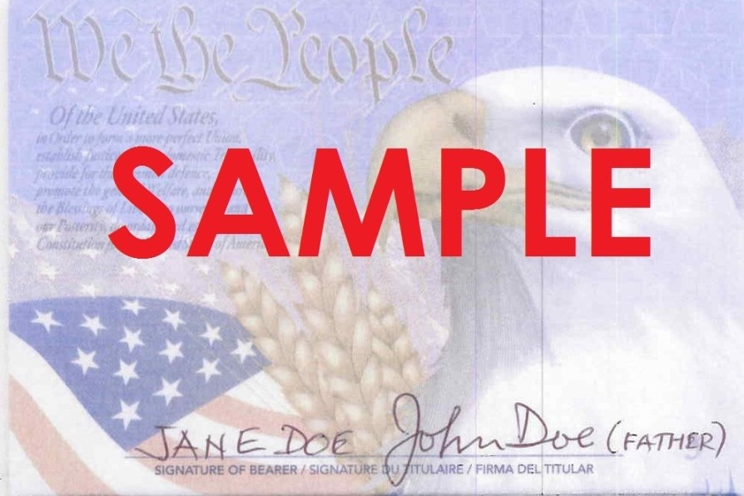
By law – children UNDER 16 are not allowed to sign their passport
Here is how to sign your child’s passport.

