Slide 1

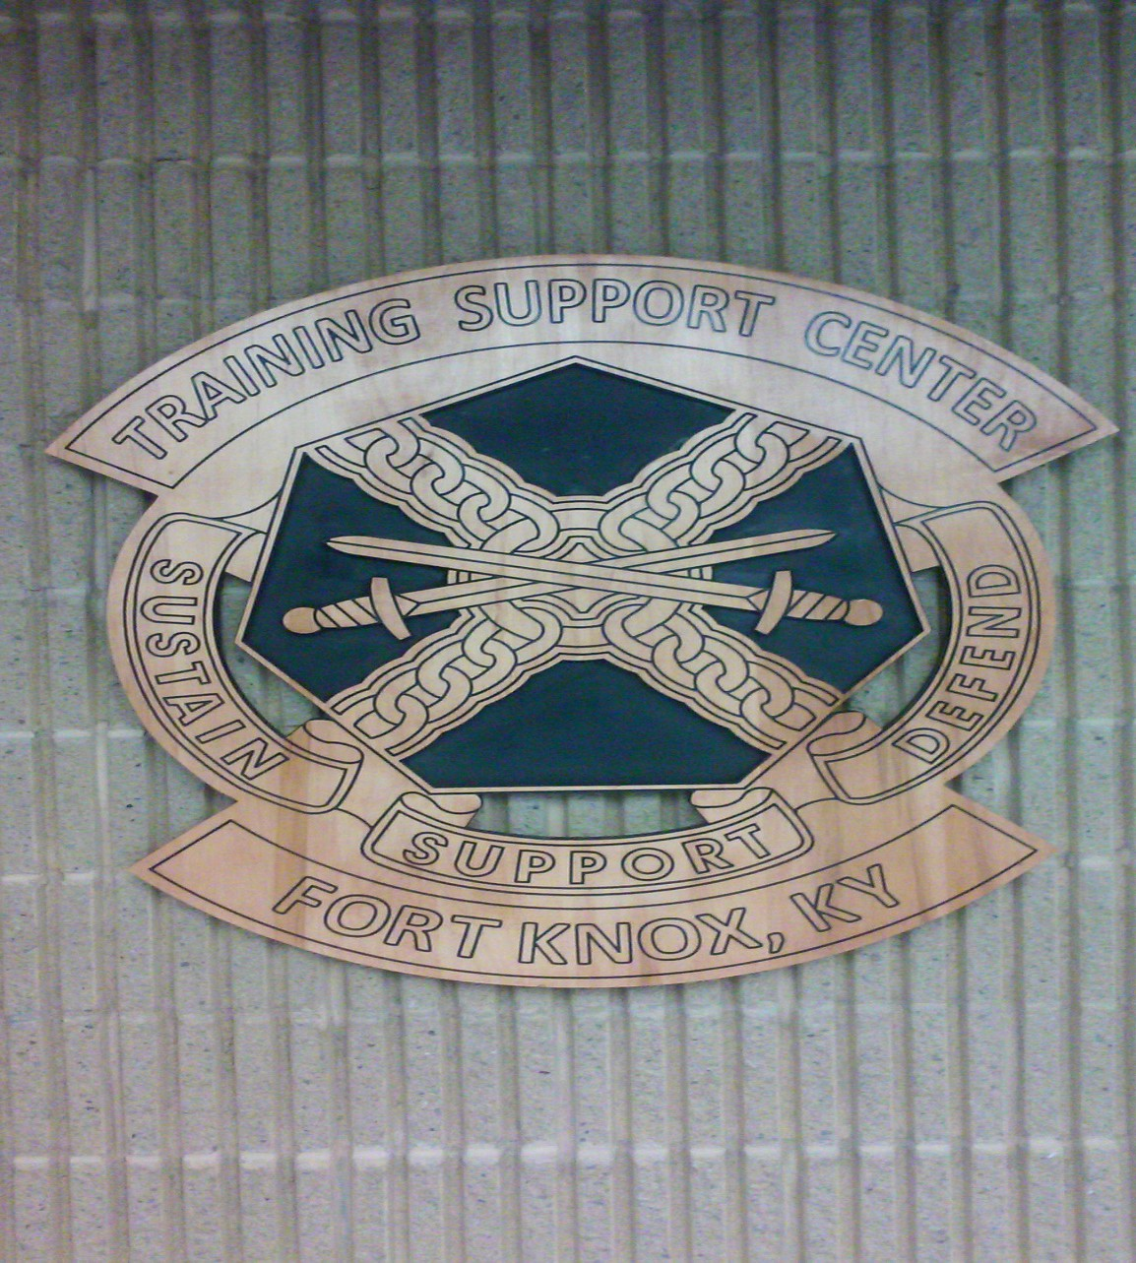
FORT KNOX
TRAINING SUPPORT CENTER
TADSS CATALOG

Slide 2
FORT KNOX TRAINING SUPPORT CENTER
TADSS LOAN and ISSUE
TABLE OF CONTENTS
CONTACT INFORMATION
LOCATION AND HOURS OF OPERATION
GUIDELINES
GRAPHIC TRAINING AID’S (GTA)
BLUEFOR WEAPONS
OPFOR WEAPONS
UNIFORMS
BANNERS/SIGNS
ENGINEER ITEMS
EXPLOSIVE HAZARD DEFEAT TRAINING THREAT SET (EHD-TTS)
MINES
CACHE KITS
INERT IED’S AND EXPLOSIVE ITEMS
ROCKETS
ORDIANCE RECOGNITION BOARDS
HME CLORATE LAB AND SCENT GENERATOR
CHECKPOINT OPERATIONS
MANIKINS/RESCUE RANDY
MEDICAL EQUIPMENT
AIR DEFENSE (STINGER)
CCMCK, M287 AT4, AIMTEST .50 CAL INBORE
JAVELIN BST/FTT, TOW-ITAS BST
MARSMANSHIP/QUALIFICATION/LAND NAVIGATION TRAINING
DETAIL/TASKING EQUIPMENT
CBRN EQUIPMENT
SIMULATORS
MILES/TVS/TOW-ITAS/LTIDS/CV-TESS
VTC TRAINERS AND SIMULATORS

Slide 3
FORT KNOX TRAINING SUPPORT CENTER
TADSS LOAN and ISSUE
CONTACTS
Justin Wagoner
justin.d.wagoner.civ@army.mil
TADSS/MILES Training Instructor
Installation Management Command
Training Support Center (TSC)
Bldg. 2359 Black Horse Regiment Ave
Fort Knox, KY 40121
Desk: 520-945-1469
DSN: 464-3093
Todd Broach
todd.k.broach.civ@army.mil
TADSS/MILES Training Instructor
Installation Management Command
Training Support Center
Bldg. 2359 Black Horse Regiment Ave
Fort Knox, KY 40121
Desk: 502-624-4946
DSN: 464-4946
Please send all TADSS request to the email listed below
usarmy.knox.id-training.mesg.tsc-tadss-request@army.mil

Slide 4
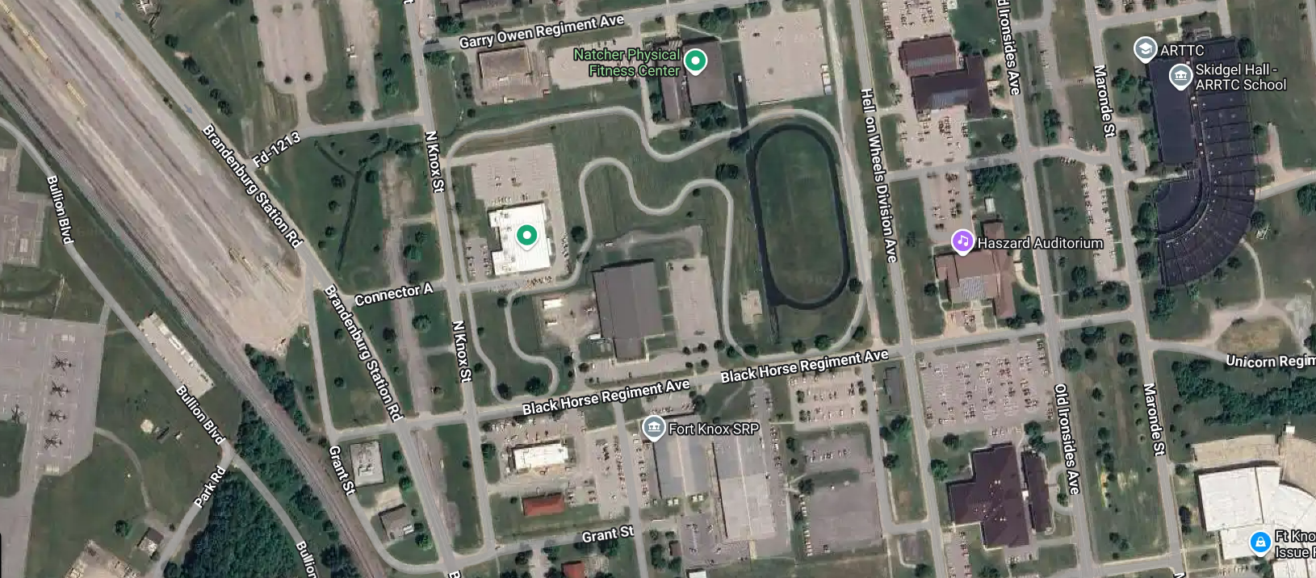

FORT KNOX TRAINING SUPPORT CENTER TADSS LOAN and ISSUE
2359 Black Horse Regiment Ave.
WE ARE LOCATED IN 2359 BLACK HORSE REGIMENT AVE..
MON/WED/THURS/FRI: LUNCH:
0800-1130 and 1230-1600
1130-1230
CLOSED ON ALL FEDERAL HOLIDAYS AND CLOSED ON SELECTED DAYS FOR PRIORITY MISSIONS
ALL ISSUES AND TURN-INS ARE DONE BY SCHEDULED APPOINTMENT
WALK IN REQUESTS ARE NOT GUARANTEED IMMEDIATE SERVICE

Slide 5
FORT KNOX TRAINING SUPPORT CENTER WAREHOUSE
GUIDELINES AND SOP NOTES
1. Must have current account with TSC DA Form 1687 and signed Commander’s Assumption of Command orders. DA Form 1687 must be digitally or manually signed by all personnel listed on form.
2. Must provide a detail to assist with loading/unloading of TADSS/MILES. TSC personnel will not load/unload unit vehicles/POVs. All Simulators must be picked up in GOV/Military Vehicle
3. If 30 minutes late from scheduled pick-up/return/training class-request
is canceled and considered a NO-SHOW. Unit must submit new request with new date.
All TADSS/MILES will be cleaned/dry prior to turn in. TSC facility is not a cleaning facility. Any dirty/wet items brought in will result in kickback and require reschedule. Unit account will be frozen until returned cleaned/dry.
Any damaged/missing items will have a memorandum signed by Commander and either a FLIPL or statement of Charges initiated. Unit account will be frozen until FLIPL or Statement of Charges is completed.
Certain TADSS/MILES may be signed out on a long-term basis.
Hours of operation: Mon thru Fri 0730-1130 and 1230-1600. Closed on all Federal Holidays.
Walk in requests will be honored on a case-by-case basis. Best practice is to schedule and request equipment ahead of desired date needed. Do not assume if you walk in unscheduled that you will walk out with equipment.
Units will be issued initial load of batteries for MILES, additional replacement is unit’s responsibility

Slide 6
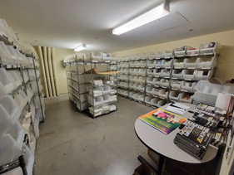
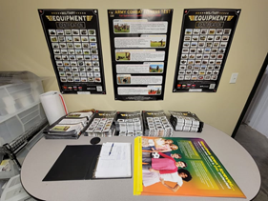
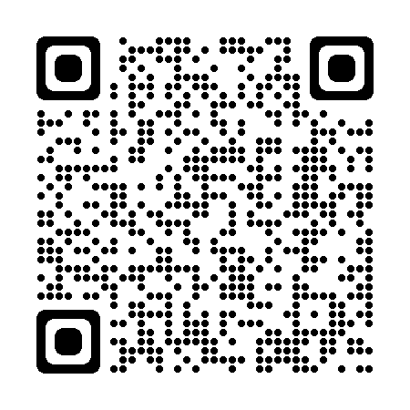
FORT KNOX TRAINING SUPPORT CENTER TADSS LOAN and ISSUE
GRAPHIC TRAINING AID SELF-SERVE ROOM*
The Fort Knox TSC Warehouse carries a wide assortment of GTAs for units to sign for and keep. Units should bring a box to carry out the GTA's. If a GTA is not in stock or a large quantity is needed, TSC can order on behalf of units to pick up at scheduled appointment date. Remote Units can set up a GTA account to order GTA’s to home station.
Follow QR Code below to the Central Army Registry Registry for access to CAR only GTA’s
POC for GTA’s is Mr. Wagoner
Justin.d.wagoner.civ@army.mil
*Fort Knox Maps Available at Range Control
*GTA’s do not require an active TS-MATS Account

Slide 7
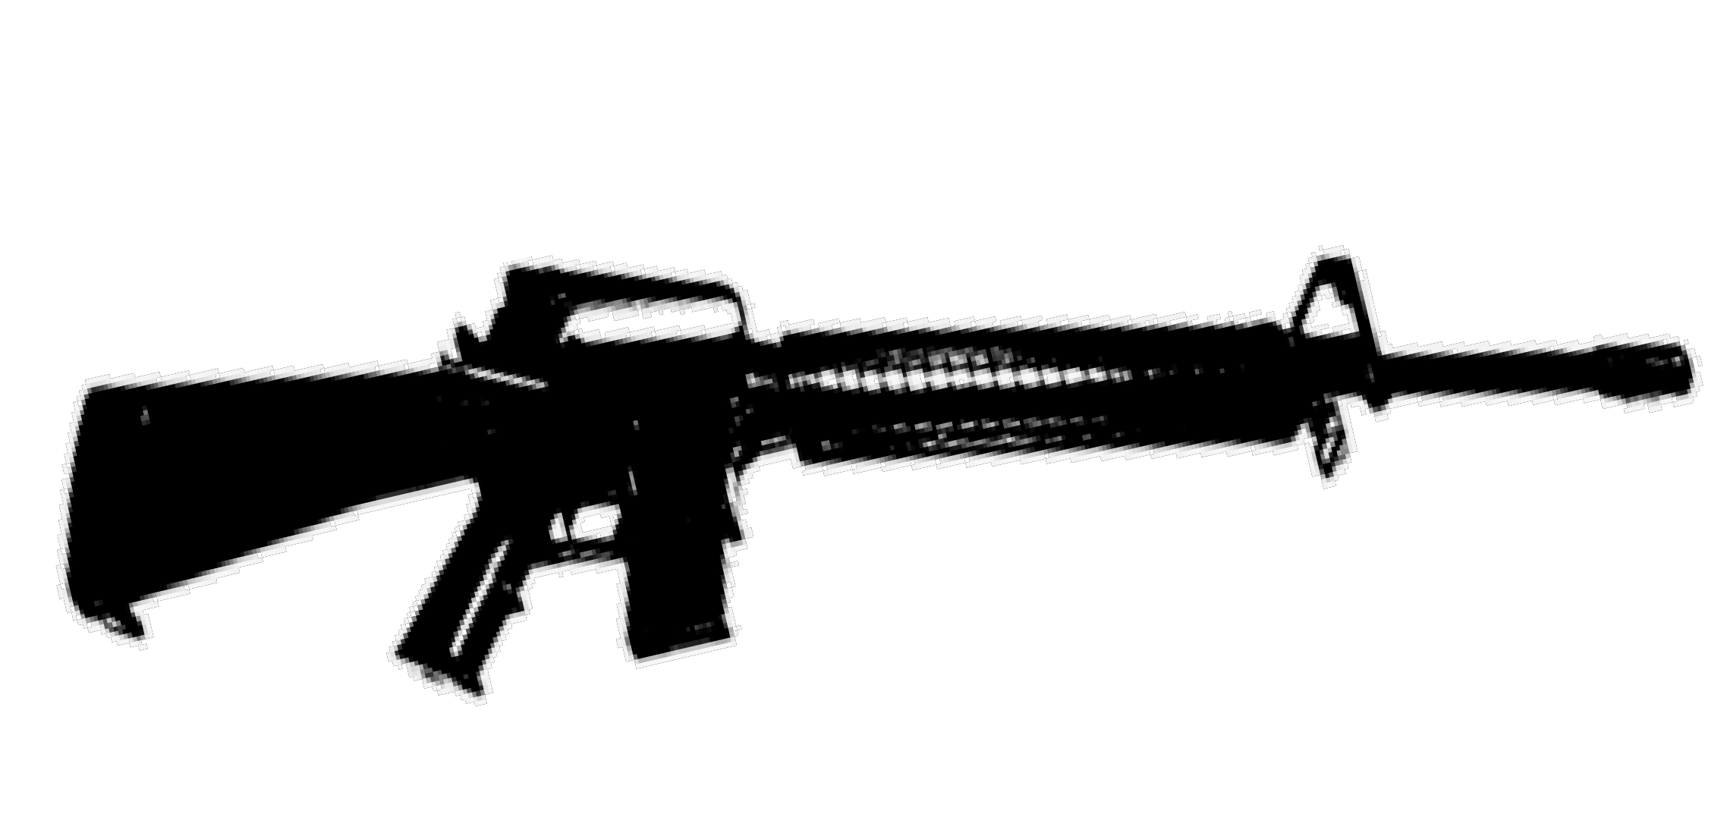
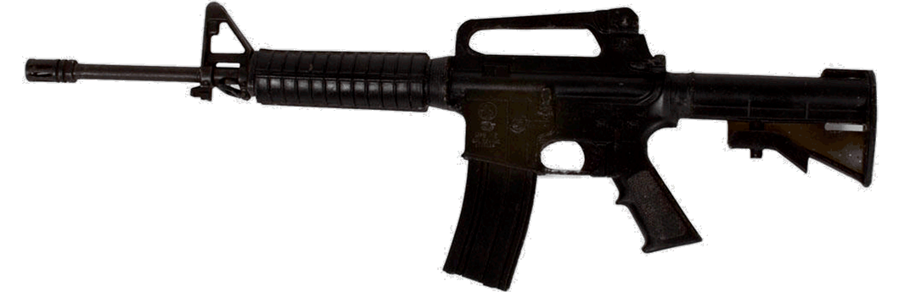
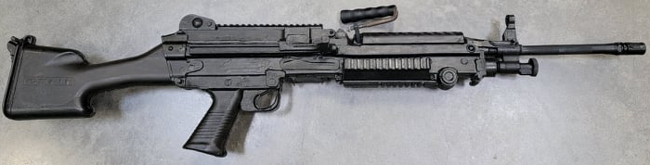
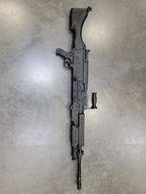
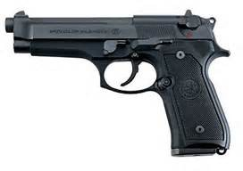
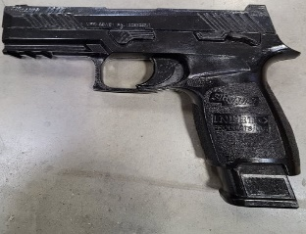
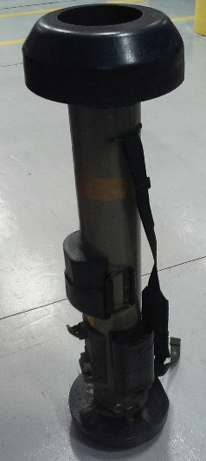
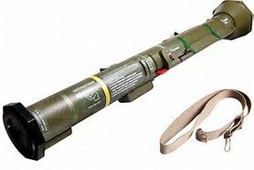
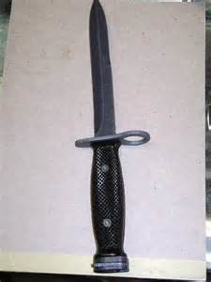
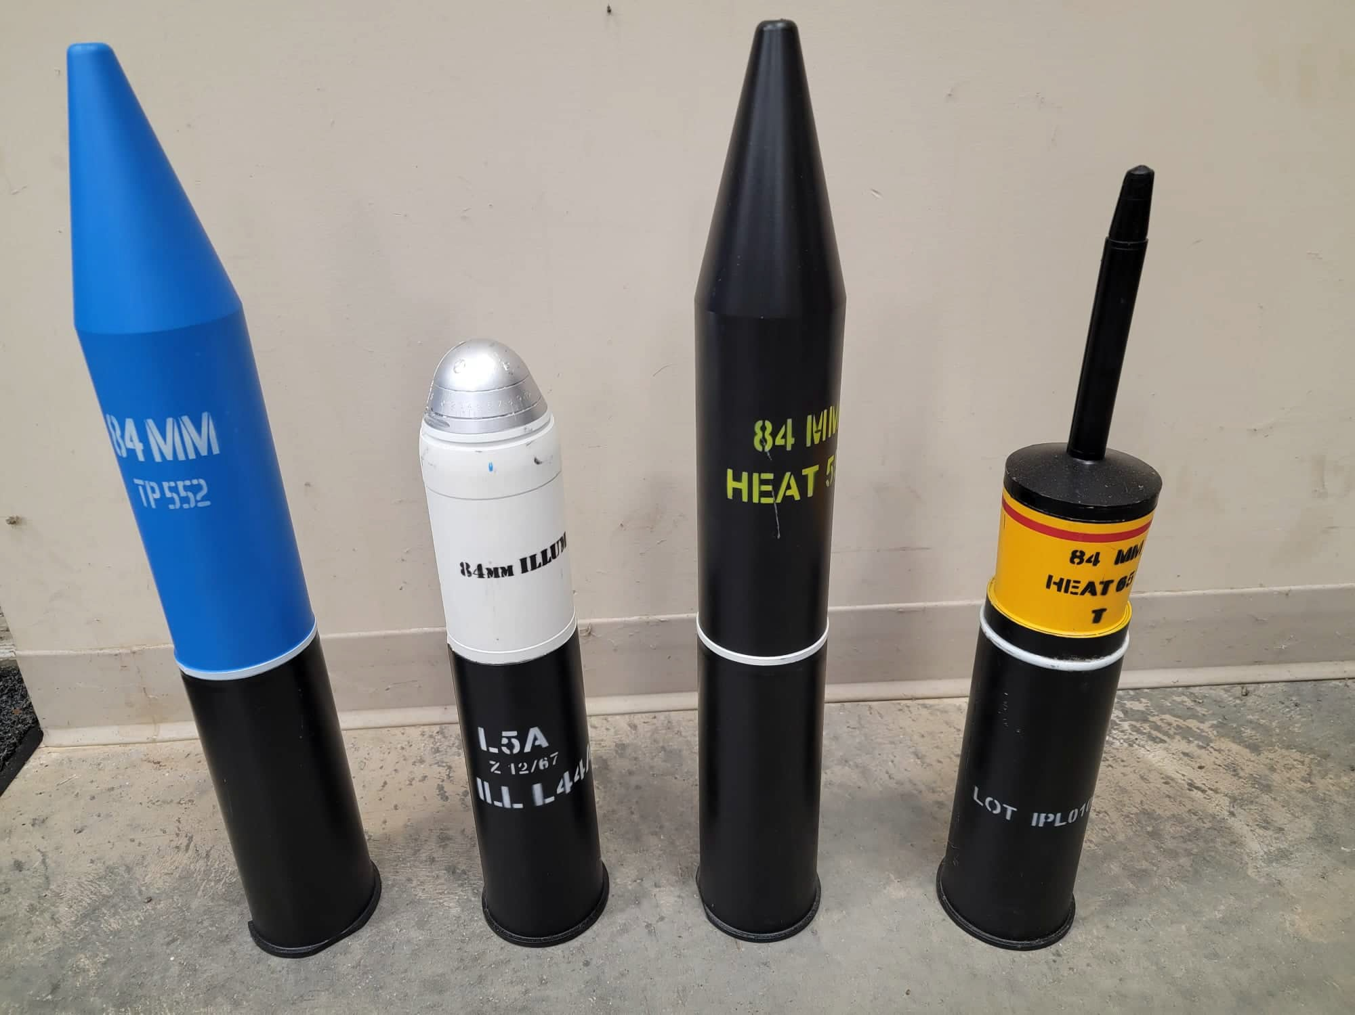
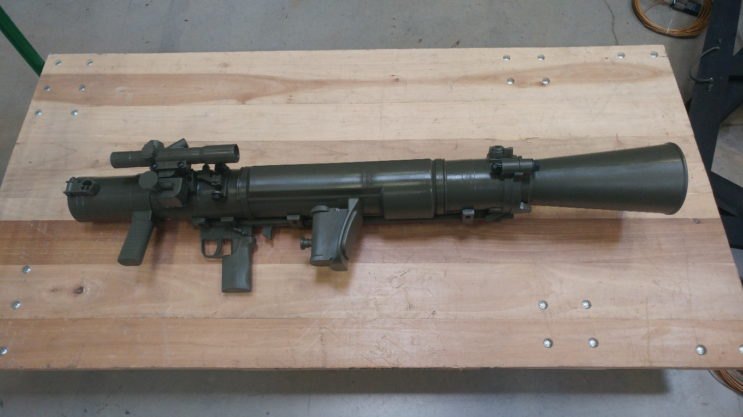
FORT KNOX TRAINING SUPPORT CENTER TADSS LOAN and ISSUE
M4 PLASTIC RIFLE
M16A2 PLASTIC RIFLE
M240
M249 SAW
9MM PISTOL
SIG SAUER P320-M17
AT4 ROCKET LAUNCHER
PLASTIC BAYONET
JAVELIN MSR
84MM CARL GUSTAV
84MM CARL GUSTAV ROUNDS

Slide 8
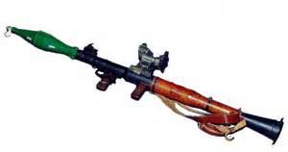
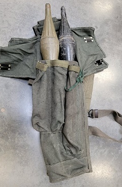
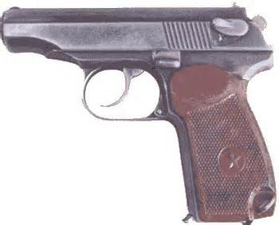
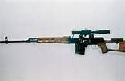
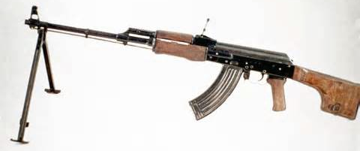
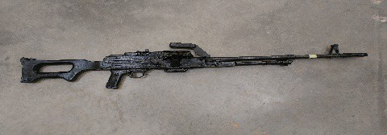
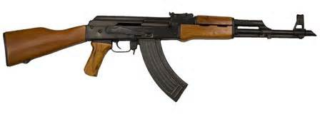
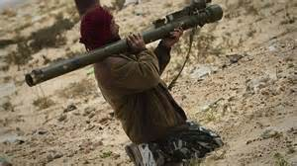
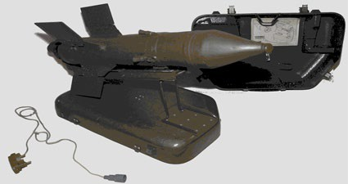
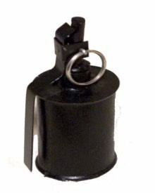
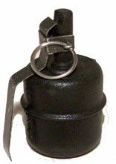
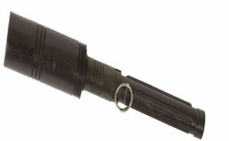
FORT KNOX TRAINING SUPPORT CENTER TADSS LOAN and ISSUE
RPG-7
RPG-7 WARHEAD BAG
PM-50
SVD
RPK
PKM
AK-47
SA-7 GRAIL
SAGGER
SOVIET GRENADES

Slide 9
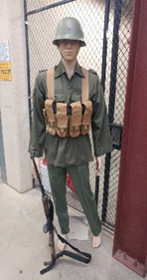
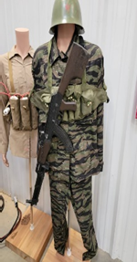
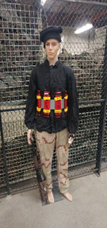
FORT KNOX TRAINING SUPPORT CENTER TADSS LOAN and ISSUE
VARIOUS MILITARY UNIFORMS
BLACK SHIRTS/PANTS
BLACK BOONIE CAPS
TAN SHIRTS
WHITE SHIRTS
DCU SHIRTS/PANTS
BDU SHIRTS/PANTS/CAPS
OD SHIRTS/PANTS
GREEN BOONIE CAPS
OPFOR HELMETS
TIGER STRIPE UNIFORMS
ISLAMIC ITEMS AVAILABLE

Slide 10
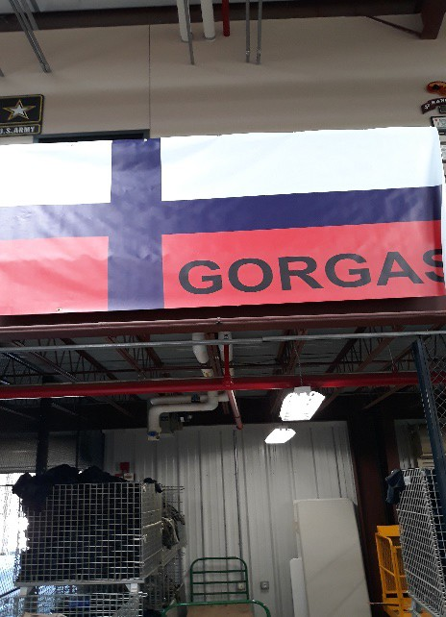
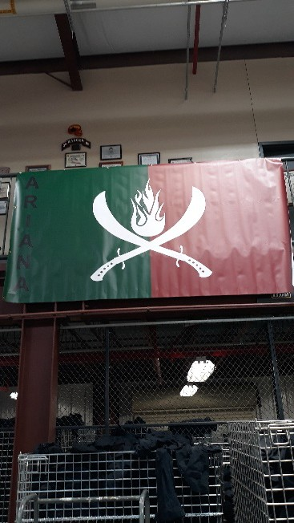
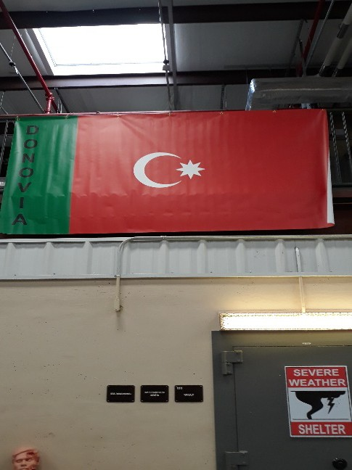
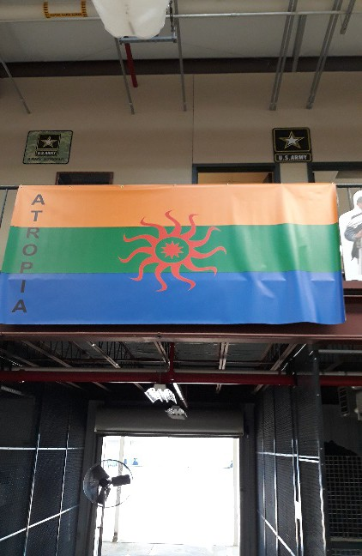
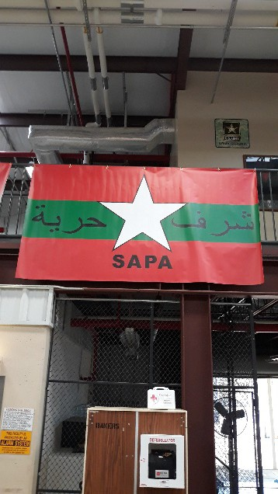
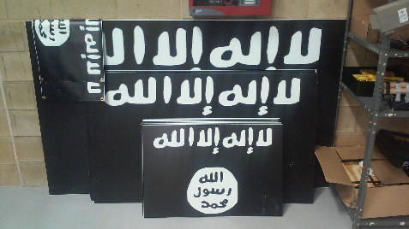
FORT KNOX TRAINING SUPPORT CENTER TADSS LOAN and ISSUE
BANNERS/SIGNS

Slide 11
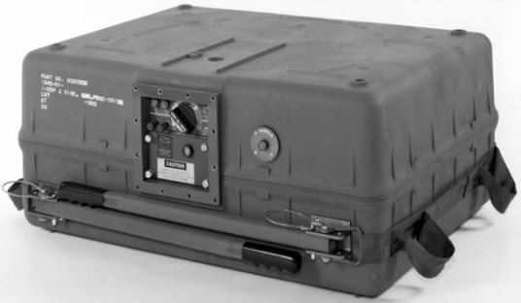
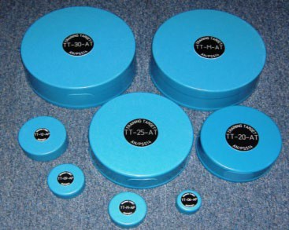
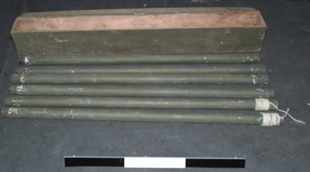
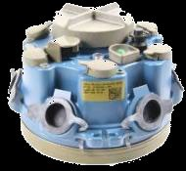
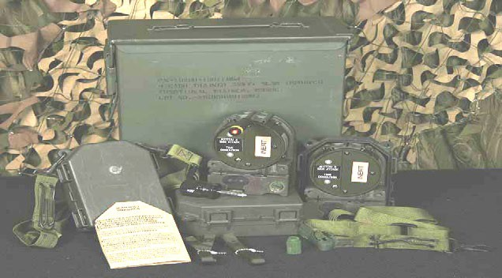
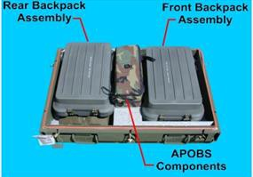
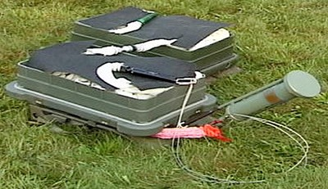
FORT KNOX TRAINING SUPPORT CENTER TADSS LOAN and ISSUE
ENGINEER ITEMS
DVC # 05-20 MODULAR MINE PACK SYSTEM (MOPMS) TRAINING DISPENSER
DVC # 05-105 PSS-14 TRAINING MINE SET
BANGALORE
DVC # 05-22 M7 SPIDER
DVC # 05-104 SELECTABLE LIGHTWEIGHT ATTACK MUNITION (SLAM)
DVC # 05-103 ANTI-PERSONNEL OBSTICLE BREACHING SYSTEM (APOBS)

Slide 12
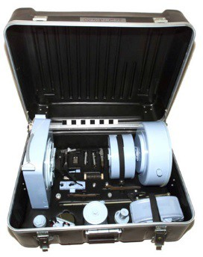
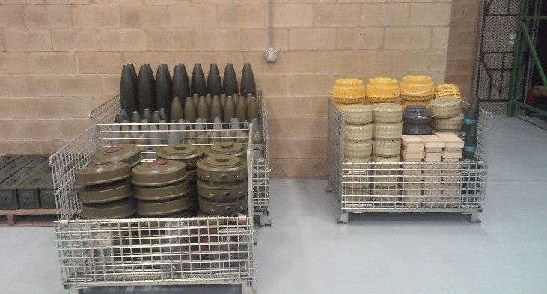
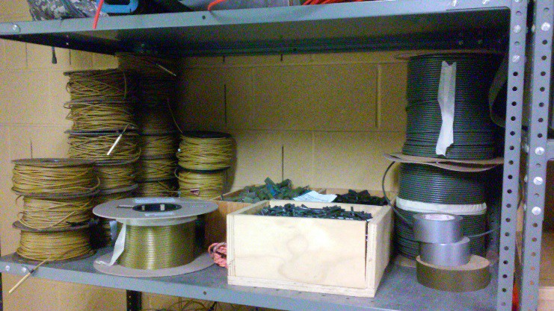
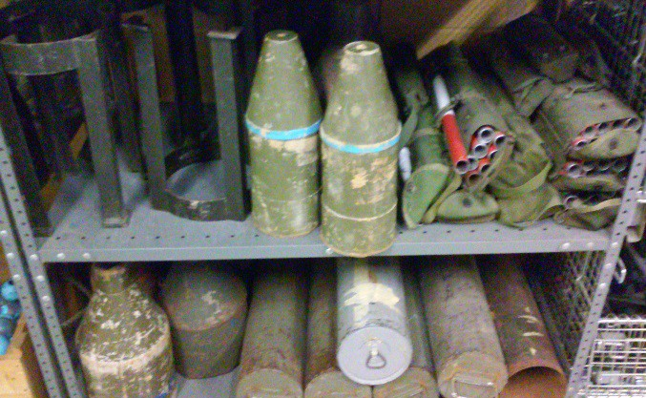
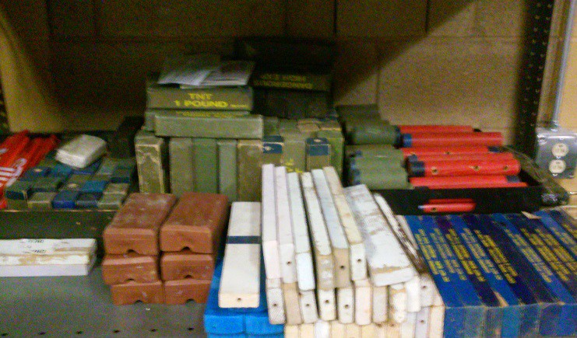
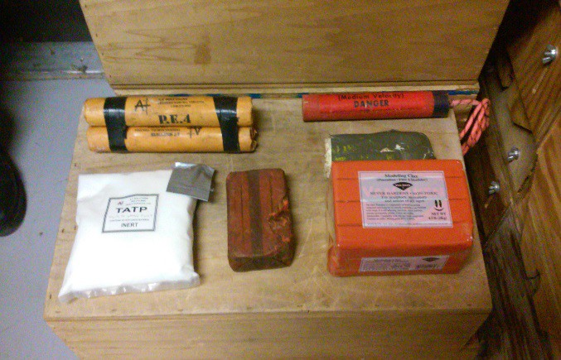
FORT KNOX TRAINING SUPPORT CENTER TADSS LOAN and ISSUE
ENGINEER ITEMS
VARIOUS MINES AND PROJECTILES
PLACED MINE TRAINING KIT
ASSORTED TUBES/CORDS/CAPS
CRATERING/SHAPE CHARGES/STANDS
SIMULATED TNT/DYNAMITE/PLASTIC/C4
ASSORTED EXPLOSIVES

Slide 13



FORT KNOX TRAINING SUPPORT CENTER TADSS LOAN and ISSUE
ENGINEER ITEMS
DOOR BREACH
WALL BREACHING CHARGE
DOUGHNUT BREACHING CHARGE

Slide 14

FORT KNOX TRAINING SUPPORT CENTER TADSS LOAN and ISSUE
Explosive Hazard Defeat Training Threat Set (EHD-TTS)
Used to train Engineers on collective mission of route and area clearance /CIED tasks consisting of detect, mark, interrogate, identify, neutralize and cordon off. Current vehicle systems that will utilize the EHP-TTS are:
TWHS HUSKY, MPCD BUFFALO, MMPV TYPE II, VOSS, MTRS and PSS-14 REV 6 EXPOLSIVE HAZARD DETECTOR

Slide 15







FORT KNOX TRAINING SUPPORT CENTER TADSS LOAN and ISSUE
MINES
VARIOUS MINES
AFGHAN MINES
M21
M14
M19
M15
CLAYMORE MINE

Slide 16

FORT KNOX TRAINING SUPPORT CENTER TADSS LOAN and ISSUE

Slide 17







FORT KNOX TRAINING SUPPORT CENTER TADSS LOAN and ISSUE
CACHE KITS
WEAPON CACHE
ROCKET CACHE
VARIOUS AMMO TYPE CACHE
MONEY CACHE
82MM MORTOR CACHE

Slide 18


FORT KNOX TRAINING SUPPORT CENTER TADSS LOAN and ISSUE
CACHE KITS
BOOBYTRAPPED COFFIN

Slide 19







FORT KNOX TRAINING SUPPORT CENTER TADSS LOAN and ISSUE
INERT IED/EXPLOSIVE ITEMS

Slide 20





FORT KNOX TRAINING SUPPORT CENTER TADSS LOAN and ISSUE
INERT IED/EXPLOSIVE ITEMS
IED KITS
VARIOUS IED ITEMS

Slide 21






FORT KNOX TRAINING SUPPORT CENTER TADSS LOAN and ISSUE
INERT IED/EXPLOSIVE ITEMS
TRIGGER DEVICES
SUICIDE BRIEFCASE

Slide 22





FORT KNOX TRAINING SUPPORT CENTER TADSS LOAN and ISSUE
INERT IED/EXPLOSIVE ITEMS
ASSORTED IED ITEMS
VBIED ITEMS
STATIC MORTAR TUBES
FAKE ROCK IED
CHEMICAL GRENADE KIT

Slide 23






FORT KNOX TRAINING SUPPORT CENTER TADSS LOAN and ISSUE
INERT IED/EXPLOSIVE ITEMS
PIPE BOMBS
MAGNETIC DYNAMITE DEVICE
NITRATE BAGS W/EXPLOSIVE DEVICE
PRESSURE COOKER BOMBS
NITRATE BAGS
VBIED

Slide 24


FORT KNOX TRAINING SUPPORT CENTER TADSS LOAN and ISSUE
IED/TERRORIST CELL PHONES AND LAPTOPS

Slide 25



FORT KNOX TRAINING SUPPORT CENTER TADSS LOAN and ISSUE
SUICIDE VESTS

Slide 26



FORT KNOX TRAINING SUPPORT CENTER TADSS LOAN and ISSUE
155MM ARTILLERY PROJECTILES/CHARGES (HEAVY)

Slide 27



FORT KNOX TRAINING SUPPORT CENTER TADSS LOAN and ISSUE
ROCKETS

Slide 28



CHINESE AND NORTH KOREAN ROCKETS, MORTAR ROUNDS AND LANDMINE
FORT KNOX TRAINING SUPPORT CENTER TADSS LOAN and ISSUE
CHINESE 120MM HE MORTAR ROUND
CHINESE 107MM ROCKET ROUND
NORTH KOREAN AP BOXMINE

Slide 29







FORT KNOX TRAINING SUPPORT CENTER TADSS LOAN and ISSUE
DVC-T 05-050 UXO Recognition Set 7 Boards

Slide 30

FORT KNOX TRAINING SUPPORT CENTER TADSS LOAN and ISSUE
DVC-T 05-051 Mine Recognition Set 4 Boards

Slide 31






FORT KNOX TRAINING SUPPORT CENTER TADSS LOAN and ISSUE
DVC-T 05-052 Afghanistan Mine Recognition Set 6 Boards

Slide 32





FORT KNOX TRAINING SUPPORT CENTER TADSS LOAN and ISSUE
DVC-T 05-053 Bosnia Mine Recognition Set 5 Boards

Slide 33





FORT KNOX TRAINING SUPPORT CENTER TADSS LOAN and ISSUE
DVC-T 05-054 Iraqi Mine Recognition Set 5 Boards

Slide 34


HME CLORATE LAB AND SCENT GENERATOR
FORT KNOX TRAINING SUPPORT CENTER TADSS LOAN and ISSUE
IN ORDER TO UTLIZE SCENT MACHINE, NEED ELECTRICAL POWER

Slide 35








FORT KNOX TRAINING SUPPORT CENTER TADSS LOAN and ISSUE
CHECKPOINT MATERIAL

Slide 36





FORT KNOX TRAINING SUPPORT CENTER TADSS LOAN and ISSUE
TRAFFIC CONTROL POINTS SIGNS

Slide 37







RESCUE RANDY/MANIKINS
FORT KNOX TRAINING SUPPORT CENTER TADSS LOAN and ISSUE
RESCUE RANDY (180LBS)
DOWNED JET PILOT
DOWNED HELICOPTER PILOTS
INJURIED SOLDIER (80LBS)
BOMB BLAST VICTIM
TRAUMA ARMS
KIA SUICIDE BOMBER

Slide 38









FORT KNOX TRAINING SUPPORT CENTER TADSS LOAN and ISSUE
MEDICAL ITEMS
WAR MOULAGE KIT
CASUALTY SIMULATION KIT
FLEXIBLE STRETCHER
TRAINING KIT, NERVE AGENT ANTIDOTE, MARK I, TYPE 1
CONVULSANT ANTIDOTE FOR NERVE AGENT TRAINING DEVICE
SKEDCO/LITTERS
TALON LITTER

Slide 39


AIR DEFENSE
FORT KNOX TRAINING SUPPORT CENTER TADSS LOAN and ISSUE
STINGER TROOP PROFICIENCY TRAINER (STPT)
STINGER TROOP PROFICIENCY TRAINER (STPT) (IMPROVED)

Slide 40






CLOSE COMBAT MISSION CAPABILITY KIT ( CCMCK)
FORT KNOX TRAINING SUPPORT CENTER TADSS LOAN and ISSUE
UTM
9MM BOLTS
M11 SIG 229 BOLTS
M4/M16 BOLTS
PROTECTIVE MASK-REQUIRED WITH CCMCK
M249 BOLTS
CCMCK MAGAZINES-PROVIDED BY TSC UPON REQUEST

Slide 41

FORT KNOX TRAINING SUPPORT CENTER TADSS LOAN and ISSUE
UTM
DVC # 07-68 M287 TRACER BULLET TRAINER (TBT) FOR THE M137 AT4 ANTI-TANK WEAPON

Slide 42

FORT KNOX TRAINING SUPPORT CENTER TADSS LOAN and ISSUE
UTM
AIMTEST .50 CAL INBORE DEVICE

Slide 43





FORT KNOX TRAINING SUPPORT CENTER TADSS LOAN and ISSUE
DVC # 07-126 JAVELIN BASIC SKILLS TRAINER (BST)
DVC # 07-78/B TOW ITAS BASIC SKILLS TRAINER (BST)
JAVELIN FEILD TACTICAL TRAINER (FTT)

Slide 44









FORT KNOX TRAINING SUPPORT CENTER TADSS LOAN and ISSUE
MARKSMANSHIP/QUALIFICATION
LAND NAVIGATION TRAINING
TIMING BOARD
SPOTTING SCOPE 6-100X100
RIFLE REST AND TARGET BOX
SIGHTING DEVICE M16A2
RIDLE SIGHTING DEVICE
REAR SIGHT MOCK UP M16A2
FRONT SIGHT MOCK UP M16A2
TARGET BOX PADDLE
RANGE SAFTEY PADDLE

Slide 45



FORT KNOX TRAINING SUPPORT CENTER TADSS LOAN and ISSUE
MARKSMANSHIP/QUALIFICATION
LAND NAVIGATION TRAINING
LENSATIC COMPASS
DVC # 07-59 .50 CAL BFA
SMALL ARMS BFA

Slide 46


FORT KNOX TRAINING SUPPORT CENTER TADSS LOAN and ISSUE
DETAIL/TASKING EQUIPMENT
CASKET
Full sized casket for training funeral detail
SABERS Award/Change of Command Ceremonies

Slide 47


FORT KNOX TRAINING SUPPORT CENTER TADSS LOAN and ISSUE
CBRN EQUIPMENT
CHEMICAL MONITOR SIMULATOR
RADIAC TRAINING SYSTEM

Slide 48



FORT KNOX TRAINING SUPPORT CENTER TADSS LOAN and ISSUE
Simulator Training and Operation
The Training Support Center Warehouse can provide training to your personnel on all simulators in this catalog. Maximum number of personnel to be trained for all simulators is eight (8).
Timeline for classes are:
0800-1130 Training/Issue
1130-1230 Lunch
1230-1600 Training/Issue
Appointed Unit Representative can sign for simulators and must be on a valid DA 1687 Signature Card
Only trained/certified personnel can operate simulators, they assume all responsibility for safe operation of simulators in unit possession.
Soldiers must bring gloves, eye and hearing protection. Some PPE available at the Warehouse if necessary.
Certification training is good for 12 months. Recertification does not require full classroom instruction

Slide 49










FORT KNOX TRAINING SUPPORT CENTER TADSS LOAN and ISSUE
XM-2A SMALL ARMS
AK-47
XM-10 ARTY/IED BLAST
X-CAL MACHINEGUN SIMULATOR
KPV 14.5 MM HEAVY MACHINE GUN
PKM
82MM MORTAR TUBES
SPG9
.50 CAL MG
DSHK 12.7MM
PERSONNEL MUST BE TRAINED AND CERTIFIED TO OPERATE

Slide 50





FORT KNOX TRAINING SUPPORT CENTER TADSS LOAN and ISSUE
T80 LANDMINE TRAINER
FOUR-GANG SUICIDE VEST
ANIT-PERSONEL LANDMINE SIM
FLASH-BANG POWDER GRENADES

Slide 51








FORT KNOX TRAINING SUPPORT CENTER TADSS LOAN and ISSUE
MIL-SIM-FX DEVICES
MIL-SIM CLAYMORE
155MM EXPLODING IED KIT
MIL-SIM ECHO DEVICE
DVC # 05-113 PUSH/PULL BOOBY TRAP(IEDES)
DVC # 05-113 PRESSURE DEVICE (IEDES)
PERSONNEL MUST BE TRAINED AND CERTIFIED TO OPERATE

Slide 52







FORT KNOX TRAINING SUPPORT CENTER TADSS LOAN and ISSUE
PERSONNEL PRESSURE MAT
VEHICLE PRESSURE STRIP
SMOKE SIGNATURE MORTAR TUBE
PERSONNEL MUST BE TRAINED AND CERTIFIED TO OPERATE

Slide 53


FORT KNOX TRAINING SUPPORT CENTER TADSS LOAN and ISSUE
IWS2 INDIVIDUAL MILES
TRAIN THE TRAINER
TSC offers a three-hour instruction on the proper use and operation of the IWS2 MILES.
Training focuses on:
IWS2 components and operations
Laser Safety
Small Arms Transmitter(SAT)
Enable/Disable SAT
SAT Alignment.
In order to sign for IWS2 MILES, unit must have certified personnel, this training meets the requirement.
There will be a brief overview on use of Universal Controller GUN (UCD) and Micro Controller Device (MCD).
Soldiers will be trained on how to align SAT with the Mirror Alignment Jig Kit (MAJIK)
Soldiers must bring helmet to training.
Class size limited to TEN personnel

Slide 54

UNIVERSAL CONTROLLER DEVICE (UCD) TRAINING CLASS
FORT KNOX TRAINING SUPPORT CENTER TADSS LOAN and ISSUE
TSC offers a training class on the proper use and operation of the MILES UCD.
Training is oriented toward personnel performing Observer Controller (OC) functions and for use with Individual/Vehicle MILES operations.
Class is limited to TEN personnel.

Slide 55





INDIVIDUAL MILES IWS2
FORT KNOX TRAINING SUPPORT CENTER TADSS LOAN and ISSUE
2
MAJiK Open Case
MAJiK Components Extended (Ready for Use)
IWS MILES AVAILABLE FOR M4/M16, M240, M249, .50 CAL AND SNIPERS

Slide 56







FORT KNOX TRAINING SUPPORT CENTER TADSS LOAN and ISSUE
BUNKER DEFEAT MUNITION MILES
MK19 SIMULATION FOR MILES
AT-4 MILES
RPG-7 MILES
VEHICAL/TARGET MILES AVAILABLE UPON REQUEST
TVS, V-TESS, CV-TESS
TVS
TOW ITAS-TESS FTS MILES
DVC # 23-120 I-MILES VEHICLE TACTICAL ENGAGMENT SIMULATION SYSTEM

Slide 57




FORT KNOX VTC TRAINERS AND SIMULATORS
DVC # 07-129 ENGAGEMENT SKILLS TRAINER II (EST II)
DVC # 55-62 HIGH MOBILITY MULTIPURPOSE WHEELED VEHICLE (HMMWV) EGRESS ASSISTANCE TRAINER (HEAT)
DVC # 01-302 UH-60M BLACKHAWK AIRCREW TRAINER (BAT)
DVC # 06-124 CALL FOR FIRE TRAINER (CFFT)
ALL VTC SIMULATORS AND TRAINERS ARE SCHEDULED THROUGH RFMSS
https://rfmssbackup.altess.army.mil/KNOX/Pages/Login.aspx

