Slide 1



From the Civilian Human Resources Agency, Welcome!
Notes:
Good Morning and welcome to your in-processing from the Civilian Human Resources Agency. On behalf of CHRA, we would like to welcome you to your first day as a Government Civilian Employee. Today your presenters will be _________.
For virtual in-processing, ensure new hire names are typed into the chat box for accountability .

Slide 2
Civilian Human Resources Agency
Agenda
Slide 3: Oath of Office
Slide 4: Common Access Card (CAC)
Slide 5-6: SF-50 Notification of Personnel Action
Slide 7: Electronic Official Personnel File (eOPF) and MyBiz+
Slide 8: Service Computation Date (SCD) For Leave Purposes
Slide 9: Retired Service Members Non-Wartime Campaigns (SF-813)
Slide 10-11: Annual Leave
Slide 12: Sick Leave
Slide 13: Disabled Veteran Leave (DVL)
Slide 14: Additional Types of Leave
Slide 15: Army Benefits Center-Civilian (ABC-C)
Slide 16-17: Government and Retirement Benefits (GRB) Platform
Slide 18: Benefit Options: Terminology
Slide 19-20: Benefit Options
Slide 21: Benefits Eligibility
Slide 22: Federal Employee Retirement System (FERS)
Slide 23-24: Thrift Savings Plan (TSP)
Slide 25-26: Beneficiary Designations and forms
Slide 27: Military Buyback / Post-56 Deposit for Retirement
Slide 28-29: Pay Information
Slide 30: Within Grade Increases
Slide 31: Mandatory Training
Slide 32: Prohibited Personnel Practices
Slide 33: Whistleblowing
Slide 34: Equal Employment Opportunity (EEO)
Slide 35: American Federation of Government Employees (AFGE)
Slide 36: On-The-Job Injuries
Slide 37: Onboarding Documents to be completed following brief
Excellence through Partnership

Slide 3

Oath of Office
I, state your name, do solemnly swear (or affirm) that I will support and defend the Constitution of the United States against all enemies, foreign and domestic; that I will bear true faith and allegiance to the same; that I take this obligation freely, without any mental reservation or purpose of evasion; and that I will well and faithfully discharge the duties of the office on which I am about to enter.
So help me God.
Notes:
NOTE: When the Oath of Office is administered the American Flag must be present. At this time, please have a Commissioned Officer or Supervisor administer the Oath of Office.
You are about to take the oath of office. For the first line you can either state “do solemnly swear” or “affirm”, and the last line “So help me God” is optional.
Please stand, face the flag, raise your right hand and repeat after me.

Slide 4
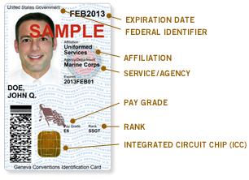
Civilian Human Resources Agency
Slide 4
Common Access Card (CAC)
What is a CAC? A smart card with encryption capabilities.
Why do I need a CAC? Used as the standard identification for access to the Installation and network.
How to obtain your CAC: Once your SF-50 is generated, contact your local DEERS office to verify you are listed in their system as a Department of Army Civilian.
What to bring with you: TWO forms of identification (at min. one must show picture ID and DOB), e.g., SSN Card, Driver’s License, etc.
*Note: the system will need at least 48 hours to generate your information prior to CAC issuance
Excellence through Partnership

Slide 5


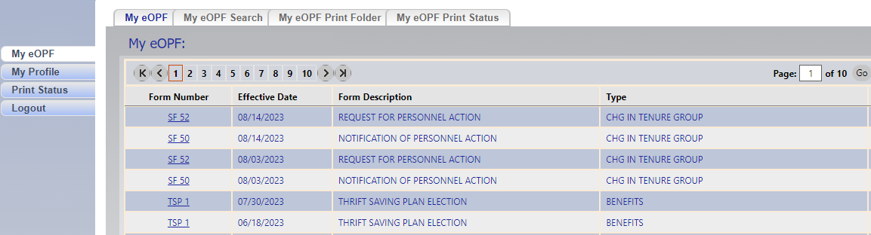
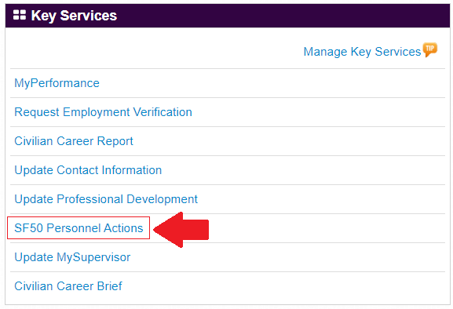
Civilian Human Resources Agency
Slide 5
SF-50 Notification of Personnel Action
What is an SF-50? An SF-50 is the Notification of Personnel Action that contains certain employment information such as your position and pay info, benefit entitlements, and more under the remarks section.
How do I locate my SF-50? Both the Electronic Official Personnel File (eOPF) and MyBiz+ are self-service websites for employees to access their SF-50s.
Excellence through Partnership

Slide 6
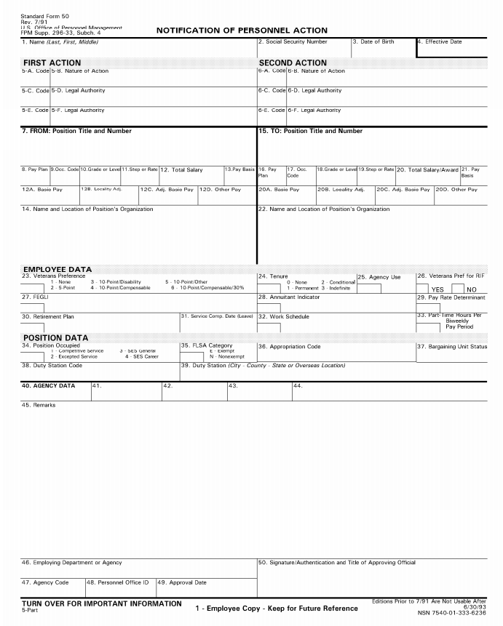
Civilian Human Resources Agency
Slide 6
SF-50 Notification of Personnel Action
VERIFY
- Full Name
- Date of Birth
- Social Security Number
Ensure
Service Computation Date (SCD) is correct. This effects leave accrual rate. SCD should reflect creditable prior Military and/or Civilian Service.
Review
- Position Information
- Pay data
Benefit Entitlements
- Timeframe to make elections
Transfer Information
- Transfers from other Federal Agencies
Disabled Veterans Leave (DVL)
- DVL will be reflected in Remarks on initial SF-50
** If any of this information is incorrect, please notify your HR specialist immediately**
Remarks :
Errors on this document, if not corrected, can affect your retirement benefits.
Excellence through Partnership

Slide 7
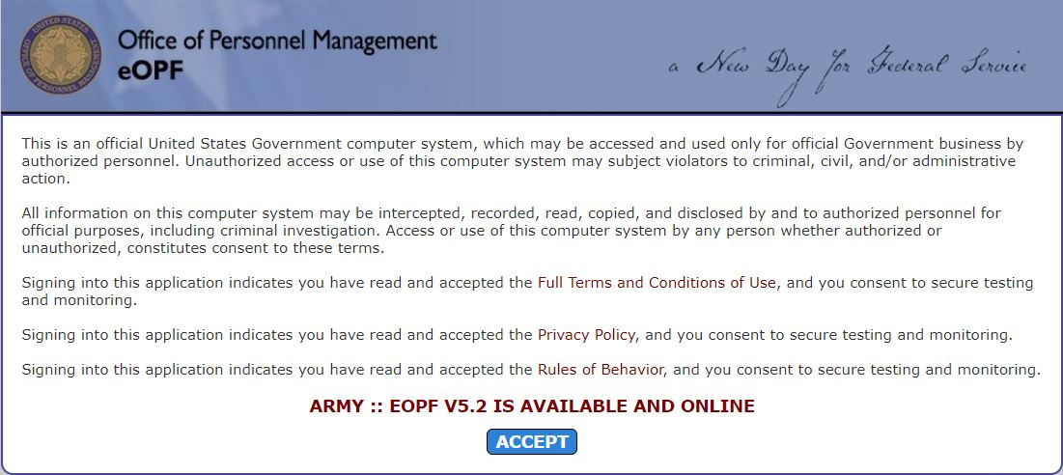
Civilian Human Resources Agency
Slide 7
Electronic Official Personnel File (eOPF) and MyBiz+
https://eopf.opm.gov/army/
https://compo.dcpds.cpms.osd.mil/
All employees have an eOPF which contains your personnel documents in a secure environment. The eOPF gives you immediate access and the capability to search for documents in your record. HR records and documents will be maintained in your eOPF throughout your career.
Email notifications are sent to employees when documents are added to their eOPF.
MyBiz+ key services include:
My Performance (Annual Appraisals)
Personnel Actions (SF 50)
Employment Verification Request
Civilian Career Report
Update Contact Information
Update Professional Development
Update Supervisor
Excellence through Partnership

Slide 8
Civilian Human Resources Agency
Slide 8
Service Computation Date (SCD) for Leave Purposes
What is SCD for Leave? SCD for Leave Purposes is used to determine the rate at which an employee accrues annual leave, up to 8 hours per pay period.
Where do I find my SCD for Leave Purposes at? Under block “31” of your SF-50.
How is SCD calculated? SCD is calculated based on your creditable service time. If you are prior military, a prior federal civilian, or a transfer from another federal agency, you may have creditable service time count towards your SCD for leave purposes.
Creditable Uniformed Service: Must have ended (1) honorably and (2) been active duty in a uniformed service.
RETIRED Service Member: Limited to service during a war or in a campaign/expedition for which a campaign badge has been authorized.
NON-RETIRED Service Member: All active-duty time documented on your DD-214 will count upon verification.
Creditable Civilian Service: All time will count upon receipt of Official Personnel Folder from previous agency or National Records Center.
Excellence through Partnership

Slide 9
Civilian Human Resources Agency
Slide 9
Verification of Non-Wartime Campaigns or Expeditions (SF-813)
For Retired Service Members.
Applicable time can be credited to your Service Computation Leave Date (SCD) to determine leave accrual rate.
Report any time spent for which you earned a Campaign Badge or Expeditionary Medal.
Please turn the SF-813 and a copy of your DD 214 into the Civilian Human Resources Agency (CHRA).
Processing adjusts your SCD accordingly and an SF-50 will be produced for your records.
Excellence through Partnership

Slide 10
Civilian Human Resources Agency
Slide 10
Annual Leave
Employee type | Less than 3 years of service | 3 years but less than 15 years of service | 15 or more years of service
Full-Time | 4 hours per pay period | 6 hours per pay period | 8 hours per pay period
Part-Time | 1 hour for every 20 hours | 1 hour for every 13 hours | 1 hour for every 10 hours
You will receive your paycheck via direct deposit and will be paid every other Thursday.
Each pay period, a Leave and Earnings Statement (LES) is generated and can be viewed via https://mypay.dfas.mil/
You will need to wait until after your first paycheck is deposited into your bank account to access the MyPay website
Excellence through Partnership

Slide 11
Civilian Human Resources Agency
Slide 11
Annual Leave Ceiling
Duty Location | Maximum Balance
Within the United States | 240 hours (30 days)
Overseas | 360 hours (45 days)
Annual leave exceeding the maximum balance for your duty location will become “use or lose”.
Any accrued annual leave in excess of the ceiling will be forfeited if not used by the final day of the leave year.
Leave year: Begins on the first day of the first full pay period in a calendar year and ends on the day immediately before the first day of the first full pay period in the following calendar year.
Excellence through Partnership

Slide 12
Civilian Human Resources Agency
Slide 12
Sick Leave
There is no limitation on the amount of sick leave that is accumulated.
Employee type | Time Accrued
Full-Time | 4 hours per pay period
Part-Time | 1 hour for every 20 hours
An employee is entitled to use sick leave for:
Personal medical needs
Family care or bereavement
Care of family member with serious health condition
Adoption-related purposes
Excellence through Partnership

Slide 13
Civilian Human Resources Agency
Slide 13
Disabled Veteran Leave (DVL)
What is DVL? Under the Wounded Warriors Federal Leave Act of 2015, an eligible Veteran may earn a separate leave category from annual/sick leave, called Disabled Veterans Leave.
How do I know I am eligible for DVL?
Be a veteran who was hired on 05-NOV-2016 or after.
Have a qualifying service-connected disability rating at 30% or higher.
If you are eligible → You are provided up to 104 hours of leave to use for service-connected related appointments.
DVL is limited to a 12-month period → The start of the 12-month period is your effective date (block “4” on SF50). If you have not received a rating yet as determined by the Veterans Business Administration (VBA), then the start of the 12-month period will be the effective date of your qualifying service-connected disability. This must be displayed on your VA Letter.
Unused DVL → After the 12-month period, unused DVL may NOT be carried over to subsequent years and is forfeited with no further entitlement. DVL is a one-time benefit limited to the first 12-months of eligibility.
Excellence through Partnership

Slide 14
Civilian Human Resources Agency
Slide 14
Additional Types of Leave
Family Medical Leave Act (FMLA): Federal employees are entitled to a total of up to 12 work-weeks of unpaid leave during any 12-month period for: childbirth, care of an ailing spouse/child/parent and other related medical circumstances.
Voluntary Leave Transfer Program (VLTP): Federal employees may donate annual leave directly to another employee who has a personal or family medical emergency and who has exhausted his or her available paid leave.
Absent Uniformed Service (Military Leave): Federal Employees are entitled to time off at full pay for certain types of active or inactive duty in the National Guard/Reserve of the Armed Forces. 120 hours is available via a single, continuous 12-month eligibility period at the beginning of your Entrance on Duty.
Leave without pay (LWOP): A temporary non-pay status and absence from duty that, in most cases, is granted at the employee's request. In most instances, granting LWOP is a matter of supervisory discretion and may be limited by agency internal policy.
Excellence through Partnership

Slide 15
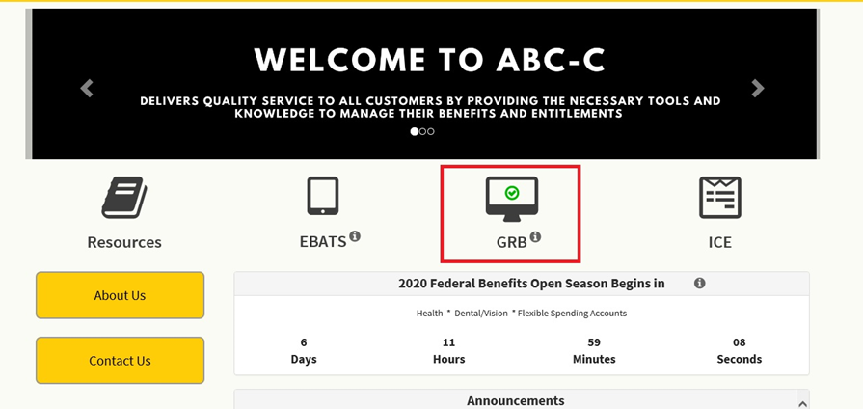
Civilian Human Resources Agency
Slide 15
Army Benefits Center – Civilian (ABC-C)
All Army Civilian employee benefits are handled through Army Benefits Center-Civilian (ABC-C).
Go to https://abc.chra.army.mil/abc
ABC-C provides you access to necessary tools and resources to manage your benefits/entitlements.
Select the “Contact Us” icon to reach out to a Benefits Specialist.
Select the “GRB” icon to be directed to the Government and Retirement Benefits Platform (GRB).
Excellence through Partnership

Slide 16
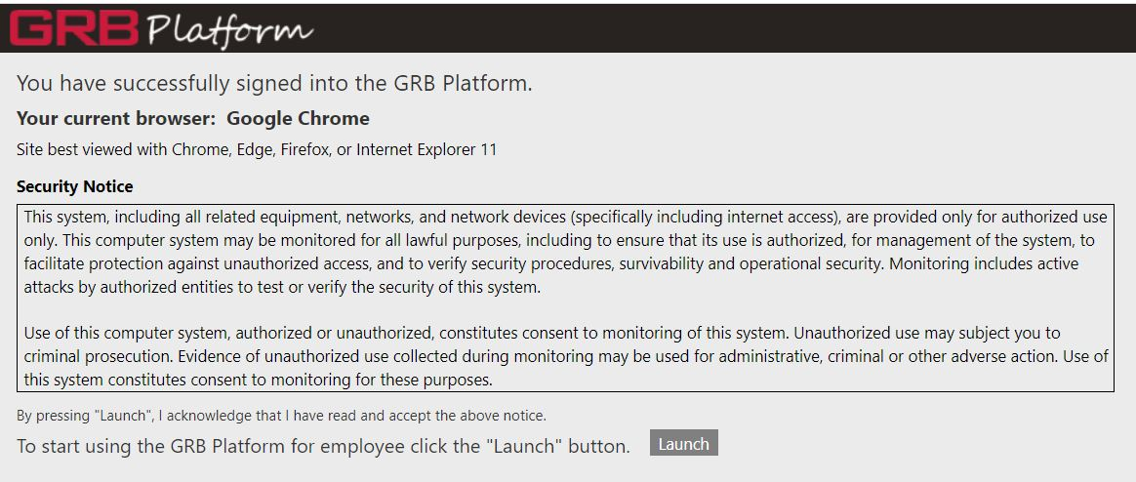
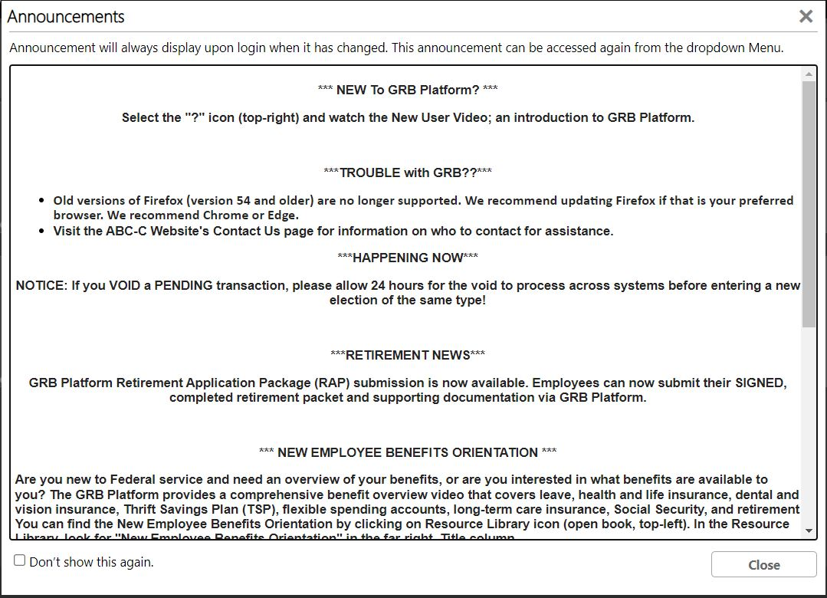
Civilian Human Resources Agency
Slide 16
Government and Retirement Benefits (GRB) Platform
You will need your CAC to access the GRB platform.
We highly encourage you as a New Employee to view the resources available to you, especially the New Employee Benefits Orientation.
Excellence through Partnership

Slide 17
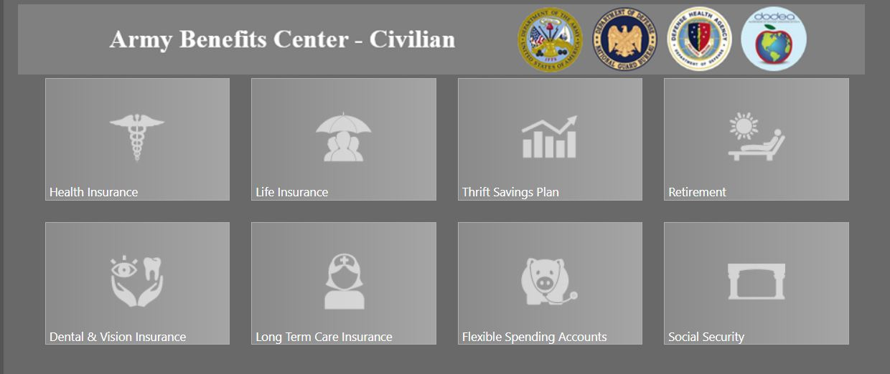
Civilian Human Resources Agency
Slide 17
Government and Retirement Benefits (GRB) Platform
All elections will be made online.
Each tile represents one of your benefits, such as Health, Life, Dental, Vision, Retirement, and more.
To make elections, select the designated tile and follow the steps accordingly. Certain benefits (FEDVIP, FLTCIP, FSAFEDS) are managed through external sites, but can be accessed through the GRB platform. Be sure to read the instructions carefully when making your initial enrollment.
Excellence through Partnership

Slide 18
Civilian Human Resources Agency
Slide 18
Benefit Options: Understanding of Terminology
60-Day Window – You have 60 days from your entry-on-duty (EOD) date to make elections to specific benefits.
Qualifying Life Event (QLE) – When status changes occur in your family, employment, pay, residence or coverage, you may be eligible to change your elections outside of the normal enrollment window.
Annual Federal Benefits Open Season – The time of year that you may update certain benefit elections (FEHB/FEDVIP/FSAFEDS) without the need for a qualifying life event. Runs annually from mid-November through mid-December. You must submit your Open Season enrollment change before midnight, on the last day of Open Season to be considered timely filed.
Infrequent Open Season – Infrequent open season means there is no timeline or specified frequency for when the next open enrollment period will be for certain benefit elections (FEGLI/FLTCIP).
Qualifying Physical Exam – Must provide satisfactory medical evidence of insurability.
If you are a transfer from another Federal agency, your current elections and coverage continue without change if there is no break-in-service of more than 3 days.
Excellence through Partnership

Slide 19



Civilian Human Resources Agency
Slide 19
Benefit Options: FEDVIP, FEHB, FEGLI
View the OPM Dental & Vision calculator here: https://www.opm.gov/healthcare-insurance/healthcare/plan-information/compare-plans/fedvip
View the OPM health insurance calculator here: https://www.opm.gov/healthcare-insurance/healthcare/plan-information/compare-plans/
View the OPM life insurance calculator here: https://www.opm.gov/retirement-services/calculators/fegli-calculator/
FEDVIP (aka BENEFEDS) provides eligible enrollees the choice among several nationwide dental & vision plans.
Enroll within 60-Day Window.
Outside initial window, you can elect to cancel or change coverage through Annual Federal Benefits Open Season or experience a Qualifying Life Event (QLE).
Cannot cancel outside open season unless you are returned to Active Duty or have loss of other insurance.
FEHB provides you and your family assistance to meet your health care needs with over 200 health plans.
Enroll within 60-Day Window.
Outside initial window, you can elect to cancel or change coverage through Annual Federal Benefits Open Season or experience a Qualifying Life Event (QLE).
FEGLI provides you two types of life insurance; (1) Basic and (2) Optional.
Automatically enrolled for Basic Coverage from your appointment date.
Waive, change or add coverage within 60-Day Window.
Outside initial window, you can adjust coverage through Infrequent Open Season, complete a Qualifying Physical Exam, or experience a Qualifying Life Event (QLE).
Excellence through Partnership

Slide 20



Civilian Human Resources Agency
Slide 20
Benefit Options: FSAFEDS, FLTCIP, TSP
View the FSA Feds calculator here:
https://www.fsafeds.com/support/savingscalculators
View the FLTCIP calculator here:
https://www.ltcfeds.com/tools/premium-calculator
View the TSP calculator here:
https://www.tsp.gov/calculators/how-much-will-my-savings-grow/#top
Flexible Spending Accounts allow you to save money for health and dependent care expenses not typically covered by health/dental/vision insurance. The word ‘dependent’ refers to young children or elders.
Enroll within 60-Day Window.
Outside initial window, you can elect to cancel or change coverage through Annual Federal Benefits Open Season or experience a Qualifying Life Event (QLE).
The U.S. Office of Personnel Management (OPM) suspended applications for coverage under the Federal Long Term Care Insurance Program (FLTCIP) effective December 19, 2022.
▪ As of December 19, 2022, individuals not currently enrolled may not apply for coverage, and current enrollees may not apply to increase their coverage. The suspension will remain in effect for 24 months, unless OPM issues a subsequent notice to end or extend the suspension period.
Thrift Savings Plan is a contribution retirement plan offered by the Government. You can make changes to your TSP allocations at any time, there is no specified enrollment period.
As a new employee, you will be automatically enrolled at 5%.
If eligible, you can receive 2 types of agency contributions to your TSP account, which together can equal as much as 5% of your basic pay.
Excellence through Partnership

Slide 21
Civilian Human Resources Agency
Slide 21
Benefits Eligibility
PERMANENT and TERM employees are eligible
TEMPORARY, SEASONAL, and INTERMITTENT employees are also eligible with restrictions:
FEHB- Eligible after completing one year of current continuous employment
FEGLI- Ineligible by law or regulation due to appointment being temporary or limited to less than 1 year
Retirement- FICA only
Excellence through Partnership

Slide 22
Civilian Human Resources Agency
Slide 22
Federal Employee Retirement System (FERS)
Employees appointed to the government for the first time are automatically covered by the Federal Employee Retirement System (FERS).
FERS is a 3-tiered retirement system:
FERS Annuity
Basic Benefit Plan (FERS: RAE – 3.1%) (FERS: FRAE – 4.4%)
The Bipartisan Budget Act of 2013, signed on
December 26, 2013, mandated a 1.3% increase in
the percentage for employee contribution for the Federal Employees Retirement System- Further Revised Annuity Employee (FERS-FRAE) for all employees hired on or after January 1, 2014, who have less than five (5) years creditable service covered under FERS.
Social Security Benefits
Thrift Savings Plan- the largest portion of your retirement
Social Security
Thrift Savings Plan
Excellence through Partnership

Slide 23
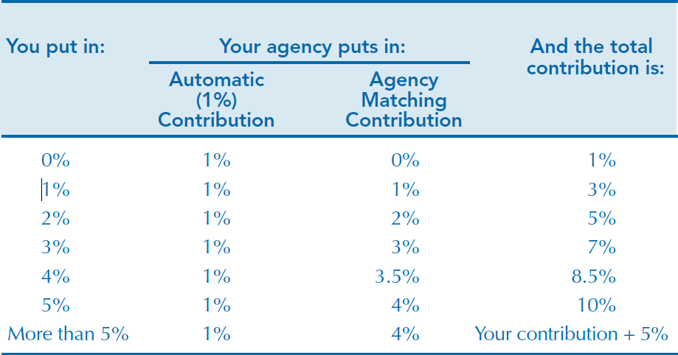
Civilian Human Resources Agency
Slide 23
Thrift Savings Plan (TSP)
Automatically enrolled at 5%.
First 3% is matched dollar for dollar
The next 2% is matched 50 cents for every dollar
Agency contribution: matching up to first 5%
Choose between Traditional (pre-tax) or Roth (post-tax) contributions
TSP offers a choice of investment options
Loan Program
Withdrawal Options
Prior military may combine active-duty TSP with civilian account
Visit TSP.gov for assistance

Slide 24
Civilian Human Resources Agency
Slide 24
Thrift Savings Plan (TSP) Contribution Limits and Loans
If you are 50 years old (or will turn 50 in 2023), TSP catch up contributions may be made in addition to standard contributions:
2023 Standard Contribution limit: $22,500
2023 Catch up contribution limit: $7,500
If you currently have a TSP loan, please inform your new agency and submit the appropriate forms to continue payments.
If you transfer to an agency that has a different pay cycle from your current agency, you should re-amortize you loan to avoid being in default.
Visit TSP.gov for more information

Slide 25
Civilian Human Resources Agency
Slide 25
Beneficiary Designations
Beneficiary designations ensure that you have the final say in how your funds are distributed. By providing complete and accurate information, you maintain control of who will receive your funds in the event something happens to you.
The order of precedence for distribution of funds is:
Beneficiary(ies) you designated.
Widow or widower.
Child, or children in equal shares.
Your parents in equal shares, or the entire amount to the surviving parent.
To the court-appointed executor or administrator of your estate.
Next of kin as determined under the laws of the state where you lived.
To access the necessary forms for designating a beneficiary(ies), you can obtain the forms from https://www.opm.gov/forms/standard-forms/ or by contacting CHRA.
As changes in your household occur, be sure to update your designations accordingly (such as marriage, divorce, birth of a child, etc.)
Excellence through Partnership

Slide 26
Civilian Human Resources Agency
Slide 26
Beneficiary Forms
SF 1152 - Designation of Beneficiary, Unpaid Compensation of Deceased Civilian Employee - File with your HR representative.
SF 2823 - Designation of Beneficiary, Federal Employees' Group Life Insurance Program - File with your HR representative.
SF 3102 - Designation of Beneficiary, Federal Employees Retirement System (FERS) - File with your HR representative.
TSP-3 - Designation of Beneficiary, TSP - Mail to TSP at the address at the bottom of the last page. Mail the original to:
Thrift Savings Plan
P.O. Box 385021
Birmingham, AL 35238
Or fax to: 1-866-817-5023
Excellence through Partnership

Slide 27
Civilian Human Resources Agency
Slide 27
Military Buyback/Post-56 Deposit
If you have served in the military, are a non-retiree, and now hold a civilian position, your military service time may apply towards your civil service retirement date.
How long do I have to buy back my military time? You are applying to buyback your military service time within three years of civilian service and therefore, no interest will be charged. For federal employees with more than three years of civilian employment prior to application to buyback your military time, there may be interest charges.
What happens when you buyback your military time? The eligible military service time is added to your retirement date immediately upon finalizing the buyback process. The buyback process MUST be completed prior to the date of separation or retirement. It will not be accepted after you apply for retirement, and you will lose the service time.
Apply via the ABC-C website. Payment is coordinated with Defense Finance Accounting Service (DFAS).
You may combine your military and civilian Thrift Savings Plans; contact TSP.gov for more information.
DFAS Military Buyback Estimator tool → MPBB / EE (disa.mil)
Excellence through Partnership

Slide 28
Civilian Human Resources Agency
Slide 28
Pay Information
Pay periods:
Two full weeks time, beginning on Sunday and ending the following week on Saturday.
There are 26 pay periods within the year.
Pay day is the second Thursday (nine working days after timecard has processed).
Please report pay and leave discrepancies to your unit’s timekeeper.
Utilize MyPay to change your address, set up allotments, update Federal Tax withholding, and change direct deposit.
MyPay accounts are established AFTER you receive your first paycheck; do NOT try to access MyPay until after this occurs.
Excellence through Partnership

Slide 29
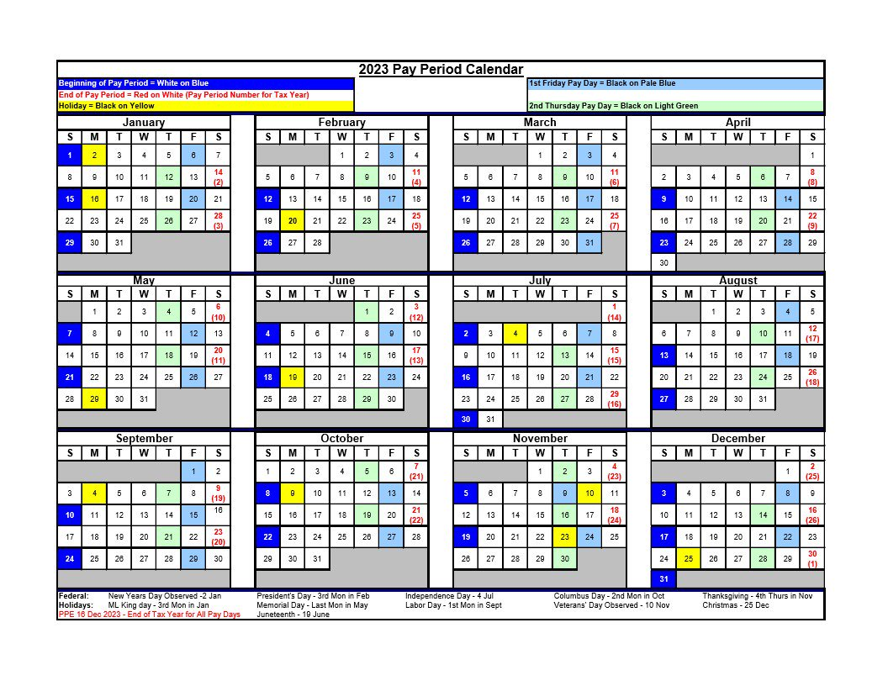
Slide 29
MyPay website: https://mypay.dfas.mil/
Notes:
On the pay calendar each pay period begins on the bright blue dates. Your first paycheck, if not a current government employee, will be the last Thursday of the 2nd pay period in which you start.
Your first payday will be in 3 ½ weeks.

Slide 30
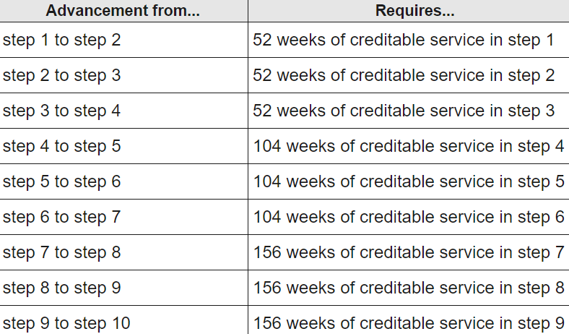
Civilian Human Resources Agency
Slide 30
Within Grade Increases
Employees who occupy permanent positions earn WGIs upon meeting the following three requirements:
The employee's performance must be at an acceptable level of competence. To meet this requirement, an employee's most recent performance rating of record must be at least Level 3 ("Fully Successful" or equivalent).
The employee must have completed the required waiting period for advancement to the next higher step.
The employee must not have received an "equivalent increase" in pay during the waiting period. (See 5 CFR 531.407.)
Excellence through Partnership

Slide 31
Civilian Human Resources Agency
Slide 31
Mandatory Training for New Employees
As a Department of Army Civilian, you are required to remain current on all mandatory training. Most training is held virtually and will need to be completed annually.
Some of these trainings include:
Cyber Awareness
Sexual Harassment/Assault Response and Prevention Program (SHARP)
Equal Employment Opportunity (EEO)
Army Substance Abuse Program (ASAP)
You are responsible for coordinating and completing the mandatory trainings with your supervisor and/or organization training coordinator.
Excellence through Partnership

Slide 32
Civilian Human Resources Agency
Slide 32
Prohibited Personnel Practices
Prohibited Personnel Practices (PPPs) are reprimands against specific practices that conflict with merit systems principles.
Federal employees, by law, may NOT:
Discriminate
Solicit or consider employment recommendations based on factors other than personal knowledge or records of job related abilities/ characteristics
Coerce the political activity of any person
Deceive or willfully obstruct any person from competing for employment
Influence any person to withdraw from job competition
Give unauthorized preference or advantage to improve or injure the prospects of any particular person for employment
Engage in nepotism
Take, or threaten to take, a personnel action because of whistleblowing
Take, or threaten to take, a personnel action because of the exercise of a lawful appeal, complaint, or grievance right
Discriminate based on personal conduct which does not adversely affect the performance of the employee or other employees
Knowingly take or fail to take personnel action in the violation of veteran’s preference laws
Violate any law, rule, or regulation implementing or directly concerning merit system principles
Implement or enforce a nondisclosure agreement or policy lacking notification of whistleblower rights
Excellence through Partnership

Slide 33
Civilian Human Resources Agency
Slide 33
Whistleblowing and Protected Whistleblowing
A federal employee authorized to take, direct others to take, recommend, or approve any personnel action may not take, fail to take, or threaten to take any personnel action against an employee because of protected whistleblowing.
Protected whistleblowing is defined as disclosing information that the discloser reasonable believes evidences:
A violation of law, rule, or regulation;
Gross mismanagement;
Gross waste of funds;
An abuse of authority; or
A substantial and specific danger to public health or safety.
A “whistleblower” is someone who discloses information that he or she reasonably believes evidences:
A violation of any law, rule, or regulation
Gross mismanagement
A gross waste of funds
An abuse of authority
A substantial and specific danger to public health or public safety
—5 U.S.C. § 2302(b)(8)—
Excellence through Partnership

Slide 34
Civilian Human Resources Agency
Slide 34
Equal Employment Opportunity (EEO)
EEO Mission: To ensure equal employment opportunities and treatment for all Federal employees and applicants, regardless of race, color, religion, sex, national origin, age and disability.
Any employee or applicant for employment who believes they have been discriminated against should contact the EEO Office within 45 days from the date of the alleged discriminatory event, the effective date of a personnel action, or the date they became aware of such discrimination.
For additional information regarding EEO and/or the No FEAR Act, please contact:
OPM.gov
(202) 606-2460
EEO@opm.gov

Slide 35

Civilian Human Resources Agency
Slide 35
Union Representation
Under the Federal Service Labor-Management Relations Statute (FSLMRS), many Federal government bargaining unit employees are eligible for union membership if there is a union at their worksite. However, not all federal employees are covered by bargaining units or eligible to be represented by a union. Employees should consult with their agency’s human resources office to determine their bargaining unit status.
Visit https://www.afge.org/ to find your local American Federation of Government Employees representative.

Slide 36
Civilian Human Resources Agency
Slide 36
Injuries
If you are injured on the job, notify your Supervisor Immediately and tell them of your intent to file a claim within 24 hours.
Work with your Supervisor to file claims electronically: https://www.ecomp.dol.gov
CA-1: Notice of Traumatic Injury
CA-2: Occupational Disease or Illness
ABC-C Injury Compensation Branch (ICB) is the point of contact for all work-related injuries:
1-866-792-7620

Slide 37
Civilian Human Resources Agency
Slide 37
Following This Brief
Login into your USA Jobs profile to complete the following forms:
SF 181: Ethnicity and Race Identification
SF 256: Self-Identification of Disability
SF 61: Appointment Affidavits
Your Declaration for Federal Employment OF-306 will be returned to you for digital signature.
Please visit https://onboard.usastaffing.gov for this task.
These forms must be completed for your in-processing to be finalized in the system.

Slide 38

Civilian Human Resources Agency
Questions?
Excellence through Partnership

