Slide 1
U.S. Army Financial Management Command
Smart Voucher
AMPO Ft Knox
Building 1384 Room 107
Ft knox, KY 40121
Notes:
[Next Slide]

Slide 2
SMARTVOUCHER
Log in
  Use CAC to login into laptop using your name
  Go to mypay.dfas.mil/homepage – DO NOT LOG IN
Information needed:
  PCS orders
  Leave form
  Receipts for anything over $75.00
    Hotels
    Air Fare
    Excess Baggage
New unit of assignment
Date of Birth of children
Date of Marriage
If dependents traveled separately, you will need two different vouchers

Slide 3
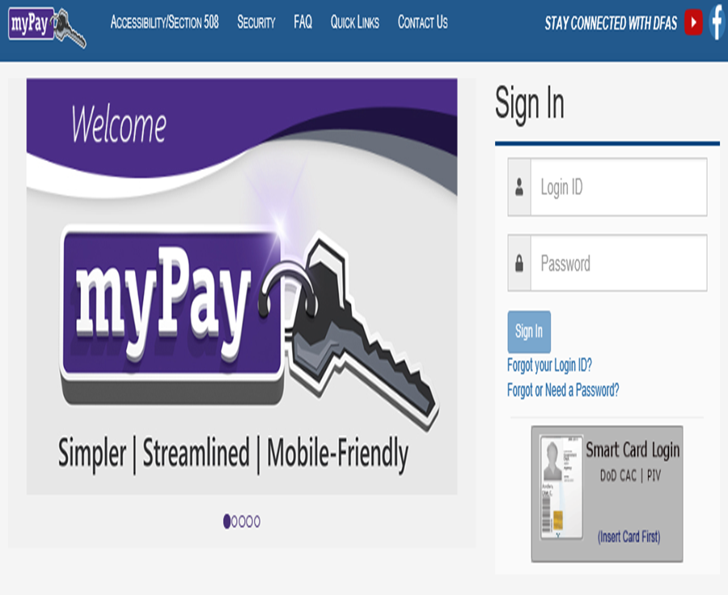
SMARTVOUCHER
Once on the myPay homepage, do NOT log in
Select “Quick Links”

Slide 4
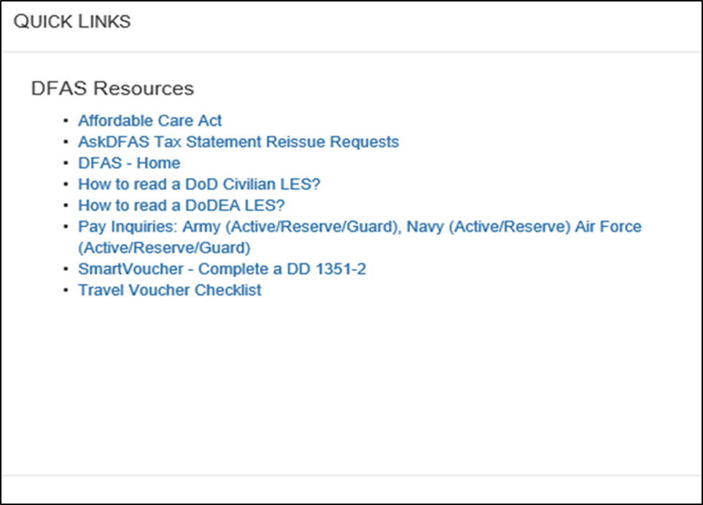
SMARTVOUCHER
Under DFAS Resources, second from the bottom of the list, select “Smart Voucher – Complete a DD Form 1351-2”

Slide 5
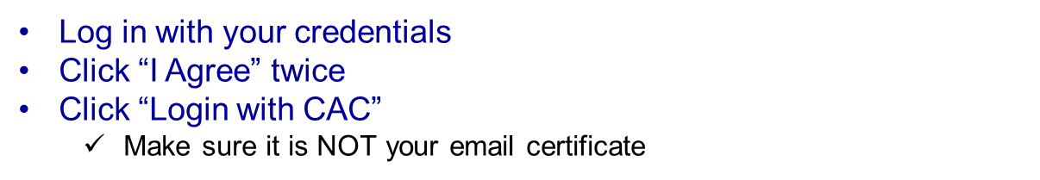
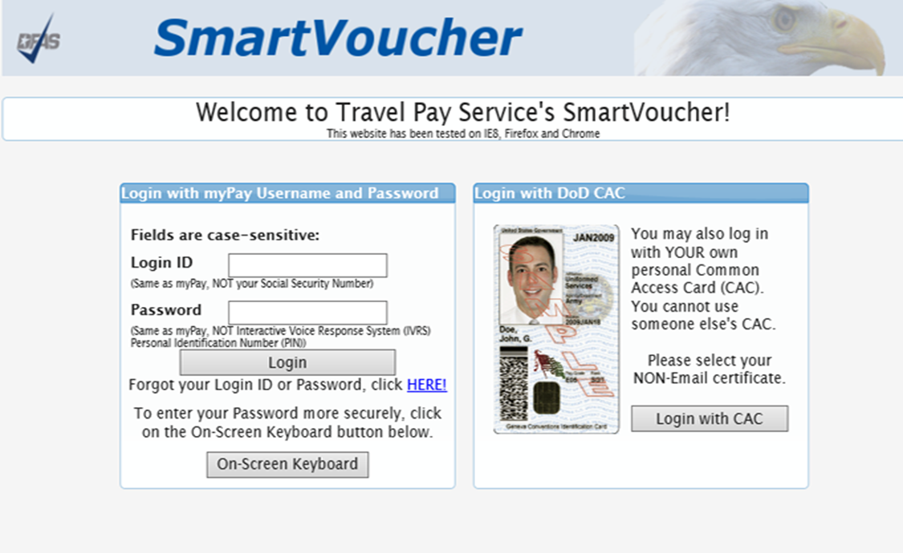
SMARTVOUCHER

Slide 6
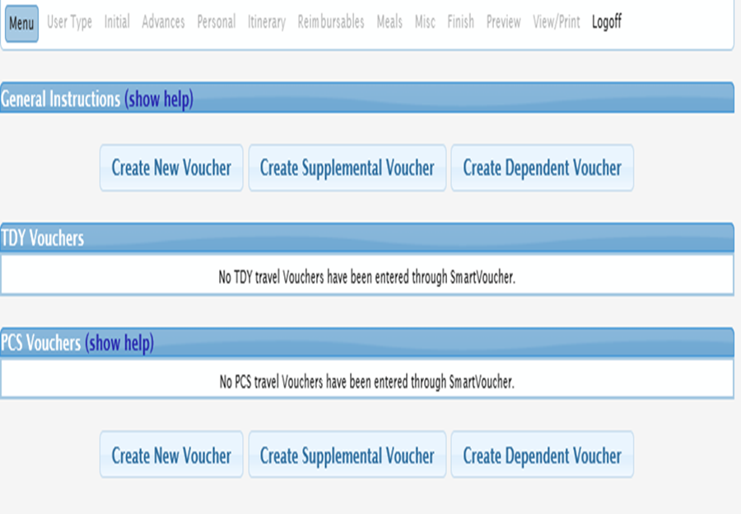
SMARTVOUCHER
Smart Voucher homepage
Can view old vouchers and create new vouchers
Move through the voucher using the menu at the top of the page
Click on “Create New Voucher”
Click on “Create Dependent Voucher” if your dependents traveled separately
When it ask about if your at AMPO Select Ft McCoy

Slide 7
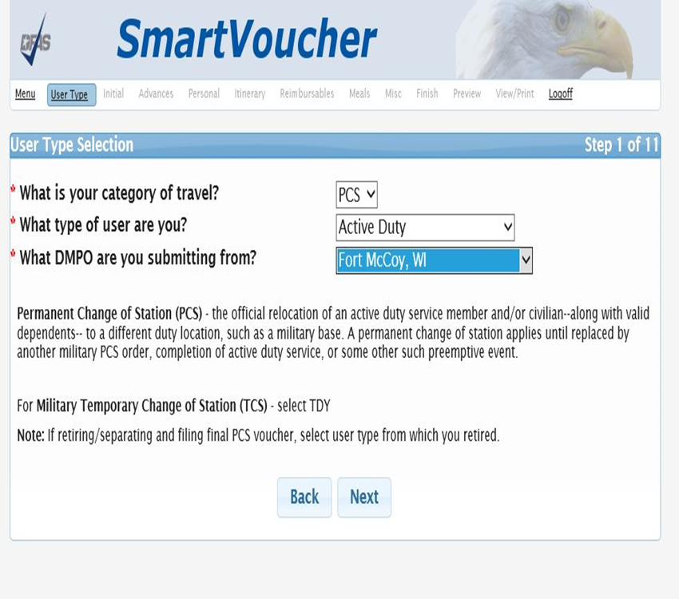
SMARTVOUCHER
Category of Travel will be “PCS”
Type of user is “Active Duty”, “AGR” or “Reservists”
Select “Fort Knox, KY” as your AMPO
Select “Next”
Fort Knox, KY

Slide 8
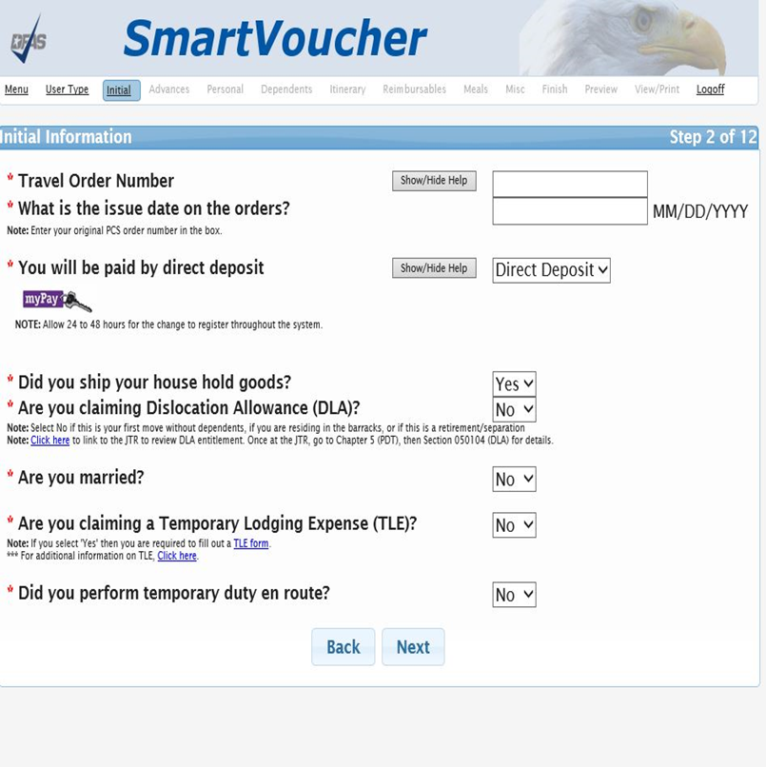
SMARTVOUCHER
Travel Order # - found in the top left corner of your orders
Issue date of orders is found in the top right corner
It will always be “Direct Deposit”
Did your household goods move
DLA if dependents with you, single E6 and above, or if coming from an unaccompanied tour
Are you married
Is you spouse active duty (will need spouse’s information
Are you claiming TLE(this is for 10 days max at either old CONUS duty station or new CONUS duty station
Did you go TDY enroute

Slide 9
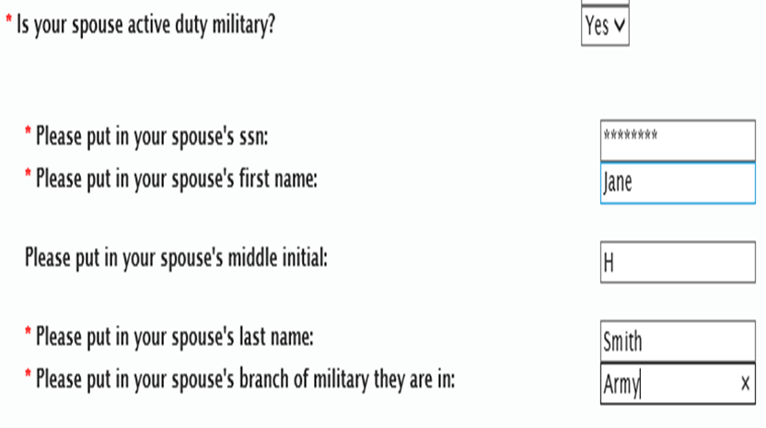
SMARTVOUCHER
If your spouse is active duty military, select “Yes”
Fill in using your spouse’s information:
  Social Security Number
  First name
  Last name
  Branch of service

Slide 10
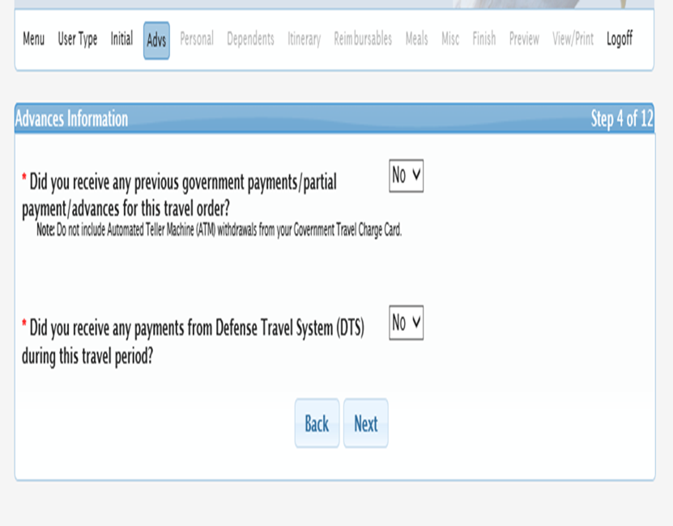
SMARTVOUCHER
If you have a GTCC, you will answer “No” to both questions
You will answer “Yes” only if you took a travel advance
  Does not include a Pay Advance or DITY Move Advance

Slide 11
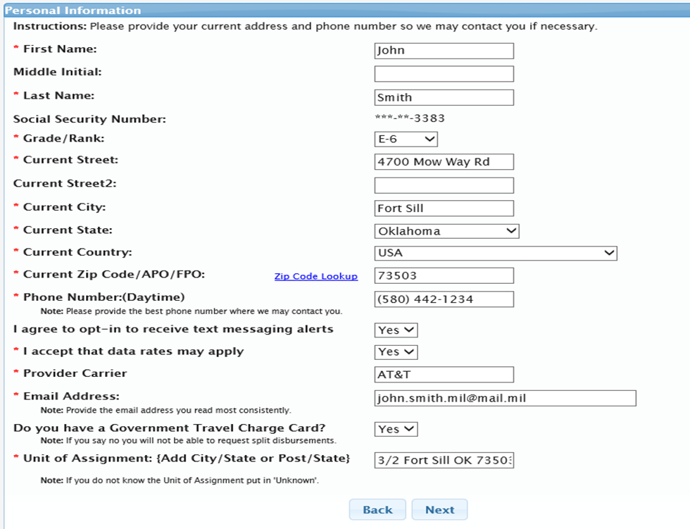
SMARTVOUCHER
Use your personal information
Use current address if you have one; if none, use unit Address
You can now opt to receive updates on your travel via text. Answer all questions if you would like to receive updates.
Email address can be military or civilian
Use an email that you use often
Do you have GTCC? – “Yes” or “No”
Unit of Assignment:
      New unit you are going to
      Make sure to include:
      City and state
      Select Next

Slide 12
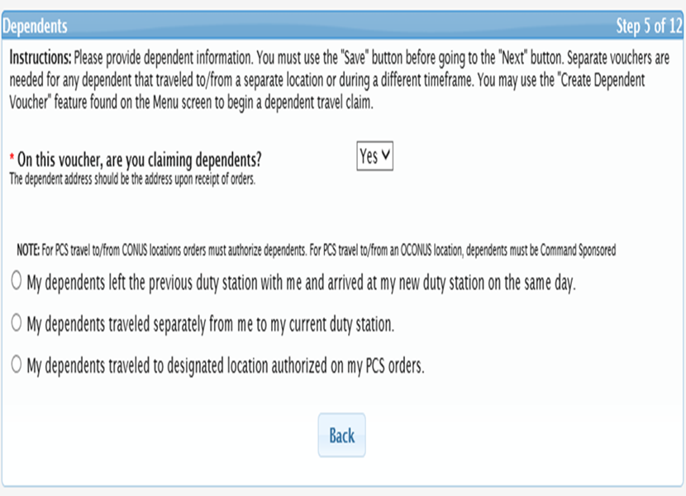
SMARTVOUCHER
If your dependents traveled with you and they are here, select “Yes” for claiming dependents.
If your dependents traveled separately or are arriving at a later date, this voucher will be for your travel only. Another voucher for your dependents will be completed upon their arrival.
Separate vouchers are needed for any dependent that traveled to/from a separate location or during a different timeframe. You may use the "Create Dependent Voucher" feature found on the Menu screen to begin a dependent travel claim.

Slide 13
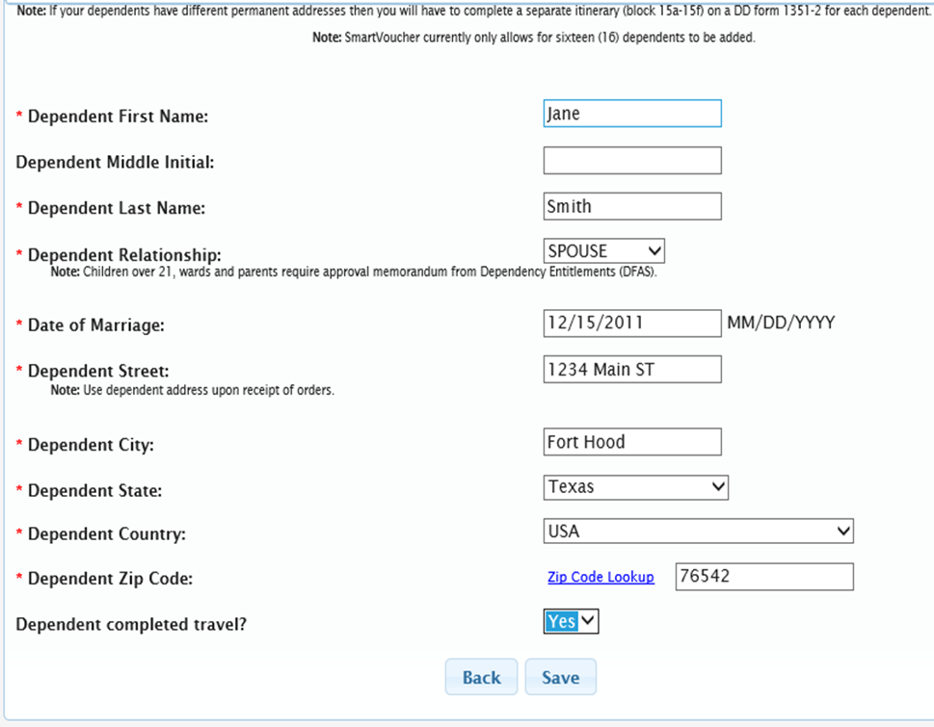
SMARTVOUCHER
Each dependent who traveled with you will be entered on separate pages
Dependent Street, City, State, Country and Zip Code is your OLD address (address at last duty station) OR your dependent’s address when you received your orders
Don’t forget to mark off “Yes” if your dependent completed travel
Click “Save” to add another dependent

Slide 14
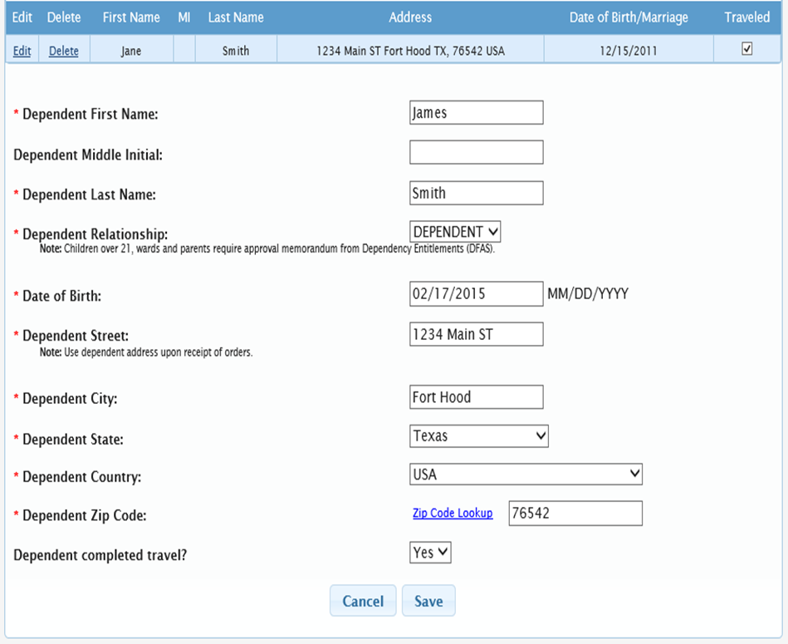
SMARTVOUCHER
Click “Add Dependent”
Address will automatically populate
Again, don’t forget to mark “Yes” for completed travel
In order to get reimbursed for all dependent travel, you need to list ALL dependents that moved with you
Once they are all listed and saved, select “Next”
If you are claiming a secondary dependent, the approval memo from DFAS is required

Slide 15
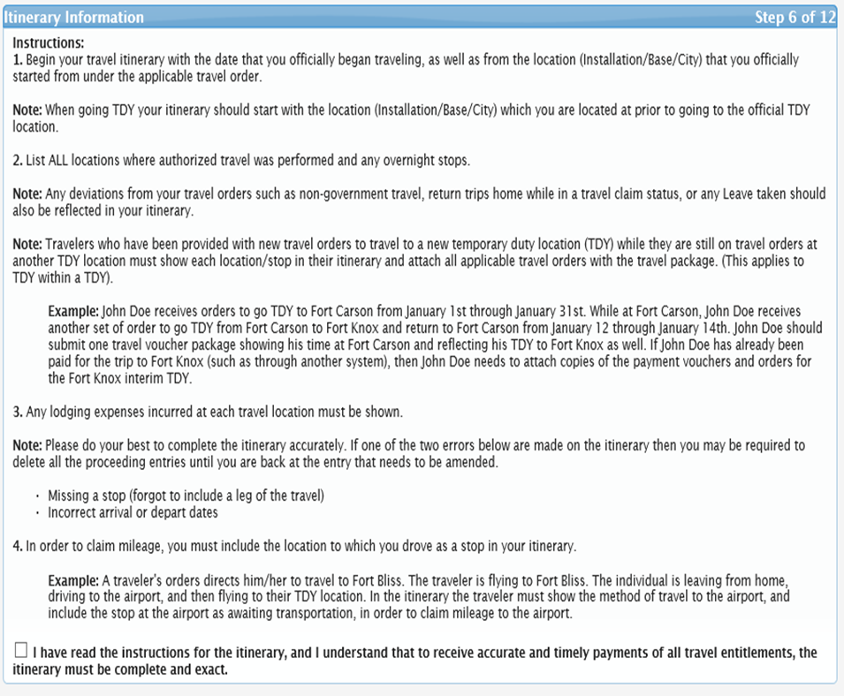
SMARTVOUCHER
This is how you get reimbursed for your travels
We need to know every time you changed modes of transportation
  i.e. Cab to the airport then got on a plane
You will need your leave form for the dates that you signed in and out (blocks 14 &16)
Select the box in the bottom left
Select “Add” on the next screen

Slide 16
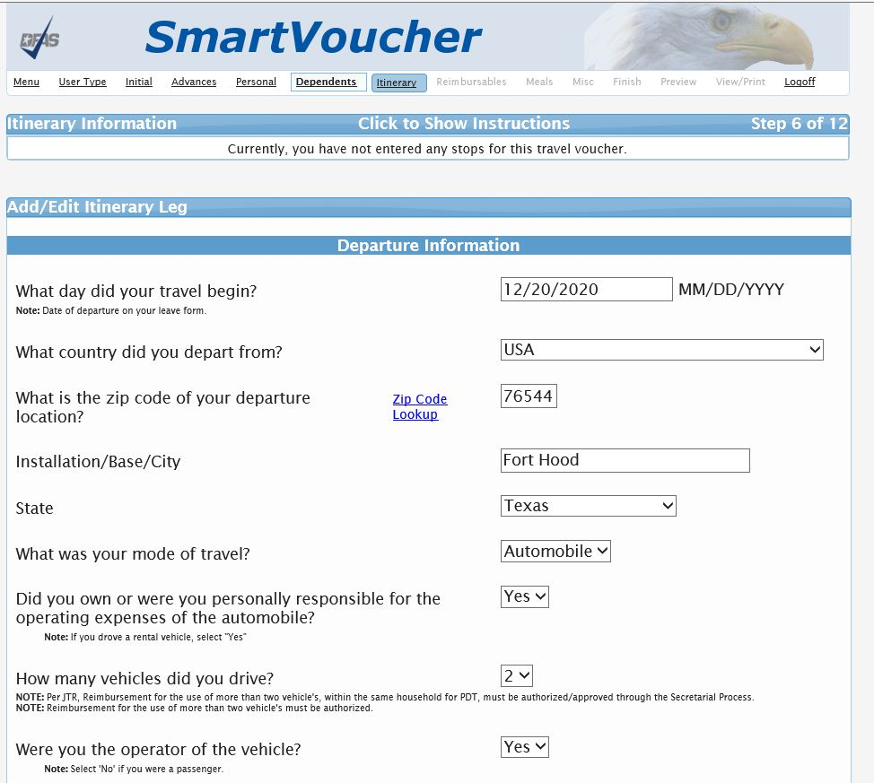
SMARTVOUCHER POV
Travel began on the day that you signed out on leave
  This must match your DA 31 block 14
Use last duty location
State/AP/FPO of last duty location
  If coming from Korea, select A/FPO FL
  If coming from other overseas locations, select A/FPO NY
Include zip code and country
Mode of Travel
    Own or operate
    How many vehicles
    Were you the operator of the vehicle

Slide 17
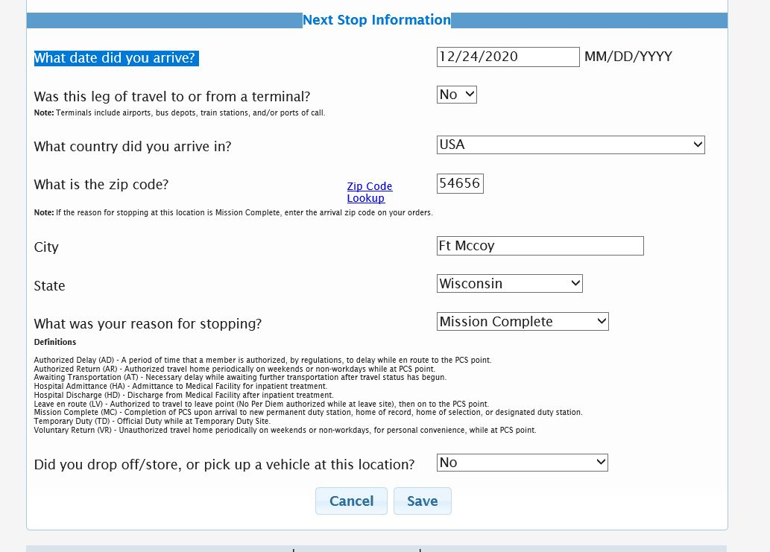
SMARTVOUCHER
Arrival Date is the day you signed in (from DA 31 block 16)
Leg to or from Terminal “NO” unless you picked up or dropped off a vehicle at a VPC
Reason for Stopping “Mission Complete”
40121
Ft Knox
Kentucky

Slide 18
SMARTVOUCHER
Common CONUS airport zip codes
Atlanta, GA Airport: 30320
Augusta, GA Airport: 30906
Baltimore, MD Airport: 21240
Columbia, SC Airport: 29170
Dallas, TX Airport: 75261
Lawton, OK Airport: 73501
New York, NY Airport: 11430
Oklahoma City, OK Airport: 73101
Richmond, VA Airport : 23250
San Antonio, TX Airport: 78216
Seattle, WA Airport: 98158
St. Louis, MO Airport: 63145
Louisville, KY Airport: 40209
Indianapolis, IN Airport: 46241

Slide 19
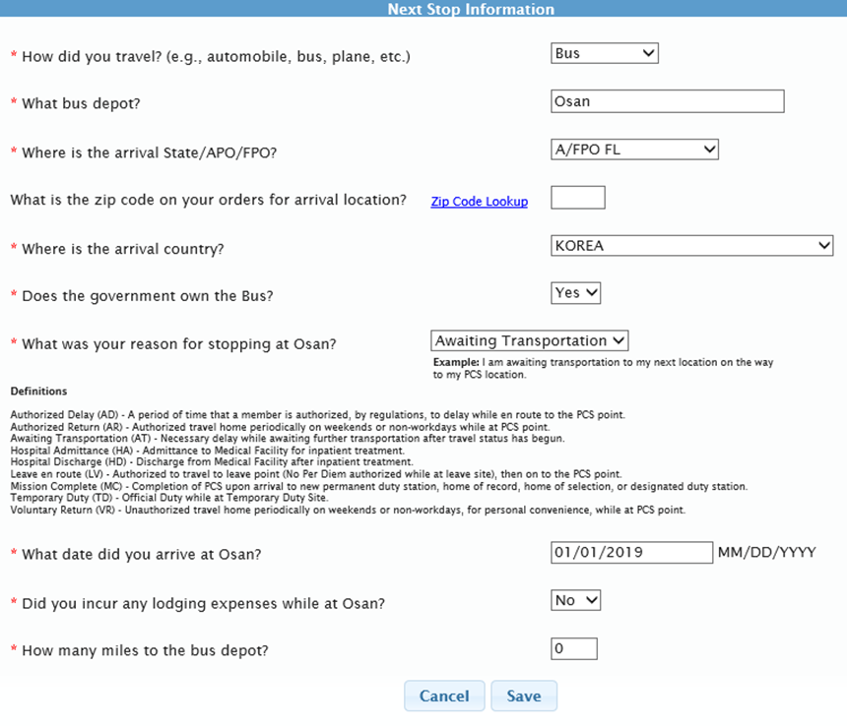
SMARTVOUCHER
Flying to Fort McCoy: Part 1
We need to know how you got to the airport first.
Mode of travel is “Automobile” if you took a cab or someone drove you; “Bus” if you took a bus
In arrival city/state, put the city/state that the airport that you flew out of is located
Answer the next questions based on your travel
Reason for stopping at the airport is “Awaiting Transportation”
Day you arrived should be the same day or next day
Lodging expenses? Only if you have an authorized delay
You will only enter miles if you were driving a personal vehicle

Slide 20
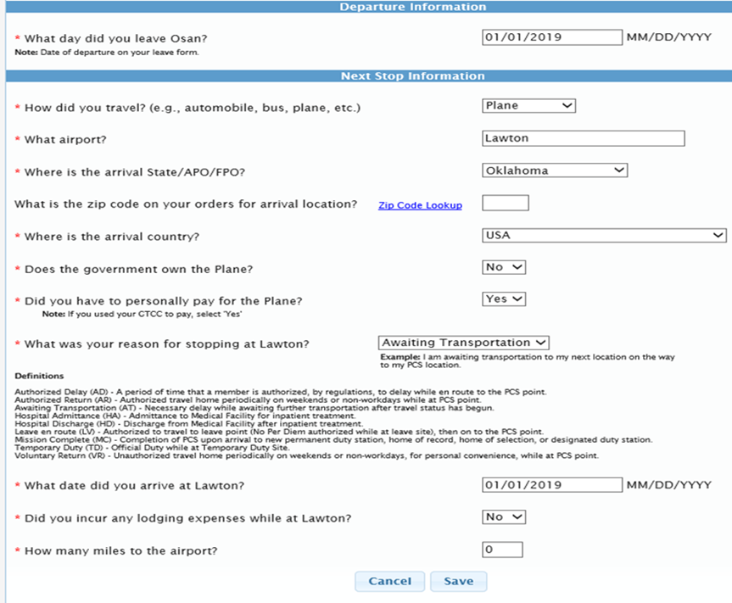
SMARTVOUCHER
Flying to Fort McCoy: Part 2
Part 2 is about the day you left the airport
Mode of travel “Plane”
Arrival city/state is the location that you flew into and did not get back on a plane
Did the government own the plane?
Did you have to pay for your plane ticket?
If you used your GTCC, you personally
paid for your ticket
Reason for stopping in Lawton is “Awaiting Transportation”
Arrival date to Lawton
Should be same day or next day
Lodging expenses?
Does not include TLE
You will only list miles if you drove a personal vehicle

Slide 21
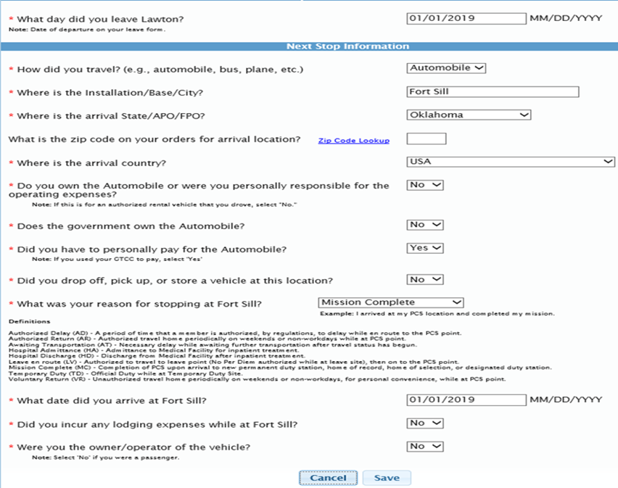
SMARTVOUCHER
Flying to Fort McCoy: Part 3
Part 3 is about the day you left the arrival airport
Arrival city is “Duty Location”
  Your final arrival city will always be your new duty location
Answer the questions regarding mode of travel
Drop off, pick up, or store a vehicle is for VPC purposes
Reason for stopping at your new duty location is ALWAYS “Mission Complete”
Your arrival date is the day that you signed in
Needs to match sign in date on DA 31 block16
Lodging expenses do not include TLE
Will be filled out a separate form
Were you the operator of the vehicle?

Slide 22
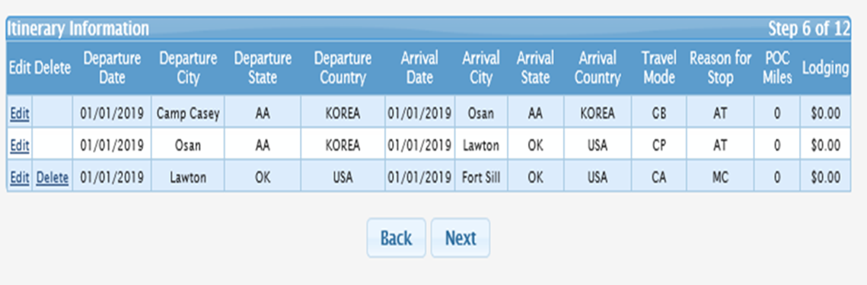
SMARTVOUCHER
Check your itinerary for completeness
Remember, we need to know every time you change modes of transportation
Select “Next”

Slide 23
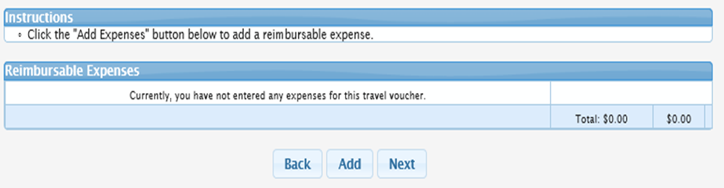
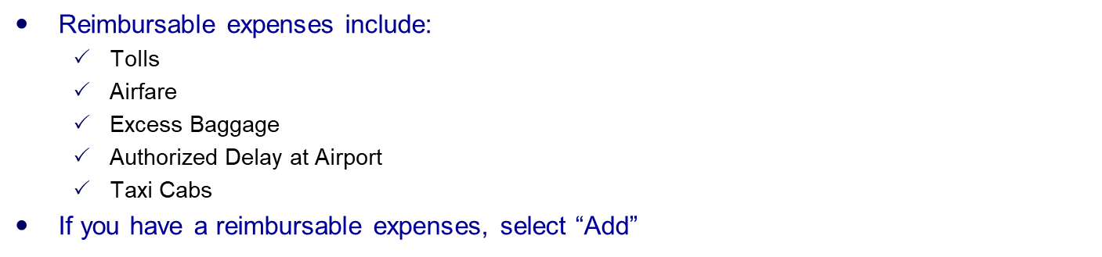
SMARTVOUCHER

Slide 24
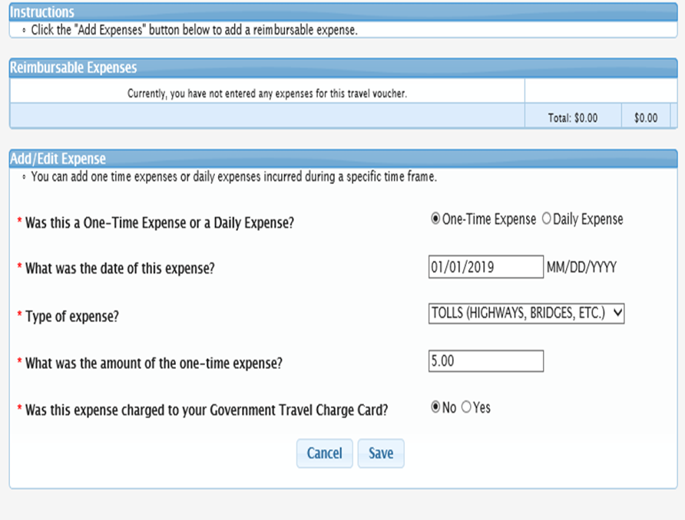
SMARTVOUCHER
Select “One Time Expense” or “Daily Expense”
Select date of expense
Select type of expense
Insert the amount
Remember, a receipt is needed for anything over $75
Select “No” or “Yes” if it was charged to you GTCC
Click “Save”
If you have other Reimbursable Expenses, select “Add”
If no others, select “Next”

Slide 25
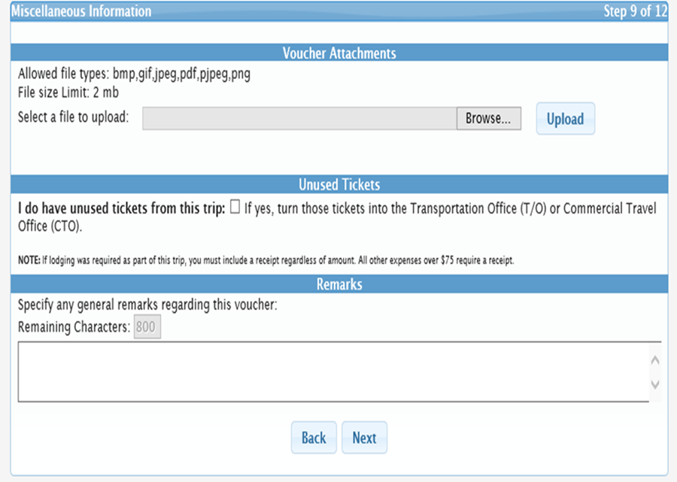
SMARTVOUCHER
The S1 personnel or Command Secretary will help you upload your document
Specify if you have any unused plane tickets; this may be left blank
Specify any general remarks

Slide 26
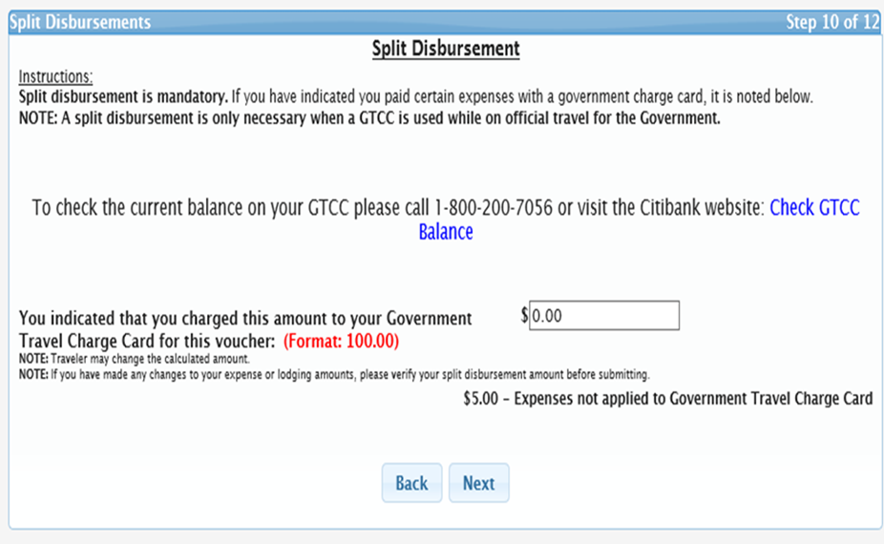
SMARTVOUCHER
Split Disbursement is used if you have a GTCC and used it
You can opt to have a specified amount go straight to your GTCC
You’ll have time to call Citi Bank to find out your balance
Keep in mind, you are responsible for your GTCC
Select “Next”

Slide 27
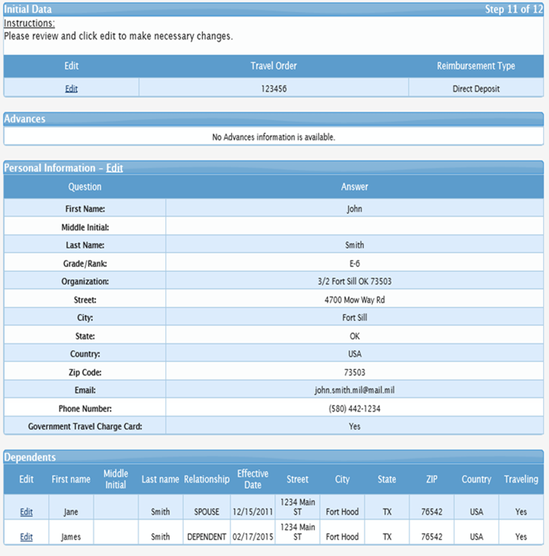
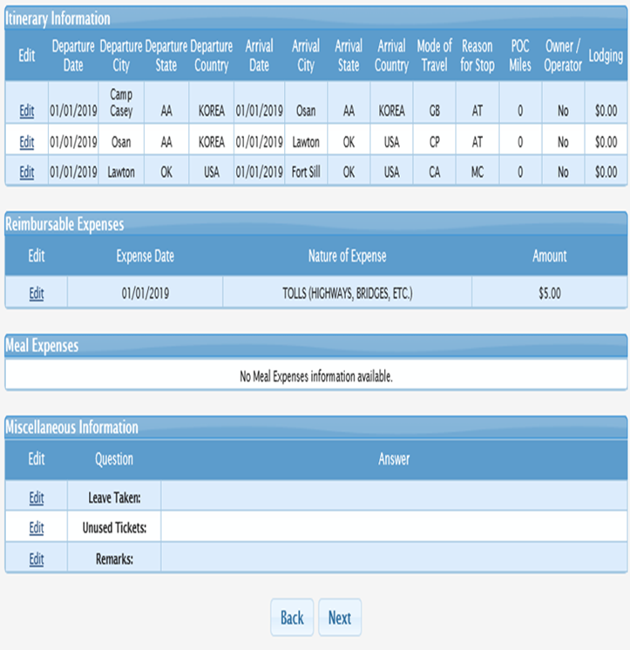
SMARTVOUCHER
Verify all of your information then select “Next”

Slide 28
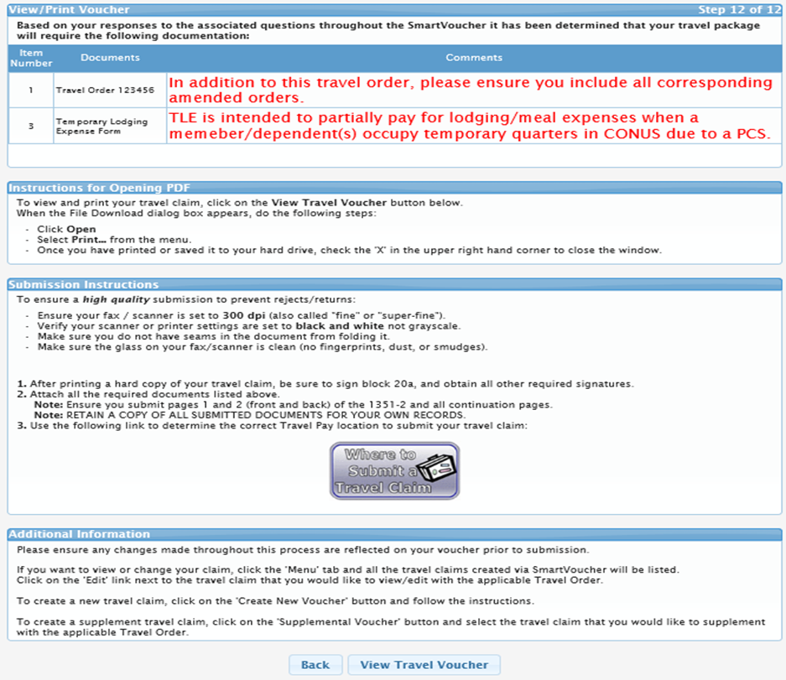
SMARTVOUCHER
Review these comments. If you need any supporting documents, Smart Voucher will let you know what is needed.
Click on “View Travel Voucher” to preview what your Smart Voucher will look like.

Slide 29
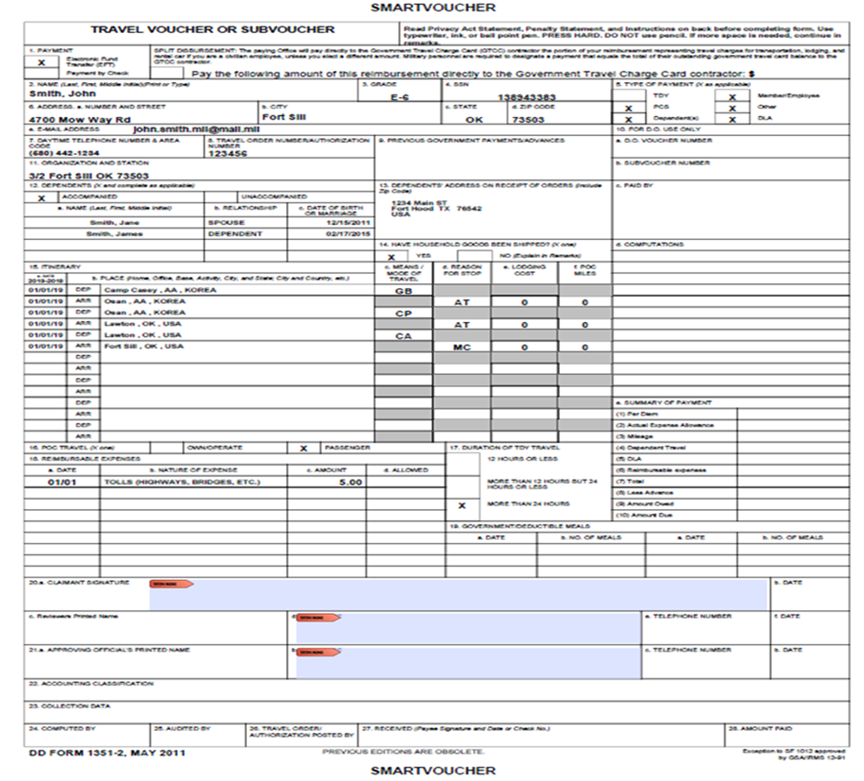
SMARTVOUCHER
This is your Smart Voucher generated travel voucher in PDF format.
From here, we will collect all your supporting documents (DA 31, orders and all amendments, plus any receipts).
We will send your travel voucher up to DFAS so that you will be reimbursed for your travel expenses.
Make sure to check your email or texts for updates!

Slide 30
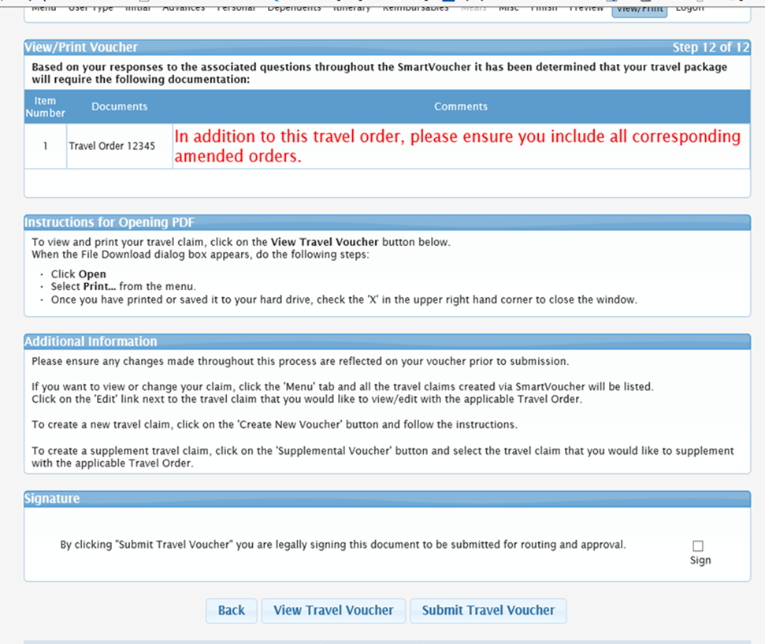
SMARTVOUCHER
Check the sign box
Click submit travel voucher
This does not submit your travel voucher to DFAS. This will submit the PCS Travel voucher to Fort Knox for Review. The voucher will be submitted to DFAS once everything is processed by the Reviewer.

Slide 31
SMARTVOUCHER
S1’s, HRNCO’s and Command Secretary’s Upload with Soldier
Upload all pages of PCS orders
Completed DA31
Command Certified DA5960 and Supporting documents (i.e. Marriage Certificates and Birth Certificates, Divorce Decree)
Any SDAP orders
TLE DFAS Form 9098 and Hotel receipt
Any receipt over $75.00
------------------------------------------------------------------------------------------
FOR ASSISTANCE, PLEASE CALL (502) 624-8010/8179.

