Slide 1
Reasonable Accommodation
Fort Knox Disability Program
U.S. Army Garrison
Fort Knox, Kentucky
i
Version 1.1 As of 09 Mar 2021

Slide 2
Fort Knox Garrison EEO Office
Staff
Fort Knox EEO Officer
(502) 624-1325
EEO Complaints Manager
(502) 624- 6196
Disability Program Manager
(502) 624-3171
DA Apprentice
(502) 624-3171
Office located at 52 Third Ave, Pike Hall, Building 1310 (on first floor), Suite 132
The ABC’s of the RA Packet

Slide 3
Reasonable Accommodation Packet
The ABC’s of the Reasonable Accommodation Packet
Applicable Laws

Slide 4
Applicable Laws
Rehabilitation Act of 1973 and Americans with Disabilities Act of 1990 as amended
Made it illegal to discriminate against a qualified person with a disability.
Made it illegal to retaliate against a person with a disability.
Requires employers to reasonably accommodate a known physical or mental limitations of qualified individuals with disabilities, unless it would impose undue hardship.
Key Terms

Slide 5
Key Terms
Individual with a “Disability”
An individual who has (i) a mental or physical impairment that substantially limits one or more major life activities, (ii) a record of such impairment, or (iii) is regarded as having such impairment.
“Qualified” individual with a Disability
A “qualified” individual with a disability satisfies the requisite skill, experience, education, and other job-related requirements of the position. The individual can perform the essential functions of the position with or without reasonable accommodation.
Key Terms Continued

Slide 6
Key Terms Continued
Reasonable Accommodation (RA)
A Reasonable accommodation (RA) is any change in the work environment or the way things are customarily done that would enable an individual with a disability to enjoy EEO. Three categories of reasonable accommodations are available for employees or applicants with disabilities:
(1) Modifications or adjustments to the application process to permit an individual with a disability to be considered for a job (for example, providing application forms in alternative formats such as large print or Braille).
(2) Modifications or adjustments necessary to enable a qualified individual with a disability to perform the essential functions of the job (for example, providing a sign language interpreter or teletype (TTY) device).
(3) Modifications or adjustments that enable IWDs to have equal benefits and privileges of employment (for example, removing physical barriers in buildings or providing wheelchairs or motorized scooters to facilitate easy access to buildings).
Key Terms Continued

Slide 7
Key Terms Continued
A Decision-maker is an agency official within the employee’s chain of command, usually the employee’s immediate supervisor. In the case of an applicant, the decision-maker will usually be the selecting official, an agency official in the selecting official’s chain of command, or an HR staff member assigned to process the vacancy (usually within the CPAC).
Department of Defense Computer/Electronic Accommodations Program (CAP)
https://www.cap.mil/
Processing Requests

Slide 8
Processing Requests for RA
Agency must make contact information for a RA available in the workplace by bulletin boards and WEB sites or handouts
Individual must inform the decision-maker of the need for an RA for reasons related to a medical condition
Can be done at any time, verbally or in writing
Not required to mention the Rehab Act, Reasonable Accommodation, or disability
Supervisor is responsible for Processing the RA Request
Supervisors will use the RA Packet to Process the request
Instructions and Forms required to process the request can be found in the RA Packet
Initiating a Request for RA

Slide 9
Initiating A Request for RA
Supervisor or Decision-maker must document the RA Request and provide a copy of the documentation to the DPM within 2 business days of the request
The Decision-maker must begin processing an oral request immediately upon receipt of the request and should not wait for written confirmation
A family member, health professional, or other representative may request a reasonable accommodation on behalf of an individual seeking reasonable accommodation. The decision-maker should confirm with the employee that the employee wants the accommodation
Processing RA Request – RA Packet

Slide 10
Processing a RA
RA Packet
Supervisor Engagement - Interactive Dialogue

Slide 11
Processing Requests for RA Continued
RA Begins with Supervisor engaging the individual
Interactive Dialogue:
Flexible discussion between the requester and the supervisor
Ask Relevant questions to assist in making an informed decision
Supervisor provides the employee with a FK 5099 Request Form
Entitled to know if the disability is covered under the Rehab Act
Disabilities not obvious, use the FK 5099a in obtaining medical documentation about the employee’s disability and functional limitations
Request for RA
Interactive Dialogue
Written Request & Medical Documents
Fort Knox Form 5099

Slide 12
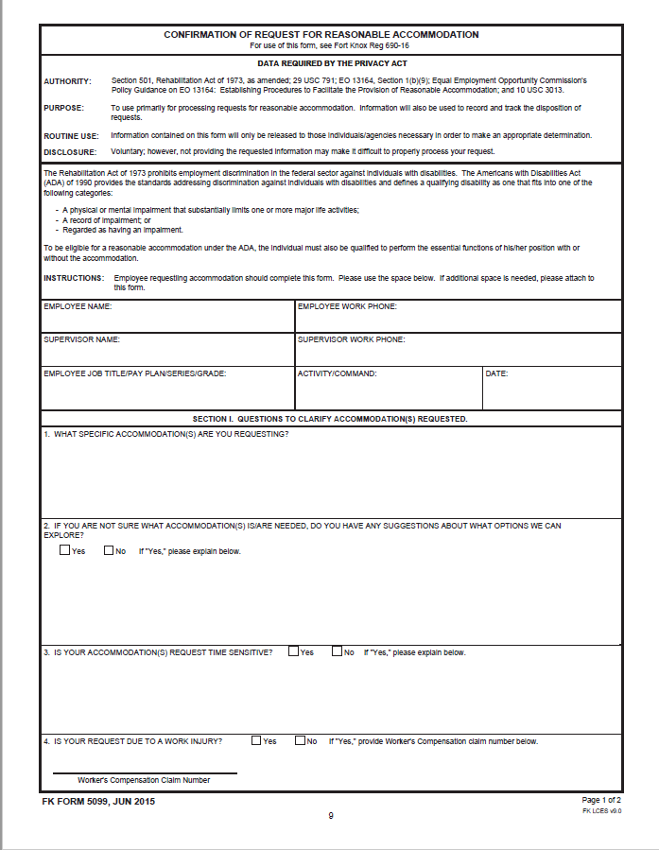
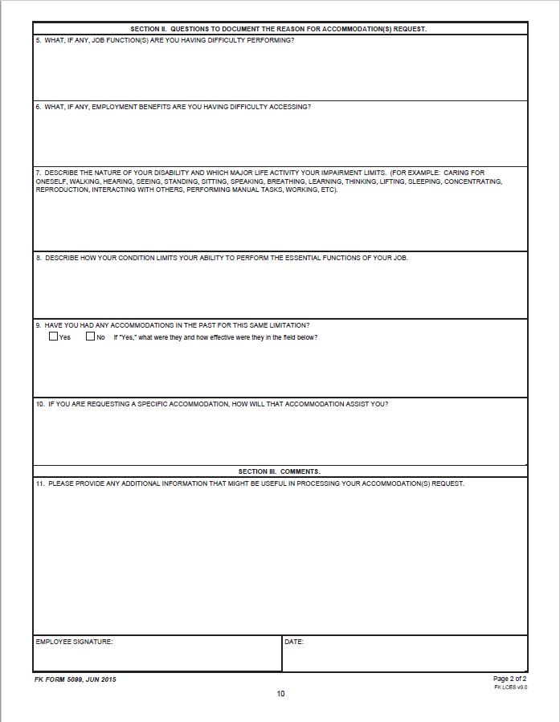
Processing a RA
Supervisor explains and provides the FK 5099 to the employee
Fort Knox Form 5099a

Slide 13
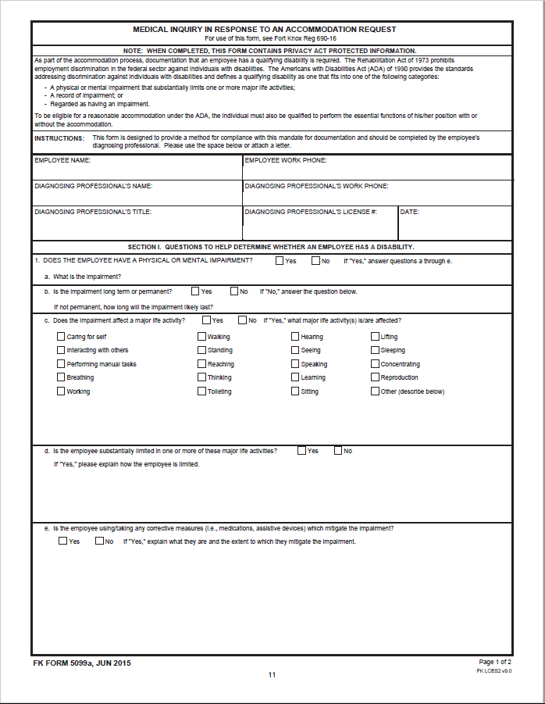
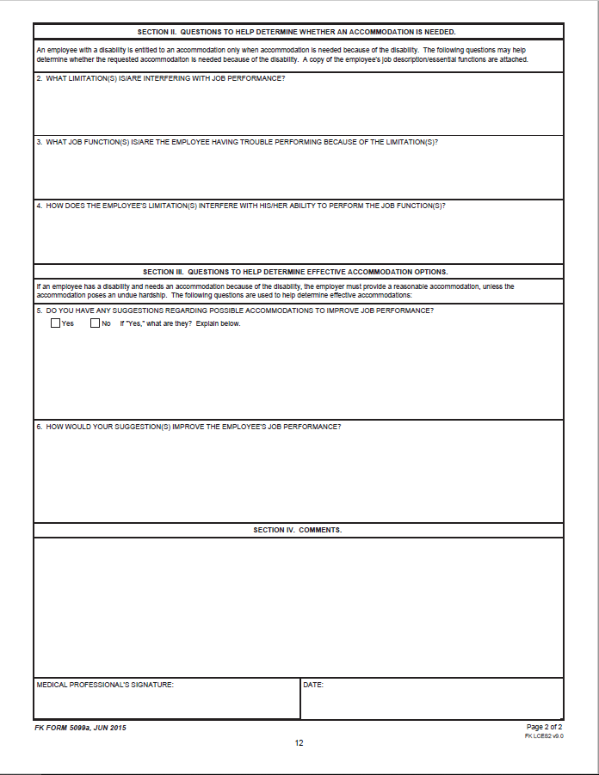
Processing a RA
Supervisor explains and provides FK 5099a to employee if additional medical documentation is needed
Interactive Dialogue

Slide 14
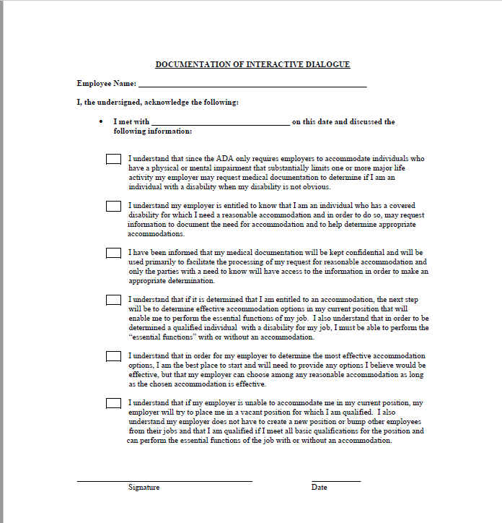
Processing a RA
Interactive Dialogue
Approval Authority

Slide 15
Processing Requests for RA Continued
Approval Authority
Supervisor:
Forward to appropriate official within 2 Days - to the Disability Program Manager (DPM) and the servicing labor counselor for information purposes
If Decision-maker does not grant the accommodation immediately they must consult directly with the DPM
Request for RA
Interactive Dialogue
Written Request & Medical Documents
Approval Authority Continued

Slide 16
Processing Requests for RA Continued
Approval Authority
Supervisor:
As soon as the Decision-maker determines that an accommodation will be provided they must immediately communicate the decision orally or in writing to the individual
If communicated orally they must follow up in writing through the use of the Information Report / in a Memo
For record keeping, a copy of the written decision will be forwarded to the DPM
Request for RA
Interactive Dialogue
Written Request & Medical Documents
Approval Authority Continued

Slide 17
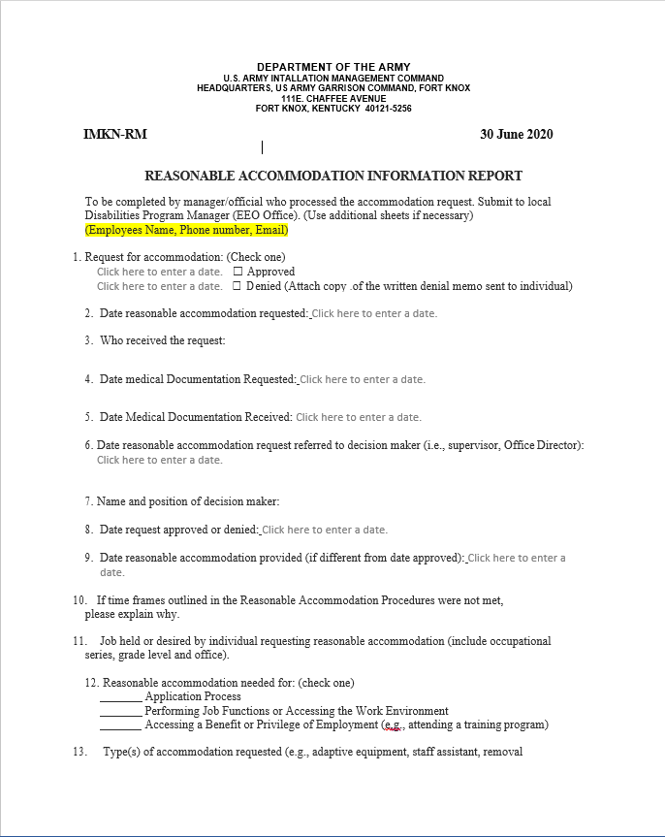
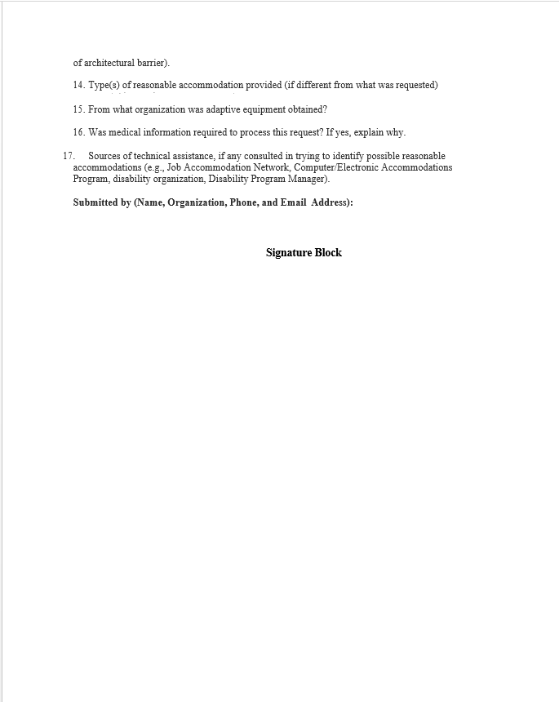
Processing a RA
Approval Authority – Information Report
Approval Authority Continued

Slide 18
Processing Requests for RA Continued
Approval Authority
Supervisor:
Absence of extenuating circumstances the RA should be granted, modified, or denied within 30 Business Days.
Request for RA
Interactive Dialogue
Written Request & Medical Documents
Approval/Denial of RA

Slide 19
Processing Requests for RA Continued
Approval/Denial
Decision-maker:
Must inform the DPM and Staff Judge Advocate before denying a request for accommodation of a particular accommodation requested
Must provide documentation that demonstrates the effort made to explore, with the requestor, other options for accommodations
Command/ Organization must obtain legal reviews for all proposed denials of an RA or the particular accommodation requested before informing the requestor of the denial
Denials of RA must be done in writing, using plain language and state the specific reason(s) for the denial
Denial of RA

Slide 20
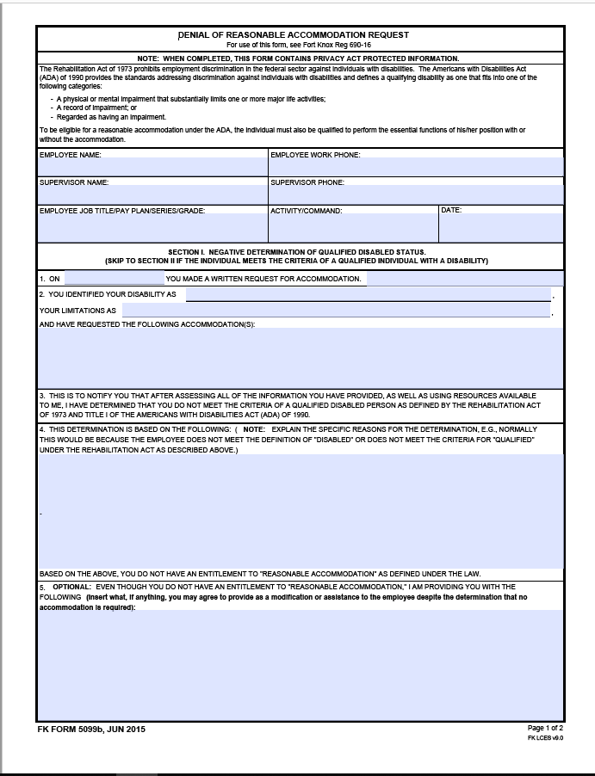
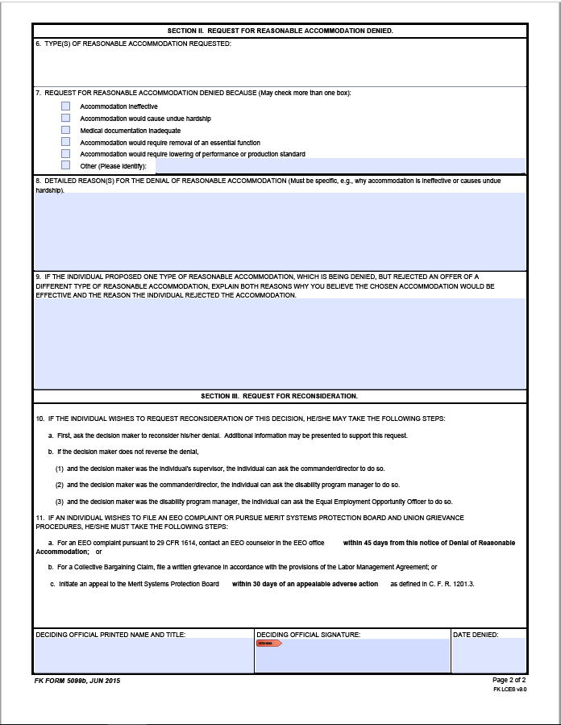
Denial of RA
Denial Form 5099b
Denial of RA Continued

Slide 21
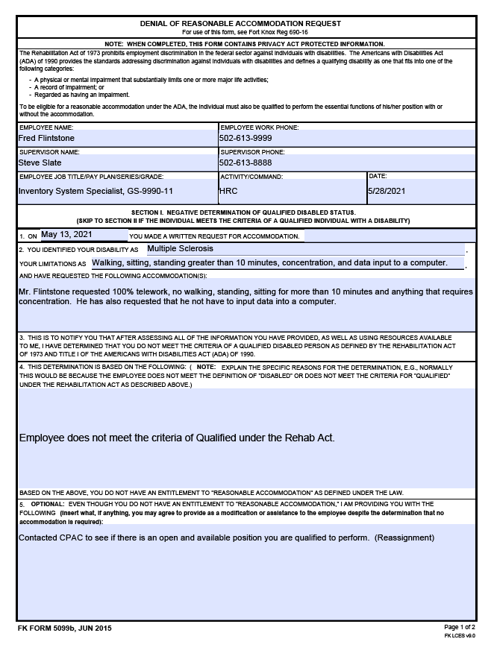
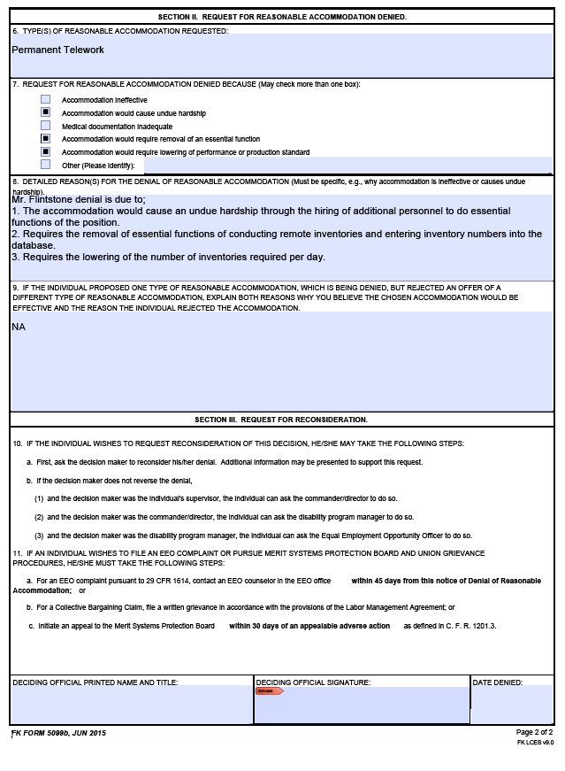
Denial of RA
Example of Denial Form 5099b
Denial of RA Continued

Slide 22
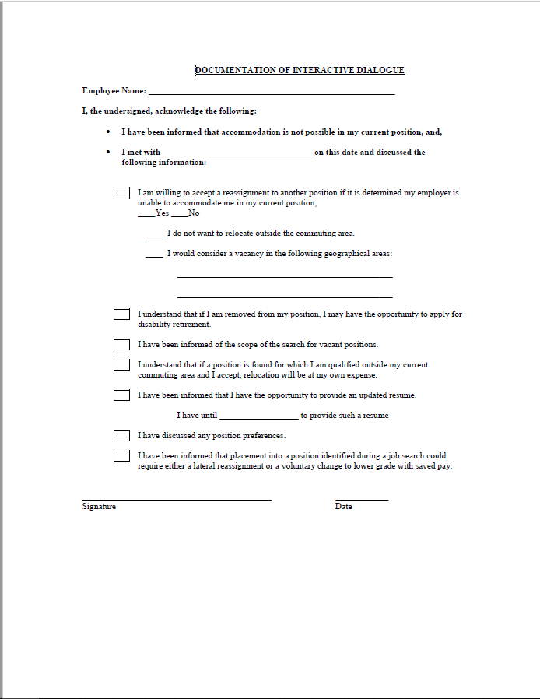
Denial of RA
Denial
Mistakes to Avoid

Slide 23
Mistakes to Avoid
Failing to explore multiple accommodations. Don’t make the mistake or simply settling into a struggle over whether you will adopt the one and only accommodation requested by an employee.
Failing to work with the employee, EEO, Employee/Labor Relations, or legal (OGC) to see if there are other feasible accommodations that are equally effective.
Tolerating unacceptable performance or conduct.
Tolerating unacceptable health or safety risks.
Telling other employees that an employee is receiving an accommodation: ADA prohibits employers from disclosing an employee’s “medical” information (with limited exceptions).
RA Resources

Slide 24
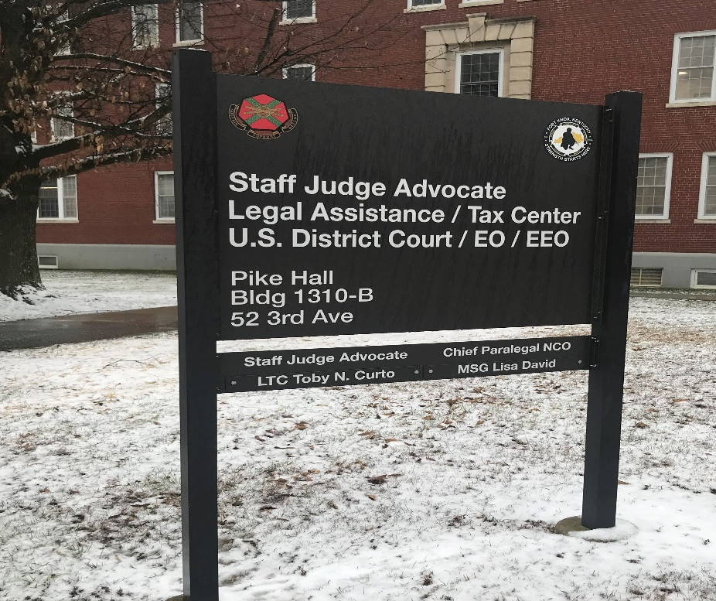
Resources Available
EEO Disability Program Manager
Human Resource Labor/Management Employee Relations
Legal (OGC)
https://www.cap.mil/
https://askjan.org/
End

Slide 25
Processing a RA
End of Brief
Disability Program Manager
(502) 624-3171
usarmy.knox.imcom-atlantic.mbx.eeo@mail.mil

