Slide 1
Installation Housing Office Plain Language Briefing
Annex F to OPORD 20-xxx – Plain Language Brief
USAG Fort Knox
As of 20 April 2020

Slide 2
Welcome to the Garrison Housing Office
The Fort Knox Housing staff are employed by the Army to assist Service Members and their Families with housing matters and advocate on their behalf with community partners/agencies both on and off the installation
The Housing Service Office (HSO) provides referral services and tenant/landlord dispute services
The Installation Housing Office provides oversight of the privatized company managing on post housing and provides tenant/landlord dispute services
The garrison Housing Manager manages the Installation Housing Office and reports directly to the Director, Public Works and garrison leadership
Garrison Leadership
Garrison Commander: COL CJ King
Garrison Command Sergeants Major: CSM William Fogle
Garrison Deputy Garrison Commander/Manager: Mr. Emmet Holley
Garrison Housing Manager: Mrs. Mary-Ellen Correia

Slide 3
Privatized Housing Contacts
Knox Hills LLC, sometimes referred to as the Residential Communities Initiative (RCI) Company, is the privatized company that owns and manages the family housing on this installation
Lend Lease is the private partner and managing member of Knox Hills LLC
Winn Residential is the property management company that manages the day to day operations of the privatized housing to include ensuring prompt and professional maintenance and repair, property concerns, and rent/billing issues. This is your landlord for privatized housing
Knox Hill Contacts:
Project Director: Mr. John Bredehoeft
Director Property Management: Mrs. Katie Huff
Maintenance Director: Mr. Brian King

Slide 4
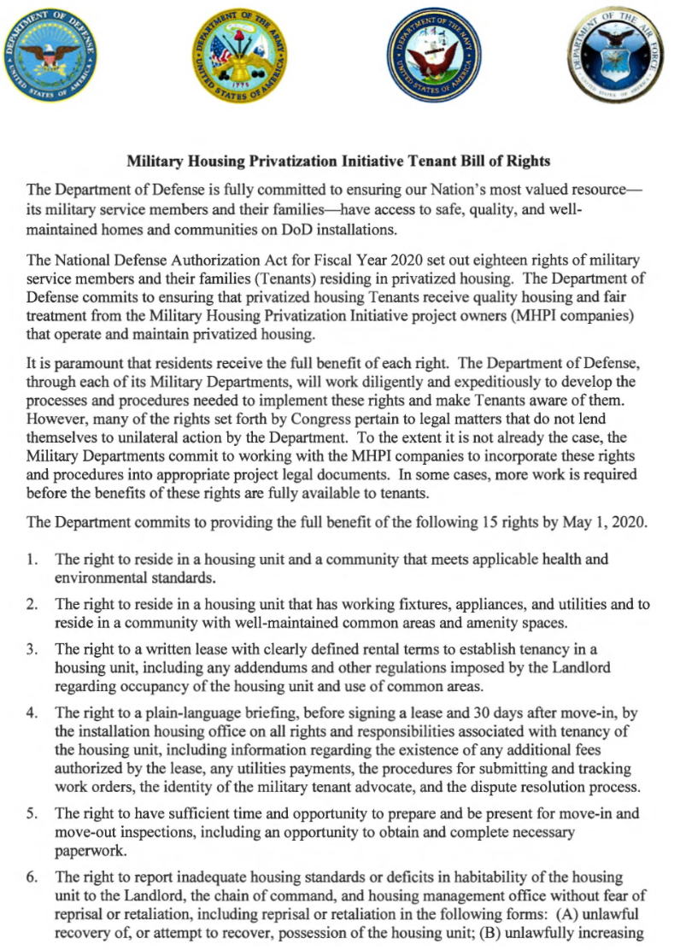
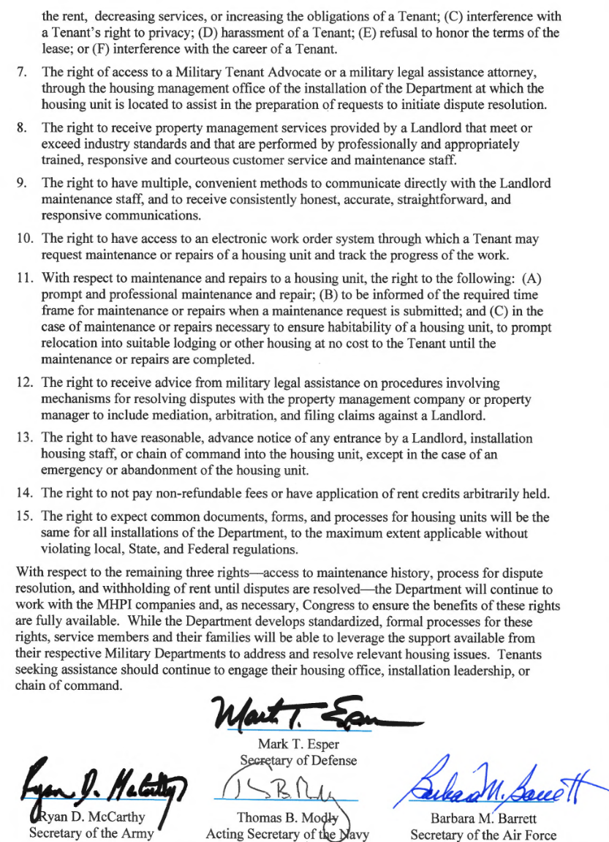
Privatized Housing - Tenant Bill of Rights
* Copy is available upon request

Slide 5
Privatized Housing - Tenant Bill of Rights
The Military Housing Privatization Initiative Tenant Bill of Rights requires the Garrison Housing Office provide a plain language brief to all residents of privatized housing prior to lease signing and again 30 days after move-in on all rights and responsibilities associated with tenancy of the housing unit
You have the right to reside in a housing unit and a community that meets applicable health and environmental standards. (Right 1)
You have the right to reside in a housing unit that has working fixtures, appliances, and utilities and to reside in a community with well-maintained common areas and amenity space. (Right 2)
You have the right to a written lease with clearly defined rental terms to establish tenancy in a housing unit, including any addendums and other regulations imposed by the Landlord regarding occupancy of the housing unit and use of common areas. (Right 3)
The right to a plain-language briefing, before signing a lease and 30 days after move-in, by the installation housing office on all rights and responsibilities associated with tenancy of the housing unit (Right 4)
You have the right to have sufficient time and opportunity to prepare and be present for move-in and move-out inspections, including an opportunity to obtain and complete necessary paperwork. (Right 5)

Slide 6
Privatized Housing - Tenant Bill of Rights
You have the right to report inadequate housing standards or deficits in habitability of the housing unit to the Landlord, the chain of command, and Installation housing office without fear of reprisal or realization, including (A) unlawful recovery of, or attempt to recover, possession of the housing unit; (B) unlawfully increasing the rent, decreasing services, or increasing the obligations of a tenant; (C) interference with a tenant’s right to privacy; (D) harassment of a tenant; (E) refusal to honor the terms of the lease; (F) interference with the career of the tenant (Right 6)
You have the right to access to a Military Tenant Advocate or a military legal assistance attorney, through the Installation housing office to assist in the preparation of requests to initiate dispute resolution (Right 7)
The right to receive property management services provided by the Landlord that meet or exceed industry standards and that are performed by professionally and appropriately trained responsive and courteous customer service and maintenance staff. (Right 8)
The Fort Knox Installation Housing Office serves as your Military Tenant Advocate.
Mary-Ellen Correia, Housing Division Chief
usarmy.knox.imcom-atlantic.mbx.dpw-housing-division@mail.mil

Slide 7
Privatized Housing - Tenant Bill of Rights
You have the right to receive advice from military legal assistance on procedures involving mechanisms for resolving disputes with the property management company or property manager in include mediation, arbitration, and filing claims against the Landlord. (Right 12)
SJA Legal Assistance Office: (502) 624-2771
You have the right to have multiple, convenient methods to communicate directly with the privatized Landlord maintenance staff, and to receive consistent, honest, accurate, straightforward and responsive communications. (Right 9)
You have the right to have access to an electronic work order system through which a tenant may request maintenance or repairs of a housing unit and track the progress of the work. (Right 10)
Knox Hills
Maintenance Shop Contact Number: (502) 799-6565
Maintenance Shop Location: 144 S. Conroy Ave.
Maintenance Website: www.rentcafe.com/residentservices/knox-hills/userlogin.aspx

Slide 8
Privatized Housing - Tenant Bill of Rights
You have the right to the following: (A) prompt and professional maintenance and repair; (B) to be informed of the required time frame for maintenance and repairs when a maintenance request is submitted; and (C) in the case of maintenance or repairs necessary to ensure habitability of a housing unit, to prompt relocation into suitable lodging or other housing at no cost to the tenant until the maintenance or repairs are completed. (Right 11)
Displaced Resident Policies
ASAIE&E Memorandum, SAIE, Feb 14, 2020, Army Residential Communities Initiative Company Minimum Standard Resident Displacement Guidelines
ASAIE&E Memorandum, SAIE, Jan 23, 2020, Subject: Procedures for Approving Privatized Housing Habitability after Remediation, Mitigation, Stabilization and abatement
IMCOM Memorandum, Headquarters Installation Management Command, IMPW-H, JAN 31 2020, subject: Procedures for Certifying Housing Habitability for Army Family Housing, Leased Housing, Unaccompanied Housing and Privatized Homes
IMCOM Memorandum, Headquarters Installation Management Command, IMPW-H, MAR 11 2020, subject: Command Guidance Army Residential Communities Initiative (RCI) Company Minimum Standard Resident Displacement Guidelines
ASA IE&E Memorandum, Dated XXX,
“Housing Maintenance Quality Assurance and Environmental Hazard Oversight Program” provides
clear standards and details of required oversight of Army housing maintenance
* Copy is available upon request

Slide 9
Privatized Housing - Tenant Bill of Rights
Residents may initiate service requests 24 hours a day, seven days a week by calling (502)799-6565 or, for routine requests, by submitting an online service request through the Military Cafe resident portal or the Knox Hills website. Residents can obtain a Permission to Enter (PTE) form at their community office, which authorizes maintenance to complete repairs in the home requested by the resident without their presence. A PTE is required to submit a routine service request online. Residents who do not authorize a PTE must be present at the time service is performed. Residents can track the progress of a service request submitted through the Military Café.
Emergency calls are defined as the following: Gas leaks, all toilets clogged, multiple plumbing fixtures backed up, only tub or toilet backed up, uncontained water leaks, total power outages, lock outs, smoke or carbon monoxide detectors in full alarm, no hot water and first floor doors or windows that cannot be secured
Urgent calls are those that are not an emergency, but require quick attention. Typical calls include contained water leaks, one of two or more toilets or sinks clogged or a partial power loss (example: no power upstairs).
Routine service calls are those that do not meet the definition of emergency or urgent service calls. The dispatcher will review work requirements and notify residents of approximate date or time that service can be expected. Residents should promptly report repairs that are beyond the capability of the resident to Knox Hills for action.

Slide 10
Privatized Housing - Tenant Bill of Rights
Work order or maintenance ticket to be closed only once the tenant and Installation Housing Office signs off
The right to have reasonable advance notice of any entrance by the Landlord, Installation housing staff, or chain of command into the housing unit, except in the case of an emergency or abandonment of the housing unit. (Right 13)
Knox Hills provides a 48-hour notice prior to entering the home.
The 48-hour notice is provided to the resident by email and phone. If no response from resident, Knox Hills posts a 48-hour notice to enter home on the front door of the residence.
The right to not pay non-refundable fees or have application of rent credits arbitrarily withheld. (Right 14)
Knox Hills does not charge any non-refundable fees.
The right to expect common documents, forms, and processes for housing units will be the same for all Army Installations, to the maximum extent applicable without violating local, state, or federal regulations. (Right 15)

Slide 11
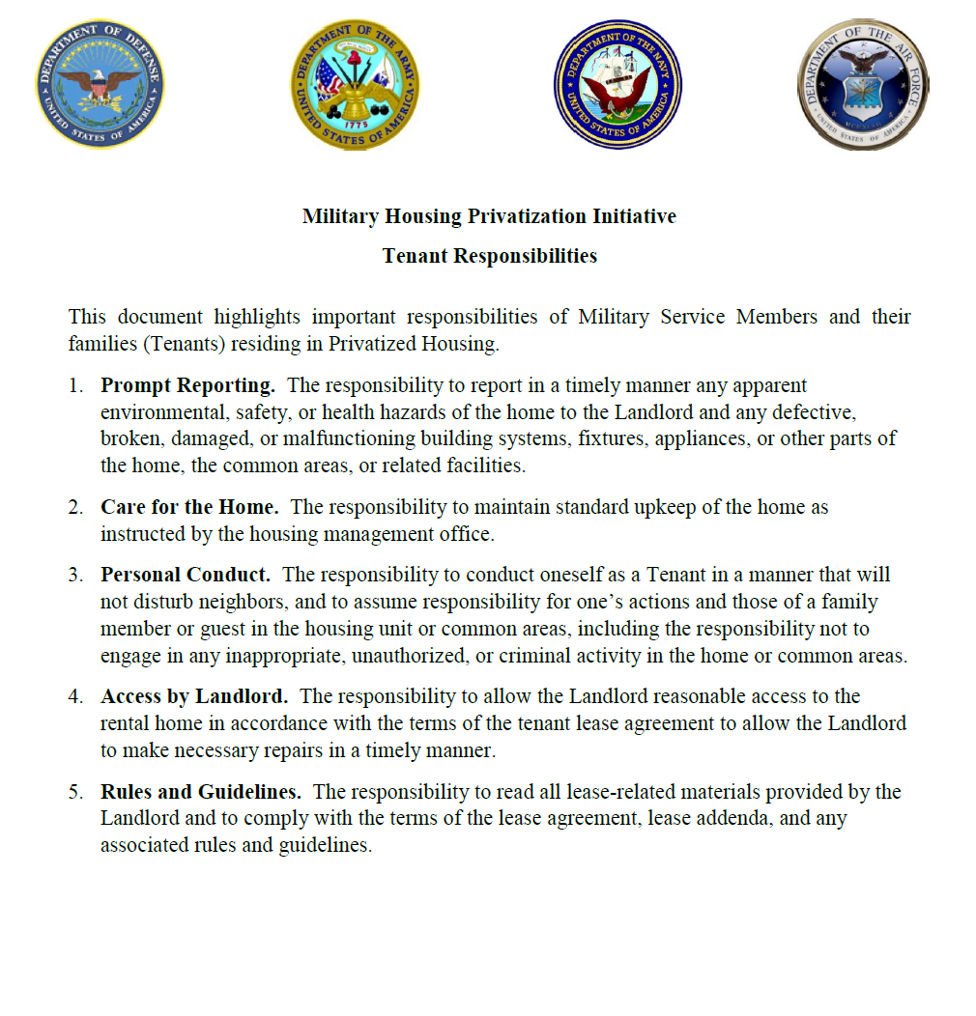
Privatized Housing – Tenant Responsibilities
* Copy is available upon request

Slide 12
Privatized Housing – Tenant Responsibilities
The Military Housing Privatization Initiative Tenant Bill of Rights highlights 5 important responsibilities for Service Members and their Families while they reside in privatized family housing.
The responsibility to report in a timely manner any apparent environmental, safety, or health hazards of the home to the Landlord and any defective, broken, damaged, or malfunctioning building systems, fixtures, appliances, or other parts of the home, the common areas, or related facilities.
The responsibility to maintain standard upkeep of the home as instructed by the housing management office.
Residents are required to perform minor maintenance tasks in their home before calling the maintenance service desk. Such tasks include plunging toilets and sinks, tightening screws on hinges, replacing light bulbs, resetting garbage disposals and other simple maintenance tasks that can be done without specialized training or tools.
Residents are asked to change the furnace filters in the home monthly.
Knox Hills provides weekly trash/bulk trash pick-up to residents and bi-weekly (twice per month) recycle pick-up. Residents are provided with one trash bin and one recycle bin at move in. Knox Hills cannot accept hazardous materials, propane tanks, refrigerators, air conditioners, tires, batteries or mattresses of any size. Residents should contact their community office for disposal of specific items.
Residents are required to mow grass and perform leaf removal in fenced-in areas of their yard, as well as one foot outside the fence line, weed flower beds and trim bushes as needed.
Residents are responsible to remove snow from driveways, porches and sidewalks within 24 hours after a snowfall.

Slide 13
Privatized Housing – Tenant Responsibilities
The responsibility to conduct oneself as a Tenant In a manner that will not disturb neighbors, and to assume responsibility for one’s actions and those of a family member or guest in the housing unit or common areas, including the responsibility not to engage in any inappropriate, unauthorized, or criminal activity in the home or common areas.
Resident responsibilities and policies, including actions deemed minor and major violations, are highlighted the Knox Hills Resident Guide.
Quiet hours for residents are the same as defined by Fort Knox, which is 10 p.m. to 6 a.m.
The Knox Hills Resident Guide is available for review and download on the Knox Hills website at https://winnmilitary.entrata.com/media_library/12710/5b0eaaf6cc7d32.53842657587.pdf
The responsibility to allow the Landlord reasonable access to the rental home in accordance with the terms of the tenant lease agreement to all the Landlord to make necessary repairs in a timely manner.
The responsibility to read all lease-related materials provided by the Landlord and to comply with the terms of the lease agreement, lease addenda, and any associated rules and guidelines.

Slide 14
Garrison Housing Services Office (HSO)
The goal of the HSO is to implement and maintain a high quality worldwide resource for relocation services that is innovative, comprehensive, and the first choice of information and support when Soldiers and families relocate.
Non-discriminatory listings of adequate and affordable rental and for-sale housing
Counseling/referral on eligible installation services (i.e. legal, education, Exceptional Family Member Program)
Preliminary inquiries to validate housing discrimination complaints
Liaison with community and government officials / organizations (on and off post)
Housing data exchange with other DoD housing offices
Liaisons with Army Community Services in support of the Housing Relocation Assistance Program
Housing market area data for use in developing market analyses Rental negotiations and lease review

Slide 15
Garrison Housing Services Office (HSO)
One-Stop, Full Service from Arrival to Departure for the Following:
Home buying counseling
Landlord-tenant dispute resolution
Basic Allowance for Housing (BAH) data submission
Property inspections
NEW---Per FY20 NDAA: If tenant is not available for pre-assignment walkthrough inspection, Housing Office must attend on tenant's behalf
NEW---Per FY20 NDAA: The Housing Manager shall initiate contact with resident 15 day and 60 days after move in regarding the satisfaction of the resident.
Administrative assistance with utility company fees/deposits, connections, and billings
Informational briefings (in- and out-processing, entitlements),community outreach

Slide 16
Furniture Safety & Additional Information
Tenants are permitted to anchor any furniture, television, or large appliance to the wall of the unit for purposes of preventing such item from tipping over without incurring a penalty or obligation to repair the wall upon vacating the unit if the Landlord does not anchor the furniture for the tenant.
Mission: U. S. Army Garrison Fort Knox delivers and integrates base support to enable training, force projection, and Soldier and Family Readiness.
Vision: Fort Knox is the Army’s premier installation to live on, work at, and deploy from, and come home to.
The strength of our nation is our armed forces. The strength of our armed forces is our service members. The strength of our service members comes from the strength of their Families. Fort Knox recognizes that the selfless dedication and commitment of our Families directly contributes to the readiness of our Soldiers. Families are the force behind the force. Here at Fort Knox we want you need to know that you're just as valuable as your Soldier. To express that, Fort Knox makes a special effort to bring together, and make available a large number of resources and benefits. Fort Knox is committed to our service members and their Families, providing a strong, supportive environment that enhances their strength and resilience.

Slide 17
End of Brief

