Slide 1

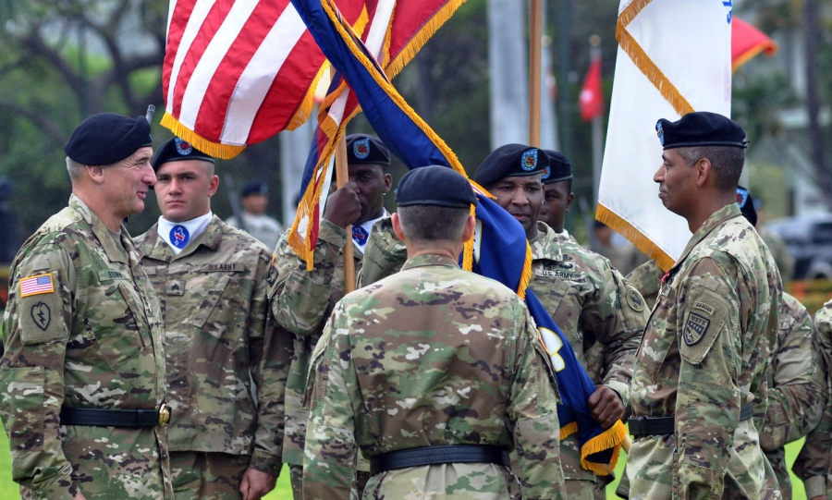
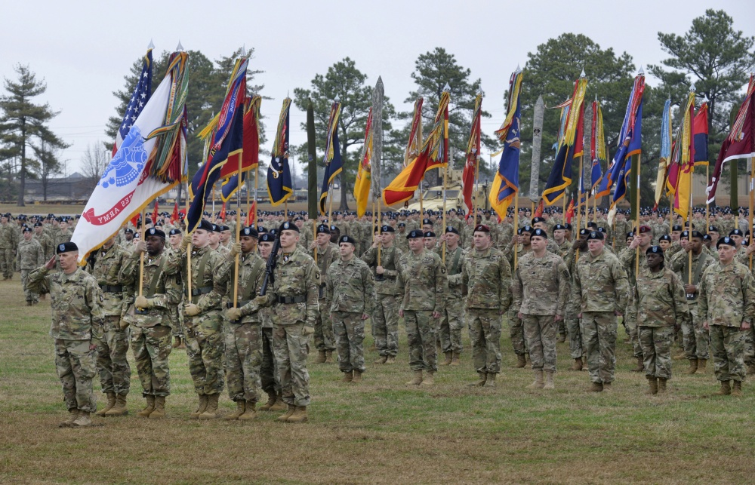
Intermediate Leader PME Equal Opportunity Training
Notes:
Show Slide 1. Show Slide: (Equal Opportunity Training Intermediate Leader PME Level V)
Read: Welcome to the Army's Equal Opportunity (EO) Program module for Intermediate Leaders. This includes: Advanced and Senior Leaders Courses, Captains Career Course, and Warrant Officer Advanced Course. We will be referring to AR 600-20, Army Command Policy, dated 6 November 2014 and all related messages governing equal opportunity during today's lesson.
Strong leadership that develops effective teams is the key to success on the battlefield. Not only must Soldiers share a common belief in the cause for which they fight, but mutual respect, trust, and confidence must prevail in every unit. The Army's Equal Opportunity Program fosters a climate of mutual respect and trust among Soldiers.
As Leaders, you directly affect Soldiers' lives by the way you support the Equal Opportunity Program in your unit. A unit that has no tolerance for violation of the EO categories (race, color, national origin, religion, sex (including gender identity), or sexual orientation) will be a successful unit. You are key to a successful Equal Opportunity Program.

Slide 2
Terminal Learning Objective
Action | Demonstrate understanding of the Army’s Equal Opportunity (EO) Program and Complaint Process
Conditions | Given regulatory requirements and instructor led scenarios/situations
Standards | Correctly apply regulatory requirements to provided scenarios
Notes:
Show Slide 2. (Terminal Learning Objective)
Note. Inform the students of the following Terminal Learning Objective requirements.
READ: At the completion of this lesson, you [the student] will be able to demonstrate understanding of the Army’s Equal Opportunity (EO) Program and Complaint Process by correctly applying regulatory requirements to provided scenarios.

Slide 3

Key Terms
The Army EO Program
Fair Treatment
Prejudice
Discrimination
Notes:
Show Slide 3. (Key Terms)
Note: Click for first bullet (• The Army Equal Opportunity Program)
Read: The standards for “The Equal Opportunity Program in the Army” are found in Chapter 6 of Army Regulation 600-20, Army Command Policy and it states, "The Army will provide equal opportunity and fair treatment for military personnel and Family members without regard to race, color, national origin, religion, sex (including gender
identity), or sexual orientation which are known as the Bases of Discrimination".
The Army will also provide an environment free of unlawful discrimination and offensive behavior. The EO Policy applies both on and off post, during duty and non- duty hours, working, living, recreational environments (both on and off-post housing), and utilizing electronic media.
Note: Click for second bullet (• Fair Treatment)
Ask: What do you think fair treatment should be based on? Solicit 2-3 student responses
Read: The EO Program formulates, directs, and sustains a comprehensive effort to maximize human potential and ensure fair treatment for all persons based solely on merit, fitness, and capability in support of readiness.
Ask: Why do you think a person would not receive fair treatment based on merit, fitness and capability?
Solicit 2-3 responses from students
Note: Click for third bullet (• Prejudice)
Read: Prejudice may be a word that comes to mind when you think of someone who does not receive fair treatment. Prejudice is defined as pre-judging a person or group without knowledge of facts. Prejudice exists on three levels: cognitive, emotional, and action oriented.
Ask: What are some examples of emotional prejudice? Solicit 2-3 examples from students
Note: e.g. “I can’t buy a house because Jews are hoarding all the property”, “I don’t feel safe anymore because of all the Muslims in America”.
Read: The last level of prejudice is action-oriented. This is the positive or negative predisposition to engage in discriminatory behavior. Action oriented prejudice can be an implied tendency to behave in discriminatory ways.
Note: Click for fourth bullet (• Discrimination)
Ask: What do you think is the difference between prejudice and discrimination? Solicit 2-3 student responses
Read: Prejudice plus action results in discrimination. Discrimination is any action that unlawfully or unjustly results in unequal treatment of persons or groups based on race, color, national origin, religion, sex (including gender identity), or sexual orientation.
Read Scenario:
Four minority Soldiers were conversing when a majority male Lieutenant opened the door adjacent to the S4 section, took a step into the office and feigned as if he was startled or taken aback. The Lieutenant continued into the office and made the comment as he passed, “Oh, I thought I was about to get jumped”.
Ask: What stereotypes are portrayed in this scenario?
Possible responses: minorities are in gangs, minorities are prone to violence.
Ask: Did the Lieutenant's behavior discriminate against the minority Soldiers?
Note: Allow students to offer there opinions based on the limited information provided. This was an actual case and was filed by the complainant under race discrimination, based on the evidence the complaint was unsubstantiated, but the officer was given a letter of concern for his actions.
Ask: Define discrimination?
Answer: Discrimination is any action that unlawfully or unjustly results in unequal treatment of persons or groups based on one of the bases of discrimination.
Read: After discussing the key terms within EO and providing you the bases of discrimination, we will now go into more detail on each basis.

Slide 4
Bases of Discrimination
Color
Religion
Race
National
Origin
Sex
(including gender identity)
Sexual Orientation
Notes:
Show Slide 4. (Bases of Discrimination)
Read: In accordance with Department of Defense (DoD) Directive 1020.02E, Diversity Management and Equal Opportunity in the DoD, there are six bases of discrimination. The bases of discrimination are race, color, national origin, religion, sex (including gender identity), or sexual orientation.
Ask: What is the definition or give an example of race discrimination? Solicit 2-3 student responses
Read: Race discrimination involves treating someone unfavorably because he/she is of a certain race or because of personal characteristics associated with race (such as hair texture, skin color, or certain facial features).
Note: The Office of Management and Budget (OMB) recognizes five race groups.
American Indian or Alaska Native. A person having origins in any of the original peoples of North and South America (including Central America) and who maintains tribal affiliation or community attachment.
Asian. A person having origins in any of the original peoples of the Far East, Southeast Asia, or the Indian subcontinents including, Cambodia, China, India, Japan, Korea, Malaysia, Pakistan, the Philippine Islands, Thailand, and Vietnam.
Black or African American. A person having origins in any of the black racial groups of Africa.
Native Hawaiian or other Pacific Islander. A person having origins in any of the original peoples of Hawaii, Guam, Samoa, or other Pacific Islands.
White. A person having origins in any of the original peoples of Europe, the Middle East, or North Africa.
Ethnicity is a cultural concept in which a large number of people who share learned or acquired traits and close social interaction regard themselves and are regarded by others as constituting a single group on that basis. Ethnicity differs from race in that members within a racial category may identify with one or more ethnic groups based on cultural or national origin characteristics (e.g., customs, traditions, language) either retrained or passed on through generations.
The two ethnic groups are:
1. Hispanic or Latino, A person of Cuban, Mexican, Puerto Rican, South or Central American, or other Spanish culture of origin, regardless of race.
2. Not Hispanic or Latino
Culture is physical or material objects as well as the nonmaterial attitudes, beliefs, customs, lifestyle, and values shared by members of a society and transmitted to the next generation. All people within an ethnic group do not necessarily share the same culture (Hispanics).
Ask: What do you think is the current state of race relations in the military versus civilian life?
Solicit 2-3 student responses
Read: As previously discussed, racism is any attitude or action of a person which subordinates a person or group because of skin color or race.
Ask: How is color discrimination different than race discrimination? Give an example or argument to support your response.
Solicit 2-3 responses from students
Note: In Korea, the paler your skin the more status or affluence you are considered to have. Darker skinned Koreans are seen as manual workers and less affluent. This is a form of color discrimination.
Ask: Can color discrimination occur when the victim is white? Give an example or argument to support your response.
Solicit 2-3 responses from students
Note: Race/color discrimination can also involve treating someone unfavorably because the person is married to (or associated with) a person of a certain race or color or because of a person’s connection with a group that is generally associated with people of a certain color.
Read: National Origin discrimination involves treating people unfavorably because they are from a particular country or part of the world, because of ethnicity or accent, or because they appear to be of a certain ethnic background.
Note: National Origin discrimination also involves treating people unfavorably because they are married to (or associated with) a person of a certain national origin or because of their connection with an ethnic organization or group. Discrimination can occur when the victim and the person who inflicted the discrimination are the same national origin.
Ask: Do you think national origin discrimination is prevalent today? Give an example or argument that does not include race/ color discrimination to support your response. Solicit 2-3 responses from students
Note: e.g. While reciting the Soldiers Creed, a Drill Sergeant would not allow a Soldier born in Russia to say, “I am an American Soldier”, the Soldier had to respond with, “I am a Russian Soldier”.
Read: Religious Discrimination involves treating a person unfavorably because of his/her religious beliefs. Religious discrimination can also involve treating someone differently because that person is married to (or associated with) an individual of a particular religion or because of his/her connection with a religious organization or group.
Ask: Can someone file a religious discrimination complaint if they do not belong to an organized religion? Give an example or argument to support your response.
Note: The law protects not only people who belong to traditional, organized religions, such as Buddhism, Christianity, Hinduism, Islam, and Judaism, but also others who have sincerely held religious, ethical, or moral beliefs. It also affords protection for non- religious personnel.
Read: Sex discrimination (including gender identity, which is a form of sex discrimination) involves treating someone unfavorably because of that person’s sex. It also can involve treating someone less favorably because of his/her connection with an organization or group that is generally associated with people of a certain sex.
Ask: What are some examples of sex discrimination or sexist behavior? Solicit 2-3 responses from the students
Note: Sexism is defined as the attitude or belief that one sex is superior to another. This also includes discrimination against an individual because of gender, gender identity, or transgender status.
Read: Sexual Orientation discrimination refers to unlawful discrimination based on a person’s emotional, romantic, and sexual attraction to individuals of a particular gender.
Ask: What are some examples of discrimination based on sexual orientation?
Note: e.g. Platoon Sergeant prefers lesbian female Soldiers because they are “less maintenance and don’t get pregnant”.
Read Scenario:
The complainant claims the subject (black) NCO has been discriminating against the complainant and other Soldiers within the section on several occasion based on their race (Caucasian). A recent comment before deploying to Atropia made to the complainant was, “You and your white privilege can only take you so far, you’re still a private in my Army.” This was in response to the complainant asking to use the open door policy and speak with the Brigade Command Sergeant Major.
Ask: Is this discrimination? If so, what type?
Note: This was an actual case based on race discrimination and was unsubstantiated, no punishment or administrative actions taken.
Ask: What would you as a commander or 1SG do if a Soldier came to you with this complaint instead of the EOA?
Note: The only wrong answer is to do nothing. Options include handling it through counseling, doing an investigation, requesting mediation from the EOA.
Ask: Are commander's required to have an open door policy?
Note: Yes, IAW AR 600-20 commanders will have an open door policy. The timing, conduct, and specific procedures of the open door policy are determined by the commander. Commander's are responsible for ensuring that Soldiers are aware of the command's open door policy.
Read Scenario: The complainant, a male specialist, had unpleasant and offensive interactions with a fellow Soldier, another males specialist, in the company. He felt that this behavior was directed at him due to his sexual orientation. Subject made slanderous comparisons between the complainant and an evil pedophile and homosexual fictional character, refusing to call complainant anything but the character's name. Subject has made sexual innuendos to imply that the complainant would be interested in homo erotic scenarios. Subject has also seemingly made it his mission to be disagreeable and outright disrespectful to the complainant and his boundaries with every passing interaction. The complaint against the subject is the use of disparaging terms in reference to the complainants sexual orientation. This has caused a toxic work environment and has brought injury to unit cohesion.
Ask: Is this discrimination? If so, what type?
Note: This was an actual case based on sexual orientation discrimination and was substantiated, UCMJ given (filed locally due to subject being a SPC).
Read: Knowing the bases of discrimination is not enough to ensure you have a positive command climate, you must also understand how those bases tie into related EO issues. One related issue is religious accommodations.

Slide 5
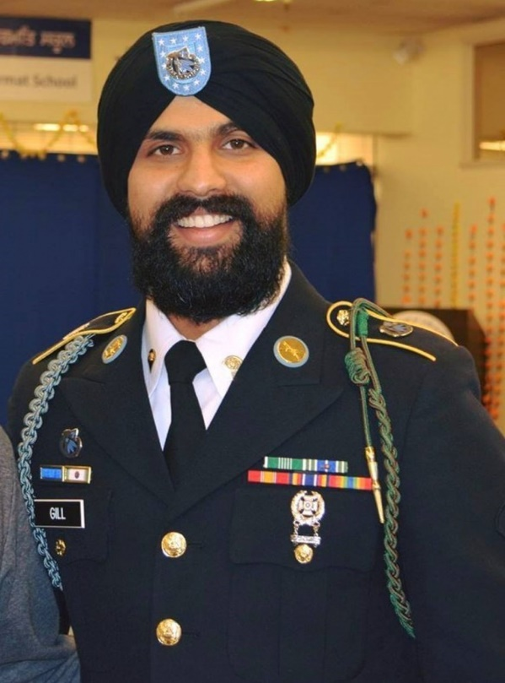
Religious Accommodation
5 Major Areas of Accommodation
Worship
Dietary
Medical
Wear and Appearance
Grooming Practices
Notes:
Show Slide 5. Religious Accommodation
Read: The Army places a high value on the rights of its Soldiers to observe tenets of their respective religions or to observe no religion at all. There are five major areas of accommodation. Worship, dietary and medical accommodations may be approved by the local commander. Accommodations for wear and appearance of the uniform and grooming practices will be forwarded to the Deputy Chief of Staff (DCS), G-1 for approval. The results will be permanently filed in the requestor’s Army Military Human Resource Record (AMHRR).
Note: All approved religious accommodation waivers will continue throughout the individual's career. Submission of a new request for accommodation is not required unless the Soldier has a break in service longer than 365 days or is requesting a modification of a previously approved waiver.
Ask: Are commanders required to approve religious accommodation requests? Solicit 1-2 student responses
Note: Requests for individual expressions of sincerely held beliefs (conscience, moral principles, or religious beliefs) should be approved when accommodation does not adversely affect:
Unit and individual readiness
Unit cohesion
Morale and good order and discipline
Safety and/or Health
Scenario: My supervisor, SGT Janowski consistently harasses me about my religion. I am Muslim and the only Muslim service I have found in Korea is in Seoul. That is a 1.5 hour bus ride from where I work. The service is held Fridays at 1400. I must catch the 1100 bus to make it to service on time. I have attended for 3 Fridays. On the last Friday I attend, SGT Janowski called and texted my phone throughout service and threatened me if I did not pick up. He now tells me I will not be allowed to attend services anymore. I asked him to see the commander on the open door policy and he told me no. I have looked at the religious accommodation information and I think SGT Janowski is wrong to not let me go to service since it does not interfere with mission accomplishment.
Ask: Is SGT Janowski allowed to deny this Soldier the right to attend worship service? Solicit 1-2 student responses.
Ask: Is this religious discrimination?
Note: Only commanders are authorized to approve or disapprove religious accommodation. It is possible this is religious discrimination. If it is found that the Soldier attending the service does not adversely affect unit and individual readiness, unit cohesion, morale and good order and discipline, and or safety and/or health, then SGT Janowski could be in violation of EO policy.

Slide 6
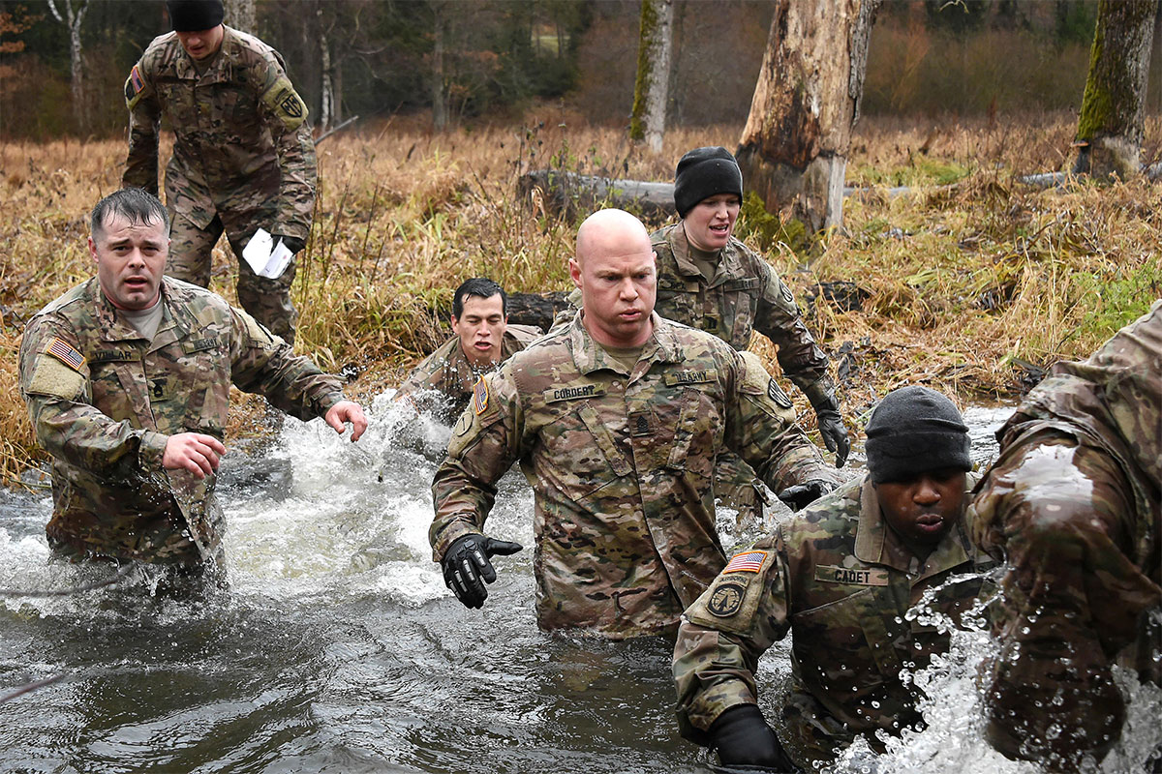
Harassment
Hazing
Bullying
Retaliation/Reprisal
Responsibilities
Administrative and Disciplinary Action
Notes:
Show Slide 6. Harassment
Image: Senior leaders with the 18th Military Police Brigade cross a creek during the brigade's first senior leader physical challenge at the 7th Army Training Command's Grafenwoehr Training Area, Germany, Nov. 28, 2017. The purpose of the senior leader physical challenge is to execute a team building training session which includes a series of physical and mentally demanding obstacles. (U.S. Army photo by Gertrud Zach)
Ask: What is considered harassment? Solicit 1-2 student responses.
Read: HARASSMENT. Behavior that is unwelcome or offensive to a reasonable person, whether oral, written, or physical, that creates an intimidating, hostile, or offensive environment. Harassment can occur through electronic communications, including social media, other forms of communication, and in person. Harassment may include offensive jokes, epithets, ridicule or mockery, insults or put-downs, displays of offensive objects or imagery, stereotyping, intimidating acts, veiled threats of violence, threatening or provoking remarks, racial or other slurs, derogatory remarks about a person’s accent, or displays of racially offensive symbols. Activities or actions undertaken for a proper military or governmental purpose, such as combat survival training, are not considered harassment.
Read: DISCRIMINATORY HARASSMENT. A form of harassment that is unwelcome conduct based on race, color, religion, sex (including gender identity), national origin, or sexual orientation.
Ask: What is the definition of hazing or provide an example? Solicit 1-2 student responses.
Read: HAZING. A form of harassment that includes conduct through which Soldiers or DoD employees, without a proper military or other governmental purpose but with a nexus to military service, physically or psychologically injures or creates a risk of physical or psychological injury to Soldiers for the purpose of: initiation into, admission into, affiliation with, change in status or position within, or a condition for continued membership in any military or DoD civilian organization. Hazing can be conducted through the use of electronic devices or communications, and by other means including social media, as well as in person.
Note: a. Hazing is evaluated by a reasonable person standard and includes, but is not limited to, the following when performed without a proper military or other governmental purpose:
(1) Any form of initiation or congratulatory act that involves physically striking another person in any manner or threatening to do the same;
(2) Pressing any object into another person’s skin, regardless of whether it pierces the skin, such as “pinning” or “tacking on” of rank insignia, aviator wings, jump wings, diver insignia, badges, medals, or any other object;
(3) Oral or written berating of another person with the purpose of belittling or humiliating;
(4) Encouraging another person to engage in illegal, harmful, demeaning or dangerous acts;
(5) Playing abusive or malicious tricks;
(6) Branding, handcuffing, duct taping, tattooing, shaving, greasing, or painting another person;
(7) Subjecting another person to excessive or abusive use of water:
(8) Forcing another person to consume food, alcohol, drugs, or any other substance; and
(9) Soliciting, coercing, or knowingly permitting another person to solicit or coerce acts of hazing.
b. Hazing does not include properly directed command or organizational activities that serve a proper military or other governmental purpose, or the requisite training activities required to prepare for such activities (e.g., administrative corrective measures, extra military instruction, or command-authorized physical training).
c. Service members may be responsible for an act of hazing even if there was actual or implied consent from the victim and regardless of the grade or rank, status, or Service of the victim.
d. Hazing is prohibited in all circumstances and environments including off-duty or “unofficial” unit functions and settings.
Ask: What is the definition of bullying or provide an example? Solicit 1-2 student responses.
Read: BULLYING. A form of harassment that includes acts of aggression by Service members or DoD civilian employees, with a nexus to military service, with the intent of harming a Service member either physically or psychologically, without a proper military or other governmental purpose. Bullying may involve the singling out of an individual from his or her coworkers, or unit, for ridicule because he or she is considered different or weak. It often involves an imbalance of power between the aggressor and the victim. Bullying can be conducted through the use of electronic devices or communications, and by other means including social media, as well as in person.
Note: a. Bullying is evaluated by a reasonable person standard and includes, but is not limited to the following when performed without a proper military or other governmental purpose:
(1) Physically striking another person in any manner or threatening to do the same;
(2) Intimidating, teasing, or taunting another person;
(3) Oral or written berating of another person with the purpose of belittling or humiliating;
(4) Encouraging another person to engage in illegal, harmful, demeaning or dangerous acts;
(5) Playing abusive or malicious tricks;
(6) Branding, handcuffing, duct taping, tattooing, shaving, greasing, or painting another person;
(7) Subjecting another person to excessive or abusive use of water;
(8) Forcing another person to consume food, alcohol, drugs, or any other substance;
(9) Degrading or damaging another’s property or reputation; and
(10) Soliciting, coercing, or knowingly permitting another person to solicit or coerce acts of bullying.
b. Bullying does not include properly directed command or organizational activities that serve a proper military or other governmental purpose, or the requisite training activities required to prepare for such activities (e.g., command-authorized physical training).
c. Service members may be responsible for an act of bullying even if there was actual or implied consent from the victim and regardless of the grade or rank, status, or Service of the victim.
d. Bullying is prohibited in all circumstances and environments, including off-duty or “unofficial” unit functions and settings.
Read: RETALIATION. Retaliation encompasses illegal, impermissible, or hostile actions taken by a Soldier’s chain of command, peers, or coworkers as a result of making or being suspected of making a protected communication. Retaliation for reporting a criminal offense can occur in several ways, including reprisal. Investigation of complaints of non-criminal retaliatory actions other than reprisal will be processed consistent with Army Regulations. Additional retaliatory behaviors include ostracism, maltreatment, and criminal acts for a retaliatory purpose in connection with an alleged related offense.
Read: REPRISAL. Reprisal is defined as taking or threatening to take an unfavorable personnel action, or withholding or threatening to withhold a favorable personnel action, for making, preparing to make, or being perceived as making or preparing to make a protected communication.
Read: RESPONSIBILITIES. All Soldiers are responsible for the following:
(1) Promptly report matters to the chain of command/supervision if they experience or witness any incidents of mistreatment of persons (hazing, bullying, online misconduct or other acts of misconduct).
(2) Conduct themselves in accordance with this paragraph and treat all persons as they should be treated with dignity and respect.
(3) Intervene or prevent, if safe to do so, mistreatment of persons, such that incidents are addressed at the lowest possible level.
Commanders have specific responsibilities and they include publishing and posting Command Policy statements on the treatment of persons. They must conduct Hazing and Bullying training for their unit annually. Lastly, they must report all allegations of hazing or bullying to their Equal Opportunity Advisor for input into the Equal Opportunity Reporting System or EORS.
Read: The enforcement of necessary or proper duties and the requirement of their performance does not violate this policy even though the duties may be arduous, hazardous, or both. When authorized by the chain of command and/or operationally required, the following activities do not constitute hazing or bullying:
The physical and mental hardships associated with operations or operational training
Lawful punishment imposed pursuant to the UCMJ
Administrative corrective measures, including verbal reprimands and command authorized physical exercises
Extra military instruction or corrective training that is a valid exercise of military authority needed to correct a Soldier’s deficient performance
Physical training and remedial physical training; and other similar activities that are authorized by the chain of command and conducted in accordance with this or another applicable regulation
ADMINISTRATIVE AND DISCIPLINARY ACTION:
Violators of this policy may be subject to:
UCMJ, ART. 92 (Failure to obey a lawful general order or regulation (AR 600-20))
UCMJ, ART. 80 (Attempts)
UCMJ, ART. 81 (Conspiracy)
UCMJ, ART. 93 (Cruelty and maltreatment)
UCMJ, ART. 117 (Provoking speech and gestures)
UCMJ, ART. 124 (Maiming)
UCMJ, ART. 128 (Assault)
UCMJ, ART. 133 (Conduct unbecoming an officer and a gentleman)
UCMJ, ART. 134 (Soliciting another to commit an offense)
In addition to judicial punishment, Soldiers and civilian employees are also subject to administrative actions (examples include: letters of reprimand, bars to reenlistment, and separation actions for Soldiers, and reprimands, unpaid suspensions, and termination for civilian employees.)
Note: Complaints based on Hazing and Bullying are reported to the Inspector General (IG). Complaints based on Sexual Harassment are reported to SHARP/VA. Complaints based on race, color, sex (including gender identity), religion, sexual orientation, or national origin and reported to the Equal Opportunity Advisor.
Read: Harassment in the Army can occur face to face but it can also occur in the online environment. Soldiers must be aware of the Army's Online Conduct Policy.

Slide 7

Online Conduct
Think, Type, Post
Online Misconduct
Social Media Myths
Notes:
Show Slide 7. Online Conduct
Read: Online conduct is the use of electronic communication in an official or personal capacity that is consistent with Army Values and standards of conduct.
Note: Later you will discuss how online misconduct may be a crime under the Uniform Code of Military Justice (UCMJ).
Read: Think, Type, Post
“Think” What message/image will be sent, who will potentially view it and what impact will it have?
“Type” messages/images consistent with Army Values.
“Post” or “Send” if the message/images demonstrates dignity and respect for self and others.
Explain: the importance of “Think, Type, Post” and the necessity to ensure they are 100% certain that the text, email, picture and/or video they are about to send meets the standards of acceptable Army conduct.
Read: Online misconduct is the use of electronic communication to inflict harm. Examples include harassment, bullying, hazing, stalking, discrimination, retaliation, or any other types of misconduct that undermine dignity and respect as required by the Army Values. As members of the Army Team, individuals’ interactions offline and online reflect on the Army and it’s values. The Army Values apply to all aspects of our life, including online conduct. The evolution of the internet, social media and other electronic communications media over the last decade have altered how people communicate and interact. Protected by a sense of anonymity and lack of accountability, some individuals in society are participating in inappropriate and potentially harmful interactions using electronic communications.
Note: Soldiers or DA Civilian employees who engage in or condone online misconduct may be subject to criminal, disciplinary, and/or administrative action. Cyber misconduct may violate Federal law under the United States Code or the Uniform Code of Military Justice (UCMJ). Crimes violating the UCMJ may result in adverse administrative action, an Article 15 or a court-martial. The following are examples of crimes under the UCMJ for discussion purposes, but this is not an exhaustive list.
(1) Army Regulation 600-20, Paragraph 4-19, Treatment of persons, addresses hazing and bullying. Paragraphs 4-14, Relationships between Soldiers of different grade, addresses fraternization. These sections are punitive, which means that violations may be punishable under the UCMJ Article 92, the failure to obey a general order or regulation.
(2) UCMJ Articles 89, Disrespect toward a superior commissioned officer, or 91, Insubordinate conduct toward a warrant officer, noncommissioned officer, or petty officer. For example, posting disparaging remarks on Facebook regarding a Superior Commissioned Officer or an NCO.
(3) UCMJ Article 120c, Other sexual misconduct, involves indecent viewing, visual recording or broadcasting. For example, e-mailing a nude picture of yourself to a co-worker. Conviction under this Article may require sex offender registration.
(4) UCMJ Article 134, General Article, includes child pornography, indecent language, communicating a threat, and solicitation to commit another offense.
Ask: “Give us some examples of online misconduct?” Solicit 2-3 student responses
Note: Reinforce elements that were correct and address incorrect responses; discuss how the conduct might violate the UCMJ.
Note: Incidents of online misconduct should be reported to your supervisor/chain of command. Commanders are responsible for maintaining good order and discipline within their organizations. Alternative avenues for reporting include: Family support services, Equal Opportunity, Equal Employment Opportunity, Sexual Harassment/Assault Response and Prevention, the Inspector General, and Army law enforcement. If you live off-post and/or the incident is committed by someone not affiliated with the Army, contact the local police. If it is an emergency, call 911.
Social Media Myths
Read: “It’s my device, so I can do whatever I want. What I say on social media does not impact my job. The Army does not have the authority to check my social media. I can use my personal email for whatever I want.”
Note: Discuss how the online conduct policy applies to each bullet. Discuss whether the conduct is inconsistent with treating all with dignity and respect and whether it may be a crime under the UCMJ. It is important to convey to all in attendance that their conduct —on and off post, 24 hours a day, and 365 days a year— can impact their career. We must always conduct ourselves as professionals regardless of duty status.

Slide 8
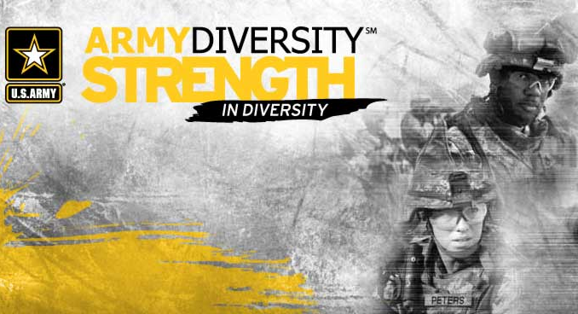
Strategies to Combat Discrimination
Education
Awareness
Bystander Intervention
Notes:
Show Slide 8. Strategies to Combat Discrimination (slide has builds)
Ask: What do you think are some strategies to combat discrimination in the military? Solicit 2-3 student responses
Note: Click to show all three bullets
Ask: How do we educate a unit to combat discrimination? Solicit 1-2 student responses
Note: Education promotes awareness. Unit training, courses, small group discussions, workshops, guest speakers, and movies provide educational opportunities for the unit. e.g. Topics related to the bases of discrimination can be addressed, including how they dehumanize people. Emphasis should always be on treating Soldiers with dignity and respect.
Ask: What is awareness? Solicit 1-2 student responses
Note: Celebrations such as National American Indian Heritage Month, Black History Month, and Woman’s History Month all help promote awareness of the contributions these groups have made to the military and the United States.
Ask: What is a bystander? Solicit 1-2 student responses
Read: A bystander is anyone who sees or otherwise becomes aware of behavior that appears worthy of comment or action.
Read: Bystander intervention includes developing the awareness, skills, and personal courage needed to intervene in a situation when another individual may need help. Bystander intervention sends a message about what is acceptable and expected behavior in the Army.
Ask: What are some reasons Bystanders often hesitate to act or intervene? Solicit 1-2 student responses
Note:
1) They fear loss of relationships with the problem person or with others who may disapprove of action.
2) They fear retaliation, especially if the problem person is powerful.
3) They fear embarrassment, especially if they may not be believed or they may be viewed as troublemakers, or viewed as violating other community norms.
4) They feel a lack of competence or uncertainty about what action would be best.
5) They believe someone else will take action perhaps someone else with more authority or expertise. With each person taking cues from people around them, a common result is that no action is taken.
Ask: What can be done about this problem? Solicit 1-2 student responses
Note: As Soldiers and members of the community, we all have a responsibility to help each other.
Bystander Intervention Strategies
Read: Avoid being a passive bystander. Intervene regardless of what others are doing and don’t worry about being wrong. It is better to be wrong than to have done nothing.
Be on the lookout for situations that may require some intervention. Learn how to recognize indications and always be aware of what is going on around you
As a bystander, it is much easier to recognize and encourage positive social behavior. It takes some practice and courage to intervene, discourage, or stop unacceptable behavior (e.g., discriminatory behavior)
There are many strategies associated with active bystander intervention.
1) Talk to the person to ensure they are doing okay.
2) Make up an excuse to get the person away from someone or the situation.
3) Call the police.
4) Point out someone’s disrespectful behavior in a safe and respectful manner that tends to de-escalate the situation.
Safety First-Before you act, you should think about the following:
1) How can you keep yourself safe in this situation?
2) What are all the options available to you?
3) Who else might be able to assist you in this situation?
4) What are the pros and cons of acting?
5) Decide how to help.
6) Be friendly.
7) Be firm.
8) Avoid violence.
Read: When in doubt, trust your gut. Instincts are there for a reason. When a situation makes us feel uncomfortable, it is generally a good indicator that something is not right.
Read Scenario: Your battle buddy appears to be having an intimate or personal relationship with a specialist in their section. You deployed together and you know that this person is an outstanding leader with a proven ability to lead Soldiers in combat. You know the relationship is consensual and the specialist if very mature for their age.
Ask: What actions do you take if any?
Follow up with: Which reason bystanders often hesitate to intervene do you think applies in this situation?
Possible responses: Fear the loss of the relationship; don't find it morally wrong; don't like confrontation; believe someone else will intervene.
Read: As leaders if we don't intervene when we see violations or discrimination, the situation can escalate or result in Soldiers using the complaint system.

Slide 9

EO Complaint System
Informal Complaints
Formal Complaints
60
14
3
ACT
FOLLOW UP
30-45
7
FILE
INVESTIGATE
APPEAL
days
days
days
days
days
Anonymous Complaints
Dependent on Information Provided
Notes:
Show Slide 9. Complaint System
Read: A key component of the Army’s EO Program is an effective and responsive complaint system. The Army’s EO complaint system concept is intended to afford the maximum protection for Soldiers by providing a means for them to bring a complaint to the Army, and have full confidence the Army will investigate and where appropriate, make an appropriate response to resolve the compliant. There are three types of complaints a Soldier may file in the Army’s EO channel, formal, informal and anonymous.
Read: An informal complaint allows a Soldier who does not wish to file in writing to verbally report inappropriate behavior without requiring a full investigation by the chain of command. When considering the use of the informal process, the following factors may help in that determination:
-Is not required to be filed in writing
-Should be resolved at the lowest level
-May use a third party
-Use confidentiality when possible
Note:
-Is not required to be filed in writing: these complaints may be voiced to the offending party, to someone in a position of authority, or both. The intention is that the offending behavior will cease with no further action required.
-Should be resolve at the lowest level: individuals are encouraged to attempt to resolve their complaints by confronting the alleged offender or by informing other appropriate officials about the offensive behavior or other allegations of disparate or unfair treatment. No requirement for chain of command intervention. However, depending on the severity of the offense, or the nature of the allegation, this may not always be appropriate. Individuals are responsible to advise the command of the specifics of discrimination and provide their chain of command an opportunity to take appropriate action to resolve the issue(s).
-May use a third party: third party intervention may be appropriate if the victim feels apprehensive or intimidated and reluctant to speak to the harasser directly. In such cases, a co-worker, supervisor, EOL, or leader can serve as an intermediary and speak to the offender on behalf of the victim.
-Use confidentiality when possible: while maintenance of confidentiality should be attempted, it will neither be guaranteed nor promised to the complainant by agencies other than the chaplain or a lawyer.
-There’s no time suspense for investigation: informal complaints are not subject to any timeline suspense, nor are they normally reportable to higher headquarters.
Note: Informal complaints are no less important than formal complaints and they should be addressed with a sense of urgency and a sincere attempt to attain resolution. The mere fact a Soldier wants to handle a complaint informally, does not prevent or exempt allegations from intervention by the chain of command. Should it be necessary to conduct a formal investigation to resolve an informal complaint, the Soldier may be required to make a sworn statement or asked to submit a formal complaint. While informal complaints are not in writing, anyone working on the resolution of informal complaints should prepare a memorandum of records (MFR). The MFR would include information indicating the nature of complaint and identifying pertinent information to assist in the identification of the unit’s command climate.
Read: A formal complaint is one that a complainant files in writing and swears to the accuracy of the information. Formal complaints require specific actions, are subject to timelines, and require documentation of the action taken. While the decision on whether to file a formal complaint rests with the individual, consideration should be based on the following factors:
Inability to resolve informally
Issue may warrant an official investigation
Soldier wants an official record of complaint
Defined complaint timeline
Read: (60 FILE) While there are no specific timelines for taking action on informal complaints, formal complaints do have defined timelines for the accomplishment of certain actions. Individuals have 60 calendar days from the date of the alleged offense in which to file a formal complaint.
Note: If a complaint is received after 60 calendar days, the commander may conduct an investigation into the allegations or appoint an investigating officer. In deciding whether to conduct an investigation, the commander should consider the reason for the delay, the availability of witnesses, and whether a full and fair investigation can be conducted. Complaints that include allegations that are criminal in nature are exempt from the 60-calendar day rule and will be immediately referred to the Military Police, CID or law enforcement agencies.
Read: (3 ACT) Commanders have three calendar days to inform the first General Courts-Martial Convening Authority (GCMCA) in the chain of command, additionally, alternative agencies have 3 calendar days to decide whether to resolve the complaint at their level or refer the complaint to the appropriate commander or agency for resolution.
Read: (14 INVESTIGATE) Commanders or alternative agencies have 14 calendar days to conduct an inquiry or investigation.
Note: If, due to extenuating circumstances, an inquiry or investigation cannot be completed in 14 calendar days, or (three MUTA 4 drill periods for Army reserve TPU Soldiers), an extension of a maximum of 30 calendar days or (two MUTA 4 drill periods for Army Reserve TPU Soldiers) may be approved by the next higher echelon commander.
Read: (7 APPEAL) The complainant will have 7 calendar days from date of notification of the results of the investigation to submit an appeal. The appeal must be in writing on DA Form 7279 and provide a brief statement which identifies the basis of the appeal. Action(s) taken against the subject, if any is taken, may not be appealed.
Read: (30-45 FOLLOW UP) The Equal Opportunity Advisor will conduct a follow-up assessment of all formal EO complaints, both for substantiated and unsubstantiated complaints, 30 to 45 calendar days (four to six MUTA 4 drill periods for RCs) following the final decision rendered on the complaint. The purpose of the assessment is to measure the effectiveness of the actions taken and to detect and deter any acts or threats of reprisal or intimidation.
Note: The EOA will also assess the complainant’s satisfaction with the procedures followed in the complaint process to include timeliness, staff responsiveness and helpfulness, and resolution of the complaint. The findings of this assessment will be annotated on DA Form 7279–1. The EOA will present findings and recommendations to the commander for further consideration/action within 15 calendar days (second MUTA 4 drill period for RCs). After the commander reviews the EOA findings and recommendation, the assessment is attached to the original complaint and maintained with the rest of the file.
Read: A key component of the Army EO complaint system is the prevention of reprisal, threats or intimidation of personnel who submit complaints. Should a military member be threatened with such action they should immediately report the incident to the chain of command, the Inspector General, or higher echelon commander. All Army personnel are prohibited from taking any action that might discourage Soldiers from filing a complaint or seeking assistance to resolve an EO grievance. Army personnel are prohibited from taking any disciplinary or other adverse action against a complainant, seeking assistance, or cooperating with investigative officers, Inspector General or other law enforcement agencies.
Note: This does not preclude commanders from taking action against Soldiers who file fraudulent complaints or give false statements. An unsubstantiated complaint is not fraudulent or false solely on the basis of its being unsubstantiated. An indicator of a healthy command climate is the willingness of Soldiers to report EO violations to the chain of command. Research has shown that many incidents of discrimination go unreported due to intimidation or fear of reprisal. It is the responsibility of the chain of command to ensure that all complainants are protected against reprisal or retaliation for filing an EO complaint. The commander will establish and implement a plan to protect the complainant, any named witnesses, and the alleged subject from acts of reprisal.
Read: There are other agencies available to assist Soldiers with the EO Complaint Process. Explain each resource.
Higher Echelon Chain of Command – You can choose to forward the complaint to your higher echelon chain of command or to one of the following alternative agencies:
Inspector General – Advises on all matters of command; receives complaints about command environment and leadership.
Housing Referral Office – Monitors and administers the installation’s housing referral program; investigates complaints about discrimination in rental or sale of off-post housing.
Staff Judge Advocate General – Advises Commander on all legal matters; may receive complaints about discrimination in legal proceedings or administering judicial or non-judicial punishment.
Military Police or Criminal Investigator – Any investigations of possible violations of the Uniform Code of Military Justice; responsible for monitoring the treatment of Soldiers and complaints of discrimination or unfair treatment by off-post activities.
Chaplain – The primary subject matter expert for issues about religious discrimination and accommodation; also the primary resource on family and marital counseling.
Medical Agency Personnel – Advise and assist on medical matters in case of a physical assault. Medical agency personnel are contacted immediately to obtain criminal evidence and assist in treating and counseling the victim.
Read: ANONYMOUS COMPLAINTS. Actions taken regarding anonymous complaints will depend upon the extent of information provided by complainants. Currently the Inspector General (IG) is the only agency that takes anonymous complaints based on Hazing and Bullying.

Slide 10
Terminal Learning Objective
Action | Demonstrate understanding of the Army’s Equal Opportunity (EO) Program and Complaint Process
Conditions | Given regulatory requirements and instructor led scenarios/situations
Standards | Correctly apply regulatory requirements to provided scenarios
Notes:
Show Slide 10. (Terminal Learning Objective)
Read: In closing, as committed professionals we must embrace and uphold the Army Values and standards of profession, always accountable to each other and the American people for our decisions and actions. As a Soldier you are held to a higher standard in real life and in your online presence. As a leader you must lead by example and demonstrate character in all that you do.

