Slide 1
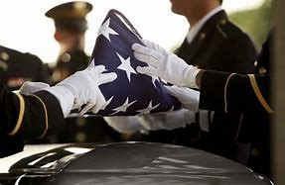
HOME REPORTING DEATH CNO/CAO TRAINING RESOURCES CONTACT US
Mission: Joint Base Myer-Henderson Hall Casualty Assistance Center (CAC) provides Casualty Notification/Assistance,
Mortuary Affairs, and Survivor Outreach Services to all Soldiers and their families residing in our area of responsibility.
CAC
Phone:
703-696-3237/3238
Email:
usarmy.jbmhh.asa.mbx.hrd-casualty-assistance@mail.mil
Location:
106 Custer Road Bldg. 202
Fort Myer, VA 22211
CAC area of responsibility: Washington, DC, Fairfax/Arlington County, Montgomery, and Prince George County.
Benefits and Entitlements
Casualty Assistance Locator
Request Funeral Honors
Request a Copy of DD214

Slide 2
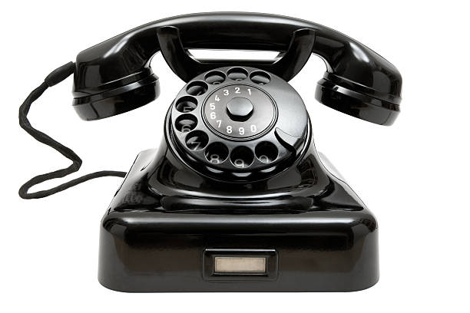
HOME REPORTING DEATH CNO/CAO TRAINING RESOURCES CONTACT US
Report a Retiree’s Death
Families must contact the nearest CAC office to ensure the death is reported to Defense Finance Accounting Service (DFAS) and Veterans Affairs (VA) to stop the retiree’s military pay and VA compensation if receiving disability benefits from VA. See map to locate the nearest CAC office in your area.
What You Need
Retiree’s name, social security number and date of death
Manner of death:
Retiree’s marital status upon death
If married, Name of spouse, social security number, address, date of birth and date of marriage

Slide 3
HOME REPORTING DEATH CNO/CAO TRAINING RESOURCES CONTACT US
The CNOs and CAOs must be currently trained and certified prior to conducting a casualty notification/assistance mission. Certification will be completed by attending the standardized three day classroom. Initial classroom certification expires 1 year after completion of training. Recertification may be obtained by completing the training module provided on the JKO website at : https://jkodirect.jten.mil/Atlas2/page/login/Login.jsf within 365 days of certification or by re-attendance at the classroom training.
To request for JBM-HH CNO/CAO classroom training, contact CNO/CAO Instructor at 703-696-6362 or email usarmy.jbmhh.asa.mbx.hrd-casualty-assistance@mail.mil

Slide 4
HOME REPORTING DEATH CNO/CAO TRAINING RESOURCES CONTACT US
JBM-HH Retiree Benefits Guide
DOD Survivor’s Guide Book
Defense Finance and Accounting Service
Military OneSource
National Personnel Records Center
Veterans Affairs
VA Burial Allowance
Tricare
ID Card/Rapids Office Locator
Tragic Assistance Program for Survivors

Slide 5
HOME REPORTING DEATH CNO/CAO TRAINING RESOURCES CONTACT US
Casualty Assistance Center (CAC) Area of Responsibility
Phone: 703-696-3237/3238 Washington D.C
Chief: 703-696-8517 Virginia Cities:
Operations Coordinator: 703-696-3024 Alexandria, Fairfax, Falls Church
Mortuary Officer: 703-696-6363 Virginia Counties:
Memorial Affairs: 703-696-6364 Arlington, Fairfax
Benefits Coordinator: 703-696-8899 Maryland Counties:
Training Coordinator: 703-696-6362 Montgomery, Prince George
CAC email inbox: usarmy.jbmhh.asa.mbx.hrd-casualty-assistance@mail.mil
After hours: 703-589-4714
Fax: 703-696-3236
Address
106 Custer Road Bldg. 202
Fort Myer, VA 22211

