Slide 1
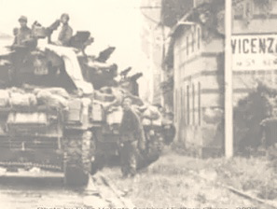

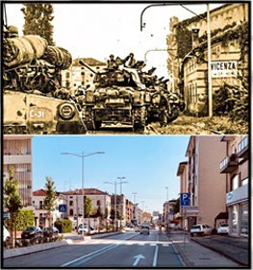
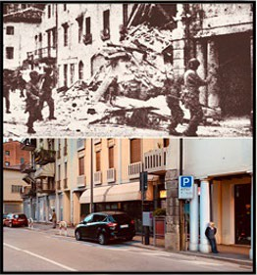
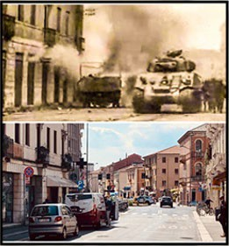
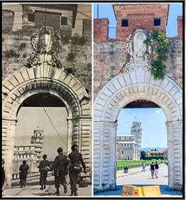



Community & Leaders Information Forum (CLIF)
Viale Verona (Strada Regionale 11)
Viale Verona (Strada Regionale 11)
Corso SS. Felice e Fortunato
Porta Santa Maria Pisa
17 SEP 2025
WE ARE THE ARMY’S HOME

Slide 2

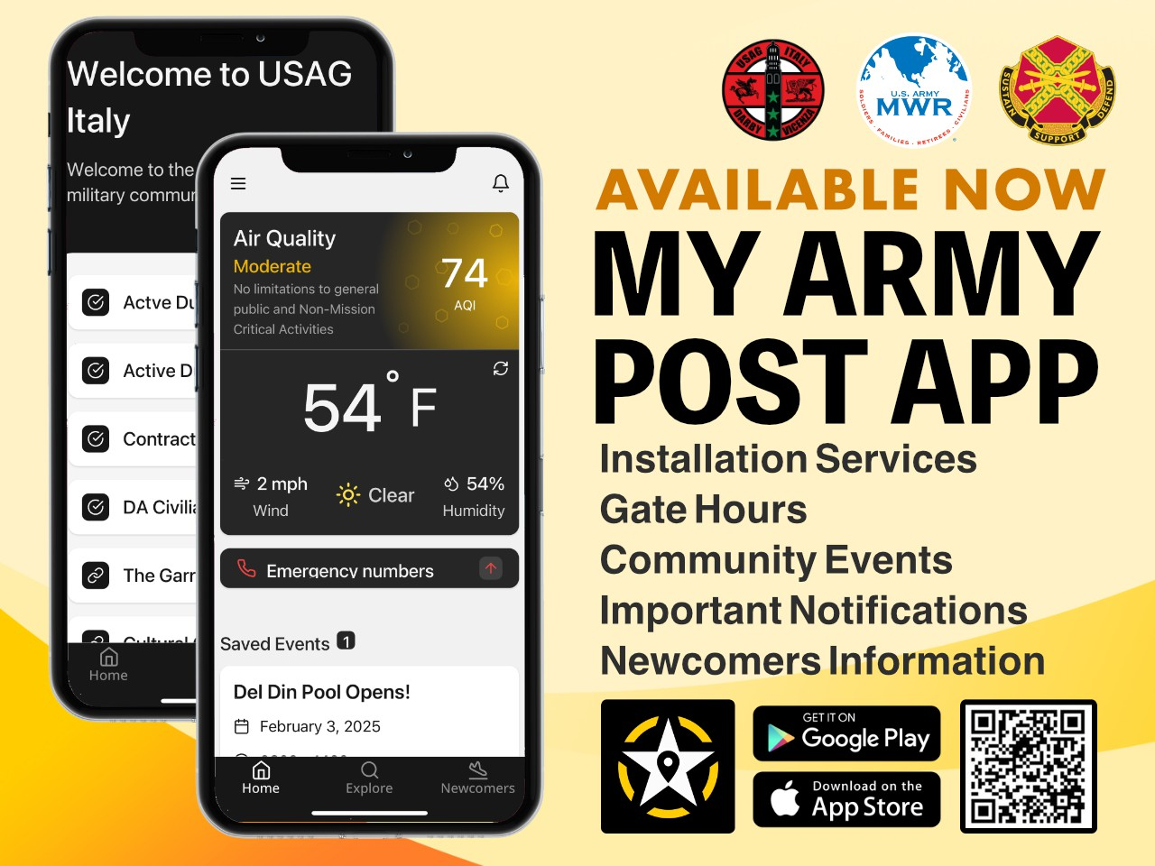



Slide 3
Agenda
Community Recognitions
DoDEA – School Calendar
DES – Ederle Gate Closures
USO – Upcoming Events
FMWR – Upcoming Events
S3 – Trunk or Treat
PAO – Upcoming Host Nation Events

Slide 4
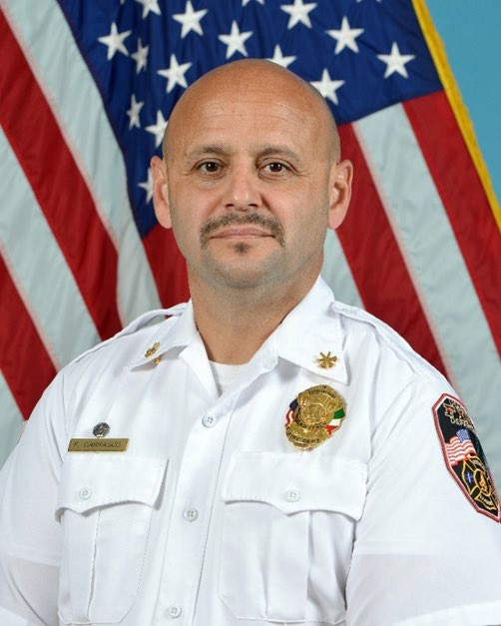
Community Recognition
Mr. Fernando Carrasco (Assistant Fire Chief)
Assistant Fire Chief Fernando Carrasco is an outstanding professional who is vital to the success of the USAG Italy Directorate of Emergency Services mission and is well deserving of recognition. Mr. Carrasco was recently reassigned to fill a critical vacancy and now serves as the department’s Assistant Chief of Operations, responsible for the supervision of 71 firefighters, 2 fire stations and management of a $7M emergency
response fleet, ensuring continuity of operations during the current hiring freeze. While balancing supervisory duties with his new position, he was also the point man behind our end of year budget push where he successfully secured over
$120K in unfunded requirements and purchased critical life-saving equipment. Further, since taking over the
Operations section, his team successfully responded to and mitigated 211 emergency responses.
Chief Carrasco’s actions had a significant impact on the safety of the Vicenza Military Community.

Slide 5
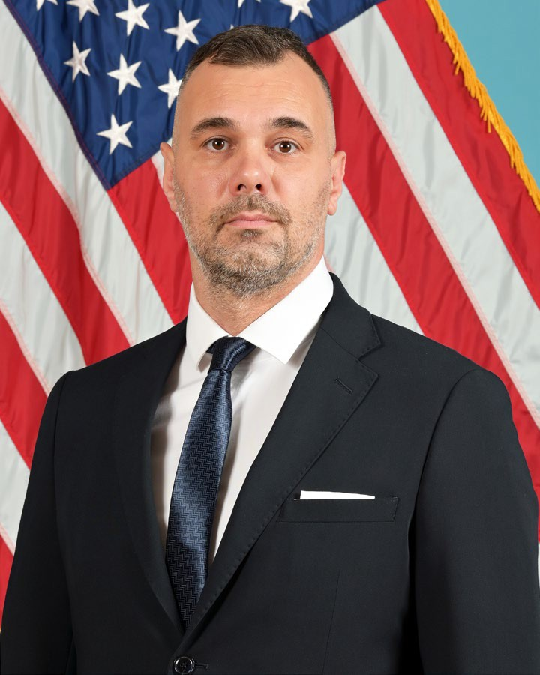
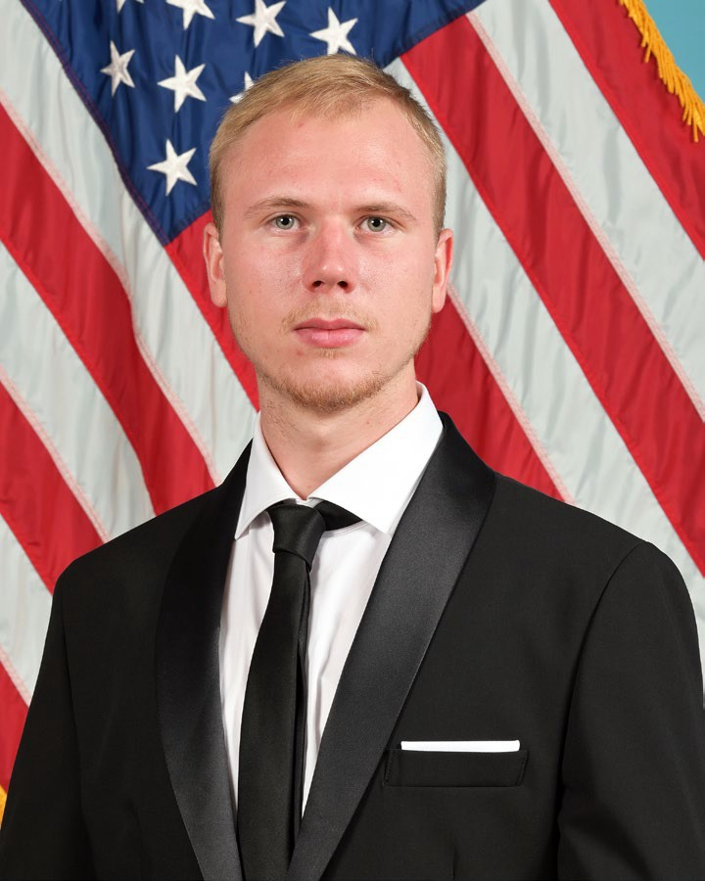
Community Recognition
Giovanni Ceccon (Mechanical Engineering Technician) and Diego Crivellaro (Public Utilities Technician)
Operations & Maintenance Division’s Giovanni Ceccon and Diego Crivellaro consistently exemplify outstanding dedication and expertise in delivering impressive results across several high-impact projects.
Giovanni played a pivotal role in the successful transformation of the new Mensa dining facility in Building 309. By expertly coordinating the mechanical and electrical workshops, he ensured that all equipment connections were flawlessly executed. His leadership and ability to synchronize diverse teams were instrumental in achieving a smooth and efficient installation process.
Together, Giovanni and Diego took initiative to enhance DPW O&M’s data management systems. Their meticulous work on the Army Energy & Water Reporting System (AEWRS) included creating preliminary data summary files that accelerated the data entry process and improved DPW’s operational efficiency.
Their most transformative contribution was their collaboration with USAG Italy’s water utility provider. Through a series of strategic meetings, they successfully negotiated a new monthly billing system for sites consuming over 3,000 cubic meters annually. This change now delivers accurate, timely data on costs and consumption thus eliminating the need for estimates and annual adjustments.
Their combined efforts reflect a deep commitment to excellence, innovation, and continuous improvement, and their contributions have both streamlined DPW’s operations and set a high standard for professionalism and initiative.
DPW celebrates Giovanni and Diego’s achievements and thanks them for making an important and lasting impact on our community!

Slide 6


Vicenza Elementary School
Continuous School Improvement (CSI) Training – Early Release
  Monday, 22 September
School Picture Days
  Tuesday, 30 September & Wednesday, 01 October
Newsletter
  Now posted on our school’s webpage
  Link was sent out via email and can also be accessed through Aspen

Slide 7


Vicenza Middle School Home of the Pumas
Health and Wellness Day (AM)
  Monday, 22 September
Continuous School Improvement (CSI) Training – Early Release
  Monday, 22 September
School Picture Day
  Thursday, 02 October

Slide 8



Vicenza High School Cougars
Continuous School Improvement (CSI) Training – Early Release
  Monday, 22 September
Homecoming Week (Week of 27 September)
  Monday, 22 September - Pep Rally
  Friday, 26 September - Friday Night Lights Game (Tailgater prior)
  Friday & Saturday, 26-27 September - Volleyball & Tennis
  Saturday, 27 September - Cross Country
School Picture Day
  Monday, 29 September

Slide 9
DES - Active Vehicle Barriers Upgrades
Projected Gate Closure Dates
Gate 4: 09 September - 25 October 2025*
Gate 1 (Inbound): 27 October* - 19 December 2025*
Gate 2: 12 January* - 26 February 2026*
Gate 1 (Outbound): 26 February* - 10 April 2026*
*Dates subject to change based on construction timelines

Slide 10
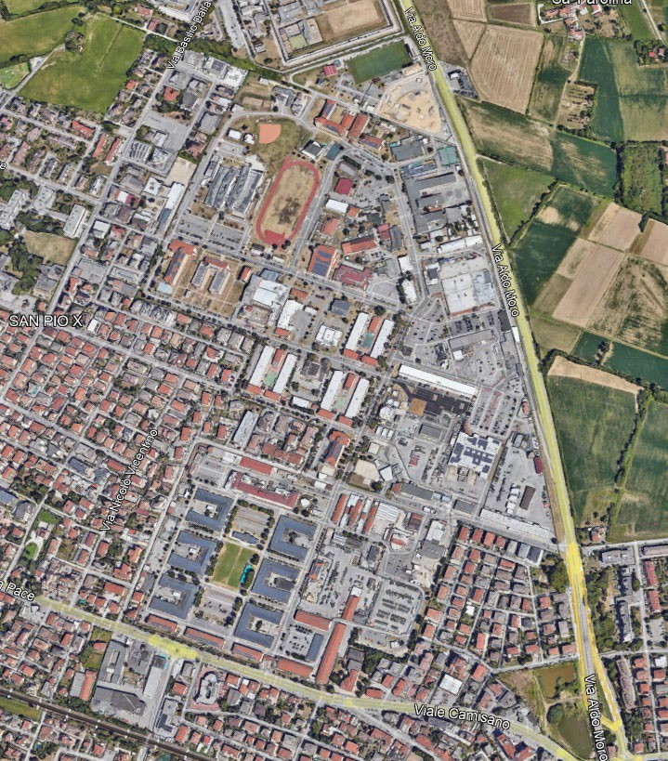
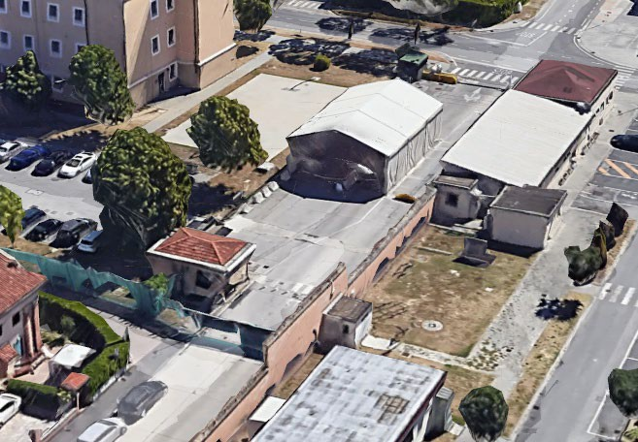
DES - Active Vehicle Barriers Upgrades
GATE 4: CLOSED from 09 SEP to 25 OCT 2025
GATE #4 (Housing Gate)
VEHICLE GATE CLOSED: 09 SEP to 25 OCT 2025
Pedestrian access will remain OPEN

Slide 11
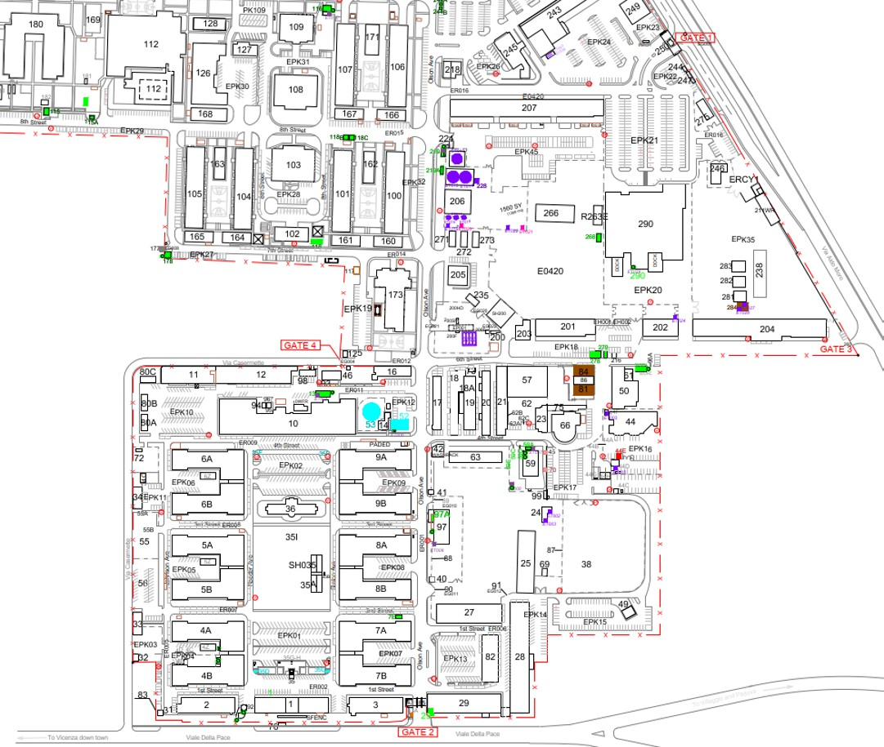


DES - Active Vehicle Barriers Upgrades
GATE 4: CLOSED from 09 SEP to 25 OCT 2025
Gate #1 (Main Gate)
Gate 4 (Housing Gate)
No vehicle access through Gate 4
No change to inbound/outbound access through Gates 1 and 2
Inbound/Outbound pedestrian access will remain available – located behind VIOS building
Gate #2 (Chapel Gate)

Slide 12
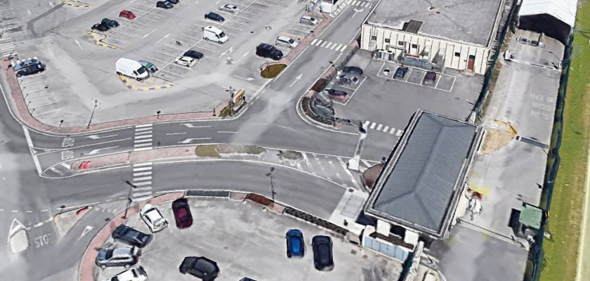
DES - Active Vehicle Barriers Upgrades
GATE 1 Inbound: CONSTRUCTION from 27 OCT to 19 DEC 2025
GATE #1 (Main Gate) Inbound
GATE 1 Construction:
27 OCT to 19 DEC 2025

Slide 13
DES - Active Vehicle Barriers Upgrades
GATE 1 Inbound: CONSTRUCTION from 27 OCT to 19 DEC 2025
Gate #1 (Main Gate)
Modified traffic flow at Gate 1
No change to inbound/outbound access through Gates 2 and 4
Visitor Control Center will remain open

Slide 14
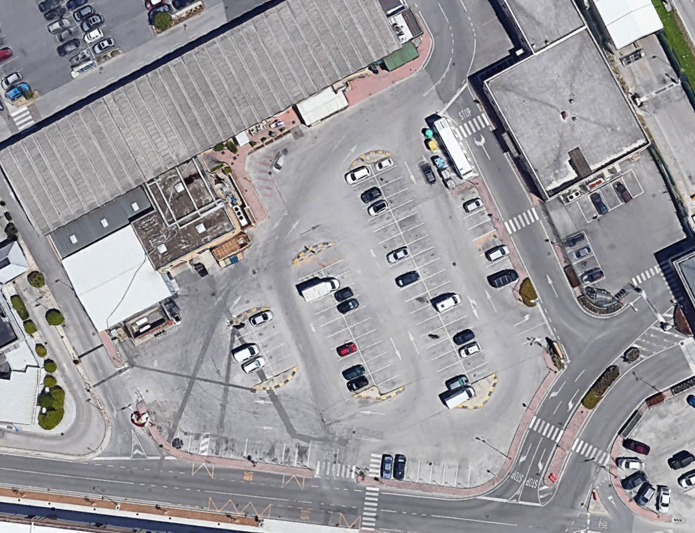
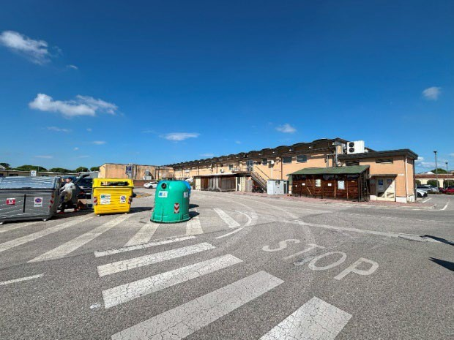
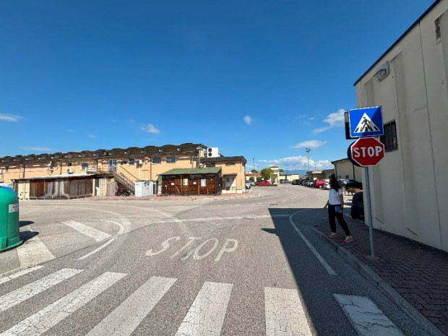
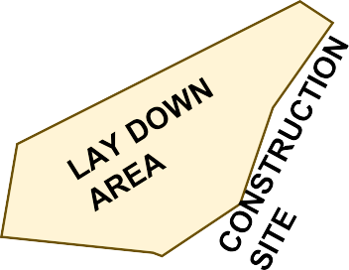
DES - Active Vehicle Barriers Upgrades
POV Traffic Plan – Gate 1 (Main Gate)
Traffic Impacts: 27 OCT to 19 DEC 2025

Slide 15


USO - Pet Run
Date: Saturday, 04 October
Time: 1000 to 1200
Location: Ederle Track & Field
Activities:
  Pet Run
  Obstacle Course
  Treats
  Swag Items
  FUN!!!
Registration is required:
**Proof of vaccination required** Please contact USO Vicenza with any questions

Slide 16


USO - Special Delivery Baby Shower
Date: Saturday, 18 October
Time: 1100 to 1300
Activities:
  Themed snacks and desserts
  Baby shower games
  Door prizes and giveaways
  Valuable information and discussions
Registration is required:
Please contact USO Vicenza with any questions

Slide 17


MWR - Cancellation of Warrior Adventure Quest
Warrior Adventure Quest (WAQ) can no longer be provided to Army units at no charge due to depleted funds
FY25 Vicenza WAQ recap: 930 Soldiers participated in:
Ski/Snowboard: 306
White Water Rafting: 273
Paintball: 207
Scuba: 53
Via Ferrata: 46
Canyoning: 26
Snowshoeing: 10
Caving: 9
Outdoor Recreation (ODR) will continue to provide high-quality adventure experiences for Soldiers
  Local hikes, mountain bike rides in the Colli Berici
  Mid-week trips to Folgaria during ski/snowboard season
  Via Ferrata/Snowshoeing
  Unit discounts on rental equipment
  Offset costs if units can provide TMP-licensed bus drivers
Call ODR at DSN 314-646-4900 or 0444-71-4900

Slide 18





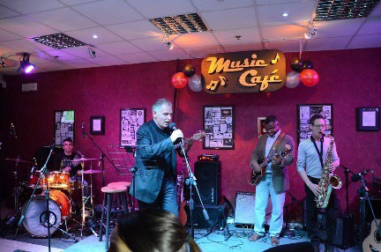
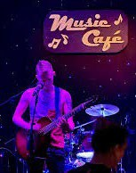
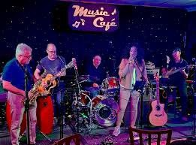
MWR - Music Café 2.0
For 15 years, Soldiers’ Theatre has been celebrating this night of music designed for music lovers, by music lovers
Date/Time: Sunday, 19 October, begins 1930
Location: Soldiers’ Theatre
(Bldg. 11, behind Ederle DFAC)
What to Expect:
  Free entry
  Amazing local on-post & off-post talent
  Refreshments available for purchase
  Food truck onsite
Want to Showcase Your Talent?
  Call Soldiers’ Theatre at 0444-71-4781

Slide 19


CYS-Youth Program - Spookfest Dance
Youth will enjoy this night of spooky fun!
Date/Time: Friday, 31 October, 1830-2200
Location: Villaggio Youth Program
Open To: Grades 6-12
What to Expect:
  Awesome music
  Cool costumes
  Fun games
  Dancing
Where To Enroll:
  Parent Central Services
(Caserma Ederle, Bldg. 108)
  Online using WebTrac

Slide 20







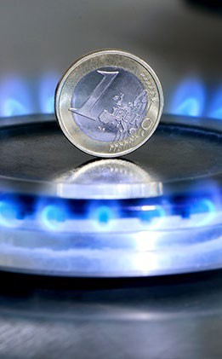
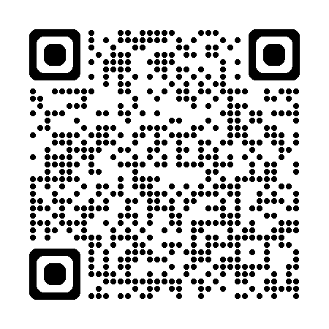
MWR - Tax Relief Office (UTEP)
Get Relief This Winter Season!
Head to the Tax Relief Office to get enrolled in the “Utility Tax Exemption Program (UTEP)”
and you can enjoy some relief this winter season!
Utility Savings:
  Save 37-48% on gas bills
  Save 10-20% on electricity
  Save €108 per year on Italian TV tax
Other Ways To Save with TRO:
  22% off any purchases over €150 IVA/VAT- exemption program
  22% off GPL tank refills
To Find Out More Info or About Eligibility:
  Stop by Tax Relief on Ederle (Bldg 367, across from CPF)
  Visit our website:
https://italy.armymwr.com/programs/italy-tax-relief-officetro
Stop by the TRO table in the back!

Slide 21




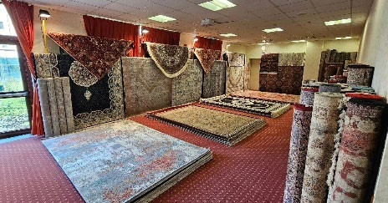
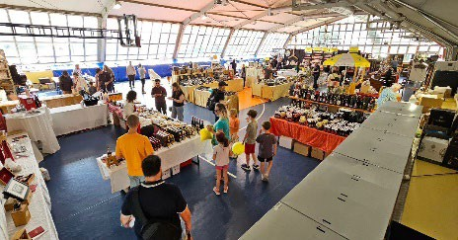


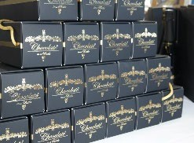
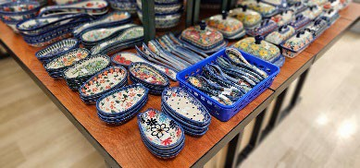
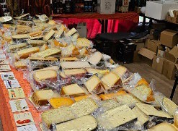

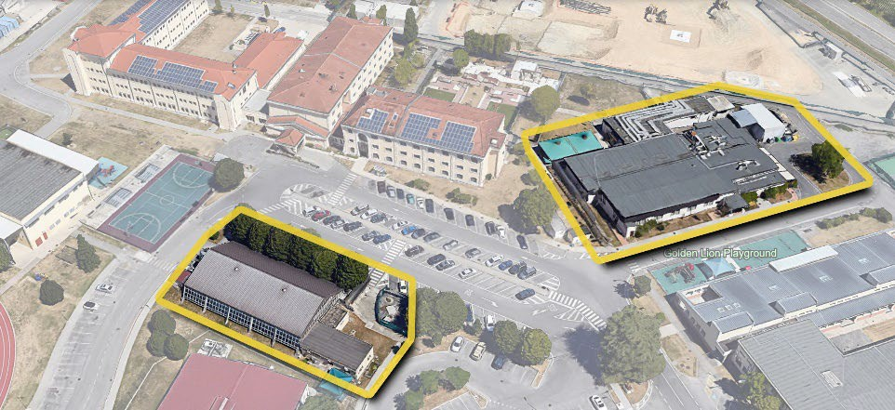


MWR - Fall Bazaar
Enjoy vendors selling amazing products from all over Europe,
just in time for the holidays!
Dates/Times:
  Friday, 24 October, 1100-1930
  Saturday, 25 October, 1000-1930
  Sunday, 26 October, 1100-1700
Locations:
  Golden Lion Conference Center
  CYS Indoor Gym
What to Expect:
  40+ Vendors – new and returning favorites
  Assorted specialty foods and drinks
  Product tastings
  Beers, wines and spirits
  Furniture and carpets
  Food trucks onsite
  Ceramics and jewelry
  Much more!

Slide 22




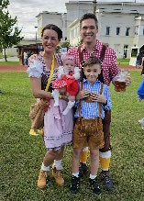
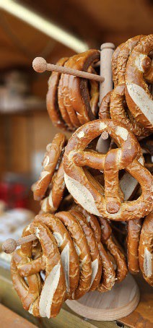

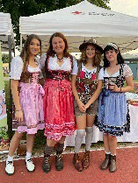



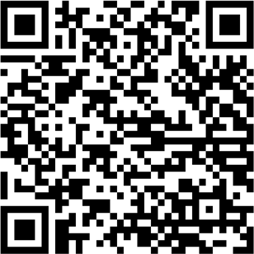
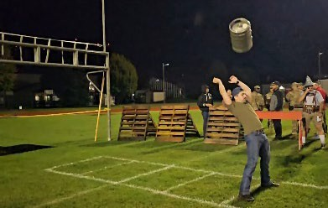
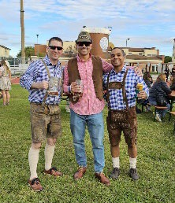
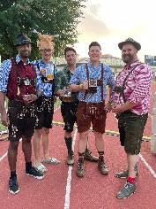
MWR - Oktoberfest 2025 Celebration
Join us for this annual celebration with festive music, food, activities, and so much more!
Date/Time: Saturday, 25 October, 1100-2300
Location: Ederle Track & Field Area
What to Expect:
  $350 VIP Tents (up to 8 people)
    Food Platters & Dedicated Servers
    To Reserve – call the Arena +39-0444-71-5181)
  Festival Tent
  Traditional Food & Drinks
  Live Music
  Lederhosen/Dirndl Contests
  Games & Challenges:
    Keg Toss, Stein Hold, etc.
Kids Activities
DoD ID Cardholders &
up to 15 Pre-Registered Guests:

Slide 23


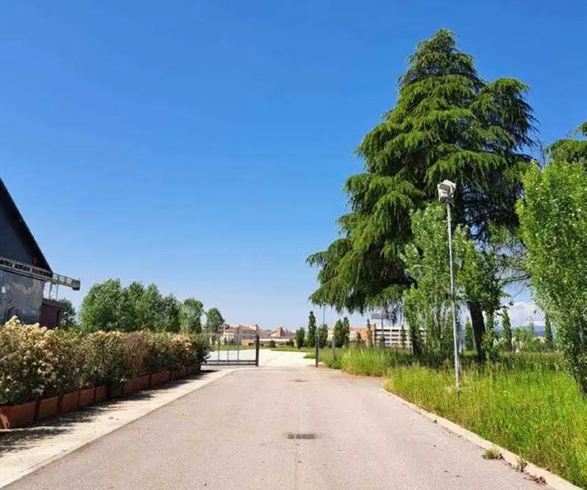









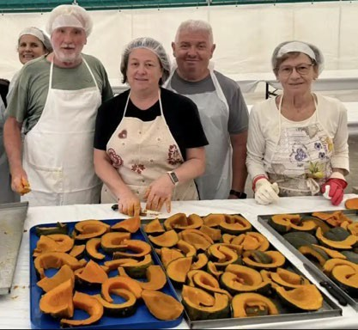


PAO - Host Nation Community Events
Peace Park opens Sept. 27
MONTECCHIO PRECALCINO
SEPT 28

Slide 24
PAO - Are You Connected?

Slide 25
Next CLIF
Wednesday, 15 October
1030-1130
GOLDEN LION, CASERMA EDERLE

