Slide 1
Community and Leaders
Information Forum (CLIF)

Slide 2
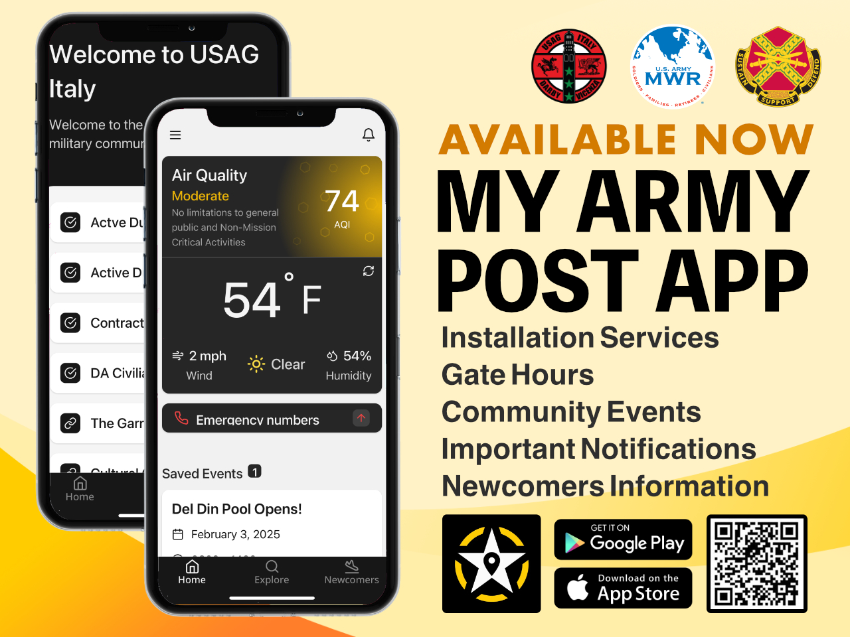

Slide 3
Agenda
Presenters
        Community Recognitions Jolly Miller
        ACS – Army Emergency Relief Campaign Maija Winesberry
        Health Clinic – Summer Transition and New Initiatives LTC Arruiza
        DoDEA – Schedules & Information and School Registration Mr. Gann
        FMWR: Richard Gerke
          Giro d’Italia Trip
          Gallery at the Garrison
          Ederle Pool on Weekends
          Independence Day Celebration
          SKIES & Summer Camps
          Job Opportunities
        DES – Emergency Phone Numbers Kevin Goodwin
        R2PC:
          VMC Wellness Day Lloyd Scharneck
          Town Hall Amy Cates
        S5 – Recent and Upcoming Moves Matt Brice
        PAO Laura Dal Pozzolo-Aguirre
        Upcoming Host Nation Events
        Giro d’Italia
        Venice Access Fees
        Are You Connected?

Slide 4
Agenda
        Community Recognitions
        ACS – Army Emergency Relief Campaign
        Health Clinic – Summer Transition and New Initiatives
        DoDEA – Schedules & Information and School Registration
        FMWR:
          Giro d’Italia Trip
          Gallery at the Garrison
          Ederle Pool on Weekends
          Independence Day Celebration
          SKIES & Summer Camps
          Job Opportunities
        DES – Emergency Phone Numbers
        R2PC:
          VMC Wellness Day
          Town Hall
        S5 – Recent and Upcoming Moves
        PAO
          Upcoming Host Nation Events
          Giro d’Italia
          Venice Access Fees
          Are You Connected?

Slide 5
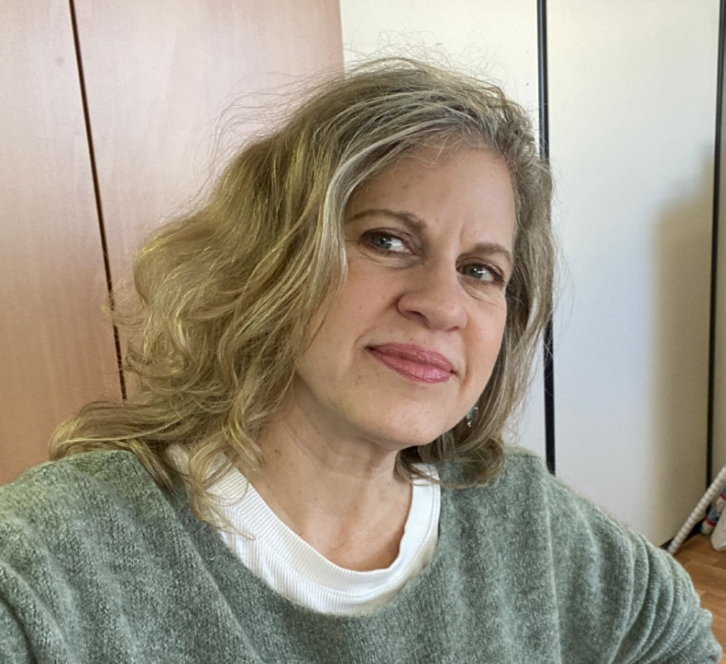
Community Recognition
Ms. Allie Vallery (Volunteer Coordinator)
Please join us in recognizing Ms. Vallery for her exceptional dedication and outstanding contributions to USAG-Italy Army Community Service from January to May 2025. During this time, she went above and beyond by managing both the Employment Readiness and Army Volunteer Corps programs following the departure of the Volunteer Program Manager and a hiring freeze. She also provided key support to the Army Family Action Plan and Army Family Team Building programs, ensuring continuity and excellence across multiple areas.
Ms. Vallery’s efforts directly enhanced the quality
and impact of these services for our community.
One of her most notable accomplishments was
organizing a successful Installation Volunteer
Recognition Ceremony, honoring 351 volunteers
for their service and saving over $1.2M in labor costs.
Ms. Vallery exemplifies teamwork, professionalism,
and dedication, and we are proud to recognize her
outstanding performance.

Slide 6
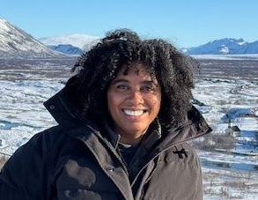
Community Recognition
Ms. Maija Winesberry (Financial Readiness Program Manager)
We’d like to recognize Ms. Maija Winesberry for her outstanding dedication and commitment to the USAG-Italy Army Community Service team. In the face of recent staffing losses, Ms. Winesberry has taken on full responsibility for both the Financial Readiness Program and the Army Emergency Relief (AER) Program, serving as the sole professional managing these critical services. Despite the increased workload, she successfully led the 2025 AER campaign and provided training to 57 AER Unit Representatives—laying the groundwork for
stronger outreach and increased support across
the community. Her initiative, resilience, and
professionalism have ensured the continued
delivery of vital financial support and education
services for Soldiers and their families.
We extend our sincerest appreciation to
Ms. Winesberry for her unwavering commitment
and impact to our community.

Slide 7


ARMY EMERGENCY RELIEF CAMPAIGN
Campaign Dates: 01 March through 14 June
Goal: To inform 100 percent of all active-duty and retired Soldiers and their family members (including spouse and children of deceased Soldiers) about the types of financial assistance available from AER and provide the opportunity for Soldiers to donate. The Army’s target for the 2025 Campaign is to achieve 25% donations from active-duty Soldiers.
**Scan to DONATE and choose one-time or recurring giving**

Slide 8



ARMY EMERGENCY RELIEF CAMPAIGN
Gary Sinise / AER Lunch
Thursday, 29 May at the Arena from 1100-1400

Slide 9

Health Clinic
Appointment Line: 0444 61 9000
https://mhs-europe.tricare.mil/Vicenza
https://www.facebook.com/VicenzaArmyHealth/
Summer Transition:
Physicals – now is a good time to schedule
2 Family Physicians Departed, 2 to arrive AUG
Optometry – underlap with backfill scheduled
New Initiatives:
NOW: AFWC Virtual Health Coach
NOW: Enhanced Medical In-processing
Scheduled Virtual Visits – Video Appts
Reminders:
MyCare Overseas App
Medical Readiness Walk-in services
Virtual PHA services
Closures:
Annual Federal Holidays
Training: 1st & 3rd Thursdays PM

Slide 10

Vicenza Elementary School
22 May – Early Release/Teacher Training (11:00 Dismissal)
23 May – School Holiday (No Student Attendance)
26 May – Memorial Day (No Student Attendance)
30 May – Field Day
10 June – LAST DAY - Early Release (11:00 Dismissal)
18 August – First Day of School for Grades K-5
28 August – Open House for Grades K-5
02 September – FIRST DAY of School for Pre-kindergarten

Slide 11

Vicenza Middle School
22 May – Early Release/Teacher Training (11:00 Dismissal)
23 May – School Holiday (No Student Attendance)
26 May – Memorial Day (No Student Attendance)
05 June – 8th Grade Award Ceremony
06 June – 8th Grade Dance at the Youth Center
10 June – LAST DAY - Early Release (11:00 Dismissal)
15 August – New Student Orientation
18 August – FIRST DAY of Instruction - OPEN HOUSE (AM)

Slide 12
Vicenza High School
Spring Sports Championships (Kaiserslautern HS):
19-22 May – Soccer Europeans
21-23 May – Baseball/Softball Europeans
22-23 May – Track & Field Europeans
22 May – Early Release/Teacher Training (11:00 Dismissal)
23 May – School Holiday (No Student Attendance)
26 May – Memorial Day (No Student Attendance)
29 May – Spring Concert
30 May – Field Day
31 May – High School Prom (Villa Tacchi)
02 June – LAST DAY of Academics
04 June – Senior Dinner
07 June – Graduation Ceremony
15 August – New Student Orientation
18 August – FIRST DAY of Instruction
28 August – Open House

Slide 13
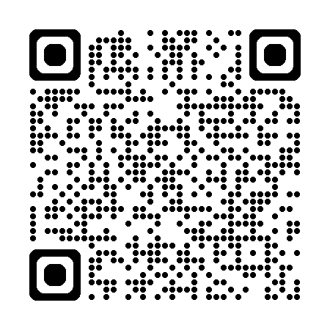


School Registration
Registration begins online process at: https://dodeasis.myfollett.com/aspen/logon.do
Following documents should be uploaded:
Copy of sponsor's orders including family travel authorization
Copy of birth certificate (elementary) or
passport and VISA (middle and high)
Immunization Records
Official School Records from previous school (to be hand-carried in sealed envelope)
Upon arrival, notify the registrars to finalize the registration in the ASPEN system.

Slide 14

MWR – Giro d’Italia Trip
Outdoor Rec’s Giro d’Italia Trip:
Date: Sunday, 25 May
Time:
  0830-0900 – Departs
  1000 – Arrive at destination
  1900-1930 – Return
Cost: $50 per person
Does not include bike rental
What to Expect:
  Transport to/from Bassano del Grappa
  Riding the same route as the pros just hours before they climb Monte Grappa
  Hospitality tent with shade, food, drinks, music
  Great view of the professionals as they race by!

Slide 15

MWR – Gallery at the Garrison
Annual Gallery at the Garrison:
Date: Thursday, 05 June
Time: 1100-1900
Locations:
  Ederle Art Center
  Soldiers’ Theatre
  Ederle Library
  Outdoor Recreation
  ACS (Bldg. 108)
  Java Café
What to Expect:
  Amazing artwork by community artists
  An “art walk” between MWR facilities
  Refreshments
Call for Artists – Still Available!
  Deadline: Thursday, 22 May
  Ask the Art Center for more info!

Slide 16

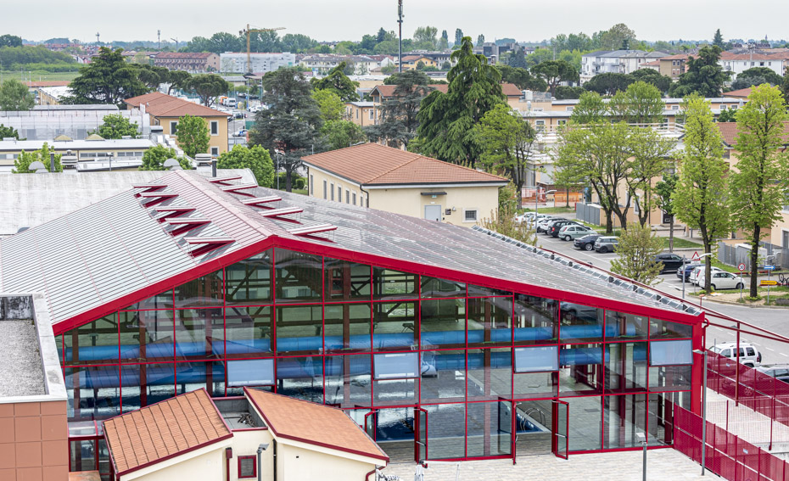
MWR – Ederle Pool on Weekends
Weekend Openings!
Weekend Hours Begin: Sunday, 15 June
Weekend Hours End: Sunday, 31 August
Time:
  Saturdays – 0930-1645
  Sundays – 1000-1645
Location: Ederle Indoor Pool

Slide 17

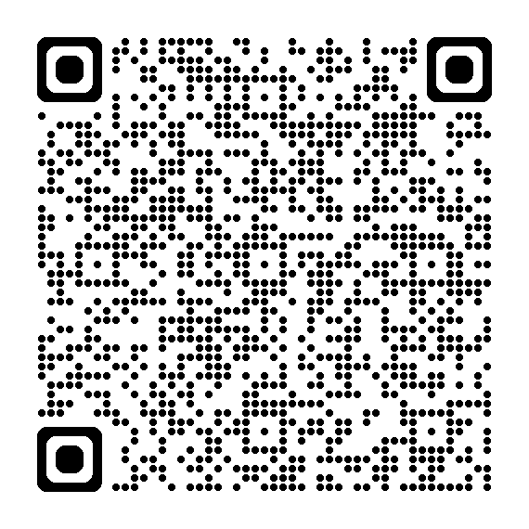
MWR – Independence Day Celebration
Independence Day Celebration:
Date: Thursday, 03 July
Time: 1600-2300
Location: Ederle Track & Field
What to Expect:
  Fireworks Show
  Live Music
  Food Trucks & Drinks
  Children’s Activities
Guest Registration:
  Up to fifteen (15) guests
  Deadline: Tuesday, 17 June
  Scan QR Code to register guests
  No pets, backpacks, bikes, skateboards, hoverboards, Heelys, outside food, helmets or drones

Slide 18




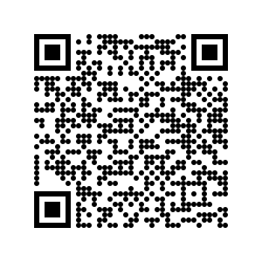
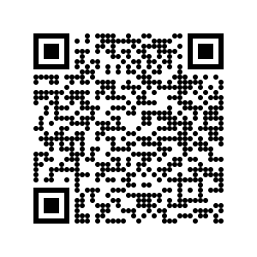
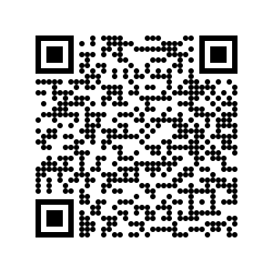
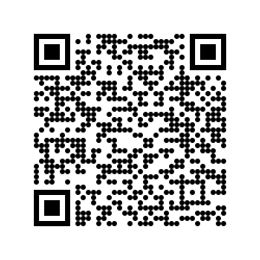
MWR – SKIES & Summer Camps
Enjoy everything CYS has to offer this summer!
SKIESUnlimited
Kinder Camps
SAC Camps
YP Teen Camps

Slide 19
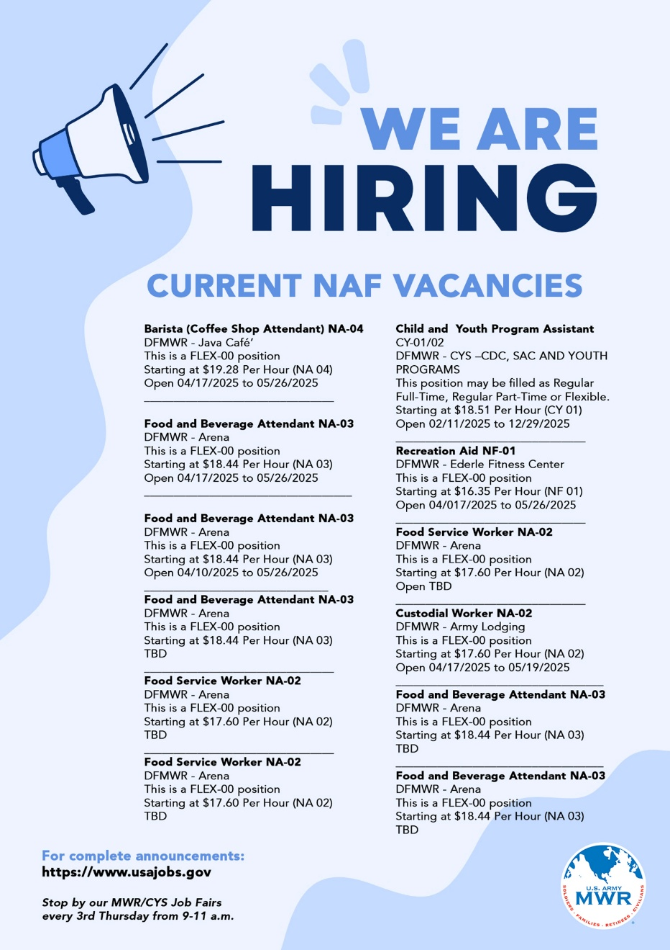

MWR – Job Opportunities
MWR & CYS Vacancies:
View the poster here, pick up a copy, or visit USAjobs.gov to find the latest vacancies for MWR and CYS.
Monthly Job Fair: Every 3rd Thursday
  Time: 0900-1100
  Location: The Arena, 2nd Floor
  What to Expect:
    Hiring managers
    Volunteer opportunities
    HR staff to answer your questions on eligibility.

Slide 20
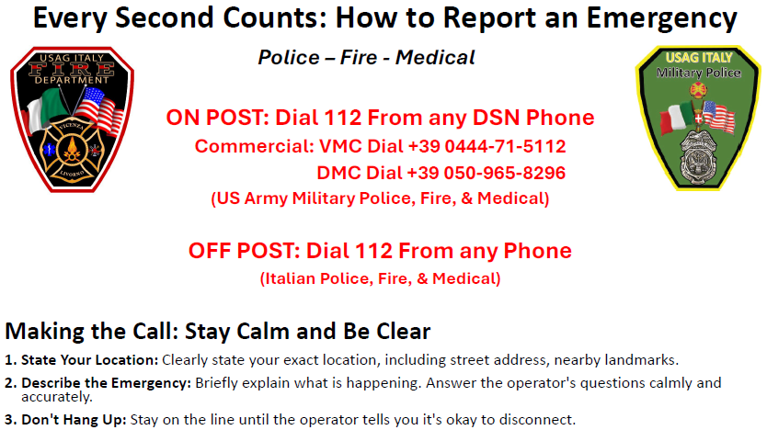
DES – Emergency Phone Numbers

Slide 21

R2PC – VMC Wellness Day
Vis Vitalis (#WellnessRevolution)
Population: Soldiers, Civilians, Contractors, Spouses, Children. Everyone who has access to services in the Vicenza Military Community.
Why:
Raise awareness for services within the VMC and ways to develop holistic wellness.
Provide free educational wellness toolkit on how to train holistic health.
Celebrate the fact that time spent focusing on being a better you is one of the best investments you can make.
When:
Two (2) all-day events 0930-1600:
  Tuesday, 24 June at Del Din, road behind Gunfighter Gym
  Thursday, 26 June at Ederle Track & Field
What:
  Five (5) Wellness Workshop Stations (repeating throughout the day)
  Raffle and Prizes, Food and Fun competitions
  Kids Area (interactive games & activities)

Slide 22
R2PC – Community Townhall
Quality of Life & Well-Being for Off-Post Residents
📅 Date: Wednesday, 24 June
🕞 Time: 1530-1700
📍 Location: Post Theater (Ederle)
🎤 Q&A Session: Share your questions and feedback!
📌 Open to all – service members, spouses, and families
~Join us for an open discussion focused on improving the quality of life for our off-post residents~
Topics Include:
MAPA App
Newcomer information, Cultural Connections, Alerts, etc.
MWR
MWR Jobs, SKIES/CYS Sports, Summer Camps, Independence Day Celebration
Housing
AFH Construction, CFMO Appliance Shortages, Private Rental vs Gov Housing, Mold Prevention
AAFES
AAFES Services, Loss Prevention, Tobacco shortages, Gas Cards
DeCA
Special Orders, Summer Promotions
DES
Summer safety tips, crime prevention, how to report suspicious activity, break-in, or car accidents

Slide 23
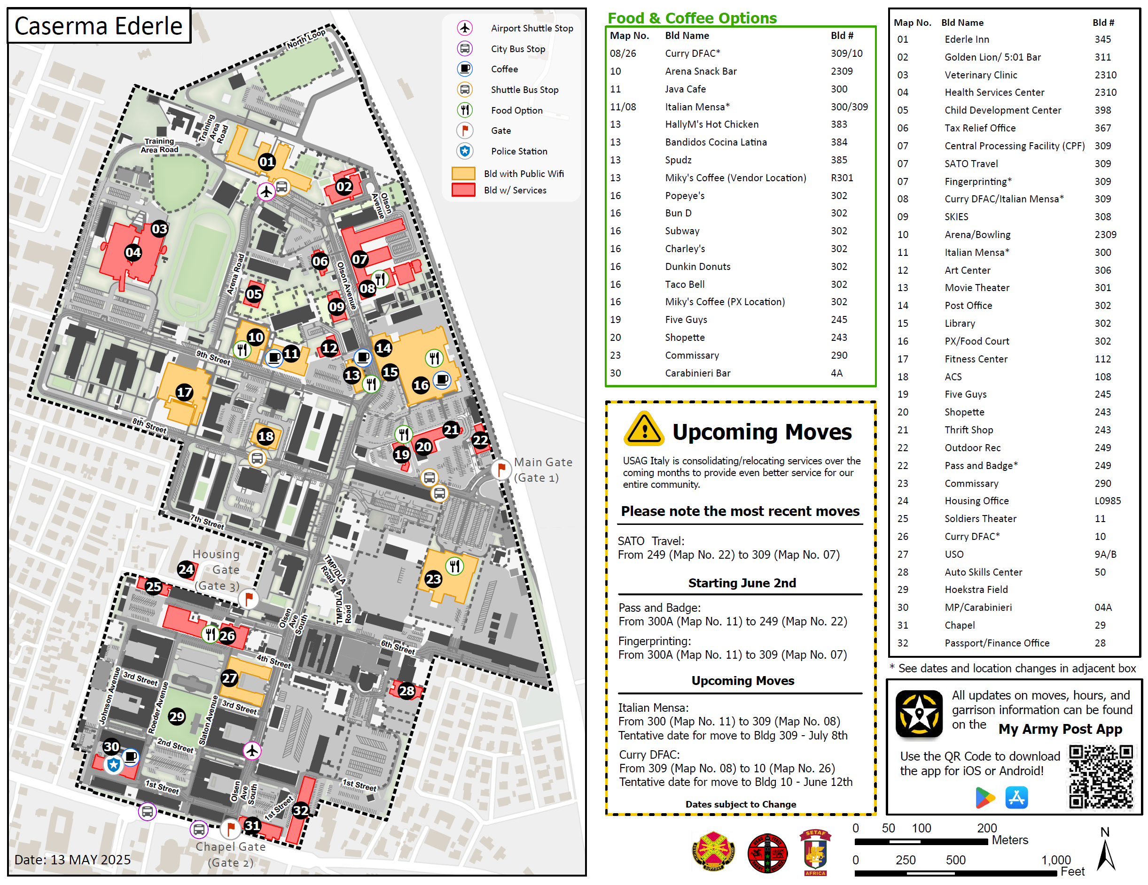
S5 – Recent & Upcoming Moves
Notes:
Phase 1 Moves (End of APR):
B393
CPF (1) to B309
B249
SATO (2) to B309
Phase 2 Moves (MAY-AUG):
B300A
S2 (3) to B309
Pass and Badge (4) to B249
B300
ESS CTRs (5) to B309
B82
DLI (6) to B309
B395
RSO (7) to B82
Temporary Relocations - Work Orders
B309
Curry DFAC to B10 (8) (May30)
B300
IT Mensa to B309 (9) (May2025-UTC) (T)
Pending Final Resolution:
B395
SHARP (10), EO/EEO (11), CR2C (12) to B393
B300A
S3 (13) to B128
B249
ODR (14) to B309
B126
TAP & ED Center (15) to B309

Slide 24


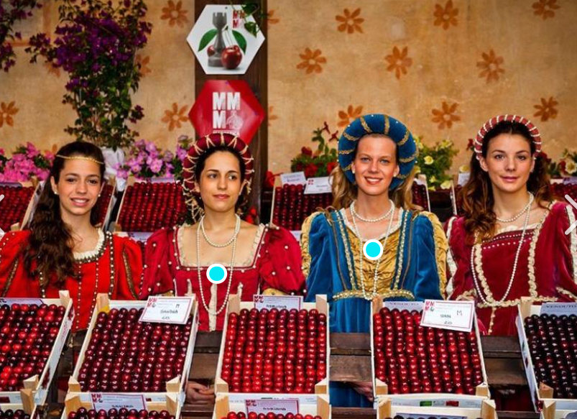



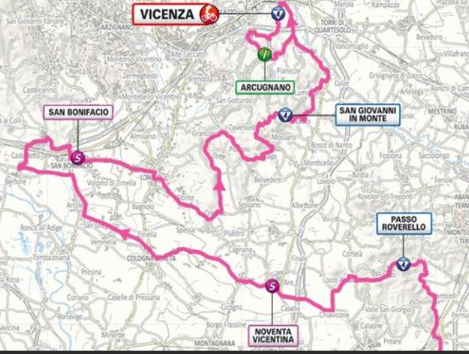

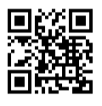
PAO – Local Community Events
https://cda.ve.it/en/
https://www.vicenzajazz.org/
20 May - 2 June
Marostica Cherry Festival
https://cda.ve.it/en/
Lumignano (Longare): Green Peas Fest
May 23: Vicenza hosts stage of Giro d'Italia
Marostica Medieval walls
Open every Sunday and Public Holidays 29 March –23 November
https://sagreautentiche.it/sagre/sagra-della-tagliata/

Slide 25
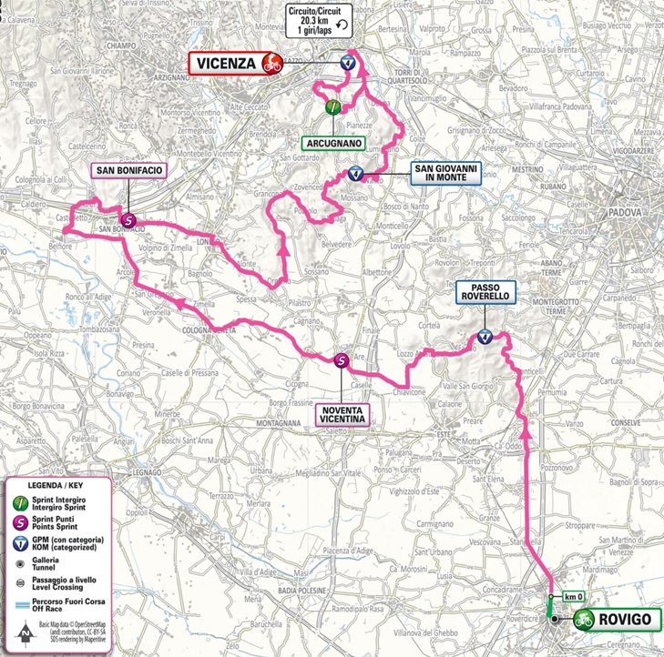

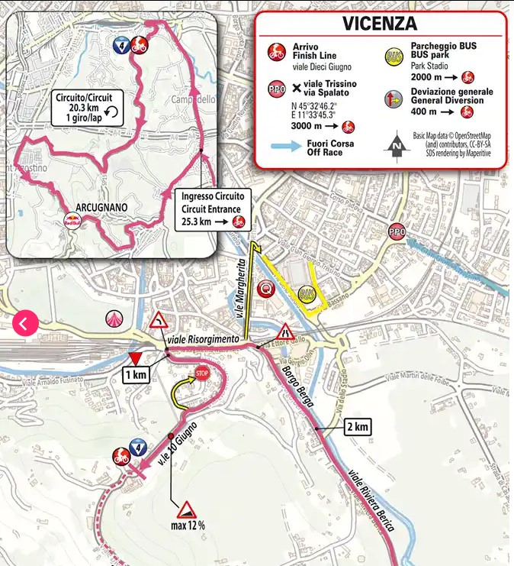
PAO – Giro d’Italia
Memorial Day Weekend (22-23 May)
International Professional Bike Race
Impacts to the Vicenza Military Community:
  Significant road closures & parking bans
  Increased Regional Traffic
No Impact to DoDEA
Friday 23 May
0500 – 2300 Closure:
  via Petrarca
  via Boccaccio
  viale Dante
  viale X Giugno
  viale D'Azeglio
  Borgo Berga
  viale dello Stadio
1345-1800 Closure:
  viale Riviera Berica
  strada del Tormeno
  viale del Risorgimento Nazionale
  viale X Giugno (Monte Berico)
1600 Race arrives at city from the south
2300 (or until end of race)
Thursday 22 May
1400 Closure:
  Monte Berico Square (Piazzale della Vittoria) until race completion
1900 Road closures & parking bans:
  viale X Giugno
  via Avogadro di Casanova
  via Natale del Grande
  via Schio (near stadium)
Train Station
Monte Berico

Slide 26
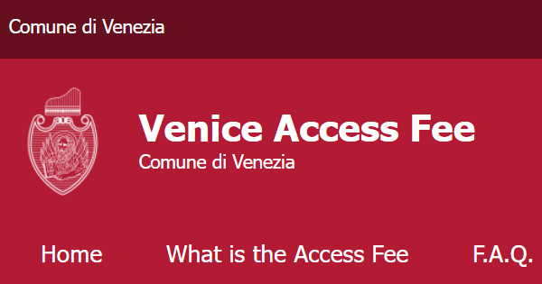
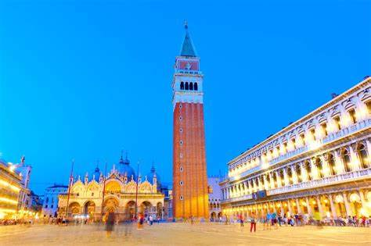
PAO – Venice Access Fee
For 54 days (18 April to 27 July) the City of Venice requires an Access Fee for all individuals aged 14 and above.
This fee applies to visitors entering the city on designated days and it is part of a broader initiative to manage over tourism.
https://cda.ve.it/en/
Key Details for Vicenza Military Community
🗓️ Access Fee Validity: Venice Access Fee is in effect
on weekends (Friday through Sunday) and public holidays.
✅ Exemption Eligibility: U.S. personnel residing in the larger Vicenza area and officially assigned to the base are exempt from the Venice Access Fee and do not need to book their visit.
📌 Proof of Residency: Be sure to carry documentation confirming your residency in Vicenza (Permesso di Soggiorno), and ID or a memo statement of assignment to the U.S. base in Vicenza.
🔍 Entry Checks: Local authorities may verify residency status at designated entry points, including train stations, ferry terminals, bus stations, and public parking garages.
❗All personnel should have their necessary documents readily available to ensure smooth access to Venice during this period.
https://cda.ve.it/en/

Slide 27
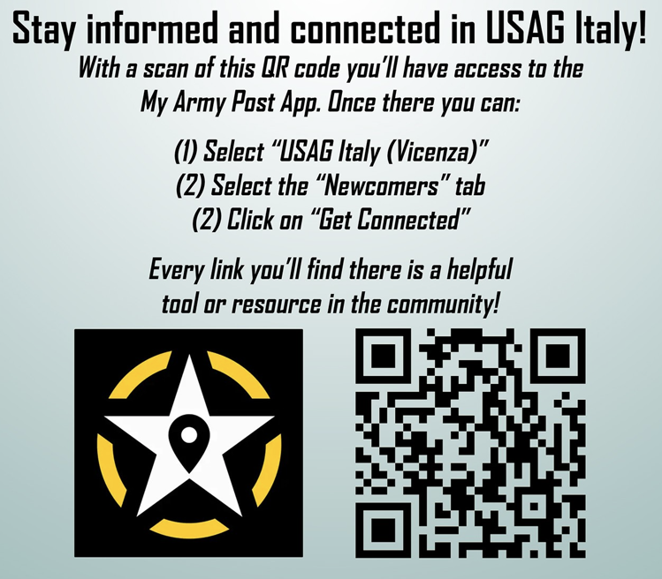
PAO – Are You Connected?

Slide 28
Next CLIF
(Back to School)
Wednesday, 13 August
1030-1130
GOLDEN LION, CASERMA EDERLE
Also:
Join us at the Townhall on Tuesday, 24 June at 1530
in the Ederle Post Theater

