Slide 1
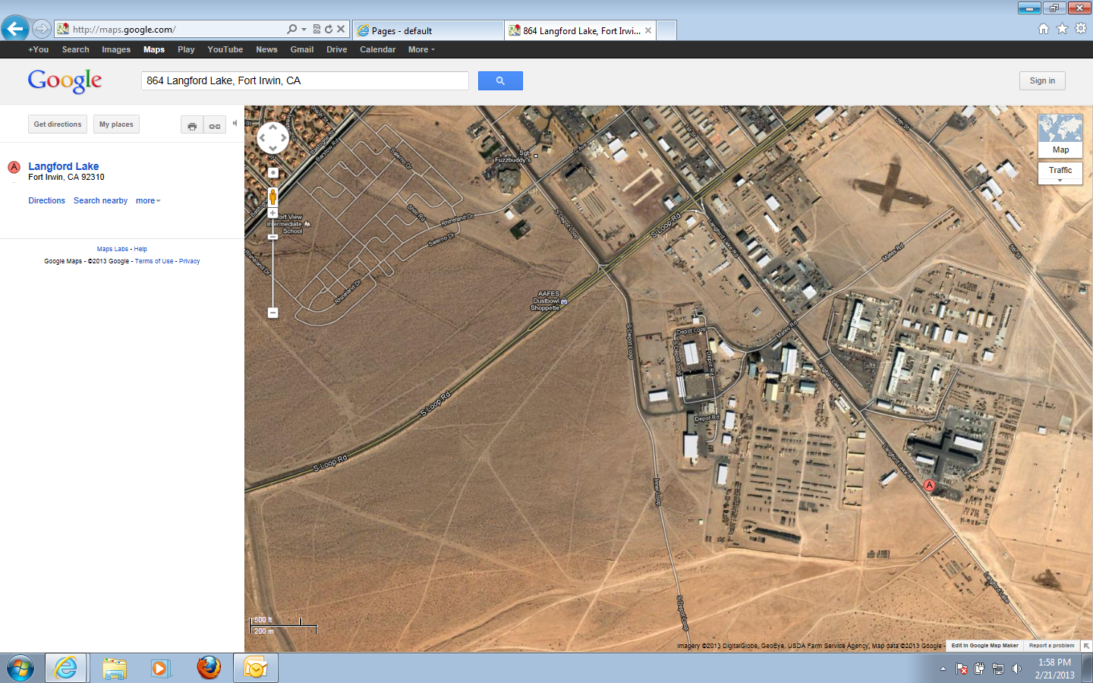
RC-OPT Billets BLDG 864 Langford Lake Road
From Ft. Irwin Main Gate

Slide 2
RC-OPT Billets
KSP1:
- 119 Beds
- 1 Toilet,
- 2 Microwaves, 2 Refrigerators
RC1:
- 32 Beds
- 2 Microwaves, 2 Refrigerators
KSP2:
- 118 Beds,
- 2 Microwaves, 2 Refrigerators
864:
- Laundry 7 Washers, 8 Dryers
- Latrines
Male: 21 Showers, 16 Toilets, 16 Urinals
Female: 3 Showers, 3 Toilets
864A:
- RM2:
- 75 Beds
2 Microwaves, 2 Refrigerators
12 Latrines
- RM3:
- 26Beds
2 Microwaves, 2 Refrigerators
12 Latrines
- RM5
- 4 Beds
1 Microwave, 1 Refrigerator
1 Latrine
NOTES
- Unit must bring cleaning supplies
- Park only in designated areas
- BLDG Managers
SFC Sellers, Crystal: 410-782-9919
SGT Lee, Deonta: 562-521-2718
Staff Duty: 760-964-1774
Designated Parking for GSA/POV
RC1
KSP2
Load/Unload Only
KSP1
Load/Unload Only
Tactical Vehicle Parking
Designated Smoking Area
RM 3
864
RM 5
RM 2
864A
Designated Parking GSA/POV
Keep Area Clear
Tactical Vehicle Parking
RC-OPT Supply
Dumpsters
- Keep lids Closed at all times
- Keep area clear for trash pick up

