Slide 1
Fort Irwin Community Town Hall
COL LANE A. BOMAR
CSM DAVID D. PALMER
U.S. Army Garrison, Fort Irwin, CA
Controlled by: HQ IMCOM Controlled by: AMIM-G3
CUI Category: N/A
Limited Dissemination Control: DL ONLY POC: anthony.l.evans18.civ@army.mil 760.380.5915
As of: 171000DEC2024
Title_Fort Irwin Community Town Hall

Slide 2
Fort Irwin Community Town Hall
Agenda
Opening Remarks
Calendar Highlights
Religious Services Holiday Dates & Start Time – Religious Support Office
Capstone
Food Inspection Grades – Weed Army Community Hospital
Telehealth Options – Health Net Federal Services
Victor Community Support Services – Military Services & Family Support
Wellness January 2025 – Army Substance Abuse Prevention – DHR
Christmas in January – Directorate of Family and Morale, Welfare and Recreation
Holiday Safety – Installation Safety Office
Block Leave Schedules
Closing Remarks
Next Town Hall : 14 JAN 2024

Slide 3
Fort Irwin Community Town Hall
Calendar Highlights
Notes:
Need TP for FIP

Slide 4


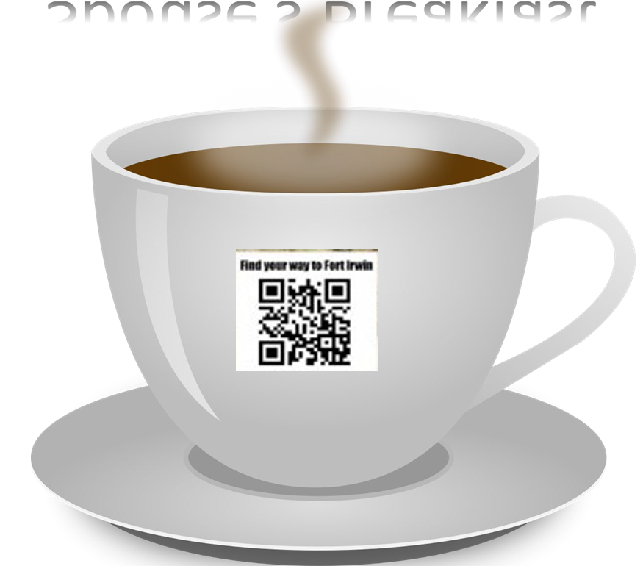




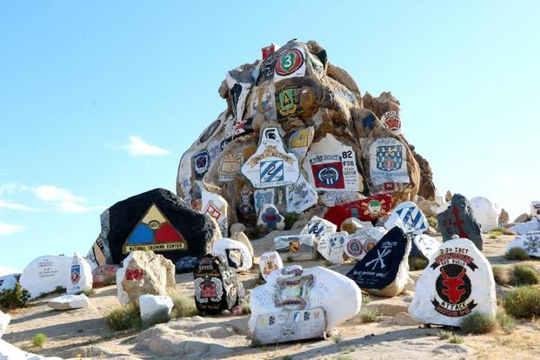




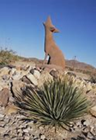
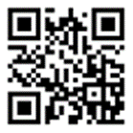
DECEMBER 2024
SUN | MON | TUES | WED | THURS | FRI | SAT
1 | 2 | 3 | 4 | 5 | 6 | 7
8 | 9 | 10 | 11 | 12 | 13 | 14
15 | 16 | 17 | 18 | 19 | 20 | 21
22 | 23 | 24 | 25 | 26 | 27 | 28
29 | 30 | 31
- Mayor's Meeting
- MEDDAC DFAC
- Indoor Soccer 3-5 Dec/FFC
- A/C Holiday Mug Class
- FICA Chambers
- Holidays Décor Sign Ups
- USO Kid's Storytime
- USO Coffee Connection
- CG Reception
- Tree Lighting @ Town Center
- SquatMas FFC
- A/C Bird Painting
- ETS Brief
- GrootMas MFC
- Santa's Workshop Toy Ruck March
- Food Pantry
- OPS GRP Ball
- BH CoR
- BH Holiday Party UJEN
- 916th Santa MPH
- FICA vs MCLB
- BOSS Chess Tournament
SMA(R) Dailey
- Michaels’s Cookies and Cocoa with Santa
- A/C Handprint Class End
- Town Hall
- Retirement Ceremony
- IPB
- BOSS Snow Summit Skiing Trip
- Housing Holliday Voting
- BOSS Christmas Party
- Army Float Decor
SVHS Finals
Housing Holliday Voting
- BOSS Tubing Trip
- BOSS Mt. High Skiing Trip
- BOSS Texas Roadhouse Trip
-
21 DEC – 05 JAN 25: BLOCK Leave / SVUSD Holiday Break
- BOSS Army Float Decor
21 DEC – 05 JAN 25: BLOCK Leave / SVUSD Holiday Break
SCAN QR CODE TO ACCESS Community Calendar
National Training Center and Fort Irwin Highlights
FICA Chambers 5 DEC
CG Reception and Tree Lighting 7 DEC
ETS Brief 9 DEC
Santa’s Workshop Ruck March 10 Dec
OPS GRP Ball 13 DEC
916th Santa MPH14 DEC
Town Hall: 17 DEC
BLOCK Leave / SVUSD Holiday Break: 21 DEC – 05 JAN 23

Slide 5





JANUARY 2025
SUN | MON | TUES | WED | THURS | FRI | SAT
 |  |  | 1 | 2 | 3 | 4
5 | 6 | 7 | 8 | 9 | 10 | 11
12 | 13 | 14 | 15 | 16 | 17 | 18
19 | 20 | 21 | 22 | 23 | 24 | 25
26 | 27 | 28 | 29 | 30 | 31
- Rose Bowl
- Step New Year 1Jan-28 Feb/MFC
- ASAP Game Night
21 DEC – 05 JAN 25: Winter Block Leave / SVUSD Winter Break
- SVUSD Back to School
- ASAP Yoga
- Food Pantry
- ASAP Holistic Approach
- Christmas In January
- BH New Year Reception
- ASAP Game Night
- ETS Brief
- ASAP Yoga
- ASAP Game Night
- Federal Holiday
- ASAP Yoga
- ASAP Game Night
- ASAP Yoga
SCAN QR CODE TO ACCESS Community Calendar
National Training Center and Fort Irwin Highlights
Rose Bowl (1 JAN)
SVUSD Back to School (06 JAN)
Christmas In January (11JAN)
ETS Brief (13 JAN)
Federal Holiday (20 JAN)

Slide 6
Fort Irwin Community Town Hall
Religious Support Office
Chaplain (COL) Brian Tung
NTC Installation Chaplain
Contact Information:
Email: brian.m.tung.mil@army.mil
Phone: (760) 380 - 4664

Slide 7
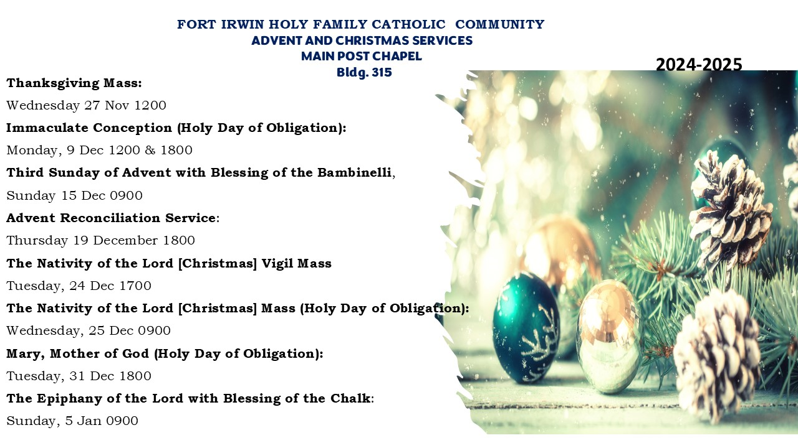
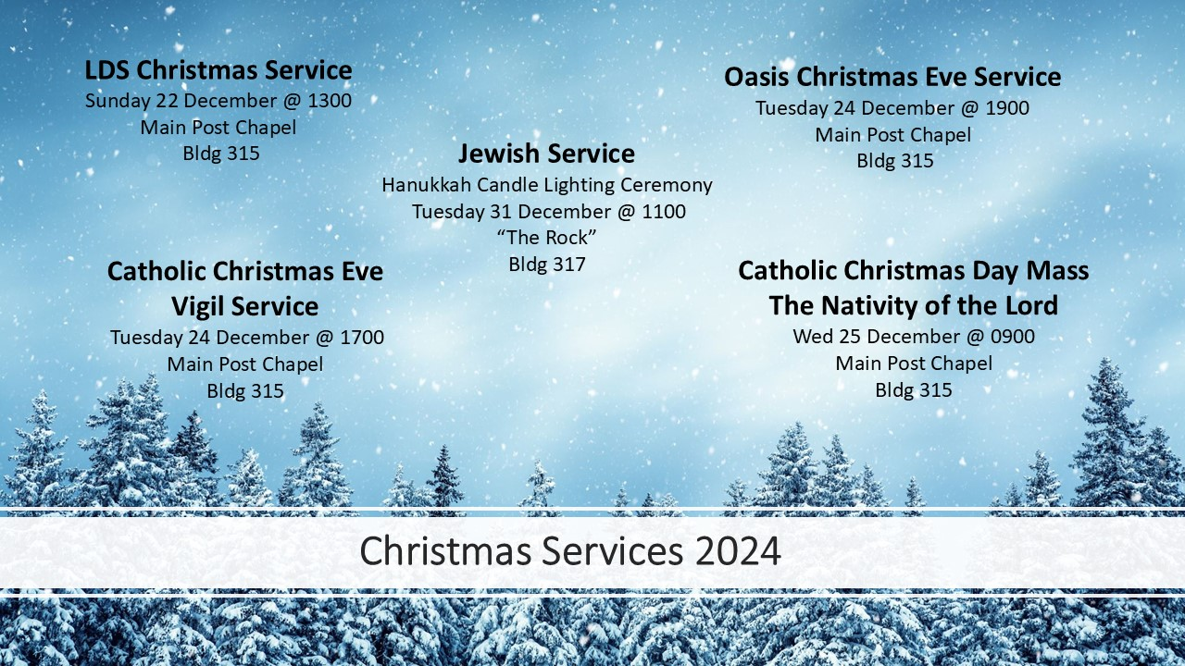

Slide 8
Fort Irwin Community Town Hall
Capstone
Notes:
Need TP for FIP

Slide 9


Project Convergence Capstone 5 (PCC5)
Mission
The National Training Center supports Project Convergence – Capstone 5 at Fort Irwin, from 03 FEB 2025 to 24 MAR 2025 in order to facilitate the Army Futures Command and Joint Modernization Command’s effort to integrate and assess concepts, capabilities and formations conducting large scale combat operations.
Intent
Inform Fort Irwin community about the influx of personnel and potential resource constraints due to PC C5.
Purpose
PC C5 demonstrates Army modernization capabilities and formations while experimenting with emerging concepts in a Multi-Domain Operations (MDO) environment at multiple echelons and with Joint Components and Multi-National Partners.
FEB | 25-04 | 1 | 2 | 3 | 4 | 5 | 6 | 7 | 8 | 9 | 10 | 11 | 12 | 13 | 14 | 15 | 16 | 17 | 18 | 19 | 20 | 21 | 22 | 23 | 24 | 25 | 26 | 27 | 28
 |  | S | S | M | T | W | TH | F | S | S | M | T | W | TH | F | S | S | M | T | W | TH | F | S | S | M | T | W | TH | F
 |  |  |  |  | 25-09 RSC |  | LTP 25-09 53 IBCT |  |  |  |  |  |  |  |  |  |  |  |  |  |  |  |  |  | 24-28 Feb Commex
 | 1/1 ID ABCT | 25-03 REGENERATION |  |  |  |  |  |  |  |  |  |  |  |  |  |  |  |  | 05 TP | 25-05 RSOI |  |  |  | 25-05 ADVON |  | 25-05 MAIN BODY
 | FORT RILEY | 04 MB |  | 25-04 RSOI |  |  |  | RO | 25-04 TRAINING DAYS |  |  |  |  |  |  |  |  |  |  |  |  |  | 25-04 REGENERATION
 | JMC CAPSTONE 5 |  |  | JMC Torch |  |  |  |  |  | JMC ADVON / Node Support Torch (ESB etc.) |  |  |  |  |  |  |  |  | Unit Torch & JMC/FCC MB |  |  |  | Unit ADVON |  |  | Unit MB Arrival Window
MAR | 25-05 | 1 | 2 | 3 | 4 | 5 | 6 | 7 | 8 | 9 | 10 | 11 | 12 | 13 | 14 | 15 | 16 | 17 | 18 | 19 | 20 | 21 | 22 | 23 | 24 | 25 | 26 | 27 | 28
 |  | S | S | M | T | W | TH | F | S | S | M | T | W | TH | F | S | S | M | T | W | TH | F | S | S | M | T | W | TH | F
 |  |  |  |  |  |  |  |  |  |  |  |  |  |  |  | SILVER VALLEY SPRING BREAK
 |  | 25-04 REGENERSTION |  |  |  |  |  |  |  |  |  | 06 TP | 25-06 RSOI |  |  |  |  | 25-06 ADVON |  | 25-06 MAIN BODY |  |  |  | 25-06 RSOI |  |  |  |  | RO
 | CAPSTONE 5 AFC | (1 - 5 Mar VALEX) CAPSTONE 5 RSOI (6-9 Mar Rehearsels) |  |  |  |  |  |  |  |  | CAPSTONE 5 TRAINING DAYS |  |  |  |  |  |  |  |  |  | CAPSTONE 5 REGEN |  |  |  |  | 25-11 RSC |  | LTP 25-11 2-2 ID SBCT

Slide 10
Project Convergence Capstone 5 (PCC5)
Timeline is 3 Feb through 23 Mar 2025
Fort Irwin will grow by ~5000 - 6000 people from 3 Feb to 23 Mar 2025 placing significant strain on RUBA facilities and Fort Irwin life support overall.
Capstone is different from typical rotations because the bulk of personnel here supporting the experiment will be in the hotel or staying off post. Capstone participants will generally work until 1700 daily.
Many personnel will not be reliant on the standard unit “mess” tents and will instead be purchasing from:
  Commissary
  PX
  Food trucks
  AAFES eating establishments
  Starbucks
  Shopette
  Warrior Zone
  Epicenter
What does this mean for the Fort Irwin Community?
Notes:
Entry and Exit control points will be significantly more congested throughout the Capstone occupation.
Expect high demands for food, fuel, and other basic necessities within the Ft. Irwin cantonment.
Increased traffic
Etc.

Slide 11
Fort Irwin Community Town Hall
Weed Army Community Hospital
SGT Jannie Fontenot
DPH BCOIC / EH NCOIC
Contact Information:
Email: jannie.u.Fontenot.mil@health.mil
Phone: (760) 383 -5804 / 5812

Slide 12
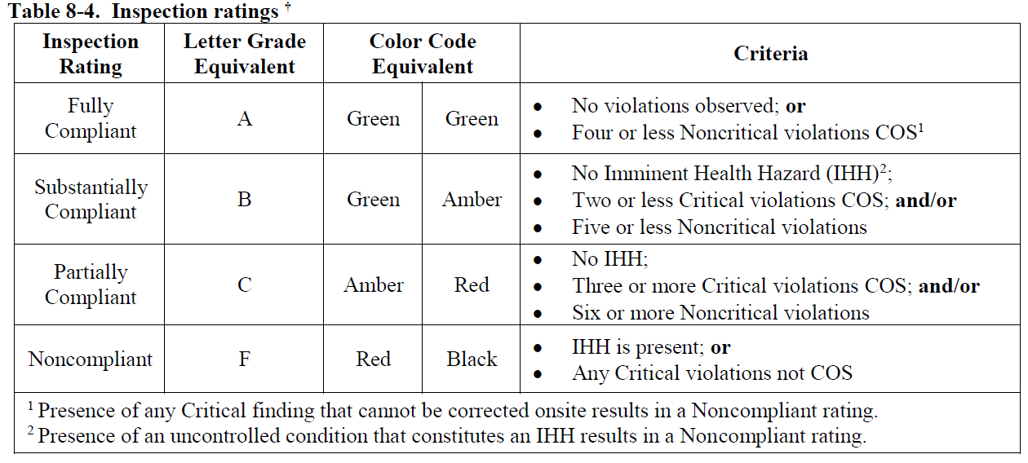
Fort Irwin Community Town Hall
Weed Army Community Hospital

Slide 13
Fort Irwin Community Town Hall
Weed Army Community Hospital
Letter grades will be provided to all food facilities at Fort Irwin and will be posted in plain view.
Grades are applicable to Fort Irwin only and may be removed by food trucks when they exit the installation; however, they must be reposted before serving food to the general public.
Failure to publicly post the facility’s letter grade:
  1st offense – Verbal Warning
  2nd offense – Written Warning
  3rd offense – Garrison involvement and closure
A letter grade of “F” will result in immediate facility closure with the Garrison Commander being briefed before the inspector departs the facility.
13

Slide 14
Fort Irwin Community Town Hall
Health NET Federal Services
Ms. Tracy Sheffield
TRICARE Beneficiary Educator – High Desert
Contact Information:
Email: tracy.Sheffield@hnfs.com
Phone: (775) 493 - 7698

Slide 15
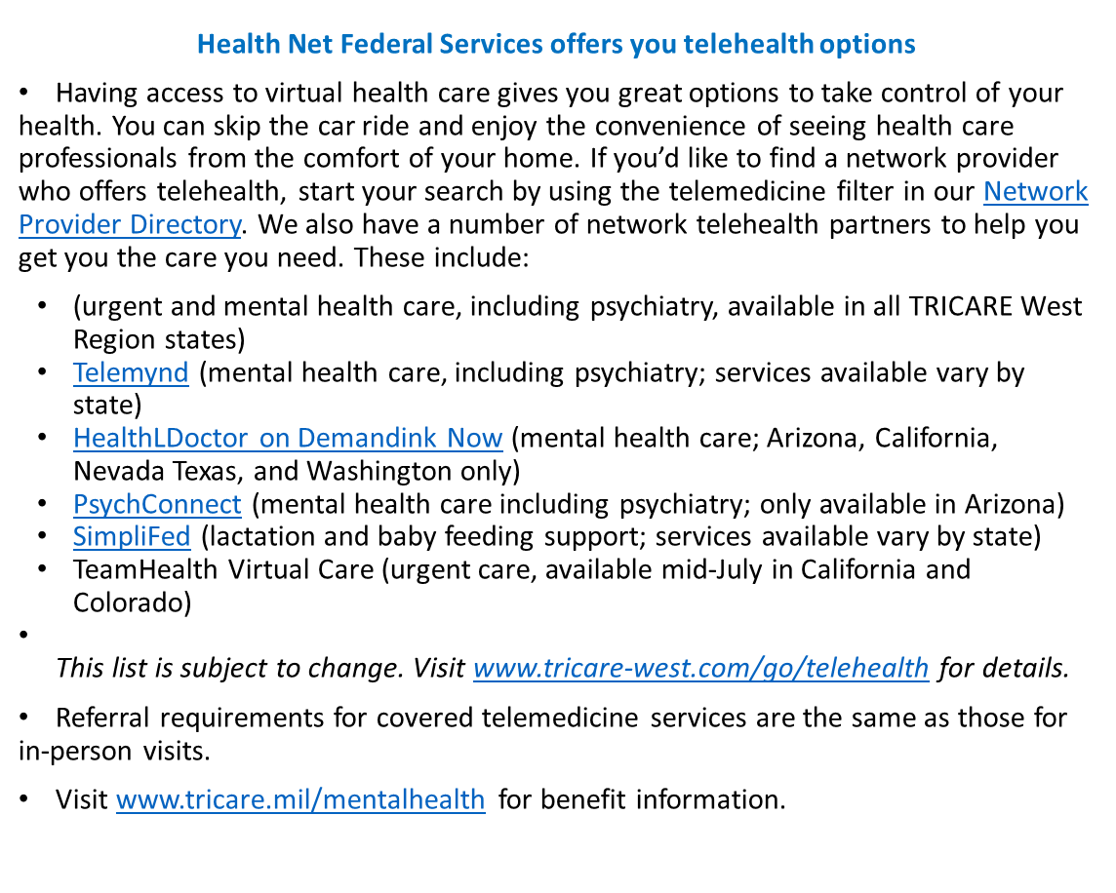
Fort Irwin Community Town Hall
Health NET Federal Services

Slide 16

Fort Irwin Community Town Hall
Victor Community Support Services
Ms. Katrina Gonzalez
Clinical Supervisor
Contact Information:
Email: Katrina.Gonzalez@victor.org
Phone: (760) 255-1496

Slide 17
Fort Irwin Community Town Hall
Victor Community Support Services
Military Services and Family Support
Our program provides in-home or community-based psycho-social assessments, family interventions, and rehabilitative support for military families in San Bernardino County. This approach increases the likelihood that military personnel will utilize services while also reducing stigma and discrimination associated with mental illness.
Our program is intended for all veterans, active duty or retired military personnel, reservists or National Guard and their families.
We provide individual counseling/therapy, couples counseling and family therapy.
We provide virtual, in home, in office and in the community services to best meet our clients needs.
We accept self-referrals and community-based referrals. We then match the client with our prevention specialist or our early intervention psychotherapist. If the needs of the clients/clients are outside of our scope of practice/competence we refer out to a more appropriate level of care.
Our services are free to the individuals and families we serve.
17
17

Slide 18
Fort Irwin Community Town Hall
Army Substance Abuse Prevention (ASAP) Program
Ms. Ashley Walay
ASAP Program Manager
Contact Information:
ashley.g.walay.civ@army.mil
(760) 380-1366

Slide 19
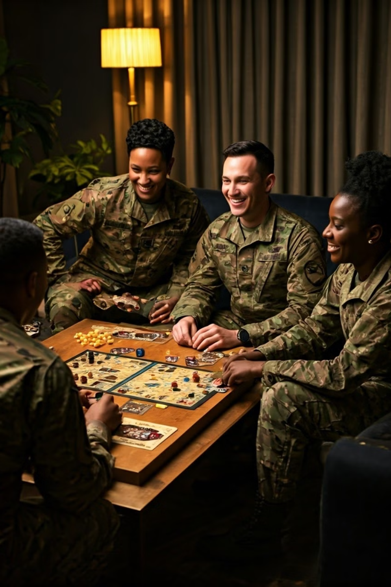
Fort Irwin Community Town Hall
Army Substance Abuse Prevention (ASAP) - DHR
“Wellness January" 2025:
Join us for a month of fun activities and events to nurture your overall well-being, health, and strengthen social connection!
1
Meditation Mondays at 6:30pm Sandy Basin
Start your week centered and calm
2
Community Game nights every Saturday
And Movie Nights
3
Wellness Fair
Explore health resources, try fitness demos, and learn about holistic well-being at our Wellness Fair on January 10th.
19
19
Notes:
Need TP for FIP

Slide 20
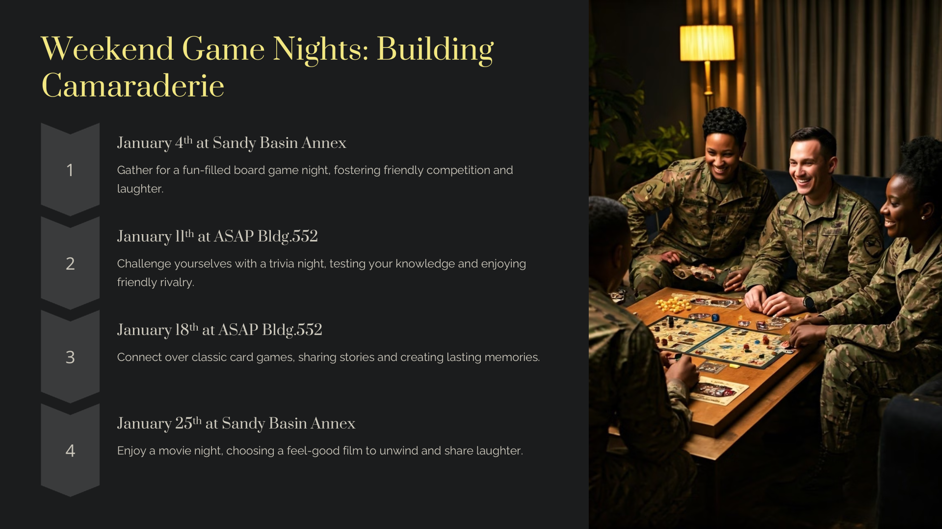

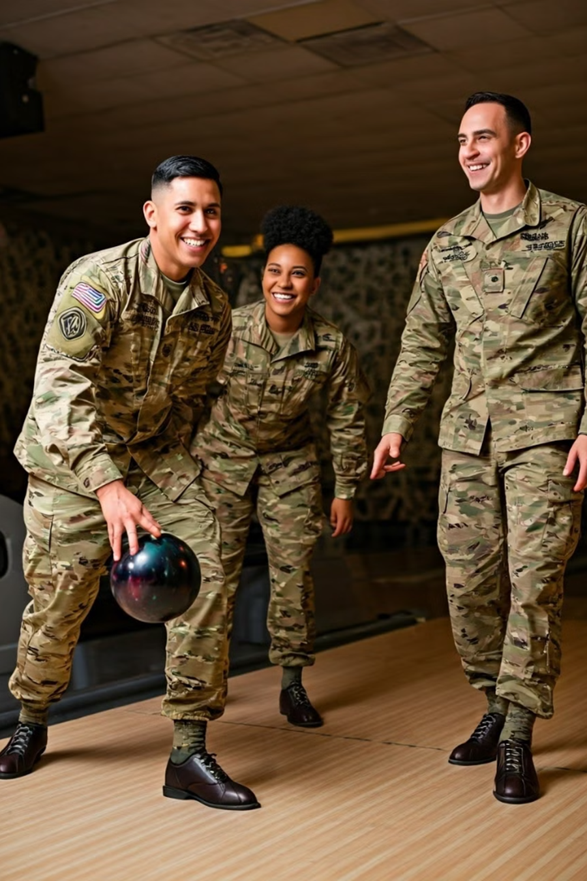
Fort Irwin Community Town Hall
Army Substance Abuse Prevention (ASAP) - DHR
20
Notes:
Need TP for FIP

Slide 21

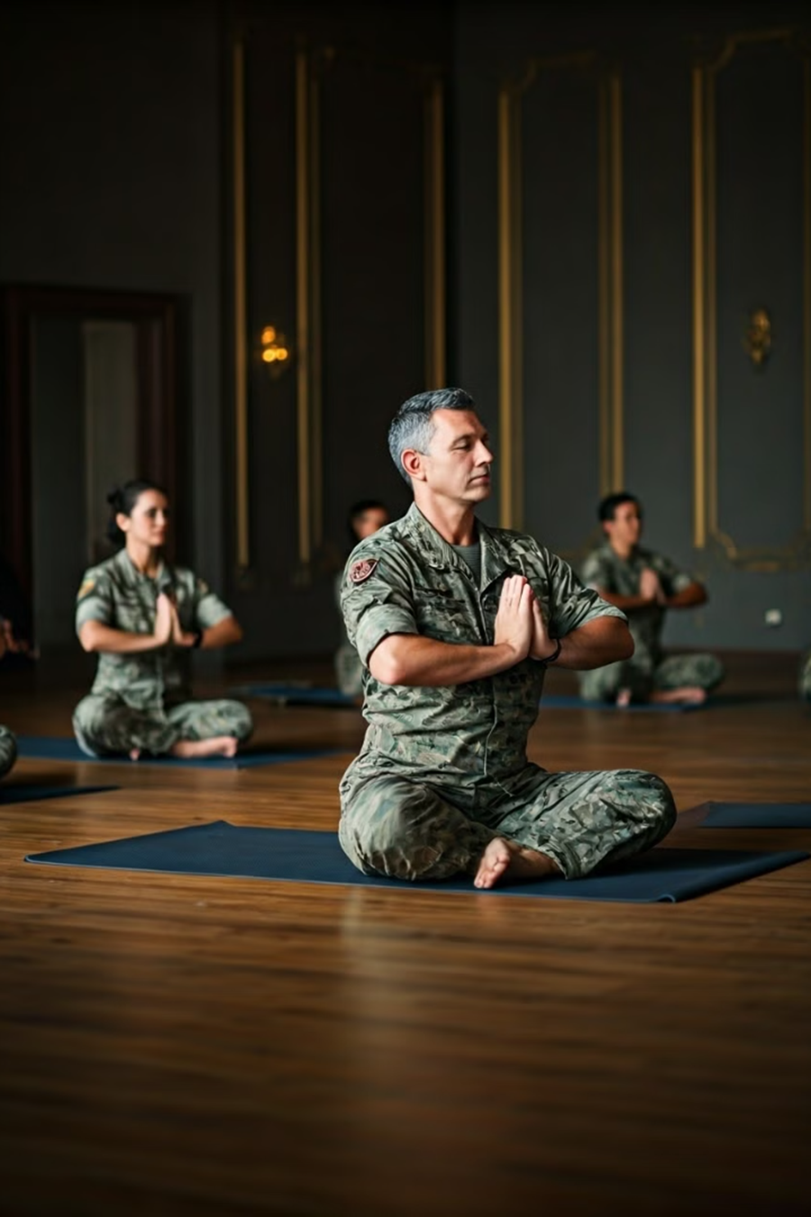
Fort Irwin Community Town Hall
Army Substance Abuse Prevention (ASAP) - DHR
Building a Strong, Resilient Military Community
21
Notes:
Need TP for FIP

Slide 22
Fort Irwin Community Town Hall
DFMWR
Ms. Danielle Underwood
Special Events Coordinator
Contact Information:
danielle.l.underwood2.naf@army.mil
(760) 380-7447
22

Slide 23

Fort Irwin Community Town Hall
DFMWR
23

Slide 24
Fort Irwin Community Town Hall
Garrison Safety Office
Mr. Mark A. Harvey
Installation Safety Director
Contact Information:
Email: mark.a.harvey3.civ@army.mil
Phone: (760) 380- 1347

Slide 25
Fort Irwin Community Town Hall
Garrison Safety Office
Holiday Safety
Traffic Safety: Seatbelts, distracted driving, driver fatigue, and weather.
Home Safety: Slips, trips and falls, and cooking safety.
Weapons Safety: Secure weapons, limit access to responsible adults.
Fire Prevention: Water natural trees, check smoke alarms and review fire escape plan, regularly check lights for exposed or frayed wires and loose connections. If using an artificial tree, check that it is labeled “fire resistant”.
Holiday Decorations: Turn off decorative lights before leaving home or going to sleep.
Holiday Gift Giving: Make sure the toy, game, or gift is appropriate for child’s age and development.
Holiday Party Guidelines: Drink responsibly and have a buddy.

Slide 26
Fort Irwin Community Town Hall
Opportunity Leave & Holiday Hours

Slide 27
Fort Irwin Community Town Hall
Directorate of Human Resources
Opportunity Leave & Holiday Hours (21 Dec 24 through 5 Jan 25)
ALL DHR FACILITIES ARE CLOSED THURSDAYS 0730-1300 FOR TRAINING AND ALL WEEKENDS AND FEDERAL HOLIDAYS
Directorate of Human Resources Bldg.106 | Mon, Tue, Wed, & Fri: 0800-1600, Thu: 1300 – 1530
DEERS Bldg.108 | Mon, Tue, Wed, & Fri: 0800-1600, Thu: 1300 - 1530
Soldier Services Bldg. 108 | Mon-Fri: 0900 - 1530
Transitions/Reassignments Bldg.107 | Mon, Wed, Fri: 0900 - 1530, Closed: Tues & Thu
Soldier for Life Transition Assistance Program Bldg. 312 | Mon, Tue, Wed, & Fri: 0730-1600, Thu: 1300-1530
Administrative Services Division Bldg. 105 | Mon, Tue, Wed, & Fri: 0800-1600, Thu: 1300-1600
Education Center Bldg. 1020 | Mon, Tue, Wed, & Fri: 0730-1600, Thu: 1300-1530
Administrative Services Division Bldg. 105 | Mon, Tue, Wed, & Fri: 0800-1600, Thu: 1300-1600

Slide 28
Fort Irwin Community Town Hall
DFMWR
Opportunity Leave & Holiday Hours (21 Dec 24 through 5 Jan 25)
ARMY COMMUNITY SERVICES (ACS)
Facility/Program | Normal Hours | DFMWR Closure 13 Dec 23 | Christmas 25 Dec 24 New Year’s 1 Jan 25 | Opportunity Leave: 16-26 Nov 24 Block Leave Hours: 18 Dec 24 - 5 Jan 25
ACS, Bldg.109 Information and Referral Army Emergency Relief Financial Readiness Family Advocacy Volunteer Coordinator Employment Readiness Mobilization and Deployment Exceptional Family Member Program New Parent Support | Mon-Fri: 0800-1600 | Closed | Closed | Mon-Fri: 0800-1600

Slide 29
Fort Irwin Community Town Hall
DFMWR
Opportunity Leave & Holiday Hours (21 Dec 24 through 5 Jan 25
BUSINESS OPERATIONS
Facility/Program | Normal Hours | DFMWR Closure 13 Dec 24 | Christmas 25 Dec 23 New Year’s 1 Jan 25 | Opportunity Leave: 16-26 Nov 24 Block Leave Hours: 18 Dec 24 - 5 Jan 25
Epicenter, Bldg. 37 | Cho’s Barbershop - M-F 0700-1630 Admin Office - Tue - Friday 1000-1800 Catering-Office Hours M 0900-1500 / W 1300-1830; by appointment Bama’s - Wed-Thu 1630-2100 / Fri & Sat 1630-2200 Sam Adams - Thu-Mon 1600-2100 | Closed | Closed | Cho’s Barbershop - Closed Admin - Mon-Fri 0800-1600 Catering - By appointment Bama’s - Closed Sam Adams - Closed
Shockwave, Bldg. 272 | Closed for renovation | Closed | Closed | Closed for renovation
Shockwave Express, Building 21 | Tue-Sat 1500-2100 | Closed | Closed | Tue-Sat 1500-2100
Desert Winds Bowling Center, Bldg.905 | Mon - Tue: Closed Wed - Thu: 0600-2100* Fri: 0600-2300* Sat: 1100-2300* Sun: 1100-2100* *Kitchen closes 1 hour prior to facility | Closed | Closed 24 &31 Dec 2023 In observation of holidays | Sun, Mon & Tue: Closed Wed-Sat: 1400-2100* * Kitchen closes 1 hour prior to facility
Paws and Claws, Bldg. 978 Office Hours | Mon - Fri: 0900-1700 | Closed | Closed | Mon - Fri: 0900-1700 Sat/Sun: By Appointment

Slide 30
Fort Irwin Community Town Hall
DFMWR
Opportunity Leave & Holiday Hours (21 Dec 24 through 5 Jan 25)
COMMUNITY RECREATION
Facility/Program | Normal Hours | DFMWR Closure 13 Dec 24 | Christmas 25 Dec 24 New Year’s 1 Jan 25 | Block Leave Hours: 21 Dec 24 - 5 Jan 25
Outdoor Recreation, Bldg. 4100 | Mon - Fri: 1000-1800 Sat: 0800- 1600 | Closed | Closed | Mon - Fri: 1000-1800
Warrior Zone, Bldg. 361 | Wed - Fri: 1300-2200 Sat: 1100-2200 Sun: 1000-2100 | Closed | Closed | Mon - Fri: 1100-1900
Tickets and Tours, Bldg. 976 | Tue - Sat: 1000-1800 | Closed | Closed | Mon - Fri: 1000-1600
Mojave Arts and Gifts, Bldg. 976 | Tue - Sat:1000- 1800 | Closed | Closed | Mon - Fri: 1000-1600
Auto Skills, Bldg. 910 | Wed - Fri: 1200-2000 Sat - Sun: 0800-1800 | Closed for Renovation | Closed for Renovation | Opportunity Leave: Wed - Sun: 1000-1800 Block Leave: Closed for Renovation
Library, Bldg. 331 | Mon - Fri: 1000 -1700 Sat: 1000-1500 | Closed | Closed | Mon - Fri: 1000-1700

Slide 31
Fort Irwin Community Town Hall
DFMWR
Opportunity Leave & Holiday Hours (21 Dec 24 through 5 Jan 25)
COMMUNITY RECREATION
Facility/Program | Normal Hours | DFMWR Closure 13 Dec 23 | Christmas 25 Dec 24 New Year’s 1 Jan 25 | Block Leave: 21 Dec 24 – 5 Jan 25
Oasis Pool, Bldg. 325 | Mon - Fri: 0600-2000 Sat: 0900-1700 | Closed | Closed | Mon - Fri: 0800-1600 Sat: 1000-1600
Freedom Fitness, Bldg. 362 | Mon - Fri: 0500-2200 Sat & Sun: 0900-1600 | Closed | Closed | Mon – Fri: 1100-1900 Sat/Sun: 0900-1600
Memorial Fitness, Bldg. 322 24 Hour Facility | Staffed Hours Mon - Fri: 0500-2200 FOB Access Mon - Fri: 2200-0500 Sat - Sun: 24 Hours | FOB Access | FOB Access | Mon - Fri: 0500-1400 FOB Access during unstaffed hours
Box Fitness, Bldg. 127 | Staffed Hours Mon - Fri: 0500-2200 FOB Access Only Mon - Fri: 2200-0500 Sat - Sun: 24 Hours | FOB Access | FOB Access | Mon - Fri: 0500-1400 FOB Access during unstaffed hours

Slide 32
Fort Irwin Community Town Hall
DFMWR
Opportunity Leave & Holiday Hours (21 Dec 24 through 5 Jan 25)
CHILD AND YOUTH SERVICES (CYS)
Facility/Program | Normal Hours | DFMWR Closure 13 Dec 23 | Christmas 25 Dec 24 New Year’s 1 Jan 25 | Block Leave: 21 Dec 24 - 5 Jan 25
CYS Administration Youth Sports, Bldg. 1317 | Mon - Fri: 0730-1600 | Closed | Closed | Mon - Fri: 0730-1600
Parent & Outreach Services School Liaison, Bldg. 21 | Mon, Tue, Wed, Fri: 0730-1630 Thu: 0730-1230 | Closed | Closed | Mon, Tue, Wed, Fri: 0730-1630 Thu : 0730-1230
Cactus Corner Child Development Center Bldg. 4150 | Mon - Fri: 0600-1800 | Closed | Closed | Mon - Fri: 0600-1800
School Age Center Bldg. 1322 | Mon, Tue, Thu, Fri: 0600-0830 & 1400-1800 Wed: 0600-0830 & 1200-1800 | Closed | Closed | 21-22 & 24 Nov: 0600-1800 18 Dec 23-2 Jan 24: Mon-Fri: 0600-1800
Middle School Teen Bldg. 1315 | Mon-Fri: 0900-1800 Fri (Teens): 1800-2100 | Closed | Closed | Mon - Fri (Camp hours): 0900-1300 Mon - Fri (Open rec): 1300-1800 Fri (Teens): 1800-2100
Family Child Care Bldg. 1313 | Mon-Fri: 0800-1600 | Closed | Closed | Mon - Fri: 0800-1600

Slide 33
Fort Irwin Community Town Hall
Exchange
Opportunity Leave & Holiday Hours (21 Dec 24 through 5 Jan 25)
Facility/Program | Normal Hours | Christmas 25 Dec 23 New Year’s 1 Jan 24 | Opportunity Leave: 16-26 Nov 23 Block Leave Hours: 18 Dec 23 - 2 Jan 24
Exchange Main Store, Bldg. 918 | Mon - Fri: 1000-1800 Sat: 0800- 1600 | Closed | Mon - Fri: 1000-1800 Sat/Sun:
Starbucks, Bldg. 323 | Mon-Fri:0530-1500 Sat/Sun:0530-1500 | Closed New Years: 0800-1500 | Mon - Fri: 0530-1500 Sat/Sun: 0800-1500
24 Hour Express | 24 Hours | Closed | 24 Hours
Taco Bell | Tue - Sat:1000- 1800 | Closed | Mon - Fri: 1100-1700 Sat/Sun:
Military Clothes Sales (MCSS) | Wed - Fri: 1200-2000 Sat - Sun: 0800-1800 | Closed Christmas Eve, Christmas Day and New Year’s Day | Mon-Fri: 1000-1800 Sat/Sun: Closed
Dust Bowl Troop Store | Mon - Fri: 1000 -1700 Sat: 1000-1500 | Closed | Closed
Burger King, Bldg 979 | Mon - Fri: 1000 -1700 Sat: 1000-1500 | Closed | 1030-1800

Slide 34
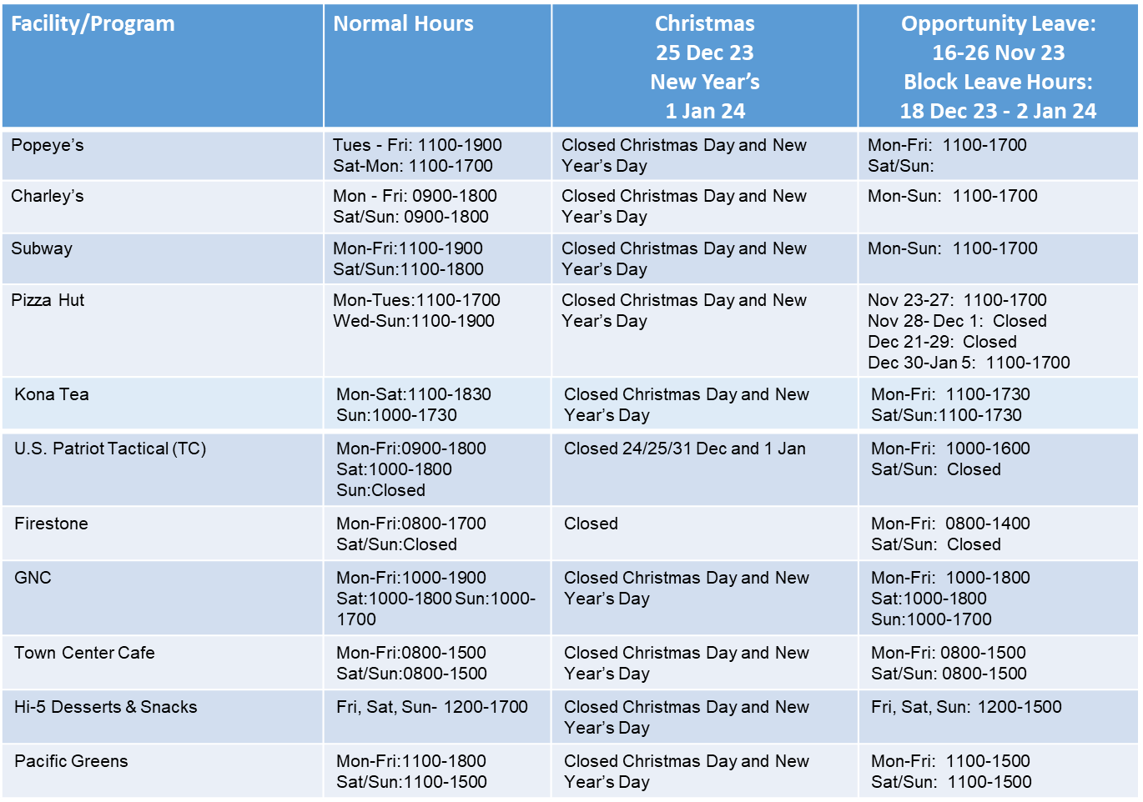
Fort Irwin Community Town Hall
Exchange
Opportunity Leave & Holiday Hours (21 Dec 24 through 5 Jan 25)

Slide 35
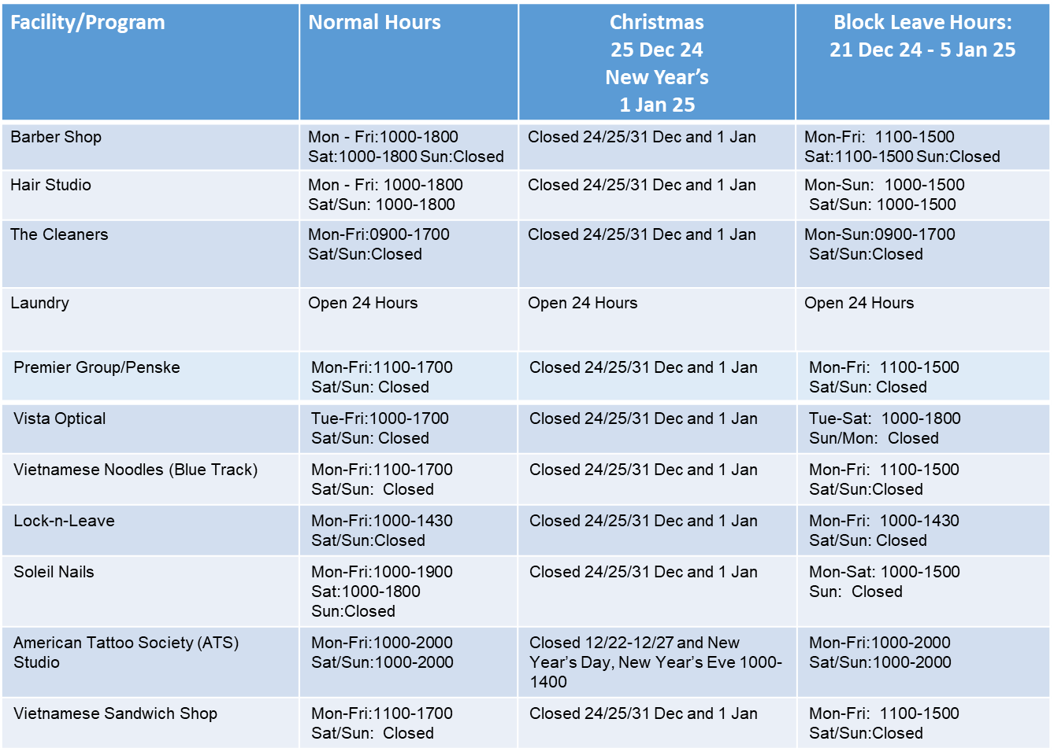
Fort Irwin Community Town Hall
Exchange
Opportunity Leave & Holiday Hours (21 Dec 24 through 5 Jan 25)

Slide 36
Fort Irwin Community Town Hall
Defense Commissary Agency (DeCA)
Opportunity Leave & Holiday Hours (21 Dec 24 through 5 Jan 25)
Facility/Program | Normal Hours | Christmas 25 Dec 24 New Year’s 1 Jan 25 | Block Leave Hours: 21 Dec 24 - 5 Jan 25
Commissary | Mon - Fri: 1100-2000 Sat/Sun: 1030-1900 | Closed | Mon-Fri: 0930-2000 Sat/Sun: 1030-1900 Christmas Eve: 0900-1600

Slide 37
Fort Irwin Community Town Hall
High Desert Support Services (HDSS)
Opportunity Leave & Holiday Hours (21 Dec 24 through 5 Jan 25)
HDSS (work order desk: 760 380-3539) | Mon - Fri: 0730 – 1600
HDSS full staff | Mon - Fri: 0700 – 1530
HDSS HVAC, plumber, boiler personnel and supervisor | Mon - Fri: 0700 – 2000
Weekend and Afterhours (760-380-3512) | Sat-Sun: 0700 – 1530
 | (No change during opportunity leave or holidays)

Slide 38
Fort Irwin Community Town Hall
Housing & Michaels (Housing)
Opportunity Leave & Holiday Hours (21 Dec 24 through 5 Jan 25)
Housing Division (Bldg. 111) | Regular Hours: Mon - Fri: 0730 - 1600
For urgent matters call 760-267-0614
Michaels (Bldg. 4553) | Mon - Fri: 0730 - 1630
For urgent matters call 760-267-3767 | Closed: 25 & 26 Dec 2024 / 1-2 Jan 2025 (Holiday schedule)
For all work orders call 760-386-2460
Routine work order call Mon-Fri 0700-1600 Urgent and Emergency, call immediately at any time

Slide 39
Fort Irwin Community Town Hall
Environmental Services
Opportunity Leave & Holiday Hours (21 Dec 24 through 5 Jan 25)
Recycle Center (bldg. 684) and Landfill | Mon-Fri: 0700-1600
 | Weekend: Closed, except for Rotational Support ; Holidays: Closed
Pollution Prevention (P2) Yard (bldg. 630): | Mon-Fri: 0700-1600
 | Weekend: Closed ; Holidays: Closed
Animal Control Facility (ACF) (bldg. 606) | Daily: 0500-2100
 | (no change in hours during holidays and opportunity leave)

Slide 40
Fort Irwin Community Town Hall
Single Soldier Housing Office (SSHO)
Opportunity Leave & Holiday Hours (21 Dec 24 through 5 Jan 25)
SSHO (bldg. 111) | Mon - Fri: 0730 – 1600
Office Number: #760-380-2776 Use ARMA For Work Order Request For Urgent/Emergency matters call: #760-265-1699 | Weekends/Federal Holidays: Closed

Slide 41
Fort Irwin Community Town Hall
Closing Remarks

Slide 42
Fort Irwin Community Town Hall
Next Town Hall
Date: 14 JAN 2024
Location: EPI Center
Start Time: 1000
Topics of Focus: Barracks Update, Capstone 2025, DeCA Preparation for Capstone 2025, 3rd Party Inspections
POC: Anthony L. Evans, DPTMS, (760) 380 - 5915, anthony.l.evans18.civ@army.mil

