Slide 1
Personality Module

Slide 2
All personalities reflect God
Psalm 139:13-14
For you created my inmost being; you knit me together in my mother’s womb. I praise you because I am fearfully and wonderfully made; your works are wonderful, I know that full well.
Genesis 1:27
So God created mankind in his own image, in the image of God he created them; male and female he created them.

Slide 3
We are the body of Christ
Romans 12:4-5
For just as each of us has one body with many members, and these members do not all have the same function, so in Christ we, though many, form one body, and each member belongs to all the others.
1 Corinthians 12:12
Just as a body, though one, has many parts, but all its many parts form one body, so it is with Christ.

Slide 4
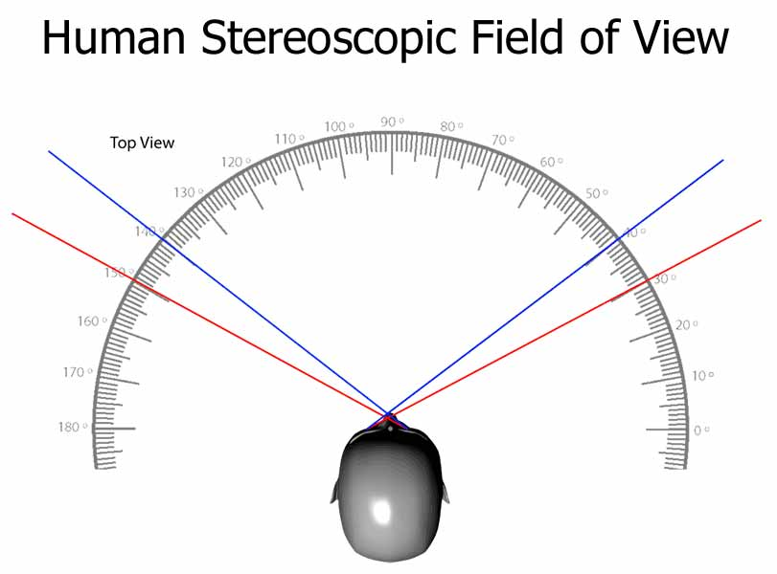
Cooperation and Communication are key

Slide 5
Read & Mark, then Discuss
Words have power. Be careful with each other. Discussing personality may be a high-risk topic for some of your teammates.
Your discussion should emphasize the value God places on every individual and His intentionality in their design.
As you take the assessment, choose descriptors that best describe you. Mark who you are, not who you wish to be. There is deep freedom in embracing your intentional design.

Slide 6
The following material is based on the research and writing of Dr. Gary Smalley and is used with permission granted by The Smalley Institute. Visit SmalleyInstitute.com for quality resources on marriage and relationships.

Slide 7
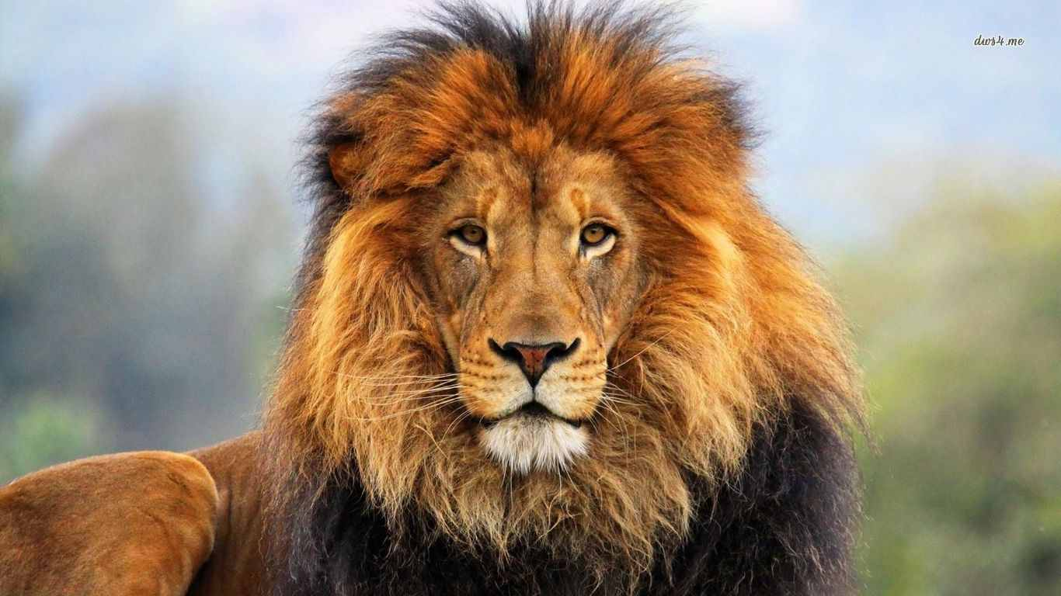
Lion
Born leader
Visionary, big-picture
Goal-oriented, enjoys challenges
Gets things done- Moves us forward!
Wants the bottom-line up front
Direct communicator
Can be aggressive and competitive
Independent
Confident
Biblical example: Paul
Motto: “Do it now!”

Slide 8
Strengths: Strengths Pushed out of Balance:
Problem Solver → Too busy
Bold, direct communication → Insensitive
Decision maker → Not thoughtful of others’ wishes
Strong-willed → Stubborn
Independent, self-reliant → Avoids people and seeking help
Action oriented, persistent → Inflexible, relentless, unyielding
Likes authority → Too direct or demanding
Takes charge → Pushy, impatient, Do it now!
Confident → Cocky, may overlook feelings
Enterprising → Big risks
Competitive → Cold blooded
Stressed: Becomes a dictator
Under Pressure: Lashes out

Slide 9
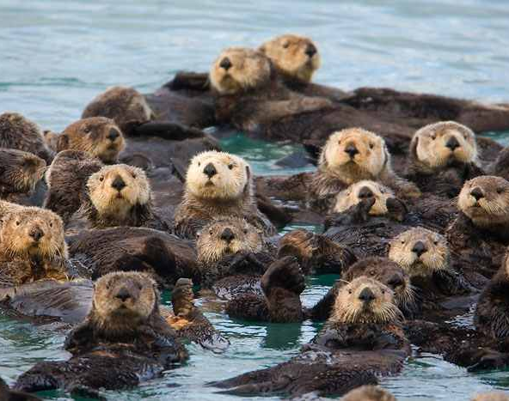
Otter
Social, friendly, loves people
Motivator, inspirational
Verbal
Fun loving
Energetic
Creative
Sees possibilities
Optimistic
Not great on follow-through
Spontaneous, enjoys change
Biblical example: Peter
Motto: “Close enough” or “Trust me, it will work out!”

Slide 10
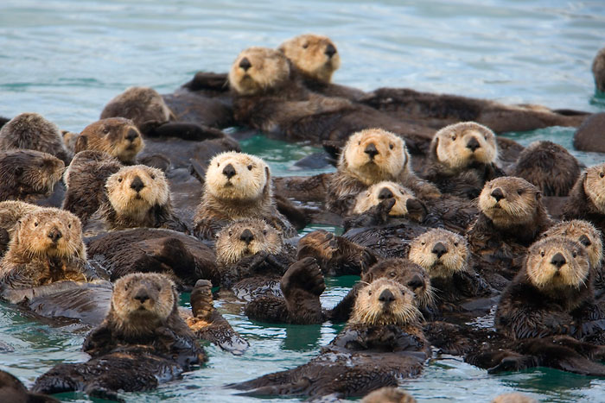
Strengths: Strengths Pushed out of Balance:
Enthusiastic → Overbearing
Takes risks → Dangerous, foolish
Visionary, inspirational → Daydreamer, phony
Fun loving, infectious laughter → Not serious, obnoxious
Motivator, promoter, initiator → Manipulator, exaggerates, pushy
Energetic → Impatient
Friendly, group oriented → Shallow relationships
Likes variety, enjoys change → Scattered, lacks follow-through
Spontaneous → Not focused
Enjoys creativity, new ideas → Unrealistic, avoids details
Stressed: They need to be allowed to be vocal/verbal without judgement
Under Pressure: They verbally attack

Slide 11
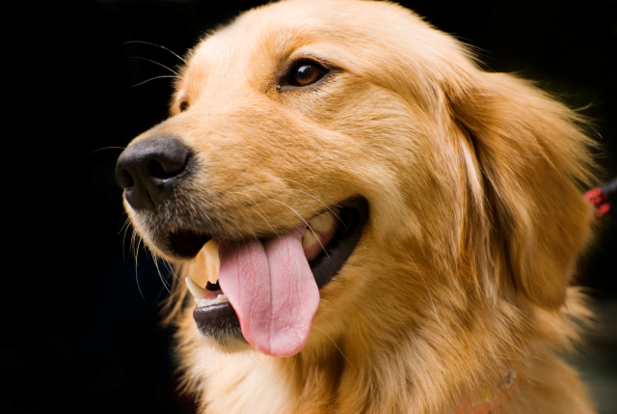
Golden Retriever
Relational expert
Loyal
Sensitive, caring
Eager to please
Does not like big changes
Has a hard time saying, “No”
Avoids confrontation
Calm, even emotions
Peacemaker
Warm, kind
Biblical example: Abraham
Motto: “Let’s keep things the way they are.”

Slide 12
Strengths: Strengths Pushed out of Balance:
Sensitive feelings → Easily hurt
Loyal → Missed opportunities
Calm, even-keel → Lacking enthusiasm
Non-demanding, patient → Pushover, doormat, taken
advantage of
Peacemaker, hates confrontation → Misses honest intimacy
Enjoys routine, dislikes change → Stays in a rut, not spontaneous
Warm and relational → Limits number of deep relationships
Accommodating → Indecisive
Sympathetic, good listener → Holds on to others’ hurt or pain
Stressed: Digs heels in
Under Pressure: Needs to be embraced and treated with gentleness and patience.

Slide 13
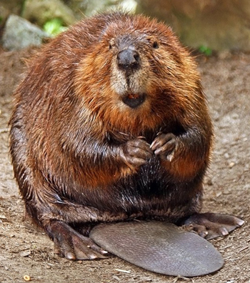
Beaver
Organized
Administrative, detailed
Precise, perfectionistic
Consistent, predictable
Sensitive, conscientious
Reserved, controlled
Discerning
Creative
Very hard on herself
Tends to see one “correct” way of doing things
Biblical example: Moses
Motto: “Let’s do this right!”

Slide 14
Strengths: Strengths Pushed out of Balance:
Perfectionistic → Too controlling
Detailed, enjoys instructions → Slow in accomplishing tasks
Accurate, precise → Too critical, too strict
Consistent, predictable → Resists spontaneity/variety; boring
Practical → Not adventurous
Sensitive → Stubborn
Conscientious → Inflexible
Analytical → Loses “big picture”
Discerning → Negative
Controlled, reserved, orderly → Too serious and stuffy; rigid
Stressed: May become overwhelmed and freeze OR may stay up all night to finish a project.
Under Pressure: Will rely only on self; will not ask for help.

Slide 17
Be especially aware of your Opposite(s)
They see your blind spots!
Cooperate
Communicate
Appreciate
Lions and Goldens are Opposites
Otters and Beavers are Opposites
L
O
B
G
Note: It is possible for a person to be strong in two “opposite” categories. This gives them the ability to be a bridge between personalities but can also create communication challenges as
they may seem unpredictable to their teammates.

Slide 18
Sample
Results from Personality Assessment:
Lion=5/31
Otter=3/31
Beaver=29/31
Golden=26/31
Patterned areas are potential blind spots.
Lion
Otter
Golden Retriever
Beaver

Slide 19
Summary
Every person is made in the image of God and created the way they are on purpose. All personalities are needed for a PWOC to be healthy and balanced.
All personalities have strengths and weaknesses. Do your best to honor each others’ strengths. When you encounter each others’ weaknesses, offer grace and forgiveness. Assume goodwill.
Learn to laugh at yourself. Love who God has made you! Appreciate how others are strong where you are weak and visa versa.
No one has a 360-degree view of the world…we are in deep need of our teammates’ perspectives. A wise leader asks what others see and makes adjustments accordingly.

Slide 20
Keep Growing! To grow deeper in your understanding and appreciation of one another, do one of the activities in the accompanying PDF document. They are designed to be low-anxiety to provide a safe space to explore and appreciate personalities.

