Slide 1
U.S. Army Financial Management Command
SmartVoucher DLA & Travel Advances Help Guide
Controlled by: HQ USAFMCOM Controlled by: Office symbol
Category: OPSEC POC: Ronesha Jordan Ronesha.d.jordan2.civ@army.mil
04 APR 2024

Slide 2
General Information
DLA and Travel Advances are requested through DFAS SmartVoucher
https://smartvoucher.dfas.mil/voucher/consent
Required Documents:
PCS Orders
Approved IPPS-A Request
UNDERSTAND
VISUALIZE
LEAD & ASSESS

Slide 3
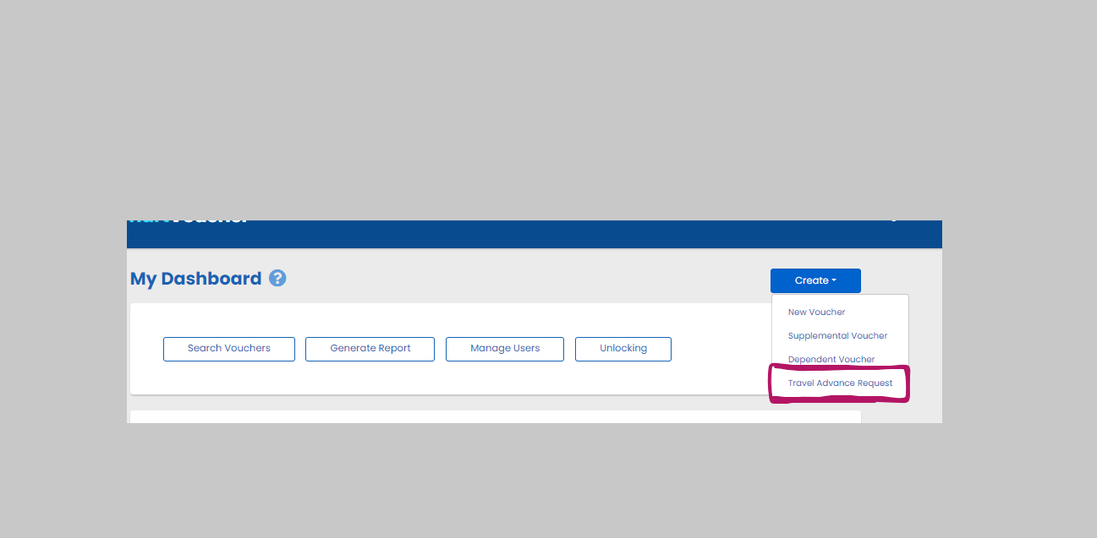
General Information
Create “ Travel Advance Request”
UNDERSTAND
VISUALIZE
LEAD & ASSESS

Slide 4
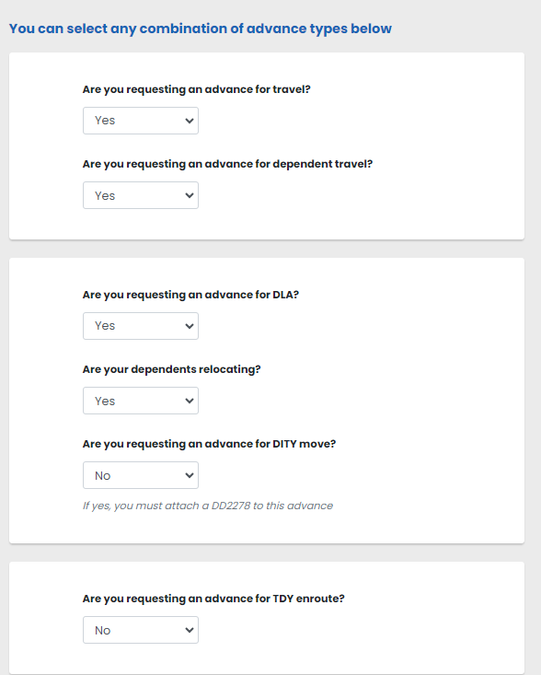
General Information
Step 1
Select advances needed
for PCS travel.
UNDERSTAND
VISUALIZE
LEAD & ASSESS

Slide 5
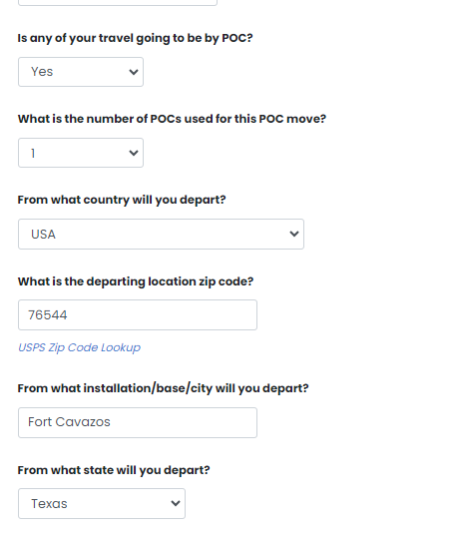
General Information
Step 2
Answer if travel will be by POC “ Privately Owned Car”
Add travel locations, losing to gaining station.
UNDERSTAND
VISUALIZE
LEAD & ASSESS

Slide 6
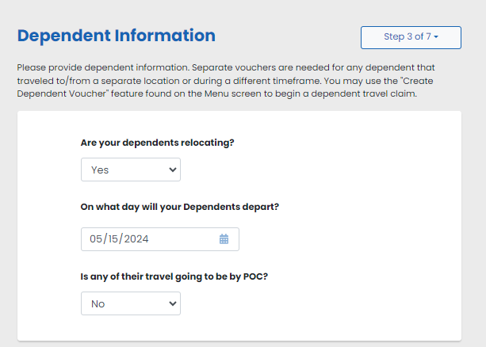
General Information
Step 3
Add dependents
POC-Privately Owned Car
UNDERSTAND
VISUALIZE
LEAD & ASSESS

Slide 7
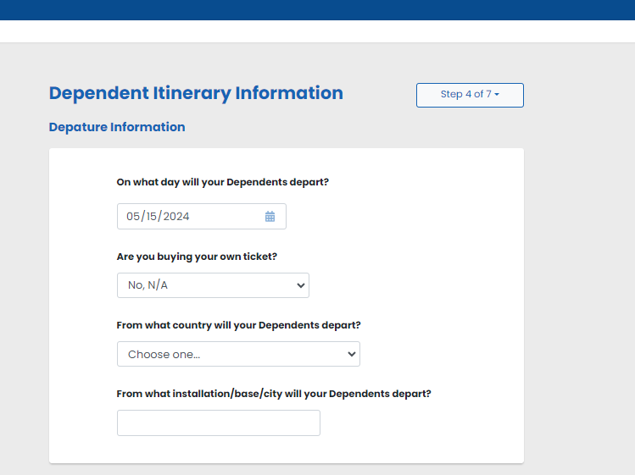
General Information
Step 4
Add dependent travel locations.
UNDERSTAND
VISUALIZE
LEAD & ASSESS

Slide 8
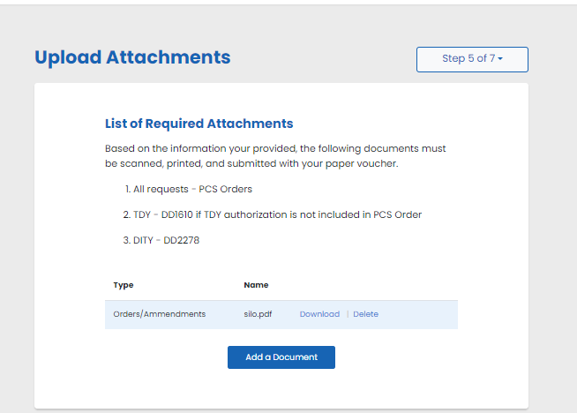
General Information
Step 5
Upload orders and leave form.
UNDERSTAND
VISUALIZE
LEAD & ASSESS

Slide 9
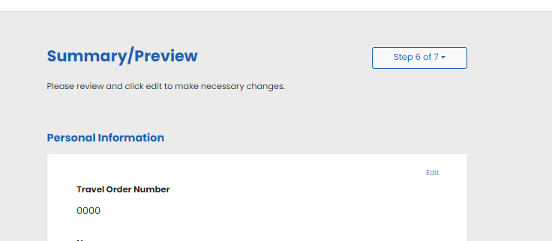
General Information
Step 6
Review Advance
UNDERSTAND
VISUALIZE
LEAD & ASSESS

Slide 10
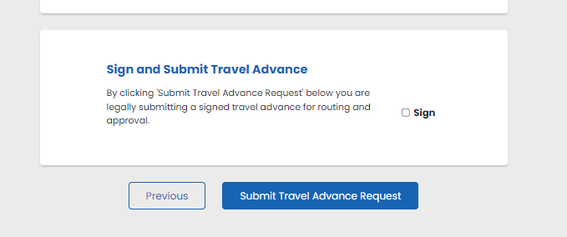
General Information
Step 7
Sign and Select Submit
UNDERSTAND
VISUALIZE
LEAD & ASSESS

Slide 11
Questions
Call
254-287-9201 or 254-618-7614
for assistance.
UNDERSTAND
VISUALIZE
LEAD & ASSESS

