Slide 1
CUI
ArmyIgnitED
Fort Hood Education Services Division
U.S. Army Installation Management Command
Effective 19 MAR 26
Notes:
Welcome to the ArmyIgnitED 101 Brief- My name is Keisha Hoffman and I am one of the Education Counselors here at the Fort Hood Education center
If you have any questions, please raise your hand
For attendance, please put your name and military email on the sign in sheet
How many People have utilized TA/CA in the past? Please raise your hand … For you it will be a refresher and for everyone else it will be an introduction to this Amazing benefit

Slide 2

CUI
2
CUI
Notes:
Purpose of this brief is to ensure your knowledge of
Benefits of ArmyIgnitED
Tuition Assistance (TA) and Credentialing Assistance (CA) these acronyms will be utilized throughout the presentation
ArmyIgnitED navigation
How to create your account
How to get Support with any issues or questions you may have
Next Steps needed to begin your education journey

Slide 3
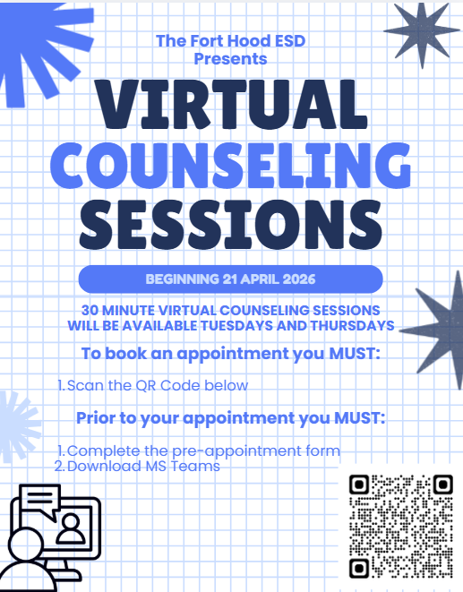
CUI
3
CUI
Notes:
Purpose of this brief is to ensure your knowledge of
Benefits of ArmyIgnitED
Tuition Assistance (TA) and Credentialing Assistance (CA) these acronyms will be utilized throughout the presentation
ArmyIgnitED navigation
How to create your account
How to get Support with any issues or questions you may have
Next Steps needed to begin your education journey

Slide 4
Purpose
CUI
If you are:
  Interested in learning how to research careers, degree programs and Academic Institutions (AIs) and choose the best fit for you
  Attend the College 101 Brief!
  Offered Wednesdays @1030
  Fort Hood Education Center
4
CUI
Notes:
If you are unsure about what you want to be when you grow up; you have no clue how to get started with college, unsure about what program to choose or what school to go to? This is not the briefing for you. Please attend the College 101 briefing first!

Slide 5
Benefits of ArmyIgnitED
CUI
Access funds for tuition and industry recognized credentials
Submit funding requests 24/7
See your balance, funding requests, degree progress and Tuition Assistance (TA) and Credentialing Assistance (CA) blockers in one place
Message your Education Center and AI directly through the system
5
CUI
Notes:
Benefits of ArmyIgnited
Provides easy access to requesting TA and CA for all Soldiers: Active Duty, Army Reserve and Army National Guard
This site is available 24/7 allowing you to complete a request at your convenience
You have access to TA record to view TA balances, grades, course enrollments and the ability to submit and cancel your request
You have access to a virtual messaging tool that connects you directly with your ED Center and Academic Institution so if you have questions or need assistance you have a direct link to them
24/7 Helpdesk Technical Support if your having challenges with your ArmyIgnited account
All this is available at the touch of your fingertips, all you need is a CAC enabled computer or CAC reader and a CAC and your ready to start your journey

Slide 6

Agenda
TA Eligibility and Policy
CA Basics
Portal Navigation
Next Steps

Slide 7

Eligibility for TA
CUI
Officers’ TA Eligibility
Will incur an Additional Duty Service Obligation (ADSO)
    2-year ADSO for Active-Duty Officers
    4-year ADSO for Reserve Officers
The ADSO begins on the end date of the last TA funded class and runs concurrently with other ADSOs
7
CUI
Notes:
Now let’s look at Military Service Obligation (MSO) for officers: Officers incur a service obligation when using TA.
It’s the law that Officers incur a service obligation when using TA. The MSO is calculated from the end date of the last class for which TA was issued. Multiple MSOs are served concurrently
MSO (01 and above and WO2 and above)
Active Duty Officers incur a 2-year Service obligation and Reserve/National Guard Officers incur a 4-year Service Obligation
If Officers separate prior to completion of the service obligation, they must repay a portion of the TA money
Are there any questions about TA eligibility?

Slide 8
Eligibility for TA
CUI
Not flagged IAW AR 600-8-2 Suspension of Favorable Personnel Actions (Flags)
No suspensions due to two unsuccessful grades within the same fiscal year
Maintain a 2.0 Grade Point Average (GPA) after completion of 15 semester hours (SH) for undergraduate level courses and a 3.0 GPA after completion of 6 SH for graduate level courses
Provide an Evaluated Degree Plan (EDP) by the time you’ve completed 2 TA-funded courses
8
CUI
Notes:
Now that we have covered the Tuition Assistance Basics, we going to move on and look at Eligibility for TA
Grade Point Average (GPA) acronym (explain GPA)
GPA stands for “grade point average” and is a standardized way of measuring academic achievement in the United States on a scale of 0 to 4
It is calculated by adding all the numbered grades you’ve received and dividing them by the number of credits you’ve taken
The average obtained by dividing the total number of grade points earned by the total number of credits attempted
Personnel Action Flags feed into the ArmyIgnitED system from your IPPS-A account
Speak to your Education Center about Other Funded Courses that can be utilized to increase your GPA in ArmyIgnitED to become TA Eligible after GPA Blocker has been placed on your account
The EDP is an official academic document provided by the AI that articulates all degree requirements for degree completion, identifies all courses required for graduation and includes an evaluation of all successfully completed prior coursework. Evaluated credit for military training and experience and other credit sources applied to the AI’s degree requirements are also included.

Slide 9
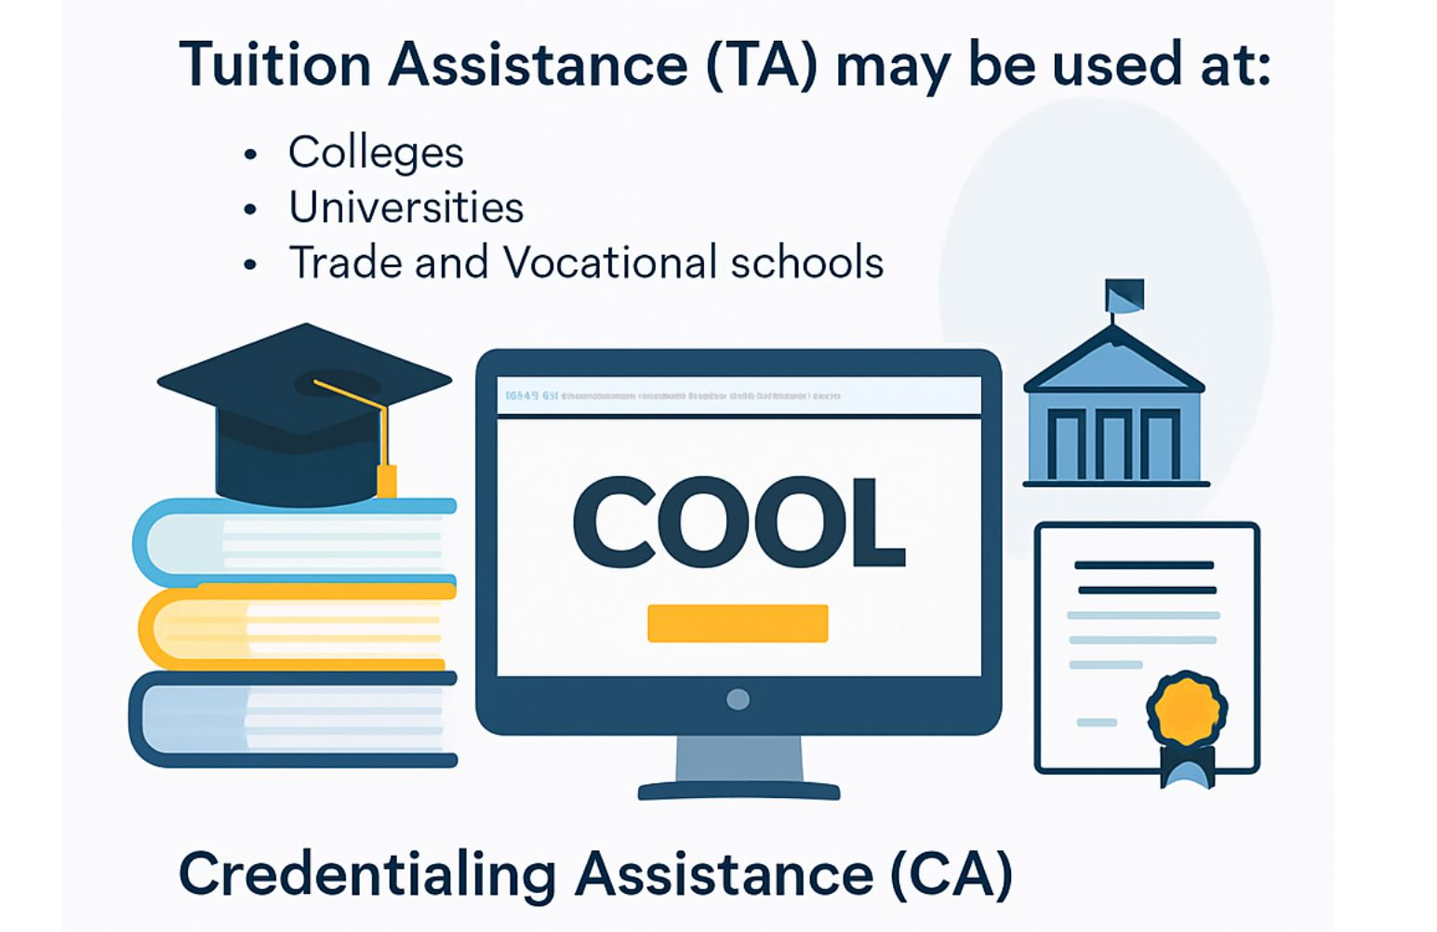
Eligibility for TA
Approved training providers listed on the Army Credentialing Opportunities Online (COOL) site
https://dhra.appianportalsgov.com/DoD-MOU/page/ta-decide
https://www.cool.osd.mil/army/index.html

Slide 10
Fort Hood Partner Schools
CUI
Central Texas College: 254-226-1574
  Offers associate degrees & certificates
Texas A&M-Central Texas University: 254-327-1683
  Offers bachelor’s/master’s degrees
  Must have 30 SH of undergraduate coursework completed prior to enrollment
University of Maryland Global Campus: 254-202-9650
  Offers associate/bachelor’s/master’s degrees & certificates
10
CUI
Notes:
1. Drops are done before start dates or within AI’s drop period
Soldiers must cancel TA Requests in their account prior to the course start date
If the course was dropped after the term start date and within the AI’s drop period, the AI will invoice as a dropped course within ArmyIgnitED
2. Withdrawals are done after the term start date or after the school has assessed a fee (Specific withdrawal times at school)
3. Submit WMs before the term ends, so that you don’t have grade point average issues at your school

Slide 11

What Can You Study
CUI
One Degree per Level
Associate
Bachelor's
Masters
Exceptions
Special programs
Strategic foreign language and host nation classes
ESL classes
Remedial classes
Graduate prerequisite classes
One Certifice per Lifetime
Undergraduate
Graduate
11
CUI
Notes:
Pre-Commissioning Programs: AMEDD Enlisted Commissioning Program, the Doctor of Physical Therapy Program, the Enlisted to Medical Degree Preparatory Program, the Interservice Physician Assistant Program, the Master of Social Work Program, the Master’s Program in Nutrition, the Occupational Therapy Doctorate, and the United States Military Academy. - Can establish this goal concurrently with another undergraduate goal – Must be created by Education Center
College Preparatory/Remedial: Classes must be credit bearing toward undergraduate degree. Must be listed in EDP or Documentation from AI Required
Strategic Foreign Language Programs-Soldiers:
In Army- approved Strategic Language classes –Requirement of DLPT or OPI if DLPT not available after 6 SH completed. No minimum score. Must be within 90 Days of when grades get posted – Additional 6 SH can be used after DLPT/OPI is submitted (12SH Total Limit)
-List can be found at on the Human Resources Command (HRC) website https://www.hrc.army.mil/>In search bar type “Army Strategic Language List” click on “Foreign Language Proficiency Bonus” to find the most current list
-The student must be in-country and pursue with on approved orders before a Host Country goal can be approved. This means that if the Soldier is station in Italy that the Soldier may be approved to take courses in Italian, only. A Soldier in Italy asking for TA for Spanish would not be approved
College Preparatory and Remedial Classes/Graduate Admission Courses – Must be part of the Evaluated Degree Plan (EDP) or Documentation from AI specifying additional coursework necessary for program
1. Already know what you want to study? Search for schools based on your major/program of study
2. Don’t know what to study, but you want to start college courses? Choose a General Studies/general curriculum degree. Get started with courses in English, Math, Humanities, Government, History, Language etc
3. Degree Types:
Certificate - 3 month to 2-year programs, focused on a specific area, general education usually not included in curriculum. Can be undergraduate or graduate level
Associates - 2-year programs, include Associate of Arts and Associate of Science which are designed to transfer to a University for continuation of a Bachelor’s degree. Associate of Applied Science is intended for entry-level jobs and not designed to fully transfer to a University
Bachelor’s - 4-year programs, first half is focused on general education and 2nd half is focused on major and minor courses
Masters- 2-3 year programs in a specialized field or discipline
4. Class Delivery Modes:
Face-to-face/on-site: Meets in person at specific times and days
Online: Need a computer and internet access. Need to be a self-learner and manage time well
Hybrid/Blended: Class is partially offered face-to-face and partially online
Are their any question before we move on?
Additional Talking Points:
Pre-Commissioning Programs: AMEDD Enlisted Commissioning Program, the Doctor of Physical Therapy Program, the Enlisted to Medical Degree Preparatory Program, the Interservice Physician Assistant Program, the Master of Social Work Program, the Master’s Program in Nutrition, the Occupational Therapy Doctorate, and the United States Military Academy. - Can establish this goal concurrently with another undergraduate goal – Must be created by Education Center
College Preparatory/Remedial: Classes must be credit bearing toward undergraduate degree. Must be listed in EDP or Documentation from AI Required
Graduate Admission Courses : Courses must be listed in EDP or Documentation from AI Required
Strategic Foreign Language Programs-Soldiers:
In Army- approved Strategic Language classes –Requirement of DLPT or OPI if DLPT not available after 6 SH completed. No minimum score. Must be within 90 Days of when grades get posted – Additional 6 SH can be used after DLPT/OPI is submitted (12SH Total Limit)
-List can be found at on the Human Resources Command (HRC) website https://www.hrc.army.mil/>In search bar type “Army Strategic Language List” click on “Foreign Language Proficiency Bonus” to find the most current list
-The student must be in-country and pursue with on approved orders before a Host Country goal can be approved. This means that if the Soldier is station in Italy that the Soldier may be approved to take courses in Italian, only. A Soldier in Italy asking for TA for Spanish would not be approved
College Preparatory and Remedial Classes/Graduate Admission Courses – Must be part of the Evaluated Degree Plan (EDP) or Documentation from AI specifying additional coursework necessary for program
1. Already know what you want to study? Search for schools based on your major/program of study
2. Don’t know what to study, but you want to start college courses? Choose a General Studies/general curriculum degree. Get started with courses in English, Math, Humanities, Government, History, Language etc
3. Degree Types:
Certificate - 3 month to 2-year programs, focused on a specific area, general education usually not included in curriculum. Can be undergraduate or graduate level
Associates - 2-year programs, include Associate of Arts and Associate of Science which are designed to transfer to a University for continuation of a Bachelor’s degree. Associate of Applied Science is intended for entry-level jobs and not designed to fully transfer to a University
Bachelor’s - 4-year programs, first half is focused on general education and 2nd half is focused on major and minor courses
Masters- 2-3 year programs in a specialized field or discipline
4. Class Delivery Modes:
Face-to-face/on-site: Meets in person at specific times and days
Online: Need a computer and internet access. Need to be a self-learner and manage time well
Hybrid/Blended: Class is partially offered face-to-face and partially online

Slide 12
What Can You Study
CUI
  Undergraduate Degree
    Soldiers whose highest level of Civilian Education is at least a High School Diploma may pursue an Associate and/or Bachelor's degree
  Graduate Degree
    Soldiers must have a Bachelor’s Degree to pursue a Master’s degree
Academic Certificates
    Soldiers can pursue ONE academic certificate in a lifetime, either undergraduate or graduate
    Soldiers may not pursue the certificate concurrently with an education goal for an Associate, Bachelor’s, or Master's degree
    The lifetime limit of 21 SHs does not count against the lifetime limits for an undergraduate or graduate degree
12
CUI
Notes:
Continuing with WHAT YOU CAN STUDY.
If you ARE not ready to start a degree CONSIDER An ACADEMIC CERTIFICATE AS AN option.
Academic Certificates are another way to broaden your knowledge base.
You can pursue a Undergraduate or Graduate Certificate
YOU RECEIVE A Lifetime Limits of 21 Semester Hours
For an Undergraduate certificates you can have any education level: High School Diploma, Associates Degree, Bachelors Degree or Masters Degree
Graduate Academic certificates require a Bachelors Degree or higher
Doctoral level classes are not authorized for the Academic Certificate education goal
Are there any question before moving on to the next slide? If there are no questions we will move on

Slide 13
Tuition Assistance Basics
CUI
What TA Covers
Fiscal Year (FY) Limits (FY=1 Oct – 30 Sep of the following year):
  $4,500 per FY
  18 Semester Hours (SH) per FY
  $250 per SH
  Funds to do not roll over to the next FY
  Lifetime SH limits:
    130 Undergraduate SH – (Associate & Bachelor’s)
    39 Graduate SH – (Master’s)
    21 Academic Certificate SH – (Undergraduate or Graduate)
    39 SH towards 1 Special Program
13
CUI
Notes:
Tuition Assistance Basics
As a thank you The Army provides you with $4,500.00 per fiscal year, fiscal year is 1 Oct to 30 Sep
Use or Lose – $4,500.00 Funding resets every FY and nothing gets carried over to the next FY
TA covers 18 credits per fiscal year which is roughly 6 courses per year
The funding has been capped at $250 per credit, so if a school charges more than $250 per credit then you are responsible for the additional cost. TA only pays for the course, we encourage you to do your research when choosing a school, maybe even look for schools that offer free e-books and to apply for Federal student aid and ask your college or university about available scholarships to help with any additional expenses .
Lifetime Limits:
- Undergraduate- 130 SHs Associates or Bachelors degree
- Graduate- 39 SHs Masters degree
-Academic Certificates – 21 SHs
-Special Program – 39 SHs for prerequisites for programs like the Pre-Commissioning Programs (AMEDD) or Interservice Physician Assistance Program (IPAP

Slide 14
Eligibility for TA
CUI
The Evaluated Degree Plan is an official document provided by the AI that lists all the requirements needed for degree completion.
An EDP must be uploaded to ArmyIgnitED by the time you complete 2 classes at your AI, or your account will be blocked.
If the EDP is not uploaded when creating your education goal, you must submit the EDP to an Education Center for upload.
A valid EDP MUST include the following:
- Soldier’s name
- AI's name
- Name of degree program
- Number of credits (SH or QH) required for degree completion
- Evaluation of prior completed academic coursework
- Evaluated military training and experience (to include JST credit)
- Other evaluated credit sources such as CLEP, DSST, APT
14
CUI
Notes:
Now that we have covered the Tuition Assistance Basics, we going to move on and look at Eligibility for TA
Grade Point Average (GPA) acronym (explain GPA)
GPA stands for “grade point average” and is a standardized way of measuring academic achievement in the United States on a scale of 0 to 4
It is calculated by adding all the numbered grades you’ve received and dividing them by the number of credits you’ve taken
The average obtained by dividing the total number of grade points earned by the total number of credits attempted
Personnel Action Flags feed into the ArmyIgnitED system from your IPPS-A account
Speak to your Education Center about Other Funded Courses that can be utilized to increase your GPA in ArmyIgnitED to become TA Eligible after GPA Blocker has been placed on your account
The EDP is an official academic document provided by the AI that articulates all degree requirements for degree completion, identifies all courses required for graduation and includes an evaluation of all successfully completed prior coursework. Evaluated credit for military training and experience and other credit sources applied to the AI’s degree requirements are also included.

Slide 15

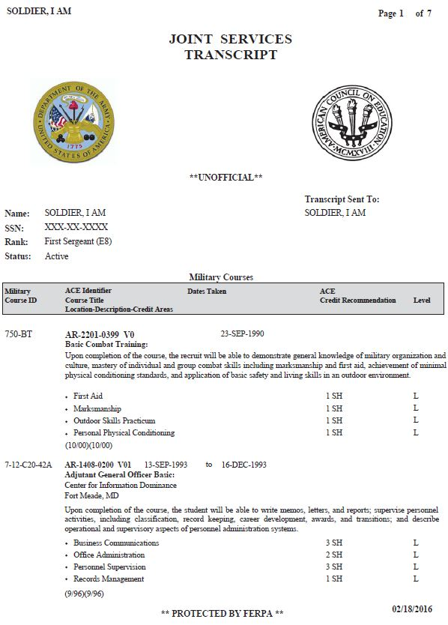
Joint Services Transcript (JST)
CUI
JST keeps track of all your military training and experience
American Council on Education evaluates your military training and experience and recommends college credit
AIs MAY accept this credit toward your degree
Any credit awarded toward your degree means less time in the classroom
Request your official JST to be sent to your AI
Transcript requests are free of charge
Login at https://jst.doded.mil/
15
CUI
Notes:
Highlight Basic Training – 6 potential credits (savings in SH annual and lifetime limits and ~$1,500 a fiscal year)
Military training is evaluated by the American Council on Education (ACE)
JST must be evaluated by AI to confirm credits
JST does not stand alone for promotion points until evaluated by an AI
Once evaluated, the AI Transcript is used to validate JST credit
5. How do I update missing or incomplete training data on my JST?
Prior to contacting Army JST support staff, please ensure your training records are correct in ATRRS and they are "qualified". If you are missing an ACE accredited course you completed more than two months (60 days) ago and it is an ACE accredited course, please send a copy of all documentation training certificates (DA-1059) and justification will be sent through opening a case on the JST website. Please note that you can submit your official JST to any institution located on the “Official Transcript Request” page on this website. For all other inquiries, log in to JST and open a case and upload any documentation for review if necessary.

Slide 16
Tuition Assistance (TA) Basics
CUI
First-time TA Users MUST complete one of the Decision Support Tools (DST) listed below and upload their results to ArmyIgnitED prior to creating an education goal:
Kuder Journey:
https://dantes.kuder.com/landing-page
Career Path Decide:
https://www.careerpathdecide.org/profile-work-type
16
CUI
Notes:
Soldiers must complete standardized ArmyIgnitED training provided by the
education center on their installation or their Component Headquarters prior to receiving
TA for the first time. This training will help Soldiers better understand education benefits
and procedures for requesting TA.
2. Soldiers must complete the Kuder Journey Career Planning System tool
prior to using TA for the first time and can access it at https://www.dantes.mil/kuder/. This tool is
designed to help service members identify their career goals and determine if the
chosen career goal aligns with their TA program of study. Soldiers are required to
provide the assessment results generated from the site to their counselor prior to having their
education goal approved in ArmyIgnitED.

Slide 17
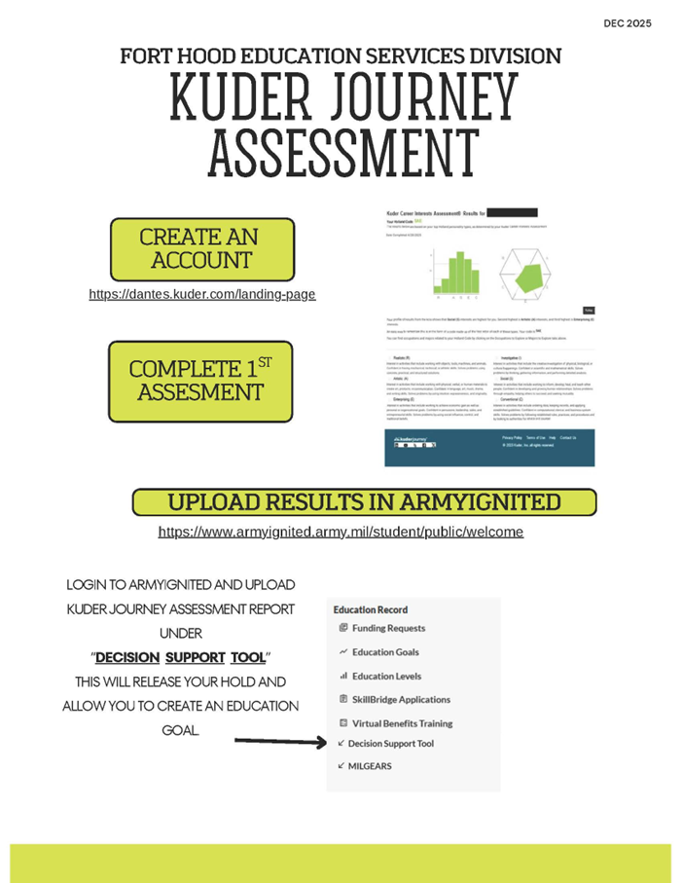
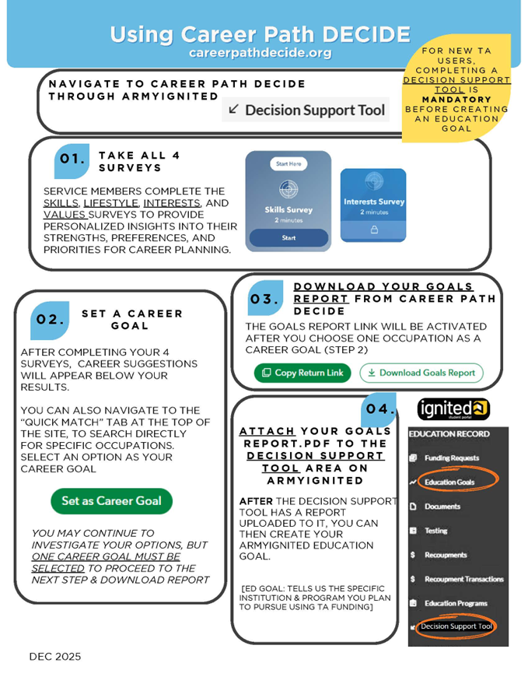
Tuition Assistance (TA) Basics
CUI
17
CUI
Notes:
Soldiers must complete standardized ArmyIgnitED training provided by the
education center on their installation or their Component Headquarters prior to receiving
TA for the first time. This training will help Soldiers better understand education benefits
and procedures for requesting TA.
2. Soldiers must complete the Kuder Journey Career Planning System tool
prior to using TA for the first time and can access it at https://www.dantes.mil/kuder/. This tool is
designed to help service members identify their career goals and determine if the
chosen career goal aligns with their TA program of study. Soldiers are required to
provide the assessment results generated from the site to their counselor prior to having their
education goal approved in ArmyIgnitED.

Slide 18
Tuition Assistance (TA) Basics
CUI
Requesting TA:
  Upload DST results to ArmyIgnitED
  Create an education goal
  Input Supervisor’s information
  Register for course(s) through your AI
  Submit TA request(s) (TAR) in ArmyIgnitED and ensure it matches course registration information EXACTLY
  Submit 1 TAR per course, DO NOT add multiple courses to one TAR
  If a TAR needs to be edited or manually created by an Education Counselor, a Soldier signature will be required to finalize approval
  Manual TARs are only authorized for class retakes, and must be created 60-7 days before a term start date
  Edits to TARs are only authorized for waitlisted or cancelled classes and must be edited within 5 business days of the AI’s notification of class cancellation or waitlist rejection
18
CUI
Notes:
There are a few situations where a TAR has to be created or edited by a counselor; course retake, within 7 days (with proof of system/counselor error) etc.
Soldiers will register for course through their AI student portal prior to submitting TA requests
Stress the importance of matching TA request information to the registered course information as mismatched data such as term dates can lead to invoicing issues/deletion.
Encourage soldier not to bundle TARs, submit request for each individual course
Inform Soldiers if their TAR must be corrected or submitted by an EC, the Soldier must sign the request in order to finalize approval. SM will be reminded on days 1 and 15 of the action to sign. Otherwise, the TAR will be at risk of deletion 30 days after term start date has passed.

Slide 19
Tuition Assistance (TA) Basics
CUI
Important Dates:
  Soldiers may apply for TA no more than 60 calendar days and no less than 7 days prior to the term start date NLT 1759 CST on day 7!
  All TARs must be approved by a Supervisor no less than 6 days before the term start date
    TARs not signed will delete at 0100 EST 5 days before the term start date
      0000 CST 6 days before the term start date!
  Term start date must not be less than 60 days from a Soldier’s separation date and the must be no less than 14 days prior to separation
  If a TAR is not approved prior to the term start date, it will remain in a deferred status for 30 days from the start date before being automatically deleted
19
CUI
Notes:
1. TA Caps out at $4500 or 18 SH credits; (or 27 QH)
2. QH Equivalency – ~$165/QH
3. Use or Lose – Funding resets every FY and nothing gets carried over to the next FY
4. Clarify that PhD is not eligible for TA

Slide 20
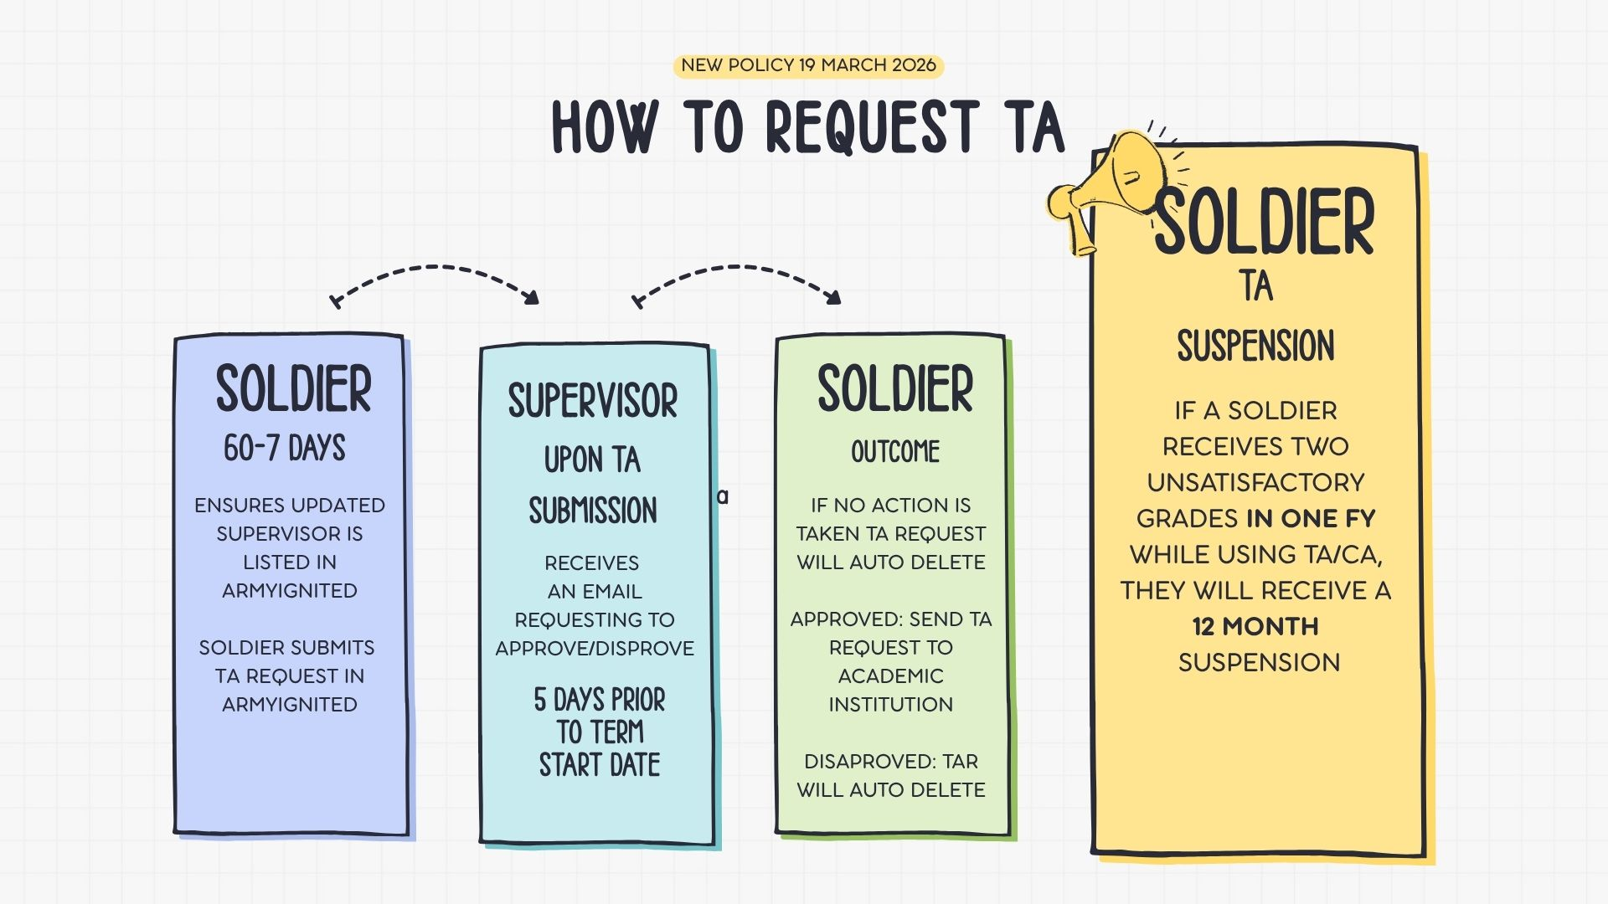

New Policy Update 19 MAR 2026

Slide 21
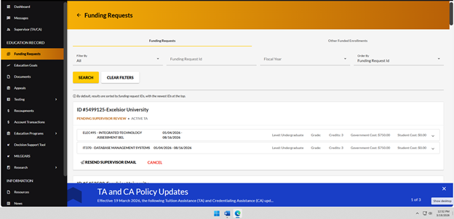
New Policy Update 19 MAR 2026
Soldiers, regardless of rank, must receive Supervisor approval on all TARs/CARs as a part of the ArmyIgnitED approval process
Before requesting TA make sure Supervisor tab is updated with current information

Slide 22
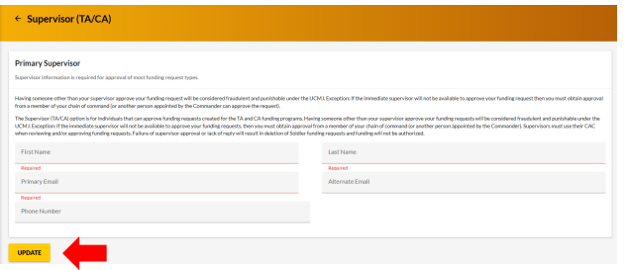
Add Supervisor Contact Information

Slide 23
Reviewing TARs/CARs
In the Supervisor Review Page, the Supervisor has 3 options:
Approve
Disapprove
“I DO NOT SUPERVISE THIS PERSON”
If the Supervisor selects “I DO NOT SUPERVISE THIS PERSON,” the TAR/CAR will be deleted
The Soldier will receive a message in ArmyIgnitED stating the Supervisor they listed does not supervise them. The Soldier must update their Supervisor information in ArmyIgnitED and resend their TAR/CAR for approval
Soldiers may not list themselves as their Supervisor!

Slide 24
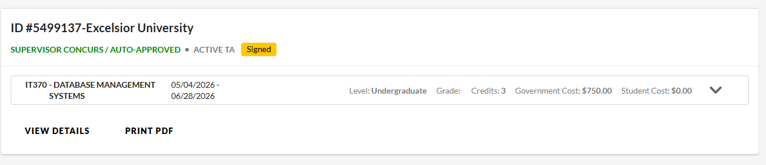
How will the Soldier know the Supervisor has approved?
CUI
Once the TAR or CAR is approved by the Supervisor,
the request will display:
‘Supervisor Concurs/ AUTO-APPROVED’
28 / #
CUI

Slide 25
Dropping / Withdrawing Classes
CUI
Drops occur before the term start date or within the AI’s drop period
Withdrawals happen after the course has started
  Soldiers withdraw through the AI, and the AI must record the withdrawal in ArmyIgnitED
  Results in “W” Grade
Withdrawals are either Personal or Unforeseen and occur after a fee has been incurred
  Personal: The government cost of the course is recouped by the Army
  Unforeseen: the Army MAY waive the recoupment for the class
25
CUI
Notes:
1. Drops are done before start dates or within AI’s drop period
Soldiers must cancel TA Requests in their account prior to the course start date
If the course was dropped after the term start date and within the AI’s drop period, the AI will invoice as a dropped course within ArmyIgnitED
2. Withdrawals are done after the term start date or after the school has assessed a fee (Specific withdrawal times at school)
3. Submit WMs before the term ends, so that you don’t have grade point average issues at your school

Slide 26
Recoupment (Repayment) of TA
CUI
Repayment of TA is required:
  Course Failure
    Grade of D and below in an undergraduate course
    Grade of C or below for a graduate course
  Incomplete grades beyond 180 days of the class end date
  Course Withdrawal (W Grade)
    Personal Reasons
    Recoupment Waiver is denied
Once an unsatisfactory grade has been posted to ArmyIgnitED, you must choose a recoupment option. If you don’t choose an option within 30 days of your suspense date, ArmyIgnitED may auto enroll you in a payroll deduction
Soldier has 4 choices:
    Lump Sum Payroll Deduction
    Payroll Deduction (2 to 6 months)
    Recoupment Waiver (FOR “W” GRADE ONLY!)
    Soldiers may send a check or money order to ACED Finance, but the TA blocker will remain on your account until the money has been received and processed
26
CUI
Notes:
You may not request TA for future courses until you select your repayment plan through ArmyIgnitED or until the end of the recoupment suspense period
Course Failure - D and below for undergraduate level and C or below for Graduate level
When you must repay tuition assistance you will be sent an email with instructions on how to access the recoupment processing pages on ArmyIgnitED. (Pass/Fail Schools – Failing course)
You must login and select a repayment plan in order to maintain TA eligibility
You may select a 2 to 6 month or lump sum repayment option within 30 days of recoupment notice
The recoupment suspense period is 30 days from first notification. Notifications will be sent to the email address in ArmyIgnitED
You may request TA for the same course once a repayment option has been selected and processed

Slide 27
Recoupment Waiver
CUI
DA Form 7793 must be signed by your Commander and submitted in ArmyIgnitED for:
  Unanticipated military duties
  Unanticipated illness and/or hospitalization (of the Soldier or a family member)
  Emergency leave
  Other unforeseen situations considered on a case-by-case basis
Recoupment Waiver not approved = recoupment
Approved Recoupment Waivers return credits and funding back to a Soldier’s ArmyIgnitED account
W grades are considered unsatisfactory and may contribute to a 12-month suspension
27
CUI
Notes:
Recoupment Waiver (DA 7793) must be submitted by the Soldier in ArmyIgnitED no more than 30 days after AI has posted the grade of “W” in AIED, DA 7793 must be digitally signed by the Commander
ACCESS is located at the Combined Arms Center (CAC) at Fort Knox
Education Centers do not decide approval/rejection of WMs
(Substantiating documentation such as orders or medical reports should not be uploaded into ArmyIgnitED as the signed DA 7793 with proper justification and recommendation from Commander will be utilized for approval/disapproval) -under Administrative procedures for soldiers, h8 (Policy Update 7)

Slide 28
Policy Update 19 MAR 2026
TA/CA Suspension
If you receive 2 TA/CA funded unsatisfactory grades in 1 FY, you will be suspended from requesting TA/CA for 12 months
You may appeal your suspension. The appeal process must be completed within 60 days of your grade posting
W grades are considered unsatisfactory and will be counted as an unsatisfactory grade
If a Recoupment Waiver is granted, the unsatisfactory grade may still contribute to a suspension

Slide 29
Credentialing Assistance Basics
CUI
Enlisted Soldiers and Warrant Officers are eligible
CA funding is for industry-recognized professional and technical credentials
Soldiers MUST visit the Army COOL website and complete the mandatory CA 101 brief to request CA. THE ARMYIGNITED BRIEF DOES NOT MEET THAT REQUIREMENT!
Soldiers must utilize MilGears as a decision support tool prior to requesting CA for the first time
Annual CA use is 1 credential and $2,000 max
Cap of 3 credentials over a 10-year period
Failed training and/or exam = recoupment
To request counselor assistance, visit the Army COOL website and click on the “CONTACT AN ARMY CA COUNSELOR” button
The 5 Most Requested Credentials
Project Management Professional (PMP)
CompTIA Security+
CompTIA A+
CompTIA Network+
Certified Personal Trainer (NASM-CPT)
Army Credentialing Opportunities On-Line (COOL)
https://www.cool.osd.mil/army/index.htm
29
CUI
Notes:
1. CA creates new opportunities for Soldiers to enhance their skills and professionalism while serving and increasing their overall employability upon transitioning from the Army
2. Provides credentials relevant to Army MOSs and their correlation to civilian credentials
3. Vendors are considered colleges, universities, credentialing agencies, other organizations that provide training in support of completing a credentialing exam or license. Training Providers are listed on the COOL Website
4. Aviation Credentials (Refer to Policy Memo for AD not NG/Reserves)
5. Soldiers must submit their requests for CA no earlier than 90 days and no later than 45 days prior to the start date of the course or exam
6. A course end date must be more than 30 days prior to ETS or retirement
7. Reiterate CA/TA Funding is $4500 combined; CA will not reimburse out of pocket costs
8. Army Credentialling Assistance Program Office (ACAPO) approves CA Ed Goals and processes CA Requests
9. CA can be utilized for the initial or recertification of credentials
10. No Military Service Obligation for Officers when using CA
11. Counseling sessions are available on Microsoft Teams

Slide 30
CA Policy Update 19 MAR 2026
Commissioned Officers are INELIGIBLE for CA
Commissioned Officers who have submitted a credential education goal that has not been completed prior to 19 MAR 2026 will be allowed to request funding to complete and earn the credential

Slide 31
Credentialing Assistance Basics
CUI
CA requests (CAR) must be submitted no earlier than 90 days and no later than 45 days prior to the start date of the course/exam
Supervisors must approve CARs within 5 days of creation
Do not pay out of pocket, you will not be reimbursed
Soldiers (all COMPOs) may only receive $1,000 per FY in CA funding for certain aviation credentials (to include a pilot’s license)
CAR end date must be more than 30 days prior to your final separation date
31
CUI

Slide 32
Check-on-Learning
CUI
How many days prior to your term start date must you request funding for TA?
How many days prior to your term start date must your Supervisor approve your TA request?
What is the maximum amount per SH the Army will pay for a TA funded class?
Who incurs an ADSO for TA usage? When does the ADSO begin?
Who is ineligible for CA?
What is the maximum amount of SHs SMs are allowed per FY? What is the total dollar amount SMs have between TA and CA each FY?
32
CUI

Slide 33
Check-on-Learning
CUI
Will two W grades in one FY result in a 12-month suspension from using TA/CA?
If you receive an F in a TA funded course and fail a CA funded exam in the same FY, will you be suspended from using TA/CA for 12 months?
Will an initial education goal request be approved if there is no decision support tool report in ArmyIgnitED?
What happens if your TA request doesn’t get approved by your Supervisor at least 5 days before the term begins?
Can you submit a Recoupment Waiver for a failed course?
Will TA pay for a second Bachelor’s degree if TA didn’t pay for the first one?
33
CUI

Slide 34

Creating an ArmyIgnitED Account
CUI
Select “Get Started”
ArmyIgnitED Website: https://www.armyignited.army.mil/
34
CUI
Notes:
Slide 23
Now that we have reviewed TA policy it time to view some of the functions in ArmyIgnitED.
So, How do you get started with using all of these great benefits that you are eligible for? Before you can access these benefits you must have an ArmyIgnitED account.
Therefore, The next two slides I will be discussing how you will gain access to your ArmyIgnitED account.
At the bottom of this slide is the website you’ll need to enter into your browser
Once you enter the website this is the screen that will appear, on the left of the screen of you’ll see Get Started. Click on it. After you click the get started you will see the funding options which will be on the next slide.

Slide 35

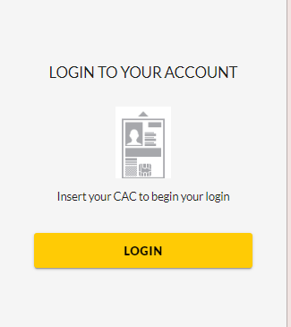
Logging Into ArmyIgnitED
CUI
If your record is not found, contact the Helpdesk for assistance.
email: ArmyIgnitEDHelp@army.mil
35
CUI
Notes:
Slide 23
Before clicking the login button make sure your CAC card is inserted (if you're using a government computer your CAC card is already inserted, but if you’re using your personal computer you will need to insert your CAC card into a Card Reader to gain access to your account)
Password and userID is not accepted, you must have a CAC card an order to gain access to your ArmyIgnitED account.
When you Log into ArmyIgnitED for the first time it will establish your account
All SMs should have a baseline account; if your account do not come up you need to refer to the BamTech Helpdesk for technical support use the phone number or email address that is listed on this slide.

Slide 36
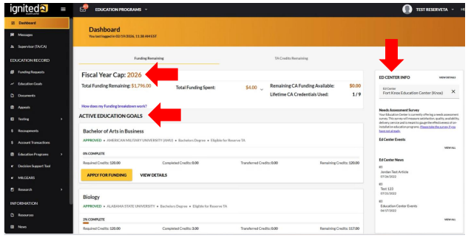
Navigating ArmyIgnitED
CUI
Student Dashboard
36
CUI

Slide 37
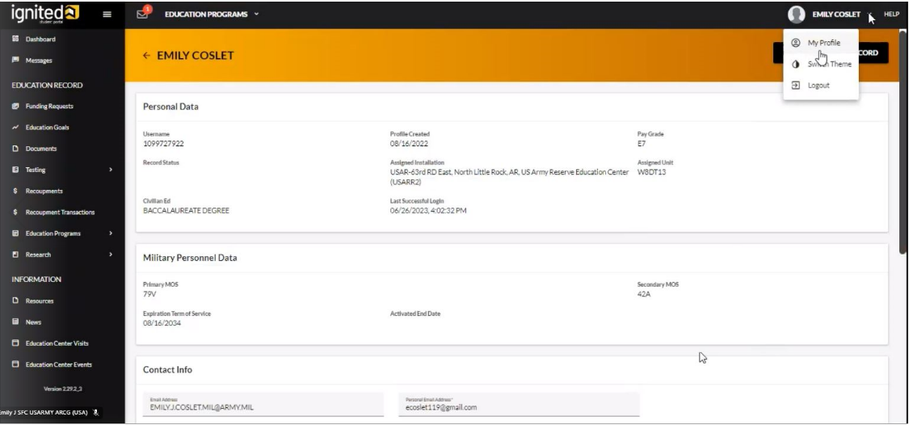
Navigating ArmyIgnitED
CUI
Reviewing Profile Page
ARMY SOLDIER
ARMY SOLDIER
0000000000
To access your Profile Page, on the top right of the page, click on your name and
click on “My Profile”. This has your user information, contact information, and mailing address.
Student and Military Information migrate into ArmyIgnitED from IPPS-A
To Update Civilian Ed Level, contact Unit Personnel / S1 Office
Civilian Education Level must be current to maintain TA/CA eligibility
37
CUI
Notes:
Temporary Civ Ed Level update may be done at the Education Center determined on a case-by-case basis to update Education Goal with source document

Slide 38
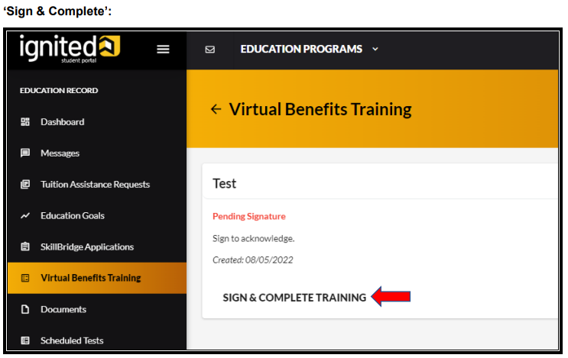
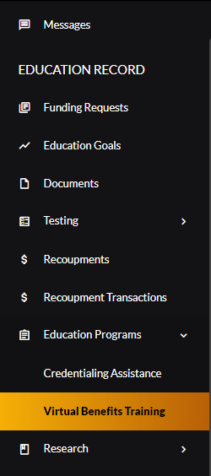
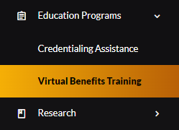
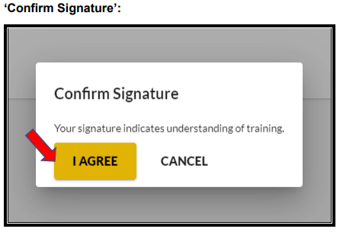
Complete Virtual Benefits Training
CUI
Before requesting Tuition Assistance, you must sign and complete the Virtual Benefits Training
You must complete your Virtual Benefits Training to request TA
38
CUI
Notes:
Completing your Virtual Benefits is important. The Virtual Benefits Training is an annual requirement. Please read this before signing as you are agreeing to the terms and conditions of TA/CA usage. If this is not completed, your account will be placed on an automatic hold, and you will not be able to request TA. You will notice that your Yellow Request Funding button is greyed out and that will be your que that something is wrong and needs to be updated. A quick tip, if you click on your ED Goal, it will let you know what is missing if your Apply for Funding is greyed out.

Slide 39
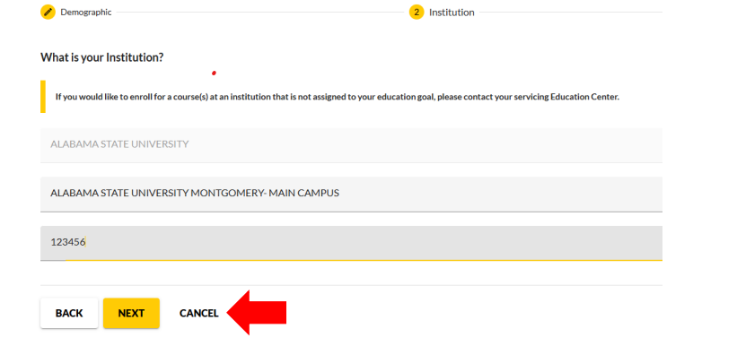
Create an Education Goal
CUI
39
CUI

Slide 40
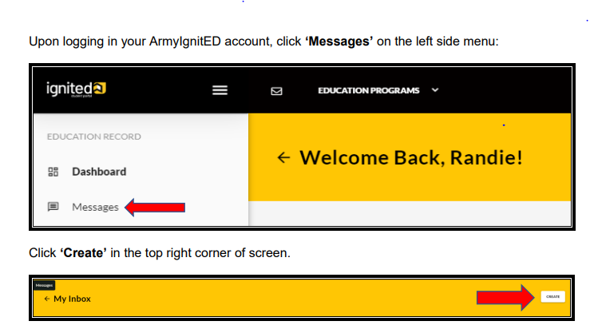
Send Messages to Education Center
CUI
40
CUI

Slide 41
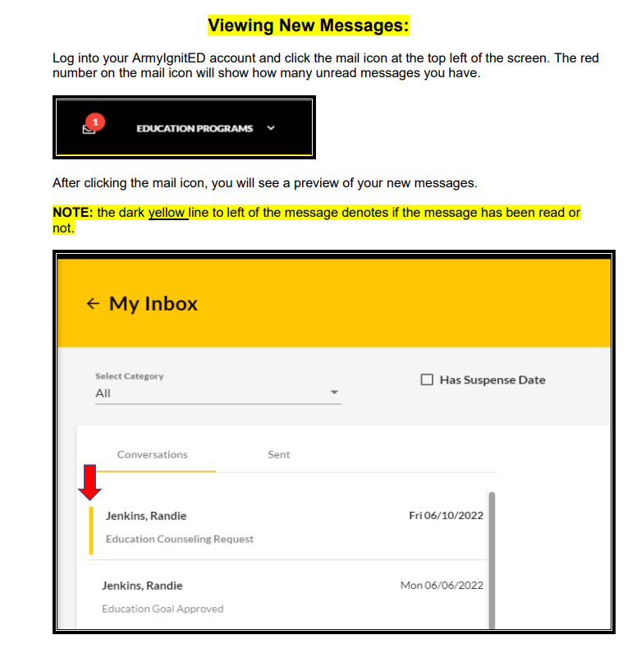
Viewing Messages in ArmyIgnitED
CUI
41
CUI

Slide 42
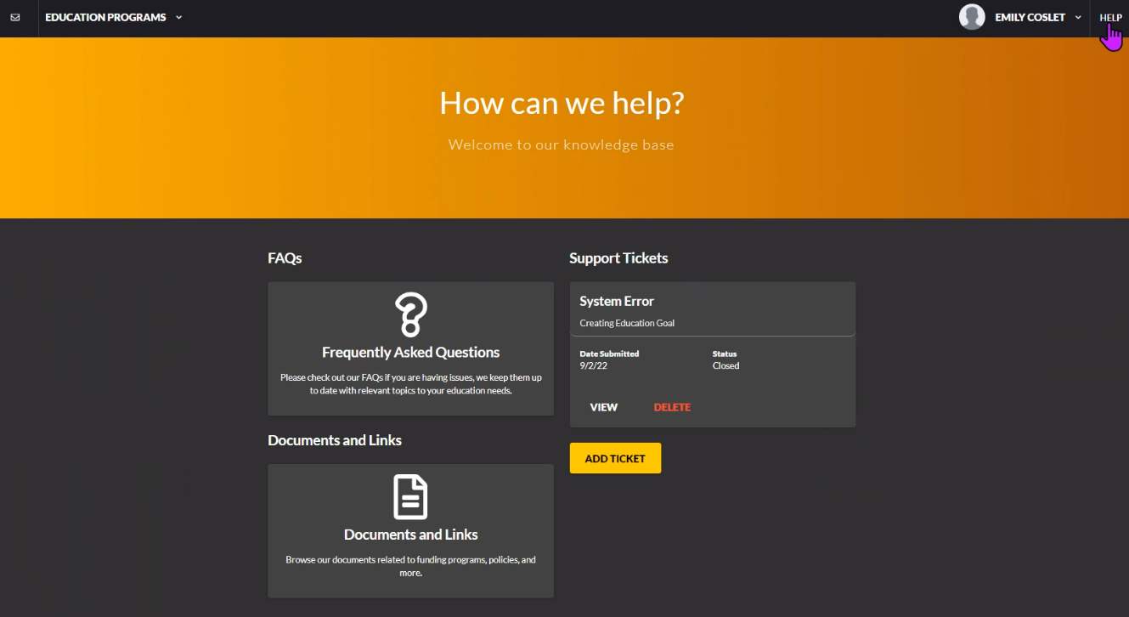

How to Get Help
CUI
Click on “Help” to find FAQs, Support (Help Desk) Tickets, and Documents/Links
ARMY SOLDIER
ARMY SOLDIER
42
CUI
Notes:
Frequently Asked Questions – Find common answers to questions regarding ArmyIgnitED
Documents and Links –Find Tutorial Guides on ArmyIgnitED Functions – IE: Submitting an Education Goal, Submitting a TA Request, Messaging System Functions, etc.
Support Tickets – View Current Support Tickets Submitted and Adding Ticket – Discussed in the next few slides

Slide 43
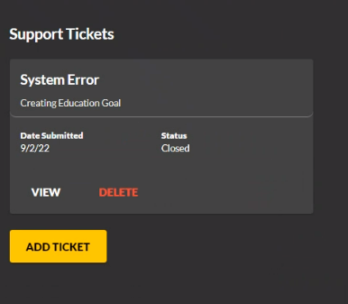
Support Ticket
CUI
ARMY SOLDIER
On the Help Home Page, under “Support Tickets” will be the status of any ticket submitted
Click on “Add Ticket” button to begin submitting a help ticket. It will take you to a page where you can submit tickets under specific categories.
43
CUI
Notes:
When you click on "Add Ticket", it will take you to the Submit Ticket Page where TA/CA or other issues can be selected to submit a message to open a ticket
Portal page needs actual ticket request

Slide 44
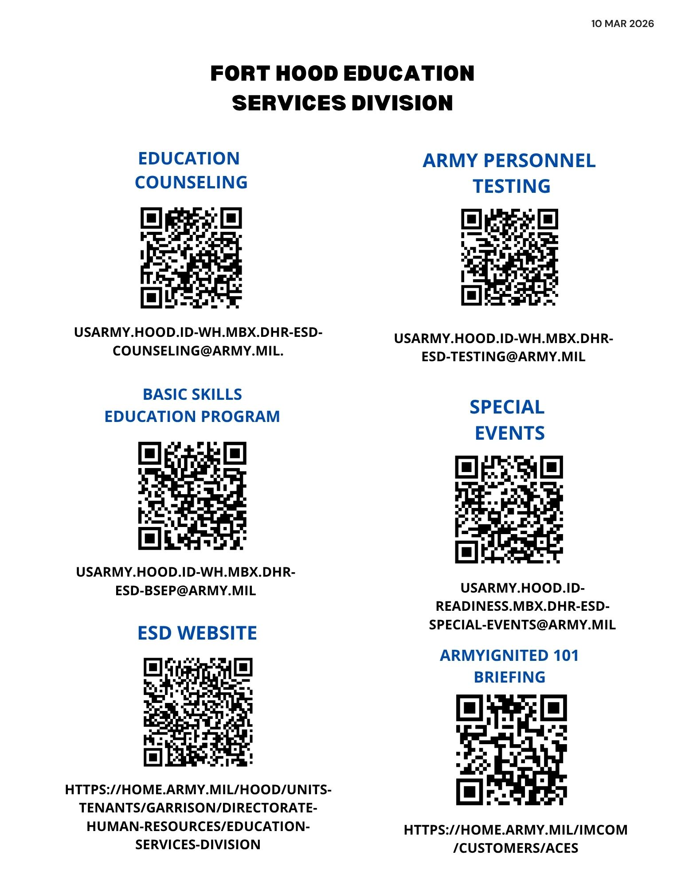
Fort Hood QR Codes
CUI
44
CUI
Notes:
This concludes our briefing on ArmyIgnitED 101
I would like to thank each of you for attending the ArmyIgnitED 101 briefing enjoy the rest of your day

Slide 45
Questions
CUI
If you have questions or need additional information, send a student message through ArmyIgnitED or email us at:
usarmy.hood.id-wh.mbx.dhr-esd-counseling@army.mil
45
CUI
Notes:
This concludes our briefing on ArmyIgnitED 101
I would like to thank each of you for attending the ArmyIgnitED 101 briefing enjoy the rest of your day

