Slide 1
ARMY OPSEC SUPPORT ELEMENT
United States Army
Operations Security (OPSEC)
Program Manager / Officer Course
Notes:
INSTRUCTOR: Welcome to the Army OPSEC Program Manager / Officer Course. This 3-day course is to give you the knowledge, skills and abilities to bring up a new program or improve on your existing program.
(Photo: https://www.dvidshub.net/image/4230835/family-matters
PowerPoint DESIGN Inspired by: MAJ Jimmy Letterman @ james.t.letterman.mil@army.mil)

Slide 2
COURSE OBJECTIVE
Action: Establish an OPSEC program through the use of the 6 step cyclic process,.
Condition: In three (3) days; in a classroom environment with no more than 15 students per class per instructor, provided with facilitated and platform instruction; given course materials, scenarios, and practical exercises, participate in individual and group discussions, successfully complete individual and group practical exercises, and final essay.
Standard: Directing an OPSEC program includes: Communicate OPSEC Fundamentals, Establish an OPSEC Program, USE the 6 step cyclic process, Integrate OPSEC program with related functions and evaluate the effectiveness of the OPSEC Program IAW NSPM 28, DOD 5205.02, CJCSI 3213.01 and AR 530-1.
Notes:
INSTRUCTOR: The purpose of this course is to Train students to perform as Level II OPSEC officers, capable of understanding and using the six-step cyclic process to protect an organization’s critical information with measures that are closely coordinated with related security programs and documented in a plan, SOP or equivalent format.
Before we get too far into OPSEC, we first need to address some administrative issues.

Slide 3
AUTHORIZED USES
Presentation and slides can only be used by Level III instructors with a current certification from the U. S. Army OPSEC Support Element (OSE) to provide OPSEC Level II training
Course books can be used as general information for others seeking Level II training in the future
Sampling of Course content can be used as part of Unit annual training (Note: Unit annual training must be tailored to the unit and local area; generic slides alone are substandard per AR 530-1)
Notes:
Listed are the only three authorized uses for this course. Any instructor who does not hold a current level III certification from the Army OSE presents this course (or portions thereof) and issues level II certification is falsifying documents in violation of regulation, and may be subject to judicial or non-judicial punishment, such as action under Article 15 of the Uniform Code of Military Justice.

Slide 4
ADMINISTRATIVE CONDUCT
  Army Training and Leader Development standards, students may be dis-enrolled or dismissed from the course for the following reasons:
  Personal conduct is such that continuance in the course is not appropriate (for example, if a student violates regulations, policies, or established discipline standards).
  Academic deficiency demonstrated by failure to meet course standards or lack of academic progress that makes it unlikely that the students can successfully meet the standards established for graduation.
  Illness or injury (as determined by a physician) which prohibits students from attending and successfully completing course requirements.
  Compassionate reasons.
A student may not miss more than two (2) hours of instruction.
If the student misses more than two (2) hours of instruction, the student will be
dis-enrolled from the course due to a failure to meet course standards or lack of academic progress.
IAW AR 350-1
Notes:
INSTRUCTOR: IAW AR 350-1 Army Training and Leader Development standards, Personal conduct, Academic deficiency, Illness or injury.
A student may miss no more than two (2) hours of instruction

Slide 5
EVALUATION GRADING CRITERIA
Each Graded evaluation has an allotted time limit as per the Individual Student Assessment Plan (ISAP)
Review ISAP in welcome letter
Due to different characteristics within each evaluation, they are NOT graded the same
All graded assessments are Open Book
Notes:
INSTRUCTOR: All evaluations are open book and open notes. There are three evaluations throughout the course:
OPSEC 6-step cycle = 60 possible points (individual evaluation)
OPSEC Review = 20 possible points (conducted as a group)
Essay = 20 possible points (individual evaluation)
Minimum passing grade is 80 of the 100 points. However, No retest will be offered , If the student does not earn at least 80% they do not pass the course.

Slide 6

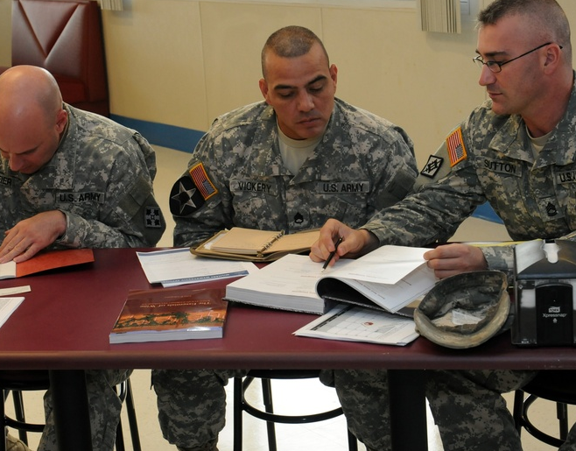


ADMINISTATIVE FAMILIARIZATION
Restrooms
Emergency Exits
Eateries
Smoking Areas
Schedule / Lunch Flexibility
No Phone / Laptop during class
Place on vibrate / turn power off to laptop
Personnel Development Skill Identifiers (PDSI)
Cannot miss more than 2 hours of class
Military Education Update: OPSEC Practitioner (H1 B) -DA PAM 611-21
Notes:
INSTRUCTOR: Please place phones on vibrate; if you must take a call please go outside. Focusing on other work can lead to missing key information, and course failure. Students have failed this course because they were too busy with other duties rather than being focused on the class.
Our schedule of classes are listed in your book as a table of contents. On average the blocks run about 50 minutes.
Lunch is flexible.
The OSE will only process active duty enlisted soldier PDSI Officers process their own,
This course makes you eligible for a PDSI; to obtain the PDSI, the requirements are as follows:
For all USAR and ARNG personnel(officer and enlisted) they must submit a DA Form 5178, 4187 and a copy of their Lvl II certificate to their S1 or Personnel Center for annotation of the PDSI on their records. Their unit will be the Authorized Agency for the action.
The OSE will top-load all active duty enlisted) to Army G1 once a quarter. Army G1 forwards to HRC and sends us confirmation that it has been forwarded to HRC. If they wish to be proactive for a promotion board they can follow the same procedure as the USAR and ARNG personnel. This does not guarantee that it will get it on the records any faster but it is a proactive measure they can use.
(Notes: Advise the students where the latrines, eateries, snack bar, smoking areas and emergency exits are located.)

Slide 7

INTRODUCTIONS
Name
Unit
Assignment
Experience with OPSEC
What is your OPSEC role?
I WANT YOU
Practicing OPSEC
Notes:
INSTRUCTOR: Now let’s get to know a little about each other.
(Notes: Use this as an opportunity to find out who are the information release authorities in the class, i.e. PAO, Contract Specialist, FOIA etc. to get them to share real-world experiences and subject matter expertise.)

