Slide 1
ARMY OPSEC SUPPORT ELEMENT
WELCOME TO DAY 2
Operations Security (OPSEC)
Program Manager / Officer Course
Notes:
Photo: https://www.dvidshub.net/image/4230835/family-matters
PowerPoint DESIGN Inspired by: MAJ Jimmy Letterman @ james.t.letterman.mil@army.mil

Slide 2
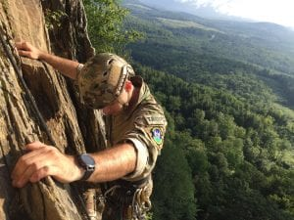

STEP # 4: ASSESS THE RISK
1. IDENTIFY CRITICAL INFORMATION & INDICATORS
6. ASSESS THE EFFECTIVENESS
2. IDENTIFY & ANALYZE THREAT
5. APPLY COUNTERMEASURES
3. ANALYZE VULNERABILITIES
4. ASSESS RISK
Notes:
Instructors: Please ensure that students grasp steps one through three before starting step four.

Slide 3
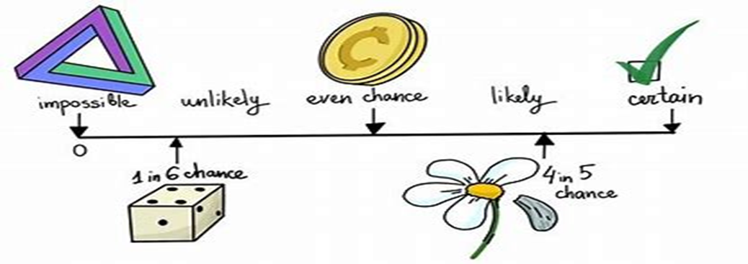
OPSEC DEFINITION OF RISK
The probability an adversary will compromise your Critical Information and the impact if the adversary is successful.
Probability is often referred to as “hazard”; “impact” is often referred to as “severity.”
Reference: (Deliberate Risk Assessment Worksheet - DRAW) (ATP 5-19)
Notes:
Definition of risk = Probability (Critical Info will be compromised) AND the impact if the adversary is successful
Discussion: Is anyone familiar with DRAW, or the older CRM or RM risk management models? How is OPSEC like or unlike them?

Slide 4
RISK = IMPACT x THREAT x VULNERABILITY
Asset
(CIL)
Impact of Unwanted Event
RISK
Threat
Probability of Unwanted Event
Risk = I x (T x V)
Vulnerability
Notes:
When the threat (T) and vulnerability (V) levels are considered together, an analyst can estimate the probability of an undesirable event. Probability of occurrence of the undesirable event (T x V) and expected Impact (I) are considered together in the estimate of the risk level.
Risk = Impact x (Threat x Vulnerability)
Why multiply? Using multiplication in the formula is based on the premise that all three elements (I and T and V) must be present to have risk (R). Thus, if there is no threat (T), there is no risk (R), if there is no vulnerability (V) for the threat (T) to exploit, there is no risk (R) and lastly, if there is a threat (T) and a vulnerability (V) to exploit but there is no impact (I) of that exploitation, there is no risk (R).
Given that a few very rare, but very significant, events can have disproportionate effects, it’s wise to also take into account one or two of the largest-impact events, even if their probability is low. This is in addition to, not instead of, defending against the highly probable, high-impact events.

Slide 5
QUESTIONS TO ASK YOURSELF
What is the current risk without OPSEC measures?
Can OPSEC measures reduce the risk?
Can the measures’ effects be demonstrated?
What are the effects of implementing vs.
not implementing the OPSEC measure? (“So what?”)
  Cost: Dollars, Time, Personnel
  Coordination with IO, traditional security, intelligence/Counterintelligence?
  Does it create a new indicator?
Notes:
There is always a risk associated with everything you do, every action you take…even if you don’t realize it at the time.
Common activities have risks. We automatically mitigate those risks without much thought. A goal of OPSEC is to develop your personnel so that they automatically mitigate OPSEC risks the same way.
However, complex activities with multiple risks need to be analyzed and measures implemented to reduce the risk.
This is another opportunity for critical thinking. One of the aspects of critical thinking is implications; risk considers the implications of vulnerabilities, and then (after tentative measures are brought into consideration) what the implications of measures may be. If a measure isn’t adopted, what does that mean for the mission, and for Force Protection? If a measures is adopted, what are the implications and consequences?

Slide 6
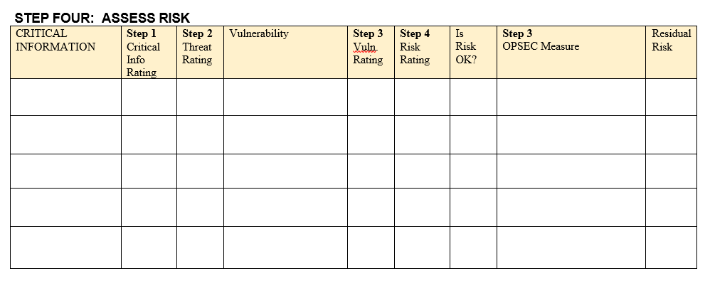
RISK WORKSHEET
Risk = Impact x (Threat x Vulnerability)
3 | HIGH: 3 x (3 x 3) = 27 | HIGH = 18 – 27
2 | MED: 2 x (2 x 2) = 8 | MED = 6 - 17
1 | LOW: 1 x (1 x 1) = 1 | LOW = 1 -5
CDR’S Acceptable Risk Level: MED = 17
Notes:
Talk about use of an assessment tool to help visualize and prioritize measures that need to be addressed- brainstorm possibilities
Talk about the math equation R=Ix(TxV) and its importance for the numbers and relate this tool using high, medium, and low

Slide 7
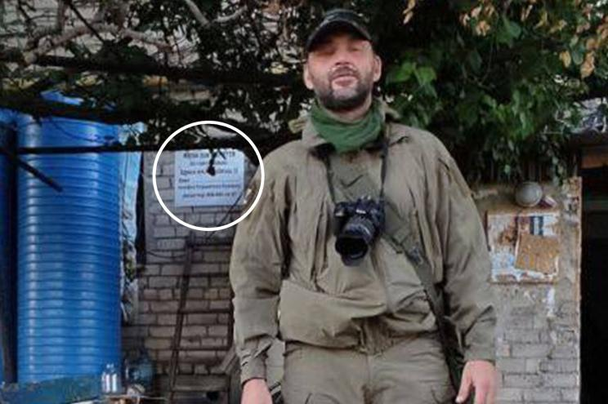
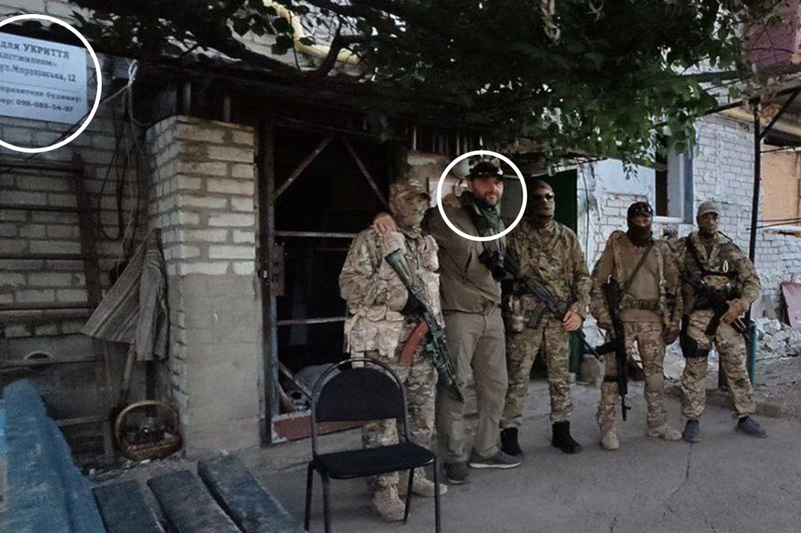
EXAMPLE
Suppose someone released a photo showing unit location?
Notes:
https://nypost.com/2022/08/15/ukraine-hits-base-of-russian-paramilitary-group-wagner-report/?fbclid=IwAR1T4BbFnshHxE6i2JT2mNc3anAujvUATUW9GiU18X9ZCfRaIV0aTL5_4Ag
Ukraine was able to locate the headquarters after a Russian propagandist, Sergei Sreda, accidentally revealed its location in photos posted to Telegram on Aug. 8, Ukrainian newspaper Ukrainska Pravda reported.

Slide 8
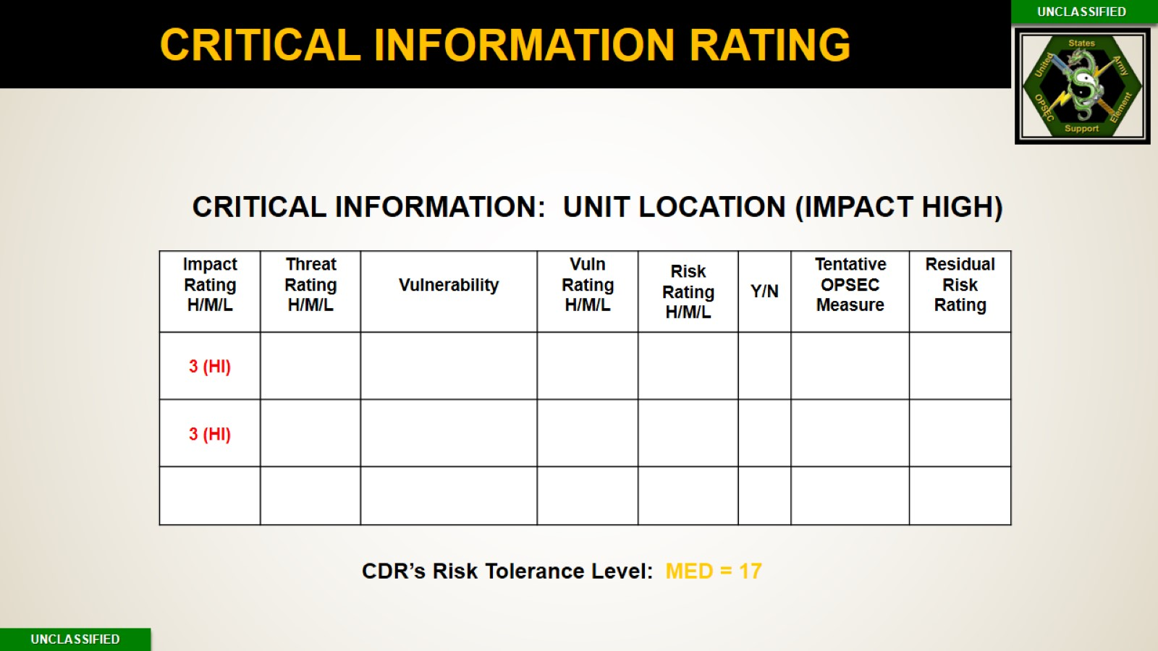
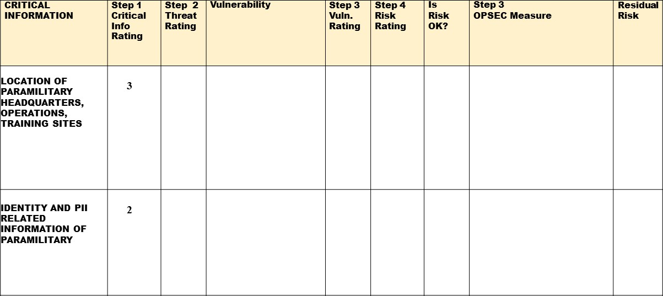

Slide 9
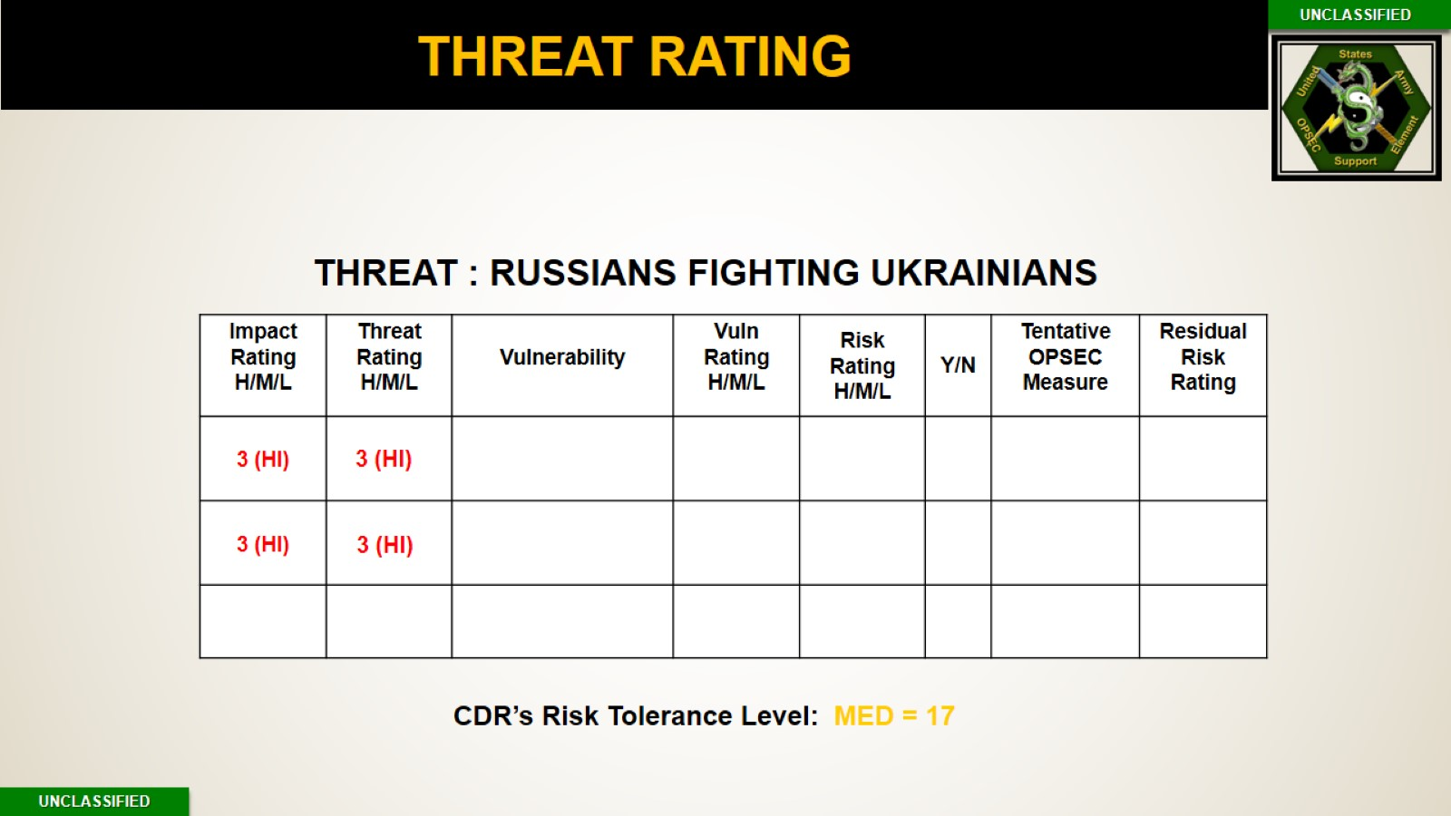


Slide 10
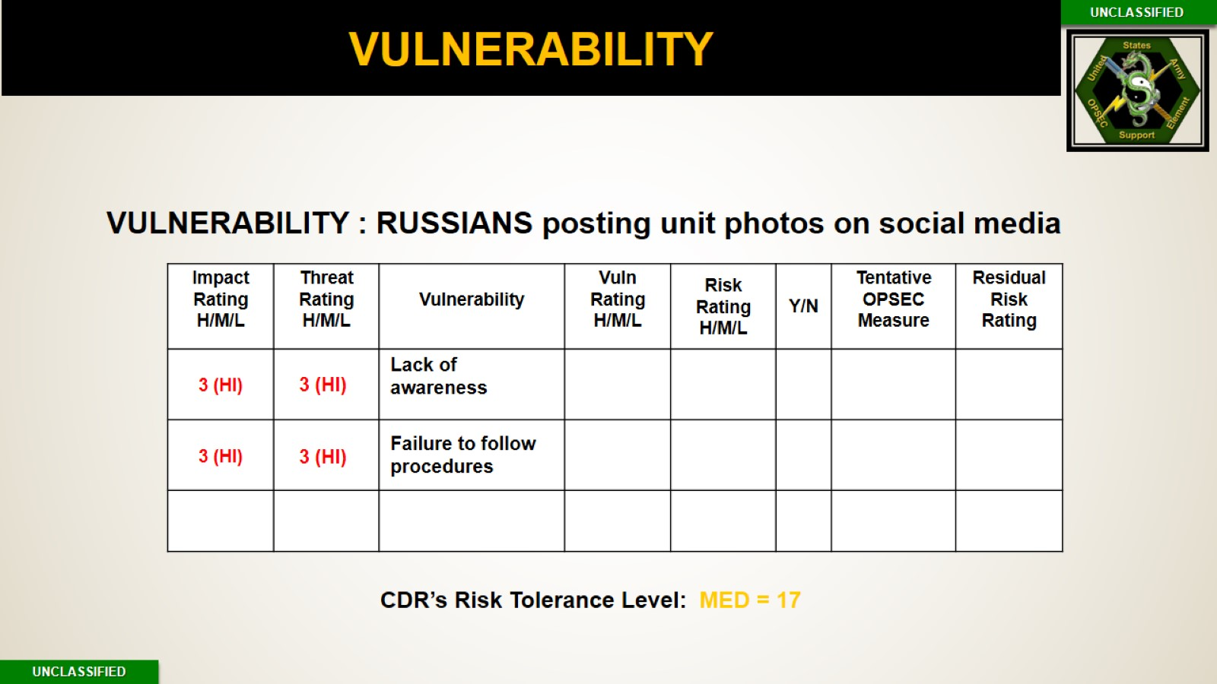
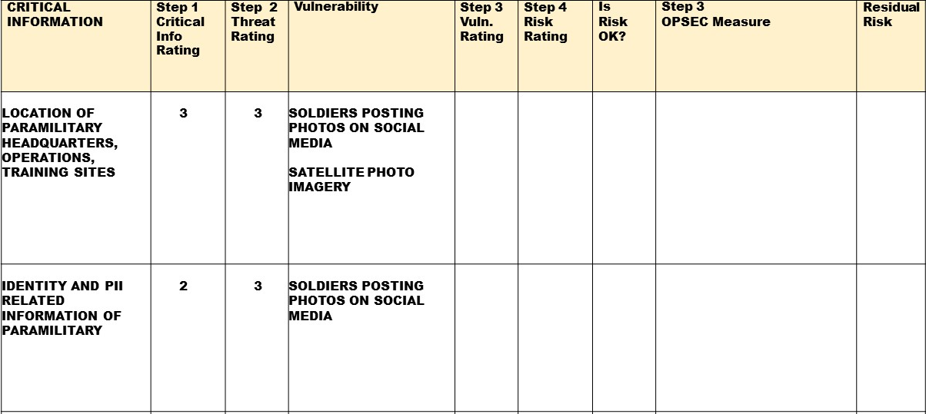

Slide 11
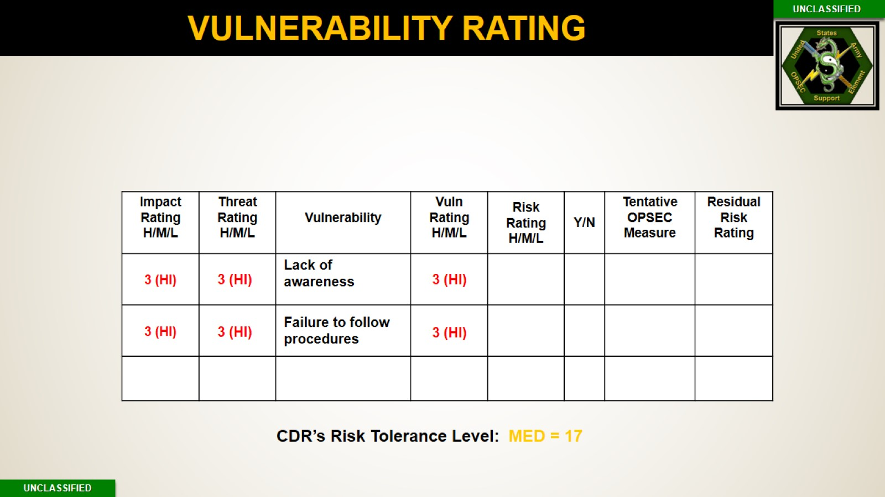
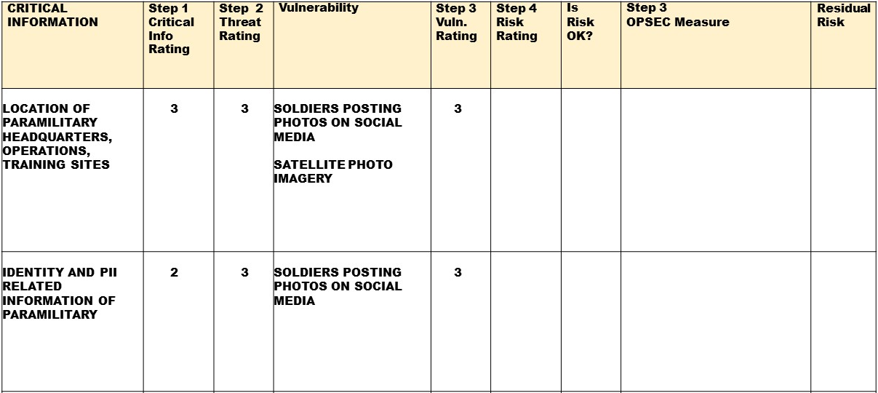

Slide 12
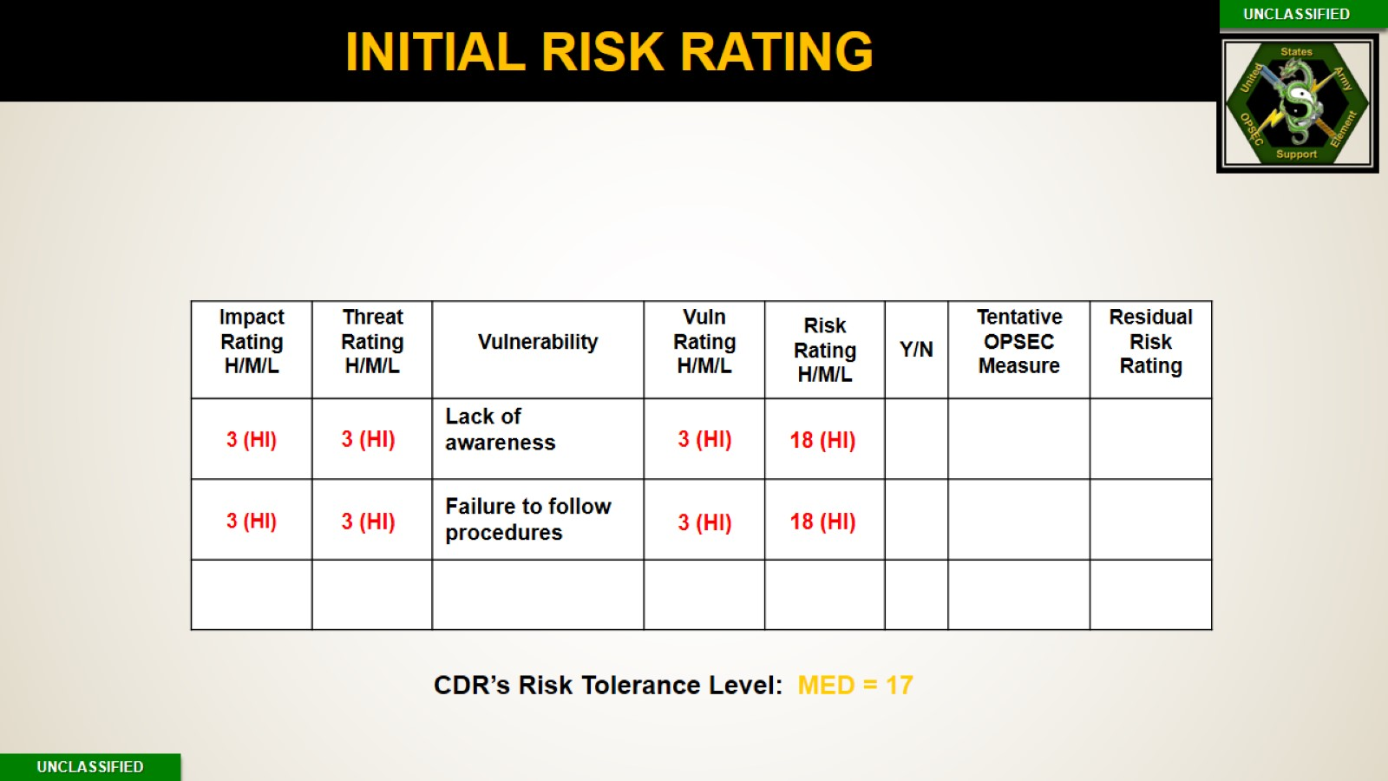
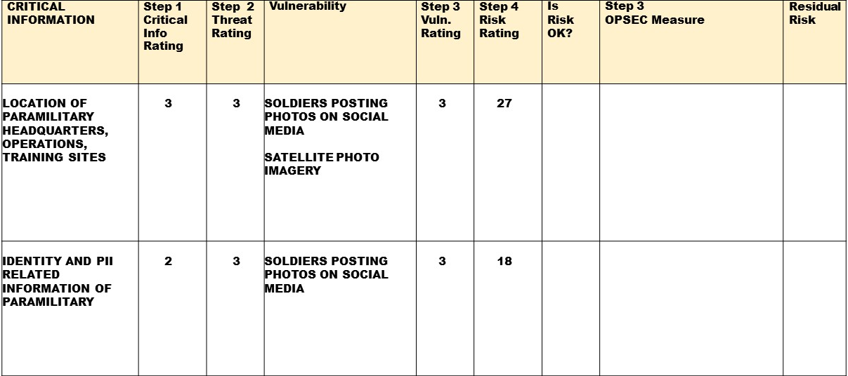

Slide 13
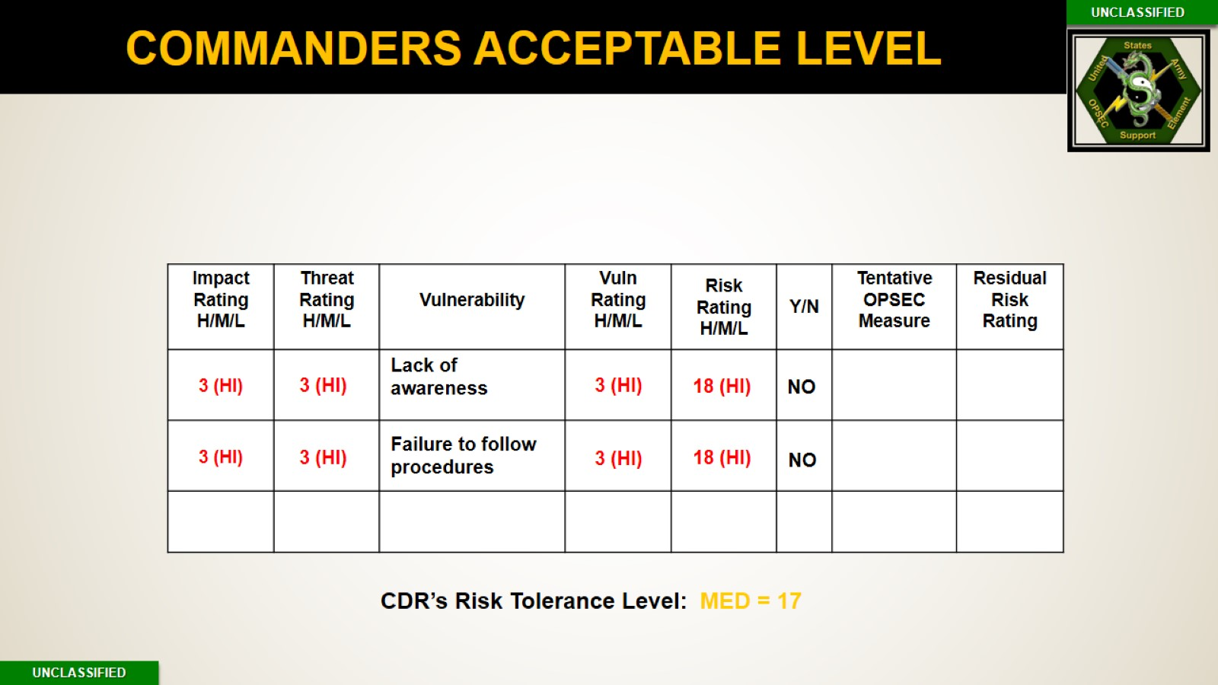
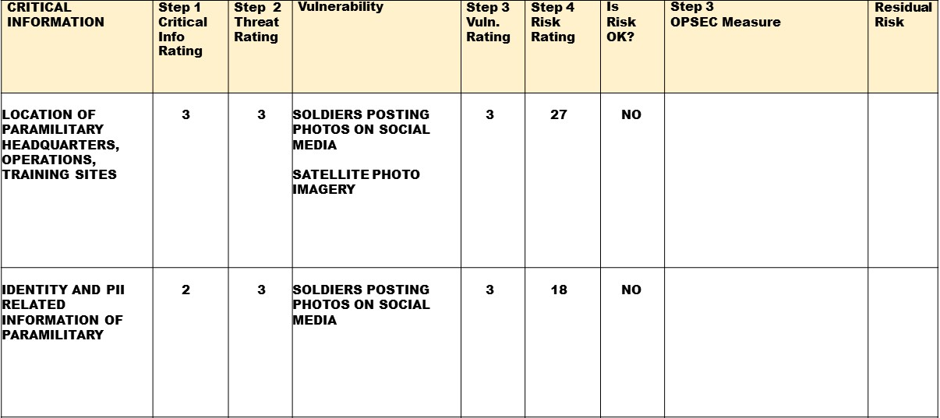

Slide 14
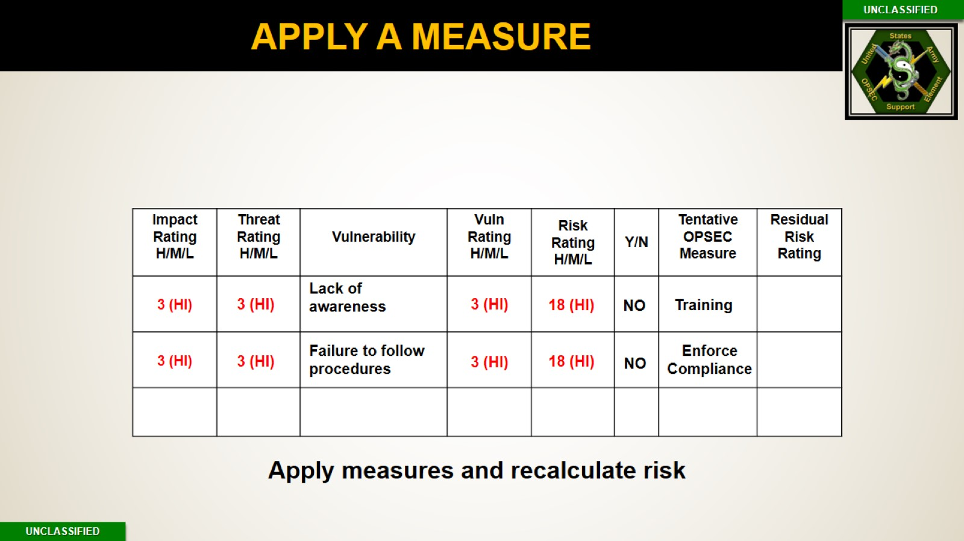
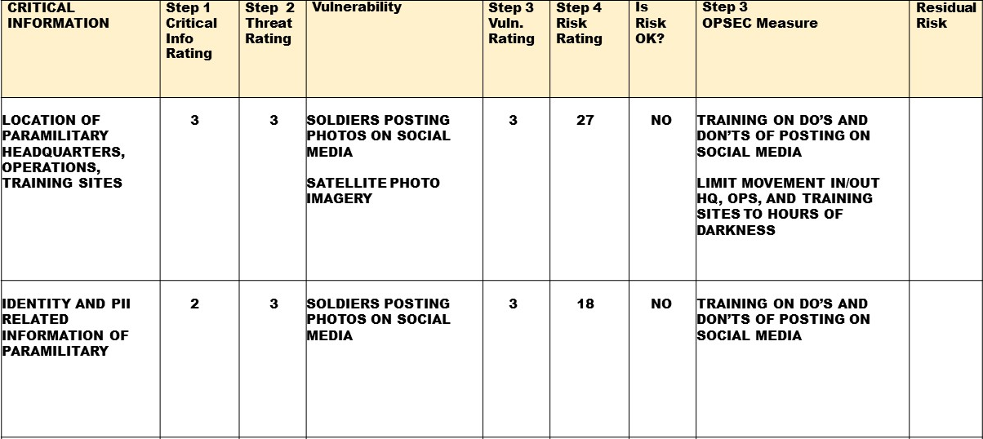

Slide 15
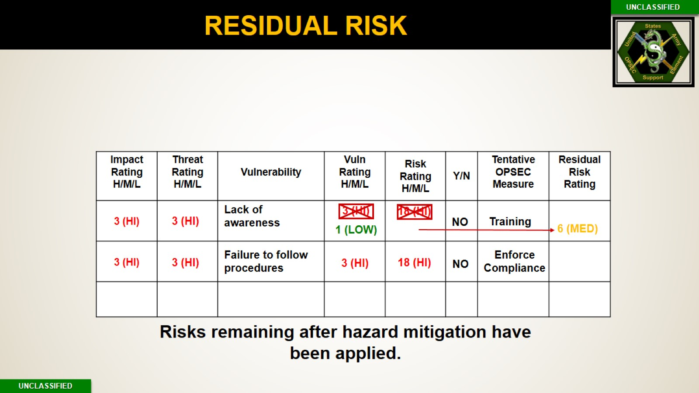


Slide 16
RISK PE
Risk = Impact x (Threat x Vulnerability)
3 | HIGH: 3 x (3 x 3) = 27 | HIGH = 18 – 27
2 | MED: 2 x (2 x 2) = 8 | MED = 6 - 17
1 | LOW: 1 x (1 x 1) = 1 | LOW = 1 -5
CDR’S Acceptable Risk Level: MED = 17
Notes:
NOTE: Break as necessary - total time for PE and break should not exceed 30 minutes
Note: The measures identified here are tentative measures, as per Step 3 (Vulnerabilities), not final measures IAW Step 5 (Measures).
Instructor best practice: Call on students in other groups to comment on the speaking group’s assessment. For example, ask one group (any group) to comment on different group’s assessment.

Slide 17
OPSEC

Slide 18
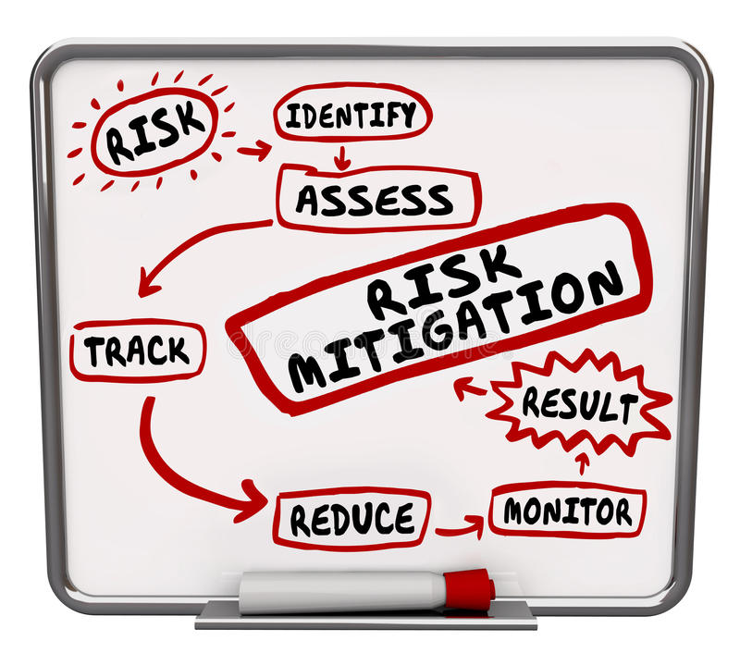
STEP # 5: APPLICATION OF COUNTERMEASURES
1. IDENTIFY CRITICAL INFORMATION & INDICATORS
6. ASSESS THE EFFECTIVENESS
2. IDENTIFY & ANALYZE THREAT
5. APPLY COUNTERMEASURES
3. ANALYZE VULNERABILITIES
4. ASSESS RISK

Slide 19

PURPOSE
Apply countermeasures to ongoing activities or plans for future operations to reduce, eliminate, or conceal indicators requires the following:
OBJECTIVES
Adversary Collection
  Documentation (AR 530-1)
  Plan the
  Implementation of
  your measure
  Coordination
OPSEC Measures
Notes:
Apply appropriate countermeasures to deny THREAT information of
specific friendly intentions, capabilities, and activities.
(1) Implement those measures that require immediate action. This
applies to current operations as well as planning and preparation for future ones.
(2) Document or task OPSEC measures by using an OPSEC annex to
the operations plan/operations order (OPLAN/OPORD).
(3) Brief OPSEC requirements to planners, participants, and support
personnel.
Note: OPSEC measures are command-directed actions executed by individuals,
who must be aware of their responsibilities.
(4) Monitor OPSEC measures during execution. Monitoring is a
continuous process of evaluating intelligence and counterintelligence. It is
necessary to monitor countermeasures for effectiveness because unevaluated
countermeasures can lead to a false and dangerous sense of security.
(5) Make adjustments to improve the effectiveness of existing
measures. This will be necessary to obtain the best protection for military
operations.
6. Define OPSEC review, assessment, and survey.
a. OPSEC review is an evaluation of a document to ensure protection of
sensitive or critical information.

Slide 20

DOCUMENT MEASURES IN YOUR PROGRAM
Why do we document implementation of measures in your program/plan or SOP?
  Required by regulation
  Continuity
  Legitimizes the program
  References for infrequent activities
  Sets clear responsibilities
  Identify materials and resources to implement the program or measure
  Identify and Evaluate
  OPSEC measures and
  OPSEC program
Notes:
Required by Regulation – AR 530-1
Continuity - Helps a new OPSEC PM / Officer or an alternate to take on the program
Legitimizes the program – Signed by the commander = enforceable & publication
References for infrequent activities – such as submitting documents for OPSEC reviews
Sets clear responsibilities - for each section or individual (e.g. who conducts OPSEC reviews, who conducts website reviews, who is required to have their publications reviewed, etc.)
Documents required material and resources – Always helpful to have a list of resources to utilize and what material and who will be required to implement certain OPSEC measures.
OPSEC measures and program evaluation –
Provides proof that OPSEC measures are being conducted (e.g. OPSEC reviews of pre-published documents maintained by OPSEC PM.)
Will be used to provide data for evaluating the effectiveness of OPSEC measures in step 6 (e.g. OPSEC reviews over time show trends or changes in critical information being caught pre-publication)
Will be used to provide data for evaluating the effectiveness of your OPSEC program during assessments (similar to evaluating OPSEC measures)

Slide 21
FORMATS AND TEMPLATES
AR 530-1, Operations Security
Appendix M: Annex/Appendix
Appendix N: OPORD/OPLAN
CJCSM 3130.03C, Adaptive Planning and Execution (APEX)
Planning Formats and Guidance
Format is stated and Required
BORROW
OPSEC Organizations
Other OPSEC PMs
Higher Headquarters
Organization/ Commander Requirements
Annexes
Memos
SOP
ARMY
JOINT
ALL
Army OSE milSuite Site:
https://www.milsuite.mil/book/groups/army-opsec-support-element-ose/activity
Notes:
Traditional formats to document your measures and your OPSEC program include the following:
OPORDS
OPLANS
Annexes
Appendixes
Memos
SOPs
Joint prescribed format is APEX If your organization does not currently have any of these seek guidance from your higher first. Then look at the other options listed.

Slide 22
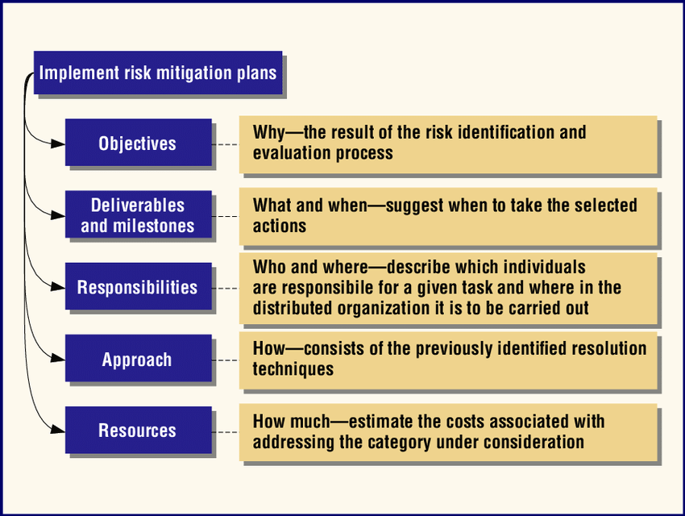
WHAT TO DOCUMENT YOUR MEASURE
NOTE: OPSEC MEASURES ARE COMMAND-DIRECTED ACTIONS EXECUTED BY INDIVIDUALS,WHO MUST BE AWARE OF THEIR RESPONSIBILITIES.
Notes:
An implementation risk mitigation plan refers to the measure to mitigate the vulnerability.

Slide 23
Additional Document Requirements
  6 Step Cyclic Process
  Processes & Procedures
  Tasks & Responsibilities
  Evaluation Plan/Criteria
  Policy letters
  Assessments
  Measure of performance/ Measures of effect
  Evaluation Results
  OPSEC and PAO Review process
  Public review recommendations and results
PROGRAM PLAN
OPORD
ORGANIZATION
SOP
Electronic File Folder
NOTE: IF THE COMMANDER SELECTED A NO-MEASURES ALTERNATIVE, DOCUMENT THAT AS WELL
Notes:
OPSEC MEASURES REQUIREMENTS
Policies: Document an policies regarding you OPSEC Measure implementation such as 100% shred policy. SOP
6step , OPSEC Measures – Annotate the measures themselves. Measures must reflect when information is no longer critical. Program PLAN
Processes & Procedures – in regards to implementing OPSEC measures such as the process for submitting documents for OPSEC Reviews. SOP
Responsibilities – Who is responsible for different aspects of an OPSEC measures, such as who is conducting OPSEC reviews. Remember the who should be a position and not a person. ORDER/SOP/MEMO
Evaluation Plan/Criteria – We’ll talk about this in step 6 along with the OPSEC Measure Evaluation Results but this is how we will ensure that our OPSEC measures are doing what they’re supposed. SOP/PLAN
Results documented in the program plan
OPSEC MEASURE RESULTS
OPSEC Reviews – Required by AR 530-1 and very useful when evaluating your OPSEC measures in the next step as well as for OPSEC assessments and surveys. We’ll talk about how to do an OPSEC review in it’s own block of instruction.
OPSEC Assessments – Also required by AR 530-1 and will let you know how effective your OPSEC Program is. We’ll talk more about OPSEC assessments in it’s own block of instruction
OPSEC Measure Evaluation Results – This should be included in the OPSEC Estimate as an evaluation of friendly OPSEC effectiveness (AR 530-1).
Note: If the commander selected a no-measures alternative, state that fact.
So what formats to use? Next slide

Slide 24
COORDINATING WITH TRADITIONAL SECURITY
Essential secrecy = OPSEC + traditional security
Traditional security includes a variety of programs that can help protect Critical Information
  Information Security (380-5)
  Personnel Security (380-67)
  Communications Security (380-40)
  Physical Security (190-13)
  Industrial Security (380-49)
  Personal Security (190-58)
Notes:
Remember essential secrecy:
Therefore, coordination is not only appropriate, but necessary for essential secrecy

Slide 25
BENEFITS OF COORDINATION
Information Security: Division of labor
Physical Security: Mutual support and benefit
Information Assurance / Communications Security: Mutual protection required
Personnel Security: Can support legitimate release of Critical Information
Industrial Security: Can aid in protection of critical information by other organizations
Personal Security: Similar techniques, protection of individuals with access to critical information
Notes:
Even if it’s not OPSEC, failures in traditional security can create indicators or vulnerabilities

Slide 26
COORDINATION WITH INFORMATION SECURITY
AR 380-5 provides classification guidance
  Outlines CUI, FOUO, SBU, etc. and their use
  Defines sanctions for release of classified or sensitive information
Most common interaction: Document review
  Situation: Aggregation of information may result in classification of a document; Consult with your Security Classification Guide and your INFOSEC officer
Very common interaction; recommend OWG
SECRET

Slide 27

COORDINATION WITH PERSONNEL SECURITY
Personnel security addresses individuals’ access to classified information
Less interaction with OPSEC than most traditional security disciplines
May be useful as an informal vetting process for allowing access to critical information, especially when working with personnel outside your unit in terms of special NDA’s
Notes:
Uncommon interaction; OWG membership could be beneficial to discuss responsibilities with additional vetting, NDA’s and how they get injected into contracting

Slide 28
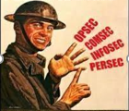
COORDINATION WITH CYBER SECURITY
  Encompasses Communications Security (COMSEC), Computer Security (COMPUSEC), Emanation Security (EMSEC) and Information Management (IA)
  Most common interaction: Password security, commercial off the shelf apps vulnerabilities
  Hackers are aware that the easiest way into a system may be to target the user.
  Providing awareness training on user susceptibilities to (social engineering), and human nature and latest vulnerabilities assist in the reduction of vulnerabilities.
  Additional interaction; OWG membership recommended dependent upon the unit or mission
DODI 8550.01, AR 380-53, AR 380-40, AR 380-27, AR 25-1
Notes:
AR 25-1, page 53 supports AR 530-1-
Website reviews. In accordance with AR 530–1, the public affairs officer and operations security officer for each
Army organization will review and approve the content and format for each of the organization’ s public-facing websites
before content is posted online. The designated certified reviewer(s) will conduct routine reviews of websites on a quarterly
basis to ensure that each website is in compliance with applicable policies and that the content remains relevant and appropriate. The minimum review will include all of the website’s internal control checklist questions (see DA Pam 25–1–1).

Slide 29
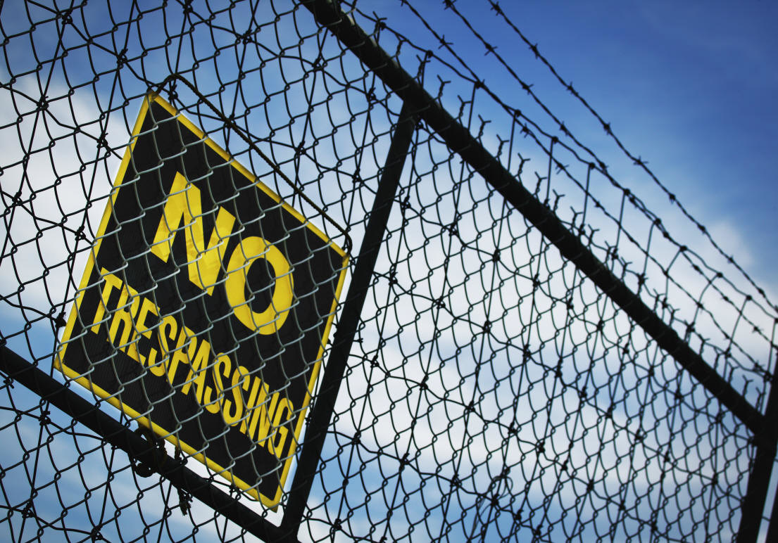
COORDINATION WITH PHYSICAL SECURITY
Required to integrate w/OPSEC per AR 190-13
Very common interaction; OWG membership recommended
Most common interactions involve measures which enhance both physical security and OPSEC
  Physical security risk process parallels OPSEC risk process; new officers in each can learn from the other
  OPSEC can identify indicators or signatures we may need to conceal.
Notes:
Internal Physical Security budget funds measures that also support OPSEC at no additional cost
Physical security must protect against the intelligence threat, which benefits OPSEC
Physical security links with law enforcement, and so may provide LE information to the OWG

Slide 30

COORDINATION WITH INDSUTRIAL SECURITY
Deals with private information which is vital to national security
Most common interaction: Addressing the critical information from contractors and Government Critical information protection
Interaction is not usually so common that regular contact is required
Release of information to contractors is covered in AR 381-10 and AR 380-49

Slide 31
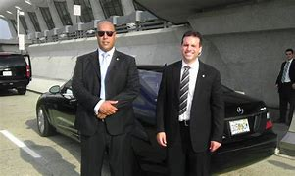
COORDINATION WITH PERSONAL SECURITY
Focuses on protection of high risk personnel
Lower level of interaction; OWG membership not required
Contact through Force Protection is usually sufficient
Ensure Personal Security office considers OPSEC (CALI) in their protective measures

Slide 32
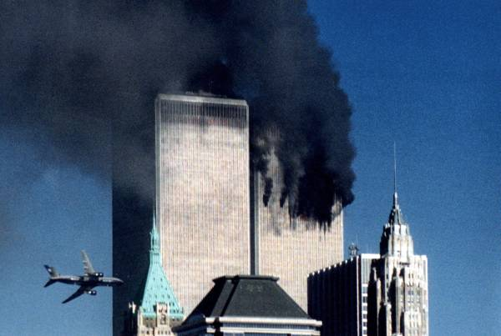
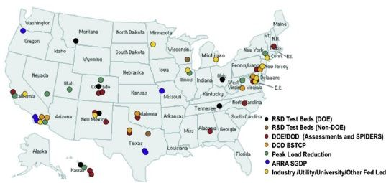
COORDINATION WITH FORCE PROTECTION
FP’s mission includes protection of personnel, resources, facilities, and critical infrastructure.
  Vulnerabilities that reveal critical information also endanger personnel, resources, infrastructure and facilities.
  Force Protection can also offer resources that can enhance both FP and OPSEC posture.
  OPSEC Program Managers should become a member of the FP Working Group and a member of the Threat Working Group (TWG).
https://www.greentechmedia.com/articles/read/the-military-microgrid-as-smart-grid-asset
2013
Notes:
OPSEC is vital in the following ways:
OPSEC identifies indicators of observable actions that represent a vulnerability (tactical or garrison)
OPSEC measures can help negate collection of information needed for terrorists’ planning
OPSEC can identify indicators and recommend measures to reduce possible or existing vulnerabilities in protective measures
OPSEC assists traditional security in ensuring their protective measures are in the right place at the right time
OPSEC develops critical information that identifies what must not be released to the public to prevent collection by a terrorist
PICTURE: Comment could you use this article to determine DOD smart Grid assets, or does this give you the idea to type in “DOD Smart Grid Assets”? What other things could you look up and find out from this picture?
DOD and the Department of Energy are also working on standardizing the technologies that go into microgrids, via the Smart Power Infrastructure Demonstration for Energy Reliability and Security (SPIDERS) projects underway at Fort Carson, Colo. and at Pearl Harbor-Hickam Air Force Base and Camp Smith in Hawaii. Military microgrid developers include SAIC, Lockheed Martin, Power Analytics (formerly EDSA) and General Electric, which is already in a big microgrid project with the U.S. Marine Corps.

Slide 33

COORDINATION WITH INTELLIGENCE
Intelligence task in support of OPSEC:
identifies capabilities and limitations of the threat’s intelligence system, including adversary intelligence objectives and means, procedures, and facilities that collect, process, and analyze information.
(J2, G2, G34, S2, etc.)
OPSEC helps support the identification of indicators
that adversary intelligence capabilities and systems might detect that could be interpreted or pieced together to obtain “critical information” in time to use against friendly forces.
Evaluating enemy intelligence capabilities as they affect operations security, signals security, counter-surveillance, security operations, military deception planning, military information support operations, and protection.
FM 2-0, FM 6-0
Notes:
Intelligence and counterintelligence (CI) capabilities, provide intelligence and CI support to the command’s OPSEC program. When this is not practical or possible, forward requirements through channels to the appropriate threat analysis center. The OPSEC process depends on reliable intelligence and CI support to properly identify critical information, analyze the threat, analyze vulnerabilities, conduct a risk assessment, and implement OPSEC measures. AR 525-23
FM 2-0

Slide 34
COUNTERINTELLIGENCE
Counterintelligence supports OPSEC by providing information about:
    Adversarial TTP’s
    Foreign Intelligence Services that should be a concern
    Collection methods
    Abilities
    Countermeasures in conjunction with OPSEC to hinder/stop collection
OPSEC supports Counterintelligence by providing:
  Possible vulnerabilities the adversary may seek to exploit
  Feedback on unclassified indicators the adversary may be focusing on
  Countermeasures to protect unclassified information and programs
  Awareness of the current collection efforts against the workforce
Counterintelligence will play a key role in Step 2, analyze the threat, Step 3, identify vulnerabilities and Steps 5/6 Implement and Assess measures
FM 2-22.2, para 3-40
Notes:
3-40. CI support to OPSEC entails identifying adversary intelligence, TTP, collection methods, analysis, and exploitation capabilities that target our Critical Information , and then developing countermeasures. (FM 2-22.2, para 3-40)
Counterintelligence will play a key role in step 2, analyze the adversary, of the 5 step Analytical OPSEC process. The OPSEC Officer will need to know what is the threat to the command and in the operations area to appropriately conduct assessments and develop countermeasures.
Some of the key questions Counterintelligence helps OPSEC answer include:
Who are the adversaries?
Who has the intent and capabilities to act against the planned operation?
What are probable adversary objectives?
What are likely adversary actions against friendly operations?
What information do adversaries already know?
What collection capabilities do adversaries possess or have access to by
financial arrangement or shared ideologies, or coordinated coalitions/
alliances?
Which OPSEC indicators can be faked to deceive adversaries?

Slide 35
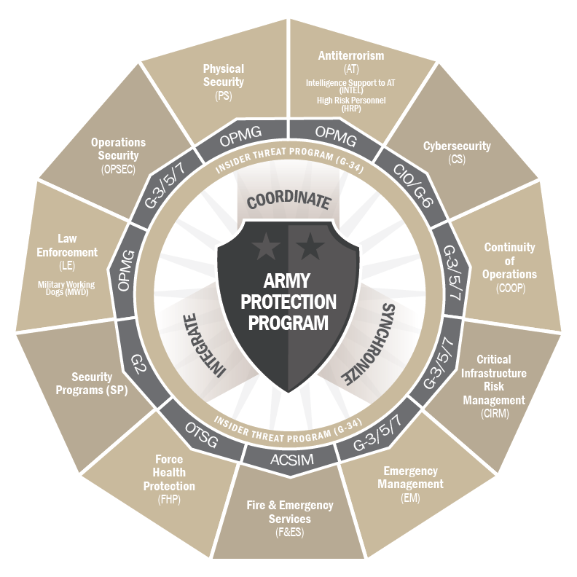
COORDINATION WITH FORCE PROTECTION
The Army Protection Program (APP) is the over- arching management framework for synchronizing, prioritizing and coordinating protection policies and resources.
Force Protection is responsible for the threat working group providing OPSEC with additional inputs from intelligence, counterintelligence, and primary inputs from law enforcement, etc.
The operations security officer prepares a portion of Annex E (Protection) to the operation order or operation plan.
FM 6-0, AR 525-2, AR 525-13
Notes:
Purpose is to create a robust and flexible over-arching framework that serves as a strategic "umbrella" for aligning key protection-related components and functions, achieving unity of effort and managing issues and tasks in a cross functional, holistic manner that allows army leaders to rapidly adjust to emerging risks, threats and requirements and better manage the risks relative to the safety and security of our Soldiers, Families, Civilians, and infrastructure. Note that protection is very broad, as a function. Protecting people, missions, equipment, and information all fall under this duty. OPSEC, as a process for protecting information in order to better protect missions, equipment, and lives, is clearly relevant information in today's highly dynamic threat environment (Army Directive 2011-04 and AR 525-2, 12/8/2014)
At division level and higher, the integration of the protection function and tasks is conducted by a designated protection cell and the chief of protection. At brigade level and below, the integration occurs more informally, with the designation of a protection coordinator from among the brigade staff or as an integrating staff function assigned to a senior leader. Chiefs of protection and protection coordinators participate in various forums to facilitate the continuous integration of protection tasks into the operations process. This occurs through protection working groups, staff planning teams, and staffs conducting integrating processes
Note: While working in these areas terminology may change. Critical information may change to critical assets, and your critical information list may be reflected in the CCIRs by doctrine

Slide 36
ARMY ANTITERRORISM PROGRAM SUPPORT
DURING GARRISON OPERATIONS
OPSEC helps deny the terrorist information that they need to plan.
Deny intelligence and information to terrorists
Avoid rigid operational routines, Random Antiterrorism Measures (RAMs)
Know Terrorist collection techniques
Integrate OPSEC into physical security, personal protection, information security, critical infrastructure, computer security
Develop Critical information list to focus denial efforts
Produces the OPSEC annex to the AT plan when required
JCS PUB 3-07.2, JCS TTP FOR AT
Notes:
INSTRUCTOR: OPSEC must be functioning to protect the critical information.
OPSEC helps deny the terrorist information that he needs to plan. Deny intelligence and information to terrorists
Avoid rigid operational routines
Know Terrorist collection techniques
Integrate OPSEC into physical security, personal protection, information security, critical infrastructure, computer security
Develop CII to focus denial efforts

Slide 37
CRITICAL INFRASTRUCTURE
High Risk Target (HRT): Resource/facilities considered to be at risk as potential terrorist targets because of mission sensitivity, ease of access, isolation, symbolic value, and/or potential for mass casualty.
Mission essential vulnerable areas (MEVA): facilities or activities within the installation that, by virtue of their function, are evaluated by the commander as vital to the successful accomplishment of installation’s, State National Guard, or major U.S. Army Reserve Command mission. This includes areas nonessential to the installation’s/facility’s operational mission but which, by the nature of the activity, are considered vulnerable to theft, trespass, damage or other criminal activity.
HOW WOULD OPSEC SUPPORT CRITICAL INFRASTRUCTURE?
DoDD 3020.40, DOD 5205.02, AR 525–26
Notes:
INSTRUCTOR: What information about a HRT, MEVA or an HRP if known by a terrorist would provide planning information, would reveal a weakness or vulnerability.
Infrastructure Risk Management Army Regulation 525–26
In turn supports Recognizing how critical the infrastructure is to accomplishing DoD's missions and the effects of vulnerabilities to threats and hazards of infrastructure assets, DoD Directive 3020.40, DoD Policy and Responsibility for Critical Infrastructure, established the Defense Critical Infrastructure Program (DCIP), a program responsible for coordinating the management of risk to the critical infrastructure that DoD relies upon to execute its missions.
Not everyone will gets this CIL ,distribute to ATO and need to know.

Slide 38

U.S. ARMY PUBLIC AFFAIRS MISSION
Public affairs fulfills the Army’s obligation to keep the American people and the Army informed and helps to establish the conditions that lead to confidence in America’s Army and its readiness to conduct operations in peacetime, conflict, and war.
Every member of the Army team contributes to effective PA. The soldier is the most effective communicator of the Army story. The primary PA functional areas are command information, public information, and community relations.
Example of redacted document
PAO will Inform Soldiers, family members, and Army civilians of their rights under the Privacy Act, operations security responsibilities, and roles as implied representatives of the command when interacting with news media. FM 6-0
AR 360-1, App. H addresses the DOD principles of information.
Notes:
Finding the balance requires coordination with Public Affairs, as well as with legal advisers who can more fully explain the implications of FOIA to senior leaders.

Slide 39
OPSEC AND PAO MUTUAL SUPPORT
Safeguarded information will not be discussed, shown, or made available to unauthorized individuals. All Army personnel must be aware of and support the Army’s OPSEC program. Information, materials, or records must be reviewed for OPSEC considerations in accord with the critical information AR 530-1 and the organizations OPSEC program prior to public release.
The staff office or agency providing the information, materials, or records to the PA office for release must accomplish the OPSEC review with their agencies CIL and provide the PA office with the CIL to check.
Just as PAO is the authority for public releases an OPSEC program manager is the authority for All things OPSEC, both may work together to review information.
Both the PAO and the OPSEC officer will develop a public release process and publish it in the organizations OPSEC and PAO SOP
Notes:
Key Points:
Prior unofficial release or publication is not grounds for official release, the information must receive an OPSEC review. PA Reviews do not satisfy the requirement for an OPSEC review of material released to the public. However, if the PAO is trained/certified as an OPSEC Officer and he/she has completed the HQDA OPSEC Officer course, the
requirement will have been met.

Slide 40

WORKING GROUP
Tenant units will coordinate with and participate in the garrison installation-level OPSEC working groups. (Requirement to facilitate integration)
Program Managers at Army Commands (ACOMs), Army Service Component Commands (ASCCs), and Direct Reporting Units (DRUs) are required to organize and provide oversight to an OPSEC working group. (Synchronizes all OPSEC within a command)
Garrison/Installation OPSEC is also required to have an OPSEC working group to advise and support installation operations, threats, and force protection. (Synchronizes OPSEC and shares local information and usually is conducted in support of the force protection working group)
What other coordination methods are use in other organizations?
AR 530-1, Ch. 2-21, 2-19, App H3
Notes:
While most OPSEC officers are not required to lead a working group, everyone is required to coordinate with related functions, and a working group is usually the most effective and efficient method for coordination. All OPSEC officers will participate in there ACOM, ASCC, or DRU OPSEC working group this allows synchronization of OPSEC within a command.
The benefit of tenant units attending the Garrison OPSEC working group is the sharing of knowledge, and support
What other coordination methods are use in other organizations?

Slide 41
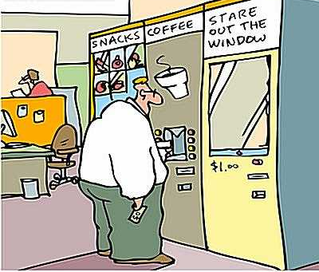
B
R
E
A
K
T
I
M
E
!

Slide 42
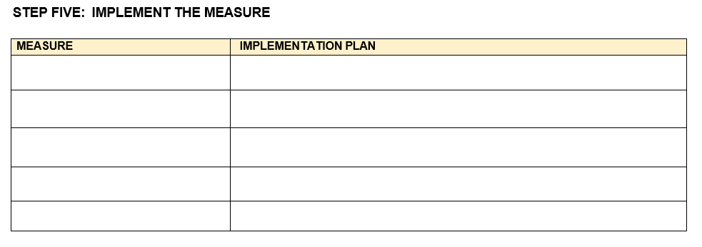
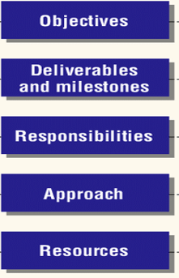
APPLICATION MEASURES WORKSHEET PE
1.Train on do’s and don’ts of social media
Notes:
Instructor: Use your experience to discuss the following for each measure; the objective of the measure, deliverables , milestones, who is responsible and for what include approach and resources needed.

Slide 43
BREAK

Slide 44
STEP # 6: ASSESSMENT OF EFFECTIVENESS
OBJECTIVES
Identify MOPs and MOEs
Monitor OPSEC measures during execution.
Make adjustments to improve the effectiveness of existing measures.
Understand OPSEC reviews and assessments to determine measure effectiveness or performance
1. IDENTIFY CRITICAL INFORMATION & INDICATORS
6. ASSESS THE EFFECTIVENESS
2. IDENTIFY & ANALYZE THREAT
5. APPLY COUNTERMEASURES
3. ANALYZE VULNERABILITIES
4. ASSESS RISK
Notes:
3-678 301-371-1050 14 December 2007 STP 21-1-SMCT
Performance Steps
(4) Monitor OPSEC measures during execution. Monitoring is a
continuous process of evaluating intelligence and counterintelligence. It is
necessary to monitor countermeasures for effectiveness because unevaluated
countermeasures can lead to a false and dangerous sense of security.
(5) Make adjustments to improve the effectiveness of existing
measures. This will be necessary to obtain the best protection for military
operations.
6. Define OPSEC review, assessment, and survey.
a. OPSEC review is an evaluation of a document to ensure protection of
sensitive or critical information.

Slide 45
IDENTIFY INTENT OF MEASURE
Consider what the OPSEC measure is designed to do or address:
Extent of Collection Disruption
Deter
Detect
Target Specific Collection Methods
Individual
Staff Element G/S 1-6
Prevention
Observe
Delay/Disrupt
Deny/Defend
Orient
Decide
Act
GEOINT
HUMINT
MASINT
OSINT
SIGINT
OPSEC Performance
Notes:
In order to know if a measure is working, its intended purpose must be identified.
Consider what an OPSEC measure is supposed to do in order to evaluate it. For example, as a force protection measure, buildings throughout Washington, DC with federal functions were directed to have barriers put in place to enforce stand-off distance. However, a number of federal agencies did not want those barriers, because they drew attention to the building as one in which governmental functions were performed. Many of these agencies arranged for exemptions, because they felt they were better protected by keeping a low profile than by the presence of barriers.
If one is defending against a VBIED, the barriers may be great. If one is defending against enemy collection, then the barriers may be bad. The purpose of the measure will help you to judge whether a measure is effective or not.
Target specific collection methods
If the implemented measure is encrypting emails, which targets SIGINT collection, the measure is not going to have much of an effect on HUMINT because it wasn’t designed to target that collection method. This is an obvious example but some can be a little more complex
Extent of collection disruption
Know to what extent collection was supposed to be disrupted because a measure can look like it failed if some information gets out but the measure may have only be meant to delay collection due to the mission circumstances. For instance, if the adversary gets information about an event close enough to the when it is going to occur, it will no longer be useful to them because they will not have enough time to act.
OPSEC Performance
Certain measure may target performance such as enforcement of certain policies. Providing consequences for not attending training may not seem to be effective if the training itself is ineffective. That doesn’t mean that the enforcement wasn’t successful. In this case, the training needs to be addressed but the enforcement should be maintained. This information will help you pinpoint where the failure actually is.
Prevention
If a measure is intended to disrupt the adversary’s ability to analyze our indicators, it may not prevent the adversary from actually getting our indicators. This may lead the OPSEC PM to believe that the measure is not working when, in fact, the measure was never intended to prevent collection (Observe phase), only the analysis (Orient phase) of the indicators once they’ve already collected the indicators

Slide 46
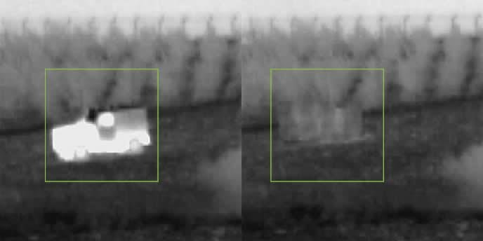
DEVELOP CRITERIA
Objective
Quantitative/ Qualitative
Tailored
MOP: (DoD) A criterion used to assess friendly actions that is tied to measuring task accomplishment.
MOE: (DoD) A criterion used to assess changes in system behavior, capability or operational environment that is tied to measuring the attainment of an end state, achievement of an objective or creation of an effect.
Image that displays the use of camouflaging thermal signatures is it MOE or POE
(JP 3-0)
Notes:
We are going to use the framework of Measures of Performance (MOP) and Measures of Effectiveness (MOE) as the foundation of our evaluation criteria.
Let’s start by looking at some official definitions then we will dig into the difference between them.

Slide 47
DEVELOP EVALUATION CRITERIA
MOP
Evaluates
Compliance
Evaluates
Effect or Outcome
1. Was the action taken?
2. Was the measure performed to standard?
1. Did the measure accomplish what it was supposed to? To what degree?
2. Was there an OPSEC compromise/violation of critical information? To what degree?
MOE
Starts WITH Implementation
Starts AFTER Implementation
Notes:
A good way to better understand MOPs and MOEs is to examine the difference between the two.
MOPs measure COMPLIANCE with an OPSEC measure while MOEs measure the outcome of that OPSEC measure in protecting critical information after and while compliance occurs
MOPs
Evaluating compliance includes:
Determining whether the task was conducted or not
Determining if the task is/was being conducted correctly
Did we do it and did we do it right?
MOPs should answer the following questions:
Was the action taken or task completed?
Did the entire organization receive the training or just 50%
Was the measure performed fully and correctly? To what extent?
Did the training cover the correct information?
MOEs
Evaluating the outcome/effects include:
Determining whether the critical information and/or indicators were protected or not specifically due to the OPSEC measure in question
Determining if there was a compromise of critical information or if indicators were released in a source that the OPSEC measure in question was intended to target
MOEs should answer the following questions
Did the measure accomplish what it was supposed to?
In general, what is the purpose of an OPSEC measure? To protect critical information and indicators
Protecting critical information and indicators will always be the infrastructure of every MOE you develop – But it may look different based on the OPSEC measure you are addressing
However, beyond the foundational purpose of an OPSEC measure, each OPSEC measure is designed with specific vulnerabilities in mind. To answer this question, we need to know if the OPSEC measure protected critical information in relation to how it was intended to do so.
For example, if the OPSEC measure was intended to prevent Soldiers from posting indicators on Social media, did it specifically prevent that? We will not evaluate this measure by looking at if that OPSEC measure prevented critical information from being gleaned from unencrypted emails because it wasn’t designed to do that.
Did requiring Pre-Publication reviews prevent critical information and indicators from being published? (Looking at OPSEC reviews to see if critical information or indicators were caught and removed before publication is one good way to find out if this OPSEC measure worked.)
As you can see, MOPs are measured starting with implementation and can continue through execution. In contrast, MOEs are not measured until after implementation because you can’t evaluate if the measure is working until it is actually fully implemented and being executed.
Example: As an example, let’s look at pre-publication OPSEC reviews as an OPSEC measure. When implementing this measure, you will need to communicate the policy to the organization personnel and the organization will have to execute the policy by submitting all items to be published for an OPSEC review before it is published. There are a lot of compliance aspects or MOPs that can be measured here such as
Was the policy communicated effectively to everyone in the organization? (At implementation)
The number of items that received an OPSEC review before being published (Throughout execution)
But you cannot evaluate whether the measure worked at implementation because it hasn’t yet been executed. Once executed and items are being published after the policy was implemented and communicated, you can check if any critical information or indicators were published.

Slide 48
MAKE MOPS/MOES QUANTIFIABLE WHEN POSSIBLE
OPSEC Measure: Training on Social Media
MOP
100% of unit trained
MOE
Reduction by % or no OPSEC compromises found on social media
OPSEC Measure: 100% Shred Policy
MOP
No paper found in trash
MOE
No OPSEC compromises found in trash or there was a % of change from last assessment.
OPSEC Measure: Pre-Publication OPSEC Reviews
MOP
100% of public facing content received OPSEC review prior to publication
MOE
No OPSEC compromises found in public facing documents or webpages
Theme: All include a focus on protecting critical information/indicators
Tailored to the OPSEC Measure
Notes:
Here are some examples of MOPs and MOEs for three different OPSEC Measures. We’ve only provided 1 example for each measure. There are other MOPs & MOEs for these OPSEC measures.
Again, Did we do it and do it correctly vs. Did it work?
Notice that all of the MOEs, no matter the OPSEC measures, have a theme of protecting critical information and indicators. This includes OPSEC violations/compromises because that tells you if critical information was protected or not.
The only difference between the MOEs for all of these measures is that each is tailored to the specific OPSEC measure
You can almost insert “No/reduction in OPSEC violations” or “no critical information released” to create a MOE for any OPSEC measure. Then just add the measure.
For example:
No/reduction in OPSEC compromise found in Unencrypted emails
No/reduction in OPSEC compromise found in On social media
No/reduction in OPSEC compromise found in In public facing webpages
Also notice how all of the MOPs and MOEs here are quantifiable. This may not always be the case but you should be able to make them quantifiable 99% of the time. You may have to think outside the box though.

Slide 49
WAYS TO VALIDATE MOPS AND MOES
Intelligence/Counterintelligence Reports
Open Source Research
Public Media Disclosures
Website Reviews
Direct Observation
Workforce Interviews
Documentation on OPSEC Reviews
Previous/Current Assessments
OPSEC Compromises/Violations
Communications Security Monitoring (COMSEC)
AR 530-1
Notes:
Here are some sources of data to consider.
Intelligence/Counterintelligence Reports:
If friendly intelligence reports that the adversary is confused because they don’t know what is going on, or bored because they think nothing is going on, then your measures are likely working. On the other hand, if enemy websites are trumpeting their latest successes and describing how they intend to blunt your upcoming operation, then your measures have not protected that upcoming operation very well. Your own assessments are also very important, determining both if measures are really being implemented according to plan, and if an adversary (when you emulate one) could gather critical information.
Open Source Research:
This will allow you to conduct research from the perspective of the adversary to see if you can find any critical information or indicators. This will provide information on where information may be getting out
Public Media Disclosures:
This is a part of open source research with a focus on the media. An example of a great use of this is when you have an event coming up, you can keep an eye on the media to see if any reports are coming out about the event or indicators about it.
Website Reviews:
Find OPSEC compromises – Will show if measures that targeted this are working
Direct Observation:
Find OPSEC compromises – Will show if measures that targeted whatever it is that you are observing are working. You can observe to see if people are wearing their ID badges outside of the building.
Workforce Interviews:
Depending on what questions you use, can provide a lot of insight. For example, asking people what is on the CIL, who their OPSEC PM is, or if they know some of the OPSEC measures (what do they need to do if they are going to publish a document?)
Documentation on every OPSEC Review:
Will show what people are putting in documents – for example, if training was the measure, this will show if the training was effective – if trained personnel are aware and not putting critical information out there
Previous/Current Assessments/Surveys:
Provide the big picture of what is going on with your program
OPSEC Compromises:
This will show you where information is getting out
Communications Security Monitoring (COMSEC):
F

Slide 50
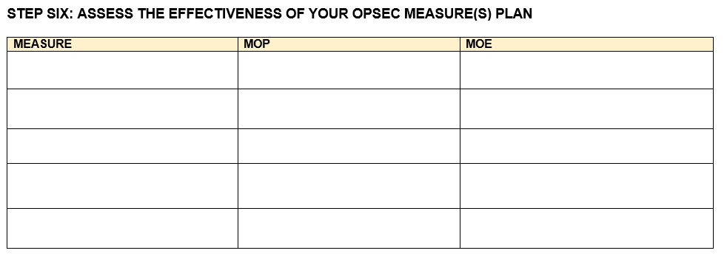
MEASURES EVALUATION WORKSHEET (PE)
1.Train on do’s and don’ts of social media | MOP: % of unit trained (100% within 30 days) MOE: Decrease in OPSEC compromises on social media | OPSEC PM to conduct open source research Webmaster to conduct quarterly OPSEC reviews of official websites and provide report to OPSEC PM

Slide 51
That’s
Lunch!

Slide 52

SELF ASSESSMENTS
EVALUATION METHODS
OPSEC REVIEW
OPEN SOURCE RESEARCH
Notes:
Evaluation includes: Identify what is an OPSEC Review, policies and processes
OPSEC review is an evaluation of a document to ensure protection of sensitive or critical information.
5–1. General
The OPSEC review is an evaluation of an information or visual product to ensure protection of critical or sensitive information. A reviewed product may be, but is not limited to, a memorandum, letter, e-mail message, article, academic paper, video, briefing, contract, news release, technical document, proposal, plan, order, response to Freedom of Information Act (FOIA), Privacy Act requests, or other visual or electronic media. The OPSEC officer will conduct a review of these products related to U.S. Government or military operations, and other supporting programs, prior to release in the public domain. An OPSEC review is normally conducted in conjunction with a public affairs review for the release of official information to the public. The OPSEC review of a product is unrelated to the annual program review.

Slide 53

OPSEC REVIEW
PURPOSE:
Reviews are for information related to U.S. Government or military operations and other supporting programs prior to release in the public domain and for External Official Presence to ensure protection of critical and/or sensitive information.
AR 530-1 Ch. 5-1
Notes:
Evaluation includes: Identify what is an OPSEC Review, policies and processes
OPSEC review is an evaluation of a document to ensure protection of sensitive or critical information.
5–1. General
The OPSEC review is an evaluation of an information or visual product to ensure protection of critical or sensitive information. A reviewed product may be, but is not limited to, a memorandum, letter, e-mail message, article, academic paper, video, briefing, contract, news release, technical document, proposal, plan, order, response to Freedom of Information Act (FOIA), Privacy Act requests, or other visual or electronic media. The OPSEC officer will conduct a review of these products related to U.S. Government or military operations, and other supporting programs, prior to release in the public domain. An OPSEC review is normally conducted in conjunction with a public affairs review for the release of official information to the public. The OPSEC review of a product is unrelated to the annual program review.

Slide 54

REVIEW GUIDANCE
The PAO and OPSEC review process needs to be developed and disseminated to the work force the best practice is to place it in an SOP.
It should clearly state the individual conducts the initial review against the CIL. Submit the CIL and the document through the organizations process.
Reviews are conducted on anything going to the public such as memorandum, letter, e-mail message, article, academic paper, video, briefing, contract, news release, technical document, proposal, plan, order, response to Freedom of information Act (FOIA) request, Privacy Act requests, or other visual or electronic media
PAO and OPSEC will determine if addition security or legal reviews are required
Notes:
Discussion question: Why would we want an OPSEC officer or other OPSEC-trained person to review documents before they’re published?
-OPSEC reviews are one of the most common OPSEC Officer tasks. The purpose of a review is to determine if protection is required to prevent disclosure of an indicator, or of any form of Critical Information. Reviews can determine if protections are required or applied.
The below are two examples; research other AR’s that apply to your program to see if they also require reviews.
AR 380-10 FOREIGN DISCLOSURE
(2) Public domain. For the purposes of this regulation, unclassified information that does not qualify for the status of CUI, as described in (1), above, is deemed to be actually or potentially in the public domain (in other words, suitable for disclosure to the public at large). All U.S. Army information must be reviewed prior to release to the public. The proponent for the disclosure of U.S. Army public domain information is the U.S. Army Public Affairs Office.
AR 360-1 PAO
5–4. Safeguarding information
Safeguarded information will not be discussed, shown, or made available to unauthorized individuals. All Army personnel must be aware of and support the Army’s OPSEC program. Information, materials, or records must be reviewed for OPSEC considerations in accord with AR 530–1 prior to public release. The staff office or agency providing the information, materials, or records to the PA office for release should accomplish OPSEC reviews.
b. Additionally, releasable information must be accurate and must adhere to published DOD and Army policies.

Slide 55
WHAT IS A REVIEW ?
  A formal written process
  Can be requested or directed
  Documented for all personnel to reference
  Reviews are a form of OPSEC evaluation - can show MOEs/MOPs
  An evaluation for classified or unclassified:
    Technical knowledge and research
    Controlled Unclassified Information (CUI)
    Classified Military Information ( or indicators)
    CMI) (CTI)(AR 380-10)
Justification required and referenced in regulatory guidance.
If required, state the legal basis, such as public law or federal
statute.
Notes:
An OPSEC Officer may not have technical or operational knowledge of all areas within an organization. You may need a subject matter expert to review certain material. Some documents may require a classification review, so use the appropriate classification authority. Do not simply state that a document is sensitive. Identify why it is sensitive, and how it should be protected, and cite in writing any governing regulatory guidance.

Slide 56

HOW TO CONDUCT A DOCUMENT REVIEW
  First pass - Look for items matching the Critical Information
    Provide a copy of the Critical Information List (CIL) and relevant Security Classification Guide (SCG)
  Second pass - Aggregation of Data; look at the overall information provided; compare to the CIL and SCG
  Third pass - Review the document in light of previous releases on information
    Third pass relies on existing expertise and awareness

Slide 57

HOW TO CONTINUED
Fourth Pass: What does closer review mean?
  Consider the perception
    Reading an article as a DA official, or even as an American, may create a different impression than the same article read by an Arabic, Chinese, Russian, or Korean individual
  Review existing information
    A brief Google search for related information can help determine if a document has a high potential for combined utility as an indicator

Slide 58
REVIEWING THE CONTENT
Consider the classification of the review
Be specific and technically correct (based on regulatory
guidance or appropriate laws)
Purpose of reviewing the document or visual information
  Prevent release of critical information
  Read each sentence for critical information
  Evaluate as a whole, taken together, does this release critical
  information?
  Evaluate in light of previous releases and possible aggregation
  of information (Considered with what is already public, does this
  release critical information?)
Notes:
Question: Why are previous releases important?
Note: You cannot really evaluate the importance (impact/criticality) of a release without context. This is one reason why OPSEC officers must be vigilant, not just relying on a keyword list. A release that notes that Equipment A is at Location B may not be a problem. A release that states that Unit C is at Location B may not be a problem. But if Unit C is not to be associated with Equipment A, then the release of both would be a problem- and only an active OPSEC officer will catch problems like that and prevent them.
Always consider what you are putting into writing. If you say a paragraph contains sensitive information about XYZ, then you fax your reviews to the originator, you may have made a mistake. Think about what you write. Look at the intended use of the document- Is it, for example, a news release or an OPORD? These two actions do not necessarily have the same criteria to be considered.

Slide 59
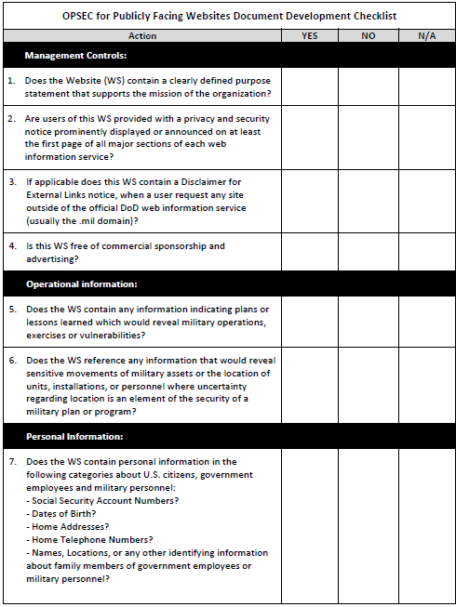
PUBLIC FACING WEBSITE REVIEWS
Technological Data:
. Does the WS contain any technical data such as:
-Weapon Schematics?
-Weapon System Vulnerabilities?
-Electronic Wire Diagrams?
-Frequency Spectrum Data?
OPSEC Considerations (Tip Off Indicators)
Communications:
- RF emissions and associated documentation.
- Changes in activity or communications patterns.
- Use of Internet and/or e-mail by unit personnel(personal or official business).
- Availability of secure communications.
- Hypertext links with other agencies or units.
- Family support plans.
- Bulletin board/messages between soldiers and family members.

Slide 60
SUMMARY
Individual may request an OPSEC review or the
Commander may direct a review
Specify in the OPSEC program document (Plan, SOP,
OPORD, etc..) which documents require reviews
PAO clearance is NOT the same as an OPSEC review
For additional guidance see DoDI 8550.01, September
11, 2012, Appendix to enclosure 3, Information review
process
Notes:
OPSEC Officers *will* conduct reviews IAW AR 530-1

Slide 61

REVIEW PE
In your assigned group read the background scenario underline the information that can not be released to the public because it is on the critical information list. At the end of the sentence list the number of the critical information it violates. 30 minutes is allotted for this exercise.
Notes:
In the review as group 1 to identify what the underlined and what cIL item it violated.
After the last paragraph
ASK: What did you think of the CIL, what problems did you have . When writing your CIO have someone not in your office read the list to see if they understand what you mean
Ask what do you do if you find critical information not on the list =put it on the list
elemental mercury
Ask about the 2 inoperable plants

Slide 62
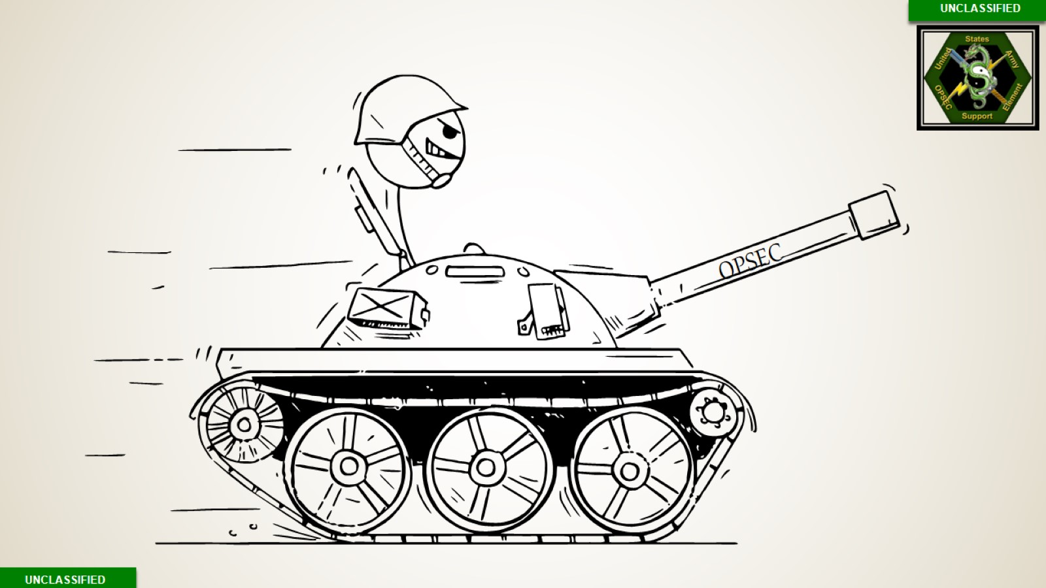

Slide 63

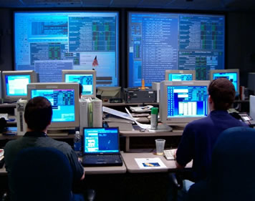




OPEN SOURCE RESEARCH
Notes:
Cyber criminals or adversaries of the U.S. Government rarely obtain all their information from one source. A command’s social media page on its own will most likely not provide an adversary the information they need to disrupt a command’s mission. However, when adversaries are able to aggregate information from multiple sources they may be able to gain a clear understanding of a command’s mission and information critical to the accomplishment of that mission. NTTP-3-13.3M, 10.4
Deep Internet
The term ―Deep Internet‖ or ―Deep Web‖ refers to web content that is not accessible through a search engine, and includes the vast majority of Internet information. The primary sources of Deep Web information are databases, unlinked websites, and ―disallowed web content. Deep Web content is significantly more voluminous and beyond the ability of conventional search engines to acquire and index.
Online News Sources
Media outlets on the Web can be critical to missions because they will often be the only sources reporting in a particular area. Online media will often be the first source to report on a situation or event so it is especially important to monitor online news reporting. However, be alert for biases that online media may reflect because of their commercial agenda.
Social Media
The term ―social media‖ refers to online platforms that allow users to share information, often within the public domain; popular examples include Facebook, Twitter, MySpace, and Google. While information shared through social media is sometimes inconsequential, it is a great way to gauge popular sentiment and track emerging situations, such as the Japanese tsunami or the Arab Spring in 2011. Where the infrastructure is established to support social media, analysts should regularly monitor messages sent across these platforms.
http://search.twitter.com/advanced
Blog Search Engines
Web-logs or blogs are user-generated webpages generally directed at specific topics. Similar to general search engines that index content found throughout the Web, blog search engines index blog content to allow users to sift through information found only in blogs. As is the case with many social media platforms, blogs are often public and search engines ―harvest them frequently. By using blog search engines as trackers, you can gain insight into specific geographic and topical areas that relate to mission needs.
Use the blog search engines at:
http://blogsearch.google.com
http://www.google.com/blogsearch
http://technorati.com
Video Sharing Websites
Video sharing websites allow users to post or upload personal videos and make them publicly available on the Web. As technology continues to advance, it has become increasingly common for people to capture videos with smartphones and upload them to video sharing websites like Youtube. Videos uploaded to the Web are often unedited and uncut and can provide valuable information about developing situations or specific information about a particular area that can be critical to your mission.
Photo Sharing Websites
Photo-sharing sites operate just like video-sharing sites; they allow users to capture images and post them on the Web. Sites such as Flickr and Panaramio can be valuable sources of information in providing details about what a particular location looks like without having to go there.
Gray literature
Gray literature is essentially information (not classified), that is available to the public if they know where to look. Sometimes this is studies by universities, think tanks, or other organizations. This category also includes unclassified scientific material that may relate to weapons/equipment capabilities, or even corporation proprietary information.
Trash Analysis
Direct Observation
Does your sudden change in hours across your organization imply a change in Alert Status? What can be gleaned from your observable actions?
An individual has a zero-fade haircut, polished toe dress shoes, watched on the left arm (flipped backwards), and a molle strap backpack– who do they likely work for? >>>DoD in some capacity<<<

Slide 64
OPEN SOURCE RESEARCH vs. OSINT
Open Source Research is not OSINT, but is modeled on enemy OSINT. OSINT is relevant information derived from the systematic collection, processing, and analysis of publicly available information in response to intelligence requirements.
Open Source is any person, group, or system that provides information without the expectation of privacy.
Publicly available information is data, facts, instructions, or other material published or broadcast for the general public’s consumption
OPSEC Indicators are friendly detectable actions and open-source information that can be interpreted or pieced together by an adversary to derive critical information. – JTP 3-33.3, I-2
* AR 530-1, 1d(2) and JP 3-13.3, IV-3
Notes:
Group Question: Where does the Army get the Authority to perform Open Source Research from?
The AR 530-1 and JP 3-13.3, both provide authorities to conduct open-source research in order to report critical information, assess indicators (which are found in open-source) and conduct OPSEC surveys.
(Note: If the point of the OPSEC process is to identify critical information and indicators and then mitigate the risk of an adversary identifying that information and using it to prevent friendly mission accomplishment, and if indicators can be available via open source, by implication OPSEC officers and program managers must be able to review open sources in order to identify critical information and indicators.)
AR 530-1, 1d(2)
d. OPSEC compromise.
(2) Critical or sensitive information that has been compromised and is available in open sources and the public domain should not be highlighted or referenced publicly outside of intra-governmental or authorized official communications because these actions provide further unnecessary exposure of the compromised information.
(Note: If the instructions tell you how to report that Critical Information has been compromised via open sources, the implication is that you have the ability to check open sources for the presence of critical information.)
Additionally, within JP 3-13.3, Operations Security
Page 49: CH IV-1c(2), Assessments and Surveys
In combat, an assessment’s emphasis should be on identifying vulnerabilities and indicators
that signal friendly intentions, capabilities, and limitations and that permit the adversary to counter
friendly operations or reduce their effectiveness.
(Note: “Indicators” is defined on Page II-4 to include open-source information.)
Page IV-2, OPSEC Surveys:
These surveys may include telecommunications monitoring, radio frequency monitoring,
network and computer systems assessment, and open-source collection.
AR 5301-, Appendix D–1. Characteristics
Indicators are data derived from open sources or from detectable actions that adversaries can piece together or interpret to reach personal conclusions or official estimates concerning friendly capabilities, activities, limitations, and intentions. An item which meets any of the characteristics below (Signature, Association, Profile, Contrast, or Exposure) is an indicator.

Slide 65

RULES AND CONCEPTS
Use specialized search tools and techniques
Consider internet privacy and security issues
Utilize specific topic research
Bookmark your links
Search Engines...other than Google
Yippy A metasearch engine; does not track cookies
Slideshare Presentations, slide decks, webinars
Board Reader Message board search
Wolfram Alpha A computational knowledge engine
DuckDuckGo Warning; returns Yandex and Onion results
Geographic Information Systems
Bing Maps
Google Maps
Wikimapia
ACME Mapper 2.1
Directories
Best of the Web
World Digital Library
Library Spot
Google Hacking for Penetration Testers, Volume 3
by Johnny Long, Bill Gardner, Justin Brown
“Syngress”, 2015
[The Internet] “is surely a labyrinth, but it is a labyrinth devised by men, a labyrinth destined to be deciphered by men.”
–Tlön, Uqbar, Orbis Tertius

Slide 66
TOOLS AND TECHNIQUES
Spell it Out - Define the topic, critical information list, key words, acronyms, “what” and “who” - define the end product (when are you done?)
Strategize - Choose your approach, which online resources, search tools How are you going to search for critical information without typing it in the browser?
Search - Use advanced search features and advanced operators
  Advanced operators use a syntax such as the following:
    site:army.mil/portals
    site:army.mil/ AND filetype:pptx OR filetype:pdf
    site:army.mil/ AND filetype:pdf AND intext:CIL OR intext:critical information list
    intext:forum "post"|inurl:forum|"posts:"|inurl:viewtopic AND “1st IO Cmd“
Sift & Save – Follow leads, make bookmarks, take notes, organize results
Do not search for persons of your organization. It is considered targeting and illegal.
Notes:
How Advanced Operators work.
Google advanced operators help refine searches.
They are included as part of a standard Google query.
Advanced operators use a syntax such as the following:
operator:search_term
Capitalization matters; like OR and AROUND(), while others Cannot be capitalized, like any of the operators that combine a colon.
“OR” = Search for X or Y. This will return results related to X or Y, or both.
Example: jobs OR gates / jobs | gates
inurl: = Find pages with a certain word (or words) in the URL. For this example, any results containing the word “apple” in the URL will be returned.
Example: inurl:apple
There’s no space between the operator, the colon, and the search term!
Using the site: search on a specific website bypasses that site’s own internal search function, blocking the website from tracking or knowing the exact search terms (unless a link result is clicked directly, giving the search referral.
If a searcher wants to find an official government position on a subject, the domain can be indicated, as in site:gov Iran nuclear or site:gov.uk Iran nuclear, limiting the search to the US government or the UK government, respectively. Likewise, the search can be formulated to search only educational facilities, as in site:edu Iran nuclear or site:ac.uk Iran nuclear in which the academic networks of the US and UK, respectively, are searched.
The site: search can also search a specific network or website, such as site:justice.gov cartels or site:fbi.gov cartels, in which the Department of Justice network is searched, including any departments on the network, or the website specifically belonging to the FBI is searched. A selected portion, or folder of a website can also be searched by adding the subdomain or folder, as in site:houston.fbi.gov AND “cartels” or site:fbi.gov/news_cartels.
The filetype: operator forces all results to come in the format of the selected filetype by using the file extension. This search works with any type of file extension that is usable on the Internet, including pdf, ppt, doc, xml, html, and more. For instance, using filetype:pdf will return only PDF documents which are, generally, post-published documents or reports. PDF is often used to seal a document, making its contents harder to alter and therefore used as the final word by the publishing entity.
Powerpoint files (ppt or pptx) are usually training materials, briefings, or collections of images. A search for "drug culture"site:edu (filetype:ppt OR filetype:pptx) will return training materials and briefs about drug culture coming only from US academic institutions. Note the OR statement: (filetype:ppt OR filetype:pptx) that must be used when dealing with Microsoft Office document searches. In 2007, Microsoft Office added an x to the end of all file extensions. Both versions of the file extension must be searched using the OR operator within parentheses or a thorough search will not be performed.
Searchers can also search for titles of documents using the intitle: operator; however that may not be as fruitful because titles of Excel files are not typically very robust. Another section to search is the data fields themselves. This can be useful when looking for unknown attributes about a known item, or if searching for an unknown item with known attributes. An example of the former is this search (filetype:xls OR filetype:xlsx) t-72b for the attributes of the T-72B tank, while an example of the latter could be this attribute search (filetype:xls OR filetype:xlsx)Soviet MBT w/Kontak for equipment with the selected attributes.

Slide 67

CENTER OF GRAVITY
Legend
Information Source
Vulnerable Information
Violations
Is CIL data being released?
Manpower
Intent to mobilize
Alert status / Schedules
Direct Observation / Trash Analysis
Equipment –
The User
– Family Support Groups
Scenario target –
– Blogs, TikTok, YouTube, Facebook,
LinkedIn, Twitter
Readiness Rate –
Social
Media
Rules of Engagement –
– Official External Media Presence
AAR Notes / Lessons Learned –
Training
– Anonymous Company Reviews
HQ & FO Public Websites –
Org.
Command Structure / Authorities –
– Major News Networks
TTPs, SOP, Plans, Doctrine –
Mission
News
– PAO News Release
Intentions / Capabilities –
– Unit News Letter
Critical Infrastructure –
– Commercial Open-Source Journals (i.e., Janes, DefenseOne)
Budget / Travel –
Contracts
Compromise
Job Postings / Gov. Contract Listings
Aggregation
Is unprotected sensitive information leaking?
Contractor Corporate Websites
Are multiple sources creating too clear of a picture?
Analytical methods & processes
Security classification of program
“Even minutiae should have a place in our collection, for things of a seemingly trifling nature, when enjoined with others of a more serious cast, may lead to valuable conclusion.” —General Washington
Notes:
Center of Gravity Analysis
Remember: Certain data,(emblems, command affiliation, etc.) has less time criticality than deployment orders for exercises or real-world operations. The value of information may also flex over time.
Anonymous Company reviews include websites such as “Glassdoors”. These reviews often contain complaints about a company’s shortfalls and when accompanied by the mission, can reveal sensitive information such as schedule, methods, equipment, SOPs, and CMD structure.

Slide 68
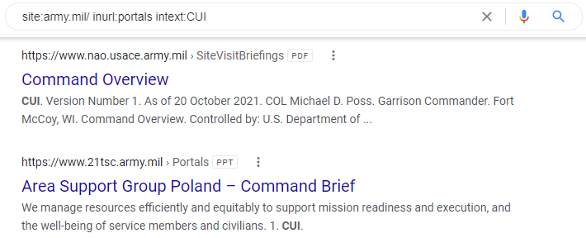
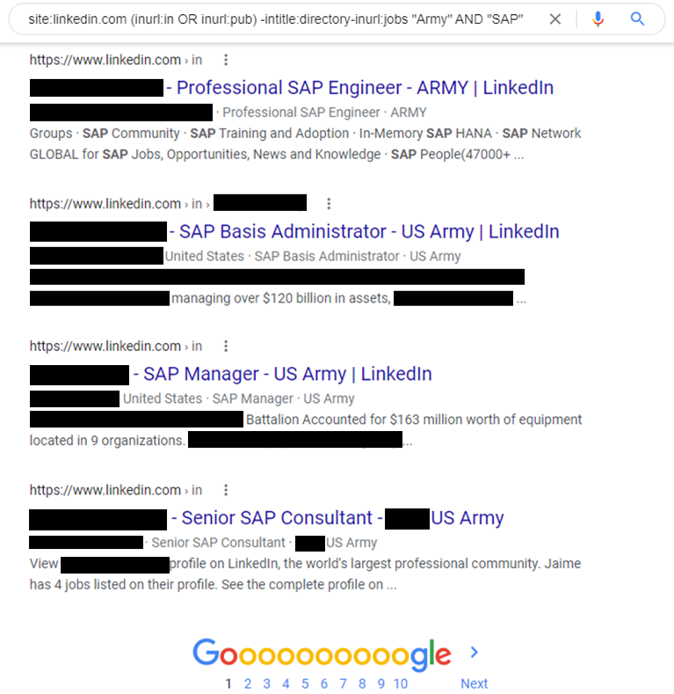
ADVANCED OPERATORS
Search Examples
This search can be tailored by replacing “army.mil” with your organization’s URL
site:army.mil/ inurl:portals intext:CUI
Replace “Army” with your organization’s name
site:linkedin.com (inurl:in OR inurl:pub) -intitle:directory-inurl:jobs "Army" AND "SAP"
Notes:
How Advanced Operators work.
Google advanced operators help refine searches.
They are included as part of a standard Google query.
Advanced operators use a syntax such as the following:
operator:search_term
Capitalization matters; like OR and AROUND(), while others Cannot be capitalized, like any of the operators that combine a colon.
“OR” = Search for X or Y. This will return results related to X or Y, or both.
Example: jobs OR gates / jobs | gates
inurl: = Find pages with a certain word (or words) in the URL. For this example, any results containing the word “apple” in the URL will be returned.
Example: inurl:apple
There’s no space between the operator, the colon, and the search term!
Using the site: search on a specific website bypasses that site’s own internal search function, blocking the website from tracking or knowing the exact search terms (unless a link result is clicked directly, giving the “search referral”).
If a searcher wants to find an official government position on a subject, the domain can be indicated, as in site:gov Iran nuclear or site:gov.uk Iran nuclear, limiting the search to the US government or the UK government, respectively. Likewise, the search can be formulated to search only educational facilities, as in site:edu Iran nuclear or site:ac.uk Iran nuclear in which the academic networks of the US and UK, respectively, are searched.
The site: search can also search a specific network or website, such as site:justice.gov cartels or site:fbi.gov cartels, in which the Department of Justice network is searched, including any departments on the network, or the website specifically belonging to the FBI is searched. A selected portion, or folder of a website can also be searched by adding the subdomain or folder, as in site:houston.fbi.gov AND “cartels” or site:fbi.gov/news_cartels.
The filetype: operator forces all results to come in the format of the selected filetype by using the file extension. This search works with any type of file extension that is usable on the Internet, including pdf, ppt, doc, xml, html, and more. For instance, using filetype:pdf will return only PDF documents which are, generally, post-published documents or reports. PDF is often used to seal a document, making its contents harder to alter and therefore used as the final word by the publishing entity.
Powerpoint files (ppt or pptx) are usually training materials, briefings, or collections of images. A search for "drug culture"site:edu (filetype:ppt OR filetype:pptx) will return training materials and briefs about drug culture coming only from US academic institutions. Note the OR statement: (filetype:ppt OR filetype:pptx) that must be used when dealing with Microsoft Office document searches. In 2007, Microsoft Office added an x to the end of all file extensions. Both versions of the file extension must be searched using the OR operator within parentheses or a thorough search will not be performed.
Searchers can also search for titles of documents using the intitle: operator; however that may not be as fruitful because titles of Excel files are not typically very robust. Another section to search is the data fields themselves. This can be useful when looking for unknown attributes about a known item, or if searching for an unknown item with known attributes. An example of the former is this search (filetype:xls OR filetype:xlsx) t-72b for the attributes of the T-72B tank, while an example of the latter could be this attribute search (filetype:xls OR filetype:xlsx)Soviet MBT w/Kontak for equipment with the selected attributes.

Slide 69



KEY WORD SEARCH
Using the following "key words" conduct a search using the search tool. As a result of this search conduct a random screen of any documents found:
- Deployment Schedules
- Exercise Plans
- Contingency Plans
- New, Special, one of a kind
- Inspection results, findings, deficiencies
- Employment opportunities
Phone Directories, Lists
CUI
Notes:
Keywords are the foundation of search engine success.

Slide 70
CENTER OF GRAVITY
CHECK ON LEARNING
What is the difference between open source research and open source intelligence?
Define Open Source information and public information.
What search tools and methods are available to you?

Slide 71




OPSEC ASSESSMENTS
It’s More Than A Checklist! ”
Notes:
INSTRUCTOR: The OPSEC assessment is an analysis of an operation, exercise, test or activity to determine the overall OPSEC posture and to evaluate the degree of compliance of subordinate organizations with the published OPSEC Program, OPSEC plan or other form of OPSEC guidance.

Slide 72
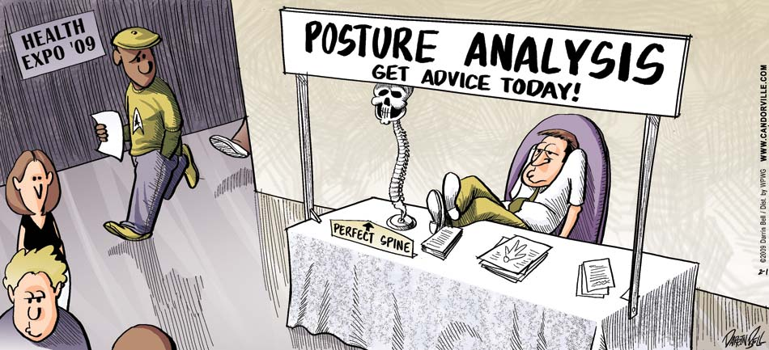

OPSEC SELF ASSESSMENTS
Purpose of an assessment
DETERMINE THE OPSEC POSTURE AND/OR COMPLIANCE
Evaluative process specifically addressing OPSEC, The
OPSEC assessment team should be composed of the OPSEC
PM/OPSEC officer and appropriate subject matter experts
throughout the organization
Conducted Annually For:
  Organization, operation, activity, exercise, or support function
  To determine if effective OPSEC measures are in place to
  protect critical information.
Notes:
Discussion: What do you think the difference is between posture and compliance?
Note: Compliance is the paperwork meeting regulatory standards; posture is the unit’s practical OPSEC working, such as if they understand and implement measures properly
What does that mean, though, in concrete terms? It means taking a hard look at the program to check whether: a) assigned OPSEC measures are being done (Measures of Performance), and b) Performed work is accomplishing the desired goal (Measures of Effectiveness)
Assessments give us insight into the ground truth of how a unit is really doing in its OPSEC program- not the positive spin that some people want to put on it, but the real view that an adversary would get if they targeted this aspect of your unit right now. Assessments demonstrate that not only can vulnerabilities happen here, they do happen here, and are happening here and will continue to happen here unless additional OPSEC measures are put into place.
Emphasize that assessments are NOT inspections, but are diagnostic tools to improve unit awareness of and compliance with the requirements of the OPSEC program.
5–4. Procedures
a. Each OPSEC PM/officer will conduct an annual self-assessment to determine the effectiveness of his or her OPSEC program, and as a minimum, assess the status of the following:
(1) Unit personnel’s knowledge of critical information or publication of the CIL.
(2) Unit personnel’s knowledge of the collection threat to the unit.
(3) OPSEC measures in place to protect identified critical information.
(4) The status of OPSEC training.
b. At each command level, the organization must conduct an OPSEC assessment of subordinate units using the published OPSEC guidance to determine if the unit being assessed is implementing higher headquarters-directed and their own OPSEC policies and procedures. The command OPSEC officer submits a written assessment with results and recommendations to the assessed unit commander or commander that directed the assessment. As a minimum, the following will be assessed:
(1) Identification of critical information.
(2) Unit personnel’s knowledge of critical information or publication of the CIL.
(3) Unit personnel’s knowledge of the collection threat to the unit.
(4) OPSEC measures in place to protect identified critical information.
(5) The status of OPSEC training.
(6) Application of a formal OPSEC checklist based on restrictions in existing laws, statutes, regulation and policy,
including any specific requirements applicable only to the assessed organization and/or other organizations of its type.
(a) The higher headquarters must develop and publish an OPSEC checklist (or checklists, if differing OPSEC requirements apply to different subordinate organizations) as part of the organizational inspection program (OIP)/ command inspection program (CIP).
(b) This does not preclude OPSEC assessments from being conducted other than as part of the annual CIP.

Slide 73

OPSEC POSTURE ASSESSMENT
Each OPSEC PM / officer will conduct an annual self-assessment to determine the effectiveness of his or her OPSEC program
At each command level, the organization must conduct an OPSEC assessment of subordinate units
At a minimum the following will be assessed:
(1) Unit personnel’s knowledge of critical information or publication of the CIL
(2) Unit personnel’s knowledge of the collection threat to the unit
(3) OPSEC measures in place to protect identified critical information
(4) The status of OPSEC training
(5) MOEs and MOPs
POSTURE
Notes:
Assessments are not to be conducted as an inspection. Assessments are to HELP identify where a unit may not be in compliance, and what the results of non-compliance. Assessments help fix the problem, or at least help to find a solution to be suggested to the senior leadership.
OPSEC assessments are central to credibility; they allow the OPSEC officer to prove that OPSEC measures are working, or to discover that they are not. In either case, it’s better to know the truth the easy, but sometimes embarrassing, way (assessments) rather than the deadly way- enemy attack based on OPSEC vulnerabilities that could have been addressed, but weren’t because no one wanted to embarrass someone else.
OPSEC Assessment Procedures
5–4. b. As a minimum the following will be assessed:
(1) Identification of critical information.
(2) Unit personnel’s knowledge of critical information or publication of the CIL.
(3) Unit personnel’s knowledge of the collection threat to the unit.
(4) OPSEC measures in place to protect identified critical information
(5) The status of unit OPSEC training.

Slide 74
OPSEC COMPLIANCE ASSESSMENT
OPSEC Benchmarks are used for the Organizational Inspection Program (OIP) inspections. The higher headquarters is only required to develop and publish an OPSEC checklist (or checklists, if differing OPSEC requirements apply to different subordinate organizations) as part of the OIP.
OIP’s do not prevent an organization from conducting self-assessments.
AR 530-1, Ch. 5-3, 5-4
Notes:
Discussion question: Can assessments (non-punitive) work alongside inspections (which can be punitive)?
5–4. Procedures
a. Each OPSEC PM/officer will conduct an annual self assessment to determine the effectiveness of his or her OPSEC program, and as a minimum, assess the status of the following:
(1) Unit personnel’s knowledge of critical information or publication of the CIL.
(2) Unit personnel’s knowledge of the collection threat to the unit.
(3) OPSEC measures in place to protect identified critical information.
(4) The status of OPSEC training.
b. At each command level, the organization must conduct an OPSEC assessment of subordinate units using the published OPSEC guidance to determine if the unit being assessed is implementing higher headquarters-directed and their own OPSEC policies and procedures. The command OPSEC officer submits a written assessment with results and recommendations to the assessed unit commander or commander that directed the assessment. As a minimum, the following will be assessed:
(1) Identification of critical information.
(2) Unit personnel’s knowledge of critical information or publication of the CIL.
(3) Unit personnel’s knowledge of the collection threat to the unit.
(4) OPSEC measures in place to protect identified critical information.
(5) The status of OPSEC training.
(6) Application of a formal OPSEC checklist based on restrictions in existing laws, statutes, regulation and policy, including any specific requirements applicable only to the assessed organization and/or other organizations of its type.
(a) The higher headquarters must develop and publish an OPSEC checklist (or checklists, if differing OPSEC requirements apply to different subordinate organizations) as part of the organizational inspection program (OIP).
(b) This does not preclude OPSEC assessments from being conducted other than as part of the annual OIP.

Slide 75
PREVIOUS ASSESSMENTS
Review previous assessments prior to start (if possible)
  Identify trends, good or bad
  Has their OPSEC posture improved?
  Do the same vulnerabilities exist?
  Has awareness improved?
  Do the results correlate with policy, intent and goals?
  Need more / fewer / different assessments?
  Need outside assistance?
  Do assessments cover the entire unit?
  Assess interaction with other / supporting units
Notes:
Discussion question: Why do past assessment results matter?
See what was found previously
Take a look at the past assessments that should be in your OPSEC Program continuity book. Look for trends and make sure old problems were corrected.
Take a look at the many other empirical studies done as well. See what information is disclosed in telephone and email monitoring; ask to see the IA assessment results or the AT/FP assessments; ask to see the latest threat assessment.

Slide 76
OPSEC ASSESSMENT
“How to”:
  Direct observation - watch how your unit operates
  Trash / discarded material analysis
  Workforce interviews
  Open Source Research

Slide 77

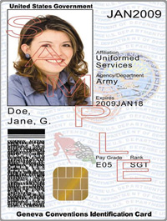
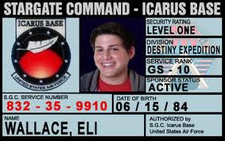
COMMON RESULTS: DIRECT OBSERVATION
Cell Phones
  Disregard for posted signs
  Used in unauthorized areas or briefings
Un-cleared personnel not escorted
Doors propped open for smokers
Unauthorized shredders used or not used at all
Badges worn outside of authorized area
(parking garage, etc.)
Consider your organization: do you have similar issues?
Notes:
Instructors: Note that CAC card blanks and CAC printing machines are commercially available to anyone.
You are supposed to be looking at your command through the eyes of the adversary….how are you going to do that if you don’t get out there and observe?
Look at OPSEC MEASURES - are people following employees inside? When reviewing entry control procedures – if the policy is no piggy backing, is piggybacking still happening?
Are they wearing their badges in the parking lot, or at the local fast food joint, or some other spot that would allow an adversary to take photos of the badges and later replicate them?
Cameras are a good tool here, but make sure you have permission before you start happy snapping your way around.

Slide 78

TRASH ANALYSIS
Privacy Act Information
  SSN / Marriage license
  Spouse and children’s names
Commander’s itinerary (GO Level)
Photocopy of CAC
Unit alert roster (Name, rank, home address, home/cell #)
Building / floor schematics
FOUO / Classified
Building access requests (Name, SSN, address, home #, etc.)
Shredding Documents Frustrates The Adversary!
One man’s trash is another man’s treasure….
Notes:
Discussion question: Is trash a vulnerability for your organization?
Note: Only way to find out is to get out there and look at your trash!
While you can dive the dumpster - one technique is to get your cleaning crew to bring it to you before it goes in the dumpster.
An even more simple way is to canvas the trash cans before they leave the office – allows for on the spot corrections! Don’t forget to look in recycle bins too
One word of caution – before you go jumping in dumpsters, might want to let your security people know!
Same as OPEN SOURCE – what happens if you find classified? Report it!

Slide 79
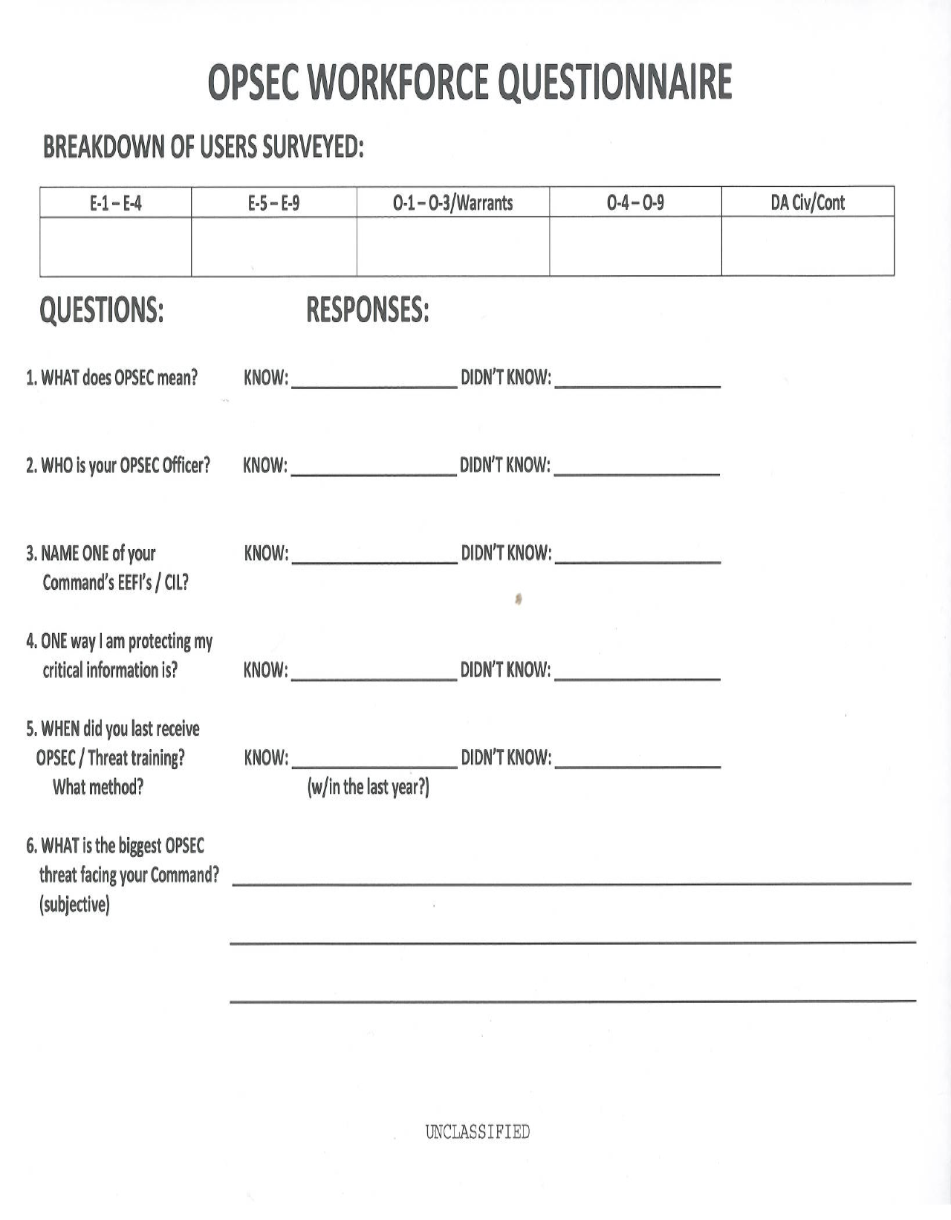
INTERVIEW QUESTIONNAIRE
Common results: The workforce doesn’t know what to protect, how to protect it, or who to ask for help
Notes:
The reason and importance of these surveys is to provide the measuring stick on how successful your OPSEC program is.
Some answers from these we’ve encountered- things that highlight the need for better OPSEC awareness:
“Critical Information- what’s that?”
“We don’t have any threat here; we’re in CONUS.” Also: There’s no threat here; we’re inside the wire.” (said in Iraq)
“Our biggest threat is that the installation is too big.”
“No, I know OPSEC. 1-800-CALL-SPY, right?”
“I don’t know who the OPSEC officer is.” (frequent)
“Can’t recall last time I had OPSEC training” (frequent)

Slide 80


LESSONS LEARNED
Critical Information List (CIL) is not identified,
disseminated or known
Insufficient OPSEC Training and Awareness
  Workforce unaware of threat collection
  Workforce has no recollection of training
OPSEC Review not formalized or conducted
Notes:
Discussion question: What is an internet archive, like Wayback Machine? Can information be permanently removed from the Internet?
Personnel can more effectively protect critical information when they know which information is critical. When the Critical Information list is classified, or is mistakenly marked as such, then tighter controls on dissemination hamper effectiveness. In short, the more personnel have access to the CIL, the more personnel can assist in denying critical information to the adversary. In general, the assessed commands’ personnel were not knowledgeable on how to apply OPSEC to their daily tasks.
Most units did not have an OPSEC training program in place, and individual interviews reflected this lack of training. For the command’s operations security to be effective, all personnel should know what OPSEC is, why OPSEC is important to the organization, why OPSEC is important to them and how they can contribute to the unit’s OPSEC program. The OPSEC Officer must be aware of how to apply OPSEC measures to prevent inadvertent disclosure of U.S. military capabilities, intentions and plans to an adversary.

Slide 81
ASSESSMENT REPORT
Report
  Be clear and concise
  Limit the length and classification of the threat
  statement
  Identify and define each vulnerability
  Provide detailed recommendations for corrective
  actions
Lessons Learned: Identify all technical and managerial
best and worst practices
Notes:
Discussion point: Why are best practices important to capture in the report?
Inform students that time is of the essence when doing the report. The need to set a timeline for all the SME’s who were involved in the assessment to have their portion of the report completed. Otherwise they will be waiting for months before they see the report. Additionally, it is easier to write the report while it is fresh on everyone's mind.

Slide 82
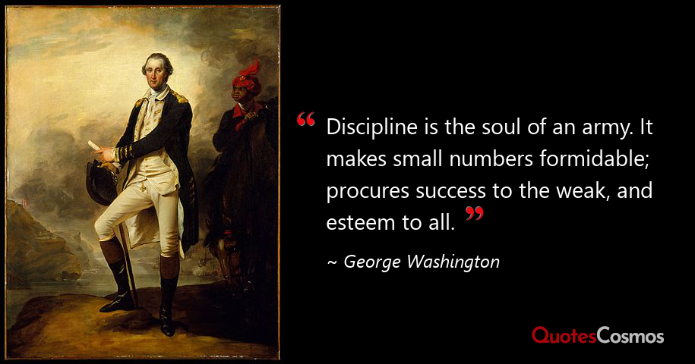
Break Time
Notes:
Take break as applicable.

Slide 83
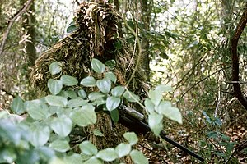
SIX STEP CYCLIC PROCESS EVALUATION
Student will have 90 minutes to complete the evaluation
You must score 40 out of 50 point to continue
If using the Appendix’s in the back of the student notebook write out the example you are using not the Appendix letter and the paragraph or sub paragraph number /letter
Once complete you are released, papers will be graded this evening and reviewed in the morning.

